Slide 2
The Human Body—An Orientation
Anatomy
Study of the structure and shape of the body and its parts
Observation is used to see sizes and relationships of parts

Slide 3
Anatomy—Levels of Study
Gross anatomy
Large structures
Easily observable

Slide 4
The Human Body—An Orientation
Let’s look at an example of gross anatomy using the digestive system organs

Slide 5
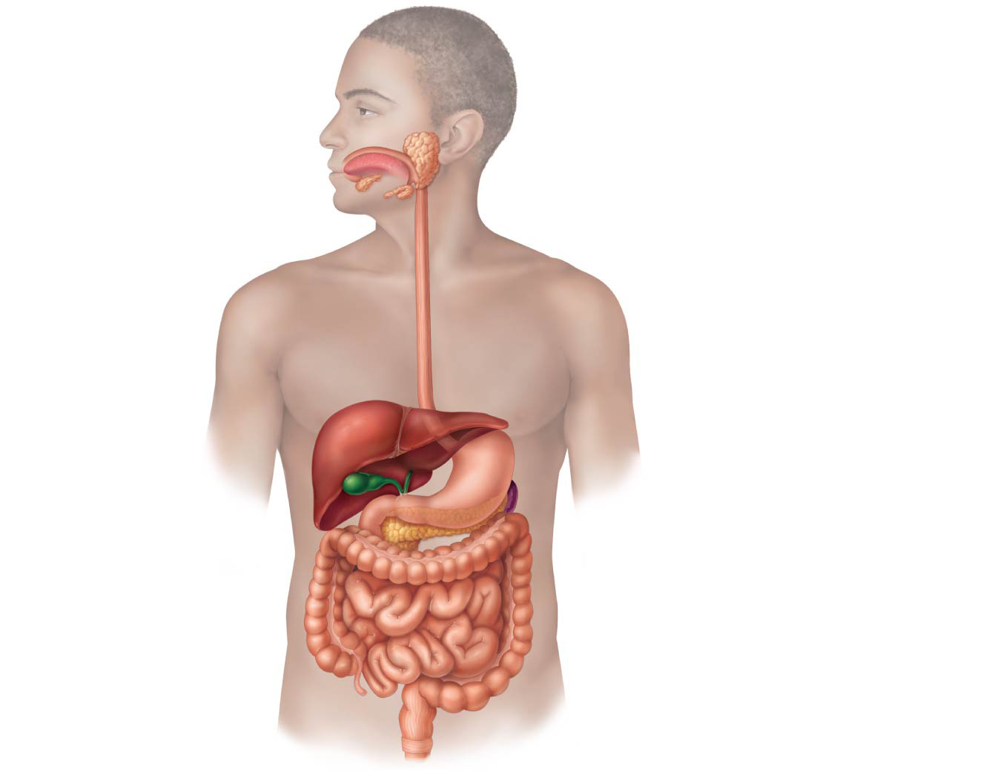
Figure 14.1 The human digestive system: Alimentary canal and accessory organs.
Mouth (oral cavity)
Parotid gland
Tongue
Sublingual gland
Salivary glands
Submandibular
gland
Esophagus
Pharynx
Stomach
Pancreas
(Spleen)
Liver
Gallbladder
Transverse colon
Duodenum
Descending colon
Small
intestine
Jejunum
Ileum
Ascending colon
Cecum
Large intestine
Sigmoid colon
Rectum
Appendix
Anus
Anal canal

Slide 6
Anatomy—Levels of Study
Microscopic anatomy
Structures cannot be seen with the naked eye
Structures can be viewed only with a microscope

Slide 7
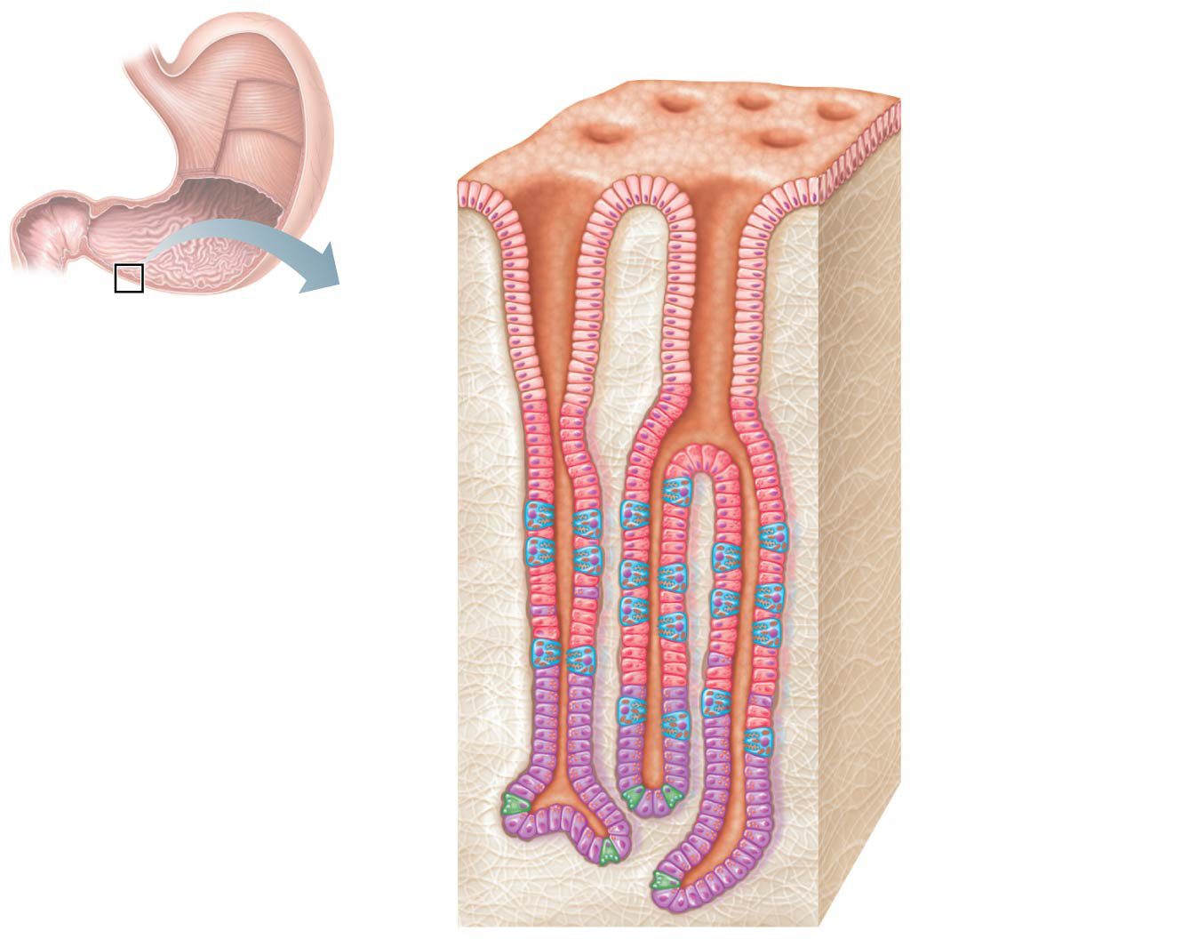
Figure 14.4c Anatomy of the stomach.
Gastric pits
Surface
epithelium
Gastric
pit
Pyloric
sphincter
Mucous
neck cells
Parietal cells
Gastric gland
Gastric
glands
Chief cells
(c)

Slide 8
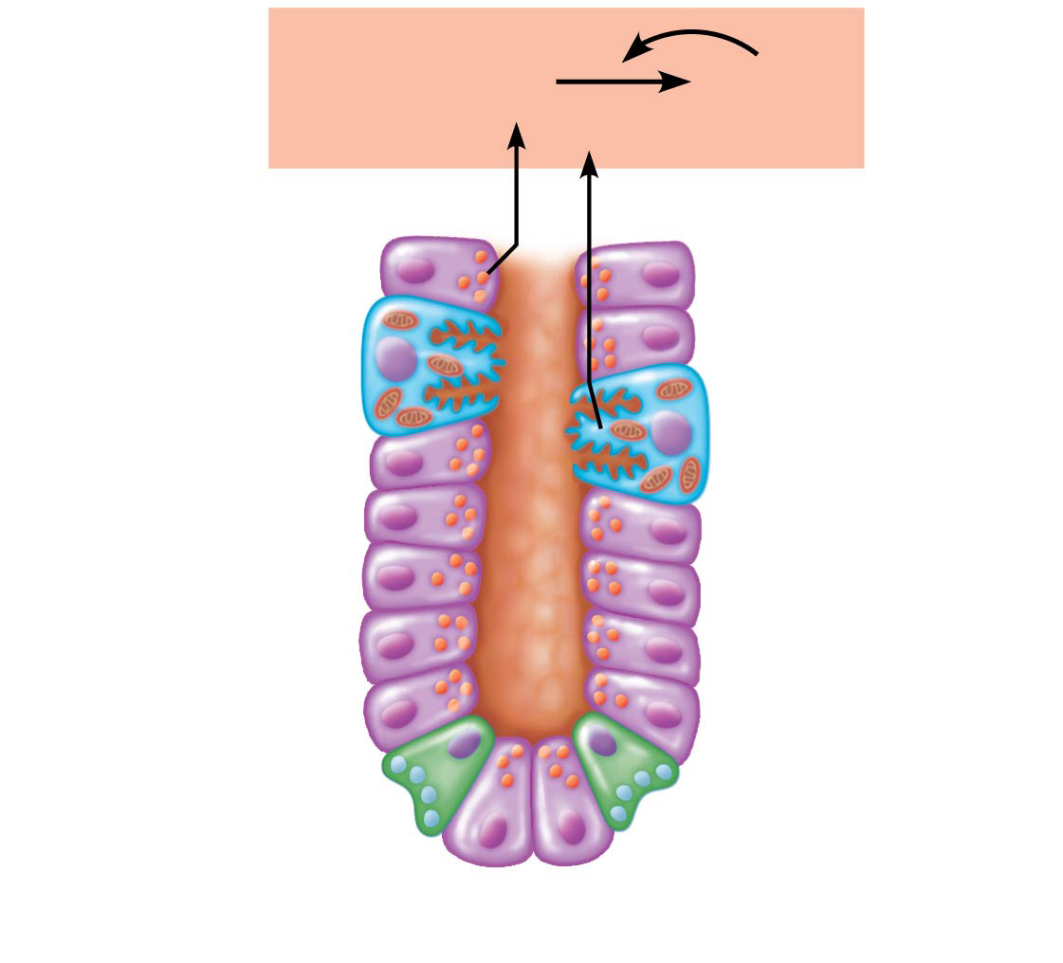
Figure 14.4d Anatomy of the stomach.
Pepsinogen
Pepsin
HCI
Parietal cells
Chief cells
Enteroendocrine
cell
(d)

Slide 9
The Human Body—An Orientation
Physiology
Study of how the body and its parts work or function

Slide 10
Relationship between Anatomy and Physiology
Structure determines what functions can occur
If structure changes, the function must also change

Slide 11
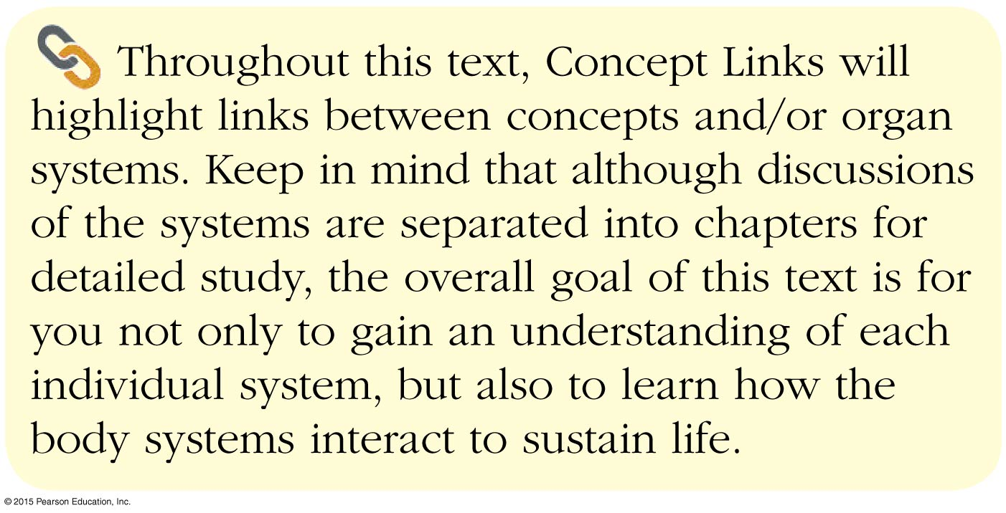

Slide 12
Levels of Structural Organization
Six levels of structural organization
Atoms
Cells
Tissues
Organs
Organ systems
Organisms

Slide 13
Figure 1.1 Levels of structural organization.
Slide 1
Smooth muscle cell
Atoms
Molecules
1
2
Chemical level
Atoms combine to
form molecules.
Cellular level
Cells are made
up of molecules.
Smooth
muscle
tissue
3
Tissue level
Tissues consist of
similar types of cells.
Blood
vessels
Heart
Epithelial
tissue
Smooth
muscle
tissue
Blood
vessel
(organ)
Cardio–
vascular
system
Connective
tissue
4
Organ level
Organs are made up of
different types of tissues.
5
6
Organ system level
Organ systems consist of
different organs that work
together closely.
Organismal level
Human organisms are
made up of many organ
systems.

Slide 14
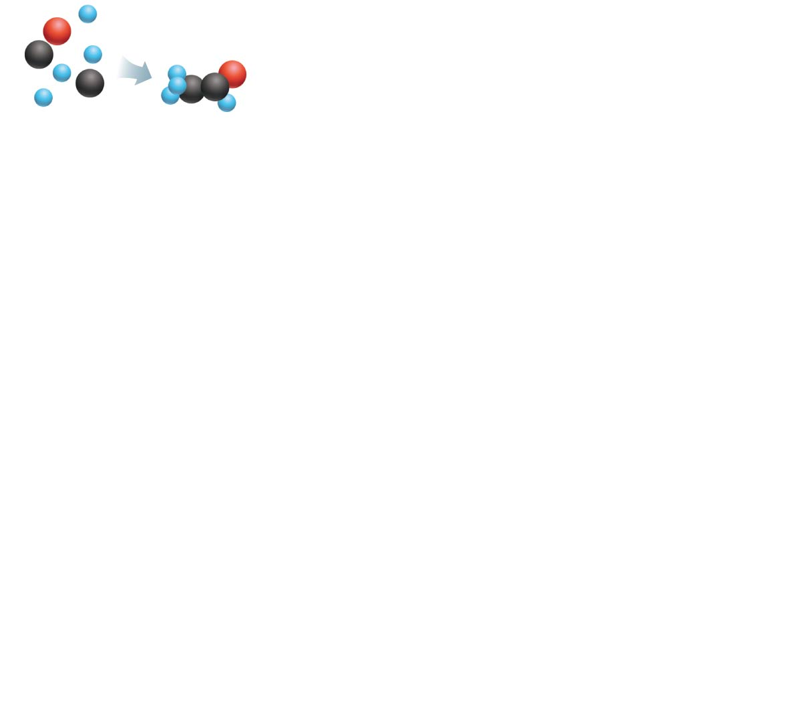
Figure 1.1 Levels of structural organization.
Slide 2
Atoms
Molecules
1
Chemical level
Atoms combine to
form molecules.

Slide 15
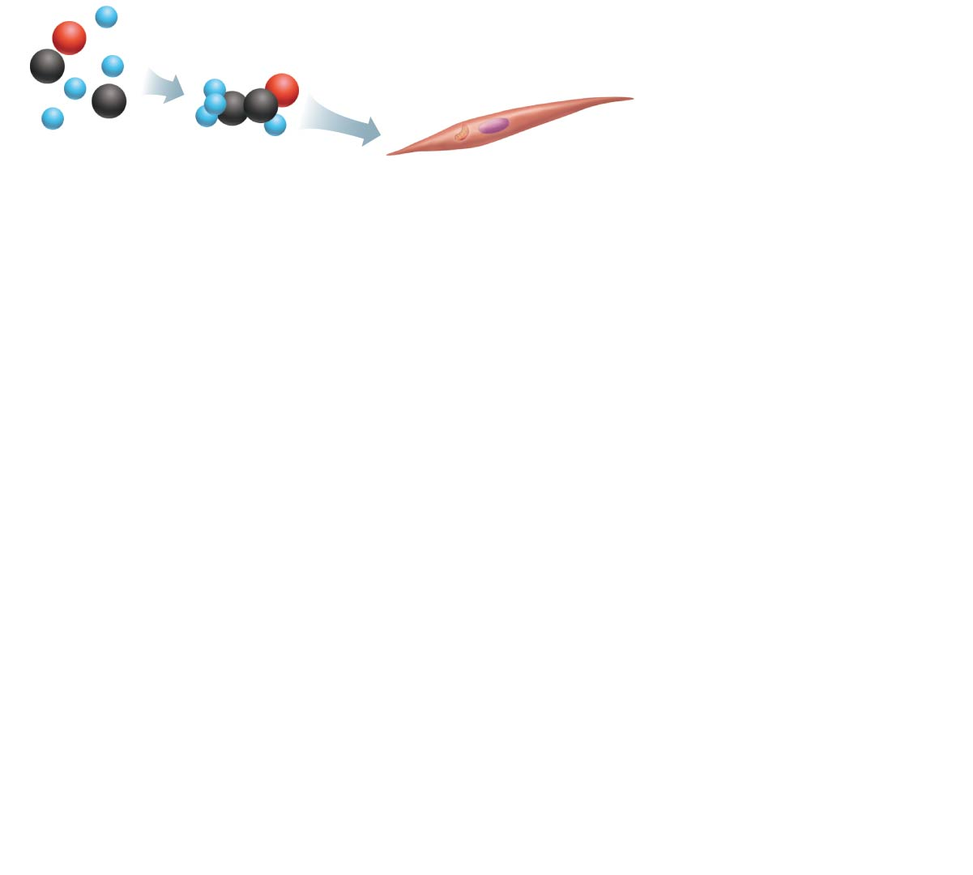
Figure 1.1 Levels of structural organization.
Slide 3
Smooth muscle cell
Atoms
Molecules
1
2
Chemical level
Atoms combine to
form molecules.
Cellular level
Cells are made
up of molecules.

Slide 16
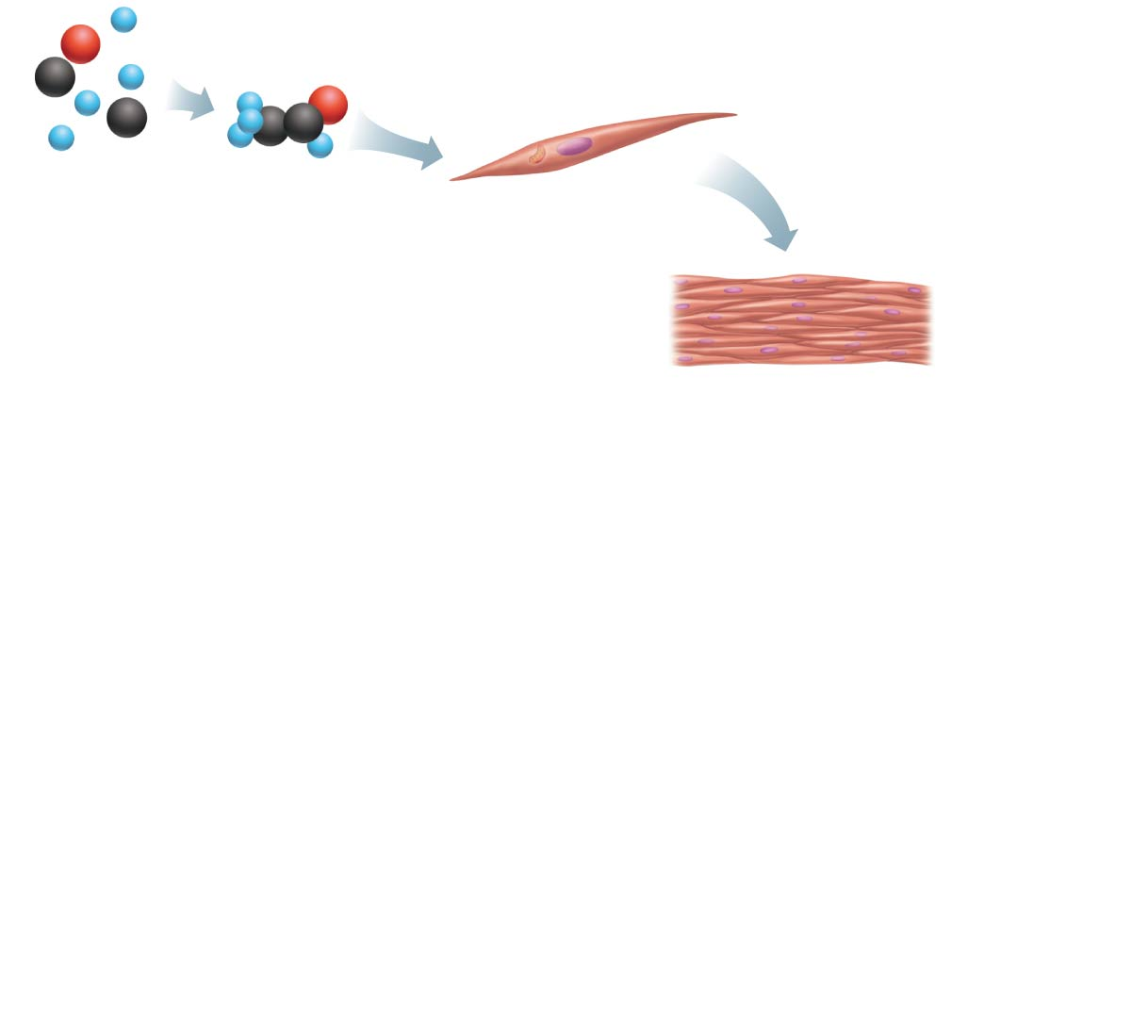
Figure 1.1 Levels of structural organization.
Slide 4
Smooth muscle cell
Atoms
Molecules
1
2
Chemical level
Atoms combine to
form molecules.
Cellular level
Cells are made
up of molecules.
Smooth
muscle
tissue
3
Tissue level
Tissues consist of
similar types of cells.

Slide 17
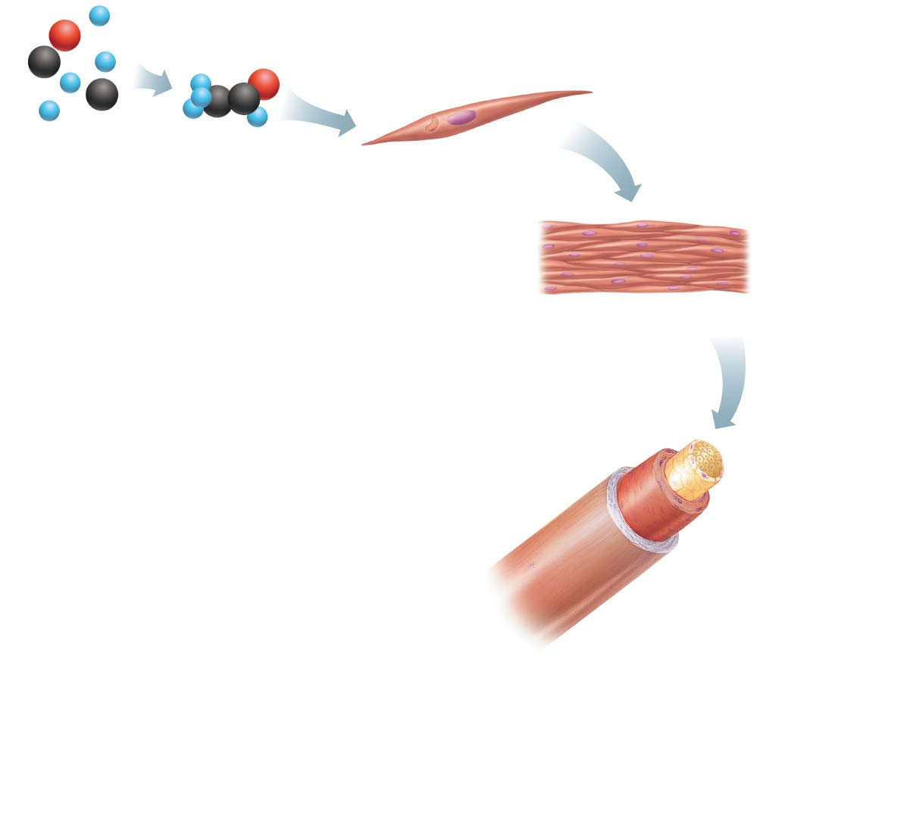
Figure 1.1 Levels of structural organization.
Slide 5
Smooth muscle cell
Atoms
Molecules
1
2
Chemical level
Atoms combine to
form molecules.
Cellular level
Cells are made
up of molecules.
Smooth
muscle
tissue
3
Tissue level
Tissues consist of
similar types of cells.
Epithelial
tissue
Smooth
muscle
tissue
Blood
vessel
(organ)
Connective
tissue
4
Organ level
Organs are made up of
different types of tissues.

Slide 18
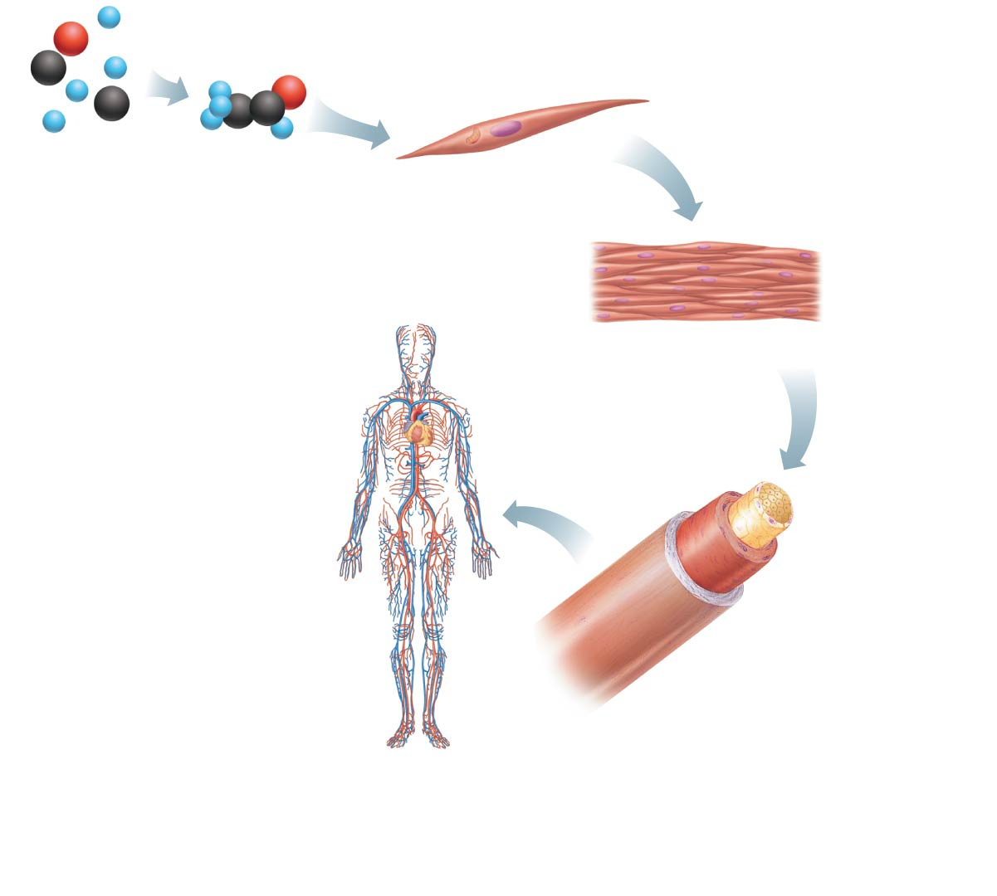
Figure 1.1 Levels of structural organization.
Slide 6
Smooth muscle cell
Atoms
Molecules
1
2
Chemical level
Atoms combine to
form molecules.
Cellular level
Cells are made
up of molecules.
Smooth
muscle
tissue
3
Tissue level
Tissues consist of
similar types of cells.
Blood
vessels
Heart
Epithelial
tissue
Smooth
muscle
tissue
Blood
vessel
(organ)
Cardio–
vascular
system
Connective
tissue
4
Organ level
Organs are made up of
different types of tissues.
5
Organ system level
Organ systems consist of
different organs that work
together closely.

Slide 19
Figure 1.1 Levels of structural organization.
Slide 7
Smooth muscle cell
Atoms
Molecules
1
2
Chemical level
Atoms combine to
form molecules.
Cellular level
Cells are made
up of molecules.
Smooth
muscle
tissue
3
Tissue level
Tissues consist of
similar types of cells.
Blood
vessels
Heart
Epithelial
tissue
Smooth
muscle
tissue
Blood
vessel
(organ)
Cardio–
vascular
system
Connective
tissue
4
Organ level
Organs are made up of
different types of tissues.
5
6
Organ system level
Organ systems consist of
different organs that work
together closely.
Organismal level
Human organisms are
made up of many organ
systems.

Slide 20
Organ System Overview
Integumentary system
Forms the external body covering (skin)
Protects deeper tissue from injury
Helps regulate body temperature
Location of cutaneous nerve receptors

Slide 21
Figure 1.2a The body’s organ systems.
Skin
(a) Integumentary System
Forms the external body covering; protects
deeper tissue from injury; synthesizes
vitamin D; location of cutaneous receptors
(pain, pressure, etc.) and sweat and oil glands.

Slide 22
Organ System Overview
Skeletal system
Consists of bones, cartilages, ligaments, and joints
Supports the body
Provides muscle attachment for movement
Site of blood cell formation (hematopoiesis)
Stores minerals

Slide 23
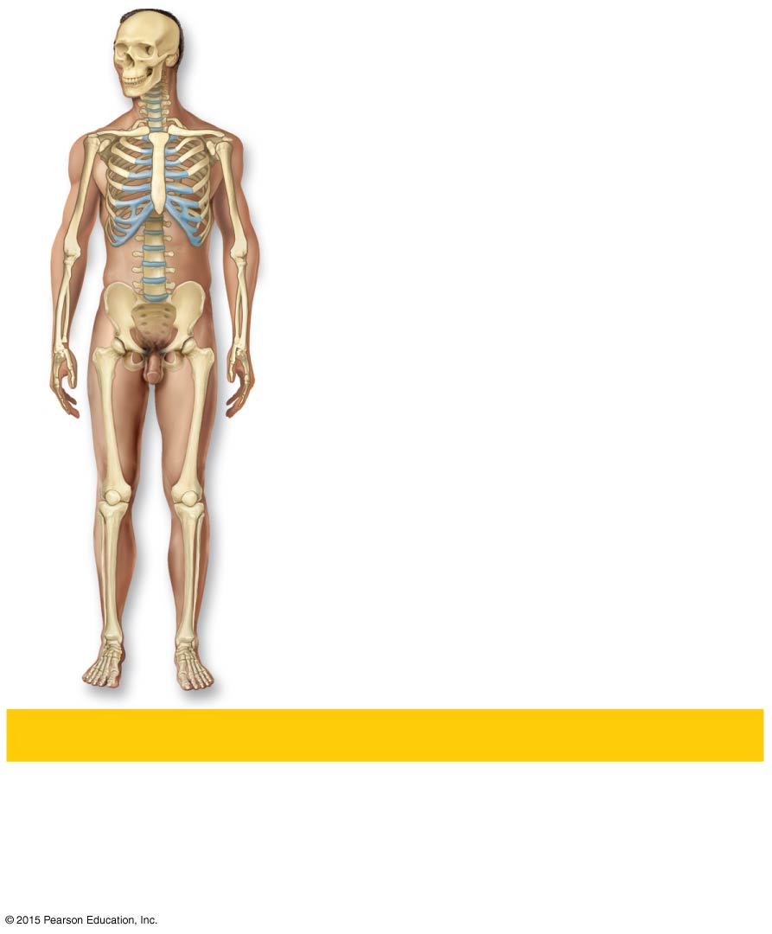
Figure 1.2b The body’s organ systems.
Cartilages
Joint
Bones
(b) Skeletal System
Protects and supports body organs; provides a
framework the muscles use to cause movement;
blood cells are formed within bones; stores
minerals.

Slide 24
Organ System Overview
Muscular system
Skeletal muscles contract or shorten
Produces movement of bones

Slide 25
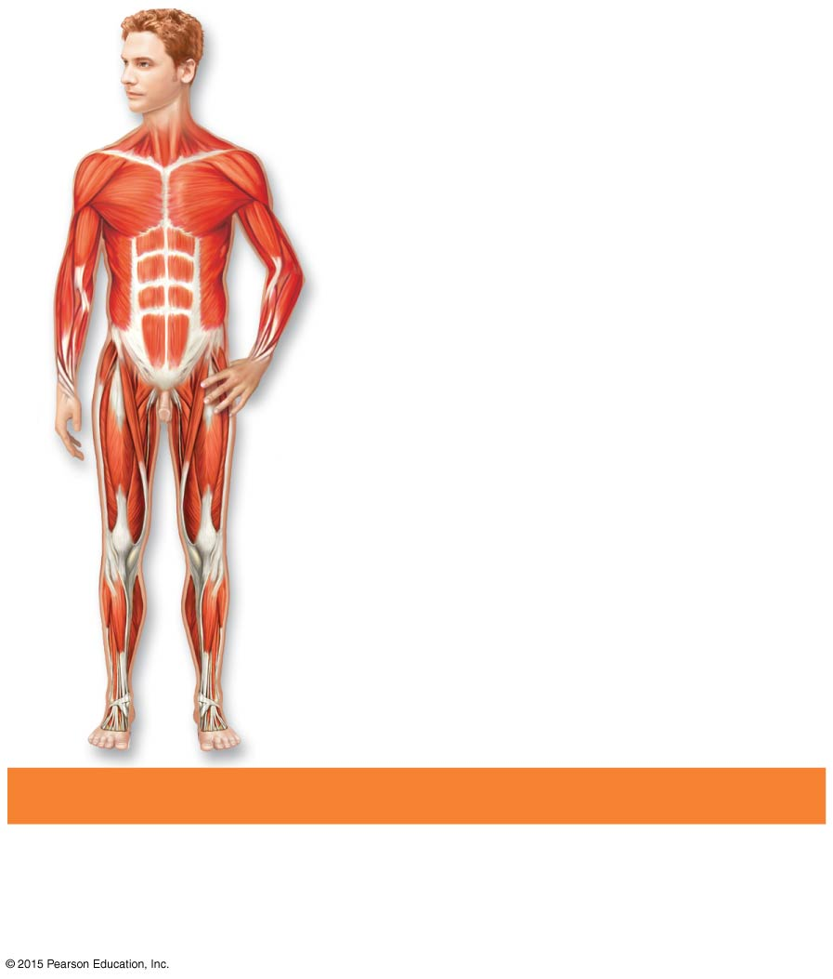
Figure 1.2c The body’s organ systems.
Skeletal
muscles
(c) Muscular System
Allows manipulation of the environment,
locomotion, and facial expression; maintains
posture; produces heat.

Slide 26
Organ System Overview
Nervous system
Fast-acting control system
Consists of brain, spinal cord, nerves, and sensory receptors
Responds to internal and external change
Sends messages via nerve impulses to central nervous system
Central nervous system activates effectors (muscles and glands)

Slide 27
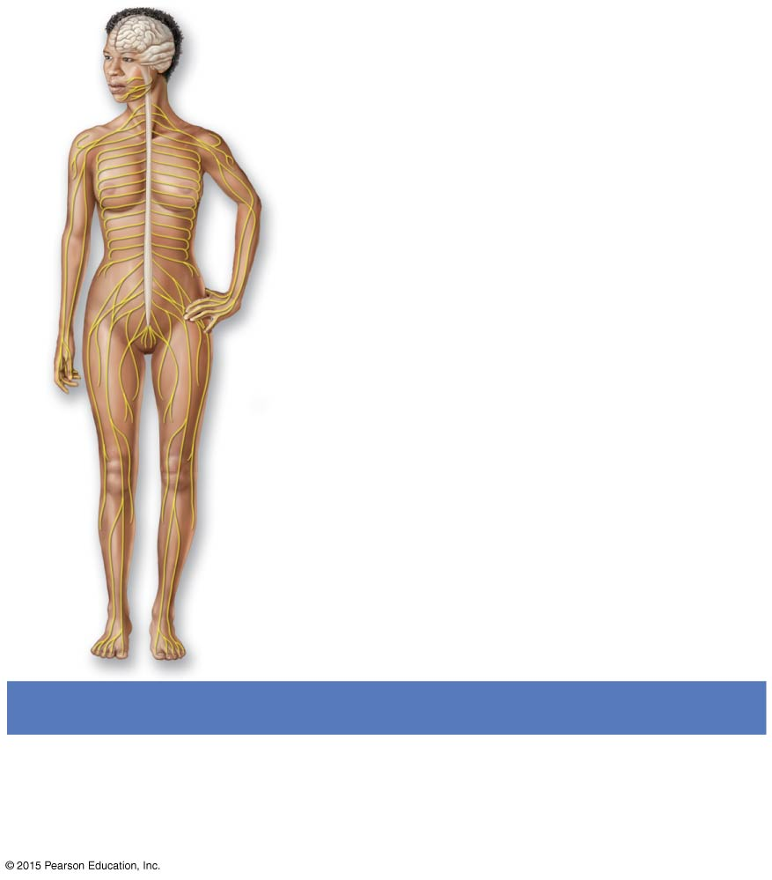
Figure 1.2d The body’s organ systems.
Brain
Sensory receptor
Spinal cord
Nerves
(d) Nervous System
Fast-acting control system of the body;
responds to internal and external changes by
activating appropriate muscles and glands.

Slide 28
Organ System Overview
Endocrine system
Endocrine glands include:
Pituitary gland
Thyroid and parathyroids
Adrenal glands
Thymus
Pancreas
Pineal gland
Ovaries (females) and testes (males)

Slide 29
Organ System Overview
Endocrine system
Secretes regulatory hormones
Growth
Reproduction
Metabolism

Slide 30
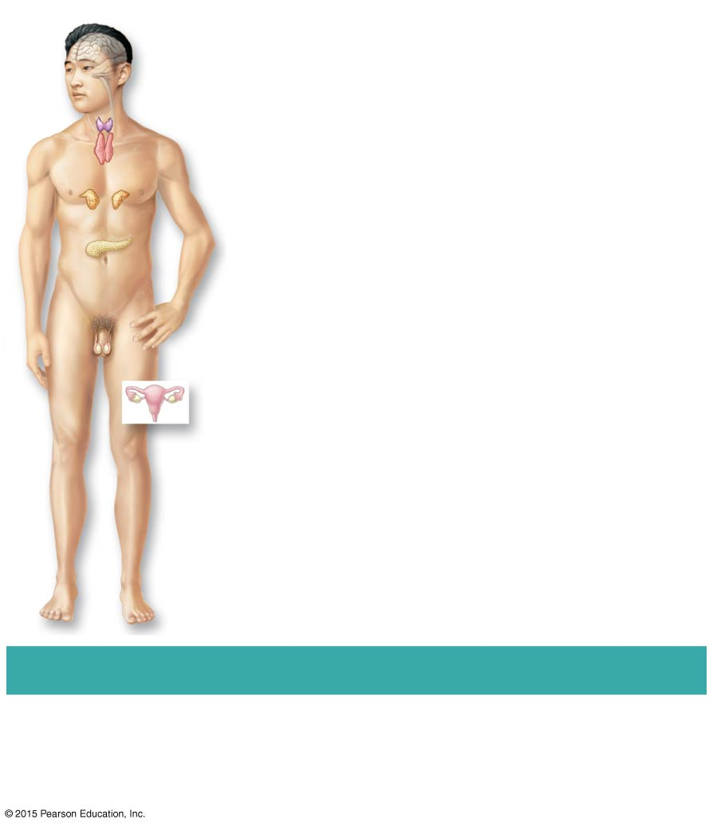
Figure 1.2e The body’s organ systems.
Pineal gland
Pituitary gland
Thyroid gland (parathyroid
glands on posterior aspect)
Thymus gland
Adrenal glands
Pancreas
Testis (male)
Ovary (female)
(e) Endocrine System
Glands secrete hormones that regulate
processes such as growth, reproduction, and
nutrient use by body cells.

Slide 31
Organ System Overview
Cardiovascular system
Includes heart and blood vessels
Heart pumps blood
Vessels transport blood to tissues
Transports materials in body via blood pumped by heart
Oxygen and carbon dioxide
Nutrients
Wastes

Slide 32
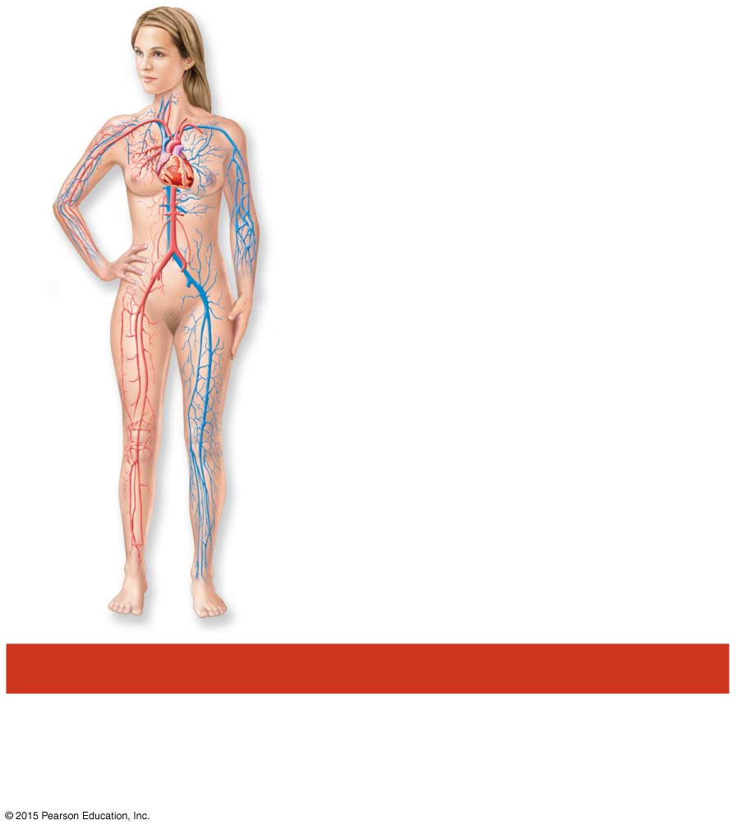
Figure 1.2f The body’s organ systems.
Heart
Blood
vessels
(f) Cardiovascular System
Blood vessels transport blood, which carries
oxygen, carbon dioxide, nutrients, wastes, etc.;
the heart pumps blood.

Slide 33
Organ System Overview
Lymphatic system
Includes lymphatic vessels, lymph nodes, and lymphoid organs
Returns leaked fluids back to blood vessels
Cleanses the blood
Involved in immunity

Slide 34
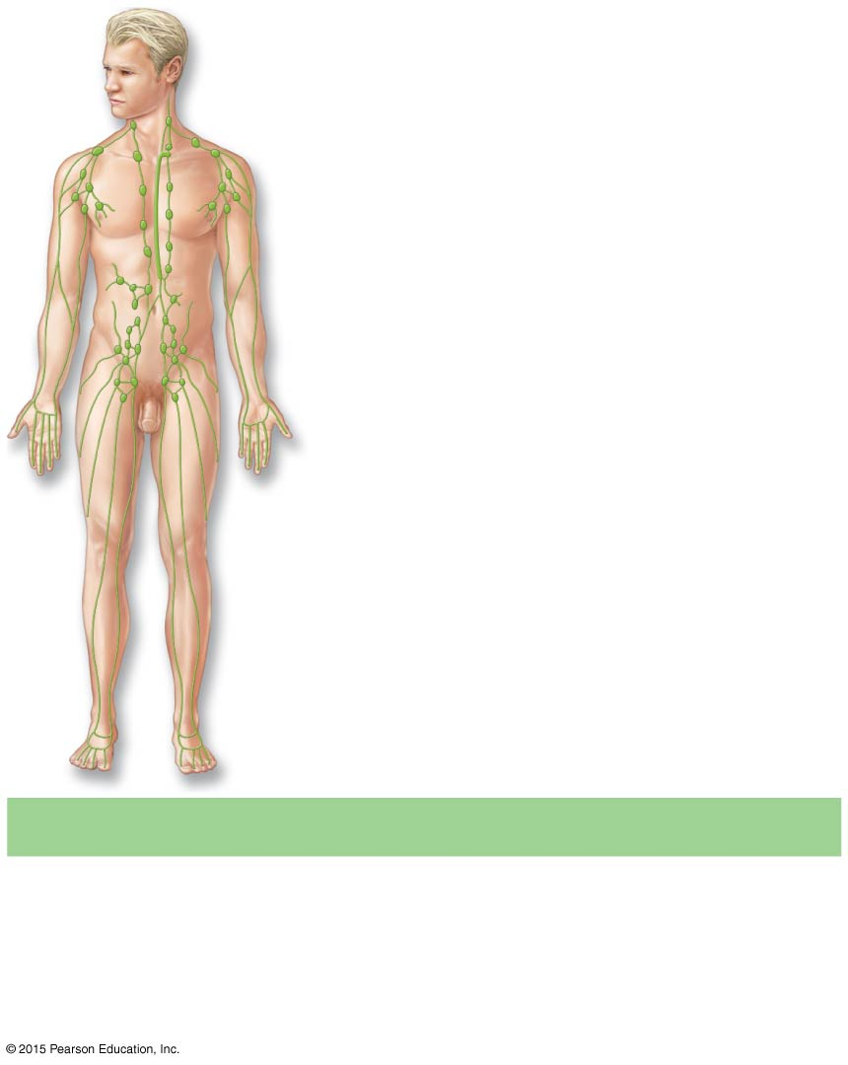
Figure 1.2g The body’s organ systems.
Thoracic duct
Lymph nodes
Lymphatic vessels
(g) Lymphatic System
Picks up fluid leaked from blood vessels and
returns it to blood; disposes of debris in the
lymphatic stream; houses white blood cells
involved in immunity.

Slide 35
Organ System Overview
Respiratory system
Includes the nasal passages, pharynx, larynx, trachea, bronchi, and lungs
Supplies blood with oxygen
Removes carbon dioxide

Slide 36
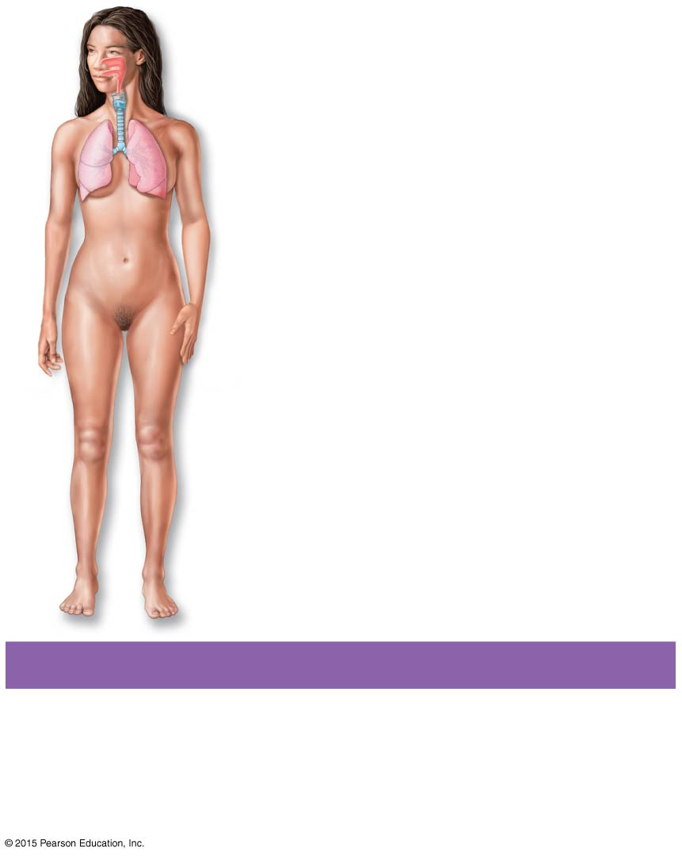
Figure 1.2h The body’s organ systems.
Nasal cavity
Pharynx
Larynx
Trachea
Bronchus
Left lung
(h) Respiratory System
Keeps blood constantly supplied with oxygen
and removes carbon dioxide; the gaseous
exchanges occur through the walls of the air
sacs of the lungs.

Slide 37
Organ System Overview
Digestive system
Includes the oral cavity, esophagus, stomach, small and large intestines, and accessory organs
Breaks down food
Allows for nutrient absorption into blood
Eliminates indigestible material as feces

Slide 38
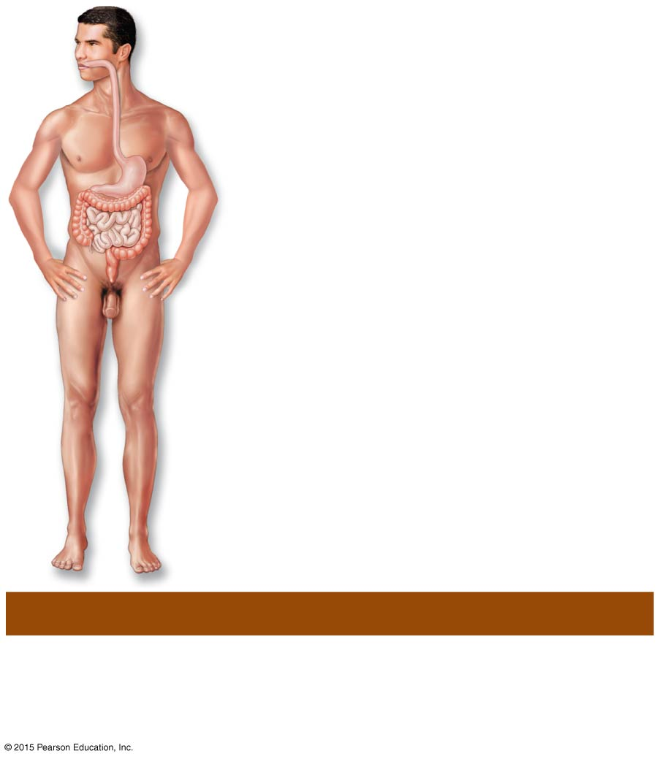
Figure 1.2i The body’s organ systems.
Oral cavity
Esophagus
Stomach
Small intestine
Large intestine
Rectum
Anus
(i) Digestive System
Breaks food down into absorbable units that
enter the blood for distribution to body cells;
indigestible foodstuffs are eliminated as feces.

Slide 39
Organ System Overview
Urinary system
Includes the kidneys, ureters, urinary bladder, and urethra
Eliminates nitrogenous wastes
Maintains acid-base balance
Regulates water and electrolytes

Slide 40
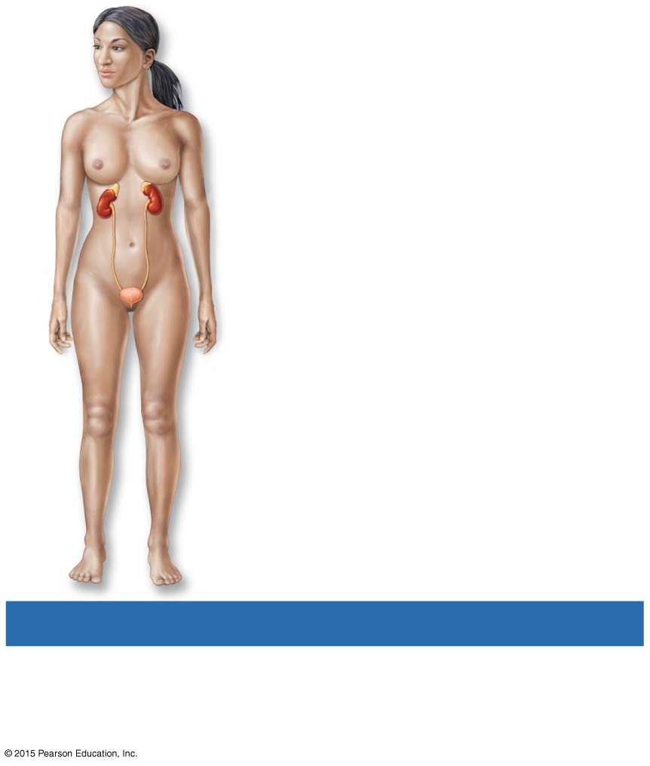
Figure 1.2j The body’s organ systems.
Kidney
Ureter
Urinary bladder
Urethra
(j) Urinary System
Eliminates nitrogen-containing wastes from
the body; regulates water, electrolyte, and
acid-base balance of the blood.

Slide 41
Organ System Overview
Reproductive system
For males, includes the testes, scrotum, penis, accessory glands, and duct system
Testes produce sperm
Duct system carries sperm to exterior
For females, includes the ovaries, uterine tubes, uterus, and vagina
Ovaries produce eggs
Uterus provides site of development for fetus

Slide 42
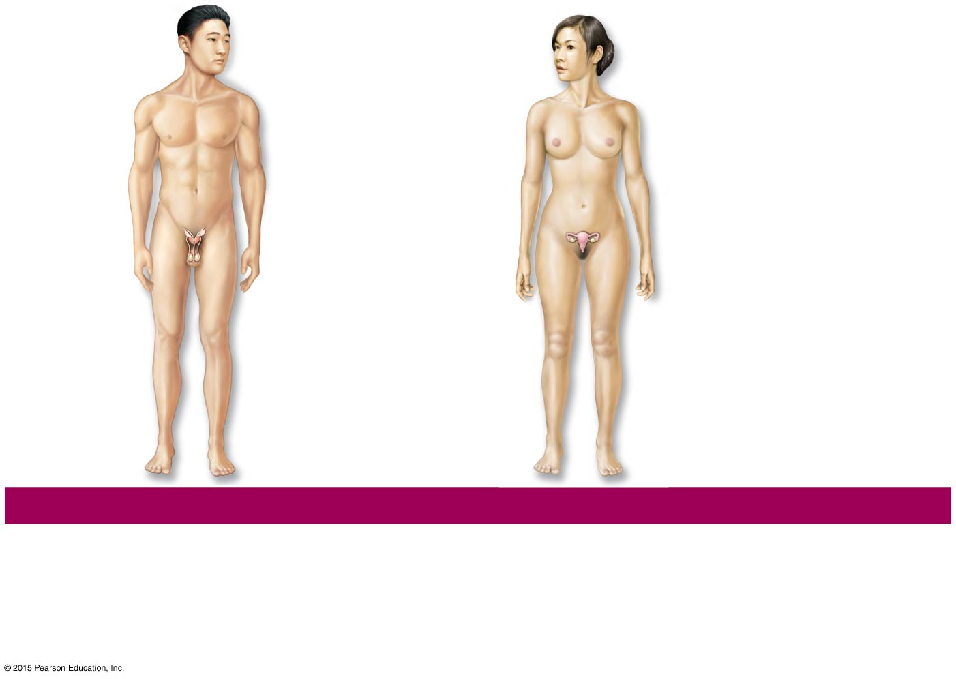
Figure 1.2k-l The body’s organ systems.
Mammary glands
(in breasts)
Prostate gland
Seminal
vesicles
Uterine tube
Ovary
Uterus
Penis
Vas deferens
Testis
Vagina
Scrotum
(k) Male Reproductive System
(l) Female Reproductive System
Overall function of the reproductive system is production of offspring. Testes produce
sperm and male sex hormone; ducts and glands aid in delivery of viable sperm to the
female reproductive tract. Ovaries produce eggs and female sex hormones; remaining
structures serve as sites for fertilization and development of the fetus. Mammary
glands of female breast produce milk to nourish the newborn.

Slide 43
Maintaining Life: Necessary Life Functions
Maintain boundaries
Movement
Locomotion
Movement of substances
Responsiveness
Ability to sense changes and react
Digestion
Breakdown and absorption of nutrients

Slide 44
Necessary Life Functions
Metabolism—chemical reactions within the body
Break down complex molecules into smaller ones
Build larger molecules from smaller ones
Produces energy
Regulated by hormones
Excretion
Eliminates waste from metabolic reactions
Wastes may be removed in urine or feces

Slide 45
Necessary Life Functions
Reproduction
Occurs on cellular level or organismal level
Produces future generation
Growth
Increases cell size and number of cells

Slide 46
Survival Needs
Nutrients
Chemicals for energy and cell building
Includes carbohydrates, proteins, lipids, vitamins, and minerals
Oxygen
Required for chemical reactions

Slide 47
Survival Needs
Water
60 to 80 percent of body weight
Most abundant chemical in the human body
Provides for metabolic reactions
Stable body temperature
37°C (98°F)
Atmospheric pressure
Must be appropriate for gas exchange

Slide 48
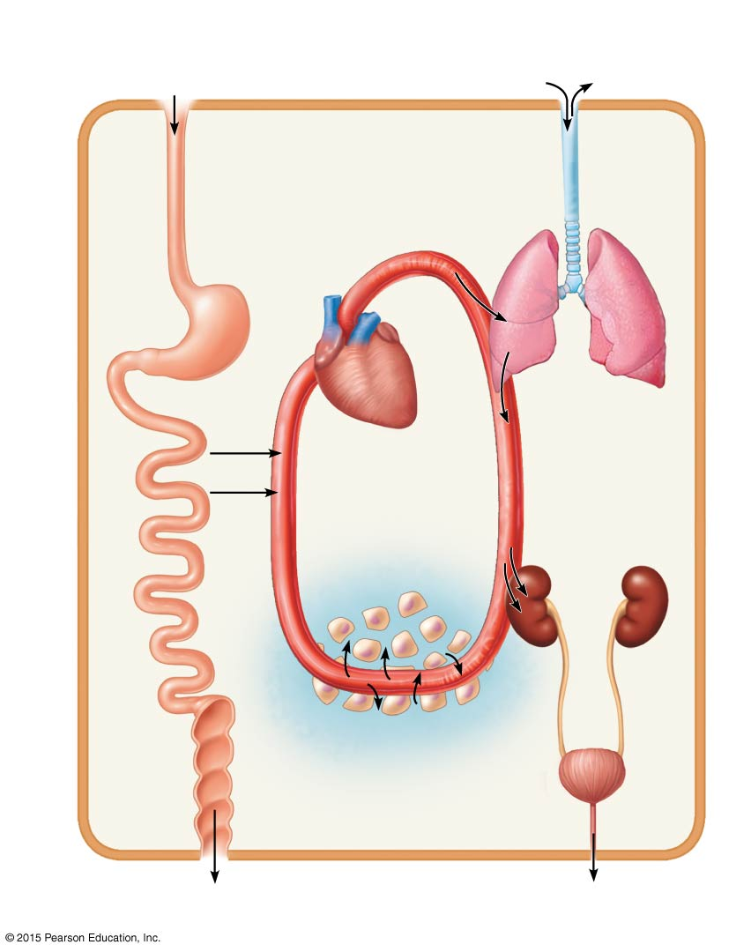
Figure 1.3 Examples of selected interrelationships among body organ systems.
Digestive system
Takes in nutrients, breaks them down,
and eliminates unabsorbed matter (feces)
Respiratory system
Takes in oxygen and eliminates
carbon dioxide
Food
O₂
CO₂
Cardiovascular system
Via the blood, distributes oxygen
and nutrients to all body cells and
delivers wastes and carbon
dioxide to disposal organs
Blood
CO₂
O₂
Heart
Urinary system
Eliminates
nitrogen-
containing
wastes and
excess ions
Nutrients
Interstitial fluid
Nutrients and wastes pass
between blood and cells
via the interstitial fluid
Integumentary system
Protects the body as a whole
from the external environment
Feces
Urine

Slide 49
Homeostasis
Homeostasis—maintenance of a stable internal environment
A dynamic state of equilibrium
Necessary for normal body functioning and to sustain life
Homeostatic imbalance
A disturbance in homeostasis results in disease

Slide 50
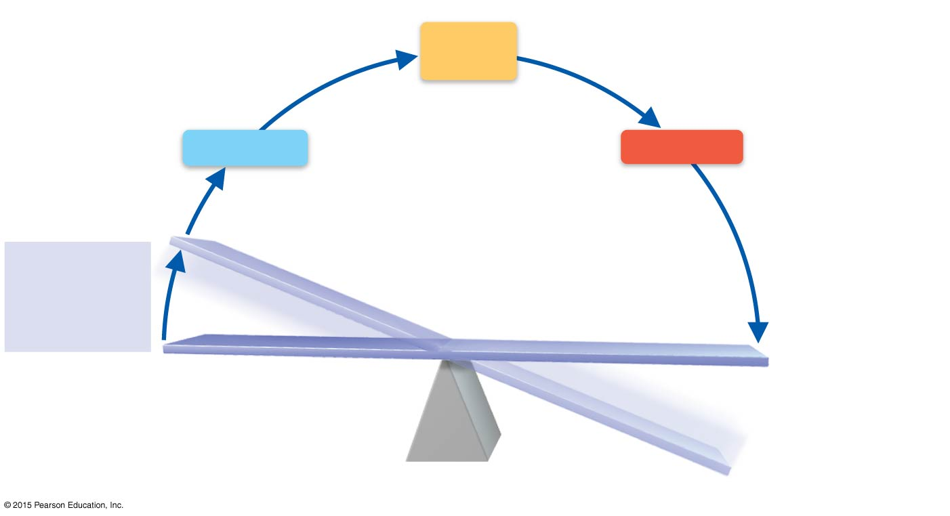
Figure 1.4 The elements of a homeostatic control system.
Slide 1
3
4
Input: Information
is sent along afferent
pathway to control
center.
Output: Information
is sent along efferent
pathway effector.
Control
Center
Afferent
pathway
Efferent
pathway
Receptor
Effector
2
Receptor
detects change.
5
Response
of effector feeds
back to reduce
the effect of
stimulus and
returns variable
to homeostatic
level.
1
IMBALANCE
Stimulus
produces
change in
variable.
VARIABLE (in homeostasis)
IMBALANCE

Slide 51
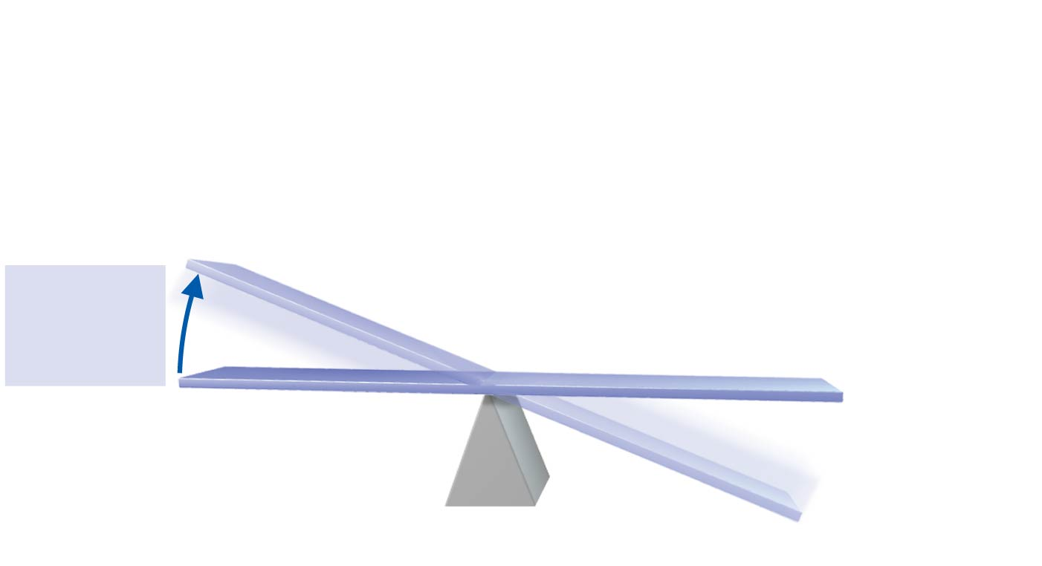
Figure 1.4 The elements of a homeostatic control system.
Slide 2
1
IMBALANCE
Stimulus
produces
change in
variable.
VARIABLE (in homeostasis)
IMBALANCE

Slide 52
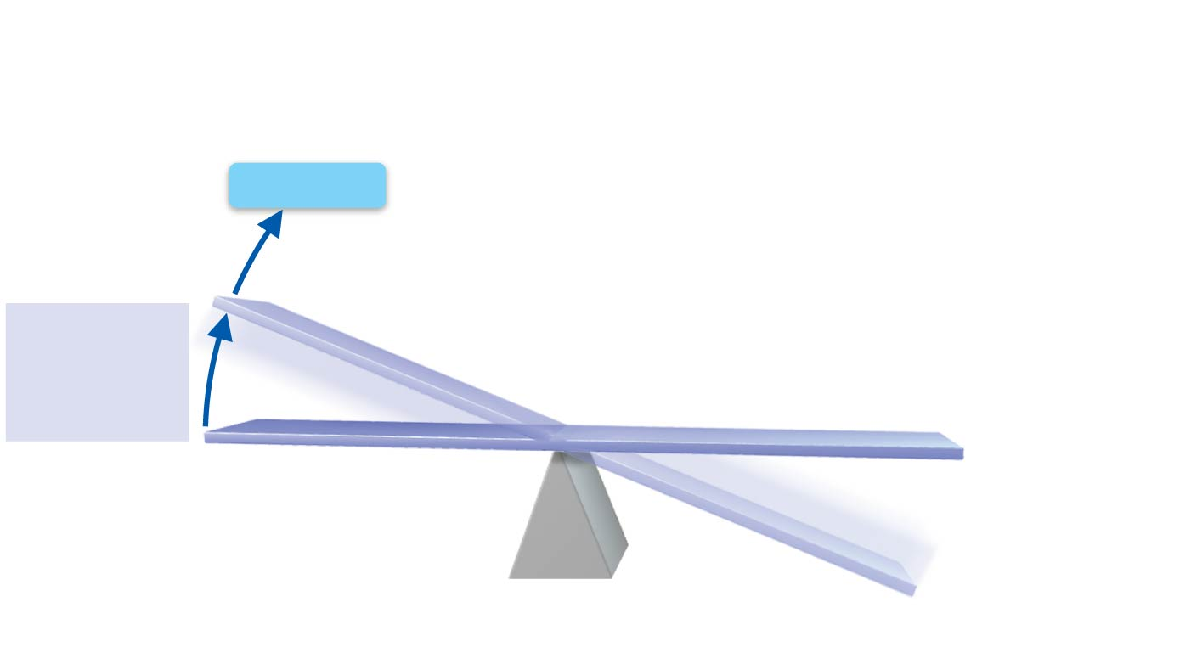
Figure 1.4 The elements of a homeostatic control system.
Slide 3
Receptor
2
Receptor
detects change.
1
IMBALANCE
Stimulus
produces
change in
variable.
VARIABLE (in homeostasis)
IMBALANCE

Slide 53
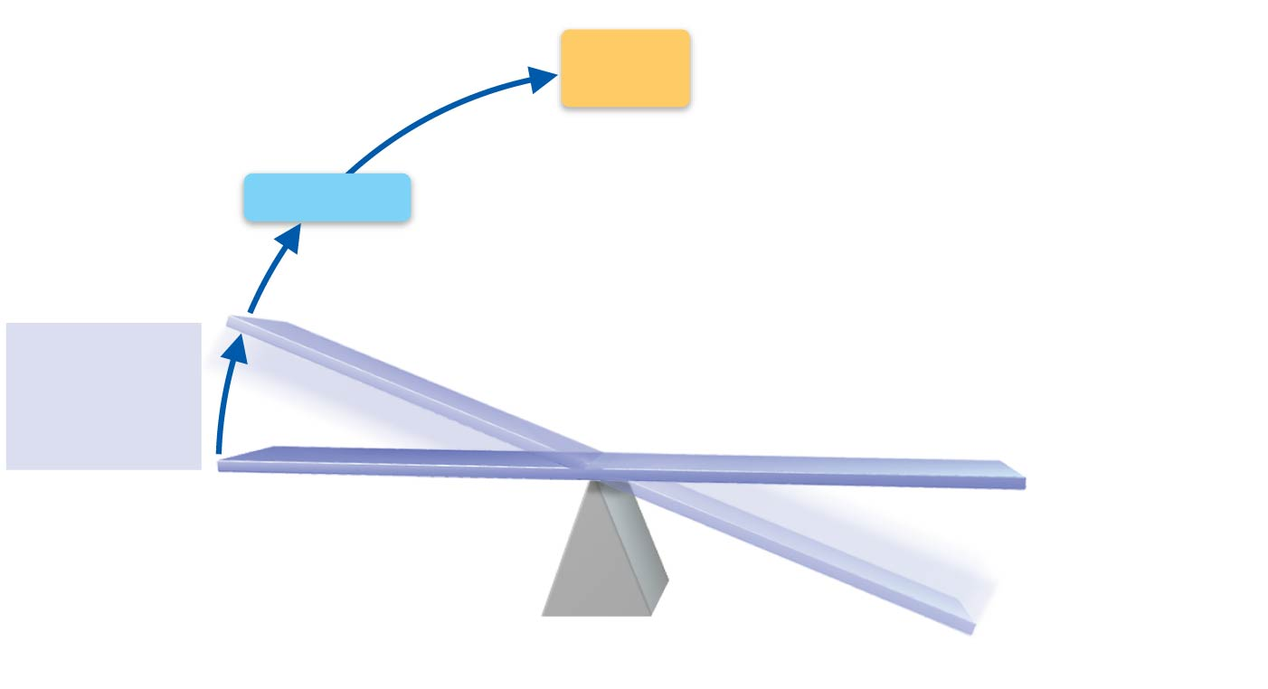
Figure 1.4 The elements of a homeostatic control system.
Slide 4
3
Input: Information
is sent along afferent
pathway to control
center.
Control
Center
Afferent
pathway
Receptor
2
Receptor
detects change.
1
IMBALANCE
Stimulus
produces
change in
variable.
VARIABLE (in homeostasis)
IMBALANCE

Slide 54
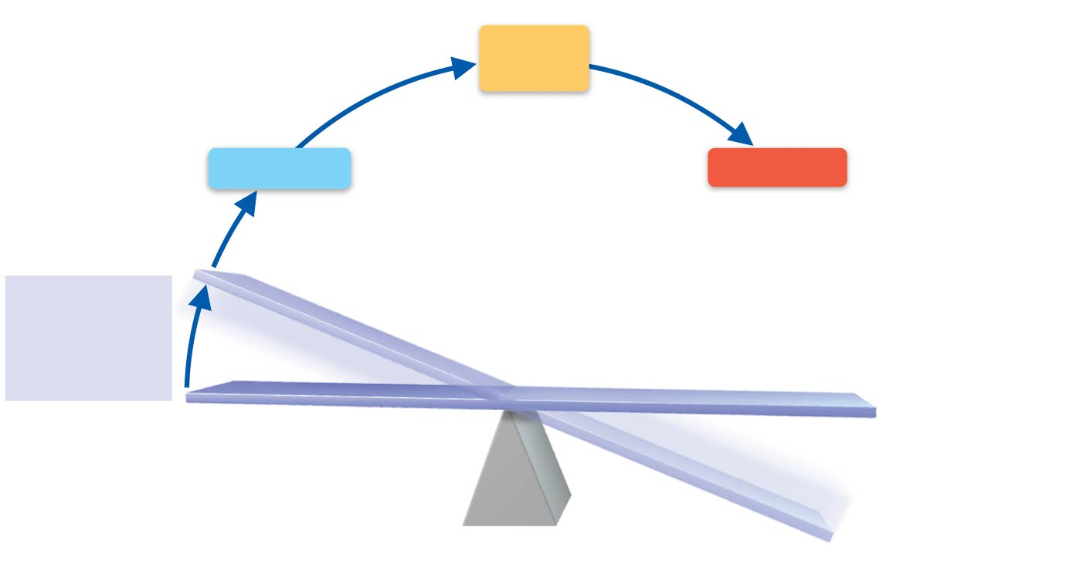
Figure 1.4 The elements of a homeostatic control system.
Slide 5
3
4
Input: Information
is sent along afferent
pathway to control
center.
Output: Information
is sent along efferent
pathway effector.
Control
Center
Afferent
pathway
Efferent
pathway
Receptor
Effector
2
Receptor
detects change.
1
IMBALANCE
Stimulus
produces
change in
variable.
VARIABLE (in homeostasis)
IMBALANCE

Slide 55
Figure 1.4 The elements of a homeostatic control system.
Slide 6
3
4
Input: Information
is sent along afferent
pathway to control
center.
Output: Information
is sent along efferent
pathway effector.
Control
Center
Afferent
pathway
Efferent
pathway
Receptor
Effector
2
Receptor
detects change.
5
Response
of effector feeds
back to reduce
the effect of
stimulus and
returns variable
to homeostatic
level.
1
IMBALANCE
Stimulus
produces
change in
variable.
VARIABLE (in homeostasis)
IMBALANCE

Slide 56
Maintaining Homeostasis
The body communicates through neural and hormonal control systems
Receptor
Responds to changes in the environment (stimuli)
Sends information to control center along an afferent pathway

Slide 57
Maintaining Homeostasis
Control center
Determines set point
Analyzes information
Determines appropriate response
Effector
Provides a means for response to the stimulus
Information flows from control center to effector along efferent pathway

Slide 58
Feedback Mechanisms
Negative feedback
Includes most homeostatic control mechanisms
Shuts off the original stimulus or reduces its intensity
Works like a household thermostat

Slide 59
Feedback Mechanisms
Positive feedback
Increases the original stimulus to push the variable farther
Reaction occurs at a faster rate
In the body positive feedback occurs in blood clotting and during the birth of a baby

Slide 60
The Language of Anatomy
Special terminology is used to prevent misunderstanding
Exact terms are used for:
Position
Direction
Regions
Structures

Slide 61
The Language of Anatomy
Anatomical position
Standard body position used to avoid confusion
Terminology refers to this position regardless of actual body position
Stand erect, feet parallel, arms hanging at the sides with palms facing forward

Slide 62
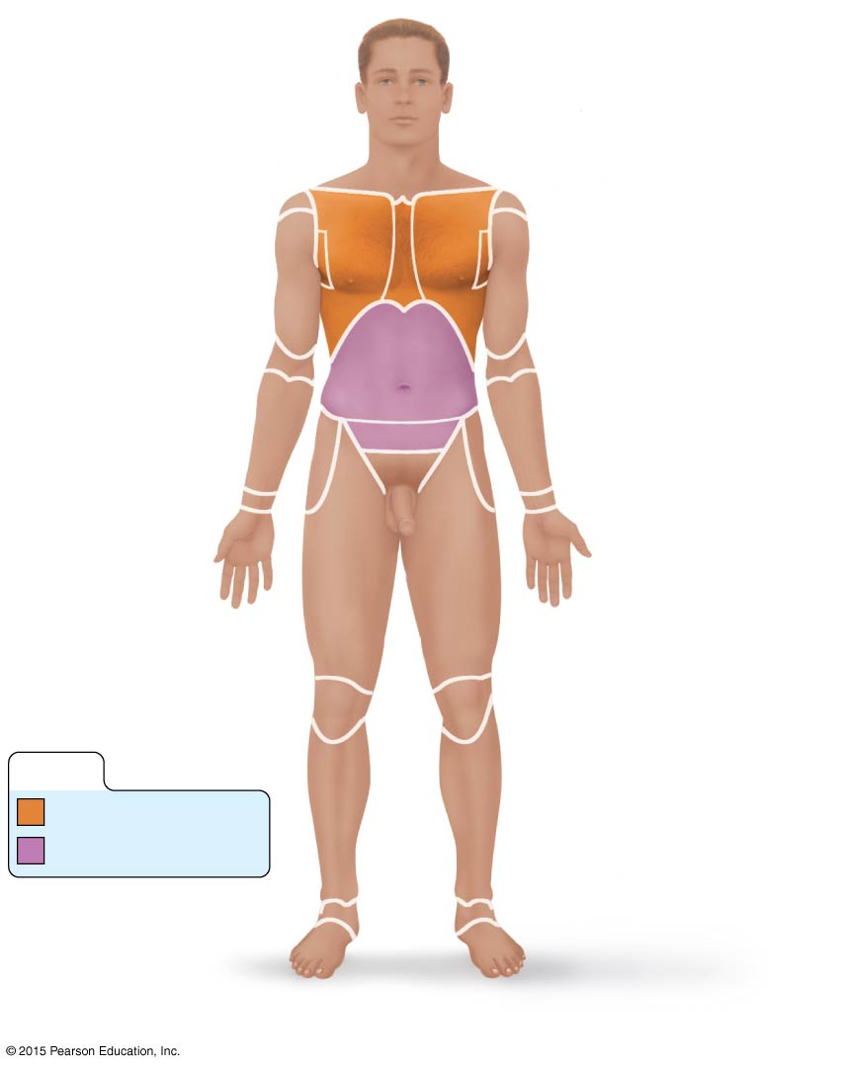
Figure 1.5a Regional terms used to designate specific body areas.
Cephalic
Frontal
Upper limb
Orbital
Upper limb
Nasal
Acromial
Buccal
Deltoid
Oral
Brachial (arm)
Mental
Antecubital
Cervical
Thoracic
Antebrachial
(forearm)
Sternal
Axillary
Carpal (wrist)
Abdominal
Umbilical
Manus (hand)
Pelvic
Digital
Inguinal
(groin)
Lower limb
Coxal (hip)
Pubic (genital)
Femoral (thigh)
Patellar
Crural (leg)
KEY:
Thorax
Fibular
Abdomen
Pedal (foot)
Tarsal (ankle)
Digital
(a) Anterior/Ventral

Slide 63
Directional Terms
Directional terms
Explains location of one body structure in relation to another

Slide 64
Directional Terms
Superior (cranial or cephalad): toward the head or upper part of a structure or the body; above
Inferior (caudal): away from the head or toward the lower part of a structure or the body; below

Slide 65
Directional Terms
Ventral (anterior): toward or at the front of the body; in front of
Dorsal (posterior): toward or at the backside of the body; behind

Slide 66
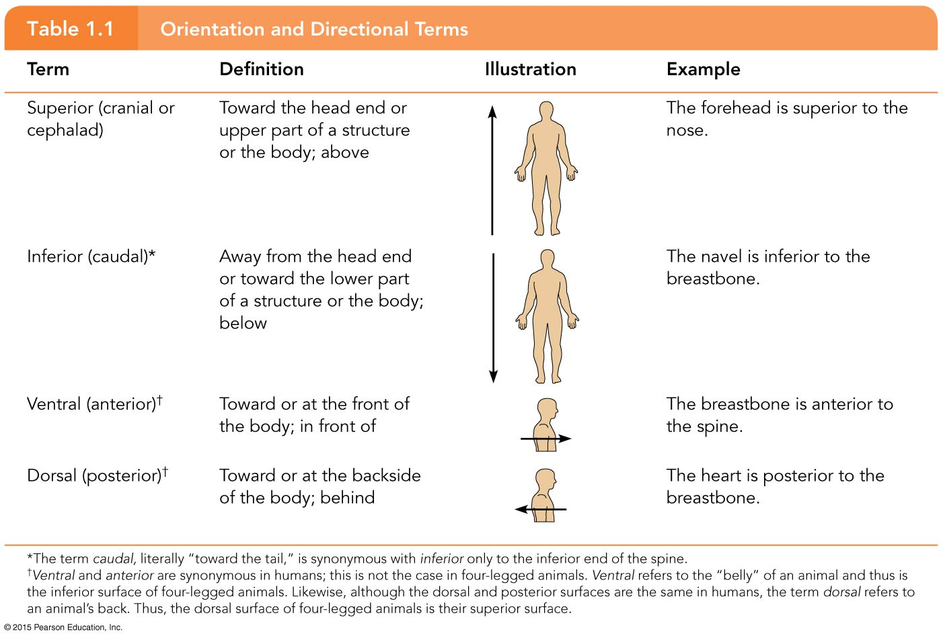
Table 1.1 Orientation and Directional Terms (1 of 3).

Slide 67
Directional Terms
Medial: toward or at the midline of the body; on the inner side of
Lateral: away from the midline of the body; on the outer side of
Intermediate: between a more medial and a more lateral structure

Slide 68
Directional Terms
Proximal: close to the origin of the body part or point of attachment to a limb to the body trunk
Distal: farther from the origin of a body part or the point of attachment of a limb to the body trunk

Slide 69
Table 1.1 Orientation and Directional Terms (2 of 3).

Slide 70
Directional Terms
Superficial (external): toward or at the body surface
Deep (internal): away from the body surface; more internal

Slide 71
Table 1.1 Orientation and Directional Terms (3 of 3).

Slide 72
Regional Terms
Anterior (ventral) body landmarks

Slide 73
Figure 1.5a Regional terms used to designate specific body areas.
Cephalic
Frontal
Upper limb
Orbital
Upper limb
Nasal
Acromial
Buccal
Deltoid
Oral
Brachial (arm)
Mental
Antecubital
Cervical
Thoracic
Antebrachial
(forearm)
Sternal
Axillary
Carpal (wrist)
Abdominal
Umbilical
Manus (hand)
Pelvic
Digital
Inguinal
(groin)
Lower limb
Coxal (hip)
Pubic (genital)
Femoral (thigh)
Patellar
Crural (leg)
KEY:
Thorax
Fibular
Abdomen
Pedal (foot)
Tarsal (ankle)
Digital
(a) Anterior/Ventral

Slide 74
Regional Terms
Posterior (dorsal) body landmarks

Slide 75
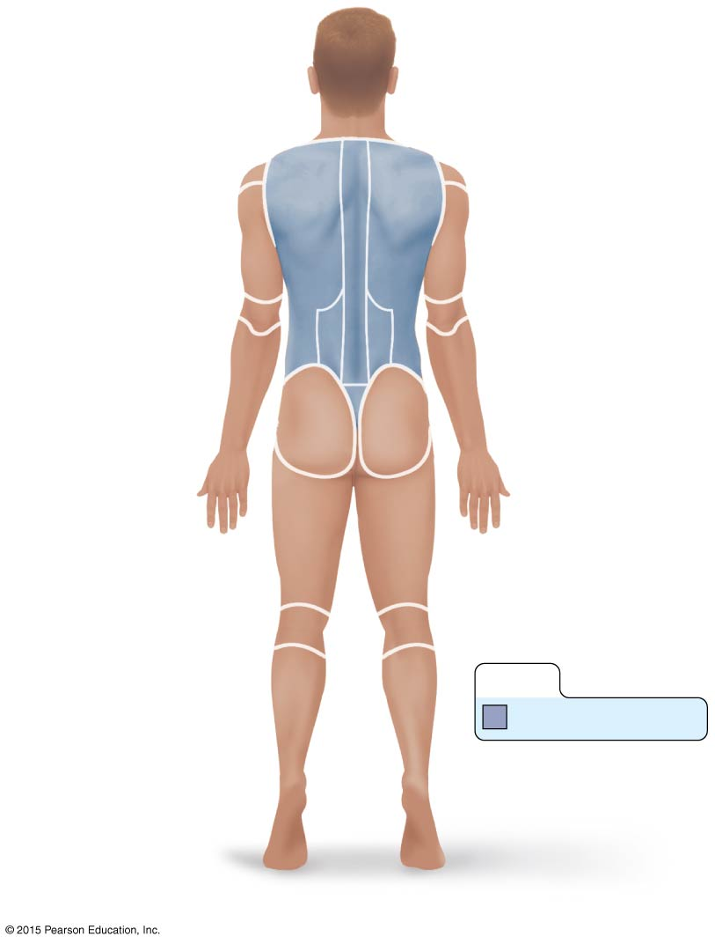
Figure 1.5b Regional terms used to designate specific body areas.
Upper limb
Cephalic
Upper limb
Occipital
(back of head)
Acromial
Cervical
Brachial (arm)
Olecranal
Back (dorsal)
Antebrachial
(forearm)
Scapular
Vertebral
Lumbar
Sacral
Manus (hand)
Gluteal
Digital
Femoral (thigh)
Popliteal
Sural (calf)
KEY:
Fibular
Back (Dorsum)
Pedal (foot)
Calcaneal
Plantar
(b) Posterior/Dorsal

Slide 76
Body Planes and Sections
Sections are cuts along imaginary lines known as planes
Three types of planes or sections exist as right angles to one another

Slide 77
Body Planes and Sections
A sagittal section divides the body (or organ) into left and right parts
A median, or midsagittal, section divides the body (or organ) into equal left and right parts
A frontal, or coronal, section divides the body (or organ) into anterior and posterior parts
A transverse, or cross, section divides the body (or organ) into superior and inferior parts

Slide 78
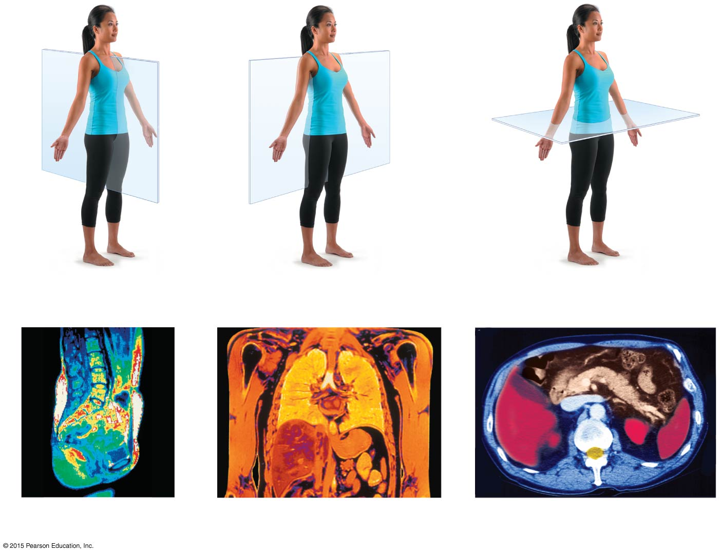
Figure 1.6 The anatomical position and planes of the body—median, frontal, and transverse with corresponding MRI scans.
(a) Median (midsagittal)
(b) Frontal (coronal) plane
(c) Transverse plane
Vertebral column
Right lung
Heart
Left lung
Liver
Aorta
Pancreas
Spleen
Rectum
Intestines
Liver
Stomach
Spleen
Subcutaneous
fat layer
Spinal cord

Slide 79
Body Cavities
Two body cavities
Dorsal
Ventral
Body cavities provide varying degrees of protection to organs within them

Slide 80
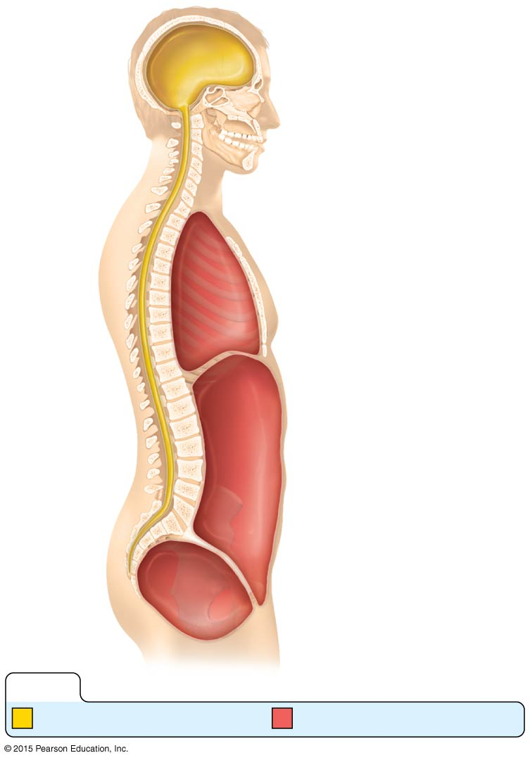
Figure 1.7 Body cavities.
Cranial
cavity
Thoracic
cavity
Diaphragm
Abdominal
cavity
Spinal
cavity
Abdominopelvic
cavity
Pelvic
cavity
KEY:
Dorsal body cavity
Ventral body cavity

Slide 81
Body Cavities
Dorsal body cavity has two subdivisions
Cranial cavity
Houses the brain
Protected by the skull
Spinal cavity
Houses the spinal cord
Protected by the vertebrae

Slide 82
Body Cavities
Ventral body cavity has two subdivisions separated by the diaphragm
Thoracic cavity
Abdominopelvic cavity

Slide 83
Body Cavities
Thoracic cavity
Cavity superior to the diaphragm
Houses heart, lungs, and other organs
Mediastinum, the central region, houses heart, trachea, and other organs

Slide 84
Body Cavities
Abdominopelvic cavity
Cavity inferior to the diaphragm
Superior abdominal cavity contains the stomach, liver, and other organs
Protected only by trunk muscles
Inferior pelvic cavity contains reproductive organs, bladder, and rectum
Protected somewhat by bony pelvis
No physical structure separates abdominal from pelvic cavities

Slide 85
Body Cavities
Abdominopelvic cavity subdivisions
Four quadrants
Nine regions

Slide 86
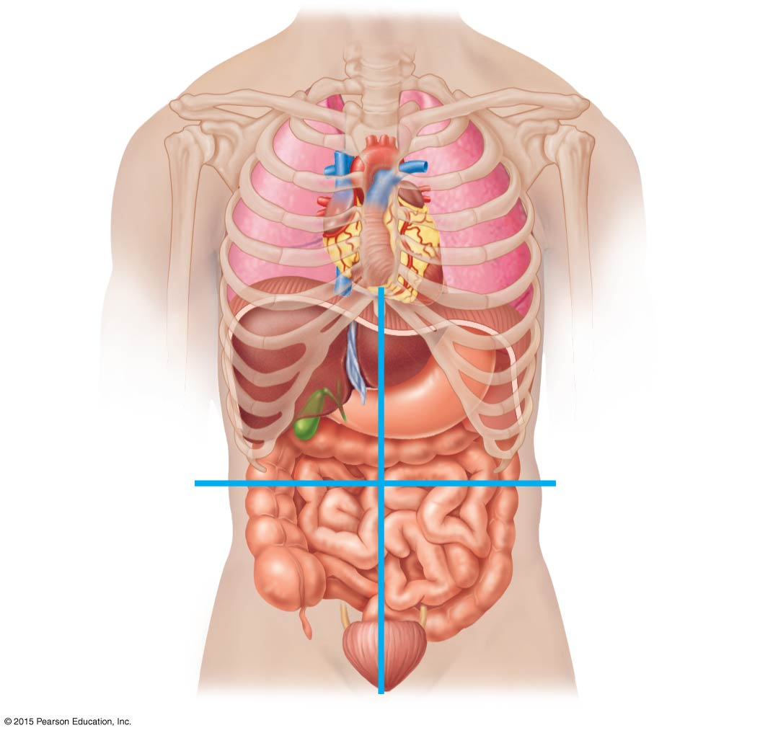
Figure 1.8 The four abdominopelvic quadrants.
Right upper
quadrant
(RUQ)
Left upper
quadrant
(LUQ)
Right lower
quadrant
(RLQ)
Left lower
quadrant
(LLQ)

Slide 87
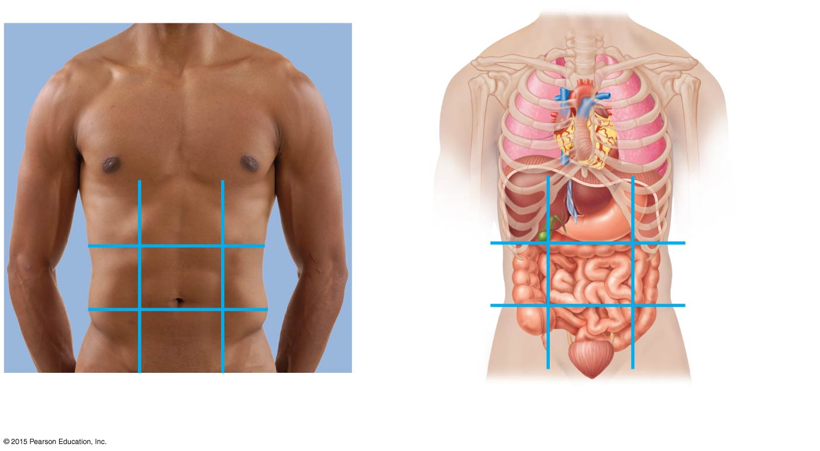
Figure 1.9 The nine abdominopelvic regions.
Diaphragm
Liver
Stomach
Right
hypochondriac
region
Left
hypochondriac
region
Gallbladder
Transverse
colon of large
intestine
Epigastric
region
Ascending
colon of
large intestine
Descending
colon of large
intestine
Right
lumbar
region
Umbilical
region
Left
lumbar
region
Small intestine
Hypo-
gastric
(pubic)
region
Cecum
Initial part
of sigmoid
colon
Right iliac
(inguinal)
region
Left iliac
(inguinal)
region
Appendix
Urinary
bladder
(a) Nine regions delineated by
four planes
(b) Anterior view of the nine regions
showing the superficial organs

Slide 88
Body Cavities
Other body cavities include:
Oral and digestive cavities
Nasal cavity
Orbital cavities
Middle ear cavities

