Slide 2
Matter and Energy
Matter—anything that occupies space and has mass (weight)
Matter may exist as one of three states:
Solid: definite shape and volume
Liquid: definite volume; shape of container
Gaseous: neither a definite shape nor volume

Slide 3
Matter and Energy
Matter may be changed
Physically
Changes do not alter the basic nature of a substance
Chemically
Changes alter the chemical composition of a substance

Slide 4
Matter and Energy
Energy—the ability to do work.
Has no mass and does not take up space
Kinetic energy: energy is doing work
Potential energy: energy is inactive or stored

Slide 5
Matter and Energy
Forms of energy
Chemical energy is stored in chemical bonds of substances
Electrical energy results from movement of charged particles
Mechanical energy is energy directly involved in moving matter
Radiant energy travels in waves

Slide 6
Matter and Energy
Energy form conversions
ATP (adenosine triphosphate) traps the chemical energy of food in its bonds

Slide 7
Composition of Matter
Elements—fundamental units of matter
96 percent of the body is made from four elements:
Oxygen (O)
Carbon (C)
Hydrogen (H)
Nitrogen (N)
Periodic table contains a complete listing of elements

Slide 8
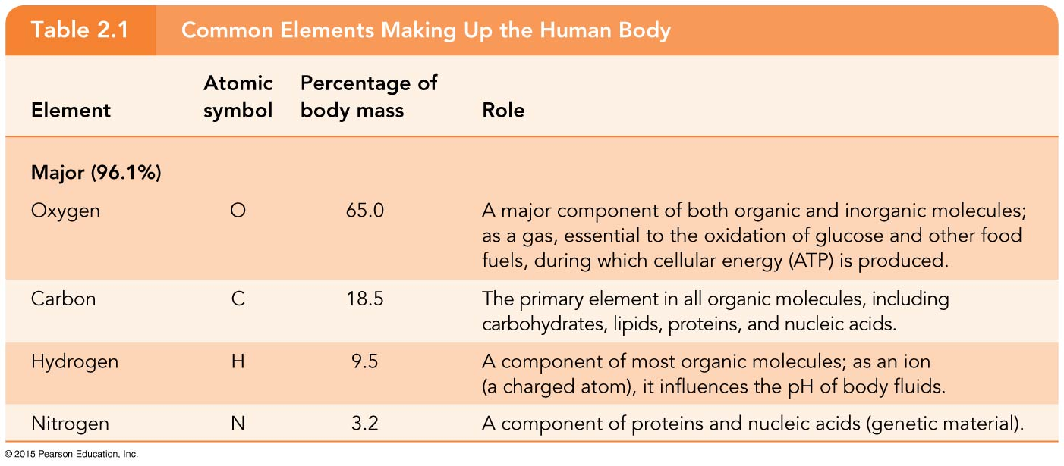
Table 2.1 Common Elements Making Up the Human Body (1 of 3).

Slide 9
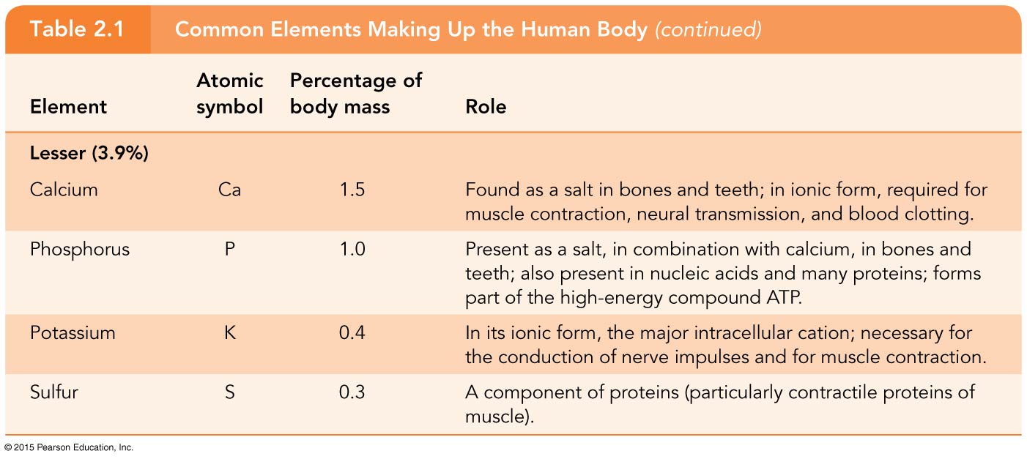
Table 2.1 Common Elements Making Up the Human Body (2 of 3).

Slide 10
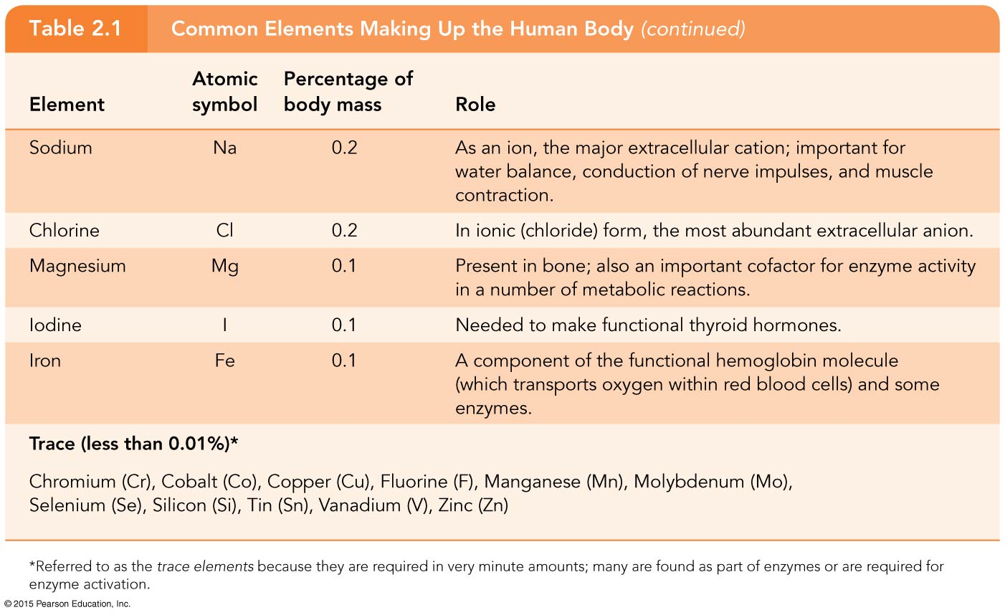
Table 2.1 Common Elements Making Up the Human Body (3 of 3).

Slide 11
Composition of Matter
Atoms
Building blocks of elements
Atoms of elements differ from one another
Atomic symbol is chemical shorthand for each element
Indivisible (“incapable of being divided”)

Slide 12
Subatomic Particles
Nucleus
Protons (p⁺) are positively charged
Neutrons (n⁰) are uncharged or neutral
Orbiting the nucleus
Electrons (e–) are negatively charged

Slide 13
Subatomic Particles
Atoms are electrically neutral
Number of protons equals numbers of electrons in an atom
Positive and negative charges cancel each other out
Ions are atoms that have lost or gained electrons

Slide 14
Table 2.2 Subatomic Particles.

Slide 15
Subatomic Particles
Planetary model
Portrays the atom as a miniature solar system
Protons and neutrons are in the nucleus
Electrons are in orbitals

Slide 16
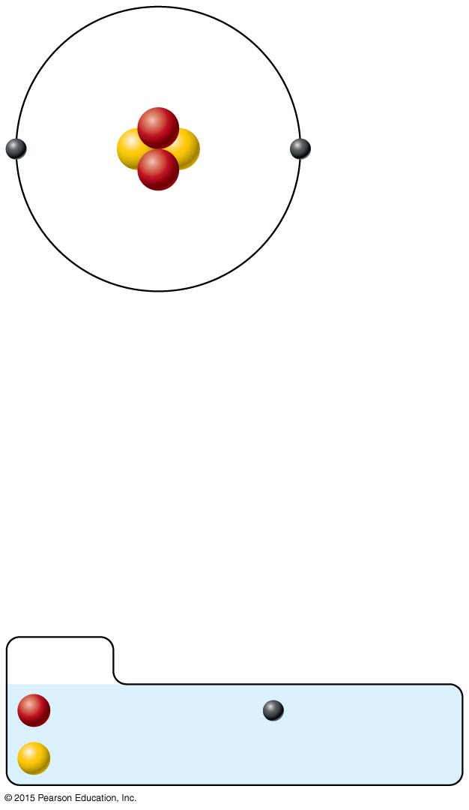
Figure 2.1a The structure of an atom.
Nucleus
Helium atom
2 protons (p⁺)
2 neutrons (n⁰)
2 electrons (e–)
(a) Planetary model
KEY:
Proton
Electron
Neutron

Slide 17
Subatomic Particles
Orbital model
More modern
Predicts chemical behavior of atoms
Electrons are depicted by an electron cloud, a haze of negative charge, outside the nucleus

Slide 18
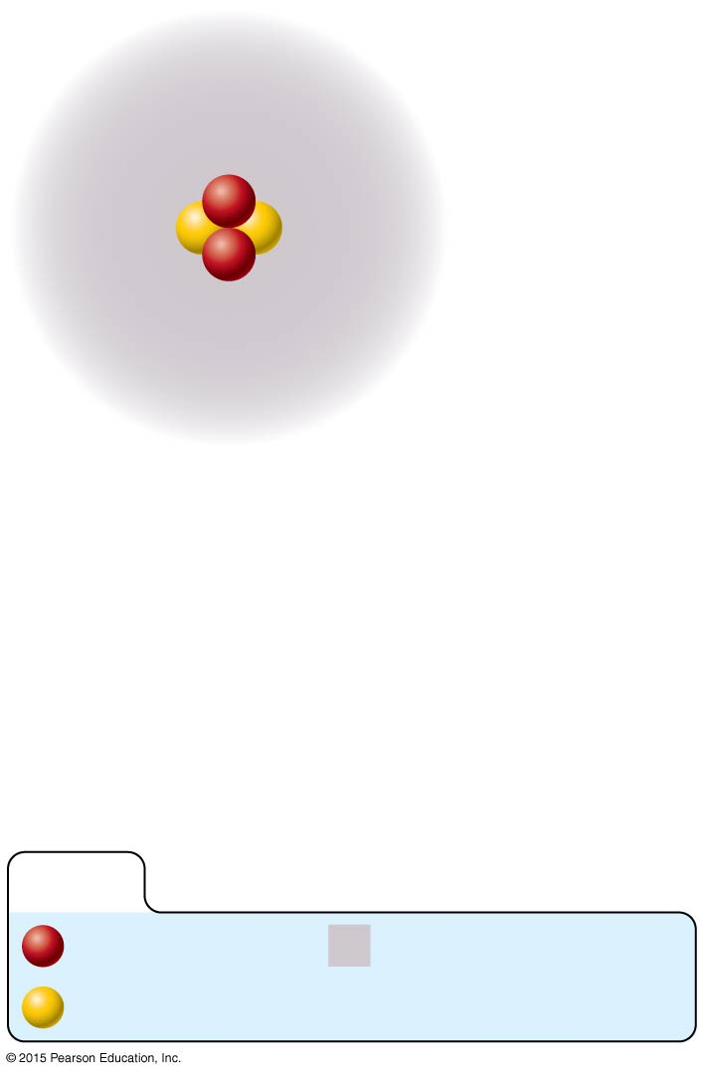
Figure 2.1b The structure of an atom.
Nucleus
Helium atom
2 protons (p⁺)
2 neutrons (n⁰)
2 electrons (e–)
(b) Orbital model
KEY:
Proton
Electron cloud
Neutron

Slide 19
Subatomic Particles
Electrons determine an atom’s chemical behavior
Although outdated, the planetary model is simple and easy to understand and use

Slide 20
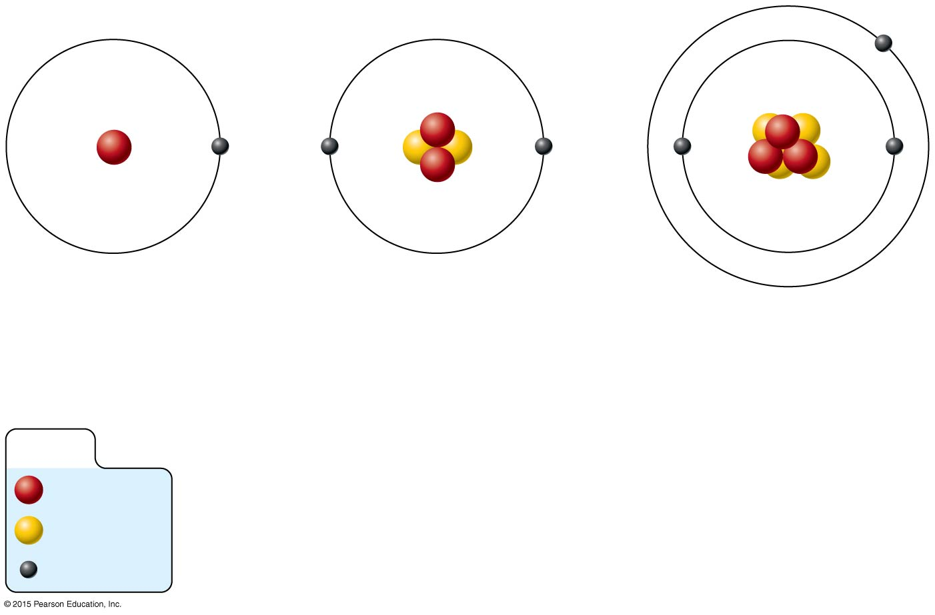
Figure 2.2 Atomic structure of the three smallest atoms.
(a) Hydrogen (H)
(b) Helium (He)
(c) Lithium (Li)
(1p⁺; 0n⁰; 1e–)
(2p⁺; 2n⁰; 2e–)
(3p⁺; 4n⁰; 3e–)
KEY:
Proton
Neutron
Electron

Slide 21
Identifying Elements
Atomic number—equal to the number of protons that the atom contains
Unique to atoms of a particular element
Indirectly tells the number of electrons in an atom
Atomic mass number—sum of the protons and neutrons contained in an atom’s nucleus

Slide 22
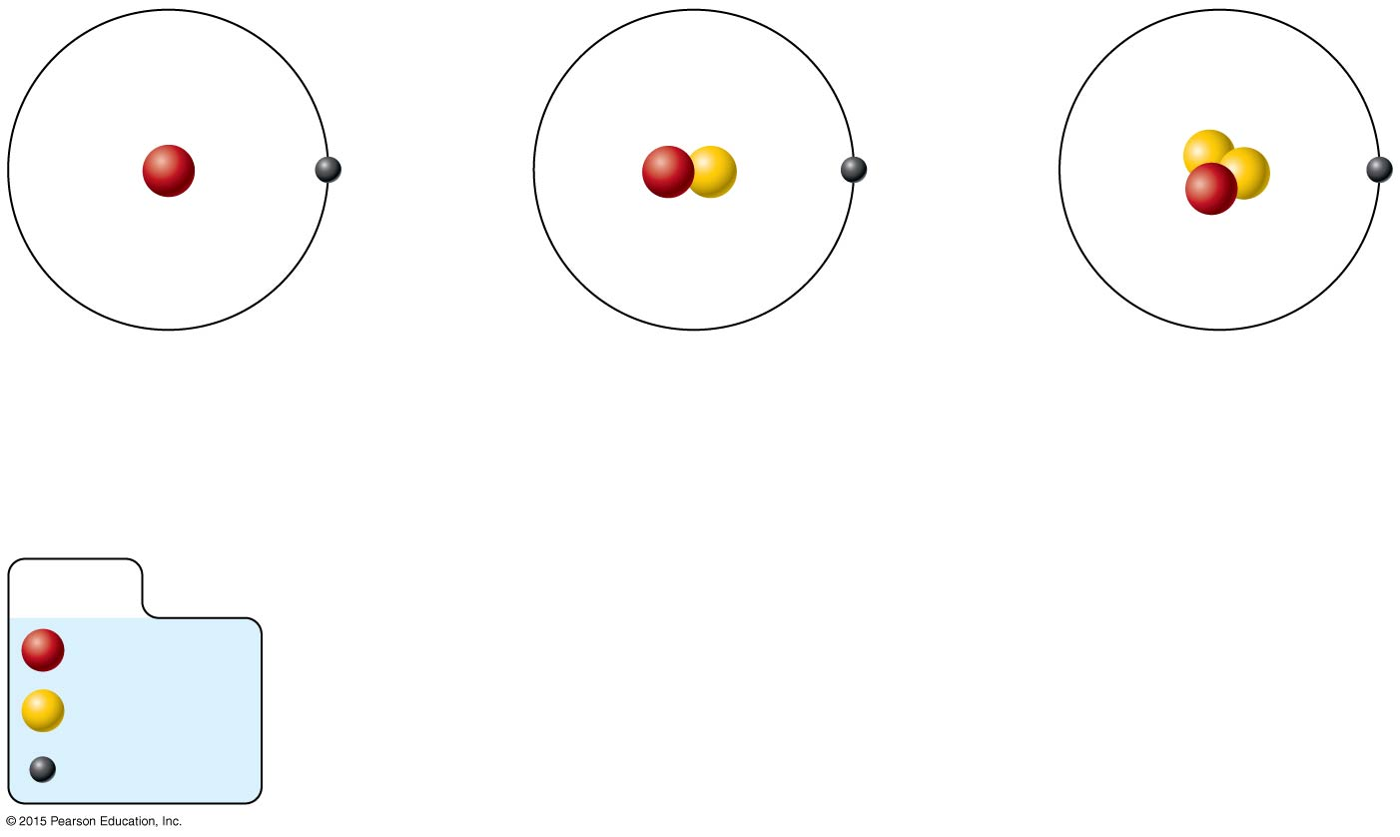
Figure 2.3 Isotopes of hydrogen differ in their numbers of neutrons.
Hydrogen (¹H)
(1p⁺; 0n⁰; 1e–)
Deuterium (²H)
(1p⁺; 1n⁰; 1e–)
Tritium (³H)
(1p⁺; 2n⁰; 1e–)
KEY:
Proton
Neutron
Electron

Slide 23
Isotopes and Atomic Weight
Isotopes
Atoms of the same element with the same number of protons and the same atomic number
Vary in number of neutrons

Slide 24
Figure 2.3 Isotopes of hydrogen differ in their numbers of neutrons.
Hydrogen (¹H)
(1p⁺; 0n⁰; 1e–)
Deuterium (²H)
(1p⁺; 1n⁰; 1e–)
Tritium (³H)
(1p⁺; 2n⁰; 1e–)
KEY:
Proton
Neutron
Electron

Slide 25
Isotopes and Atomic Weight
Atomic weight
Close to mass number of most abundant isotope
Atomic weight reflects natural isotope variation

Slide 26
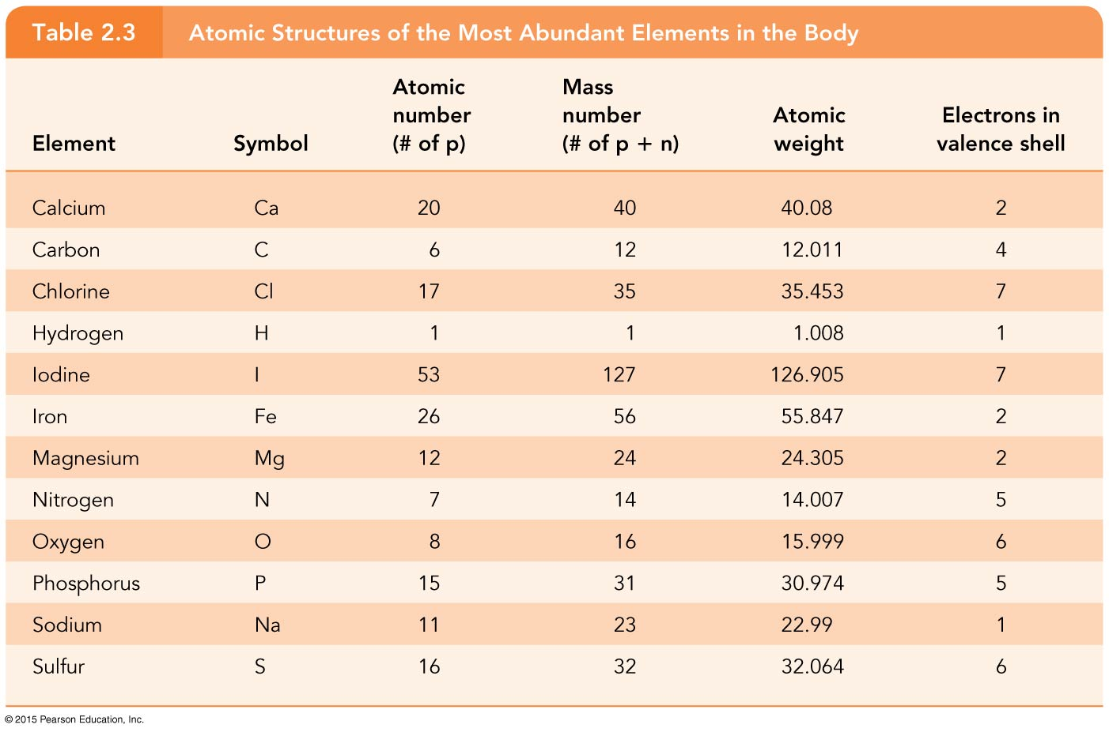
Table 2.3 Atomic Structures of the Most Abundant Elements in the Body.

Slide 27
Radioactivity
Radioisotope
Heavy isotope of certain atoms
Tends to be unstable
Decomposes to more stable isotope
Radioactivity—process of spontaneous atomic decay

Slide 28
Molecules and Compounds
Molecule—two or more atoms of the same elements combined chemically
Example of a chemical reaction resulting in a molecule:
H (atom) + H (atom) → H₂ (molecule)
The reactants are the atoms on the left
The product is the molecule on the right represented by a molecular formula

Slide 29
Molecules and Compounds
Compound—two or more atoms of different elements combined chemically to form a molecule of a compound
Example of a chemical reaction resulting in a compound:
4H + C → CH₄ (methane)

Slide 30
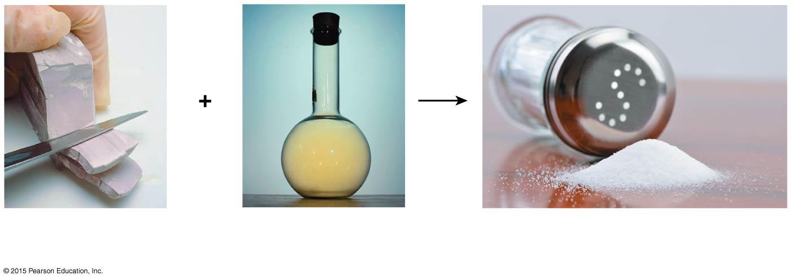
Figure 2.4 Properties of a compound differ from those of its atoms.
Sodium
(silvery metal)
Chlorine
(poisonous gas)
Sodium chloride (table salt)

Slide 31
Chemical Reactions
Chemical reactions occur when atoms combine with or dissociate from other atoms
Atoms are united by chemical bonds
Atoms dissociate from other atoms when chemical bonds are broken

Slide 32
Electrons and Bonding
Electrons occupy energy levels called electron shells (levels)
Electrons closest to the nucleus are most strongly attracted
Each shell has distinct properties
The number of electrons has an upper limit
Shells closest to the nucleus fill first

Slide 33
Electrons and Bonding
Bonding involves only interactions between electrons in the outer (valence) shell
Atoms with full valence shells do not form bonds

Slide 34
Inert Elements
Atoms are stable (inert) when the outermost (valence) shell is complete
How to fill the atom’s shells
Shell 1 can hold a maximum of 2 electrons
Shell 2 can hold a maximum of 8 electrons
Shell 3 can hold a maximum of 18 electrons

Slide 35
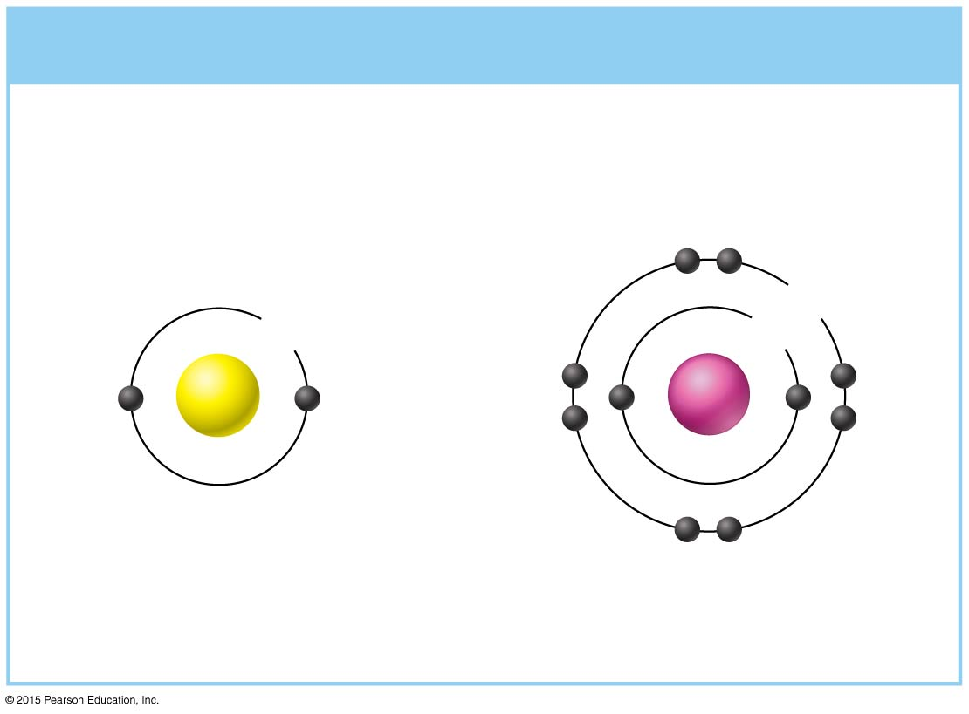
Figure 2.5a Chemically inert and reactive elements.
(a) Chemically inert elements
Outermost energy level
(valence shell) complete
8e
2e
2e
He
Ne
Helium (He)
(2p⁺; 2n⁰; 2e–)
Neon (Ne)
(10p⁺; 10n⁰; 10e–)

Slide 36
Inert Elements
Rule of eights
Atoms are considered stable when their outermost orbital has 8 electrons
The exception to this rule of eights is shell 1, which can hold only 2 electrons

Slide 37
Reactive Elements
Outermost valence shell is incomplete
Atoms will gain, lose, or share electrons to complete their outermost orbitals
Atoms reach a stable state
Bond formation produces a stable valence shell

Slide 38
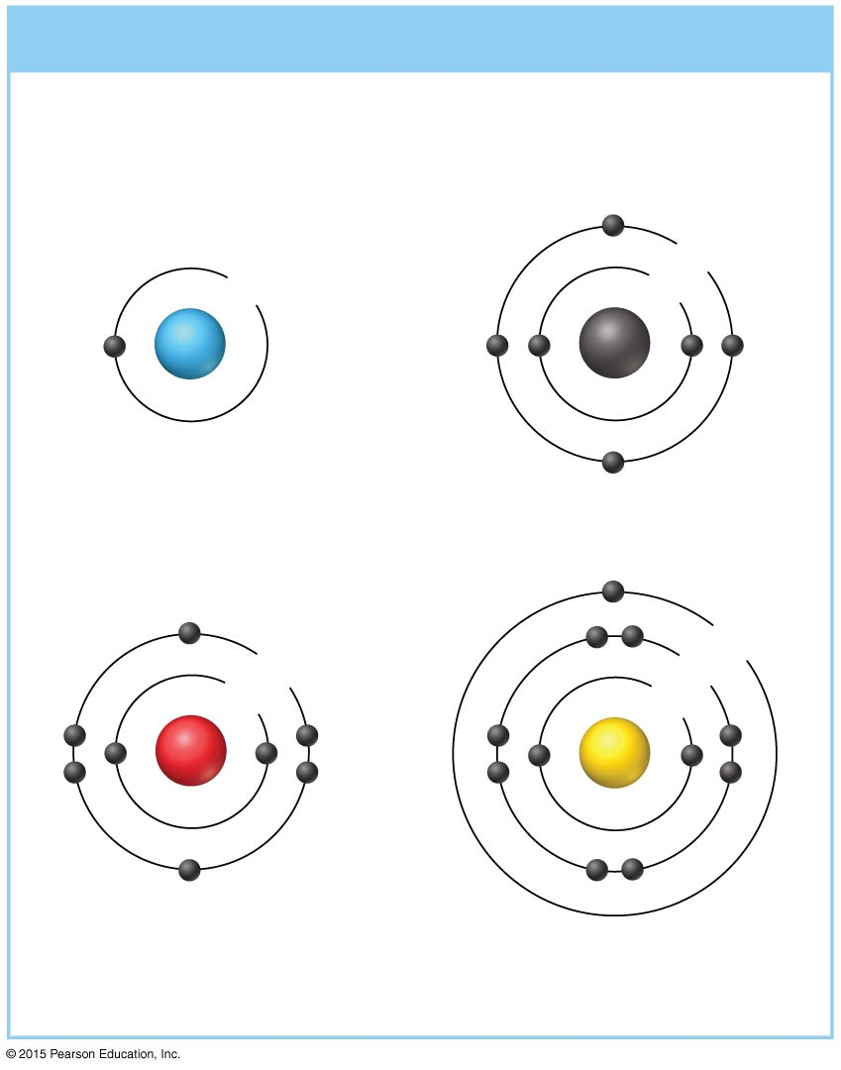
Figure 2.5b Chemically inert and reactive elements.
(b) Chemically reactive elements
Outermost energy level
(valence shell) incomplete
4e
1e
2e
H
C
Hydrogen (H)
(1p⁺; 0n⁰; 1e–)
Carbon (C)
(6p⁺; 6n⁰; 6e–)
1e
6e
8e
2e
2e
O
Na
Oxygen (O)
(8p⁺; 8n⁰; 8e–)
Sodium (Na)
(11p⁺; 12n⁰; 11e–)

Slide 39
Chemical Bonds
Ionic bonds
Form when electrons are completely transferred from one atom to another
Allow atoms to achieve stability through the transfer of electrons

Slide 40
Chemical Bonds
Ions
Result from the loss or gain of electrons
Anions have negative charge due to gain of electron(s)
Cations have positive charge due to loss of electron(s)
Tend to stay close together because opposite charges attract

Slide 41
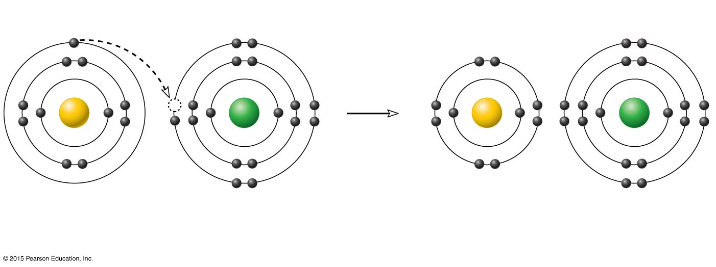
Figure 2.6 Formation of an ionic bond.
+
–
Na
Cl
Na
Cl
Sodium atom (Na)
(11p⁺; 12n⁰; 11e–)
Chlorine atom (Cl)
(17p⁺; 18n⁰; 17e–)
Sodium ion (Na⁺)
Chlorine ion (Cl–)
Sodium chloride (NaCl)

Slide 42
Chemical Bonds
Covalent bonds
Atoms become stable through shared electrons
Electrons are shared in pairs
Single covalent bonds share one pair of electrons
Double covalent bonds share two pairs of electrons

Slide 43
Figure 2.7a Formation of covalent bonds.
Reacting atoms
Resulting molecules
H
H
H
H
or
Hydrogen
atom
Hydrogen
atom
Molecule of
hydrogen gas (H₂)
(a) Formation of a single covalent bond

Slide 44
Figure 2.7b Formation of covalent bonds.
Reacting atoms
Resulting molecules
O
O
O
O
or
Oxygen atom
Oxygen atom
Molecule of oxygen gas (O₂)
(b) Formation of a double covalent bond

Slide 45
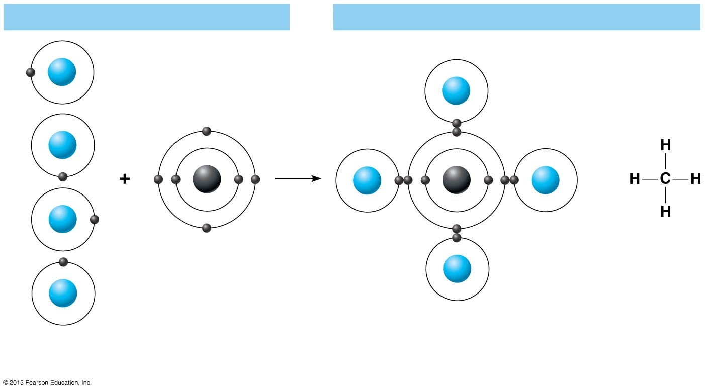
Figure 2.7c Formation of covalent bonds.
Reacting atoms
Resulting molecules
H
H
H
C
H
C
H
or
H
H
H
Hydrogen atoms
Carbon atom
Molecule of methane gas (CH₄)
(c) Formation of four single covalent bonds

Slide 46
Covalent Bonds
Covalent bonds are either nonpolar or polar
Nonpolar
Electrons are shared equally between the atoms of the molecule
Electrically neutral as a molecule
Example: carbon dioxide

Slide 47
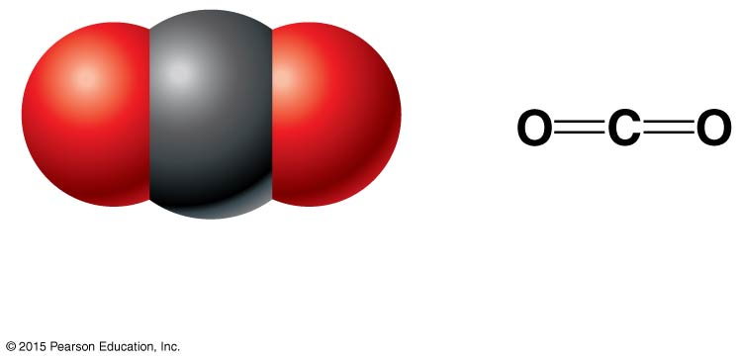
Figure 2.8a Molecular models illustrating the three-dimensional structure of carbon dioxide and water molecules.
(a) Carbon dioxide (CO₂)

Slide 48
Covalent Bonds
Covalent bonds are either nonpolar or polar
Polar
Electrons are not shared equally between the atoms of the molecule
Molecule has a positive and negative side, or pole
Example: water

Slide 49
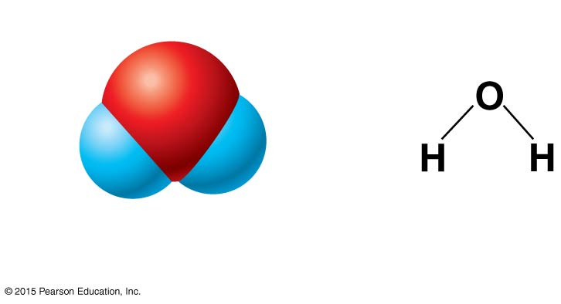
Figure 2.8b Molecular models illustrating the three-dimensional structure of carbon dioxide and water molecules.
δ–
δ⁺
δ⁺
(b) Water (H₂O)

Slide 50
Hydrogen Bonds
Hydrogen bonds
Weak chemical bonds
Hydrogen is attracted to the negative portion of a polar molecule
Provides attraction between molecules
Responsible for the surface tension of water
Important for forming intramolecular bonds, as in protein structure

Slide 51
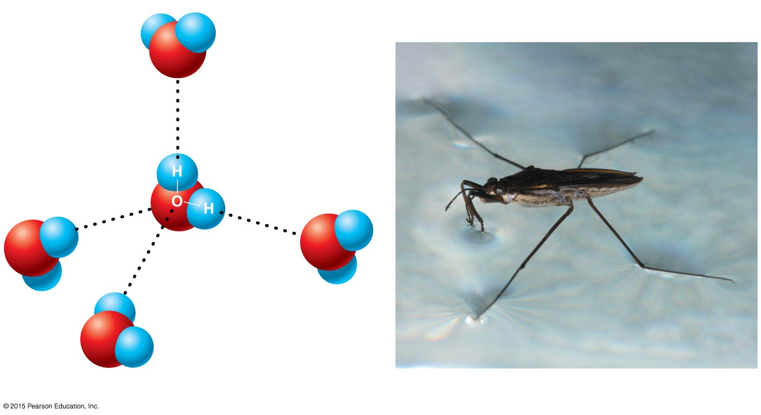
Figure 2.9 Hydrogen bonding between polar water molecules.
δ⁺
H
H
O
δ–
Hydrogen
bonds
δ⁺
δ⁺
δ–
δ–
δ–
H
O
H
O
δ⁺
δ⁺
H
H
H
δ⁺
O
H
δ–
(a)
(b)

Slide 52
Patterns of Chemical Reactions
Synthesis reaction (A + B → AB)
Atoms or molecules combine
Energy is absorbed for bond formation
Underlies all anabolic activities in the body
Decomposition reaction (AB → A + B)
Molecule is broken down
Chemical energy is released
Underlies all catabolic activities in the body

Slide 53
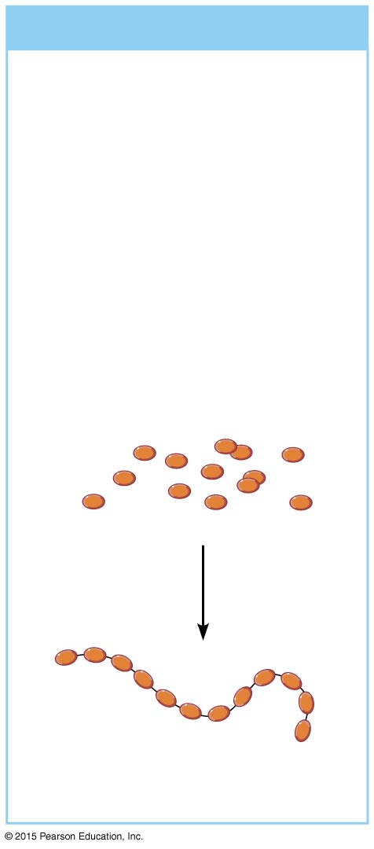
Figure 2.10a Patterns of chemical reactions.
(a) Synthesis reactions
Smaller particles are
bonded together to form
larger, more complex
molecules.
Example
Amino acids are joined
together to form a protein
molecule.
Amino acid
molecules
Protein
molecule

Slide 54
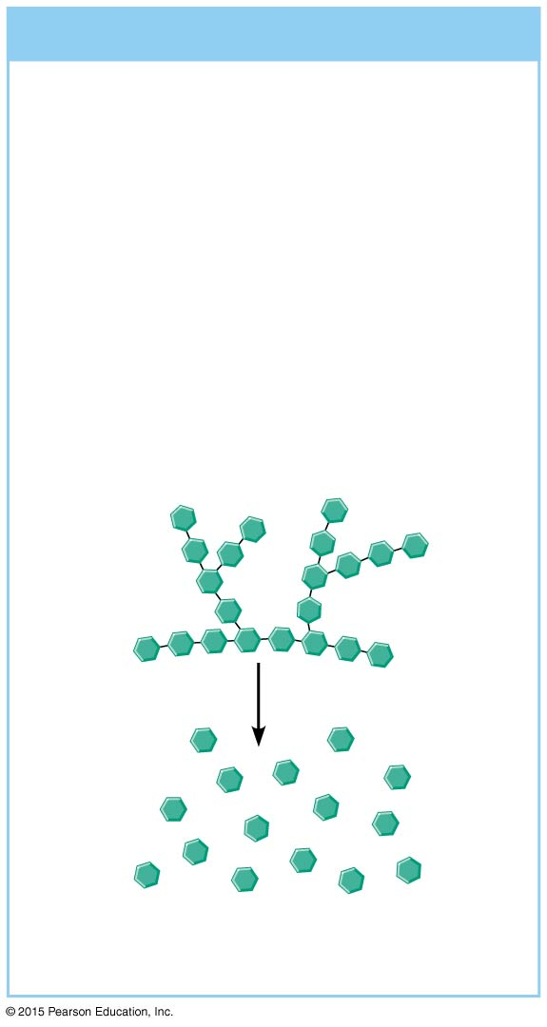
Figure 2.10b Patterns of chemical reactions.
(b) Decomposition reactions
Bonds are broken in larger
molecules, resulting in
smaller, less complex
molecules.
Example
Glycogen is broken down to
release glucose units.
Glycogen
Glucose
molecules

Slide 55
Patterns of Chemical Reactions
Exchange reaction (AB + C → AC + B and AB + CD → AD + CB)
Involves both synthesis and decomposition reactions as bonds are both made and broken
Switch is made between molecule parts, and different molecules are made

Slide 56
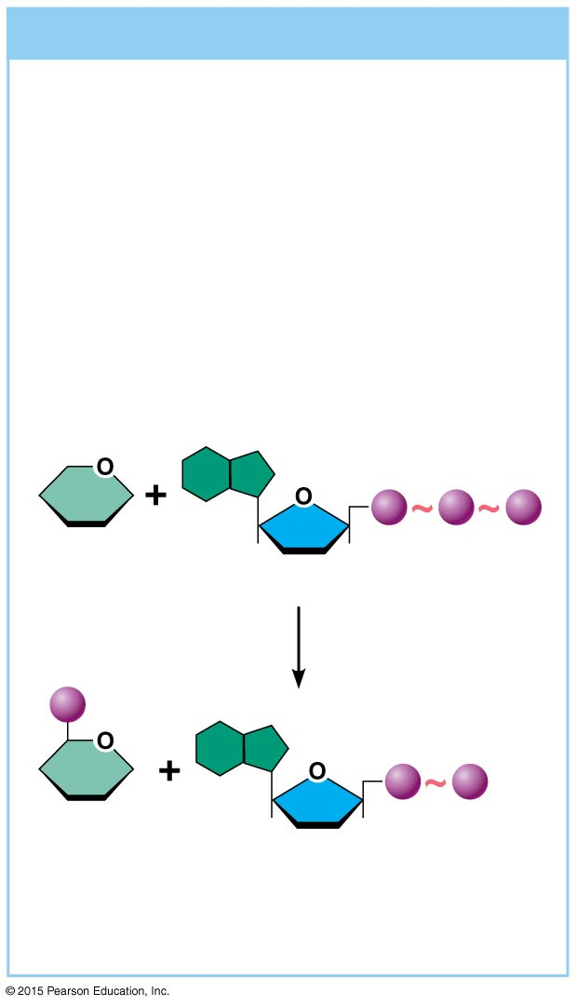
Figure 2.10c Patterns of chemical reactions.
(c) Exchange reactions
Bonds are both made
and broken.
Example
ATP transfers its terminal phosphate
group to glucose to form glucose-
phosphate.
P
P
P
Glucose
Adenosine triphosphate
(ATP)
P
P
P
Glucose-
phosphate
Adenosine diphosphate
(ADP)

Slide 57
Patterns of Chemical Reactions
Most chemical reactions are reversible
Reversibility is indicated by a double arrow
When arrows differ in length, the longer arrow indicates the more rapid reaction or major direction of progress
Factors influencing the rate of chemical reactions are shown in Table 2.4

Slide 58
Table 2.4 Factors Increasing the Rate of Chemical Reactions.

Slide 59
Biochemistry: Essentials for Life
Inorganic compounds
Lack carbon
Tend to be small, simple molecules
Include water, salts, and some acids and bases
Organic compounds
Contain carbon
All are large, covalently bonded molecules
Include carbohydrates, lipids, proteins, and nucleic acids

Slide 60
Important Inorganic Compounds
Water
Most abundant inorganic compound in the body
Vital properties
High heat capacity
Polarity/solvent properties
Chemical reactivity
Cushioning

Slide 61
Important Inorganic Compounds
High heat capacity: water absorbs and releases a large amount of heat before it changes temperature
Prevents sudden changes in body temperature

Slide 62
Important Inorganic Compounds
Polarity/solvent properties: water is often called the “universal solvent”
Solvents are liquids or gases that dissolve smaller amounts of solutes
Solutes are solids, liquids, or gases that are dissolved or suspended by solvents
Solution forms when solutes are very tiny
Colloid forms when solutes of intermediate size form a translucent mixture

Slide 63
Important Inorganic Compounds
Chemical reactivity
Water is an important reactant in some chemical reactions
Reactions that require water are known as hydrolysis reactions
Example: water helps digest food or break down biological molecules

Slide 64
Important Inorganic Compounds
Cushioning
Water serves a protective function
Examples: cerebrospinal fluid protects the brain from physical trauma, and amniotic fluid protects a developing fetus

Slide 65
Important Inorganic Compounds
Salts
Contain cations other than H⁺ and anions other than OH–
Easily dissociate (break apart) into ions in the presence of water
Vital to many body functions
Example: sodium and potassium ions are essential for nerve impulses

Slide 66
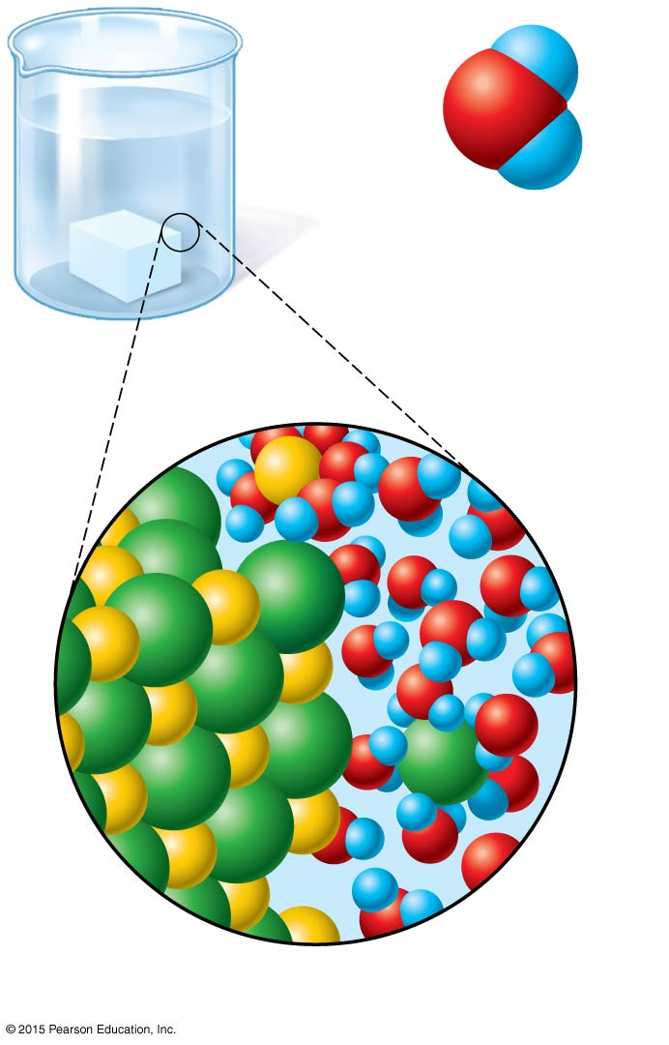
Figure 2.11 Dissociation of salt in water.
δ⁺
H
δ–
O
H
δ⁺
Water molecule
Na⁺
Na⁺
Cl–
Cl–
Salt
crystal
Ions in
solution

Slide 67
Important Inorganic Compounds
Salts
All salts are electrolytes
Electrolytes are ions that conduct electrical currents

Slide 68
Important Inorganic Compounds
Acids
Release hydrogen ions (H⁺) when dissolved in water
Are proton donors, since hydrogen ions are essentially a hydrogen nucleus
Example: HCl → H⁺ + Cl–
Strong acids ionize completely and liberate all their protons
Weak acids ionize incompletely

Slide 69
Important Inorganic Compounds
Bases
Release hydroxyl ions (OH–) when dissolved in water
Are proton acceptors
Example: NaOH → Na⁺ + OH–
Strong bases seek hydrogen ions

Slide 70
Important Inorganic Compounds
Neutralization reaction
Type of exchange reaction in which acids and bases react to form water and a salt
Example: NaOH + HCl → H₂O + NaCl

Slide 71
pH
Measures relative concentration of hydrogen ions
Based on the number of protons in a solution, expressed in terms of moles per liter
Each successive change on the pH scale represents a tenfold change in H⁺ concentration

Slide 72
pH
pH 7 = neutral
Number of hydrogen ions exactly equals the number of hydroxyl ions
pH below 7 = acidic
pH above 7 = basic
Buffers—chemicals that can regulate pH change

Slide 73
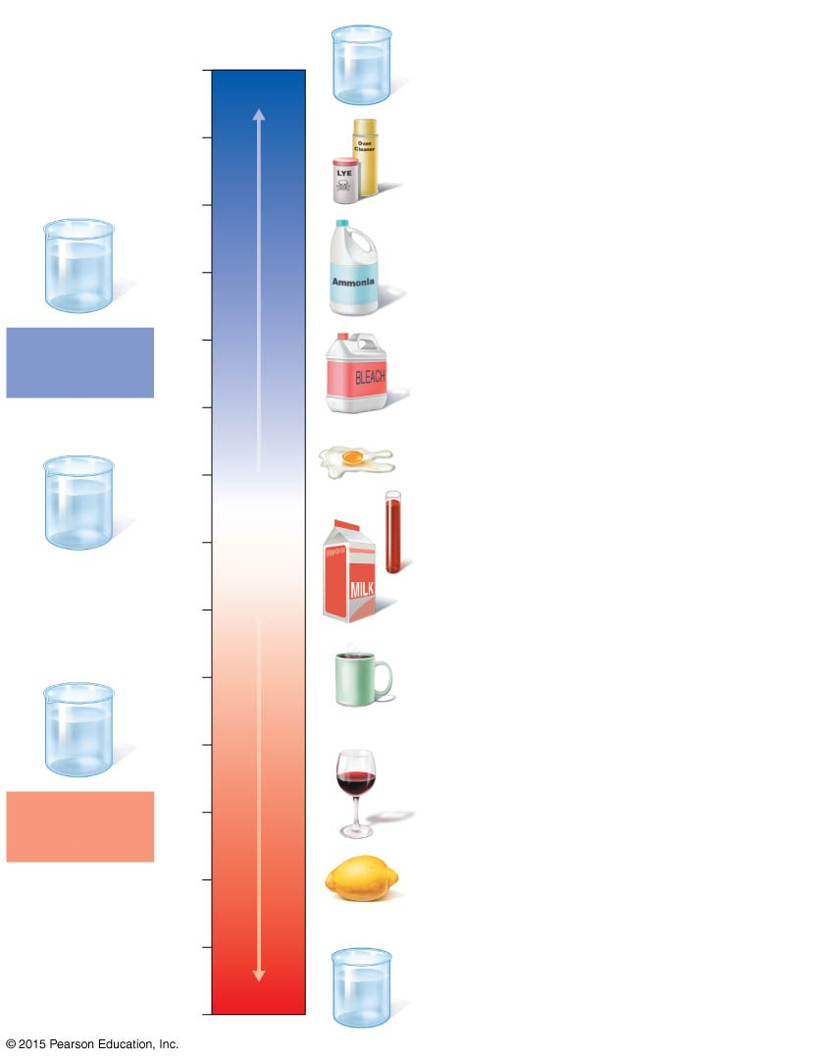
Figure 2.12 The pH scale and pH values of representative substances.
pH
Examples
14
1M Sodium hydroxide (pH 14)
13
Oven cleaner, lye
(pH 13.5)
12
OH–
Increasingly basic
Household ammonia
(pH 10.5–11.5)
OH–
OH–
11
OH–
H⁺
OH–
H⁺
OH–
Basic
solution
10
Household bleach
(pH 9.5)
9
8
Egg white (pH 8)
H⁺
OH–
OH–
H⁺
Blood (pH 7.4)
H⁺
H⁺
Neutral
OH–
OH–
7
[H⁺]=[OH–]
Neutral
solution
6
Milk (pH 6.3–6.6)
5
Black coffee (pH 5)
H⁺
OH–
H⁺
H⁺
4
H⁺
H⁺
OH–
H⁺
Wine (pH 2.5–3.5)
Acidic
solution
Increasingly acidic
3
2
Lemon juice, gastric juice
(pH 2)
1
0
1M Hydrochloric acid (pH 0)

Slide 74
Chemical Reactions
Polymer: chainlike molecules made of many similar or repeating units (monomers)
Many biological molecules are polymers, such as carbohydrates and proteins

Slide 75
Chemical Reactions
Dehydration synthesis—monomers are joined to form polymers through the removal of water molecules
A hydrogen ion is removed from one monomer while a hydroxyl group is removed from the monomer it is to be joined with
Monomers unite, and water is released

Slide 76
Figure 2.13a Dehydration synthesis and hydrolysis of biological molecules.
(a) Dehydration synthesis
Monomers are joined by removal of OH from one monomer
and removal of H from the other at the site of bond formation.
H₂O
Monomer 1
Monomer 2
Monomers linked by covalent bond

Slide 77
Chemical Reactions
Hydrolysis—polymers are broken down into monomers through the addition of water molecules
As a water molecule is added to each bond, the bond is broken, and the monomers are released

Slide 78
Figure 2.13b Dehydration synthesis and hydrolysis of biological molecules.
(b) Hydrolysis
Monomers are released by the addition of a water molecule,
adding OH to one monomer and H to the other.
H₂O
Monomer 1
Monomer 2
Monomers linked by covalent bond

Slide 79
Important Organic Compounds
Carbohydrates
Contain carbon, hydrogen, and oxygen
Include sugars and starches
Classified according to size
Monosaccharides—simple sugars
Disaccharides—two simple sugars joined by dehydration synthesis
Polysaccharides—long-branching chains of linked simple sugars

Slide 80
Carbohydrates
Monosaccharides—simple sugars
Single chain or single-ring structures
Contain 3 to 7 carbon atoms
Examples: glucose (blood sugar), fructose, galactose, ribose, deoxyribose

Slide 81
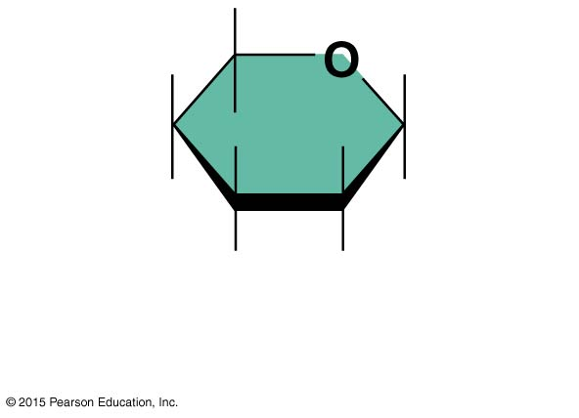
Figure 2.14a Carbohydrates.
(a) Simple sugar
(monosaccharide)

Slide 82
Carbohydrates
Disaccharides—two simple sugars joined by dehydration synthesis
Examples include sucrose, lactose, and maltose

Slide 83
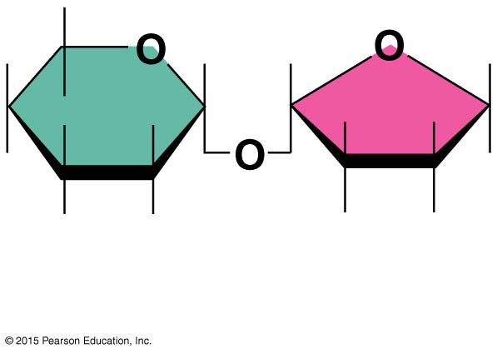
Figure 2.14b Carbohydrates.
(b) Double sugar
(disaccharide)

Slide 84
Figure 2.14d Carbohydrates.
Dehydration
synthesis
H₂O
Hydrolysis
Glucose
Fructose
Sucrose
Water
(d) Dehydration synthesis and hydrolysis of a molecule of sucrose

Slide 85
Carbohydrates
Polysaccharides: long, branching chains of linked simple sugars
Large, insoluble molecules
Function as storage products
Examples include starch and glycogen

Slide 86
Figure 2.14c Carbohydrates.
(c) Starch (polysaccharide)

Slide 87
Important Organic Compounds
Lipids
Most abundant are the triglycerides, phospholipids, and steroids
Contain carbon, hydrogen, and oxygen
Carbon and hydrogen outnumber oxygen
Insoluble in water, but soluble in other lipids

Slide 88
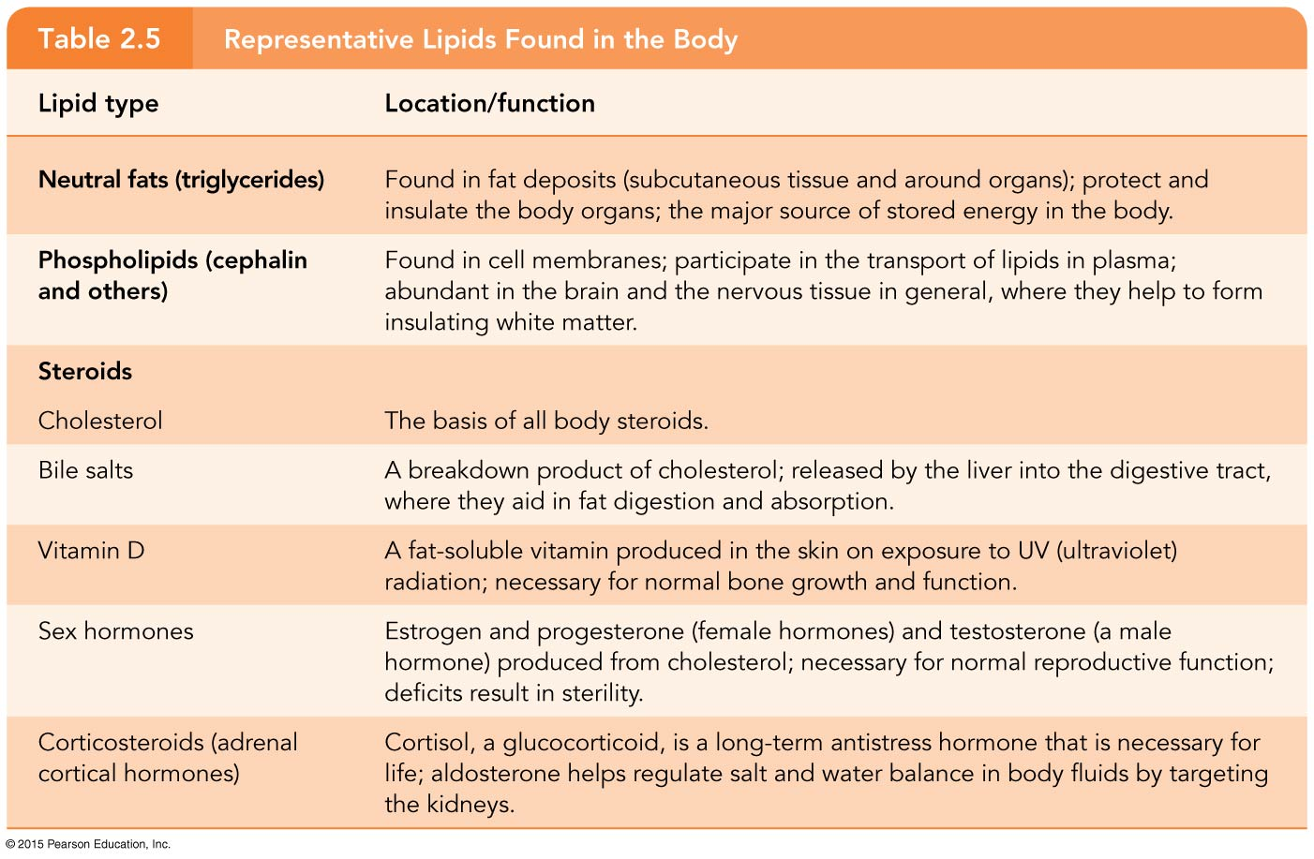
Table 2.5 Representative Lipids Found in the Body (1 of 2).

Slide 89
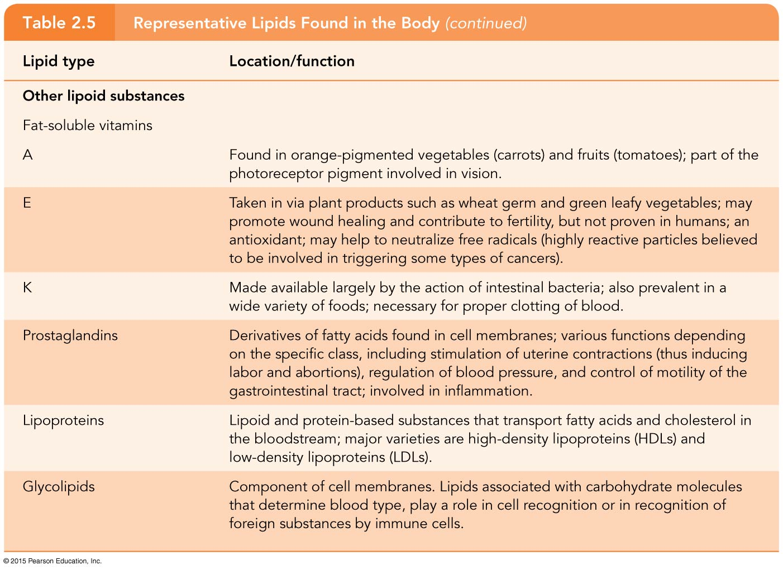
Table 2.5 Representative Lipids Found in the Body (2 of 2).

Slide 90
Lipids
Common lipids in the human body
Neutral fats (triglycerides)
Found in fat deposits
Source of stored energy
Composed of three fatty acids and one glycerol molecule
Saturated fatty acids
Unsaturated fatty acids

Slide 91
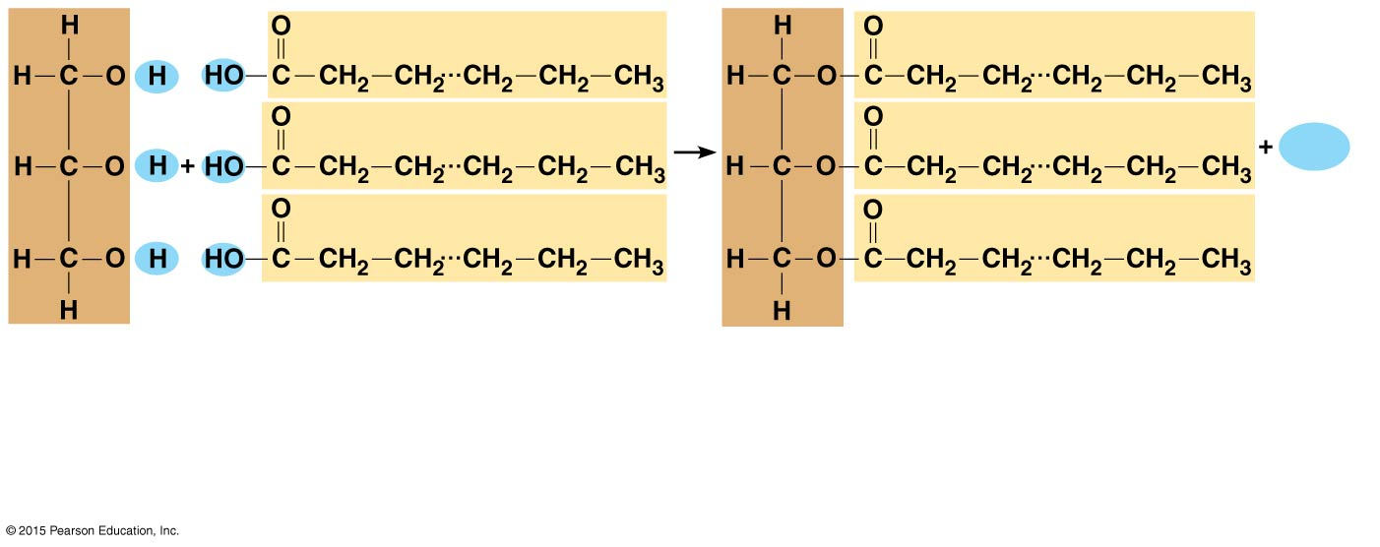
Figure 2.15a Lipids.
3H₂O
Glycerol
3 fatty acid chains
Triglyceride, or neutral fat
3 water
molecules
(a) Formation of a triglyceride. Fatty acid chains are bound to glycerol by dehydration
synthesis.

Slide 92
Lipids
Saturated fats
Contain only single covalent bonds
Chains are straight
Exist as solids at room temperature since molecules pack closely together
Unsaturated fats
Contain one or more double covalent bonds causing chains to kink
Exist as liquid oils at room temperature
Heart healthy

Slide 93
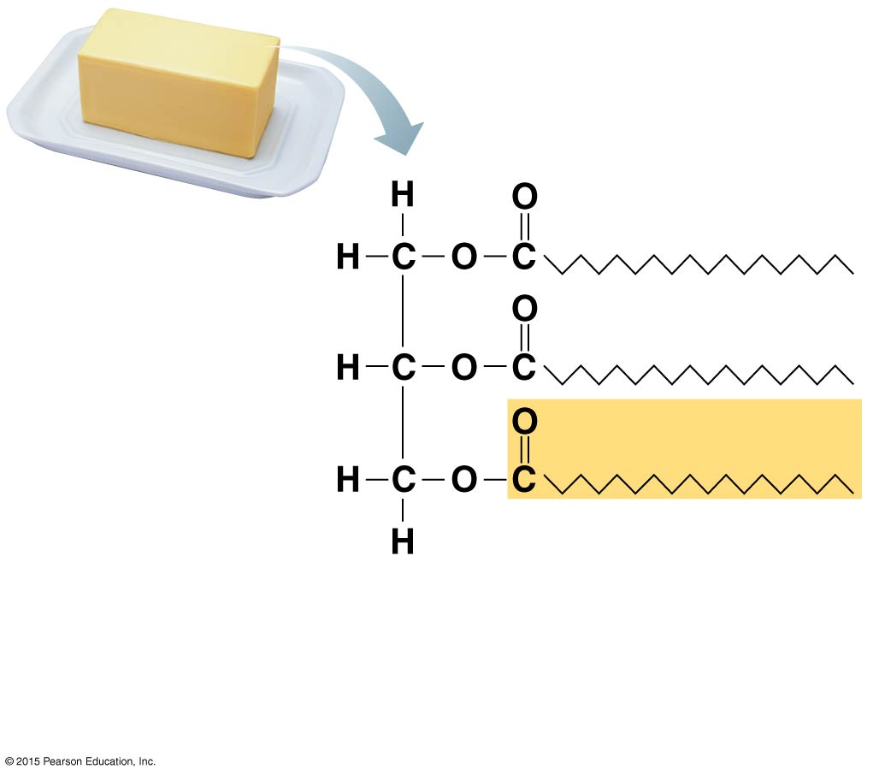
Figure 2.16a Examples of saturated and unsaturated fats and fatty acids.
Structural formula of a
saturated fat molecule.
(a) Saturated fat. At room temperature, the
molecules of a saturated fat such as this
butter are packed closely together, forming
a solid.

Slide 94
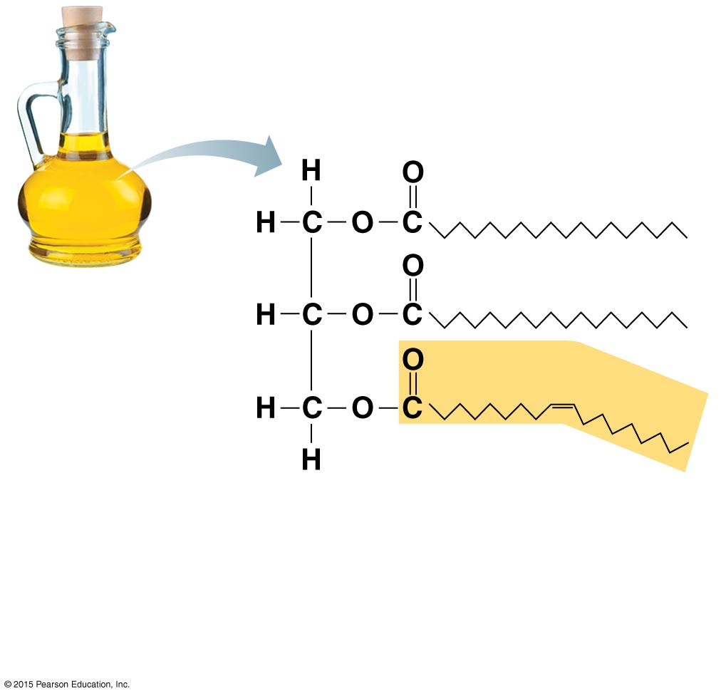
Figure 2.16b Examples of saturated and unsaturated fats and fatty acids.
Structural formula of an
unsaturated fat molecule.
(b) Unsaturated fat. At room temperature,
the molecules of an unsaturated fat such as
this olive oil cannot pack together closely
enough to solidify because of the kinks in
some of their fatty acid chains.

Slide 95
Lipids
Trans fats
Oils that have been solidified by the addition of hydrogen atoms at double bond sites
Increase risk of heart disease
Omega-3 fatty acids
Found in cold-water fish and plant sources, including flax, pumpkin, and chia seeds; walnuts and soy foods
Appears to decrease risk of heart disease

Slide 96
Lipids
Common lipids in the human body (continued)
Phospholipids
Contain two fatty acids rather than three
Phosphorus-containing “head” carries an electrical charge and is polar
Charged region interacts with water and ions while the fatty acid chains (“tails”) do not
Form cell membranes

Slide 97
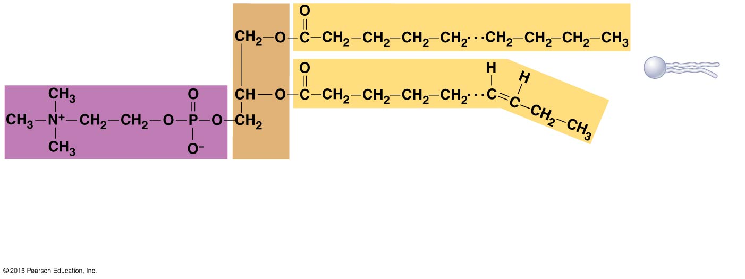
Figure 2.15b Lipids.
Polar “head”
Nonpolar “tail”
(schematic
phospholipid)
Phosphorus-containing
group (polar head)
Glycerol
backbone
2 fatty acid chains
(nonpolar tail)
(b) Typical structure of a phospholipid molecule (phosphatidylcholine). Two fatty acid
chains and a phosphorous-containing group are attached to a glycerol backbone.

Slide 98
Lipids
Common lipids in the human body (continued)
Steroids
Formed of four interlocking rings
Include cholesterol, bile salts, vitamin D, and some hormones
Some cholesterol is ingested from animal products. The liver also makes cholesterol
Cholesterol is the basis for all steroids made in the body

Slide 99
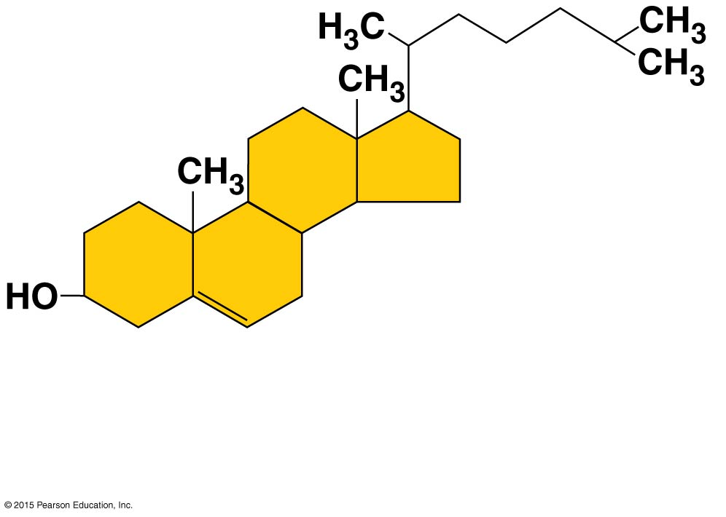
Figure 2.15c Lipids.
(c) Cholesterol. Simplified structure
of cholesterol, a steroid, formed
by four interlocking chains.

Slide 100
Important Organic Compounds
Proteins
Account for over half of the body’s organic matter
Provide for construction materials for body tissues
Play a vital role in cell function
Act as enzymes, hormones, and antibodies
Contain carbon, oxygen, hydrogen, nitrogen, and sometimes sulfur
Built from amino acids

Slide 101
Proteins
Amino acid structure
Contain an amine group (NH₂)
Contain an acid group (COOH)
Vary only by R groups

Slide 102
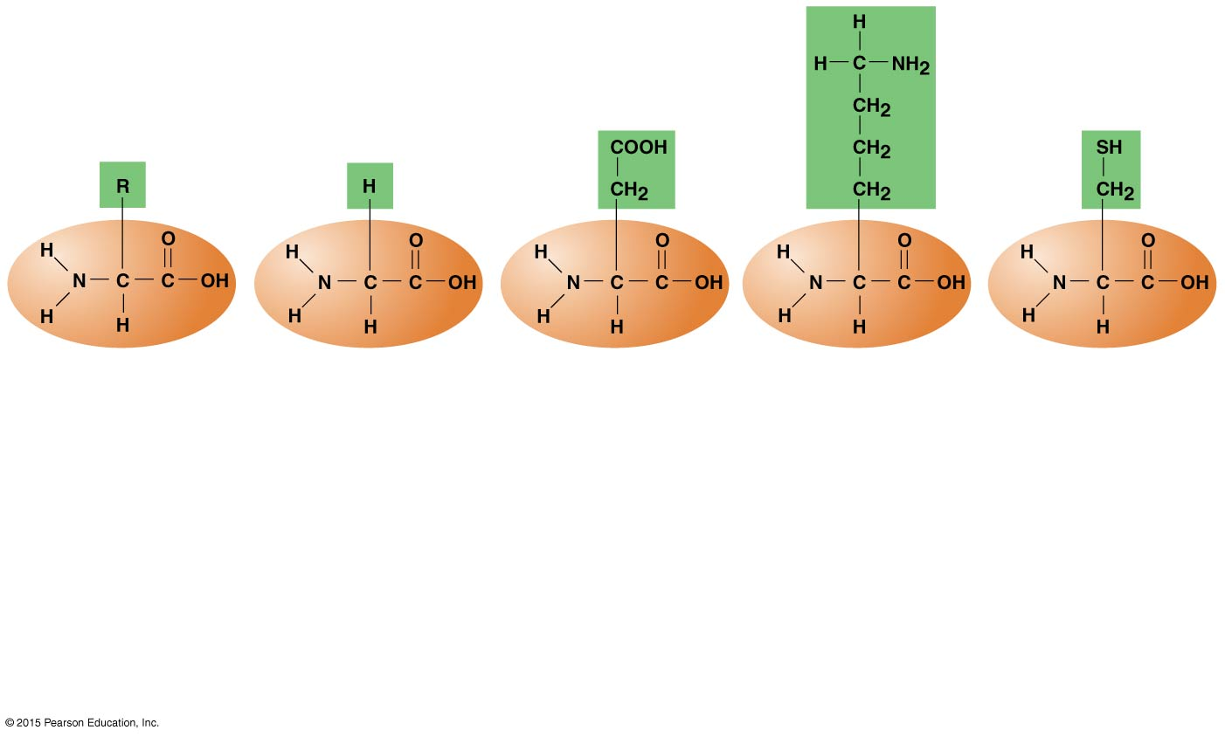
Figure 2.17 Amino acid structures.
Amine
group
Acid
group
(a) Generalized
structure of
all amino
acids.
(b) Glycine is
the simplest
amino acid.
(c) Aspartic acid
(an acidic
amino acid)
has an acid
group (—COOH)
in the R group.
(d) Lysine (a
basic amino
acid) has an
amine group
(—NH₂) in the
R group.
(e) Cysteine (a
basic amino
acid) has a
sulfhydryl
(—SH) group in
the R group,
which suggests
that this amino
acid is likely to
participate in
intramolecular
bonding.

Slide 103
Proteins
Protein structure
Polypeptides contain fewer than 50 amino acids
Large proteins may have 50 to thousands of amino acids
Sequence of amino acids produces a variety of proteins

Slide 104
Proteins
Structural levels of proteins
Primary structure
Secondary structure
Alpha helix
Beta-pleated sheet
Tertiary structure
Quaternary structure

Slide 105
Figure 2.18a The four levels of protein structure.
Leu
Ala
Ala
Glu
Ala
Ala
Cys
Met
Aps
Lys
Arg
His
Gly
Leu
Amino
acids
(a) Primary structure. A protein’s
primary structure is the unique
sequence of amino acids in the
polypeptide chain.

Slide 106
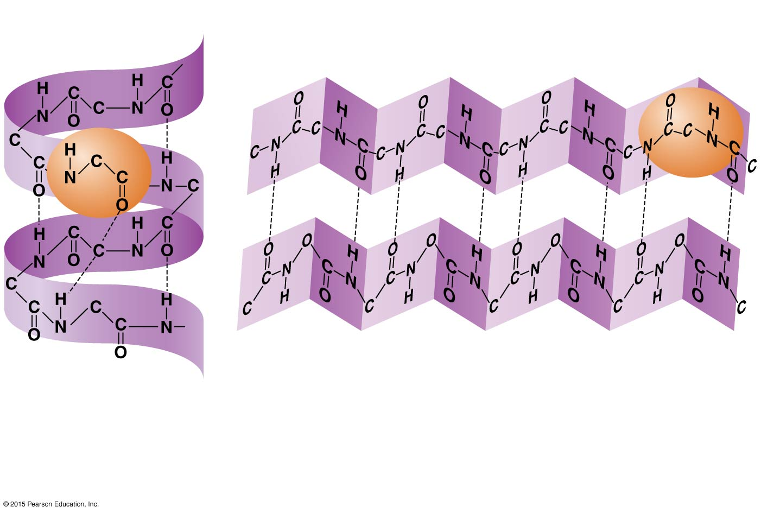
Figure 2.18b The four levels of protein structure.
Hydrogen bonds
𝛃-pleated sheet
Alpha-
helix
(b) Secondary structure. Two types of secondary structure are the
alpha-helix and beta-pleated sheet. Secondary structure is reinforced
by hydrogen bonds, represented by dashed lines in the figure.

Slide 107
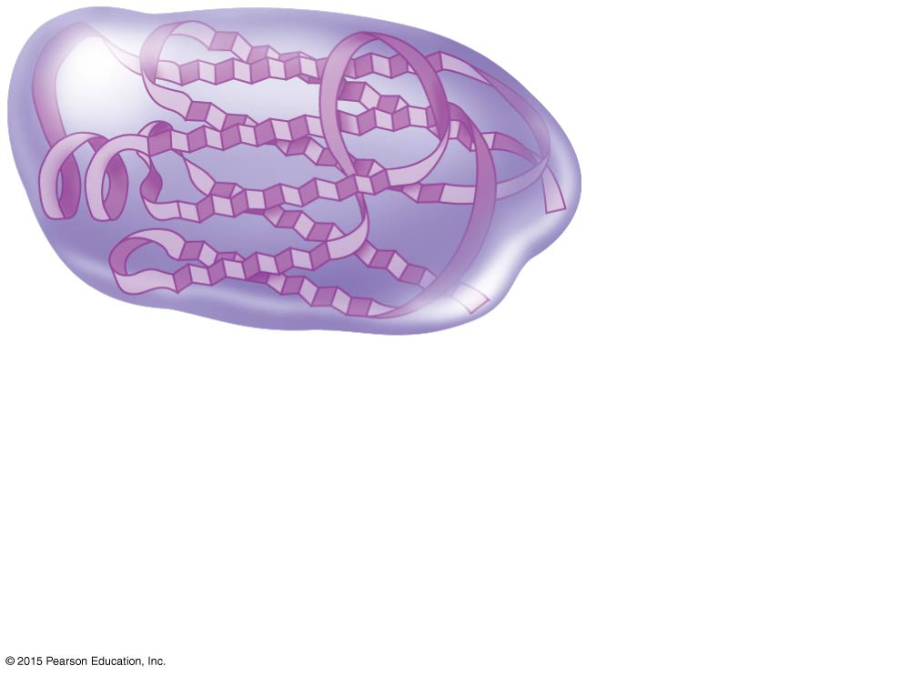
Figure 2.18c The four levels of protein structure.
Polypeptide
(single subunit)
(c) Tertiary structure. The overall three-
dimensional shape of the polypeptide
or protein is called tertiary structure. It is
reinforced by chemical bonds between
the R-groups of amino acids in different
regions of the polypeptide chain.

Slide 108
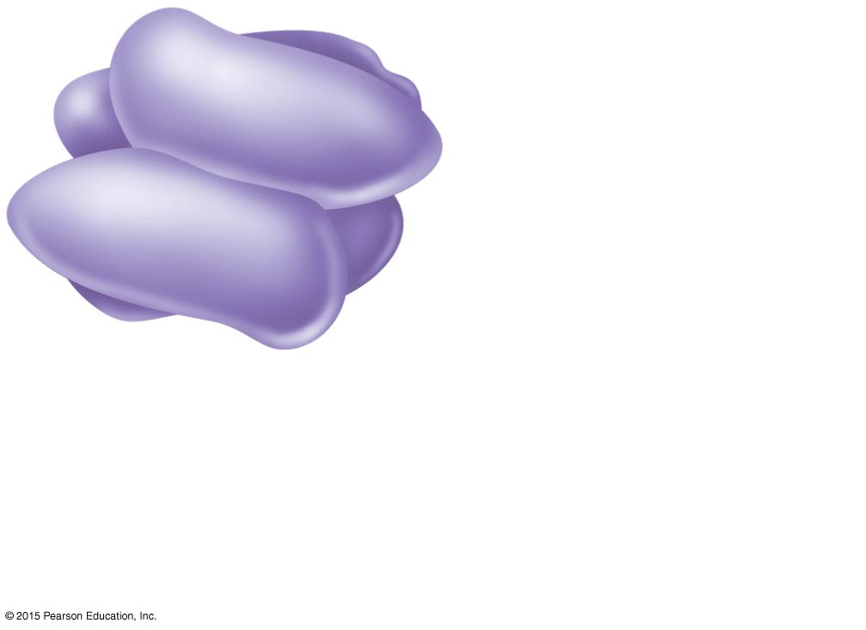
Figure 2.18d The four levels of protein structure.
Complete protein,
with four polypeptide
subunits
(d) Quaternary structure. Some proteins
consist of two or more polypeptide chains.
For example, four polypeptides construct
hemoglobin, the blood protein. Such
proteins have quaternary structure.

Slide 109
Proteins
Fibrous (structural) proteins
Appear in body structures
Exhibit secondary, tertiary, or even quaternary structure
Bind structures together and exist in body tissues
Stable proteins
Examples include collagen and keratin

Slide 110
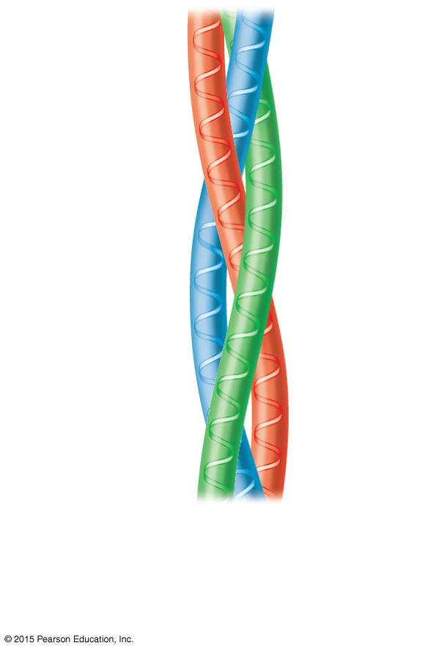
Figure 2.19a General structure of (a) a fibrous protein and (b) a globular protein.
(a) Triple helix of collagen
(a fibrous or structural
protein).

Slide 111
Proteins
Globular (functional) proteins
Function as antibodies, hormones, or enzymes
Exhibit at least tertiary structure
Can be denatured and no longer perform physiological roles
Active sites “fit” and interact chemically with other molecules

Slide 112
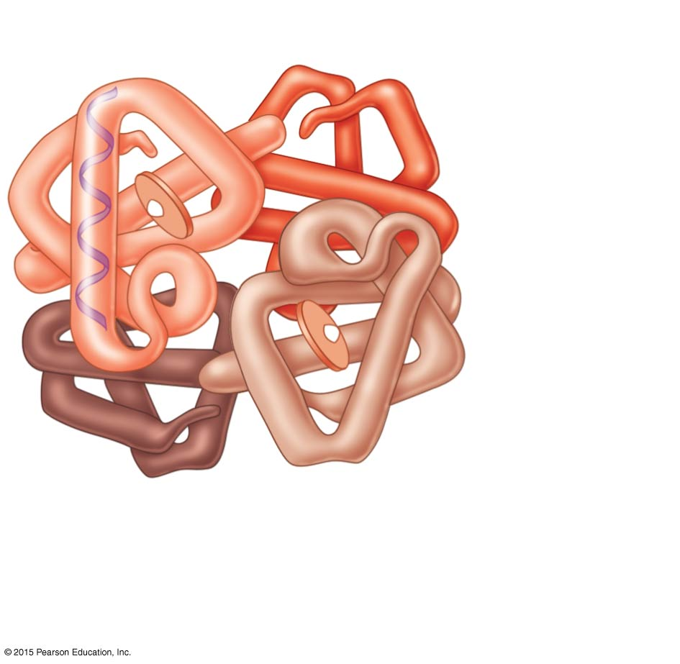
Figure 2.19b General structure of (a) a fibrous protein and (b) a globular protein.
Heme group
Globin
protein
(b) Hemoglobin molecule composed of
the protein globin and attached heme
groups. (Globin is a globular or
functional protein.)

Slide 113
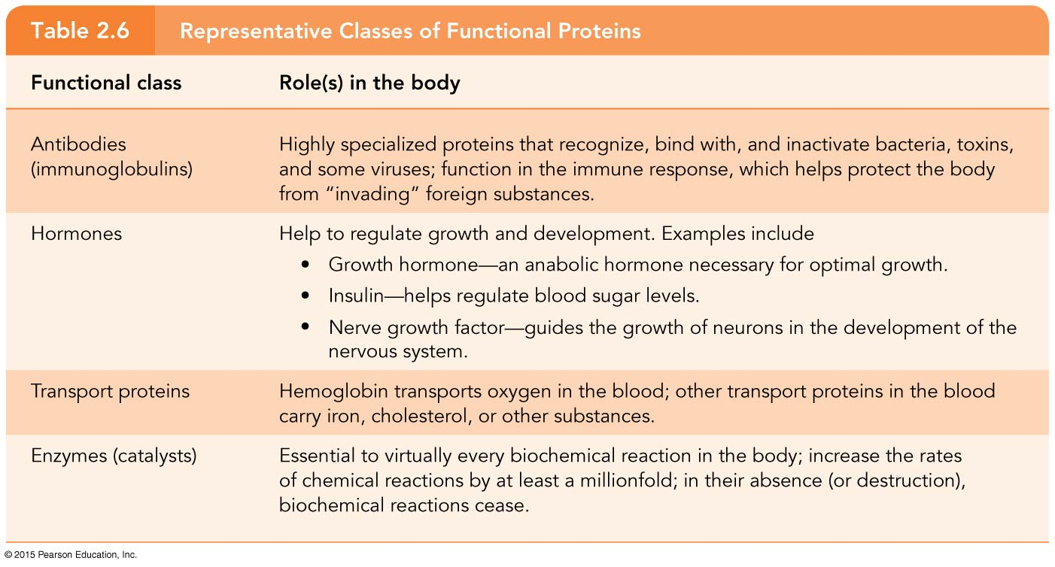
Table 2.6 Representative Classes of Functional Proteins.

Slide 114
Enzymes
Act as biological catalysts
Increase the rate of chemical reactions
Bind to substrates at an active site to catalyze reactions
Recognize enzymes by their –ase suffix
Hydrolase
Oxidase

Slide 115
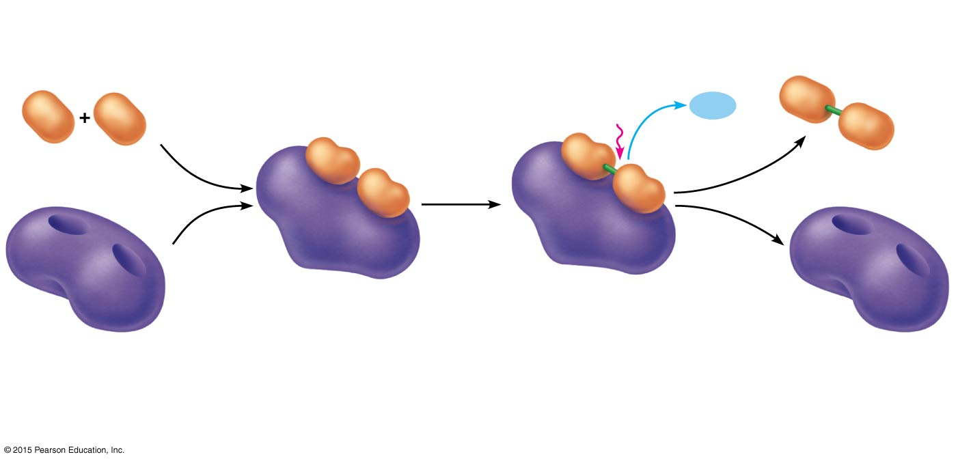
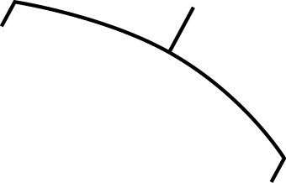
Figure 2.20 A simplified view of enzyme action.
Product (P)
e.g., dipeptide
Substrates (S)
e.g., amino acids
Energy is
absorbed;
bond is
formed.
Water is
released.
Peptide
bond
H₂O
Active site
Enzyme-substrate
complex (E-S)
Enzyme (E)
1
2
Enzyme (E)
Substrates bind at active
site, temporarily forming an
enzyme-substrate complex.
The E-S complex
undergoes internal
rearrangements that
form the product.
3
The enzyme
releases the product
of the reaction.

Slide 116
Important Organic Compounds
Nucleic acids
Make up genes
Composed of carbon, oxygen, hydrogen, nitrogen, and phosphorus atoms
Largest biological molecules in the body

Slide 117
Nucleic Acids
Built from nucleotides containing three parts:
A nitrogenous base
A = Adenine
G = Guanine
C = Cytosine
T = Thymine
U = Uracil
Pentose (five-carbon) sugar
A phosphate group

Slide 118
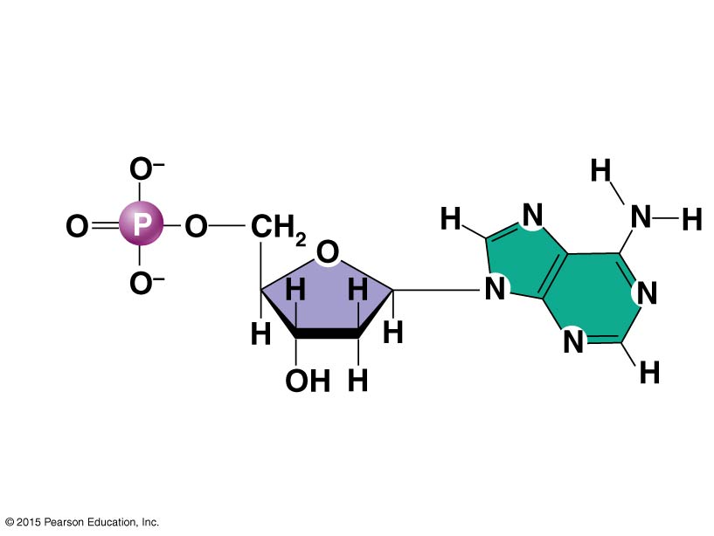
Figure 2.21a Structure of DNA.
Deoxyribose
sugar
Phosphate
Adenine (A)
(a) Adenine nucleotide
(Chemical structure)

Slide 119
Nucleic Acids
Deoxyribonucleic acid (DNA)
The genetic material found within the cell’s nucleus
Provides instructions for every protein in the body
Organized by complimentary bases to form a double-stranded helix
Contains the sugar deoxyribose and the bases adenine, thymine, cytosine, and guanine
Replicates before cell division

Slide 120
Figure 2.21b Structure of DNA.
(b) Adenine nucleotide
(Diagrammatic
representation)

Slide 121
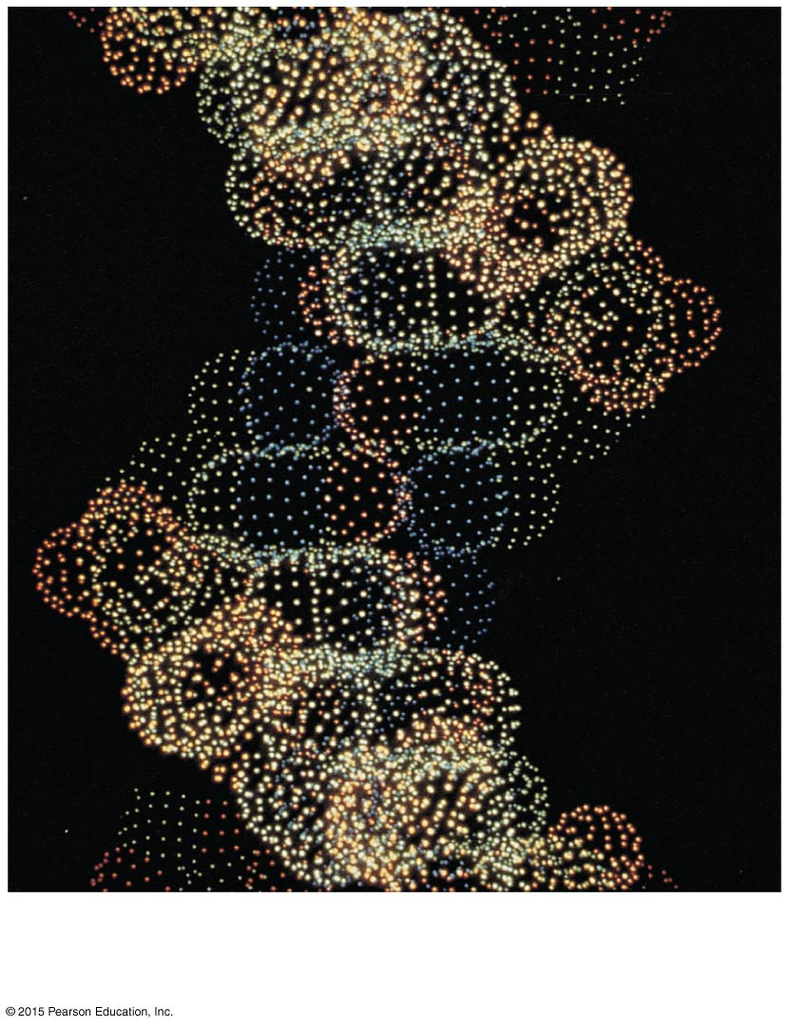
Figure 2.21c Structure of DNA.
(c) Computer-generated image of
a DNA molecule

Slide 122
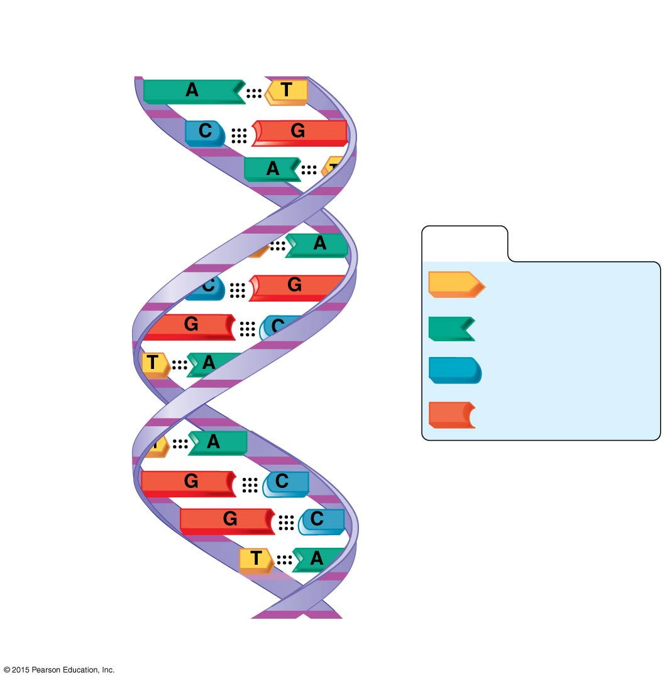
Figure 2.21d Structure of DNA.
Hydrogen
bond
Deoxyribose
sugar
Phosphate
KEY:
Thymine (T)
Adenine (A)
Cytosine (C)
Guanine (G)
(d) Diagram of a DNA molecule

Slide 123
Nucleic Acids
Ribonucleic acid (RNA)
Carries out DNA’s instructions for protein synthesis
Created from a template of DNA
Organized by complementary bases to form a single-stranded helix
Contains the sugar ribose and the bases adenine, uracil, cytosine, and guanine
Three varieties are messenger, transfer, and ribosomal RNA

Slide 124
Nucleic Acids
Adenosine triphosphate (ATP)
Composed of a nucleotide built from ribose sugar, adenine base, and three phosphate groups
Chemical energy used by all cells
Energy is released by breaking high-energy phosphate bond
ATP is replenished by oxidation of food fuels

Slide 125
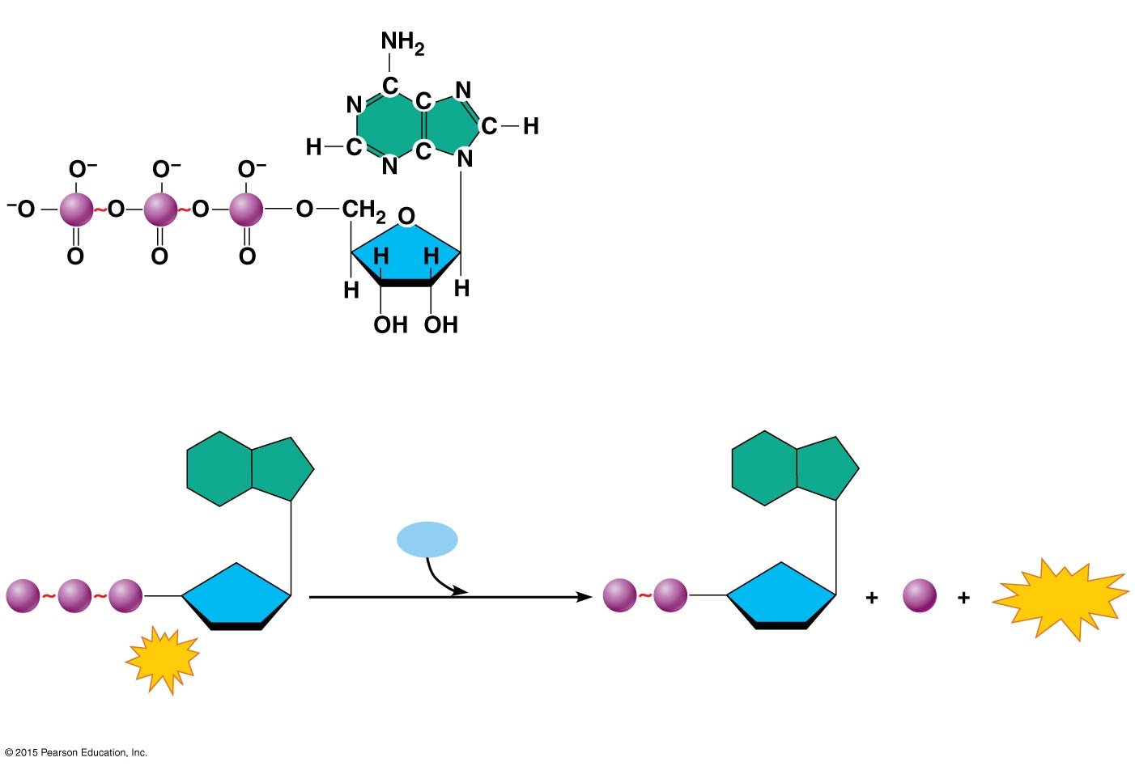
Figure 2.22 ATP—structure and hydrolysis.
Adenine
High
energy
bonds
P
P
P
Ribose
Phosphates
(a) Adenosine triphosphate (ATP)
H₂O
P
P
P
P
P
P_{i}
Energy
ATP
Adenosine diphosphate
(ADP)
(b) Hydrolysis of ATP

Slide 126
Nucleic Acids
ADP (adenosine diphosphate) accumulates as ATP is used for energy
Three examples of how ATP drives cellular work are shown next

Slide 127
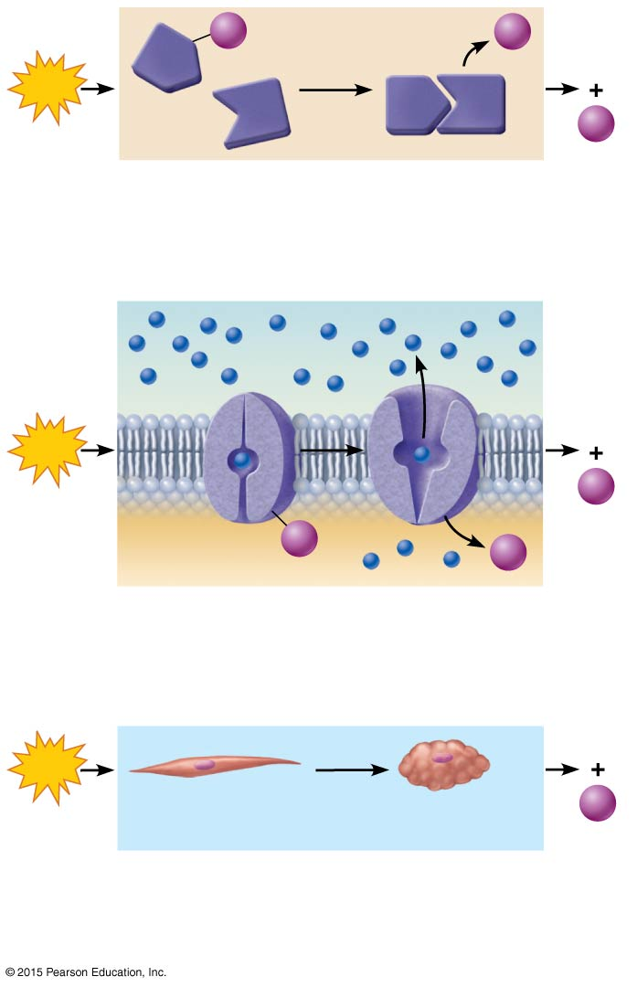
Figure 2.23 Three examples of how ATP drives cellular work.
P
P_{i}
A
ADP
ATP
A
B
B
P_{i}
(a) Chemical work. ATP provides the energy
needed to drive energy-absorbing chemical
reactions.
Solute
ATP
ADP
P_{i}
Membrane
protein
P
P_{i}
(b) Transport work. ATP drives the transport
of certain solutes (amino acids, for example)
across cell membranes.
ATP
ADP
Relaxed smooth
muscle cell
Contracted smooth
muscle cell
P_{i}
(c) Mechanical work. ATP activates contractile
proteins in muscle cells so that the cells can
shorten and perform mechanical work.

