Slide 2
The Cardiovascular System
A closed system of the heart and blood vessels
The heart pumps blood
Blood vessels allow blood to circulate to all parts of the body
Functions of the cardiovascular system:
Deliver oxygen and nutrients to cells and tissues
Remove carbon dioxide and other waste products from cells and tissues

Slide 3
The Heart
Location
Thorax, between the lungs in the inferior mediastinum
Orientation
Pointed apex directed toward left hip
Base points toward right shoulder
About the size of a human fist

Slide 4
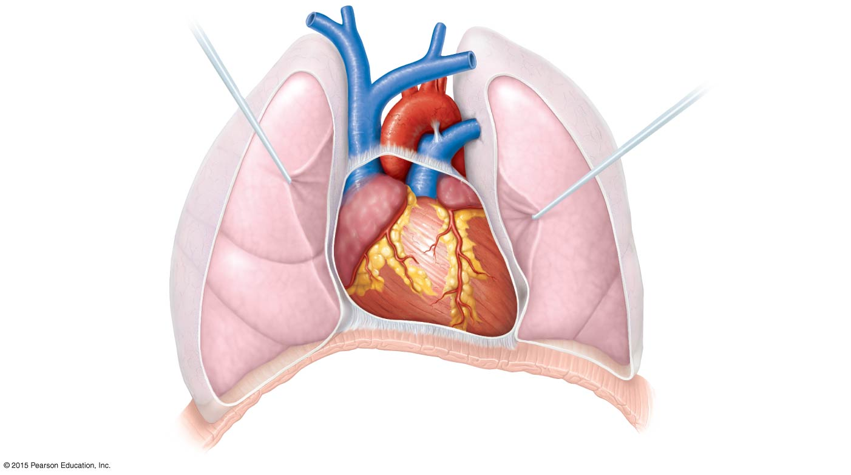
Figure 11.1a Location of the heart within the thorax.
Superior
vena cava
Aorta
Parietal
pleura (cut)
Pulmonary
trunk
Left lung
Pericardium
(cut)
Apex of
heart
Diaphragm
(a)

Slide 5
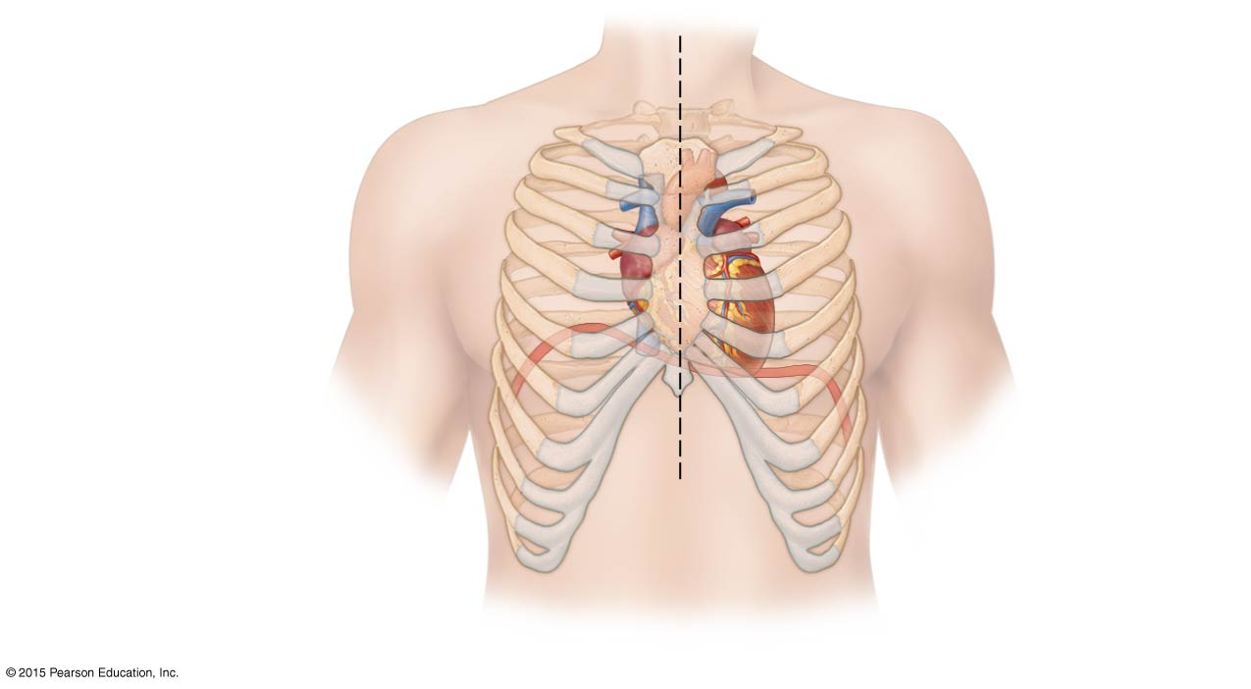
Figure 11.1b Location of the heart within the thorax.
Midsternal line
2nd rib
Sternum
Diaphragm
Point of
maximal
intensity
(PMI)
(b)

Slide 6
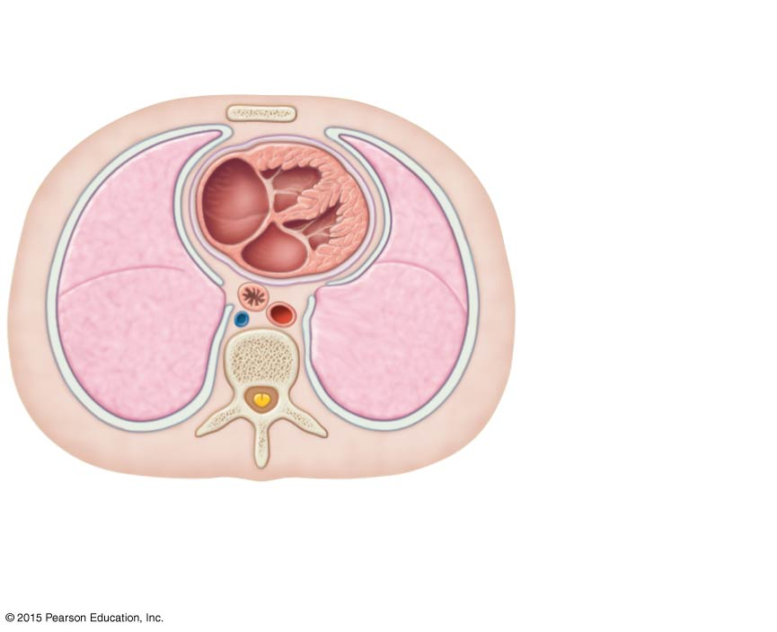
Figure 11.1c Location of the heart within the thorax.
Mediastinum
Heart
Left lung
Posterior
(c)

Slide 7
Coverings and Walls of the Heart
Pericardium—a double-walled sac
Fibrous pericardium is loose and superficial
Serous membrane is deep to the fibrous pericardium and composed of two layers:
Parietal pericardium: outside layer that lines the inner surface of the fibrous pericardium
Visceral pericardium: next to heart; also known as the epicardium
Serous fluid fills the space between the layers of pericardium

Slide 8
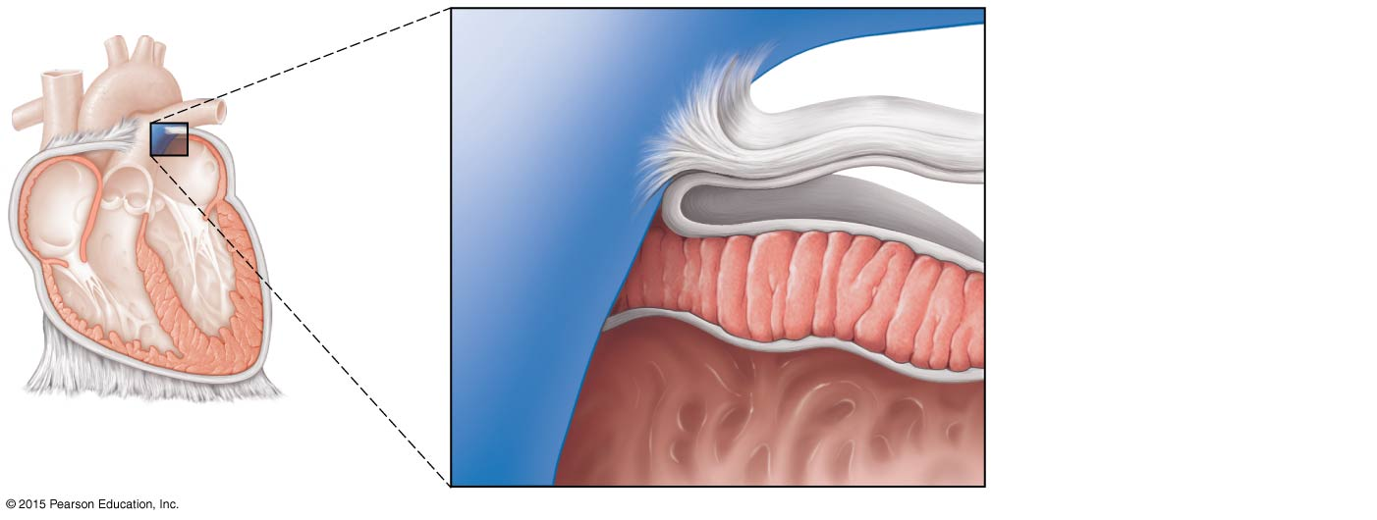
Figure 11.2 Heart wall and coverings.
Pulmonary
trunk
Fibrous pericardium
Parietal layer of
serous pericardium
Pericardium
Pericardial cavity
Myocardium
Epicardium
(visceral layer
of serous
pericardium)
Heart
wall
Myocardium
Endocardium
Heart chamber

Slide 9
Coverings and Walls of the Heart
Three layers of the heart wall:
Epicardium
Outside layer
This layer is the visceral pericardium
Connective tissue layer
Myocardium
Middle layer
Mostly cardiac muscle
Endocardium
Inner layer known as endothelium

Slide 10
Figure 11.2 Heart wall and coverings.
Pulmonary
trunk
Fibrous pericardium
Parietal layer of
serous pericardium
Pericardium
Pericardial cavity
Myocardium
Epicardium
(visceral layer
of serous
pericardium)
Heart
wall
Myocardium
Endocardium
Heart chamber

Slide 11
Chambers and Associated Great Vessels
Right and left side act as separate pumps
Four chambers:
Atria (right and left)
Receiving chambers
Ventricles (right and left)
Discharging chambers

Slide 12
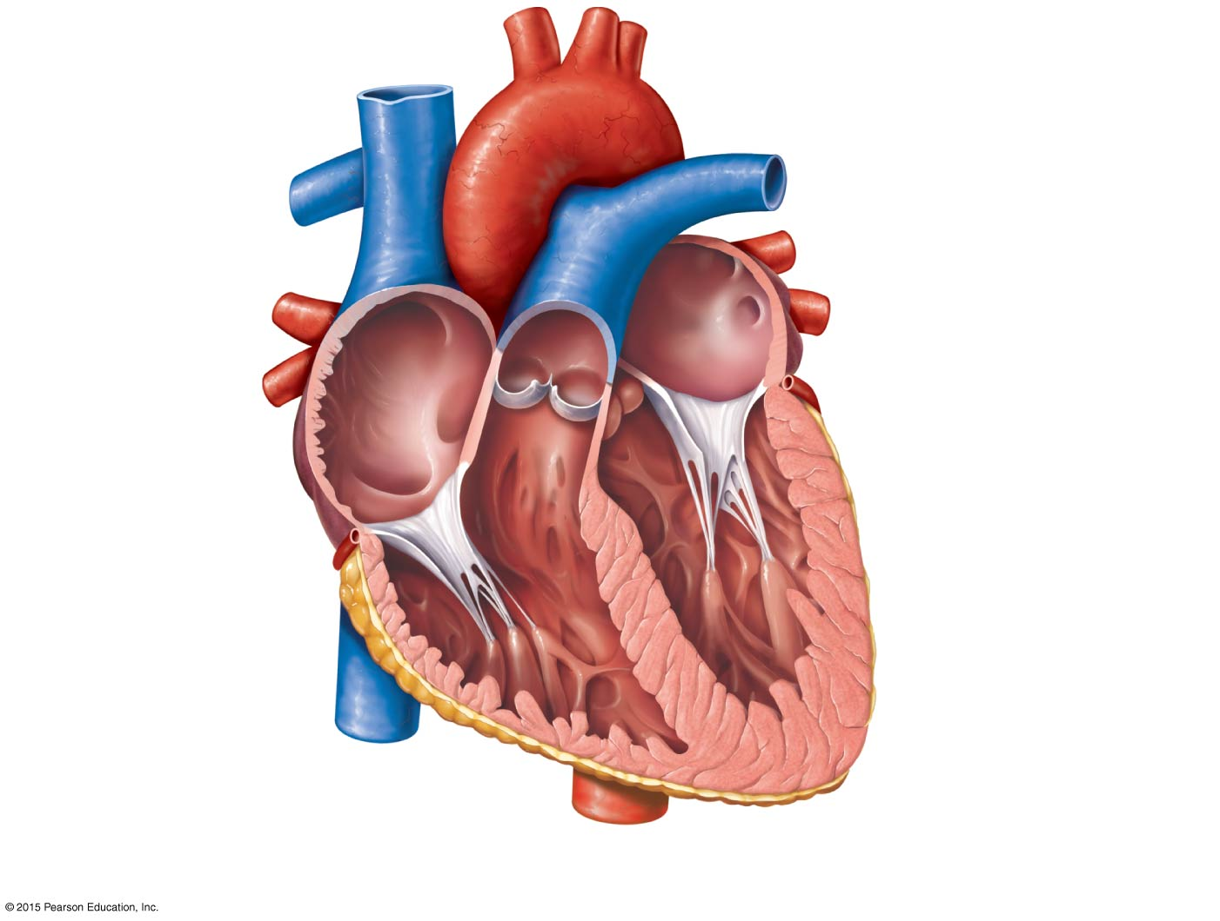
Figure 11.3b Gross anatomy of the heart.
Superior vena cava
Aorta
Left pulmonary artery
Right pulmonary
artery
Left atrium
Right atrium
Left pulmonary veins
Right pulmonary
veins
Pulmonary semilunar
valve
Left atrioventricular
valve (bicuspid valve)
Fossa ovalis
Aortic semilunar valve
Right atrioventricular
valve (tricuspid valve)
Left ventricle
Right ventricle
Chordae tendineae
Interventricular septum
Inferior vena cava
Myocardium
Visceral pericardium
(epicardium)
(b) Frontal section showing interior chambers and valves.

Slide 13
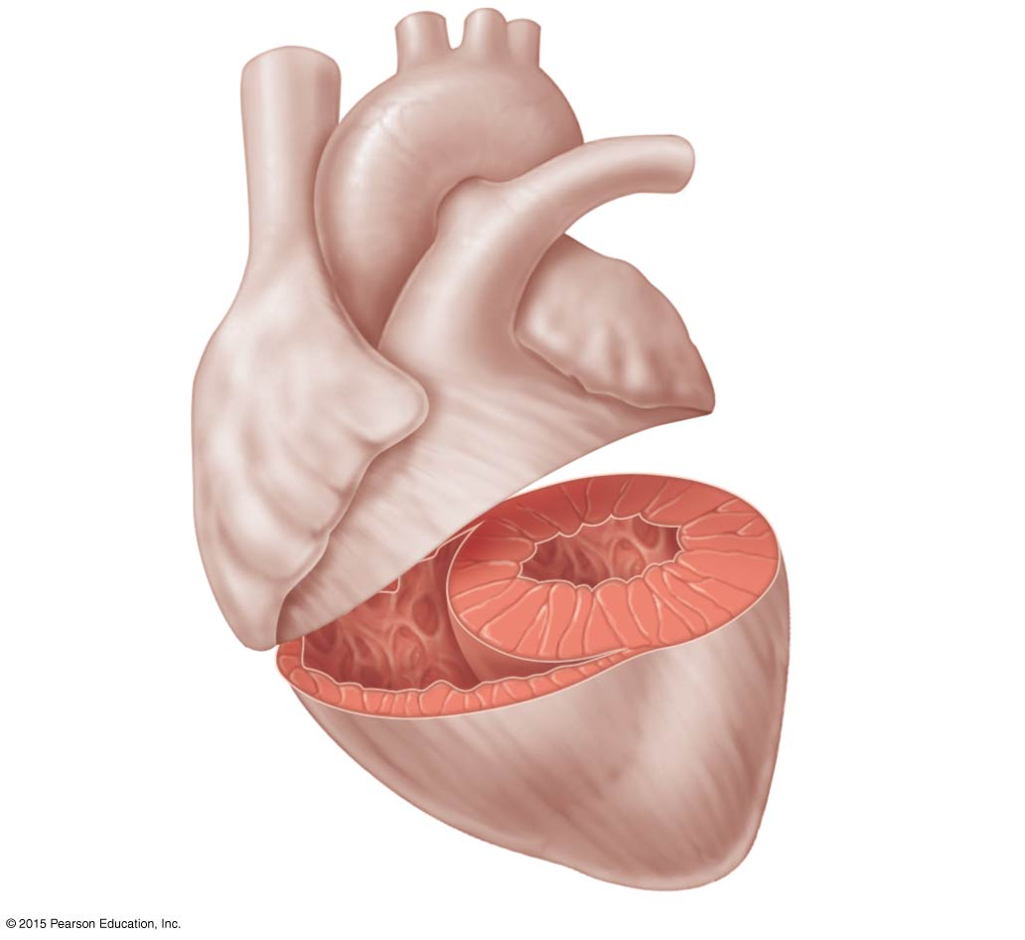
Figure 11.5 Anatomical differences in right and left ventricles.
Left
ventricle
Right
ventricle
Muscular
interventricular
septum

Slide 14
Chambers and Associated Great Vessels
Interventricular septum
Separates the two ventricles
Interatrial septum
Separates the two atria

Slide 15
Figure 11.3b Gross anatomy of the heart.
Superior vena cava
Aorta
Left pulmonary artery
Right pulmonary
artery
Left atrium
Right atrium
Left pulmonary veins
Right pulmonary
veins
Pulmonary semilunar
valve
Left atrioventricular
valve (bicuspid valve)
Fossa ovalis
Aortic semilunar valve
Right atrioventricular
valve (tricuspid valve)
Left ventricle
Right ventricle
Chordae tendineae
Interventricular septum
Inferior vena cava
Myocardium
Visceral pericardium
(epicardium)
(b) Frontal section showing interior chambers and valves.

Slide 16
Chambers and Associated Great Vessels
Pulmonary circulation
Blood flows from the right side of the heart to the lungs and back to the left side of the heart
Blood is pumped out of right side through the pulmonary trunk, which splits into pulmonary arteries and takes oxygen-poor blood to lungs
Oxygen-rich blood returns to the heart from the lungs via pulmonary veins

Slide 17
Chambers and Associated Great Vessels
Systemic circulation
Blood flows from the left side of the heart through body tissues, and back to the right side of the heart
Blood returned to the left side of the heart is pumped out into the aorta
Oxygen-poor blood circulates to systemic tissues, and returns to the right atrium via systemic veins, which empty blood into the superior and inferior venae cavae

Slide 18
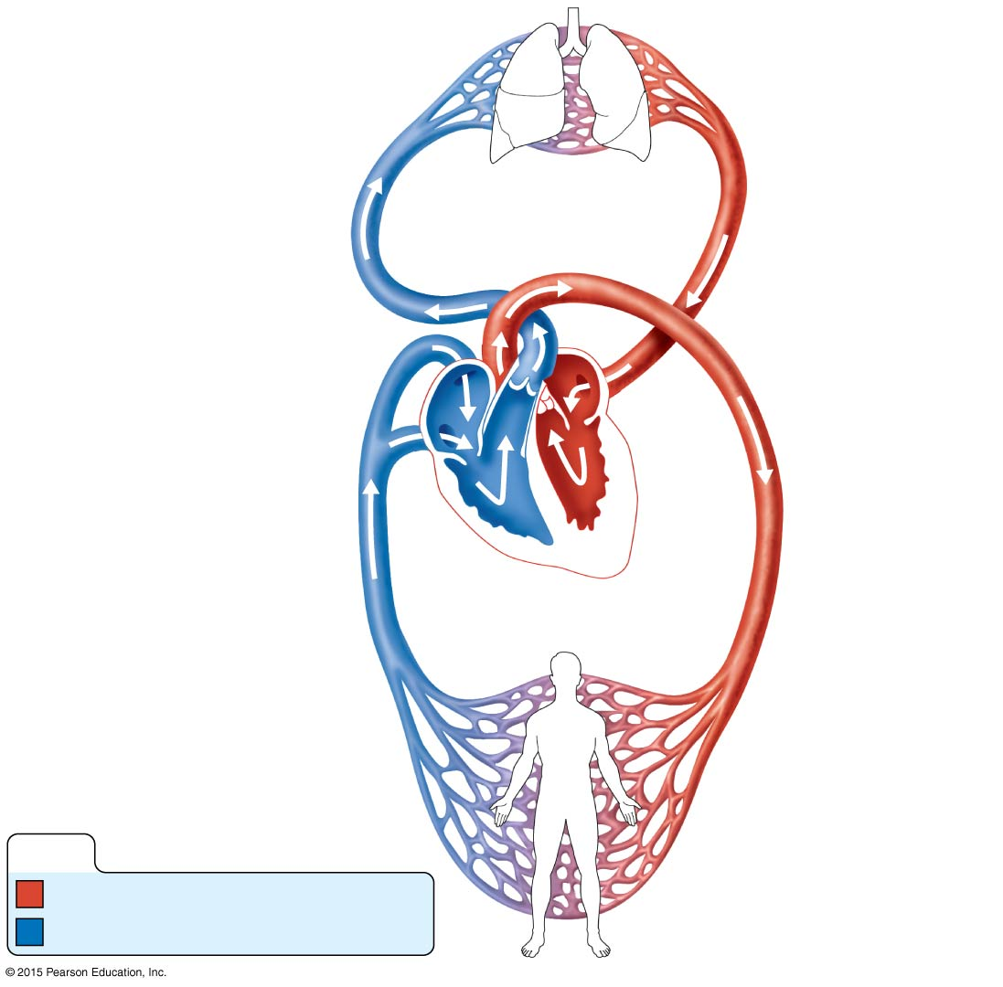
Figure 11.4 The systemic and pulmonary circulations.
Capillary beds
of lungs where
gas exchange
occurs
Pulmonary Circuit
Pulmonary
arteries
Pulmonary veins
Aorta and branches
Venae cavae
Left
atrium
Right
atrium
Left
ventricle
Right
ventricle
Heart
Systemic Circuit
Capillary beds
of all body tissues
where gas exchange
occurs
KEY:
Oxygen-rich, CO₂-poor blood
Oxygen-poor, CO₂-rich blood

Slide 19
Heart Valves
Allow blood to flow in only one direction, to prevent backflow
Four valves
Atrioventricular (AV) valves—between atria and ventricles
Bicuspid (mitral) valve (left side of heart)
Tricuspid valve (right side of heart)
Semilunar valves—between ventricle and artery
Pulmonary semilunar valve
Aortic semilunar valve

Slide 20
Heart Valves
AV valves
Anchored in place by chordae tendineae (“heart strings”)
Open during heart relaxation and closed during ventricular contraction
Semilunar valves
Closed during heart relaxation but open during ventricular contraction
These valves open and close in response to pressure changes in the heart

Slide 21
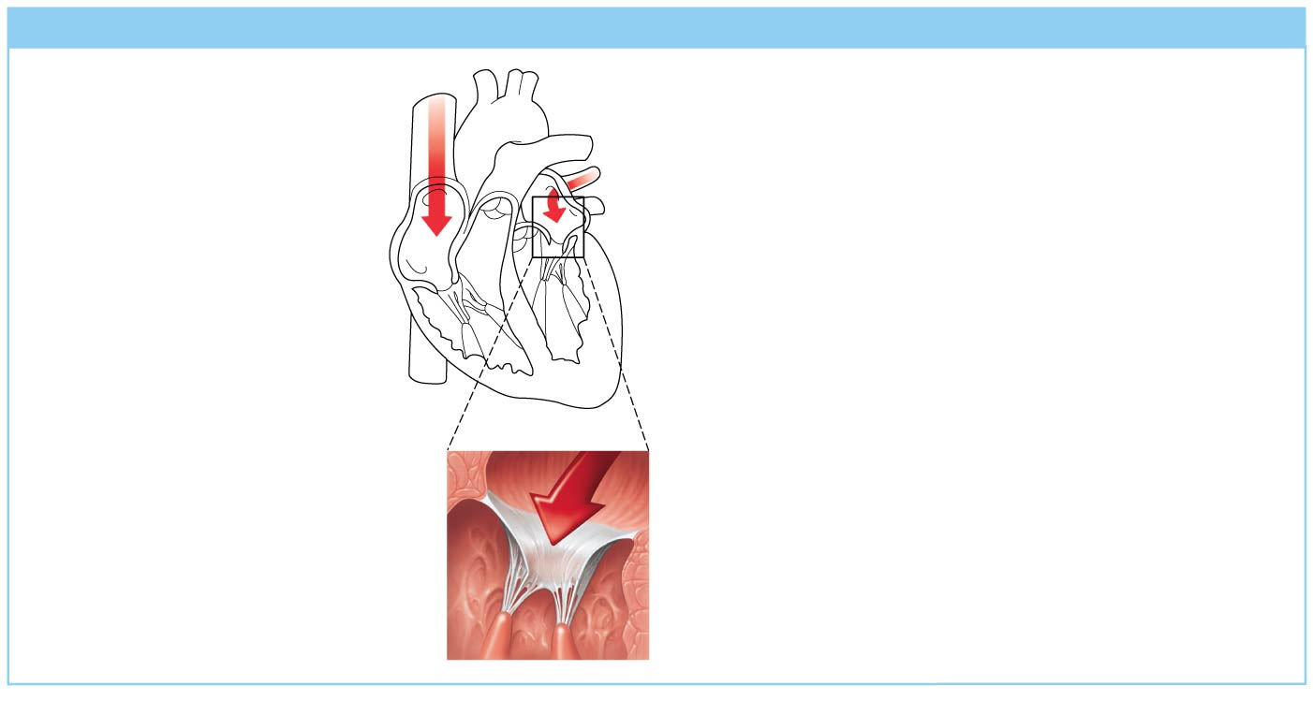
Figure 11.6a Operation of the heart valves.
Slide 2
(a) Operation of the AV valves
1
Blood returning to the
atria puts pressure against
AV valves; the AV valves
are forced open.
Ventricles

Slide 22
Figure 11.6a Operation of the heart valves.
Slide 3
(a) Operation of the AV valves
1
Blood returning to the
atria puts pressure against
AV valves; the AV valves
are forced open.
2
As the ventricles fill,
AV valve flaps hang
limply into ventricles.
Ventricles

Slide 23
Figure 11.6a Operation of the heart valves.
Slide 4
(a) Operation of the AV valves
1
Blood returning to the
atria puts pressure against
AV valves; the AV valves
are forced open.
2
As the ventricles fill,
AV valve flaps hang
limply into ventricles.
3
Atria contract,
forcing additional
blood into ventricles.
Ventricles
AV valves open;
atrial pressure
greater than
ventricular pressure

Slide 24
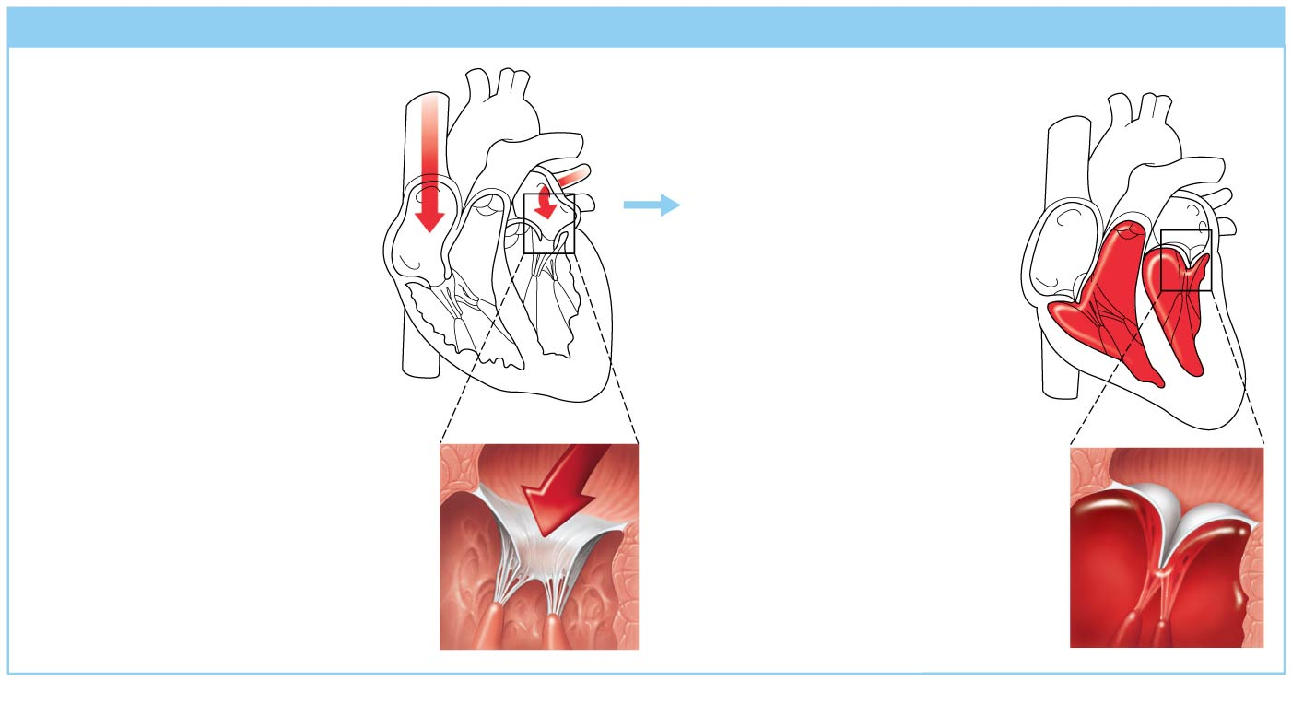
Figure 11.6a Operation of the heart valves.
Slide 5
(a) Operation of the AV valves
1
Blood returning to the
atria puts pressure against
AV valves; the AV valves
are forced open.
4
Ventricles contract,
forcing blood against
AV valve flaps.
2
As the ventricles fill,
AV valve flaps hang
limply into ventricles.
3
Atria contract,
forcing additional
blood into ventricles.
Ventricles
AV valves open;
atrial pressure
greater than
ventricular pressure

Slide 25
Figure 11.6a Operation of the heart valves.
Slide 6
(a) Operation of the AV valves
1
Blood returning to the
atria puts pressure against
AV valves; the AV valves
are forced open.
4
Ventricles contract,
forcing blood against
AV valve flaps.
AV valves close.
5
2
As the ventricles fill,
AV valve flaps hang
limply into ventricles.
3
Atria contract,
forcing additional
blood into ventricles.
Ventricles
AV valves open;
atrial pressure
greater than
ventricular pressure

Slide 26
Figure 11.6a Operation of the heart valves.
Slide 7
(a) Operation of the AV valves
1
Blood returning to the
atria puts pressure against
AV valves; the AV valves
are forced open.
4
Ventricles contract,
forcing blood against
AV valve flaps.
AV valves close.
5
2
As the ventricles fill,
AV valve flaps hang
limply into ventricles.
6
Chordae tendineae
tighten, preventing
valve flaps from
everting into atria.
3
Atria contract,
forcing additional
blood into ventricles.
Ventricles
AV valves open;
atrial pressure
greater than
ventricular pressure
AV valves closed;
atrial pressure
less than
ventricular pressure

Slide 27
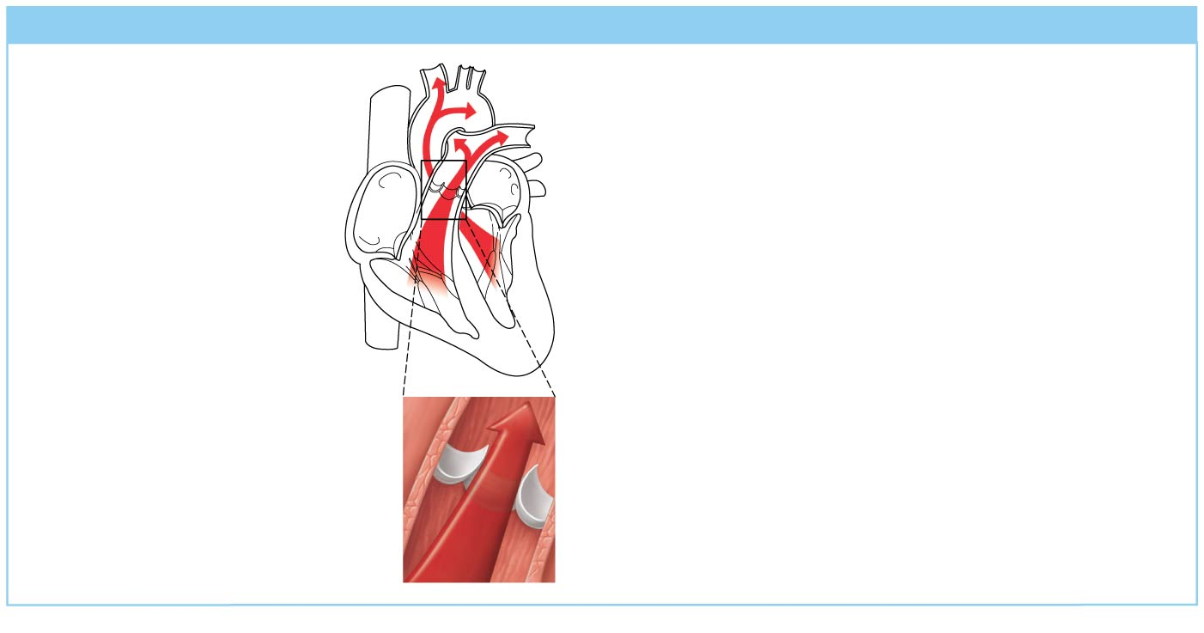
Figure 11.6b Operation of the heart valves.
Slide 2
(b) Operation of the semilunar valves
Pulmonary
trunk
Aorta
1
As ventricles contract
and intraventricular
pressure rises, blood
is pushed up against
semilunar valves,
forcing them open.
Semilunar valves open

Slide 28
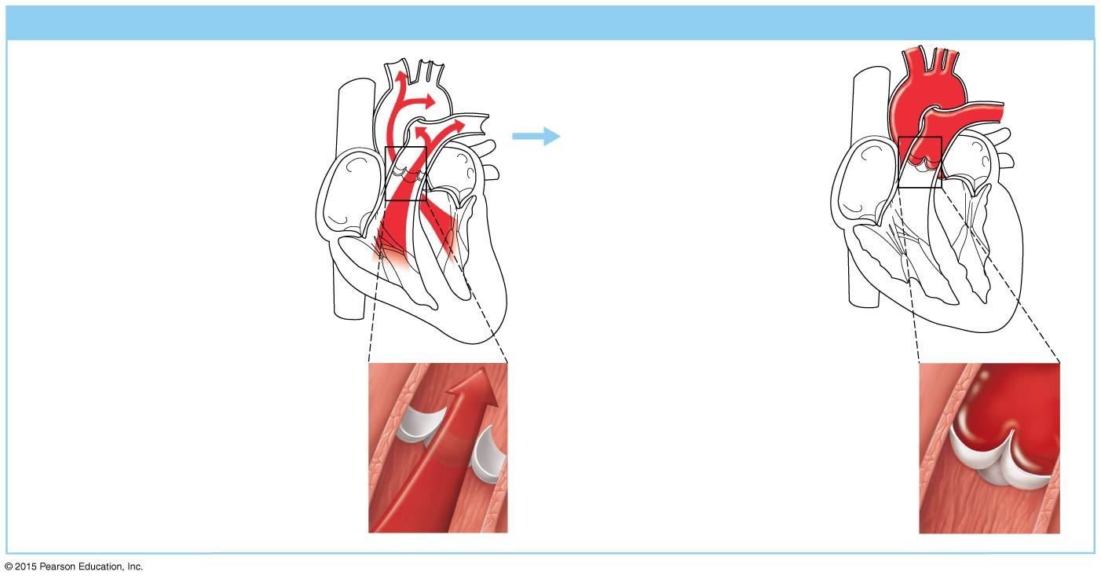
Figure 11.6b Operation of the heart valves.
Slide 3
(b) Operation of the semilunar valves
Pulmonary
trunk
Aorta
1
2
As ventricles contract
and intraventricular
pressure rises, blood
is pushed up against
semilunar valves,
forcing them open.
As ventricles relax
and intraventricular
pressure falls, blood
flows back from
arteries, filling the
leaflets of semilunar
valves and forcing
them to close.
Semilunar valves open
Semilunar valves closed

Slide 29
Cardiac Circulation
Blood in the heart chambers does not nourish the myocardium
The heart has its own nourishing circulatory system consisting of:
Coronary arteries—branch from the aorta to supply the heart muscle with oxygenated blood
Cardiac veins—drain the myocardium of blood
Coronary sinus—a large vein on the posterior of the heart, receives blood from cardiac veins
Blood empties into the right atrium via the coronary sinus

Slide 30
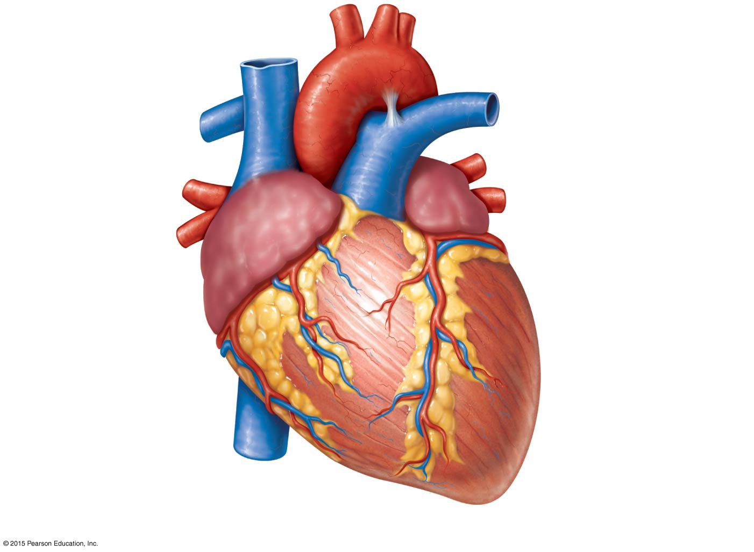
Figure 11.3a Gross anatomy of the heart.
Brachiocephalic trunk
Left common carotid artery
Superior vena cava
Left subclavian artery
Right pulmonary artery
Aortic arch
Ligamentum arteriosum
Ascending aorta
Left pulmonary artery
Pulmonary trunk
Left pulmonary veins
Right pulmonary
veins
Left atrium
Auricle of left atrium
Right atrium
Circumflex artery
Right coronary artery
in coronary sulcus (right
atrioventricular groove)
Left coronary artery in
coronary sulcus (left
atrioventricular groove)
Anterior cardiac vein
Left ventricle
Right ventricle
Great cardiac vein
Marginal artery
Anterior interventricular
artery (in anterior
interventricular sulcus)
Small cardiac vein
Inferior vena cava
Apex
(a)

Slide 31
Blood Flow Through the Heart
Superior and inferior venae cavae dump blood into the right atrium
From right atrium, through the tricuspid valve, blood travels to the right ventricle
From the right ventricle, blood leaves the heart as it passes through the pulmonary semilunar valve into the pulmonary trunk
Pulmonary trunk splits into right and left pulmonary arteries, which carry blood to the lungs

Slide 32
Blood Flow Through the Heart
In the lungs, blood picks up oxygen and drops off carbon dioxide
Oxygen-rich blood returns to the heart through the four pulmonary veins
Blood enters the left atrium and travels through the bicuspid valve into the left ventricle
From the left ventricle, blood leaves the heart via the aortic semilunar valve and aorta

Slide 33
Figure 11.4 The systemic and pulmonary circulations.
Capillary beds
of lungs where
gas exchange
occurs
Pulmonary Circuit
Pulmonary
arteries
Pulmonary veins
Aorta and branches
Venae cavae
Left
atrium
Right
atrium
Left
ventricle
Right
ventricle
Heart
Systemic Circuit
Capillary beds
of all body tissues
where gas exchange
occurs
KEY:
Oxygen-rich, CO₂-poor blood
Oxygen-poor, CO₂-rich blood

Slide 34
Intrinsic Conduction System of the Heart: Setting the Basic Rhythm
Cardiac muscle is able to initiate its own contraction in a regular way, but its rate is influenced by both intrinsic and extrinsic factors
The intrinsic conduction (nodal) system increases the rate of heart contraction and ensures that the heart beats as a unit

Slide 35
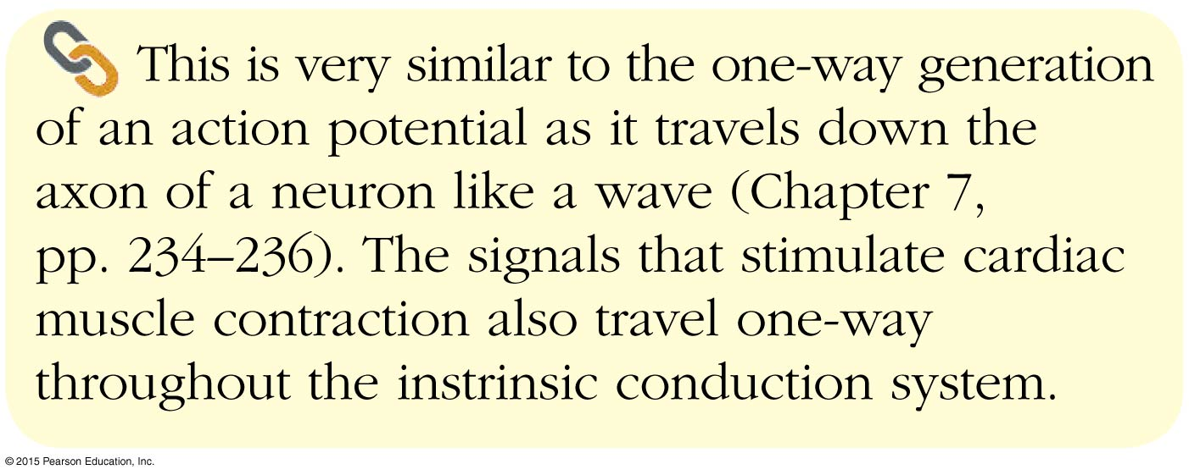
Concept Link

Slide 36
Intrinsic Conduction System of the Heart: Setting the Basic Rhythm
Sinoatrial (SA) node is the heart’s pacemaker
Atrioventricular (AV) node is at the junction of the atria and ventricles
Atrioventricular (AV) bundle (bundle of His) is in the interventricular septum
Bundle branches are in the interventricular septum
Purkinje fibers spread within the ventricle wall muscles

Slide 37
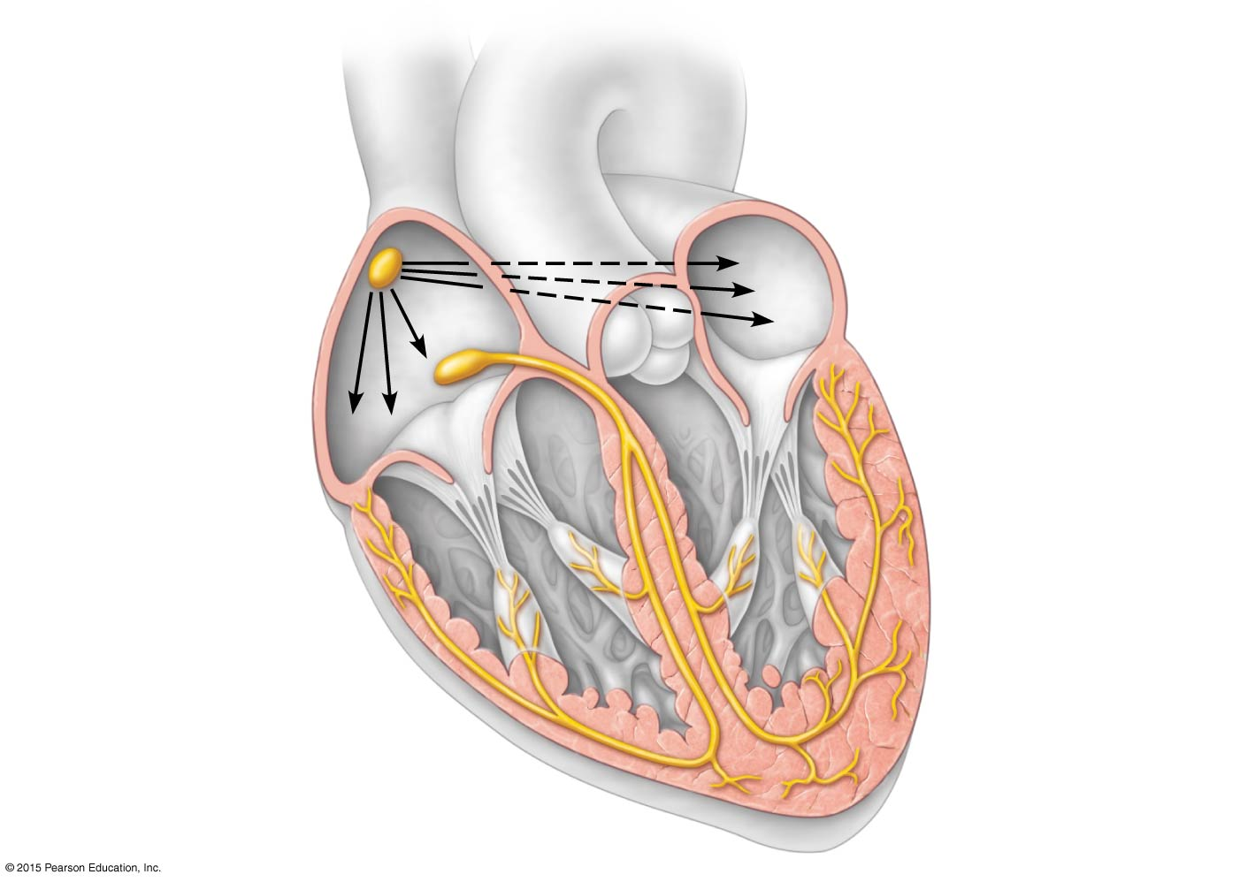
Figure 11.7 The intrinsic conduction system of the heart.
Superior
vena cava
Sinoatrial (SA)
node (pacemaker)
Left atrium
Atrioventricular
(AV) node
Right atrium
Atrioventricular
(AV) bundle
(bundle of His)
Bundle branches
Purkinje fibers
Purkinje fibers
Interventricular
septum

Slide 38
Heart Contractions
Intrinsic conduction system enforces 75 beats per minute
Contraction is initiated by the sinoatrial node (SA node)
Sequential stimulation occurs at other autorhythmic cells
Force cardiac muscle depolarization in one direction—from atria to ventricles

Slide 39
Heart Contractions
Once SA node starts the heartbeat
Impulse spreads to the AV node
Then the atria contract
At the AV node, the impulse passes through the AV bundle, bundle branches, and Purkinje fibers
Blood is ejected from the ventricles to the aorta and pulmonary trunk as the ventricles contract

Slide 40
Heart Contractions
Homeostatic imbalance
Heart block—damaged AV node releases the ventricles from control of the SA node; result is in a slower heart rate as ventricles contract at their own rate
Ischemia—lack of adequate oxygen supply to heart muscle
Fibrillation—a rapid, uncoordinated shuddering of the heart muscle

Slide 41
Heart Contractions
Homeostatic imbalance (continued)
Tachycardia—rapid heart rate over 100 beats per minute
Bradycardia—slow heart rate less than 60 beats per minutes

Slide 42
Cardiac Cycle & Heart Sounds
Cardiac cycle refers to one complete heartbeat
Systole = contraction
Diastole = relaxation
Heart beats approximately 75 times per minute
Cardiac cycle length is normally 0.8 second

Slide 43
Cardiac Cycle & Heart Sounds
Mid-to-late diastole
Pressure in heart is low
Blood flows passively into the atria and into ventricles
Semilunar valves are closed
Atrioventricular valves are open
Atria contract and force blood into ventricles

Slide 44
Cardiac Cycle & Heart Sounds
Ventricular systole
Blood pressure rises as ventricles prepare to contract
Atrioventricular valves close causing first heart sound, “lub”
Semilunar valves open as blood pushes against them
Blood travels out of the ventricles through pulmonary trunk and aorta
Atria are relaxed and filling with blood

Slide 45
Cardiac Cycle & Heart Sounds
Early diastole
At the end of systole, all four valves are briefly closed at the same time
Second heart sound is heard as semilunar valves close, causing “dup” sound
Closure prevents blood backflow into ventricles
Atria finish refilling as pressure in heart drops
Ventricular pressure is low
Atrioventricular valves open

Slide 46
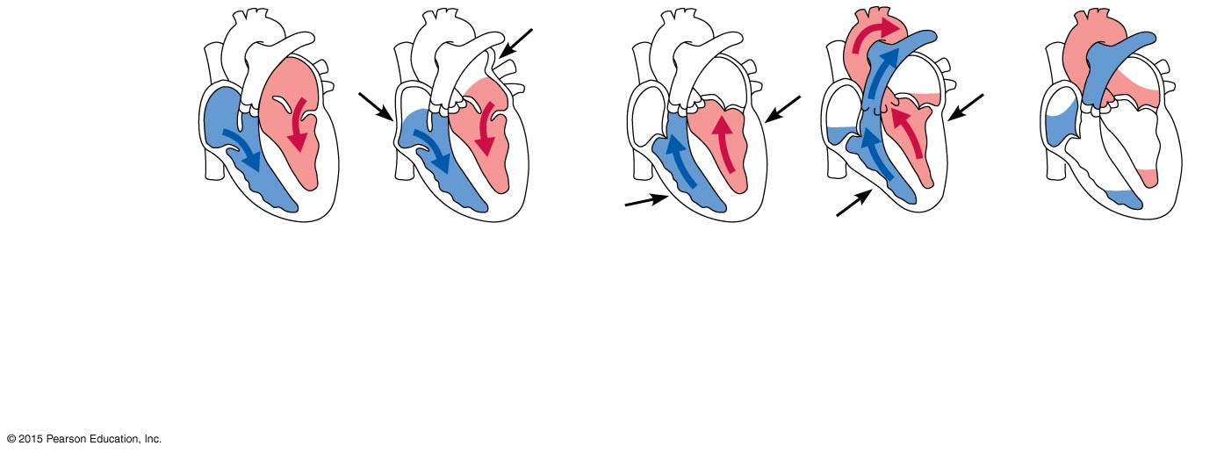
Figure 11.8 Summary of events occurring during the cardiac cycle.
Left atrium
Right atrium
Left ventricle
Right ventricle
Ventricular
filling
Atrial
contraction
Isovolumetric
contraction phase
Ventricular
ejection phase
Isovolumetric
relaxation
1
2
3
Mid-to-late diastole
(ventricular filling)
Ventricular systole
(atria in diastole)
Early diastole

Slide 47
Homeostatic Imbalance
Faulty valves reduce the efficiency of the heart as a pump and result in abnormal heart sounds (murmurs)

Slide 48
Cardiac Output
Cardiac output (CO)
Amount of blood pumped by each side (ventricle) of the heart in one minute
Stroke volume (SV)
Volume of blood pumped by each ventricle in one contraction (each heartbeat)
About 70 ml of blood is pumped out of the left ventricle with each heartbeat
Heart rate (HR)
Typically 75 beats per minute

Slide 49
Cardiac Output
CO = HR × SV
CO = HR (75 beats/min) × SV (70 ml/beat)
CO = 5250 ml/min = 5.25 L/min

Slide 50
Regulation of Stroke Volume
60 percent of blood in ventricles (about 70 ml) is pumped with each heartbeat
Starling’s law of the heart:
Critical factor controlling SV
The more the cardiac muscle is stretched, the stronger the contraction
SV rises or falls with the volume of venous return

Slide 51
Regulation of Heart Rate
Heart rate is modified by:
Neural (ANS) controls
Sympathetic nervous system
Parasympathetic nervous system
Hormones and ions
Physical factors

Slide 52
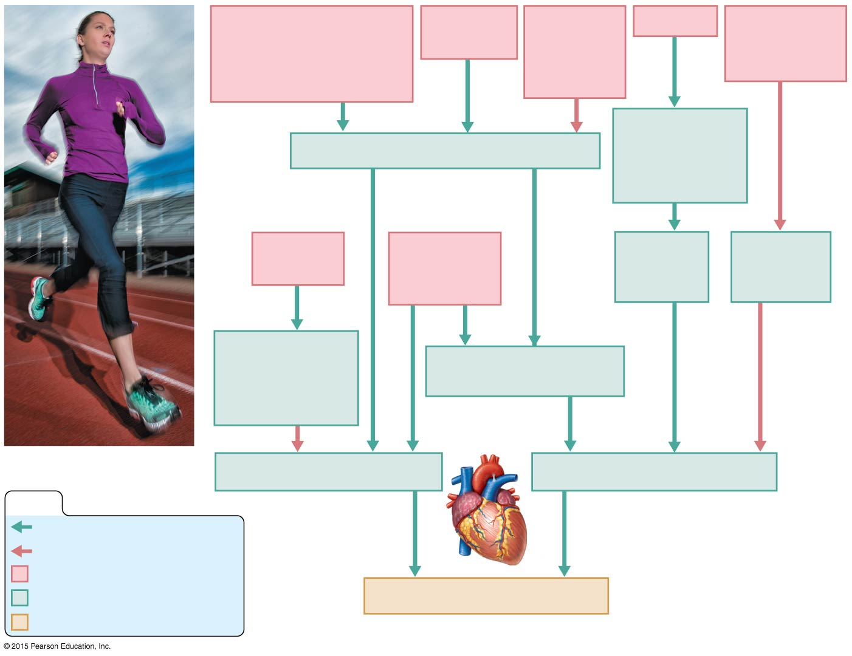
Figure 11.9 Influence of selected factors on cardiac output.
Crisis stressors
(physical or emotional
trauma; increased body
temperature; exercise)
Low blood
pressure
High blood
pressure
or blood
volume
Exercise
Decreased
blood volume
(hemorrhage)
Activation of
skeletal muscle
and respiratory
“pumps”
Sympathetic nervous system activity
Crisis has
passed
Hormones:
epinephrine,
thyroxine
Increased
venous
return
Decreased
venous
return
Parasympathetic
nervous system
controls (via
vagus nerves)
Increased contractile
force of cardiac muscle
Heart rate (beats/min)
Stroke volume (ml/beat)
KEY:
Increases, stimulates
Reduces, inhibits
Initial stimulus
Physiological response
End result
Cardiac output (ml/min)

Slide 53
Blood Vessels: The Vascular System
Vascular system transports blood to the tissues and back to the heart
Vessels that carry blood away from the heart:
Arteries and arterioles
Vessels that play a role in exchanges between tissues and blood:
Capillary beds
Vessels that return blood toward the heart:
Venules and veins

Slide 54
Microscopic Anatomy of Blood Vessels
Three layers (tunics) in blood vessels (except the capillaries):
Tunica intima forms a friction-reducing lining
Endothelium
Tunica media
Smooth muscle and elastic tissue
Controlled by sympathetic nervous system
Tunica externa forms protective outermost covering
Mostly fibrous connective tissue

Slide 55
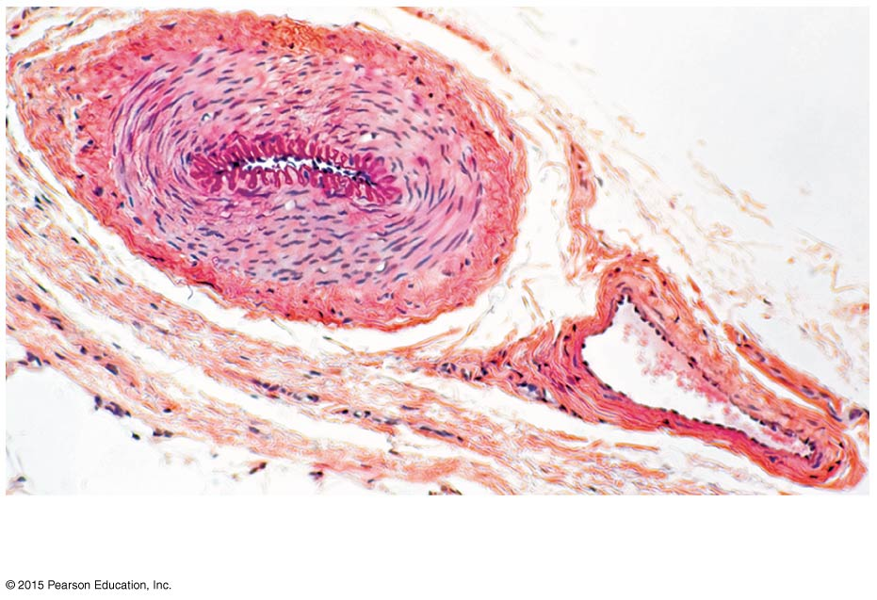
Figure 11.10a Structure of blood vessels.
(a)
Artery
Vein

Slide 56
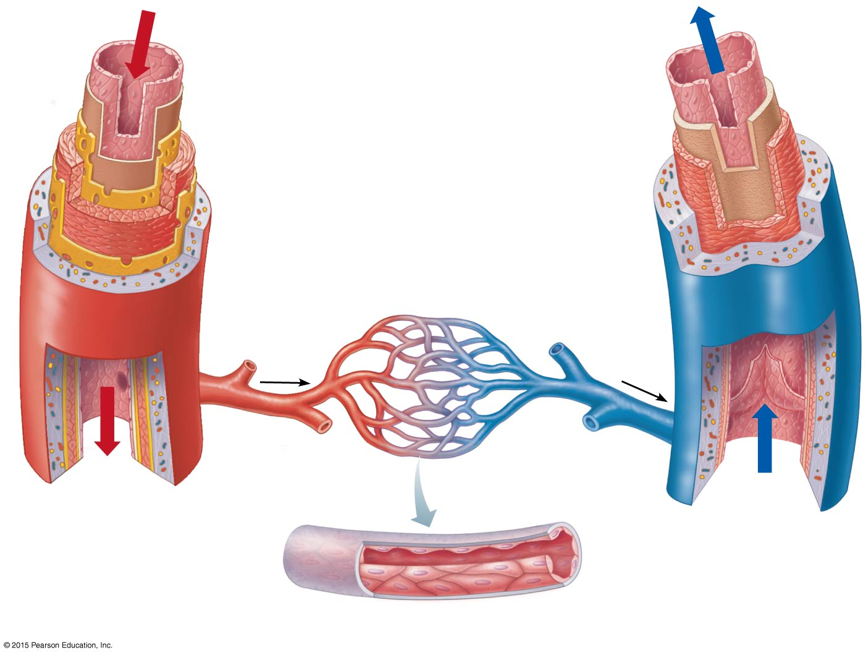
Figure 11.10b Structure of blood vessels.
Artery
Tunica intima
Vein
• Endothelium
• Loose connective tissue
Internal elastic lamina
Tunica media
• Smooth muscle
• Elastic fibers
External elastic lamina
Tunica externa
• Collagen fibers
Valve
Venule
Arteriole
Capillary
network
Lumen
Lumen
Basement membrane
Endothelial cells
(b)
Capillary

Slide 57
Structural Differences in Arteries, Veins, Capillaries
Arteries have a thicker tunica media than veins to withstand changes in pressure
Veins have a thinner tunica media than arteries and operate under low pressure
Veins also have valves to prevent backflow of blood
Lumen of veins is larger than that of arteries
Skeletal muscle “milks” blood in veins toward the heart

Slide 58
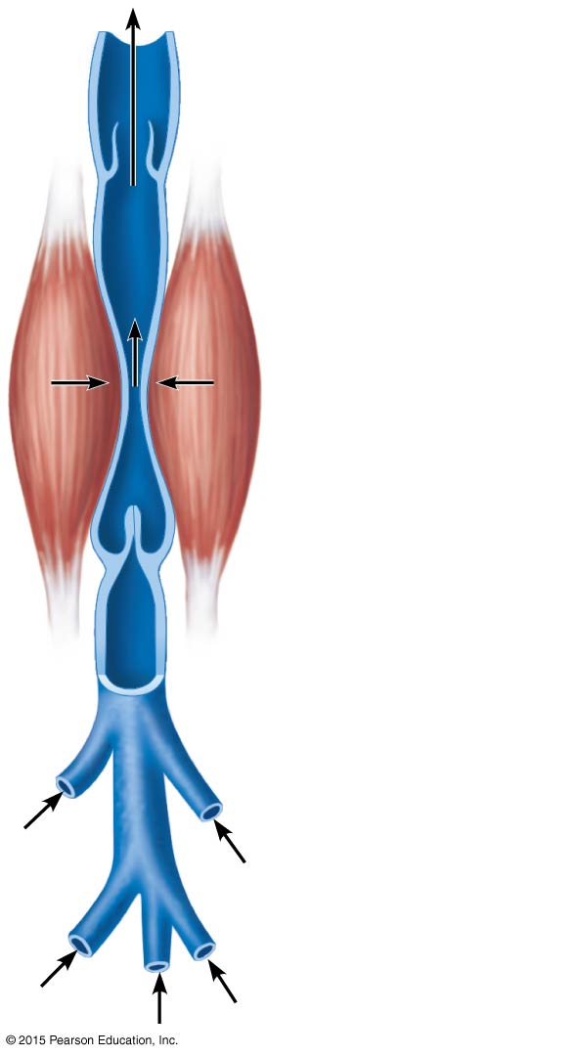
Figure 11.11 Operation of the muscular pump.
Valve (open)
Contracted
skeletal
muscle
Valve (closed)
Vein
Direction of
blood flow

Slide 59
Structural Differences in Arteries, Veins, Capillaries
Capillaries are only one cell layer thick (tunica intima), to allow for exchanges between blood and tissue
Capillaries form networks called capillary beds
Blood flow through a capillary bed is known as microcirculation

Slide 60
Structural Differences in Arteries, Veins, Capillaries
Capillary beds consist of two types of vessels:
Vascular shunt
True capillaries
Entrances to capillary beds are guarded by precapillary sphincters
Exchanges with tissue cells occur across walls of true capillaries
When precapillary sphincters are closed, blood bypasses the local area via the vascular shunt

Slide 61
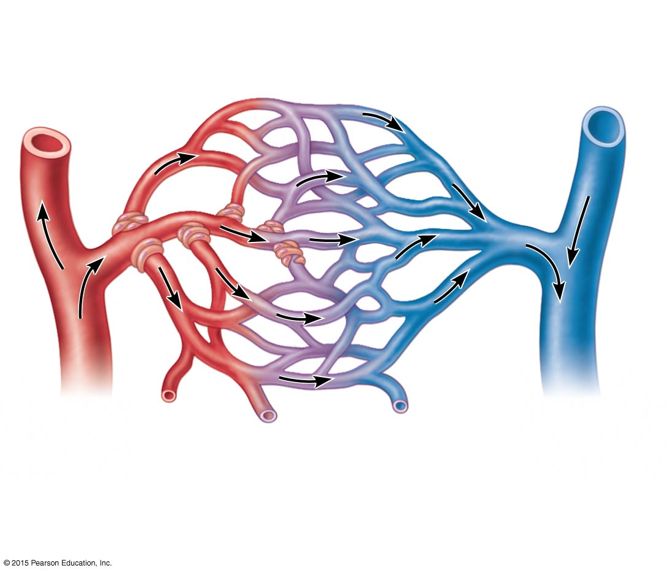
Figure 11.12a Anatomy of a capillary bed.
Vascular shunt
Precapillary sphincters
True
capillaries
Terminal arteriole
Postcapillary
venule
(a)
Sphincters open; blood flows through
true capillaries.

Slide 62
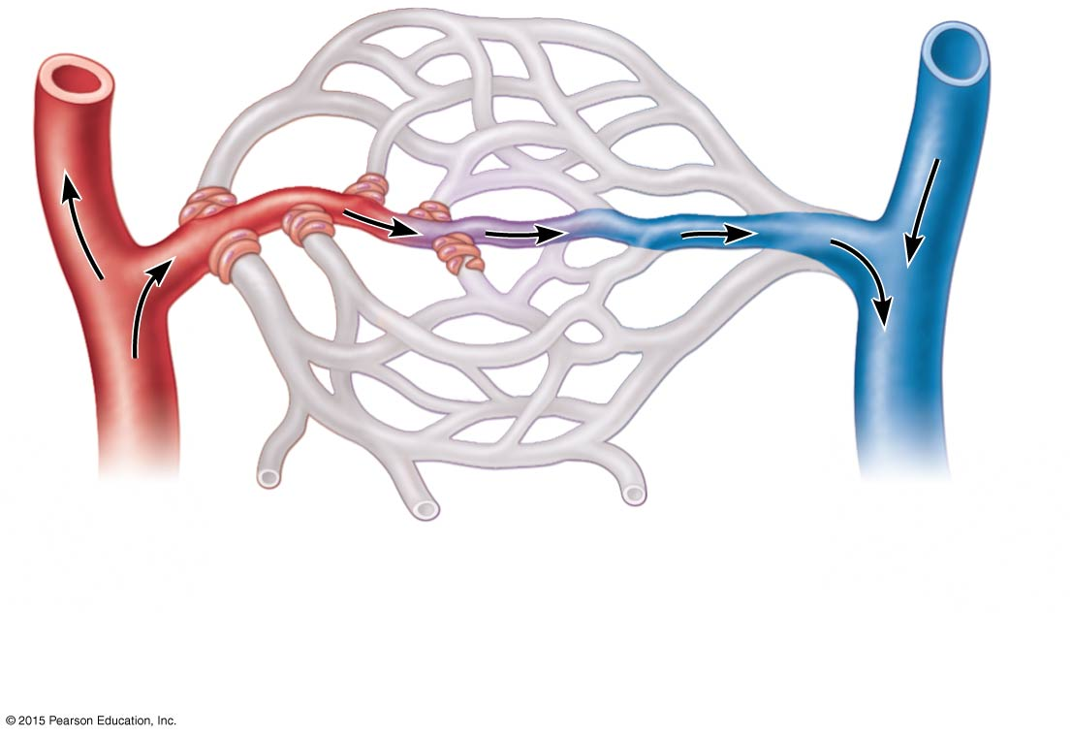
Figure 11.12b Anatomy of a capillary bed.
Terminal arteriole
Postcapillary
venule
(b)
Sphincters closed; blood flows through
vascular shunt.

Slide 63
Homeostatic Imbalance
Varicose veins
Structural defect due to incompetent valves
Common vascular problem, especially in people who are obese and people who stand for long periods of time
Predisposing factor for thrombophlebitis

Slide 64
Major Arteries of the Systemic Circulation
Aorta
Largest artery in the body
Leaves from the left ventricle of the heart
Regions
Ascending aorta—leaves the left ventricle
Aortic arch—arches to the left
Thoracic aorta—travels downward through the thorax
Abdominal aorta—passes through the diaphragm into the abdominopelvic cavity

Slide 65
Figure 11.3a Gross anatomy of the heart.
Brachiocephalic trunk
Left common carotid artery
Superior vena cava
Left subclavian artery
Right pulmonary artery
Aortic arch
Ligamentum arteriosum
Ascending aorta
Left pulmonary artery
Pulmonary trunk
Left pulmonary veins
Right pulmonary
veins
Left atrium
Auricle of left atrium
Right atrium
Circumflex artery
Right coronary artery
in coronary sulcus (right
atrioventricular groove)
Left coronary artery in
coronary sulcus (left
atrioventricular groove)
Anterior cardiac vein
Left ventricle
Right ventricle
Great cardiac vein
Marginal artery
Anterior interventricular
artery (in anterior
interventricular sulcus)
Small cardiac vein
Inferior vena cava
Apex
(a)

Slide 66
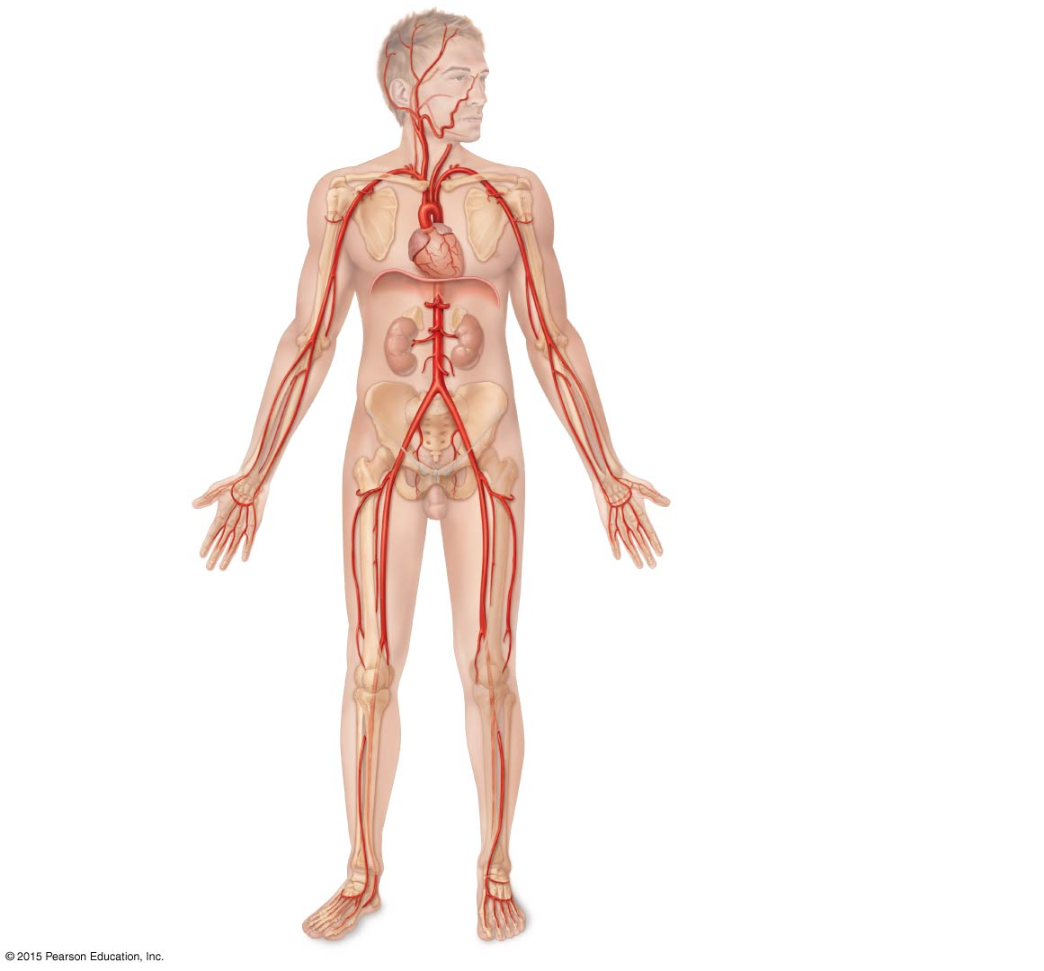
Figure 11.13 Major arteries of the systemic circulation, anterior view.
Arteries of the head and trunk
Internal carotid artery
External carotid artery
Common carotid arteries
Vertebral artery
Arteries that supply the upper limb
Subclavian artery
Subclavian artery
Brachiocephalic trunk
Axillary artery
Aortic arch
Ascending aorta
Coronary artery
Brachial artery
Thoracic aorta
(above diaphragm)
Celiac trunk
Radial artery
Abdominal aorta
Ulnar artery
Superior mesenteric
artery
Deep palmar arch
Renal artery
Superficial palmar arch
Digital arteries
Gonadal artery
Arteries that supply the lower limb
Common iliac artery
Inferior mesenteric artery
External iliac artery
Femoral artery
Popliteal artery
Internal iliac artery
Anterior tibial artery
Posterior tibial artery
Dorsalis pedis artery
Arcuate artery

Slide 67
Arterial Branches of the Ascending Aorta
Right and left coronary arteries serve the heart

Slide 68
Arterial Branches of the Aortic Arch
Brachiocephalic trunk splits into the:
Right common carotid artery
Right subclavian artery
Left common carotid artery splits into the:
Left internal and external carotid arteries
Left subclavian artery branches into the:
Vertebral artery
In the axilla, the subclavian artery becomes the axillary artery → brachial artery → radial and ulnar arteries

Slide 69
Arterial Branches of the Thoracic Aorta
Intercostal arteries supply the muscles of the thorax wall
Other branches of the thoracic aorta supply the (not illustrated):
Lungs (bronchial arteries)
Esophagus (esophageal arteries)
Diaphragm (phrenic arteries)

Slide 70
Arterial Branches of the Abdominal Aorta
Celiac trunk is the first branch of the abdominal aorta. Three branches are:
Left gastric artery (stomach)
Splenic artery (spleen)
Common hepatic artery (liver)
Superior mesenteric artery supplies most of the small intestine and first half of the large intestine

Slide 71
Arterial Branches of the Abdominal Aorta
Left and right renal arteries (kidney)
Left and right gonadal arteries
Ovarian arteries in females serve the ovaries
Testicular arteries in males serve the testes
Lumbar arteries serve muscles of the abdomen and trunk

Slide 72
Arterial branches of the Abdominal Aorta
Inferior mesenteric artery serves the second half of the large intestine
Left and right common iliac arteries are the final branches of the aorta
Internal iliac arteries serve the pelvic organs
External iliac arteries enter the thigh → femoral artery → popliteal artery → anterior and posterior tibial arteries

Slide 73
Figure 11.13 Major arteries of the systemic circulation, anterior view.
Arteries of the head and trunk
Internal carotid artery
External carotid artery
Common carotid arteries
Vertebral artery
Arteries that supply the upper limb
Subclavian artery
Subclavian artery
Brachiocephalic trunk
Axillary artery
Aortic arch
Ascending aorta
Coronary artery
Brachial artery
Thoracic aorta
(above diaphragm)
Celiac trunk
Radial artery
Abdominal aorta
Ulnar artery
Superior mesenteric
artery
Deep palmar arch
Renal artery
Superficial palmar arch
Digital arteries
Gonadal artery
Arteries that supply the lower limb
Common iliac artery
Inferior mesenteric artery
External iliac artery
Femoral artery
Popliteal artery
Internal iliac artery
Anterior tibial artery
Posterior tibial artery
Dorsalis pedis artery
Arcuate artery

Slide 74
Major Veins of Systemic Circulation
Superior and inferior venae cavae enter the right atrium of the heart
Superior vena cava drains the head and arms
Inferior vena cava drains the lower body

Slide 75
Figure 11.3b Gross anatomy of the heart.
Superior vena cava
Aorta
Left pulmonary artery
Right pulmonary
artery
Left atrium
Right atrium
Left pulmonary veins
Right pulmonary
veins
Pulmonary semilunar
valve
Left atrioventricular
valve (bicuspid valve)
Fossa ovalis
Aortic semilunar valve
Right atrioventricular
valve (tricuspid valve)
Left ventricle
Right ventricle
Chordae tendineae
Interventricular septum
Inferior vena cava
Myocardium
Visceral pericardium
(epicardium)
(b) Frontal section showing interior chambers and valves.

Slide 76
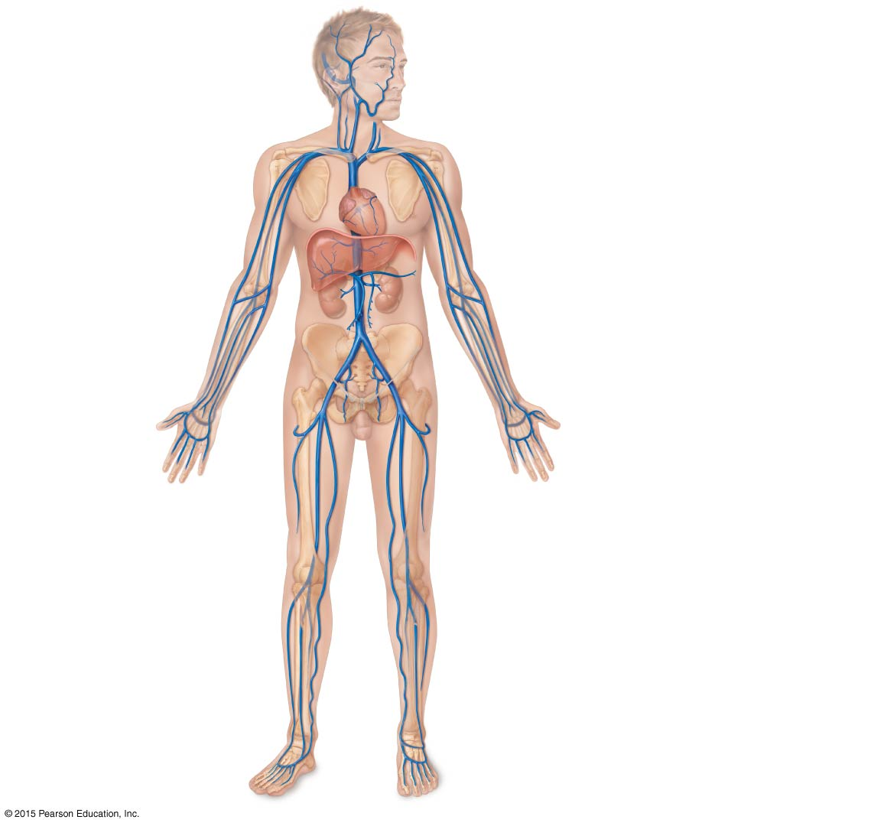
Figure 11.14 Major veins of the systemic circulation, anterior view.
Veins of the head and trunk
Dural venous sinuses
External jugular vein
Vertebral vein
Veins that drain the upper limb
Internal jugular vein
Subclavian vein
Right and left
brachiocephalic veins
Axillary vein
Cephalic vein
Superior vena cava
Brachial vein
Great cardiac vein
Basilic vein
Hepatic veins
Splenic vein
Hepatic portal vein
Median cubital vein
Renal vein
Ulnar vein
Superior
mesenteric vein
Radial vein
Inferior
mesenteric vein
Digital veins
Veins that drain the lower limb
Inferior vena cava
External iliac vein
Common iliac vein
Femoral vein
Great saphenous vein
Internal iliac vein
Popliteal vein
Posterior tibial vein
Anterior tibial vein
Small saphenous vein
Dorsal venous arch
Dorsal metatarsal veins

Slide 77
Veins Draining into the Superior Vena Cava
Radial and ulnar veins → brachial vein → axillary vein
These veins drain the arms
Cephalic vein drains the lateral aspect of the arm and empties into the axillary vein
Basilic vein drains the medial aspect of the arm and empties into the brachial vein
Basilic and cephalic veins are jointed at the median cubital vein (elbow area)

Slide 78
Veins Draining into the Superior Vena Cava
Subclavian vein receives:
Venous blood from the arm via the axillary vein
Venous blood from skin and muscles via external jugular vein
Vertebral vein drains the posterior part of the head
Internal jugular vein drains the dural sinuses of the brain

Slide 79
Veins Draining into the Superior Vena Cava
Left and right brachiocephalic veins receive venous blood from the:
Subclavian veins
Vertebral veins
Internal jugular veins
Brachiocephalic veins join to form the superior vena cava → right atrium of heart
Azygos vein drains the thorax

Slide 80
Veins Draining into the Inferior Vena Cava
Anterior and posterior tibial veins and fibial veins drain the legs
Posterior tibial vein → popliteal vein → femoral vein → external iliac vein
Great saphenous veins (longest veins of the body) receive superficial drainage of the legs
Each common iliac vein (left and right) is formed by the union of the internal and external iliac vein on its own side

Slide 81
Veins Draining into the Inferior Vena Cava
Right gonadal vein drains the right ovary in females and right testicle in males
Left gonadal vein empties into the left renal vein
Left and right renal veins drain the kidneys
Hepatic portal vein drains the digestive organs and travels through the liver before it enters systemic circulation
Left and right hepatic veins drain the liver

Slide 82
Figure 11.14 Major veins of the systemic circulation, anterior view.
Veins of the head and trunk
Dural venous sinuses
External jugular vein
Vertebral vein
Veins that drain the upper limb
Internal jugular vein
Subclavian vein
Right and left
brachiocephalic veins
Axillary vein
Cephalic vein
Superior vena cava
Brachial vein
Great cardiac vein
Basilic vein
Hepatic veins
Splenic vein
Hepatic portal vein
Median cubital vein
Renal vein
Ulnar vein
Superior
mesenteric vein
Radial vein
Inferior
mesenteric vein
Digital veins
Veins that drain the lower limb
Inferior vena cava
External iliac vein
Common iliac vein
Femoral vein
Great saphenous vein
Internal iliac vein
Popliteal vein
Posterior tibial vein
Anterior tibial vein
Small saphenous vein
Dorsal venous arch
Dorsal metatarsal veins

Slide 83
Arterial Supply of the Brain and the Circle of Willis
Internal carotid arteries divide into:
Anterior and middle cerebral arteries
These arteries supply most of the cerebrum
Vertebral arteries join once within the skull to form the basilar artery
Basilar artery serves the brain stem and cerebellum

Slide 84
Arterial Supply of the Brain and the Circle of Willis
Posterior cerebral arteries form from the division of the basilar artery
These arteries supply the posterior cerebrum

Slide 85
Arterial Supply of the Brain and the Circle of Willis
Anterior and posterior blood supplies are united by small communicating arterial branches
Result—complete circle of connecting blood vessels called cerebral arterial circle, or circle of Willis

Slide 86
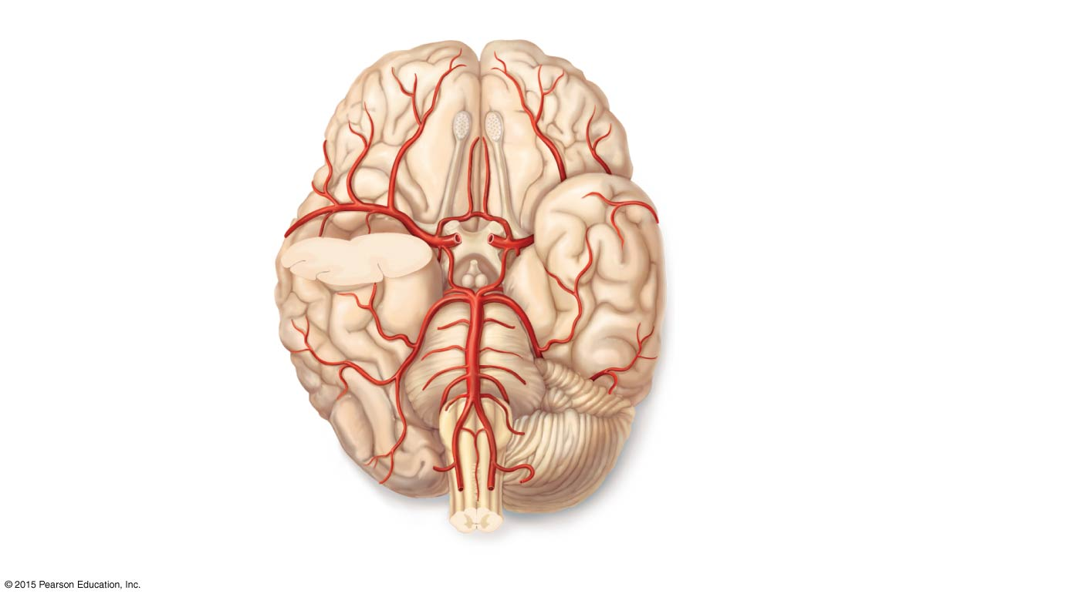
Figure 11.15a Arterial supply of the brain.
Anterior
Cerebral arterial circle
(circle of Willis)
Frontal lobe
Optic chiasma
• Anterior communicating
artery
Middle cerebral
artery
• Anterior cerebral artery
Internal carotid
artery
• Posterior communicating
artery
Mammillary body
• Posterior cerebral artery
Temporal lobe
Basilar artery
Pons
Vertebral artery
Occipital lobe
Cerebellum
(a)
Posterior

Slide 87
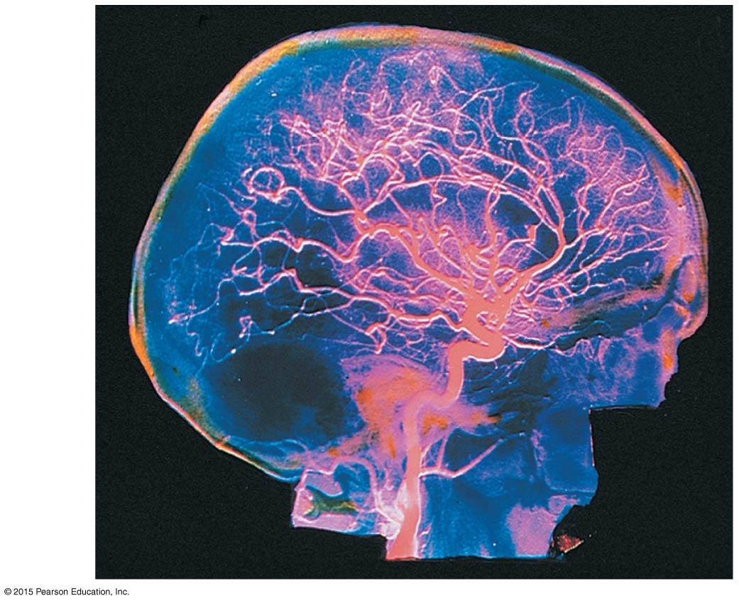
Figure 11.15b Arterial supply of the brain.
(b)

Slide 88
Hepatic Portal Circulation
The hepatic portal circulation is formed by veins draining the digestive organs, which empty into the hepatic portal vein
Digestive organs
Spleen
Pancreas
Hepatic portal vein carries this blood to the liver, where it is processed before returning to systemic circulation

Slide 89
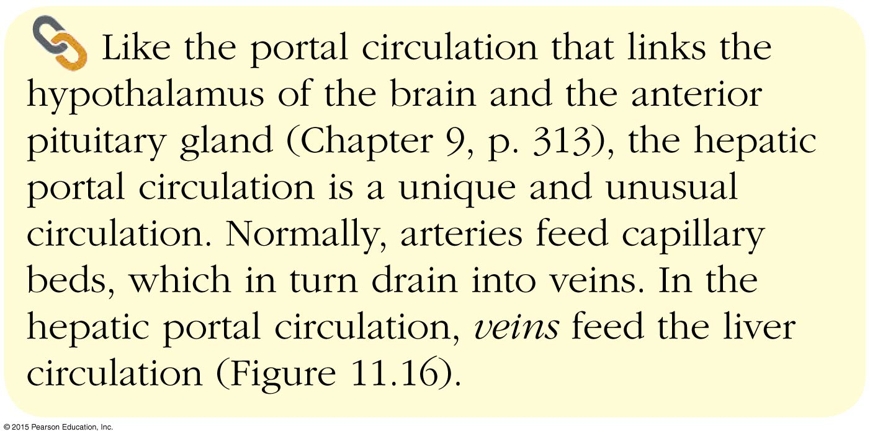
Concept Link

Slide 90
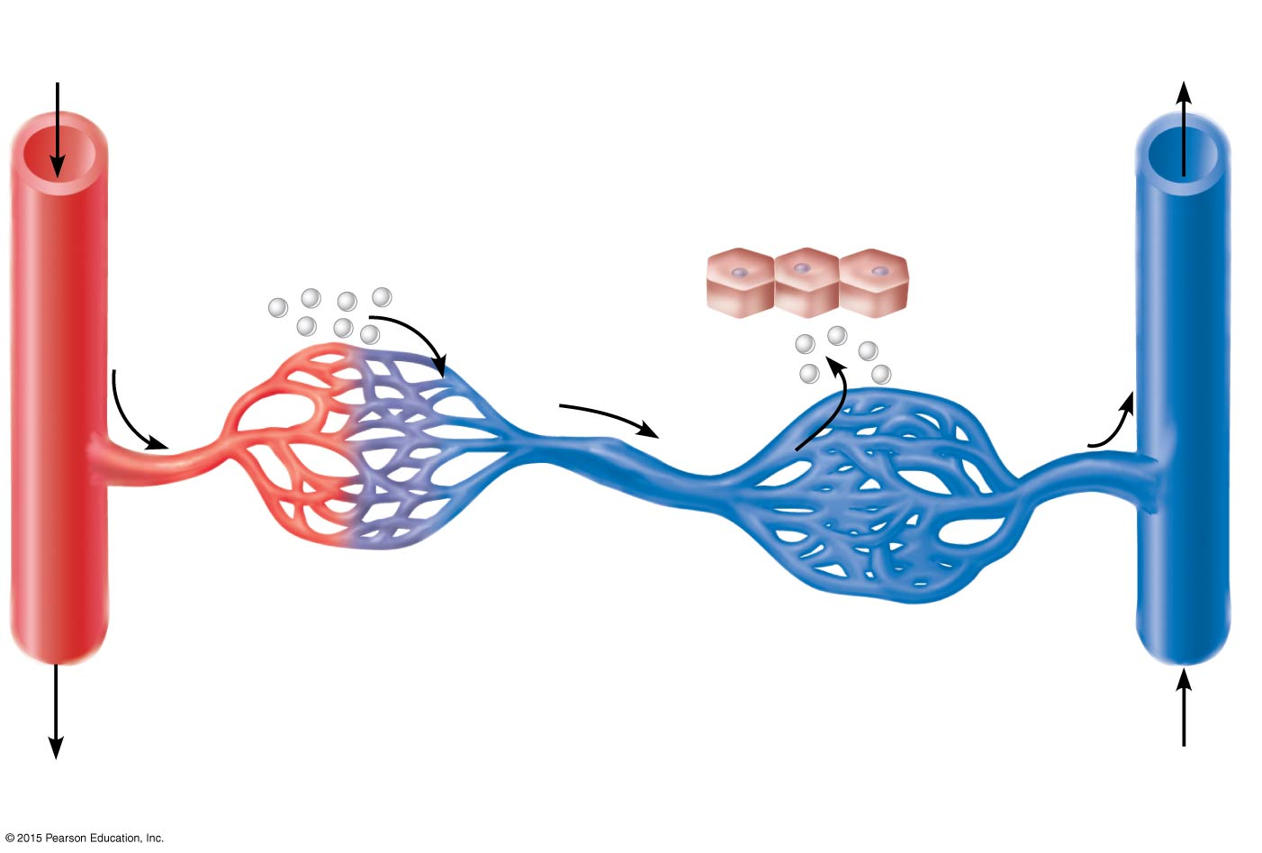
Figure 11.16 The basic scheme of the hepatic portal system.
Arterial
blood
Venous
blood
Inferior
vena cava
Stomach and intestine
Liver
Nutrients and
toxins absorbed
Liver cells (hepatocytes)
Nutrients
and toxins
leave
Hepatic
portal vein
First capillary bed
Second capillary bed
(liver sinusoids)
Hepatic
vein
Hepatic portal system

Slide 91
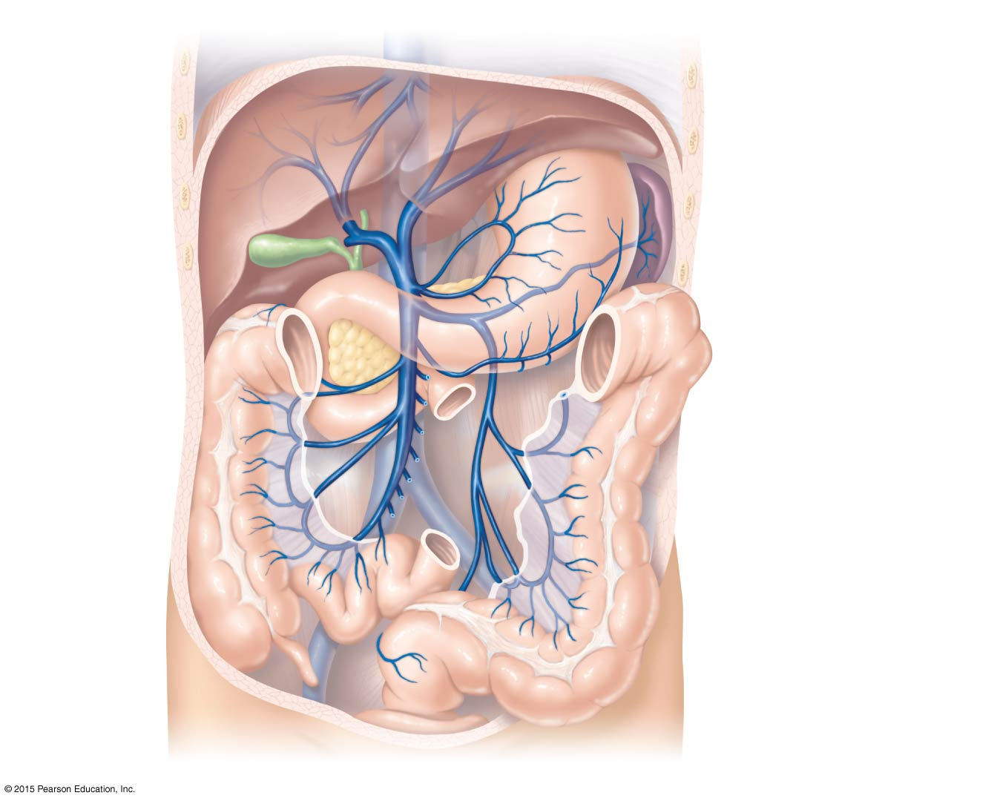
Figure 11.17 The hepatic portal circulation.
Inferior vena cava
(not part of hepatic
portal system)
Gastric veins
Liver
Spleen
Stomach
Hepatic
portal vein
Splenic vein
Inferior
mesenteric vein
Superior
mesenteric vein
Small
intestine
Large intestine

Slide 92
Fetal Circulation
Fetal circulation is a temporary circulation seen only in the fetus
Fetus receives exchanges of gases, nutrients, and wastes through the placenta
Umbilical cord contains three vessels:
Umbilical vein—carries blood rich in nutrients and oxygen to the fetus
2–3. Umbilical arteries (2)—carry carbon dioxide and debris-laden blood from fetus to placenta

Slide 93
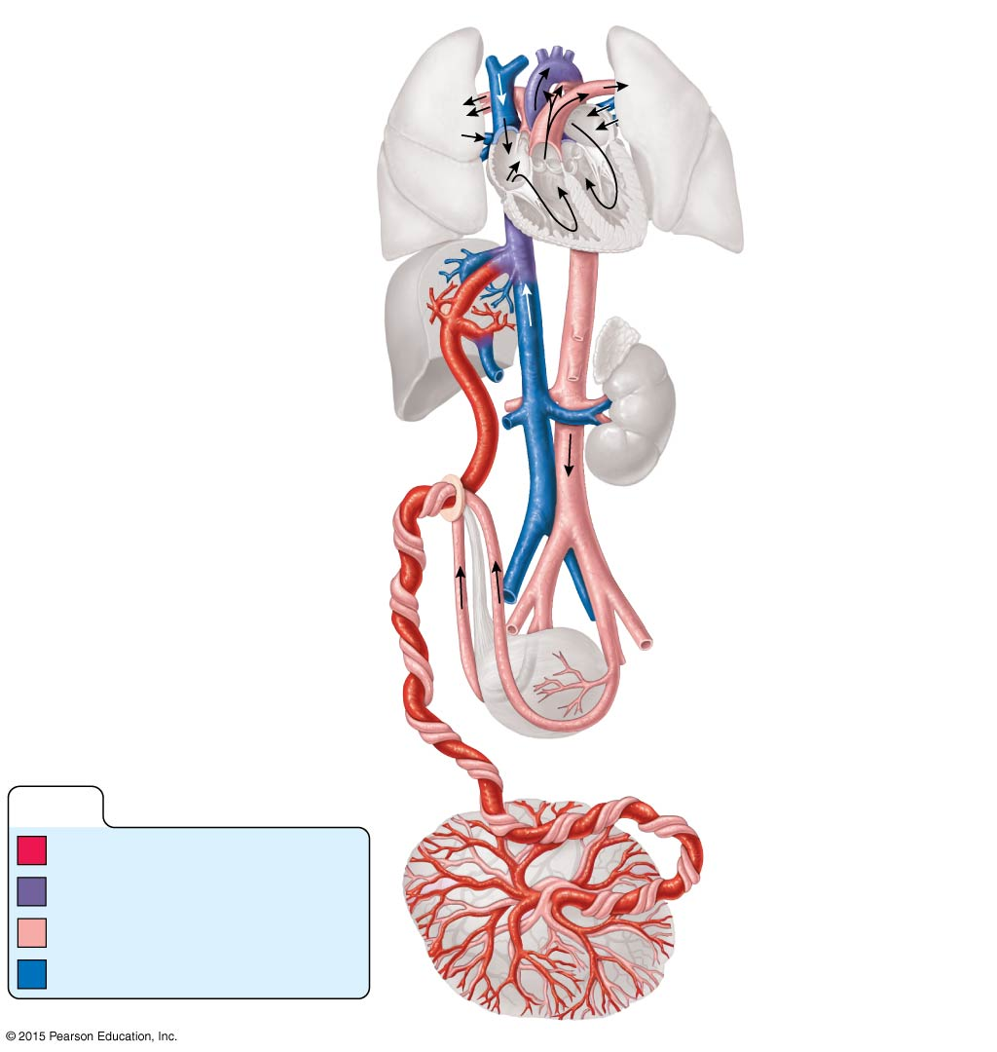
Figure 11.18 Schematic of the fetal circulation.
Superior vena cava
Ductus arteriosus
Pulmonary artery
Pulmonary
veins
Foramen ovale
Inferior vena cava
Hepatic vein
Ductus venosus
Inferior vena cava
Hepatic portal vein
Umbilical vein
Fetal umbilicus
Aorta
Umbilical cord
Common iliac artery
External iliac artery
Umbilical
arteries
Internal iliac artery
Urinary bladder
KEY:
High oxygenation
Moderate oxygenation
Low oxygenation
Placenta
Very low oxygenation

Slide 94
Fetal Circulation
Shunts bypassing the lungs and liver are also present. Blood flow bypasses the liver through the ductus venosus and enters the inferior vena cava → right atrium of heart
Blood flow bypasses the lungs
Blood entering right atrium is shunted directly into left atrium through foramen ovale (becomes fossa ovalis at or after birth)
Ductus arteriosus connects aorta and pulmonary trunk (becomes ligamentum arteriosum at birth)

Slide 95
Figure 11.3a Gross anatomy of the heart.
Brachiocephalic trunk
Left common carotid artery
Superior vena cava
Left subclavian artery
Right pulmonary artery
Aortic arch
Ligamentum arteriosum
Ascending aorta
Left pulmonary artery
Pulmonary trunk
Left pulmonary veins
Right pulmonary
veins
Left atrium
Auricle of left atrium
Right atrium
Circumflex artery
Right coronary artery
in coronary sulcus (right
atrioventricular groove)
Left coronary artery in
coronary sulcus (left
atrioventricular groove)
Anterior cardiac vein
Left ventricle
Right ventricle
Great cardiac vein
Marginal artery
Anterior interventricular
artery (in anterior
interventricular sulcus)
Small cardiac vein
Inferior vena cava
Apex
(a)

Slide 96
Figure 11.3b Gross anatomy of the heart.
Superior vena cava
Aorta
Left pulmonary artery
Right pulmonary
artery
Left atrium
Right atrium
Left pulmonary veins
Right pulmonary
veins
Pulmonary semilunar
valve
Left atrioventricular
valve (bicuspid valve)
Fossa ovalis
Aortic semilunar valve
Right atrioventricular
valve (tricuspid valve)
Left ventricle
Right ventricle
Chordae tendineae
Interventricular septum
Inferior vena cava
Myocardium
Visceral pericardium
(epicardium)
(b) Frontal section showing interior chambers and valves.

Slide 97
Arterial Pulse
Pulse
Alternate expansion and recoil of a blood vessel wall (the pressure wave) that occurs as the heart beats
Monitored at “pressure points” in superficial arteries where pulse is easily palpated
Pulse averages 70 to 76 beats per minute at rest, in a healthy person

Slide 98
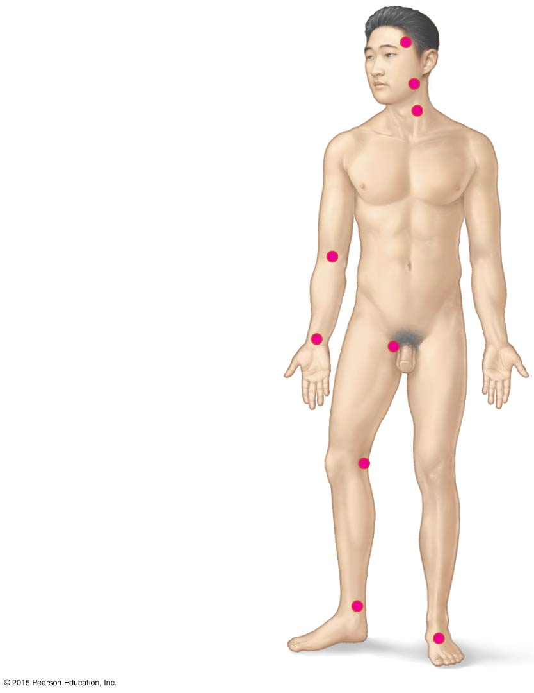
Figure 11.19 Body sites where the pulse is most easily palpated.
Superficial temporal artery
Facial artery
Common carotid artery
Brachial artery
Radial artery
Femoral artery
Popliteal artery
Posterior tibial
artery
Dorsalis pedis artery

Slide 99
Blood Pressure
Blood pressure
The pressure the blood exerts against the inner walls of the blood vessels
The force that causes blood to continue to flow in the blood vessels

Slide 100
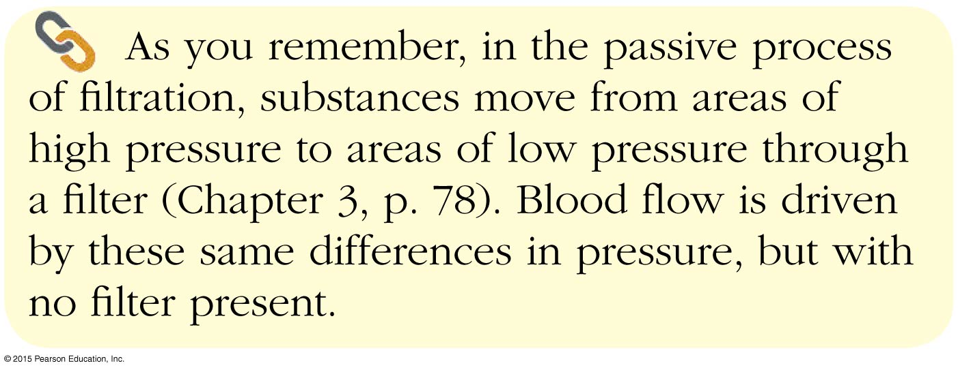
Concept Link

Slide 101
Blood Pressure Gradient
Blood is forced along a descending pressure gradient
Pressure in blood vessels decreases as distance from the heart increases
Pressure is high in the arteries, lower in the capillaries, and lowest in the veins

Slide 102
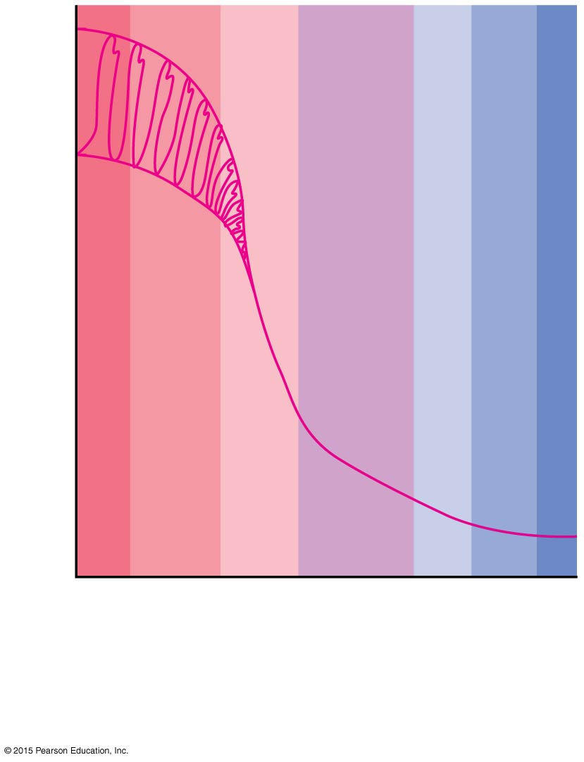
Figure 11.20 Blood pressure in various areas of the cardiovascular system.
120
Systolic pressure
100
80
Diastolic
pressure
60
Pressure (mm Hg)
40
20
0
–10
Aorta
Arteries
Venules
Veins
Arterioles
Capillaries
Venae cavae

Slide 103
Measuring Blood Pressure
Health professionals measure the pressure in large arteries
Systolic—pressure at the peak of ventricular contraction
Diastolic—pressure when ventricles relax
Expressed as systolic pressure over diastolic pressure: for example, 120/80 mm Hg

Slide 104
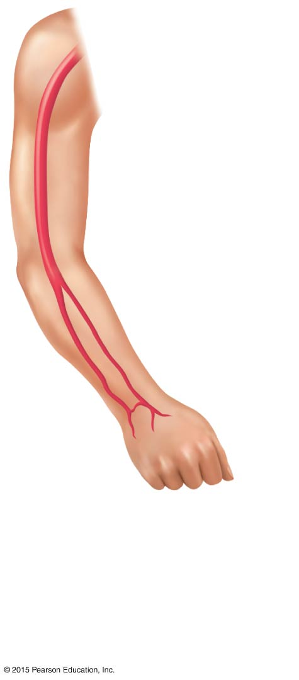
Figure 11.21a Measuring blood pressure.
Blood pressure
120 systolic
70 diastolic
(to be measured)
Brachial
artery
(a)
The course of the
brachial artery of
the arm. Assume a
blood pressure of
120/70 in a young,
healthy person.

Slide 105
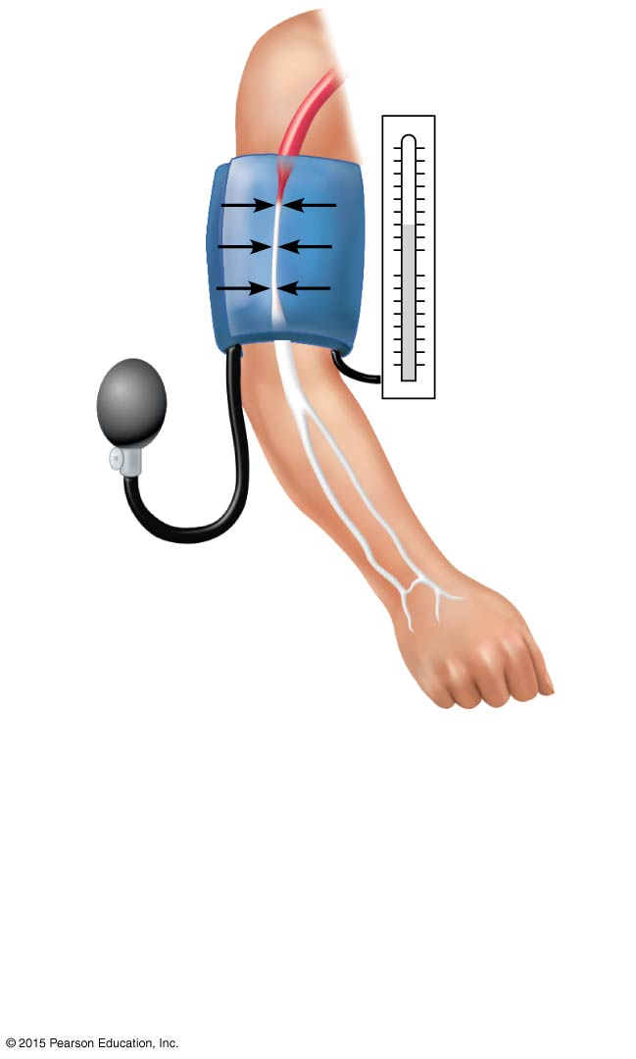
Figure 11.21b Measuring blood pressure.
Pressure
in cuff
above 120;
no sounds
audible
120 mm Hg
Rubber cuff
inflated with
air
Brachial
artery
closed
(b)
The blood pressure cuff is
wrapped snugly around the arm
just above the elbow and inflated
until the cuff pressure exceeds
the systolic blood pressure. At
this point, blood flow into the arm
is stopped, and a brachial pulse
cannot be felt or heard.

Slide 106
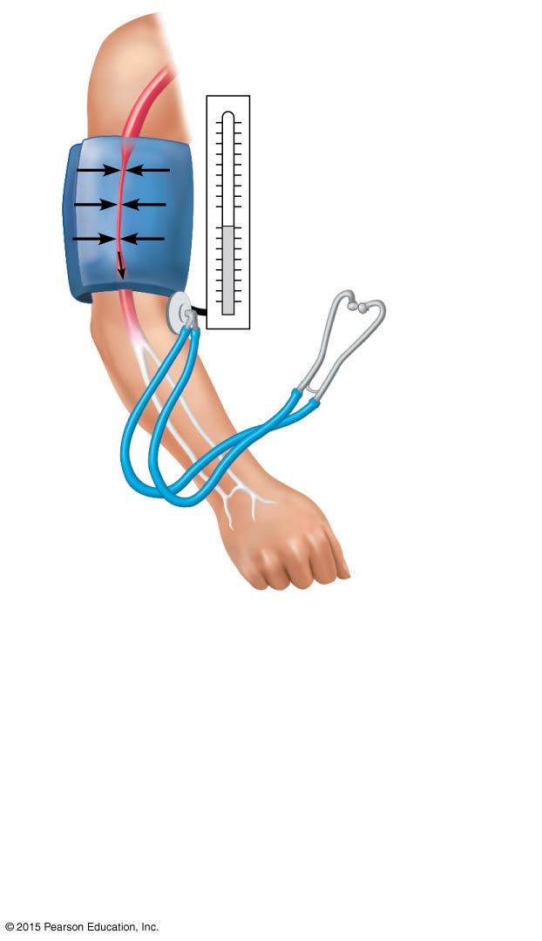
Figure 11.21c Measuring blood pressure.
Pressure
in cuff
below 120,
but above 70
120 mm Hg
70 mm Hg
Sounds
audible in
stethoscope
(c)
The pressure in the cuff is gradually
reduced while the examiner listens
(auscultates) for sounds in the
brachial artery with a stethoscope.
The pressure read as the first soft
tapping sounds are heard (the first
point at which a small amount of
blood is spurting through the
constricted artery) is recorded as
the systolic pressure.

Slide 107
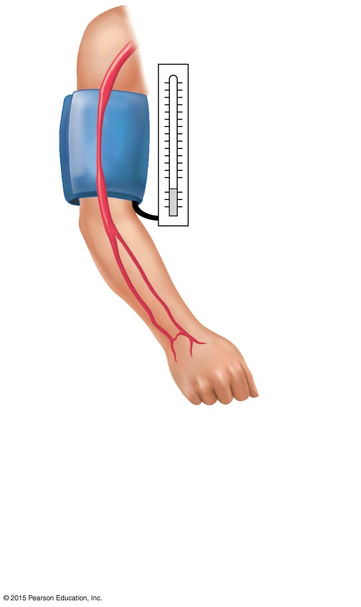
Figure 11.21d Measuring blood pressure.
Pressure
in cuff
below 70;
no sounds
audible
70 mm Hg
(d)
As the pressure is reduced still
further, the sounds become louder
and more distinct; when the artery
is no longer constricted and blood
flows freely, the sounds can no
longer be heard. The pressure at
which the sounds disappear is
recorded as the diastolic pressure.

Slide 108
Effects of Various Factors on Blood Pressure
BP = CO × PR
BP = blood pressure
CO = the amount of blood pumped out of the left ventricle per minute
PR = peripheral resistance, or the amount of friction blood encounters as it flows through vessels

Slide 109
Effects of Various Factors on Blood Pressure
Neural factors: the autonomic nervous system
Sympathetic nervous system promotes narrowing of vessels (vasoconstriction)
Vasoconstriction increases blood pressure

Slide 110
Effects of Various Factors on Blood Pressure
Renal factors: the kidneys
Regulation by altering blood volume
Renin, an enzyme, is released when arterial pressure is low
Renin triggers formation of angiotensin II, a vasoconstrictor
Angiotensin II stimulates release of aldosterone
Aldosterone enhances sodium reabsorption (and water) by kidneys

Slide 111
Effects of Various Factors on Blood Pressure
Temperature
Heat has a vasodilating effect
Cold has a vasoconstricting effect
Chemicals
Various substances can cause increases or decreases in blood pressure
Epinephrine increases heart rate and blood pressure

Slide 112
Concept Link

Slide 113
Effects of Various Factors on Blood Pressure
Diet
Commonly believed that a diet low in salt, saturated fats, and cholesterol prevents hypertension (high blood pressure)

Slide 114
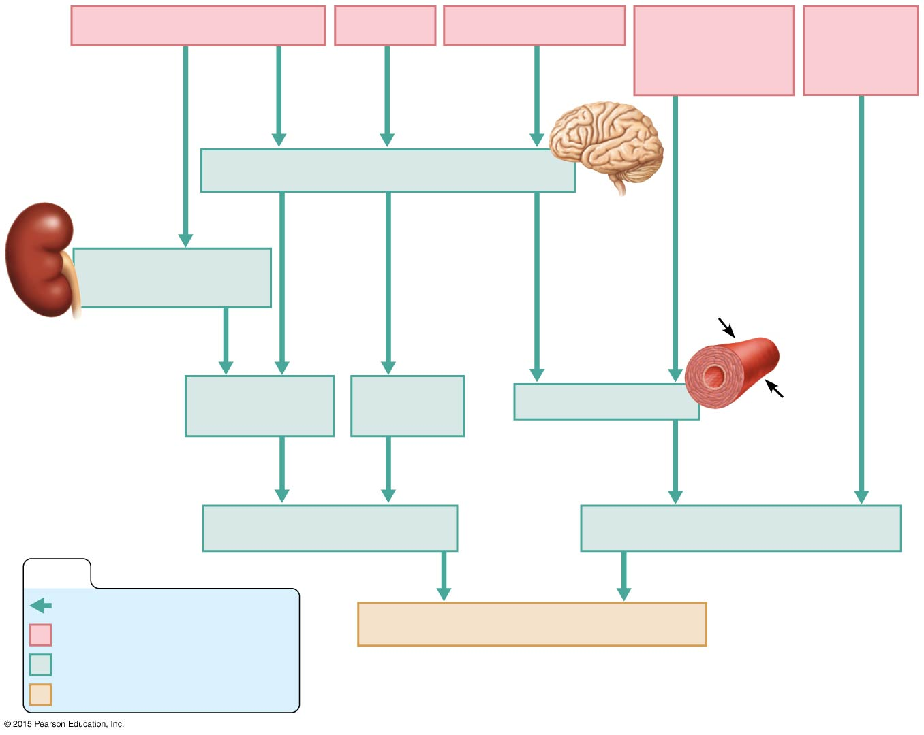
Figure 11.22 Summary of factors that increase arterial blood pressure.
Decreased blood volume
Exercise
Postural changes
Chemicals
(renin, nicotine
and others)
Increased
blood
viscosity
Sympathetic nervous system centers
Kidney conserves
water and salt
Increased
stroke volume
Increased
heart rate
Vasoconstriction
Increased cardiac output
Increased peripheral resistance
KEY:
Increases, stimulates
Initial stimulus
Increased arterial blood pressure
Physiological response
End result

Slide 115
Variations in Blood Pressure
Normal human range is variable
Normal
140 to 110 mm Hg systolic
80 to 70 mm Hg diastolic

Slide 116
Variations in Blood Pressure
Hypotension (low blood pressure)
Low systolic (below 100 mm Hg)
Often associated with illness
Acute hypotension is a warning sign for circulatory shock
Hypertension (high blood pressure)
Sustained elevated arterial pressure of 140/90 mm Hg
Warns of increased peripheral resistance

Slide 117
Capillary Exchange of Gases & Nutrients
Substances move to and from the blood and tissue cells through capillary walls
Exchange is due to concentration gradients
Oxygen and nutrients leave the blood and move into tissue cells
Carbon dioxide and other wastes exit tissue cells and enter the blood
Recall that interstitial fluid (tissue fluid) is found between cells

Slide 118
Capillary Exchange of Gases & Nutrients
Substances take various routes entering or leaving the blood:
Direct diffusion through membranes
Diffusion through intercellular clefts
Diffusion through pores of fenestrated capillaries
Transport via vesicles

Slide 119
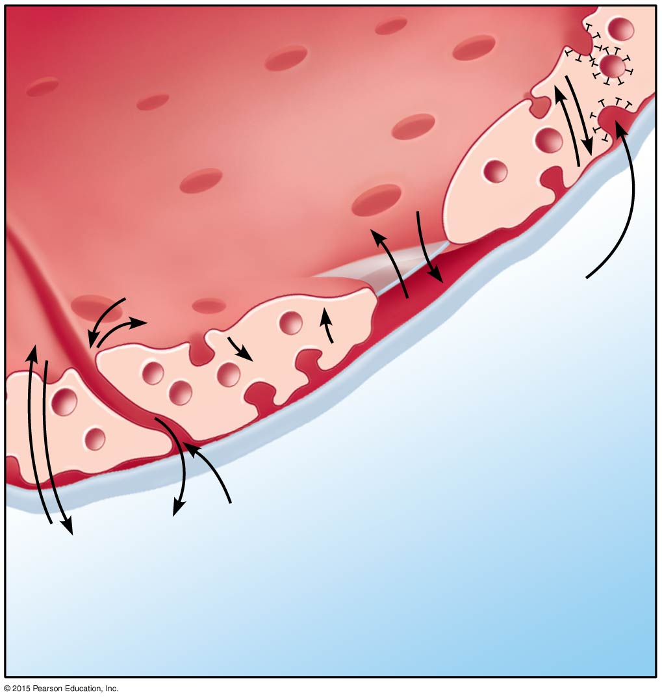
Figure 11.23 Capillary transport mechanisms.
Lumen of
capillary
Vesicles
Intercellular
cleft
Fenestra
(pore)
4
Transport
via vesicles
3
Diffusion
through pore
2
Diffusion through
intercellular cleft
1
Direct
diffusion
through
membrane
Interstitial fluid

Slide 120
Fluid Movements at Capillary Beds
Whether fluid moves out of or into a capillary depends on the difference between the two pressures:
Blood pressure forces fluid and solutes out of capillaries
Osmotic pressure draws fluid into capillaries

Slide 121
Fluid Movements at Capillary Beds
Blood pressure is higher than osmotic pressure at the arterial end of the capillary bed
Blood pressure is lower than osmotic pressure at the venous end of the capillary bed

Slide 122
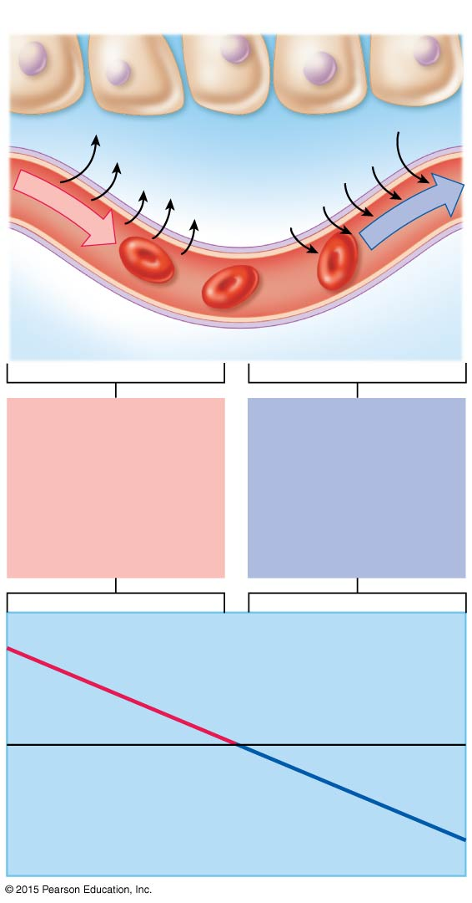
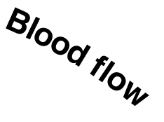
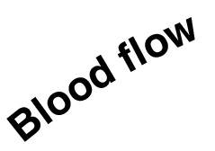
Figure 11.24 Bulk fluid flows across capillary walls depend largely on the difference between the blood pressure and the osmotic pressure at different regions of the capillary bed.
Tissue cell
Interstitial fluid
Net fluid
movement
out
Net fluid
movement
in
Arterial
end of
capillary
Venule
end of
capillary
At the arterial end of
a capillary, blood
pressure is more than
osmotic pressure,
and fluid flows out of
the capillary and into
the interstitial fluid.
At the venule end of
the capillary, blood
pressure is less than
osmotic pressure,
and fluid flows from
the interstitial fluid
into the capillary.
Blood pressure is
higher than osmotic
pressure
Osmotic pressure
remains steady
in capillary bed
Blood pressure is
lower than osmotic
pressure

Slide 123
Developmental Aspects of the Cardiovascular System
A simple “tube heart” develops in the embryo and pumps by week 4
The heart becomes a four-chambered organ by the end of 7 weeks
Few structural changes occur after week 7
Congenital heart defects account for half of all infant deaths resulting from congenital problems

Slide 124
Developmental Aspects of the Cardiovascular System
Age-related problems associated with the cardiovascular system include:
Weakening of venous valves
Varicose veins
Progressive arteriosclerosis
Hypertension resulting from loss of elasticity of vessels
Coronary artery disease resulting from fatty, calcified deposits in the vessels

Slide 125
Developmental Aspects of the Cardiovascular System
Modifications in diet (decreased consumption of fats, cholesterol, and salt), stopping smoking, and regular aerobic exercise may help to reverse the atherosclerotic process and prolong life

