Slide 2
Part I: The Lymphatic System
Consists of two semi-independent parts:
Lymphatic vessels
Lymphoid tissues and organs
Lymphatic system functions
Transports escaped fluids back to the blood
Plays essential roles in body defense and resistance to disease

Slide 3
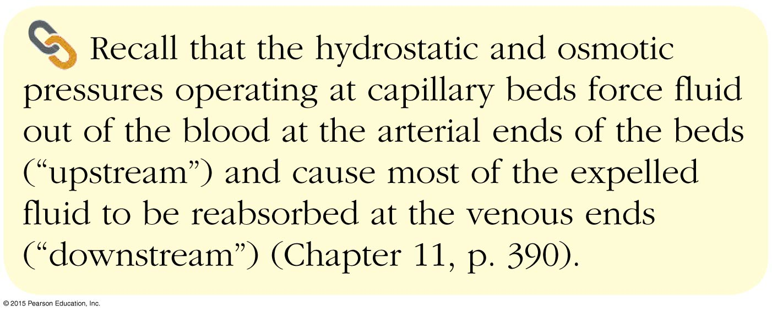
Concept Link

Slide 4
Lymphatic Vessels
Lymph—excess tissue fluid and plasma proteins carried by lymphatic vessels
If fluids are not picked up, edema occurs as fluid accumulates in tissues
Lymphatic vessels pick up excess fluid (lymph) and return it to the blood

Slide 5
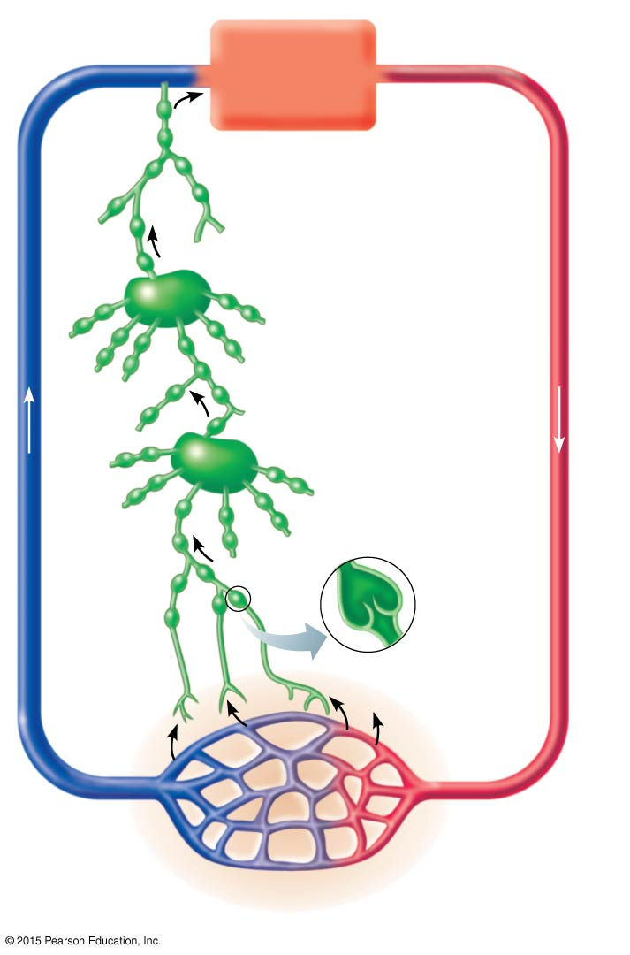
Figure 12.1 Relationship of lymphatic vessels to blood vessels.
Venous
system
Arterial
system
Heart
Lymph duct
Lymph trunk
Lymph node
Lymphatic
system
Lymphatic
collecting
vessels,
with valves
Lymph
capillary
Tissue fluid
(becomes
lymph)
Loose connective
tissue around
capillaries
Blood
capillaries

Slide 6
Lymphatic Vessels
Lymphatic vessels (lymphatics)
Form a one-way system toward the heart

Slide 7
Lymphatic Vessels
Lymph capillaries
Weave between tissue cells and blood capillaries
Walls overlap to form flaplike minivalves
Fluid leaks into lymph capillaries
Capillaries are anchored to connective tissue by filaments
Higher pressure on the inside closes minivalves
Fluid is forced along the vessel

Slide 8
Concept Link

Slide 9
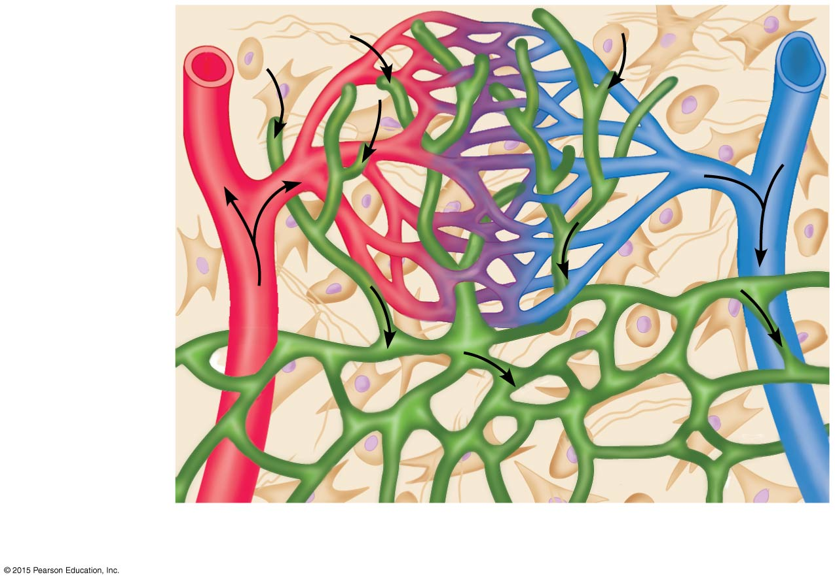
Figure 12.2a Special structural features of lymphatic capillaries.
Tissue fluid
Tissue cell
Lymphatic
capillary
Blood
capillaries
(a)
Arteriole
Venule

Slide 10
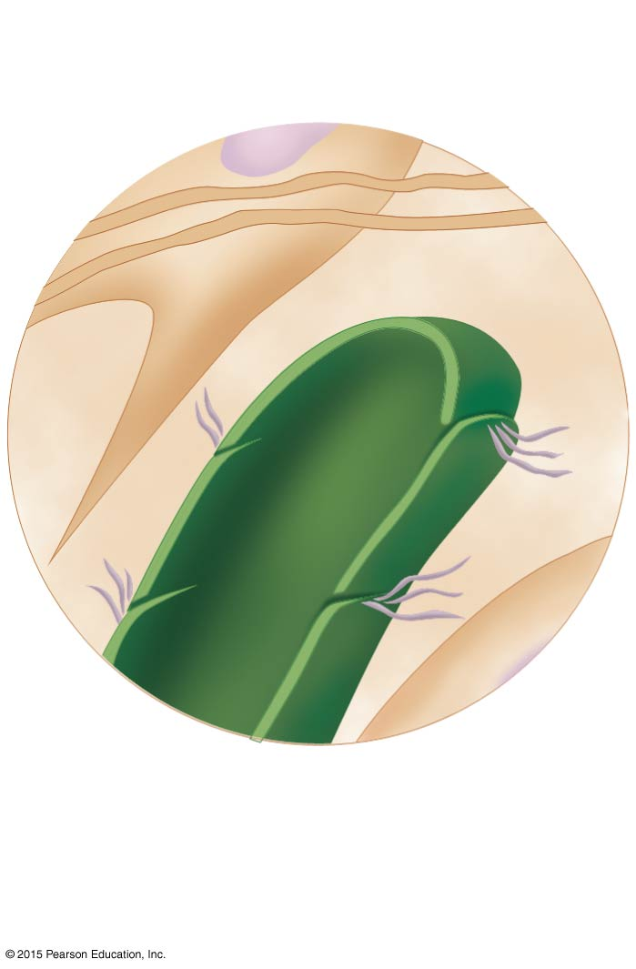
Figure 12.2b Special structural features of lymphatic capillaries.
Fibroblast in loose
connective tissue
Flaplike
minivalve
Filaments
anchored to
connective
tissue
Endothelial
cell
(b)

Slide 11
Lymphatic Vessels
Lymphatic collecting vessels
Collect lymph from lymph capillaries
Carry lymph to and away from lymph nodes
Return fluid to circulatory veins near the heart
Right lymphatic duct drains the lymph from the right arm and the right side of the head and thorax
Thoracic duct drains lymph from rest of body

Slide 12
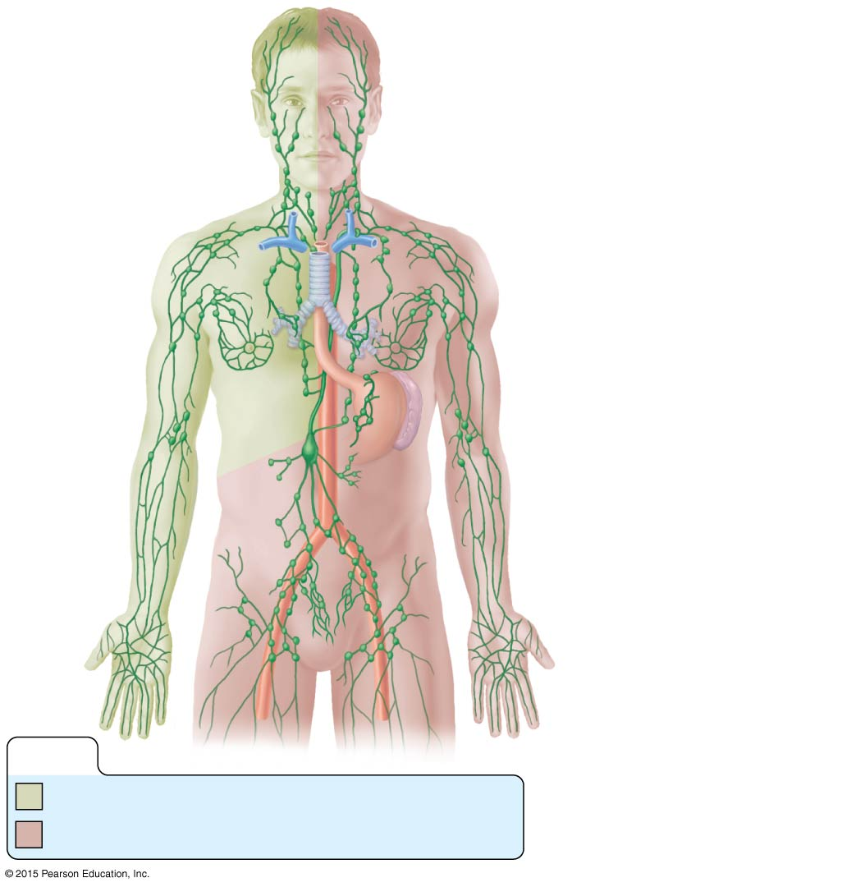
Figure 12.3 Distribution of lymphatic vessels and lymph nodes.
Regional
lymph nodes:
Entrance of right
lymphatic duct into right
subclavian vein
Cervical
nodes
Internal jugular vein
Thoracic duct
entry into left
subclavian vein
Axillary
nodes
Thoracic duct
Aorta
Spleen
Cisterna chyli (receives
lymph drainage from
digestive organs)
Inguinal
nodes
Lymphatics
KEY:
Drained by the right lymphatic duct
Drained by the thoracic duct

Slide 13
Lymphatic Vessels
Lymphatic vessels are similar to veins of the cardiovascular system
Thin-walled
Larger vessels have valves
Low-pressure, pumpless system
Lymph transported is aided by:
Milking action of skeletal muscles
Pressure changes in thorax during breathing
Smooth muscle in walls of lymphatics

Slide 14
Lymph Nodes
Lymph nodes filter lymph before it is returned to the blood
Harmful materials that are filtered:
Bacteria
Viruses
Cancer cells
Cell debris

Slide 15
Lymph Nodes
Defense cells within lymph nodes
Macrophages—engulf and destroy foreign substances such as bacteria, viruses, and foreign cells
Lymphocytes—respond to foreign substances in the lymphatic system

Slide 16
Lymph Nodes
Most are kidney-shaped and less than 1 inch long and are buried in connective tissue
Cortex (outer part)
Contains follicles—collections of lymphocytes
Germinal centers enlarge when antibodies are released by plasma cells
Medulla (inner part)
Contains phagocytic macrophages

Slide 17
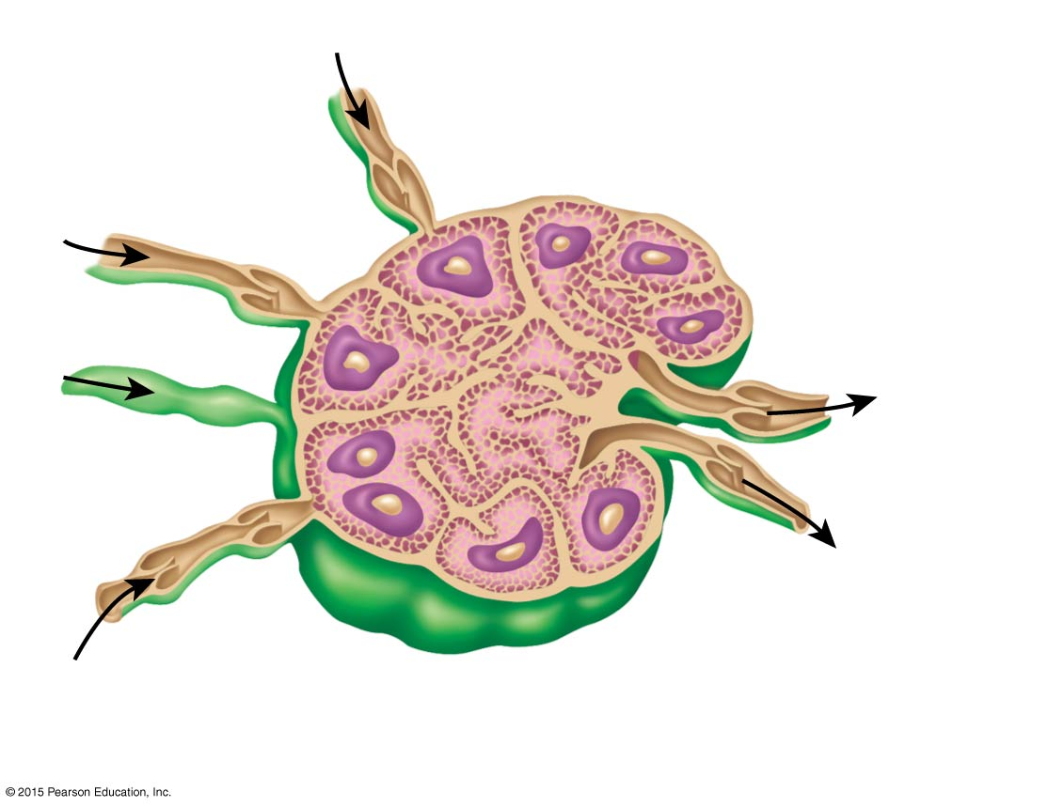
Figure 12.4 Structure of a lymph node.
Germinal
center in
follicle
Afferent
lymphatic
vessels
Capsule
Subcapsular
sinus
Trabecula
Afferent
lymphatic
vessels
Efferent
lymphatic
vessels
Hilum
Cortex
Follicle
Medullary sinus
Medullary cord

Slide 18
Lymph Nodes
Flow of lymph through nodes
Lymph enters the convex side through afferent lymphatic vessels
Lymph flows through a number of sinuses inside the node
Lymph exits through efferent lymphatic vessels
Because there are fewer efferent than afferent vessels, flow is slowed

Slide 19
Other Lymphoid Organs
Several other organs contribute to lymphatic function:
Spleen
Thymus
Tonsils
Peyer’s patches

Slide 20
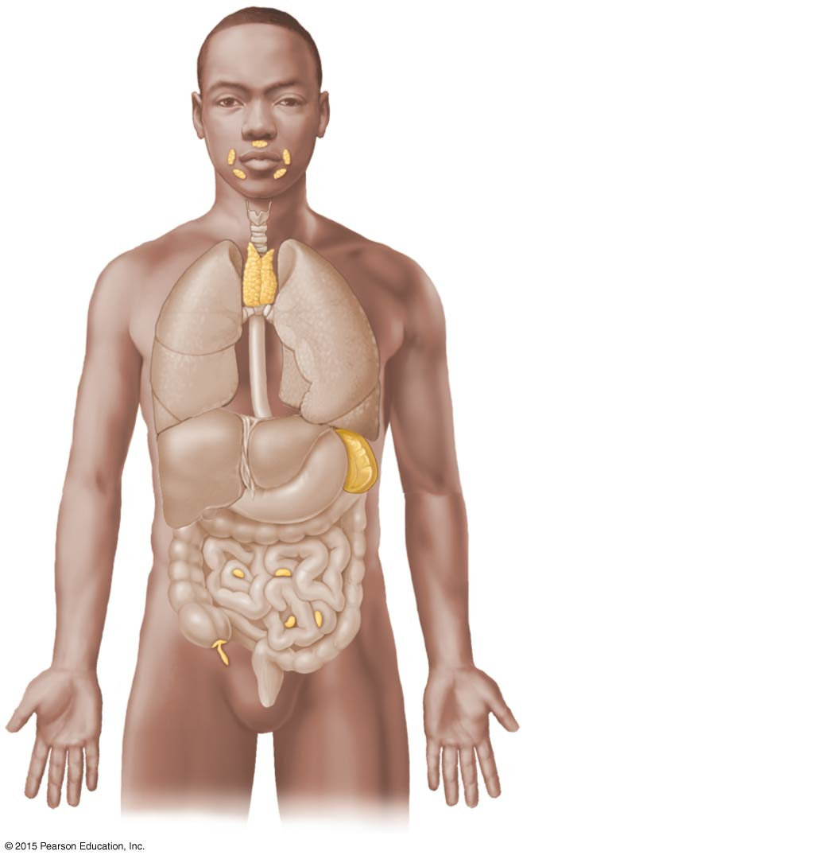
Figure 12.5 Lymphoid organs.
Tonsils (in
pharyngeal region)
Thymus (in thorax;
most active during
youth)
Spleen (curves
around left side of
stomach)
Peyer’s patches
(in intestine)
Appendix

Slide 21
Spleen
Located on the left side of the abdomen
Filters blood
Destroys worn-out blood cells
Forms blood cells in the fetus
Acts as a blood reservoir

Slide 22
Thymus Gland
Located low in the throat, overlying the heart
Functions at peak levels only during childhood
Produces hormones (such as thymosin) to program lymphocytes

Slide 23
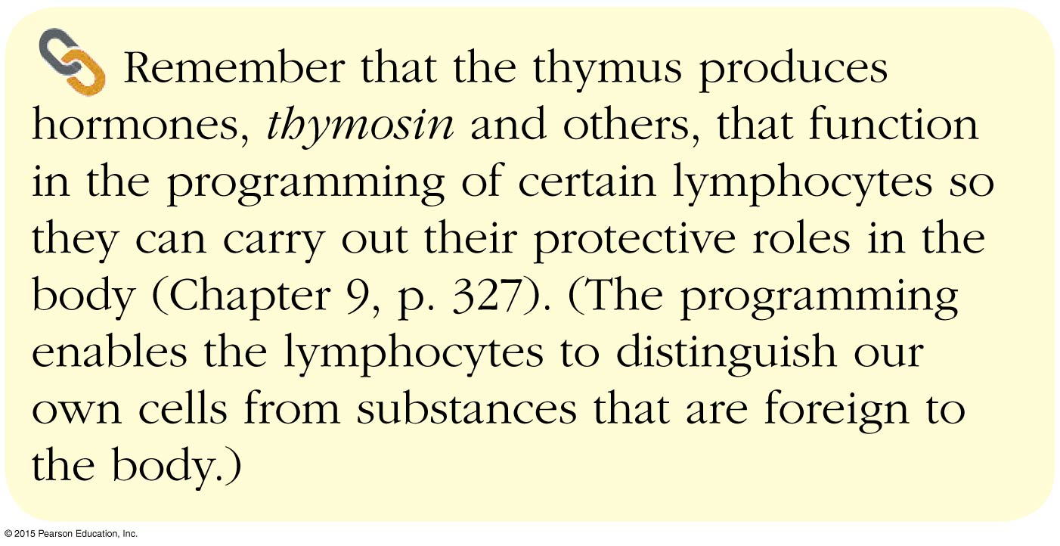
Concept Link

Slide 24
Tonsils
Small masses of lymphoid tissue around the pharynx
Trap and remove bacteria and other foreign materials
Tonsillitis is caused by congestion with bacteria

Slide 25
Peyer’s Patches
Found in the wall of the small intestine and appendix
Resemble tonsils in structure
Capture and destroy bacteria in the intestine

Slide 26
Mucosa-Associated Lymphoid Tissue (MALT)
Includes
Peyer’s patches
Tonsils
Other small accumulations of lymphoid tissue
Acts as a sentinel to protect respiratory and digestive tracts

Slide 27
Part II: Body Defenses
The body is constantly in contact with bacteria, fungi, and viruses
The body has two defense systems for foreign materials that form the immune system:
Innate (nonspecific) defense system
Adaptive (specific) defense system
Immunity—specific resistance to disease

Slide 28
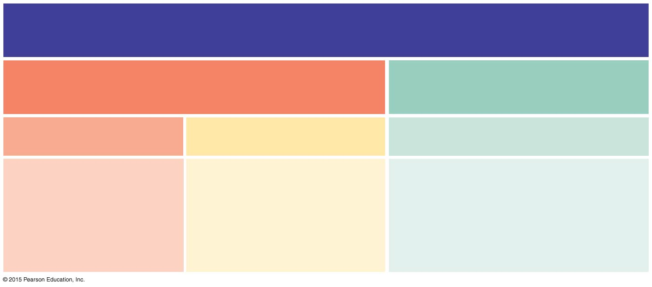
Figure 12.6 An overview of the body’s defenses.
The Immune System
Innate (nonspecific) defense mechanisms
Adaptive (specific) defense
mechanisms
First line of defense
Second line of defense
Third line of defense
• Skin
• Mucous membranes
• Secretions of skin
and mucous
membranes
• Phagocytic cells
• Natural killer cells
• Antimicrobial proteins
• The inflammatory
response
• Lymphocytes
• Antibodies
• Macrophages and other
antigen-presenting cells

Slide 29
Body Defenses
Innate (nonspecific) defense system
Mechanisms protect against a variety of invaders
Responds immediately to protect body from foreign materials
Adaptive (specific) defense system
Specific defense is required for each type of invader

Slide 30
Innate (Nonspecific) Body Defenses
Innate body defenses are mechanical barriers to pathogens (harmful or disease-causing microorganisms) and include:
Body surface coverings
Intact skin
Mucous membranes
Specialized human cells
Chemicals produced by the body
Table 12.1 provides a more detailed summary

Slide 31
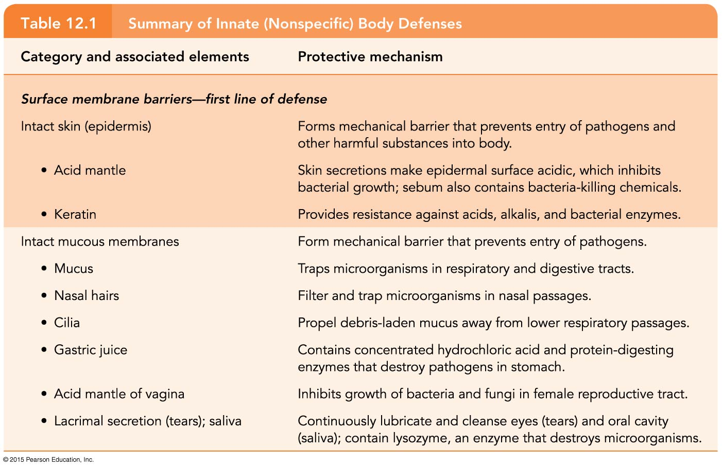
Table 12.1 Summary of Innate (Nonspecific) Body Defenses (1 of 3).

Slide 32
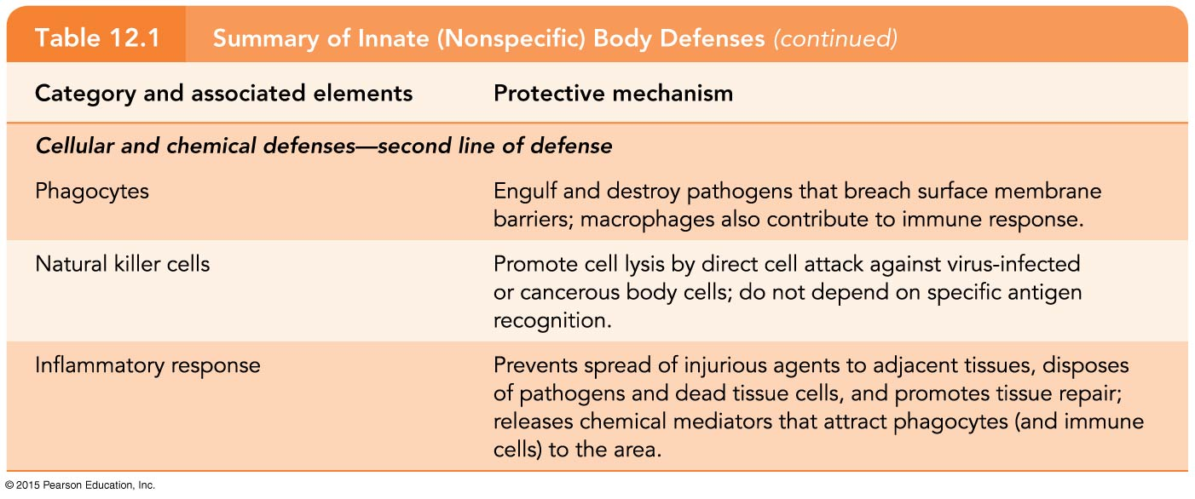
Table 12.1 Summary of Innate (Nonspecific) Body Defenses (2 of 3).

Slide 33
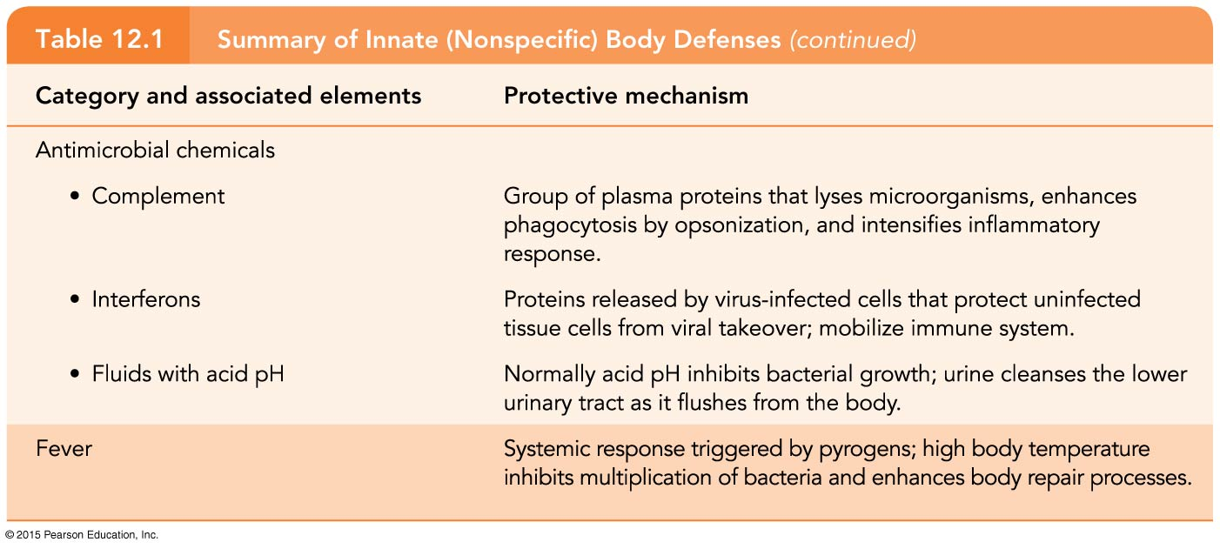
Table 12.1 Summary of Innate (Nonspecific) Body Defenses (3 of 3).

Slide 34
Surface Membrane Barriers
Surface membrane barriers provide the first line of defense against the invasion of microorganisms
Skin and mucous membranes
Physical barrier to foreign materials
Also provide protective secretions
Acidic pH of the skin inhibits bacterial growth
Sebum is toxic to bacteria
Vaginal secretions are very acidic

Slide 35
Surface Membrane Barriers
Stomach mucosa has secretions that kill pathogens
Secretes hydrochloric acid
Has protein-digesting enzymes
Saliva and lacrimal fluid contain lysozyme, an enzyme that destroys bacteria
Mucus traps microogranisms in digestive and respiratory pathways

Slide 36
Internal Defenses: Cells and Chemicals
Cells and chemicals provide a second line of defense
Natural killer cells
Inflammatory response
Phagocytes
Antimicrobial proteins
Fever

Slide 37
Natural Killer (NK) Cells
Can lyse (disintegrate or dissolve) and kill cancer cells, virus-infected cells
Release a chemical called perforin to target the cell’s membrane and nucleus, causing disintegration

Slide 38
Inflammatory Response
Triggered when body tissues are injured
Four most common indicators of acute inflammation:
Redness
Heat
Swelling
Pain

Slide 39
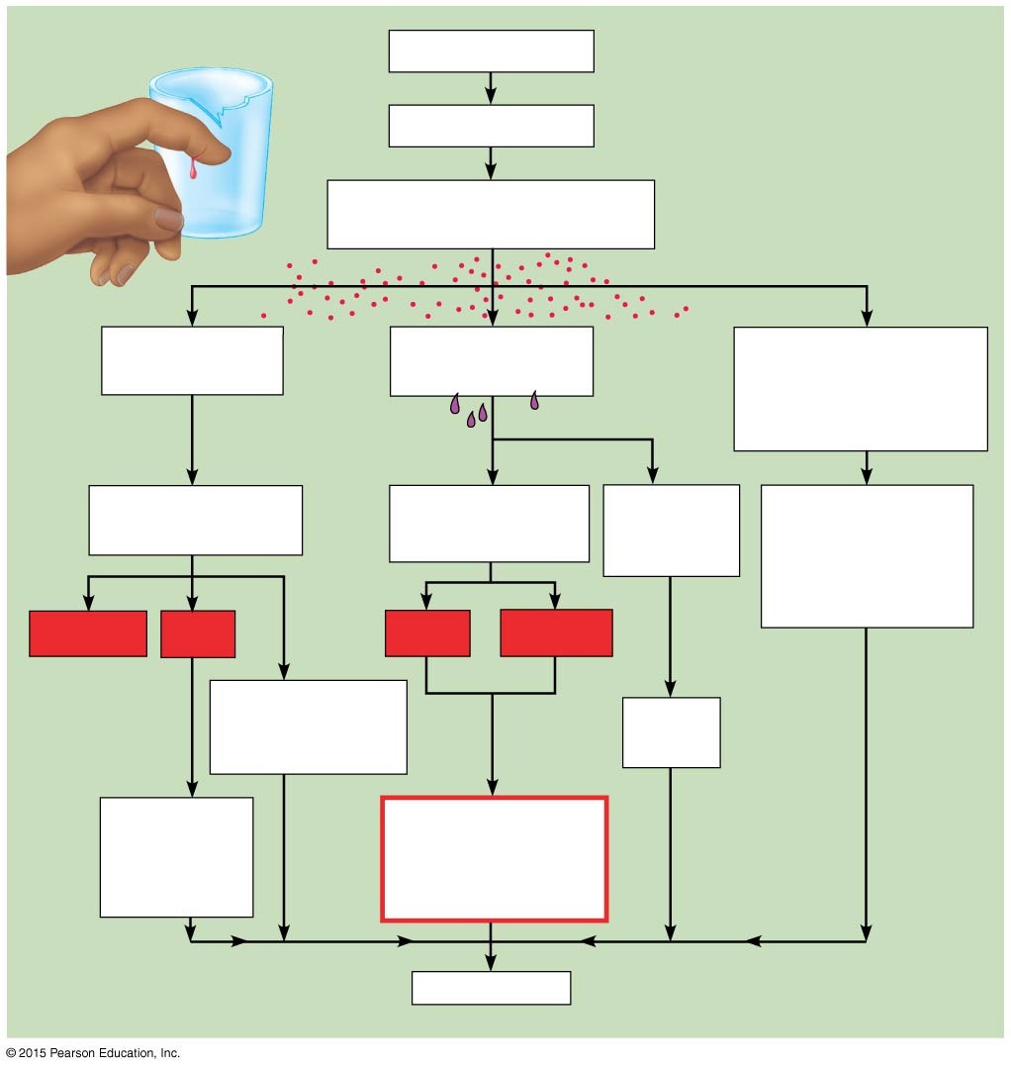
Figure 12.7 Flowchart of inflammatory events.
Injurious agents
Cells damaged
Release kinins, histamine,
and other chemicals
Blood vessels
dilate
Capillaries
become “leaky”
Neutrophils and
then monocytes
(and other WBCs)
enter area
Increased blood
flow into area
Edema (fluid in
tissue spaces)
Clotting
proteins
enter area
Removal of
damaged/dead
tissue cells and
pathogens
from area
Redness
Heat
Pain
Swelling
Brings more
nutrients and
oxygen to area
Fibrin
barrier
Increases
metabolic
rate of
tissue cells
Possible
temporary
limitation of
joint movement
Healing

Slide 40
Inflammatory Response
Functions of the inflammatory response:
Prevents spread of damaging agents
Disposes of cell debris and pathogens through phagocytosis
Sets the stage for repair

Slide 41
Inflammatory Response
Process of the inflammatory response:
Neutrophils migrate to the area of inflammation by rolling along the vessel wall
Neutrophils squeeze through the capillary walls by diapedesis to sites of inflammation
Neutrophils gather in the precise site of tissue injury (positive chemotaxis) and consume any foreign material present

Slide 42
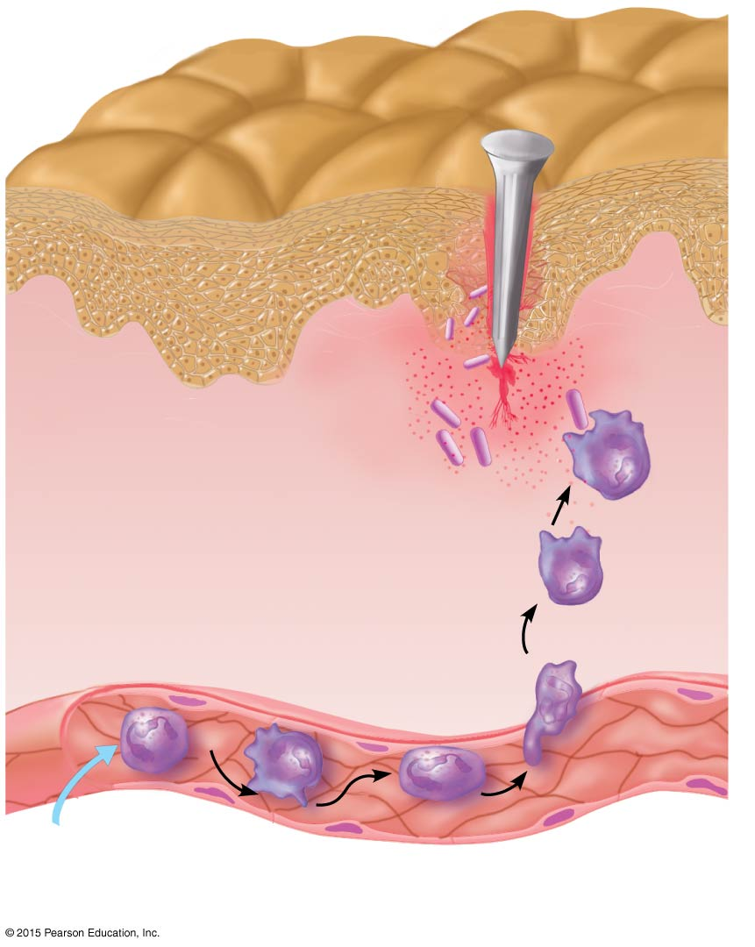
Figure 12.8 Phagocyte mobilization.
3
Positive
chemotaxis
Inflammatory
chemicals diffusing
from the inflamed
site act as chemotactic
agents
Neutrophils
1
Enter blood from bone marrow
and roll along the vessel wall
2
Diapedesis
Capillary wall
Endothelium
Basement membrane

Slide 43
Phagocytes
Cells such as neutrophils and macrophages engulf foreign material into a vacuole
Vacuole is fused with a lysosome, and enzymes from lysosomes digest the material

Slide 44
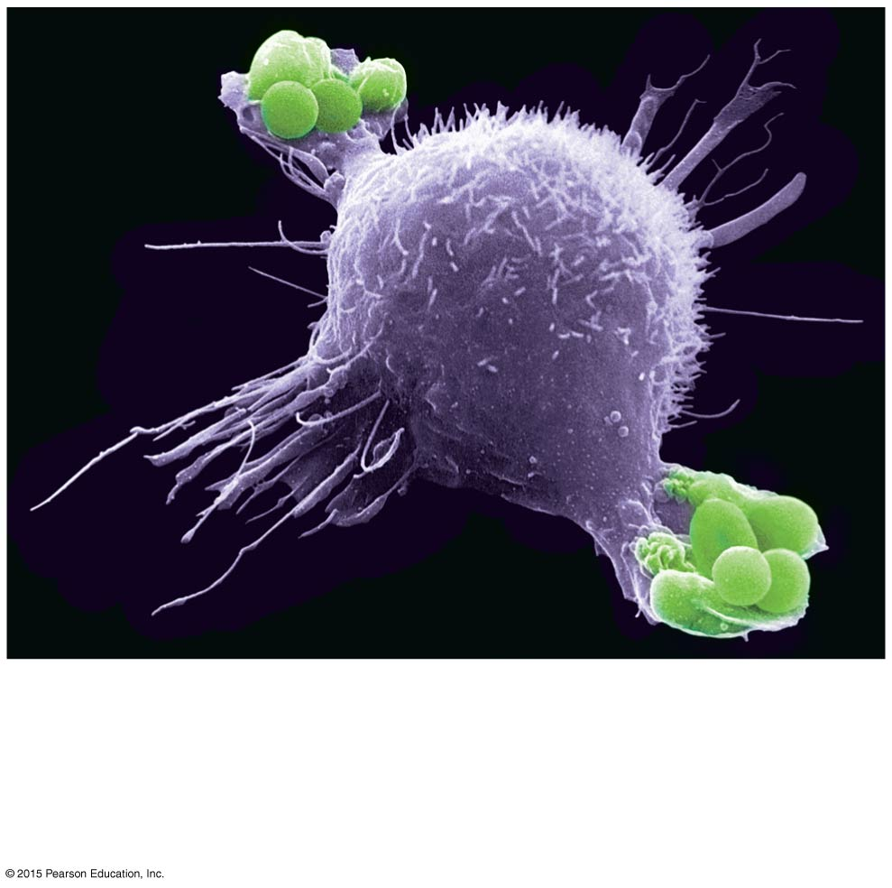
Figure 12.9a Phagocytosis by a macrophage.
(a)
A macrophage (purple) uses its
cytoplasmic extensions to pull
spherical bacteria (green) toward it.
Scanning electron micrograph (10,800×).

Slide 45
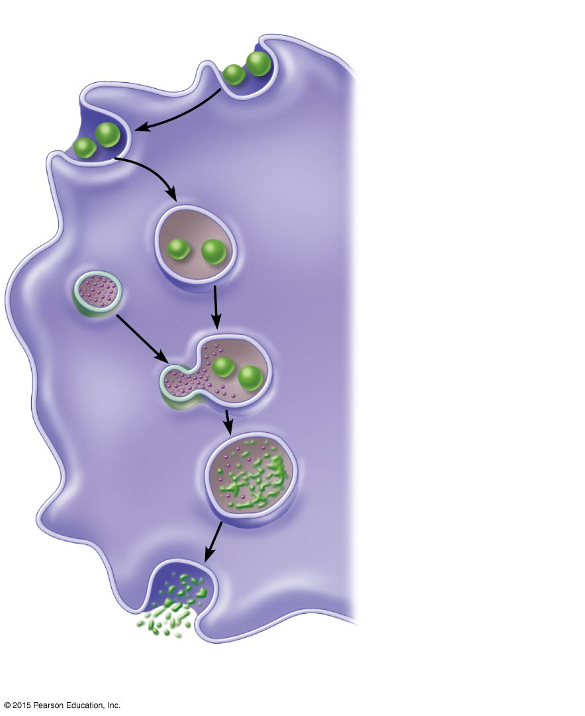
Figure 12.9b Phagocytosis by a macrophage.
Slide 1
1
Phagocyte
adheres to
pathogens.
2
Phagocyte
engulfs the
particles, forming
a phagosome.
Phagosome
(phagocytic
vesicle)
Lysosome
3
Lysosome
fuses with the
phagocytic
vesicle, forming a
phagolysosome.
Acid
hydrolase
enzymes
4
Lysosomal
enzymes digest
the pathogens or
debris, leaving a
residual body.
5
Exocytosis
of the vesicle
removes
indigestible and
residual material.
(b) Events of phagocytosis

Slide 46
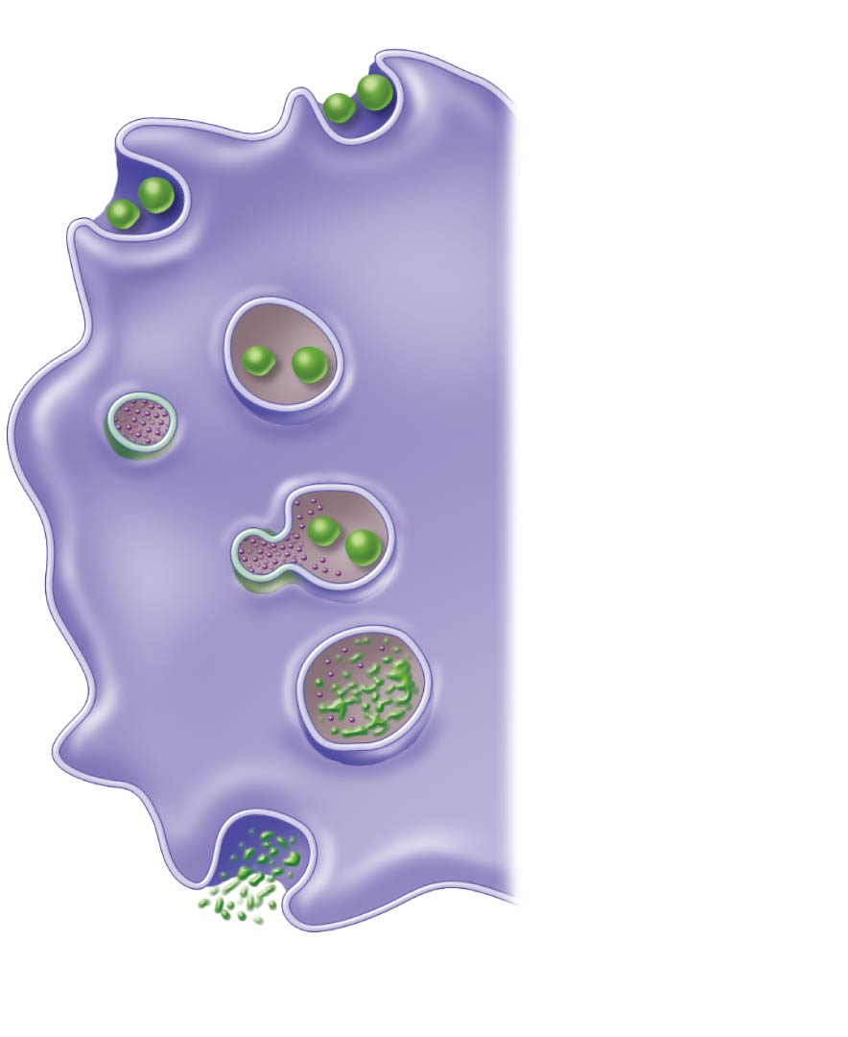
Figure 12.9b Phagocytosis by a macrophage.
Slide 2
1
Phagocyte
adheres to
pathogens.
(b) Events of phagocytosis

Slide 47
Figure 12.9b Phagocytosis by a macrophage.
Slide 3
1
Phagocyte
adheres to
pathogens.
2
Phagocyte
engulfs the
particles, forming
a phagosome.
Phagosome
(phagocytic
vesicle)
(b) Events of phagocytosis

Slide 48
Figure 12.9b Phagocytosis by a macrophage.
Slide 4
1
Phagocyte
adheres to
pathogens.
2
Phagocyte
engulfs the
particles, forming
a phagosome.
Phagosome
(phagocytic
vesicle)
Lysosome
3
Lysosome
fuses with the
phagocytic
vesicle, forming a
phagolysosome.
Acid
hydrolase
enzymes
(b) Events of phagocytosis

Slide 49
Figure 12.9b Phagocytosis by a macrophage.
Slide 5
1
Phagocyte
adheres to
pathogens.
2
Phagocyte
engulfs the
particles, forming
a phagosome.
Phagosome
(phagocytic
vesicle)
Lysosome
3
Lysosome
fuses with the
phagocytic
vesicle, forming a
phagolysosome.
Acid
hydrolase
enzymes
4
Lysosomal
enzymes digest
the pathogens or
debris, leaving a
residual body.
(b) Events of phagocytosis

Slide 50
Figure 12.9b Phagocytosis by a macrophage.
Slide 6
1
Phagocyte
adheres to
pathogens.
2
Phagocyte
engulfs the
particles, forming
a phagosome.
Phagosome
(phagocytic
vesicle)
Lysosome
3
Lysosome
fuses with the
phagocytic
vesicle, forming a
phagolysosome.
Acid
hydrolase
enzymes
4
Lysosomal
enzymes digest
the pathogens or
debris, leaving a
residual body.
5
Exocytosis
of the vesicle
removes
indigestible and
residual material.
(b) Events of phagocytosis

Slide 51
Antimicrobial Proteins
Enhance innate defenses by:
Attacking microorganisms directly
Hindering reproduction of microorganisms
Most important types are:
Complement proteins
Interferon

Slide 52
Complement Proteins
Complement refers to a group of at least 20 plasma proteins
Complement is activated when these plasma proteins encounter and attach to cells (known as complement fixation)
Membrane attack complexes (MACs), one result of complement fixation, produce lesions in cells
Some molecules released are vasodilators and chemotaxis chemicals

Slide 53
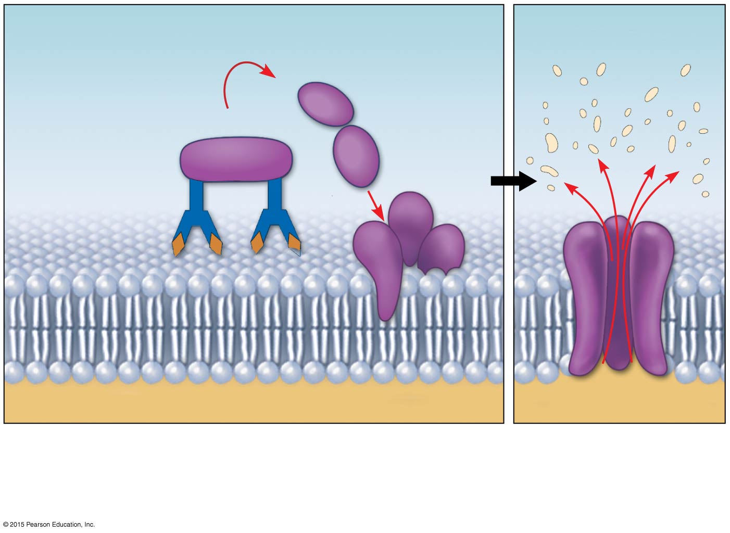
Figure 12.10 Activation of complement, resulting in lysis of a target cell.
Membrane attack
complex forming
Antibodies
attached to
pathogen’s
membrane
Pore
Activated complement proteins attach to
pathogen’s membrane in step-by-step sequence,
forming a membrane attack complex
(a MAC attack).
MAC pores in the
membrane lead to
fluid flows that cause
cell lysis.

Slide 54
Interferon
Proteins secreted by virus-infected cells
Interferons bind to membrane receptors on healthy cell surfaces to interfere with the ability of viruses to multiply

Slide 55
Fever
Abnormally high body temperature is a systemic response to invasion by microorganisms
Hypothalamus thermostat can be reset higher by pyrogens (secreted by white blood cells)
High temperatures inhibit the release of iron and zinc (needed by bacteria) from the liver and spleen
Fever also increases the speed of repair processes

Slide 56
Adaptive Body Defenses
Adaptive body defenses are the body’s specific defense system, or the third line of defense
Immune response is the immune system’s response to a threat
Immunology is the study of immunity
Antibodies are proteins that protect from pathogens
Notes:
56

Slide 57
Adaptive Body Defenses
Three aspects of adaptive defense:
Antigen specific—recognizes and acts against particular foreign substances
Systemic—not restricted to the initial infection site
Memory—recognizes and mounts a stronger attack on previously encountered pathogens
Notes:
57

Slide 58
Adaptive Body Defenses
Types of immunity
Humoral immunity = antibody-mediated immunity
Provided by antibodies present in body fluids
Cellular immunity = cell-mediated immunity
Targets virus-infected cells, cancer cells, and cells of foreign grafts
Notes:
58

Slide 59
Antigens
Antigens (nonself)
Any substance capable of exciting the immune system and provoking an immune response
Examples of common antigens:
Foreign proteins (strongest)
Nucleic acids
Large carbohydrates
Some lipids
Pollen grains
Microorganisms
Notes:
59

Slide 60
Antigens
Self-antigens
Human cells have many surface proteins
Our immune cells do not attack our own proteins
The presence of our cells in another person’s body can trigger an immune response because they are foreign
Restricts donors for transplants
Notes:
60

Slide 61
Concept Link

Slide 62
Antigens
Many small molecules (called haptens or incomplete antigens) are not antigenic, but link up with our own proteins
The immune system may recognize and respond to a protein-hapten combination
The immune response is harmful rather than protective because it attacks our own cells
Notes:
62

Slide 63
Cells of the Adaptive Defense System: An Overview
Crucial cells of the adaptive system:
Lymphocytes—respond to specific antigens:
B lymphocytes (B cells)
T lymphocytes (T cells)
Antigen-presenting cells (APCs)—help the lymphocytes, but do not respond to specific antigens
Notes:
63

Slide 64
Lymphocytes
Lymphocytes arise from hemocytoblasts of bone marrow
T cells develop immunocompetence in the thymus and oversee cell-mediated immunity
B cells develop immunocompetence in bone marrow and provide humoral immunity
Notes:
64

Slide 65
Lymphocytes
Immunocompetent lymphocytes seed lymphoid organs, where antigen challenge occurs, and circulate through blood, lymph, and lymphoid organs
Immunocompetence is signaled by the appearance of antigen-specific receptors on surfaces of lymphocytes

Slide 66
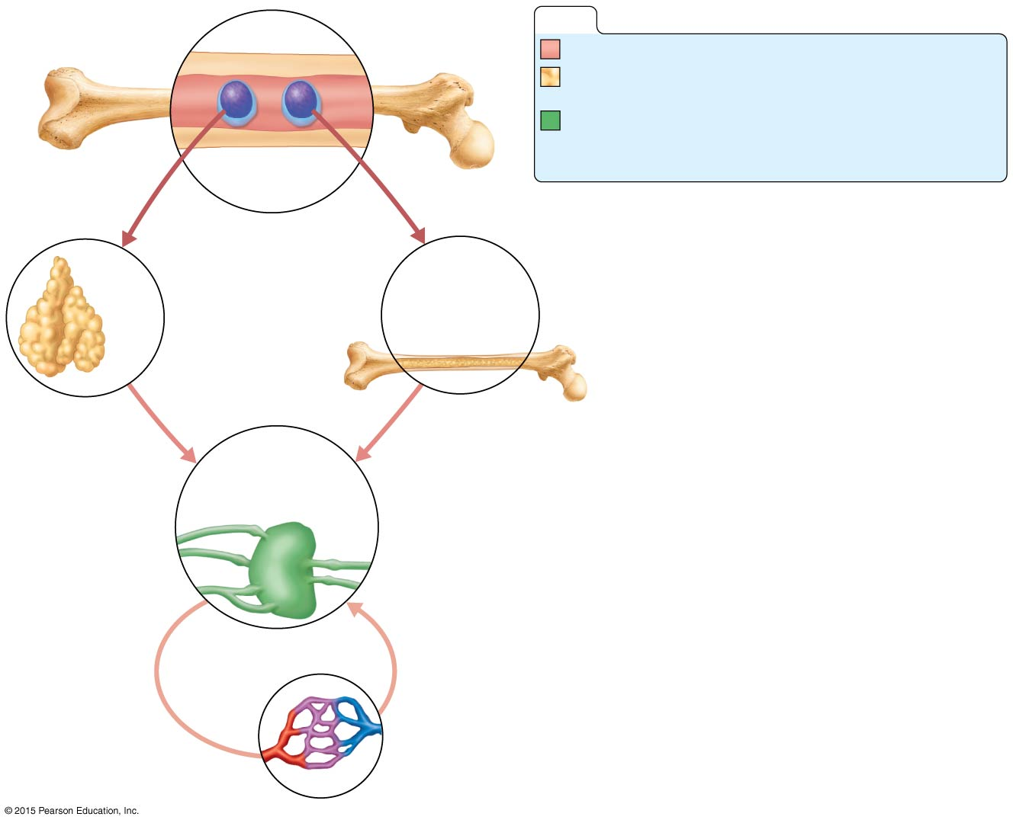
Figure 12.11 Lymphocyte differentiation and activation.
Slide 1
Red
bone marrow
KEY:
Red bone marrow: site of lymphocyte origin
Primary lymphoid organs: sites of development
of immunocompetence as B or T cells
Secondary lymphoid organs: sites of antigen
encounter, and activation to become effector
and memory B or T cells
Immature (naive)
lymphocytes
1
Lymphocytes destined to become T cells
migrate (in blood) to the thymus and develop
immunocompetence there. B cells develop
immunocompetence in red bone marrow.
Thymus
Bone marrow
2
Immunocompetent but still naive
lymphocytes leave the thymus and bone
marrow. They “seed” the lymph nodes,
spleen, and other lymphoid tissues, where
they encounter their antigen and become
activated.
Lymph nodes,
spleen, and other
lymphoid tissues
3
Antigen-activated (mature)
immunocompetent lymphocytes (effector
cells and memory cells) circulate
continuously in the bloodstream and
lymph and throughout the lymphoid
organs of the body.

Slide 67
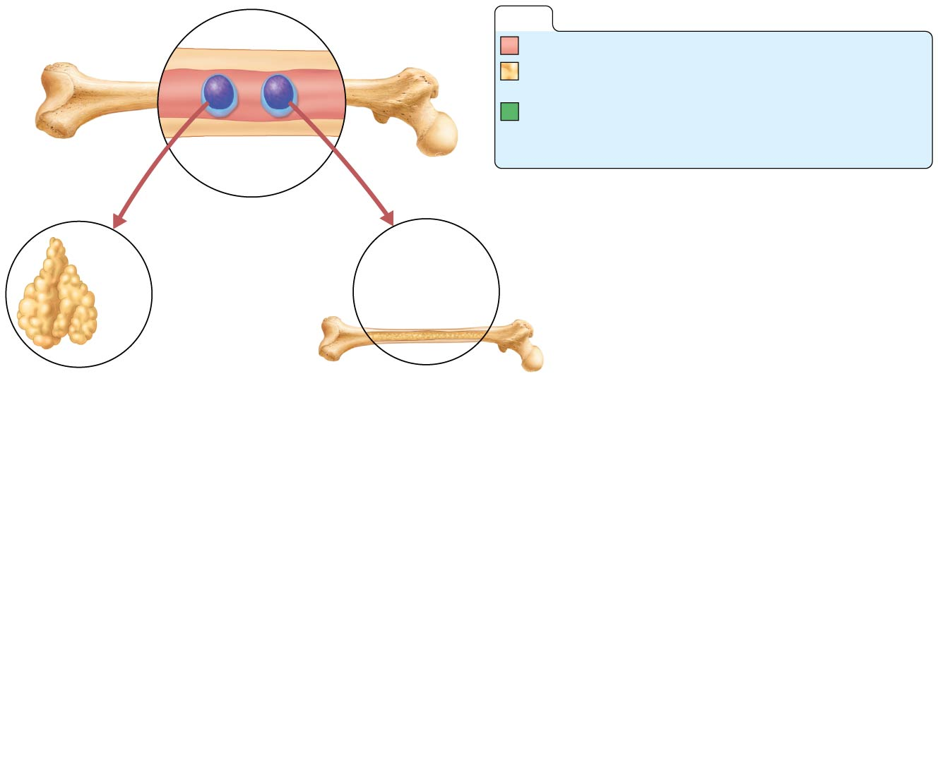
Figure 12.11 Lymphocyte differentiation and activation.
Slide 2
Red
bone marrow
KEY:
Red bone marrow: site of lymphocyte origin
Primary lymphoid organs: sites of development
of immunocompetence as B or T cells
Secondary lymphoid organs: sites of antigen
encounter, and activation to become effector
and memory B or T cells
Immature (naive)
lymphocytes
1
Lymphocytes destined to become T cells
migrate (in blood) to the thymus and develop
immunocompetence there. B cells develop
immunocompetence in red bone marrow.
Thymus
Bone marrow

Slide 68
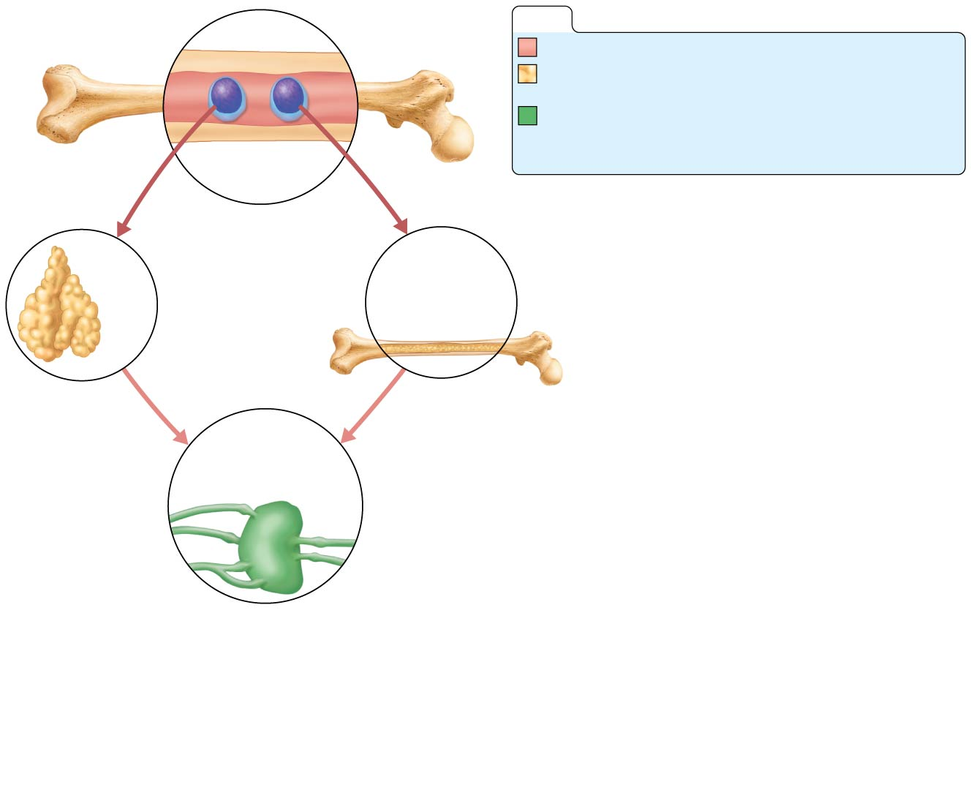
Figure 12.11 Lymphocyte differentiation and activation.
Slide 3
Red
bone marrow
KEY:
Red bone marrow: site of lymphocyte origin
Primary lymphoid organs: sites of development
of immunocompetence as B or T cells
Secondary lymphoid organs: sites of antigen
encounter, and activation to become effector
and memory B or T cells
Immature (naive)
lymphocytes
1
Lymphocytes destined to become T cells
migrate (in blood) to the thymus and develop
immunocompetence there. B cells develop
immunocompetence in red bone marrow.
Thymus
Bone marrow
2
Immunocompetent but still naive
lymphocytes leave the thymus and bone
marrow. They “seed” the lymph nodes,
spleen, and other lymphoid tissues, where
they encounter their antigen and become
activated.
Lymph nodes,
spleen, and other
lymphoid tissues

Slide 69
Figure 12.11 Lymphocyte differentiation and activation.
Slide 4
Red
bone marrow
KEY:
Red bone marrow: site of lymphocyte origin
Primary lymphoid organs: sites of development
of immunocompetence as B or T cells
Secondary lymphoid organs: sites of antigen
encounter, and activation to become effector
and memory B or T cells
Immature (naive)
lymphocytes
1
Lymphocytes destined to become T cells
migrate (in blood) to the thymus and develop
immunocompetence there. B cells develop
immunocompetence in red bone marrow.
Thymus
Bone marrow
2
Immunocompetent but still naive
lymphocytes leave the thymus and bone
marrow. They “seed” the lymph nodes,
spleen, and other lymphoid tissues, where
they encounter their antigen and become
activated.
Lymph nodes,
spleen, and other
lymphoid tissues
3
Antigen-activated (mature)
immunocompetent lymphocytes (effector
cells and memory cells) circulate
continuously in the bloodstream and
lymph and throughout the lymphoid
organs of the body.

Slide 70
Antigen-Presenting Cells (APCs)
Engulf antigens and then present fragments of them on their own surfaces, where they can be recognized by T cells
Major types of cells behaving as APCs:
Dendritic cells
Macrophages
B lymphocytes
When they present antigens, dendritic cells and macrophages activate T cells, which release chemicals

Slide 71
Macrophages
Arise from monocytes produced in bone marrow
Phagocytize pathogens, along with APCs, and present parts of the antigens on their surfaces, for recognition by T cells
Widely distributed in lymphoid organs and tend to remain fixed in the lymphoid organs
Secrete cytokines (proteins important in the immune response)
Notes:
71

Slide 72
Humoral (Antibody-Mediated) Immune Response
B lymphocytes with specific receptors bind to a specific antigen
The binding event activates the lymphocyte to undergo clonal selection
A large number of clones is produced (primary humoral response)
Notes:
72

Slide 73
Humoral Immune Response
Most B cells become plasma cells
Produce antibodies to destroy antigens
Activity lasts for 4 or 5 days
Some B cells become long-lived memory cells capable of mounting a rapid attack against the same antigen in subsequent meetings (secondary humoral response)
These cells provide immunological “memory”
Notes:
73

Slide 74
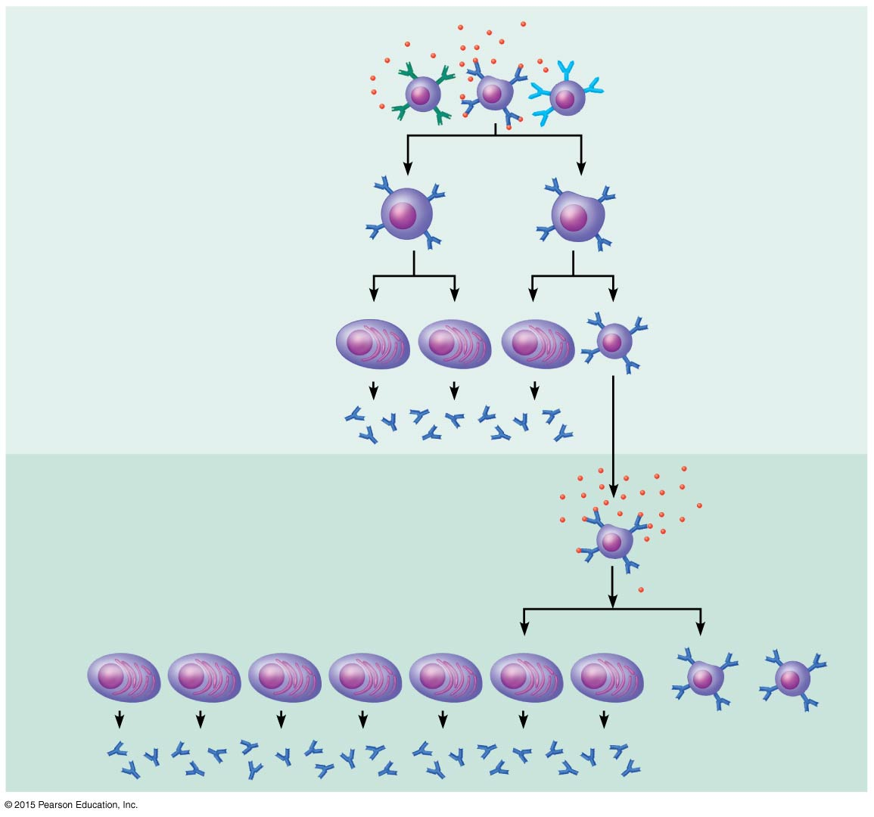
Figure 12.12 Clonal selection of a B cell.
Primary response
(initial encounter
with antigen)
Antigen
Antigen binding
to a receptor on a
specific B cell
(B cells with
non-complementary
receptors remain
inactive)
Proliferation
to form a
clone
Activated B
cells
Plasma
cells
Memory
B cell
Secreted
antibody
molecules
Secondary response
(can be years later)
Subsequent
challenge
by same
antigen results
in more rapid
response
Clone of cells
identical to
ancestral cells
Plasma
cells
Secreted
antibody
molecules
Memory
B cells

Slide 75
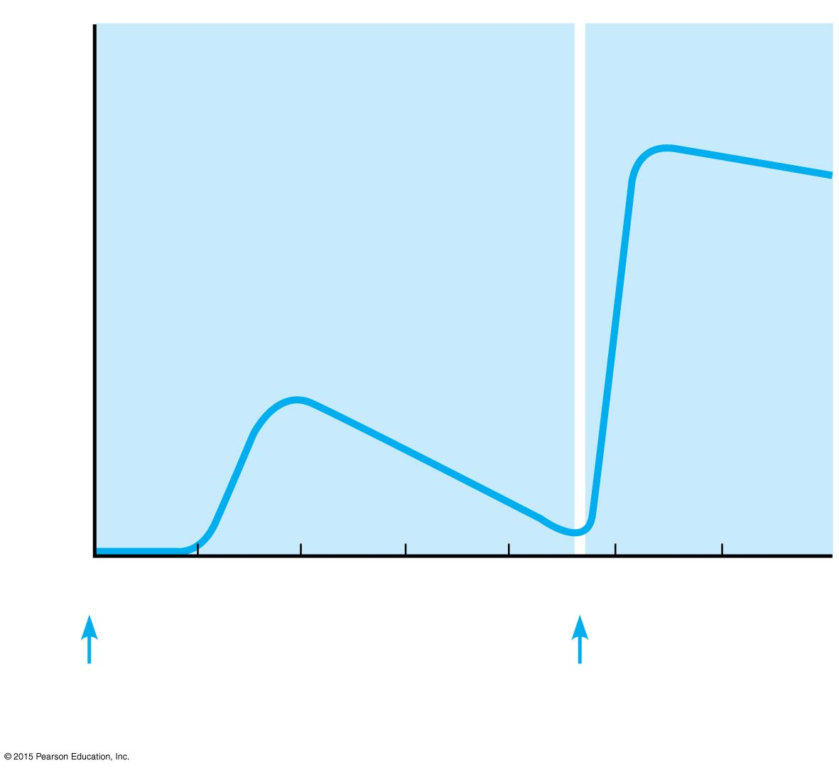
Figure 12.13 Primary and secondary humoral responses to an antigen.
Secondary
response
Relative antibody concentration
in blood plasma
Primary
response
0
1
2
3
4
5
6
Time (weeks)
Antigen
injected
Antigen
injected

Slide 76
Active and Passive Humoral Immunity
Active immunity
Occurs when B cells encounter antigens and produce antibodies
Active immunity can be:
Naturally acquired during bacterial and viral infections
Artificially acquired from vaccines
Notes:
76

Slide 77
Active and Passive Immunity
Passive immunity
Occurs when antibodies are obtained from someone else
Naturally acquired from a mother to her fetus
Artificially acquired from immune serum or gamma globulin
Immunological memory does not occur
Protection provided by “borrowed antibodies”
Notes:
77

Slide 78
Active and Passive Immunity
Monoclonal antibodies
Antibodies prepared for clinical testing for diagnostic services
Produced from descendants of a single cell line
Examples of uses for monoclonal antibodies
Diagnosis of pregnancy
Treatment after exposure to hepatitis and rabies
Notes:
78

Slide 79
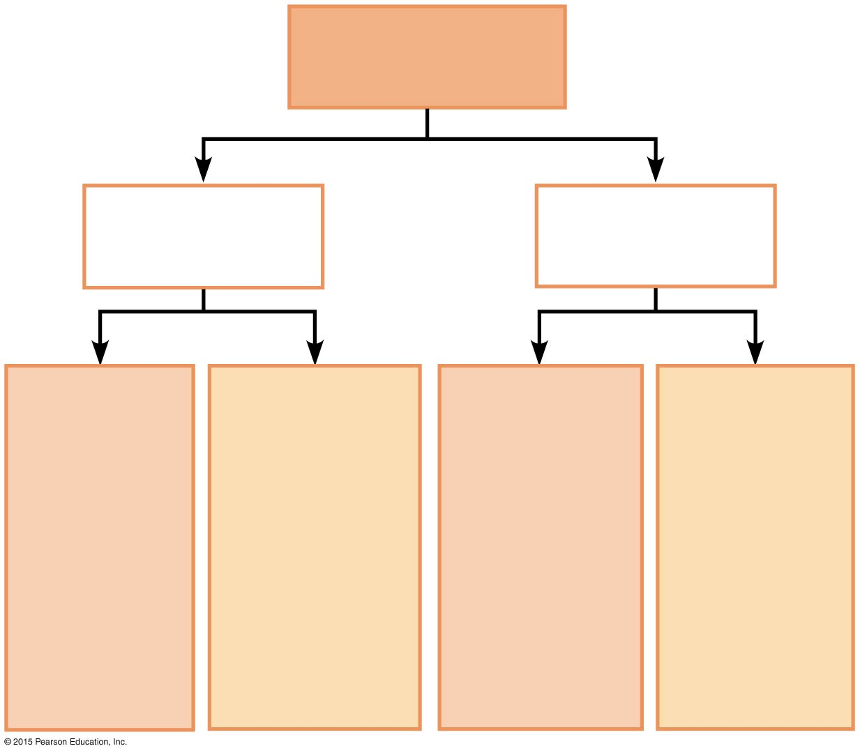
Figure 12.14 Types of acquired immunity.
Acquired
immunity
Naturally
acquired
Artificially
acquired
Active
Passive
Active
Passive
Infection;
contact
with
pathogen
Antibodies
pass from
mother to
fetus via
placenta
or to infant
in her milk
Vaccine;
dead or
attenuated
pathogens
Injection
of immune
serum
(gamma
globulin)

Slide 80
Antibodies (Immunoglobulins, or Igs)
Soluble proteins secreted by sensitized B cells (plasma cells)
Carried in blood plasma
Capable of binding specifically to an antigen
Notes:
80

Slide 81
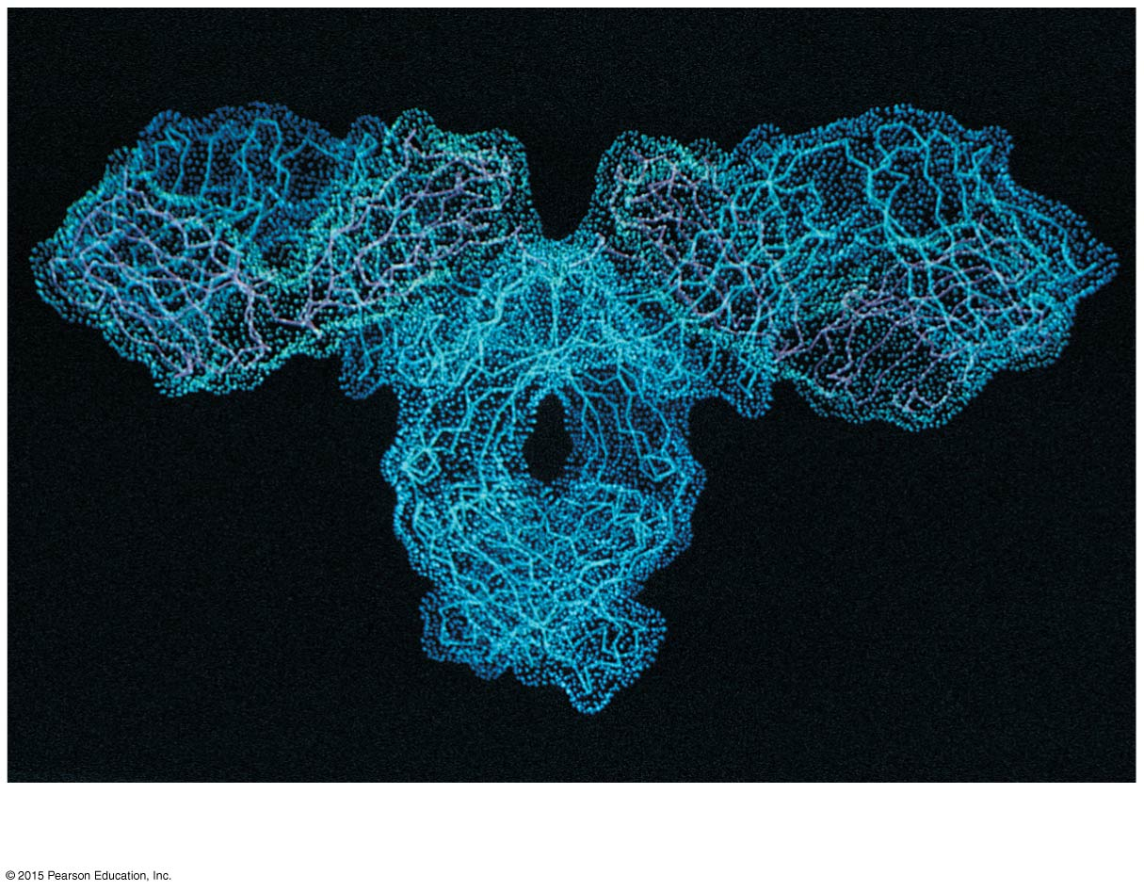
Figure 12.15a Basic antibody structure.
(a)

Slide 82
Antibodies
Antibody structure
Four amino acid chains, two heavy and two light, linked by disulfide bonds to form a T- or Y-shaped molecule
Each polypeptide chain has a variable and a constant region
Variable regions form antigen-binding sites, one on each arm of the T or Y
Constant regions determine antibody function and class
Notes:
82

Slide 83
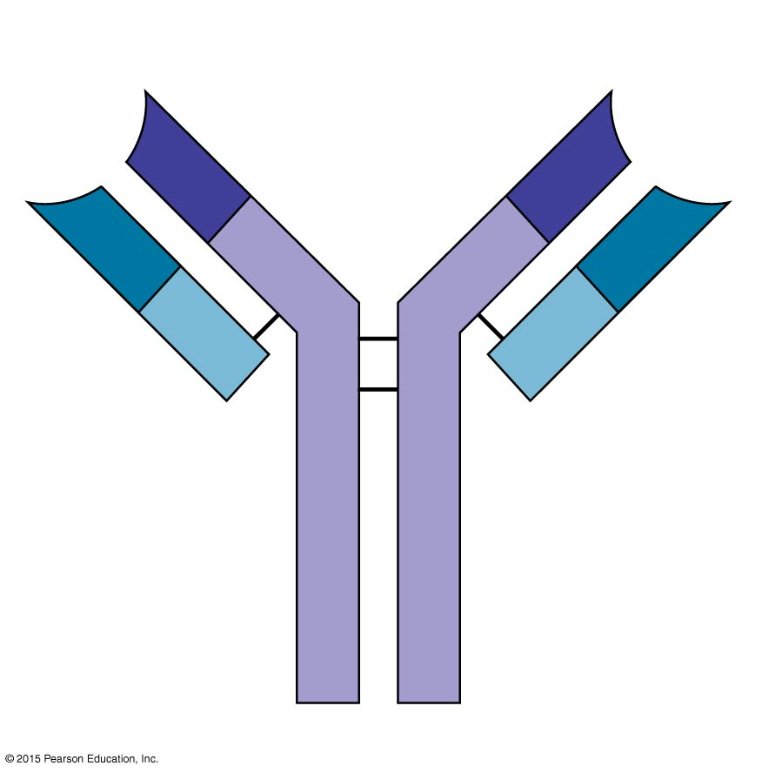
Figure 12.15b Basic antibody structure.
Antigen-binding
sites
V
V
V
V
C
C
Light
chain
Disulfide
bonds
Heavy
chain
C
C
(b)

Slide 84
Antibodies
Antibody classes
Antibodies of each class have slightly different roles and differ structurally and functionally
Five major immunoglobulin classes (MADGE):
IgM—can fix complement
IgA—found mainly in mucus
IgD—important in activation of B cell
IgG—can cross the placental barrier and fix complement
IgE—involved in allergies
Notes:
84

Slide 85
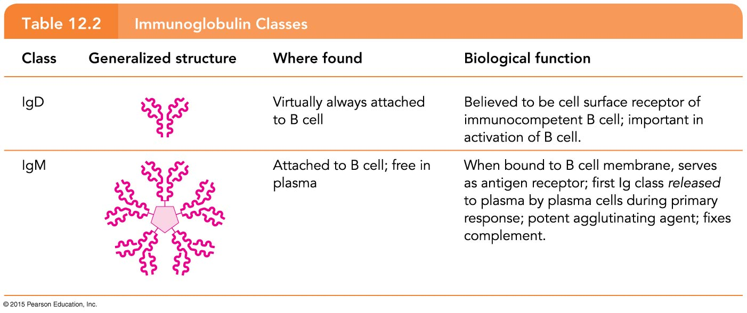
Table 12.2 Immunoglobulin Classes (1 of 2).

Slide 86
Table 12.2 Immunoglobulin Classes (2 of 2).

Slide 87
Antibody Function
Antibodies inactivate antigens in a number of ways
Complement fixation
Neutralization: antibodies bind to specific sites on bacterial exotoxins or on viruses that can cause cell injury
Agglutination: antibody-antigen reaction that causes clumping of cells
Precipitation: cross-linking reaction
Notes:
87

Slide 88
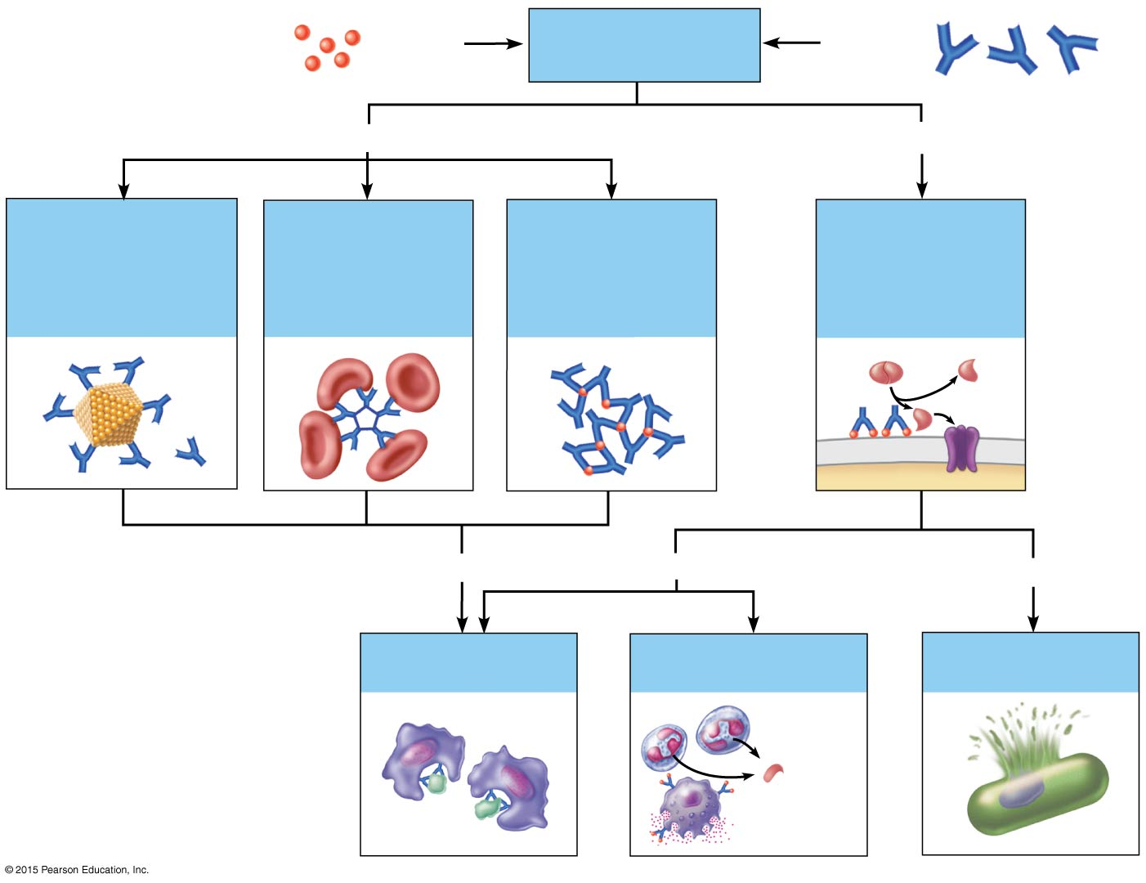
Figure 12.16 Mechanisms of antibody action.
Antigen
Antigen-antibody
complex
Antibody
Inactivates by
Fixes and activates
Neutralization
(masks dangerous
parts of bacterial
exotoxins; viruses)
Agglutination
(cell-bound
antigens)
Precipitation
(soluble
antigens)
Complement
Enhances
Enhances
Leads to
Phagocytosis
Inflammation
Cell lysis
Chemo-
taxis
Histamine
release

Slide 89
Cellular (Cell-Mediated) Immune Response
Antigens must be presented by macrophages to an immunocompetent T cell (antigen presentation)
Antigen presentation occurs as T cells are sensitized, by binding simultaneously to a nonself antigen and a self-protein displayed on the surface of a macrophage, or another type of APC
Clonal selection occurs
Clone members differentiate into effector T cells or memory T cells
Notes:
89

Slide 90
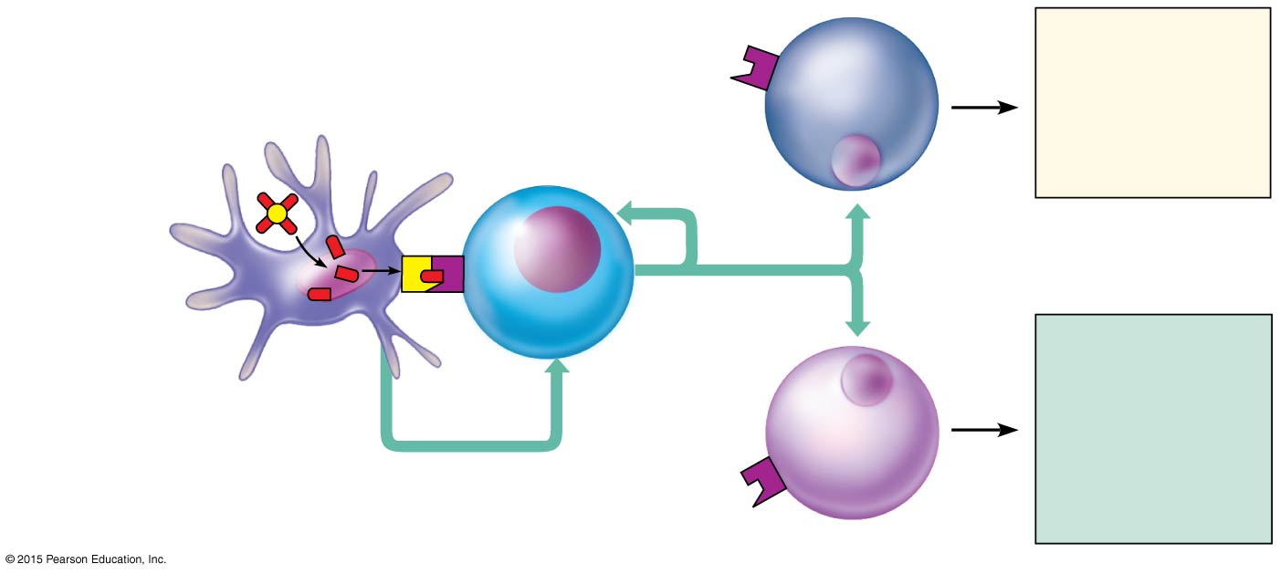
Figure 12.17 T cell activation and interactions with other cells of the immune response.
Antigen
“Presented”
antigen
Cytotoxic
(killer)
T cell
Cell-mediated
immunity
(attack on
infected cells)
T cell antigen
receptor
Dendritic
cell
Helper
T cell
Cytokines
Humoral
immunity
(secretion of
antibodies by
plasma cells)
Antigen
processing
Self-
protein
B cell
Cytokines

Slide 91
Cellular (Cell-Mediated) Immune Response
T cell clones
Cytotoxic (killer) T cells
Specialize in killing infected cells
Insert a toxic chemical (perforin)
Notes:
91

Slide 92
Cellular (Cell-Mediated) Immune Response
T cell clones: helper T cells
Recruit other cells to fight invaders
Interact directly with B cells bound to an antigen
Release cytokines, chemicals that enhance the killing activity of macrophages
Attract other leukocytes into the area
Stimulate B cells and cytotoxic T cells to grow and divide
Notes:
92

Slide 93
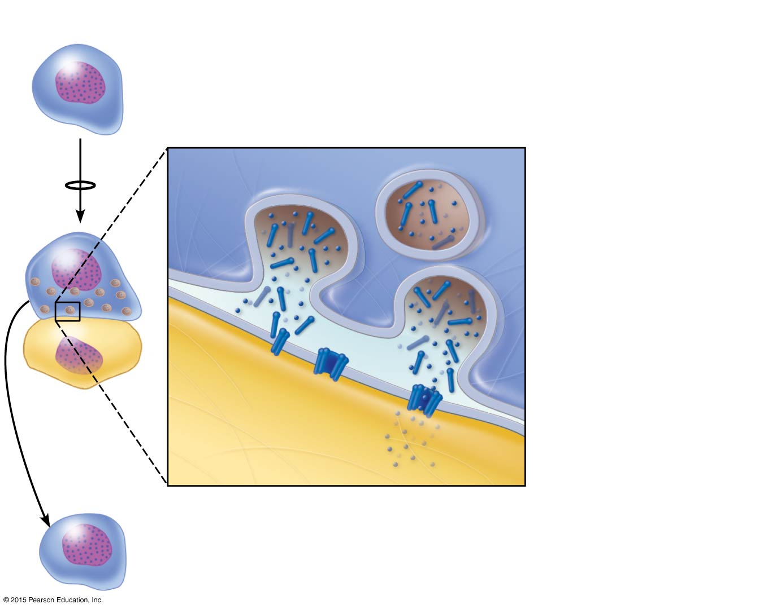
Figure 12.18 A proposed mechanism by which cytotoxic T cells kill target cells.
Slide 1
Cytotoxic
T cell
1
2
Cytotoxic T cell
binds tightly to the
foreign target cell.
Cytotoxic T cell
releases perforin and
granzyme molecules from
its granules by exocytosis.
Granule
3
Perforin
Perforin molecules
insert into the target
cell membrane and
form pores similar to
those produced by
complement activation.
T_{C} cell
membrane
Target
cell
membrane
4
Granzymes enter
the target cell via the
pores and degrade
cellular contents.
Target
cell
Perforin
pore
Granzymes
5
The cytotoxic T cell detaches
and searches for another prey.

Slide 94
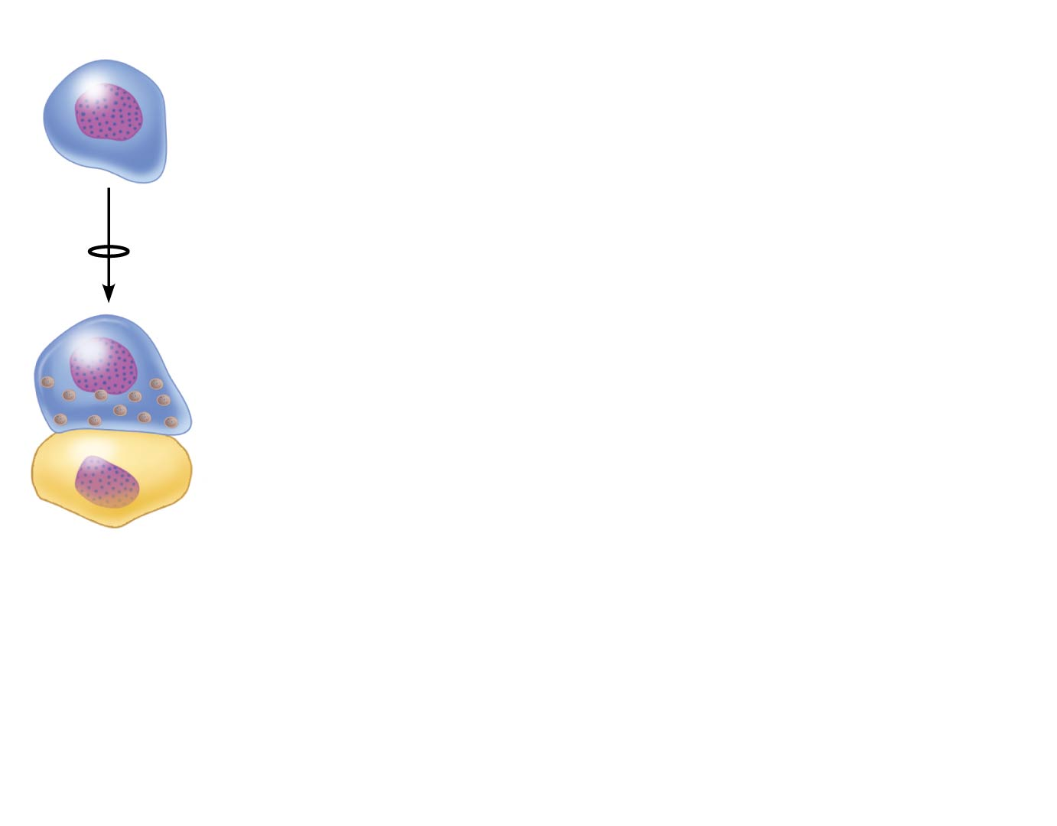
Figure 12.18 A proposed mechanism by which cytotoxic T cells kill target cells.
Slide 2
Cytotoxic
T cell
1
Cytotoxic T cell
binds tightly to the
foreign target cell.
Target
cell

Slide 95
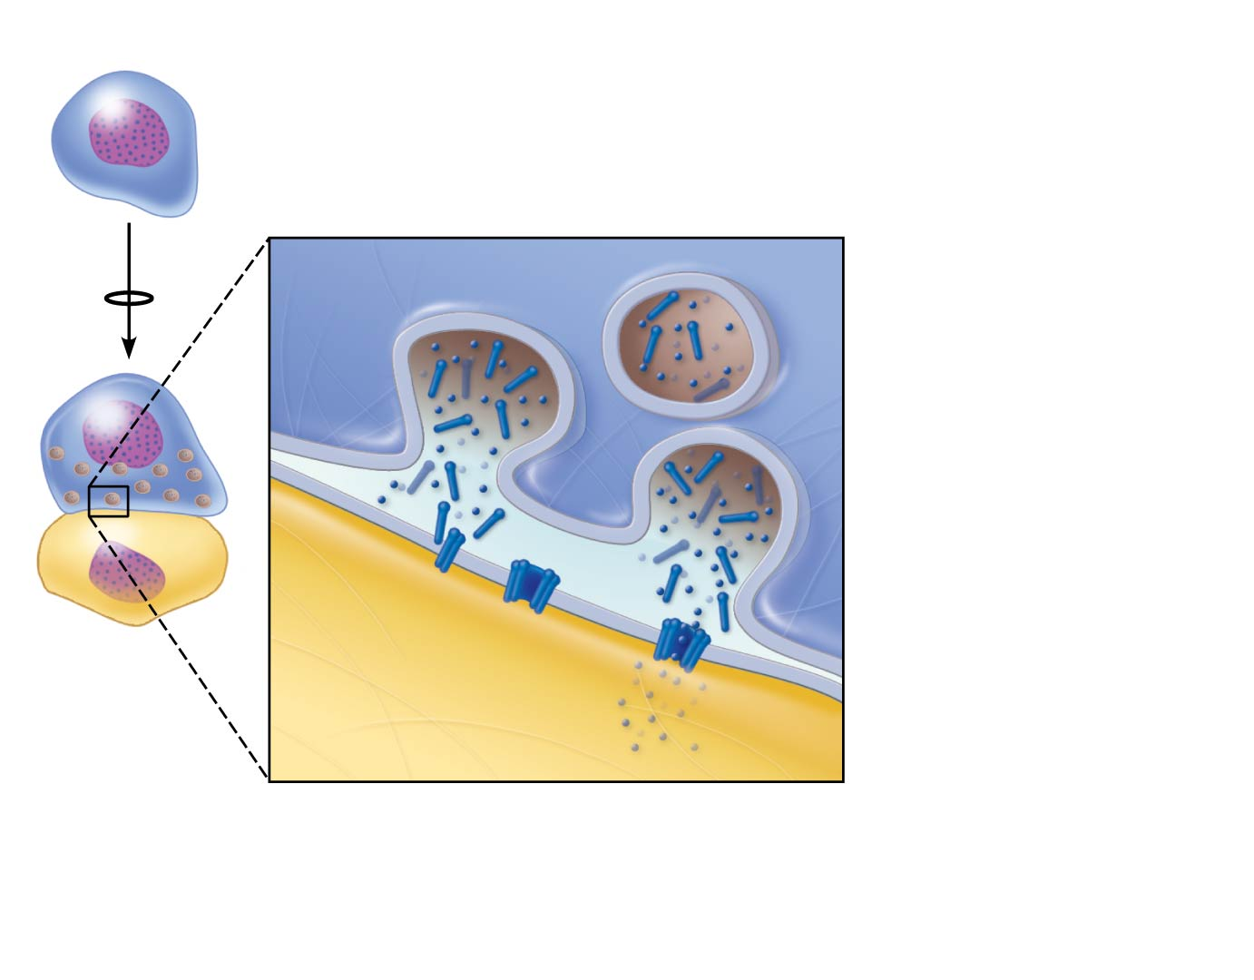
Figure 12.18 A proposed mechanism by which cytotoxic T cells kill target cells.
Slide 3
Cytotoxic
T cell
1
2
Cytotoxic T cell
binds tightly to the
foreign target cell.
Cytotoxic T cell
releases perforin and
granzyme molecules from
its granules by exocytosis.
Perforin
Granule
T_{C} cell
membrane
Target
cell
membrane
Target
cell

Slide 96
Figure 12.18 A proposed mechanism by which cytotoxic T cells kill target cells.
Slide 4
Cytotoxic
T cell
1
2
Cytotoxic T cell
binds tightly to the
foreign target cell.
Cytotoxic T cell
releases perforin and
granzyme molecules from
its granules by exocytosis.
Granule
3
Perforin
Perforin molecules
insert into the target
cell membrane and
form pores similar to
those produced by
complement activation.
T_{C} cell
membrane
Target
cell
membrane
Target
cell
Perforin
pore

Slide 97
Figure 12.18 A proposed mechanism by which cytotoxic T cells kill target cells.
Slide 5
Cytotoxic
T cell
1
2
Cytotoxic T cell
binds tightly to the
foreign target cell.
Cytotoxic T cell
releases perforin and
granzyme molecules from
its granules by exocytosis.
Granule
3
Perforin
Perforin molecules
insert into the target
cell membrane and
form pores similar to
those produced by
complement activation.
T_{C} cell
membrane
Target
cell
membrane
4
Granzymes enter
the target cell via the
pores and degrade
cellular contents.
Target
cell
Perforin
pore
Granzymes

Slide 98
Figure 12.18 A proposed mechanism by which cytotoxic T cells kill target cells.
Slide 6
Cytotoxic
T cell
1
2
Cytotoxic T cell
binds tightly to the
foreign target cell.
Cytotoxic T cell
releases perforin and
granzyme molecules from
its granules by exocytosis.
Granule
3
Perforin
Perforin molecules
insert into the target
cell membrane and
form pores similar to
those produced by
complement activation.
T_{C} cell
membrane
Target
cell
membrane
4
Granzymes enter
the target cell via the
pores and degrade
cellular contents.
Target
cell
Perforin
pore
Granzymes
5
The cytotoxic T cell detaches
and searches for another prey.

Slide 99
Cellular (Cell-Mediated) Immune Response
T cell clones: regulatory T cells
Release chemicals to suppress the activity of T and B cells
Stop the immune response to prevent uncontrolled activity
A few members of each clone are memory cells
A summary of cells and molecules follows (Table 12.3)
Notes:
99

Slide 100
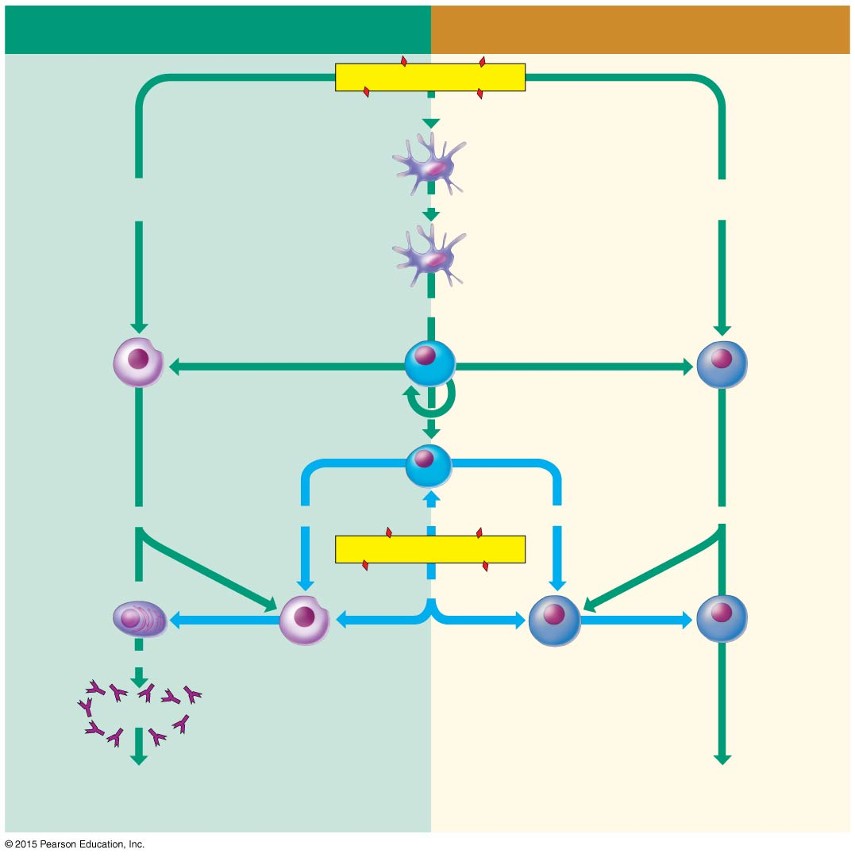
Figure 12.19 A summary of the adaptive immune responses.
HUMORAL (ANTIBODY-MEDIATED) ADAPTIVE
IMMUNE RESPONSE
CELLULAR (CELL-MEDIATED) ADAPTIVE
IMMUNE RESPONSE
Antigen (1st exposure)
Engulfed by
Macrophage
Free antigens
directly activate
Becomes
Antigens displayed by
infected cells activate
Antigen-
presenting
cell
Stimulates
Cytotoxic
T cell
B cell
Stimulates
Helper
Stimulates
T cell
Memory
T cell
Gives rise to
Stimulates
Stimulates
Stimulates
Gives rise to
Antigen (2nd exposure)
Active
cytotoxic
T cells
Stimulates
Plasma
cells
Secrete
Memory
B cells
Memory
T cells
Antibodies
Defend against extracellular pathogens by
binding to antigens and making them easier
targets for phagocytes and complement.
Defend against intracellular pathogens and
cancer by binding to and lysing the infected
cells or cancer cells.

Slide 101
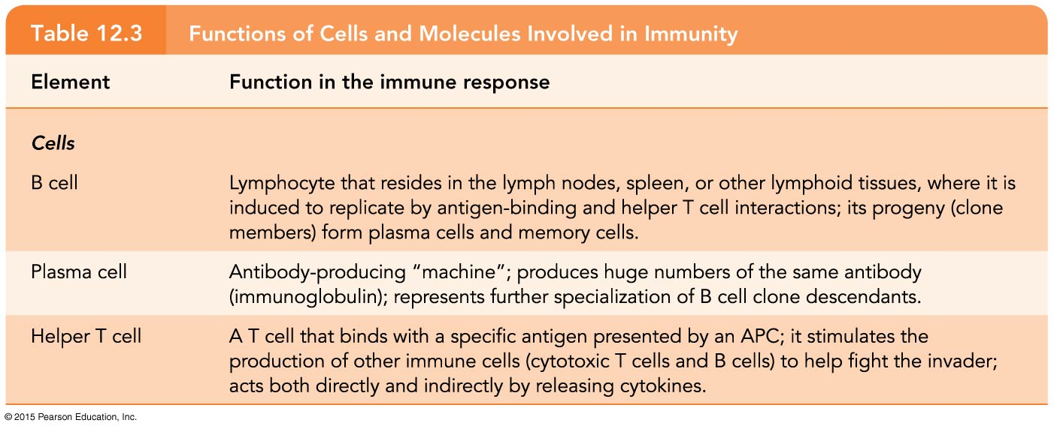
Table 12.3 Functions of Cells and Molecules Involved in Immunity (1 of 4).

Slide 102
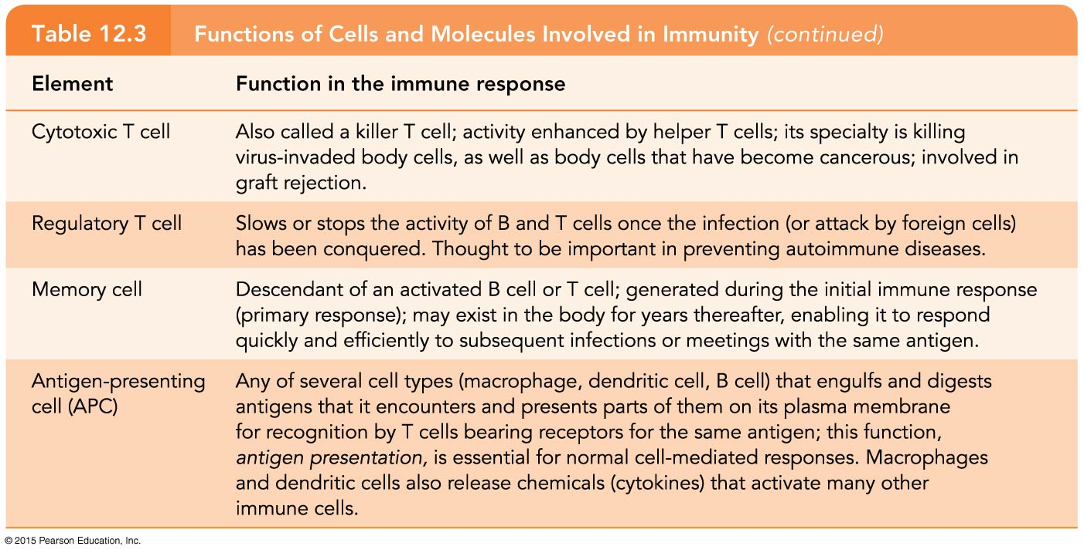
Table 12.3 Functions of Cells and Molecules Involved in Immunity (2 of 4).

Slide 103
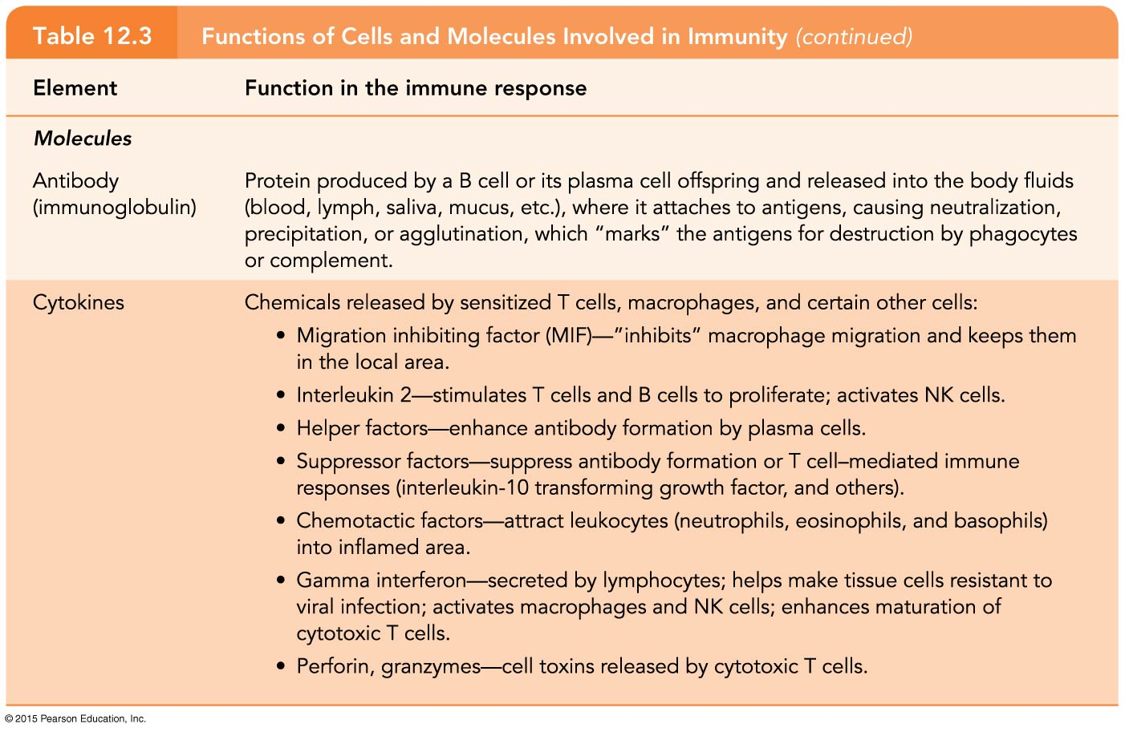
Table 12.3 Functions of Cells and Molecules Involved in Immunity (3 of 4).

Slide 104
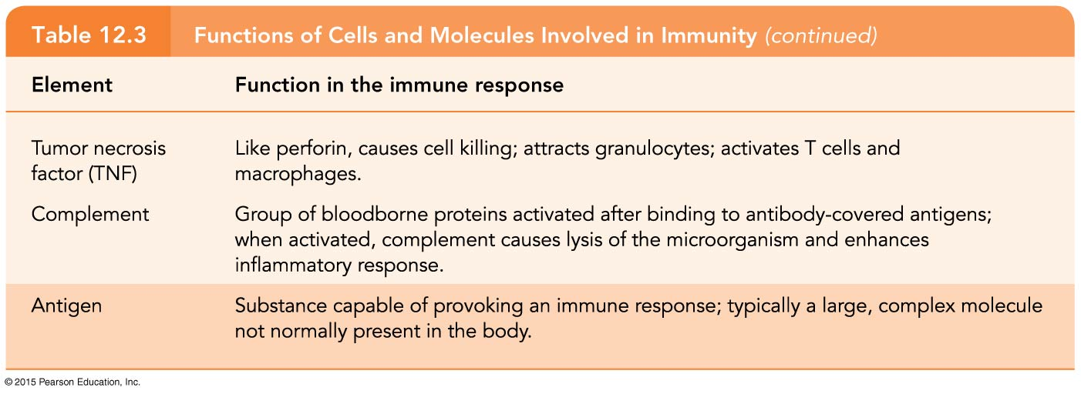
Table 12.3 Functions of Cells and Molecules Involved in Immunity (4 of 4).

Slide 105
Organ Transplants and Rejection
Major types of grafts
Autografts—tissue transplanted from one site to another on the same person
Isografts—tissue grafts from an identical person (identical twin)
Allografts—tissue taken from an unrelated person (most usual type of graft)
Xenografts—tissue taken from a different animal species (never successful)
Notes:
105

Slide 106
Organ Transplants and Rejection
Blood group and tissue matching is done to ensure the best match possible, and organ transplant is followed by immunosuppressive therapy
Notes:
106

Slide 107
Disorders of Immunity
The most important disorders of the immune system are autoimmune diseases, allergies, and immunodeficiencies

Slide 108
Autoimmune Diseases
Autoimmune disease occurs when the body’s self-tolerance breaks down
The body produces antibodies and/or sensitized T lymphocytes that attack its own tissues
Most forms of autoimmune disease result from the appearance of formerly hidden self-antigens or changes in the structure of self-antigens, and antibodies formed against foreign antigens that resemble self-antigens
Notes:
108

Slide 109
Autoimmune Diseases
Examples of autoimmune diseases
Rheumatoid arthritis—destroys joints
Myasthenia gravis—impairs communication between nerves and skeletal muscles
Multiple sclerosis—white matter of brain and spinal cord is destroyed
Graves’ disease—thyroid gland produces excess thyroxine
Notes:
109

Slide 110
Autoimmune Diseases
Examples of autoimmune diseases
Type I diabetes mellitus—destroys pancreatic beta cells that produce insulin
Systemic lupus erythematosus (SLE)
Affects kidney, heart, lung, and skin
Glomerulonephritis—impairment of renal function
Notes:
110

Slide 111
Allergies
Allergies, or hypersensitives, are abnormal, vigorous immune responses
The immune system overreacts to an otherwise harmless antigen, and tissue destruction occurs
Notes:
111

Slide 112
Allergies
Types of allergies
Immediate hypersensitivity
Seen in hay fever, hives, and anaphylaxis
Due to IgE antibodies
Delayed hypersensitivity
Contact dermatitis
Reflects activity of T cells, macrophages, and cytokines
Symptoms usually appear 1–3 days after contact with antigen
Notes:
112

Slide 113
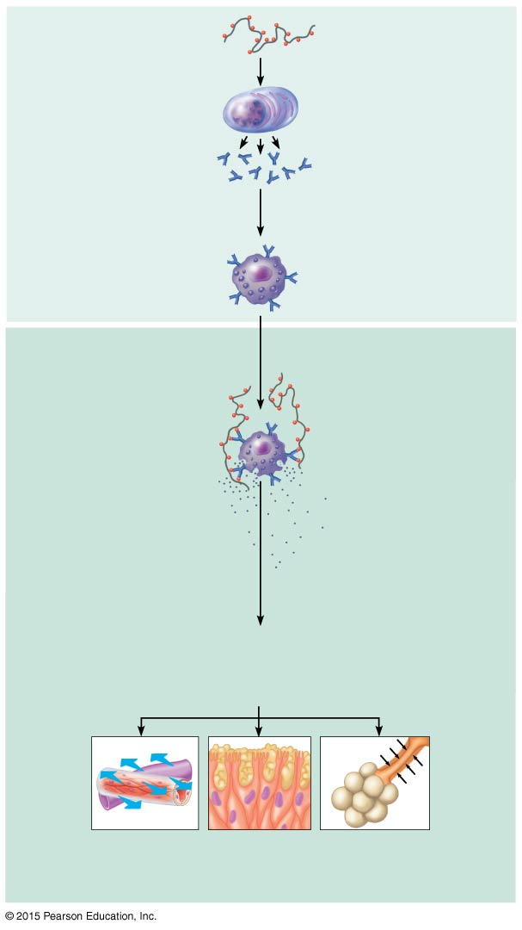
Figure 12.20 Mechanism of an immediate (acute) hypersensitivity response.
Slide 1
Sensitization stage
1
Antigen (allergen)
invades body.
2
Plasma cells
produce large
amounts of class
IgE antibodies
against allergen.
Mast cell with
fixed IgE antibodies
3
IgE antibodies attach
to mast cells in body
tissues (and to
circulating basophils).
IgE
Granules containing
histamine
Subsequent
(secondary)
responses
4
Antigen
More of same
allergen invades
body.
Mast cell granules
release contents
after antigen binds
with IgE antibodies
5
Allergen binding
to IgE on mast cells
triggers release of
histamine (and
other chemicals).
Histamine
6
Histamine causes blood vessels to dilate and
become leaky, which promotes edema; stimulates
release of large amounts of mucus; and causes
smooth muscles to contract.
Outpouring
of fluid from
capillaries
Release of
mucus
Constriction of
bronchioles

Slide 114
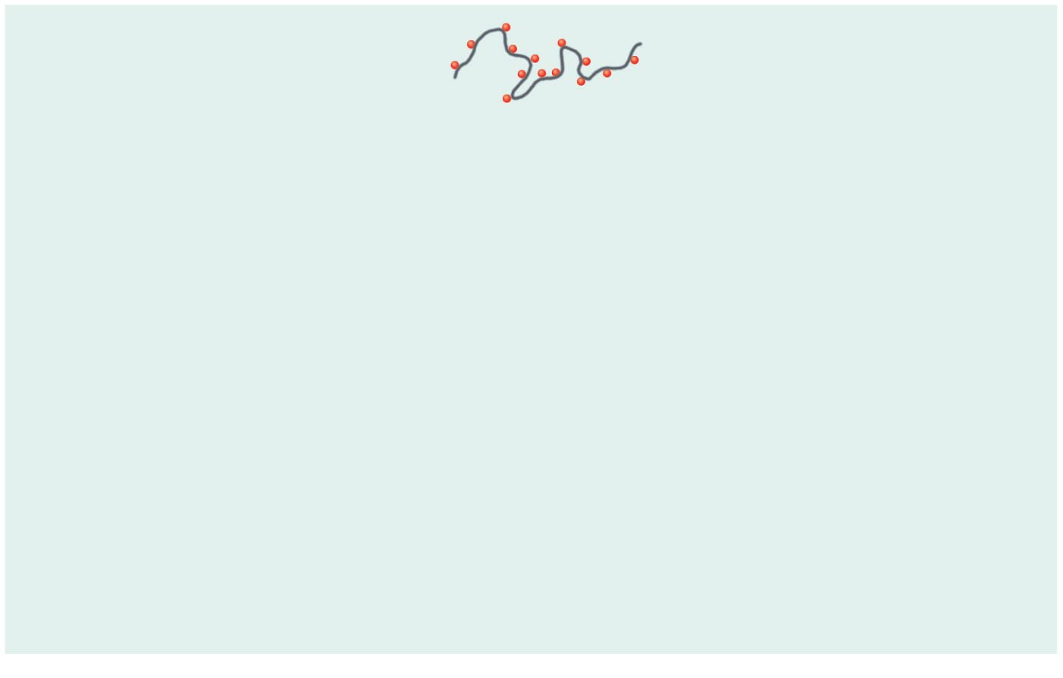
Figure 12.20 Mechanism of an immediate (acute) hypersensitivity response.
Slide 2
Sensitization stage
1
Antigen (allergen)
invades body.

Slide 115
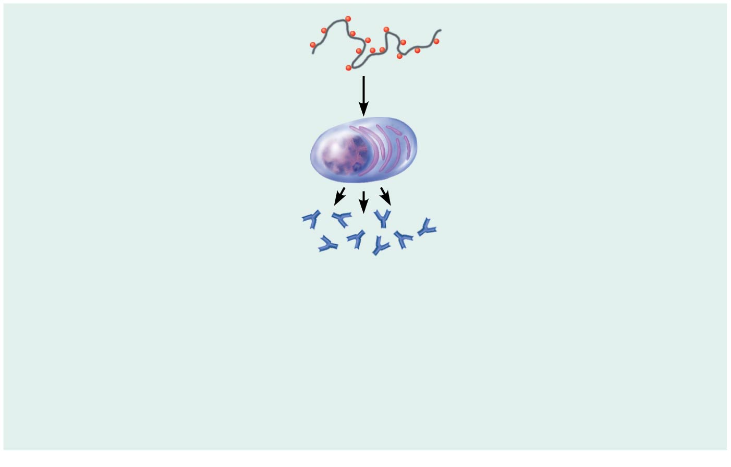
Figure 12.20 Mechanism of an immediate (acute) hypersensitivity response.
Slide 3
Sensitization stage
1
Antigen (allergen)
invades body.
Plasma cells
produce large
amounts of class
IgE antibodies
against allergen.
2

Slide 116
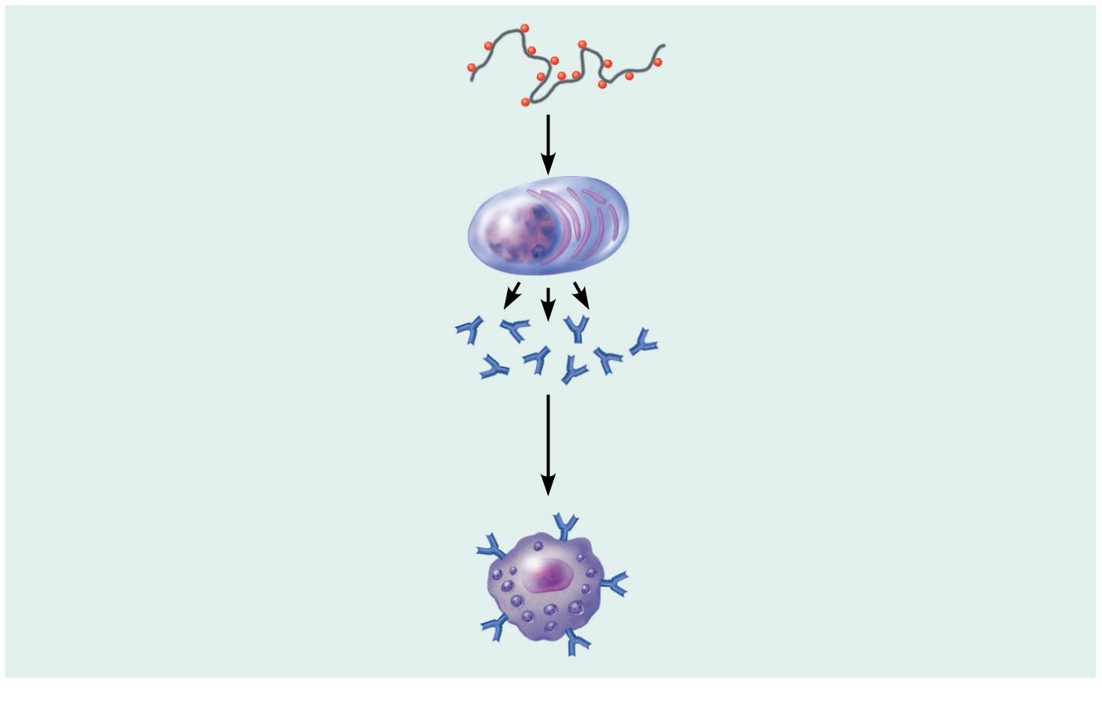
Figure 12.20 Mechanism of an immediate (acute) hypersensitivity response.
Slide 4
Sensitization stage
1
Antigen (allergen)
invades body.
Plasma cells
produce large
amounts of class
IgE antibodies
against allergen.
2
Mast cell with
fixed IgE antibodies
3
IgE antibodies attach
to mast cells in body
tissues (and to
circulating basophils).
IgE
Granules containing
histamine

Slide 117
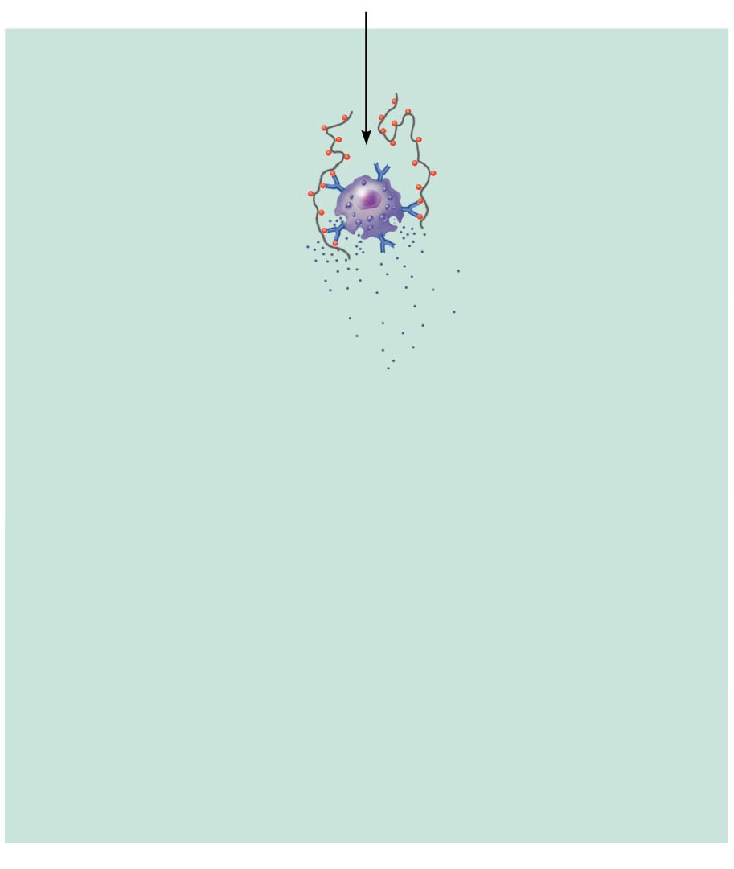
Figure 12.20 Mechanism of an immediate (acute) hypersensitivity response.
Slide 5
Subsequent
(secondary)
responses
4
Antigen
More of same
allergen invades
body.

Slide 118
Figure 12.20 Mechanism of an immediate (acute) hypersensitivity response.
Slide 6
Subsequent
(secondary)
responses
4
Antigen
More of same
allergen invades
body.
Mast cell granules
release contents
after antigen binds
with IgE antibodies
5
Allergen binding
to IgE on mast cells
triggers release of
histamine (and
other chemicals).
Histamine

Slide 119
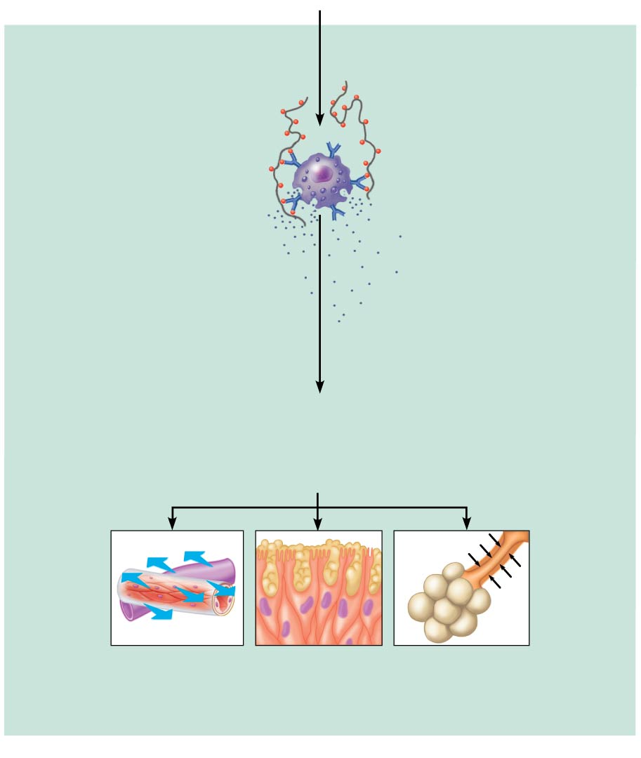
Figure 12.20 Mechanism of an immediate (acute) hypersensitivity response.
Slide 7
Subsequent
(secondary)
responses
4
Antigen
More of same
allergen invades
body.
Mast cell granules
release contents
after antigen binds
with IgE antibodies
5
Allergen binding
to IgE on mast cells
triggers release of
histamine (and
other chemicals).
Histamine
6
Histamine causes blood vessels to dilate and
become leaky, which promotes edema; stimulates
release of large amounts of mucus; and causes
smooth muscles to contract.
Outpouring
of fluid from
capillaries
Release of
mucus
Constriction of
bronchioles

Slide 120
Figure 12.20 Mechanism of an immediate (acute) hypersensitivity response.
Slide 8
Sensitization stage
1
Antigen (allergen)
invades body.
2
Plasma cells
produce large
amounts of class
IgE antibodies
against allergen.
Mast cell with
fixed IgE antibodies
3
IgE antibodies attach
to mast cells in body
tissues (and to
circulating basophils).
IgE
Granules containing
histamine
Subsequent
(secondary)
responses
4
Antigen
More of same
allergen invades
body.
Mast cell granules
release contents
after antigen binds
with IgE antibodies
5
Allergen binding
to IgE on mast cells
triggers release of
histamine (and
other chemicals).
Histamine
6
Histamine causes blood vessels to dilate and
become leaky, which promotes edema; stimulates
release of large amounts of mucus; and causes
smooth muscles to contract.
Outpouring
of fluid from
capillaries
Release of
mucus
Constriction of
bronchioles

Slide 121
Immunodeficiencies
Result from abnormalities in any immune element
Production or function of immune cells or complement is abnormal
May be congenital or acquired
Severe combined immunodeficiency disease (SCID) is a congenital disease
AIDS (acquired immune deficiency syndrome) is caused by a virus that attacks and cripples the helper T cells
Notes:
121

Slide 122
Developmental Aspects of the Lymphatic System and Body Defenses
Lymphatic vessels form by budding off veins.
The thymus and the spleen are the first lymphoid organs to appear in the embryo
Other lymphoid organs remain relatively undeveloped until after birth
The immune response develops around the time of birth
Notes:
122

Slide 123
Developmental Aspects of the Lymphatic System and Body Defenses
The ability of immunocompetent cells to recognize foreign antigens is genetically determined
Stress appears to interfere with normal immune response
Efficiency of immune response wanes in old age, and infections, cancer, immunodeficiencies, and autoimmune diseases become more prevalent

