Slide 2
Functions of the Urinary System
Elimination of waste products
Nitrogenous wastes
Toxins
Drugs

Slide 3
Functions of the Urinary System
Regulation of aspects of homeostasis
Water balance
Electrolytes
Acid-base balance in the blood
Blood pressure
Red blood cell production
Activation of vitamin D

Slide 4
Organs of the Urinary System
Kidneys
Ureters
Urinary bladder
Urethra

Slide 5
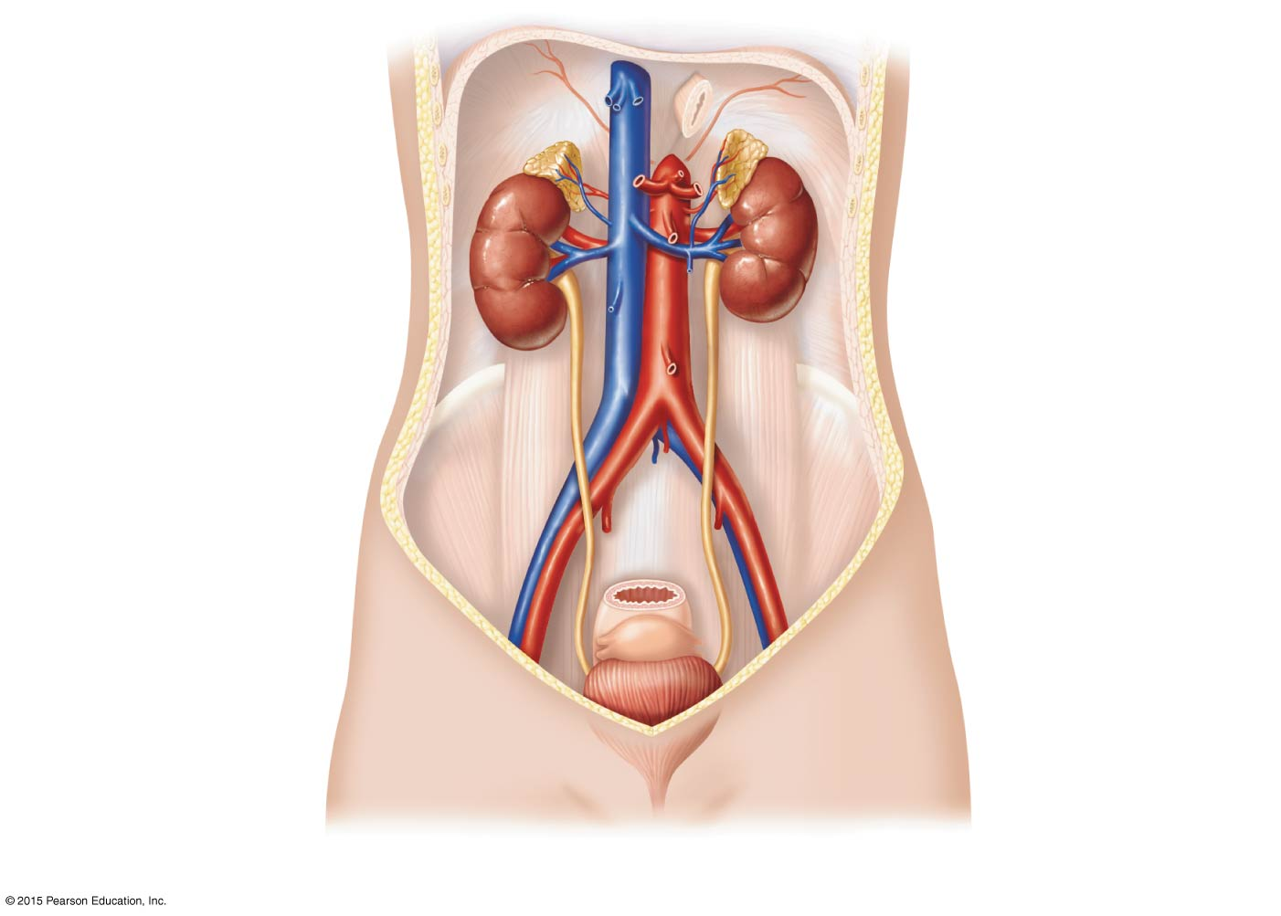
Figure 15.1a Organs of the urinary system.
Hepatic veins (cut)
Inferior vena cava
Adrenal gland
Renal artery
Renal hilum
Aorta
Renal vein
Kidney
Iliac crest
Ureter
Rectum (cut)
Uterus (part of female reproductive system)
Urinary bladder
Urethra
(a)

Slide 6
Kidneys
Location and structure
The kidneys are situated against the dorsal body wall in a retroperitoneal position (behind the parietal peritoneum)
The kidneys are situated at the level of the T₁₂ to L₃ vertebrae
The right kidney is slightly lower than the left (because of position of the liver)

Slide 7
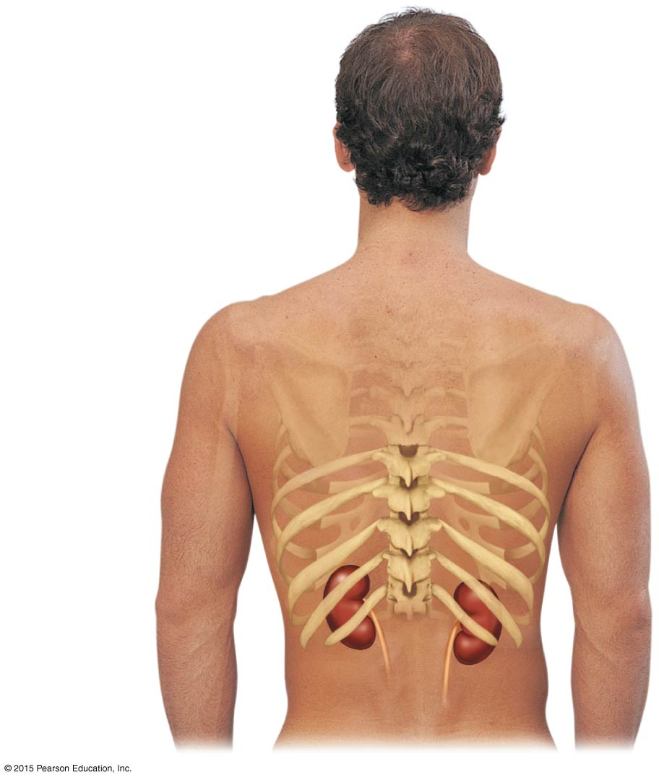
Figure 15.1b Organs of the urinary system.
12th rib
(b)

Slide 8
Kidneys
Location and structure (continued)
Renal hilum
A medial indentation where several structures enter or exit the kidney (ureters, renal blood vessels, and nerves)
An adrenal gland sits atop each kidney

Slide 9
Kidneys
Location and structure (continued)
Fibrous capsule encloses each kidney
Perirenal fat capsule surrounds the kidney and cushions against blows
Renal fascia is the outermost capsule that anchors the kidney and adrenal gland to surrounding structures

Slide 10
Kidneys
Location and structure (continued)
Three regions revealed in a longitudinal section:
Renal cortex—outer region
Renal medulla—deeper region
Renal (medullary) pyramids—triangular regions of tissue in the medulla
Renal columns—extensions of cortex-like material that separate the pyramids

Slide 11
Kidneys
Location and structure (continued)
Three regions:
Renal pelvis—medial region that is a flat, funnel-shaped tube
Calyces—cup-shaped extensions of the renal pelvis that enclose the renal pyramids
Calyces collect urine and send it to the renal pelvis, on to the ureter, and to the urinary bladder for storage

Slide 12
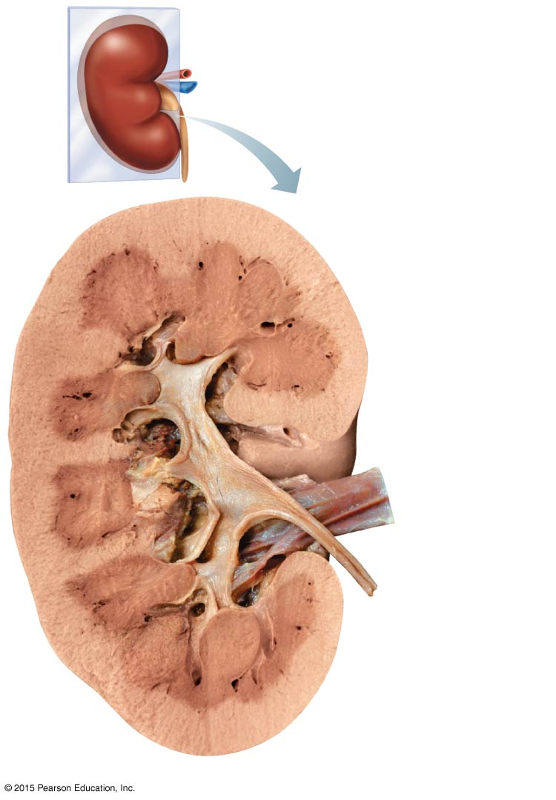
Figure 15.2a Internal anatomy of the kidney.
Renal cortex
Renal column
Major calyx
Minor calyx
Renal pyramid
(a)

Slide 13
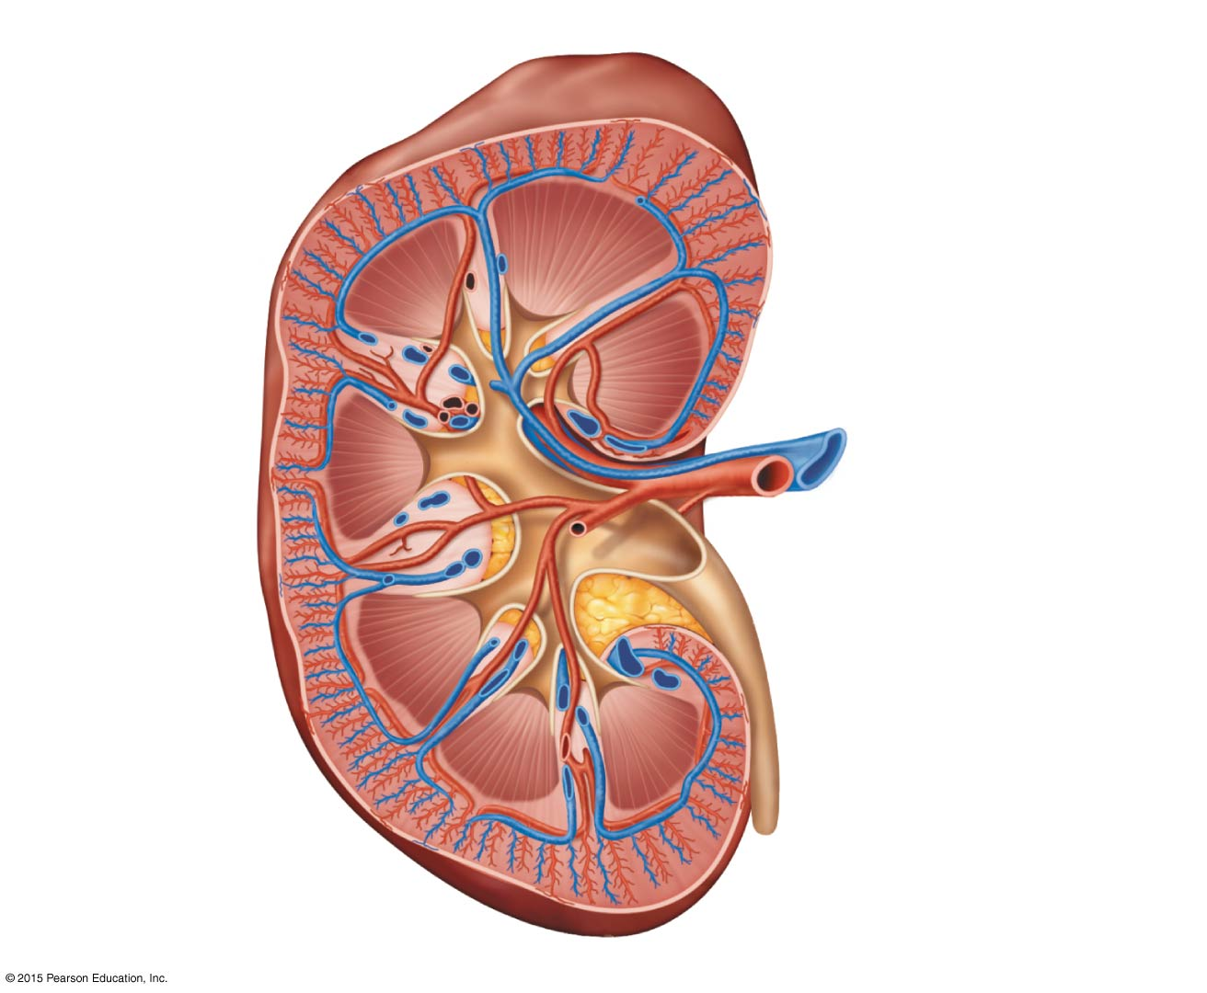
Figure 15.2b Internal anatomy of the kidney.
Cortical radiate vein
Cortical radiate artery
Renal cortex
Arcuate vein
Arcuate artery
Renal column
Interlobar vein
Interlobar artery
Segmental arteries
Renal vein
Renal artery
Minor calyx
Renal pelvis
Major calyx
Renal pyramid
Ureter
Fibrous capsule
(b)

Slide 14
Blood Supply
One-quarter of the total blood supply of the body passes through the kidneys each minute
Renal artery provides each kidney with arterial blood supply
Renal artery divides into segmental arteries → interlobar arteries → arcuate arteries → cortical radiate arteries

Slide 15
Blood Supply
Venous blood flow
Cortical radiate veins → arcuate veins → interlobar veins → renal vein
There are no segmental veins
Renal vein returns blood to the inferior vena cava

Slide 16
Figure 15.2b Internal anatomy of the kidney.
Cortical radiate vein
Cortical radiate artery
Renal cortex
Arcuate vein
Arcuate artery
Renal column
Interlobar vein
Interlobar artery
Segmental arteries
Renal vein
Renal artery
Minor calyx
Renal pelvis
Major calyx
Renal pyramid
Ureter
Fibrous capsule
(b)

Slide 17
Figure 15.2c Internal anatomy of the kidney.
Aorta
Renal artery
Segmental artery
Interlobar artery
Arcuate artery
Cortical radiate artery
Afferent arteriole
Glomerulus (capillaries)
Inferior vena cava
Renal vein
Interlobar vein
Arcuate vein
Cortical radiate vein
Peritubular capillaries
Efferent arteriole

Slide 18
Nephrons
Nephrons:
Structural and functional units of the kidneys
Responsible for forming urine
Each nephron consists of two main structures:
Renal corpuscle
Renal tubule

Slide 19
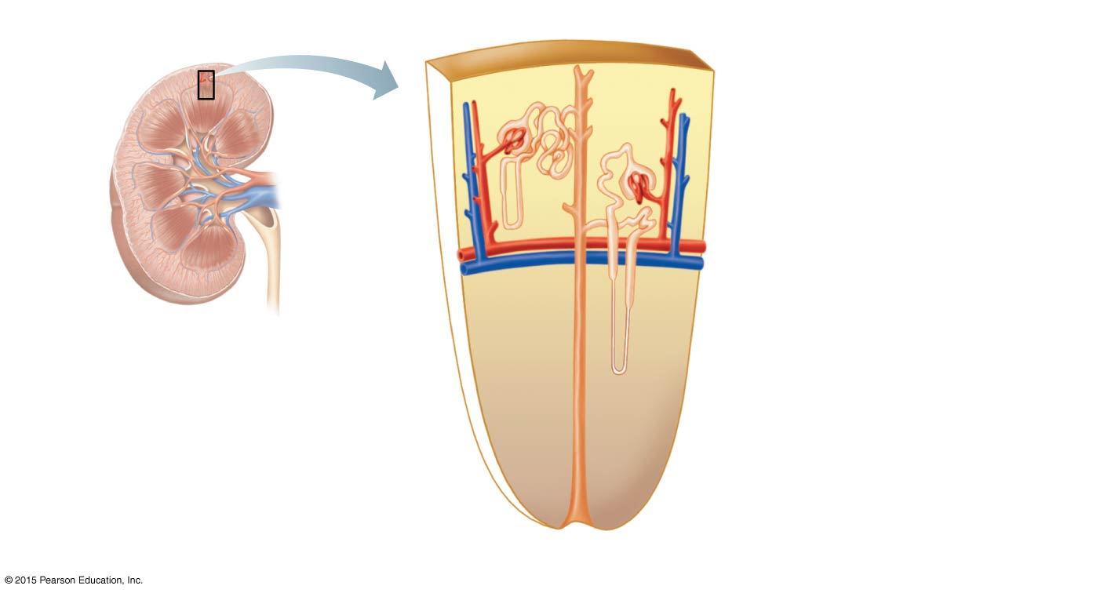
Figure 15.3a Structure of the nephron.
Cortical nephron
Fibrous capsule
Renal cortex
Collecting duct
Renal medulla
Proximal convoluted tubule
Renal cortex
Renal pelvis
Glomerulus
Juxtamedullary nephron
Ureter
Distal convoluted tubule
Nephron loop
Renal medulla
(a)

Slide 20
Nephrons
Renal corpuscle consists of:
Glomerulus, a knot of capillaries made of podocytes
Podocytes have filtration slits and foot processes that stick to the glomerulus
Glomerular (Bowman’s) capsule surrounds the glomerulus
First part of the renal tubule

Slide 21
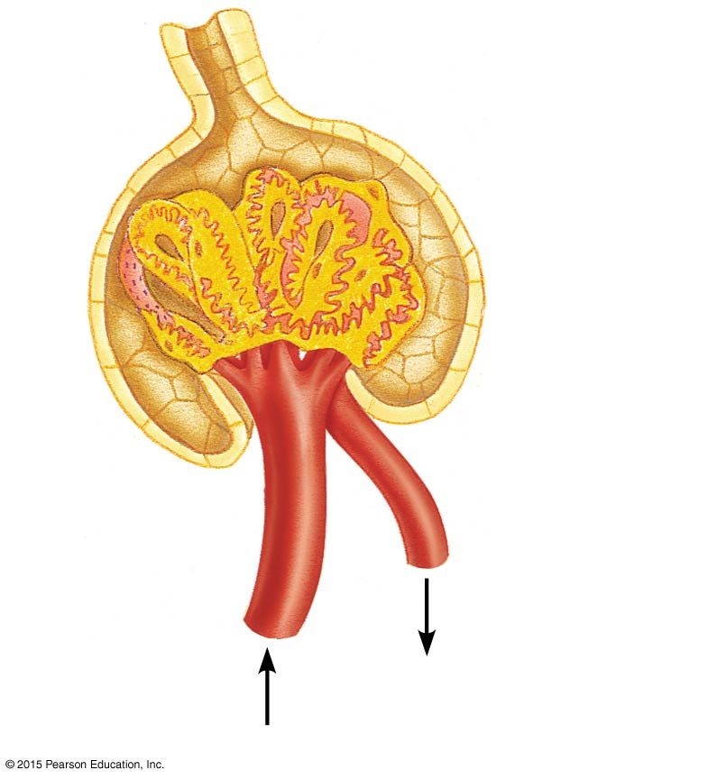
Figure 15.3c Structure of the nephron.
Glomerular capsular space
PCT
Glomerular capillary covered by podocytes
Efferent arteriole
Afferent arteriole
(c)

Slide 22
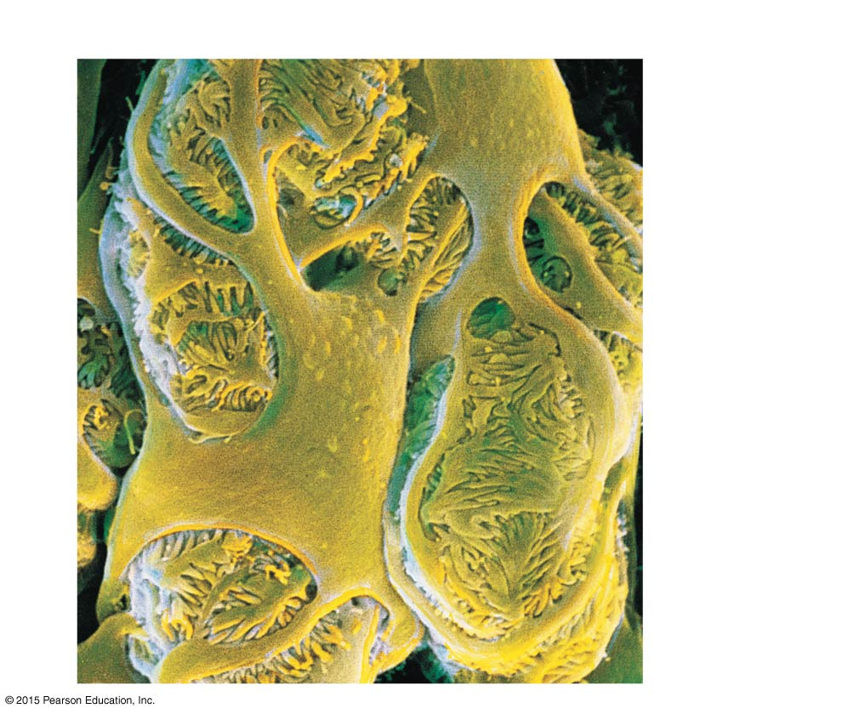
Figure 15.3d Structure of the nephron.
Filtration slits
Podocyte cell body
Foot processes
(d)

Slide 23
Nephrons
Renal tubule extends from glomerular capsule and ends when it empties into the collecting duct
From the glomerular (Bowman’s) capsule, the subdivisions of the renal tubule are:
Proximal convoluted tubule (PCT)
Nephron loop (loop of Henle)
Distal convoluted tubule (DCT)

Slide 24
Figure 15.3a Structure of the nephron.
Cortical nephron
Fibrous capsule
Renal cortex
Collecting duct
Renal medulla
Proximal convoluted tubule
Renal cortex
Renal pelvis
Glomerulus
Juxtamedullary nephron
Ureter
Distal convoluted tubule
Nephron loop
Renal medulla
(a)

Slide 25
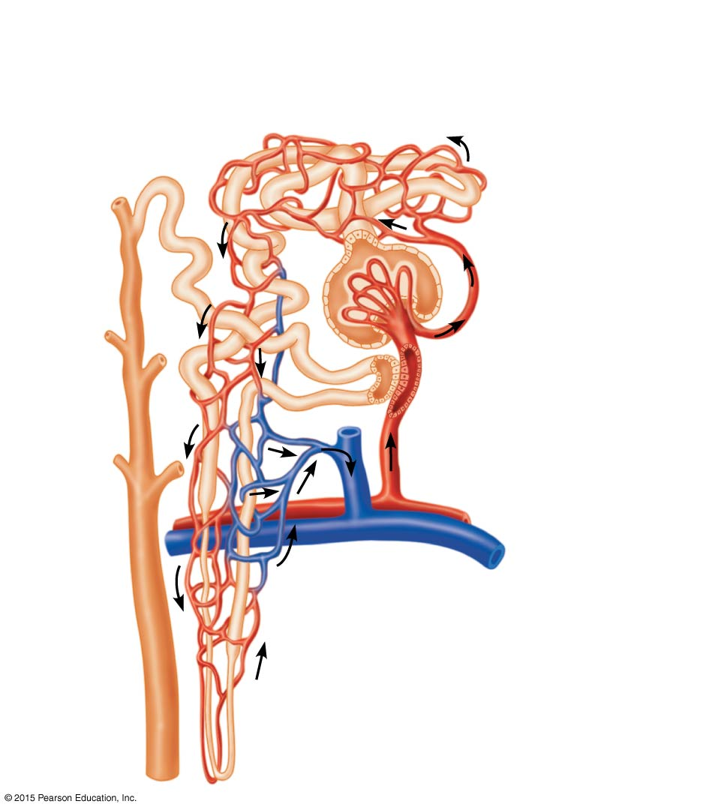
Figure 15.3b Structure of the nephron.
Proximal convoluted tubule (PCT)
Peritubular capillaries
Glomerular capillaries
Distal convoluted tubule (DCT)
Glomerular (Bowman’s) capsule
Efferent arteriole
Afferent arteriole
Cells of the juxtaglomerular
apparatus
Cortical radiate artery
Arcuate artery
Arcuate vein
Cortical radiate vein
Collecting duct
Nephron loop
(b)

Slide 26
Nephrons
Cortical nephrons
Located entirely in the cortex
Include most nephrons
Juxtamedullary nephrons
Found at the boundary of the cortex and medulla
Nephron loop dips deep into the medulla
Collecting ducts collect urine from both types of nephrons, through the renal pyramids, to the calyces, and then to the renal pelvis

Slide 27
Figure 15.3a Structure of the nephron.
Cortical nephron
Fibrous capsule
Renal cortex
Collecting duct
Renal medulla
Proximal convoluted tubule
Renal cortex
Renal pelvis
Glomerulus
Juxtamedullary nephron
Ureter
Distal convoluted tubule
Nephron loop
Renal medulla
(a)

Slide 28
Nephrons
Two capillary beds associated with each nephron:
Glomerulus
Peritubular capillary bed

Slide 29
Nephrons
Glomerulus
Fed and drained by arterioles
Afferent arteriole—arises from a cortical radiate artery and feeds the glomerulus
Efferent arteriole—receives blood that has passed through the glomerulus
Specialized for filtration
High pressure forces fluid and solutes out of blood and into the glomerular capsule

Slide 30
Figure 15.3c Structure of the nephron.
Glomerular capsular space
PCT
Glomerular capillary covered by podocytes
Efferent arteriole
Afferent arteriole
(c)

Slide 31
Nephrons
Peritubular capillary beds
Arise from efferent arteriole of the glomerulus
Normal, low-pressure, porous capillaries
Adapted for absorption instead of filtration
Cling close to the renal tubule to reabsorb (reclaim) some substances from collecting tubes
Drain into the interlobar veins

Slide 32
Figure 15.3b Structure of the nephron.
Proximal convoluted tubule (PCT)
Peritubular capillaries
Glomerular capillaries
Distal convoluted tubule (DCT)
Glomerular (Bowman’s) capsule
Efferent arteriole
Afferent arteriole
Cells of the juxtaglomerular
apparatus
Cortical radiate artery
Arcuate artery
Arcuate vein
Cortical radiate vein
Collecting duct
Nephron loop
(b)

Slide 33
Urine Formation
Urine formation is the result of three processes:
Glomerular filtration
Tubular reabsorption
Tubular secretion

Slide 34
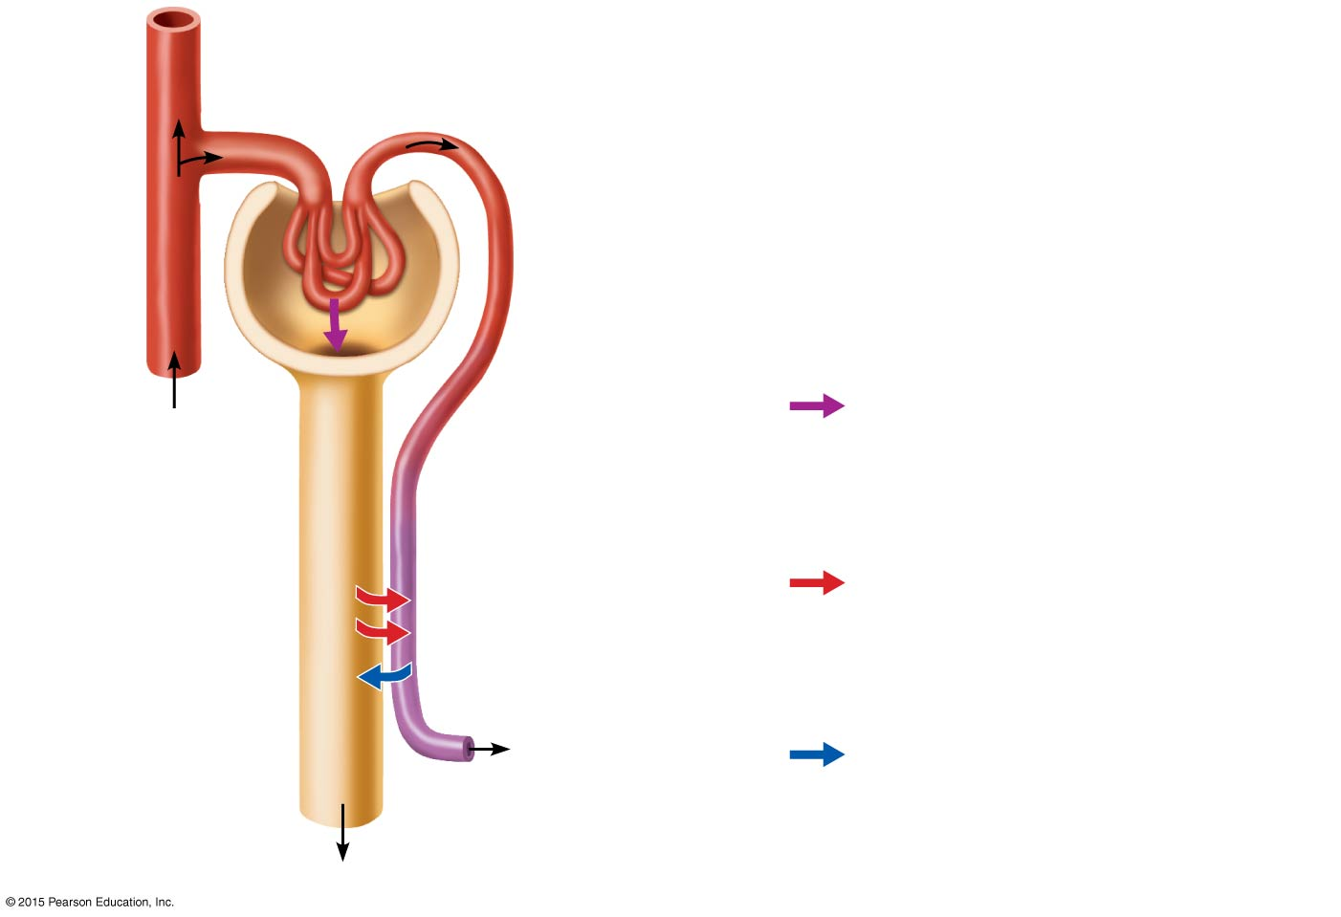
Figure 15.4 The kidney depicted schematically as a single large, uncoiled nephron.
Afferent arteriole
Glomerular capillaries
Efferent arteriole
Cortical radiate artery
1
Glomerular capsule
Three major renal processes:
Rest of renal tubule containing filtrate
1
Glomerular filtration: Water and solutes smaller than proteins are forced through the capillary walls and pores of the glomerular capsule into the renal tubule.
Peritubular capillary
Tubular reabsorption: Water, glucose, amino acids, and needed ions are transported out of the filtrate into the tubule cells and then enter the capillary blood.
2
2
3
To cortical radiate vein
3
Tubular secretion: H⁺, K⁺, creatinine, and drugs are removed from the peritubular blood and secreted by the tubule cells into the filtrate.
Urine

Slide 35
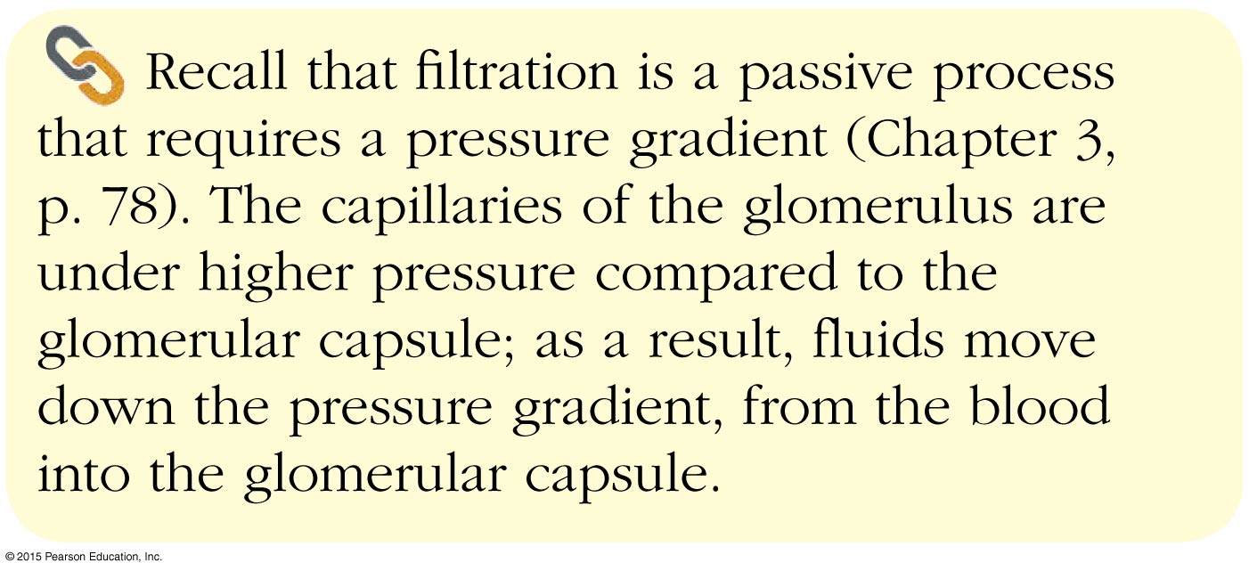
Concept Link

Slide 36
Glomerular Filtration
The glomerulus is a filter
Filtration is a nonselective passive process
Water and solutes smaller than proteins are forced through capillary walls
Proteins and blood cells are normally too large to pass through the filtration membrane
Filtrate is collected in the glomerular capsule and leaves via the renal tubule

Slide 37
Glomerular Filtration
Filtrate will be formed as long as systemic blood pressure is normal
If arterial blood pressure is too low, filtrate formation stops because glomerular pressure will be too low to form filtrate
Oligouria is abnormally low urine output (between 100 and 400 ml per day)
Anuria is less than 100 ml of urine produced per day

Slide 38
Tubular Reabsorption
The peritubular capillaries reabsorb useful substances from the renal tubule cells, such as:
Water
Glucose
Amino acids
Ions
Some reabsorption is passive; most is active
Most reabsorption occurs in the proximal convoluted tubule

Slide 39
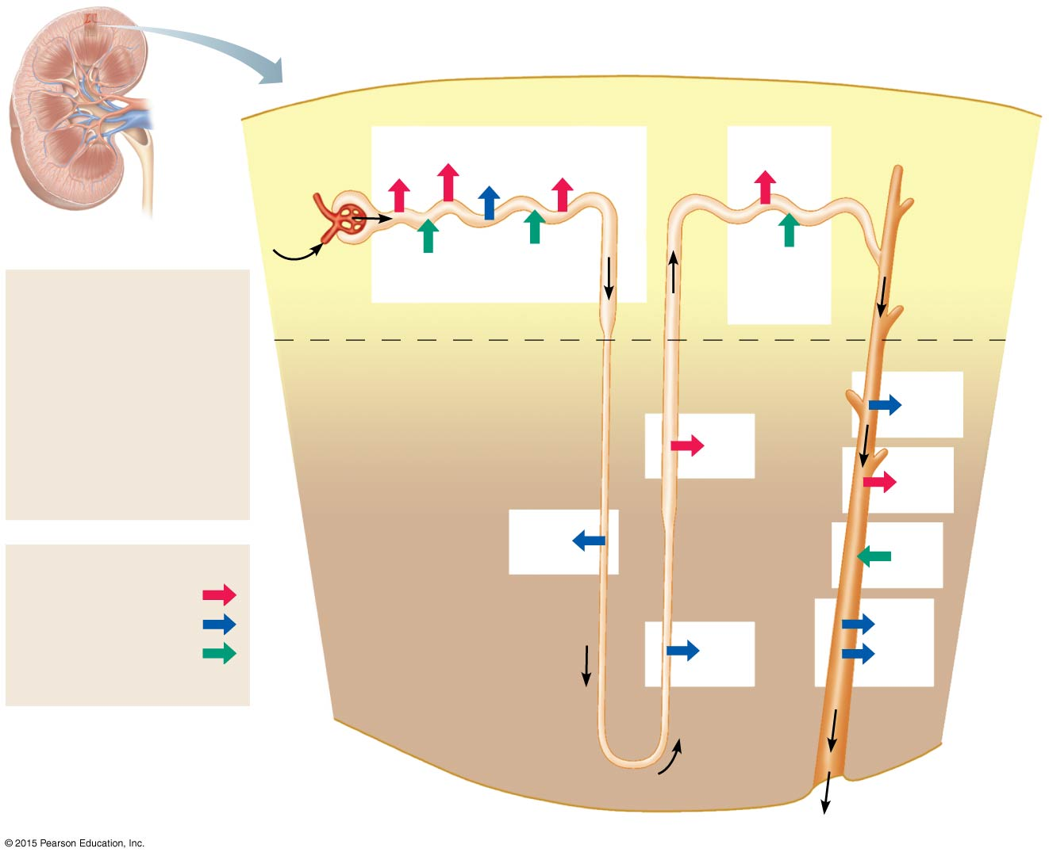
Figure 15.5 Sites of filtration, reabsorption, and secretion in a nephron.
Proximal tubule
Distal tubule
Glomerular
capsule
HCO₃⁻
Glucose and amino acids
NaCl
H₂O
NaCl
Blood
Some drugs and poisons
H⁺
K⁺ and some drugs
Filtrate
Collecting duct
H₂O Salts (NaCl, etc.) HCO₃− (bicarbonate) H⁺ Urea Glucose; amino acids Some drugs
Cortex
Medulla
H₂O
Nephron loop
NaCl
NaCl
H₂O
K⁺
Reabsorption
Active transport
Passive transport
Urea
Secretion
NaCl
H₂O
(active transport)
Urine (to renal pelvis)

Slide 40
Tubular Reabsorption
Nitrogenous waste products are poorly reabsorbed, if at all
Urea—end product of protein breakdown
Uric acid—results from nucleic acid breakdown
Creatinine—associated with creatine metabolism in muscles

Slide 41
Tubular Secretion
Tubular secretion is reabsorption in reverse
Some materials move from the blood of the peritubular capillaries into the renal tubules
Hydrogen and potassium ions
Creatinine

Slide 42
Tubular Secretion
Secretion is important for:
Getting rid of substances not already in the filtrate
Removing drugs and excess ions
Maintaining acid-base balance of blood
Materials left in the renal tubule move toward the ureter

Slide 43
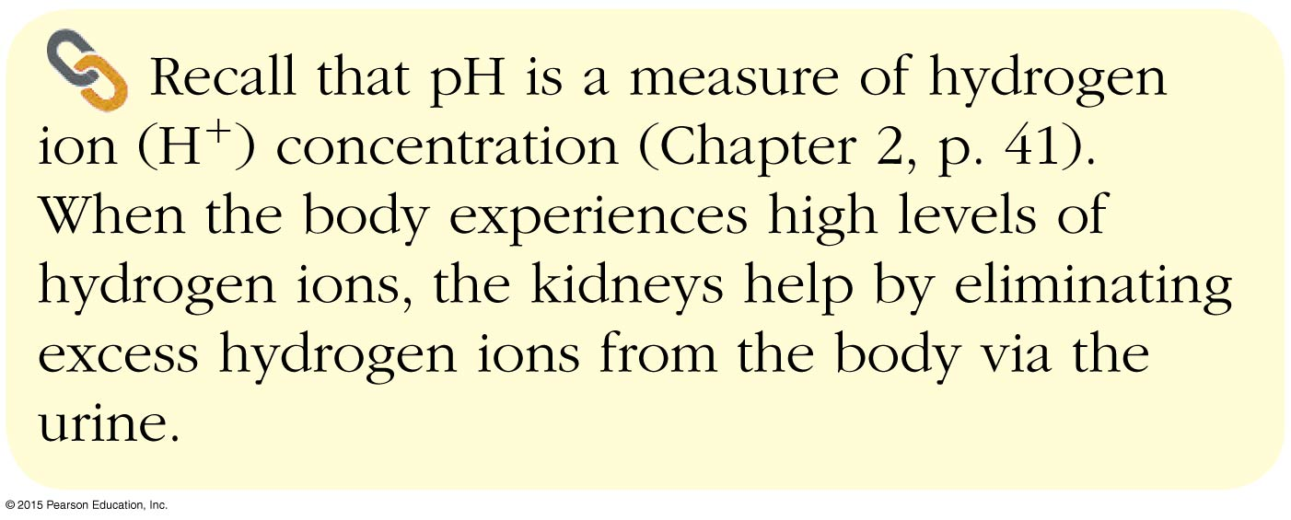
Concept Link

Slide 44
Figure 15.5 Sites of filtration, reabsorption, and secretion in a nephron.
Proximal tubule
Distal tubule
Glomerular
capsule
HCO₃−
Glucose and amino acids
NaCl
H₂O
NaCl
Blood
Some drugs and poisons
H⁺
K⁺ and some drugs
Filtrate
Collecting duct
H₂O Salts (NaCl, etc.) HCO₃− (bicarbonate) H⁺ Urea Glucose; amino acids Some drugs
Cortex
Medulla
H₂O
Nephron loop
NaCl
NaCl
H₂O
K⁺
Reabsorption
Active transport
Passive transport
Urea
Secretion
NaCl
H₂O
(active transport)
Urine (to renal pelvis)

Slide 45
Characteristics of Urine
In 24 hours, about 1.0 to 1.8 liters of urine are produced
Urine and filtrate are different
Filtrate contains everything that blood plasma does (except proteins)
Urine is what remains after the filtrate has lost most of its water, nutrients, and necessary ions through reabsorption
Urine contains nitrogenous wastes and substances that are not needed

Slide 46
Characteristics of Urine
Yellow color due to the pigment urochrome (from the destruction of hemoglobin) and solutes
Dilute urine is a pale, straw color
Sterile
Slightly aromatic
Normal pH of around 6 (slightly acidic)
Specific gravity of 1.001 to 1.035

Slide 47
Characteristics of Urine
Solutes normally found in urine
Sodium and potassium ions
Urea, uric acid, creatinine
Ammonia
Bicarbonate ions

Slide 48
Characteristics of Urine
Solutes NOT normally found in urine
Glucose
Blood proteins
Red blood cells
Hemoglobin
Pus (WBCs)
Bile

Slide 49
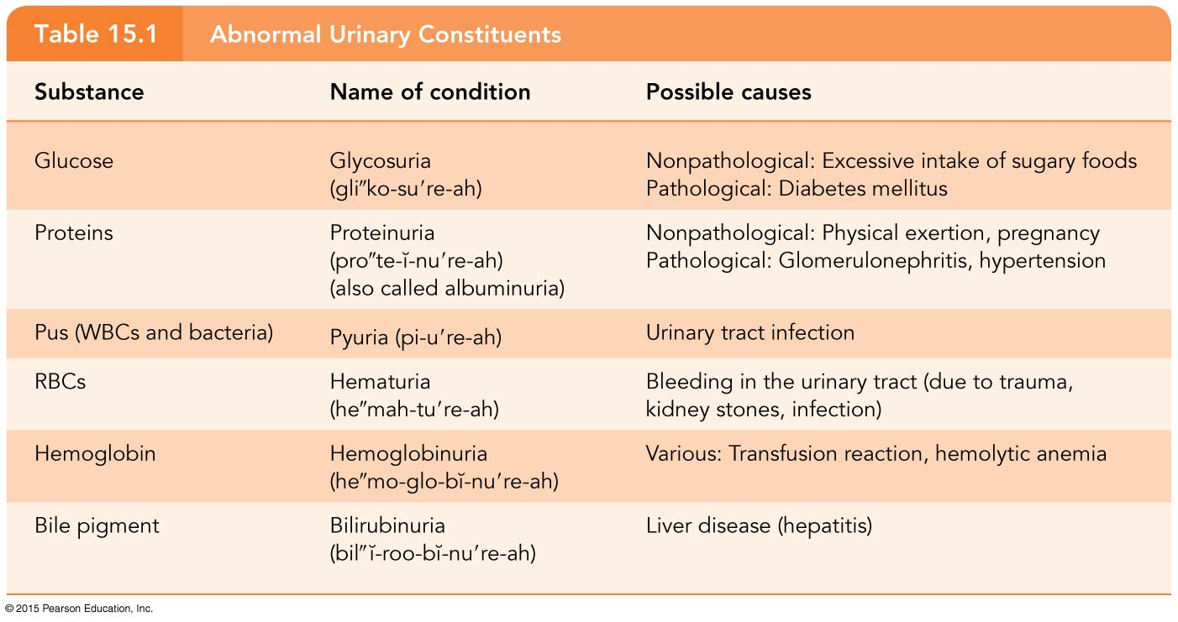
Table 15.1 Abnormal Urinary Constituents.

Slide 50
Ureters
Slender tubes attaching the kidney to the urinary bladder
Continuous with the renal pelvis
Enter the posterior aspect of the urinary bladder
Runs behind the peritoneum
Peristalsis aids gravity in urine transport

Slide 51
Figure 15.1a Organs of the urinary system.
Hepatic veins (cut)
Inferior vena cava
Adrenal gland
Renal artery
Renal hilum
Aorta
Renal vein
Kidney
Iliac crest
Ureter
Rectum (cut)
Uterus (part of female reproductive system)
Urinary bladder
Urethra
(a)

Slide 52
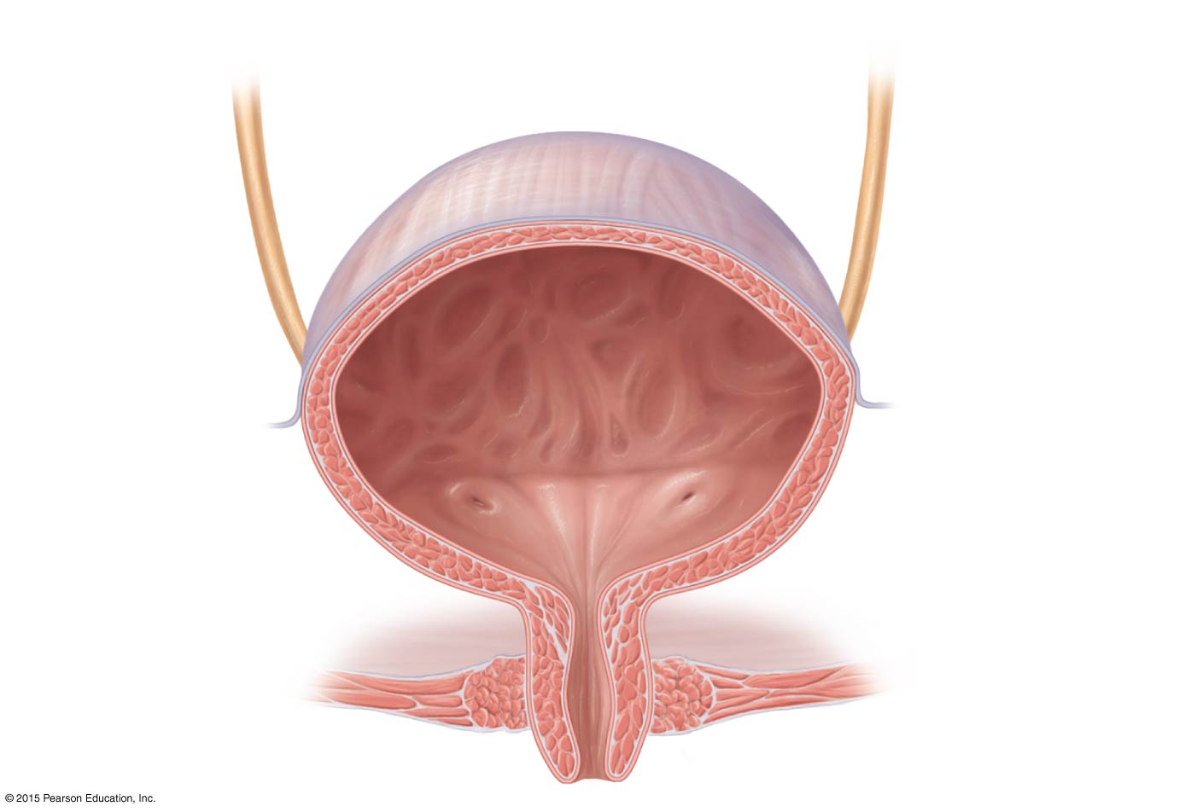
Figure 15.6 Basic structure of the female urinary bladder and urethra.
Urinary bladder
Ureter
Ureteral orifice
Internal urethral
orifice
Trigone
External urethral sphincter
Internal urethral
sphincter
Urogenital diaphragm
Urethra

Slide 53
Urinary Bladder
Smooth, collapsible, muscular sac situated posterior to the pubic symphysis
Temporarily stores urine
Trigone—triangular region of the urinary bladder base
Three openings
Two from the ureters
One to the urethra
In males, the prostate surrounds the neck of the urinary bladder

Slide 54
Figure 15.6 Basic structure of the female urinary bladder and urethra.
Urinary bladder
Ureter
Ureteral orifice
Internal urethral
orifice
Trigone
External urethral sphincter
Internal urethral
sphincter
Urogenital diaphragm
Urethra

Slide 55
Urinary Bladder
Wall of the urinary bladder:
Three layers of smooth muscle collectively called the detrusor muscle
Mucosa made of transitional epithelium
Walls are thick and folded in an empty urinary bladder
Urinary bladder can expand significantly without increasing internal pressure

Slide 56
Urinary Bladder
Capacity of the urinary bladder
A moderately full bladder is about 5 inches long and holds about 500 ml of urine
Capable of holding twice that amount of urine

Slide 57
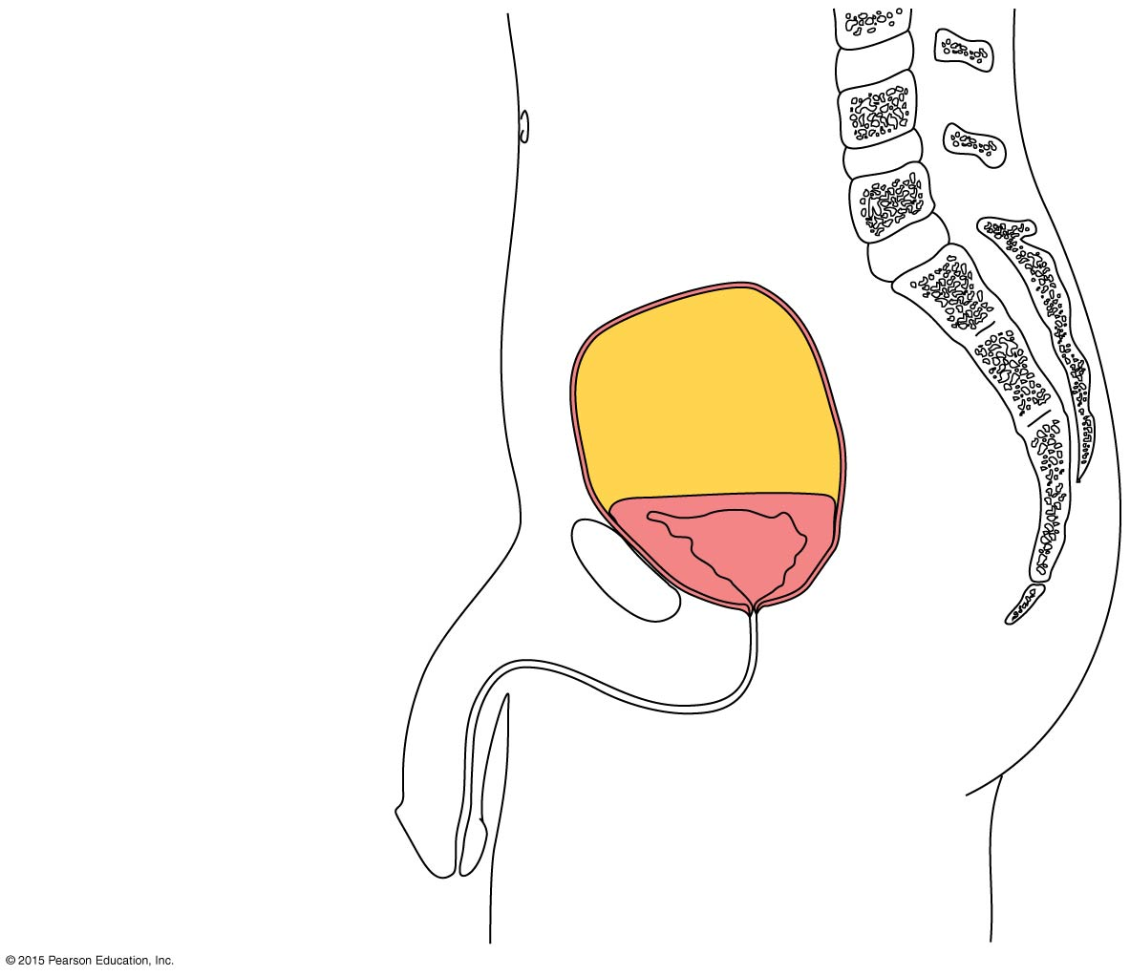
Figure 15.7 Position and shape of a distended and an empty urinary bladder in an adult man.
Umbilicus
Superior wall of distended bladder
Superior wall of empty bladder
Pubic symphysis

Slide 58
Urethra
Thin-walled tube that carries urine from the urinary bladder to the outside of the body by peristalsis
Function
Females—only carries urine
Males—carries urine and sperm

Slide 59
Urethra
Release of urine is controlled by two sphincters
Internal urethral sphincter
Involuntary and made of smooth muscle
External urethral sphincter
Voluntary and made of skeletal muscle

Slide 60
Figure 15.6 Basic structure of the female urinary bladder and urethra.
Urinary bladder
Ureter
Ureteral orifice
Internal urethral
orifice
Trigone
External urethral sphincter
Internal urethral
sphincter
Urogenital diaphragm
Urethra

Slide 61
Urethra
Length
In females: 3 to 4 cm (1 inch)
In males: 20 cm (8 inches)
Location
Females—anterior to the vaginal opening
Males—travels through the prostate and penis
Prostatic urethra
Membranous urethra
Spongy urethra

Slide 62
Figure 15.6 Basic structure of the female urinary bladder and urethra.
Urinary bladder
Ureter
Ureteral orifice
Internal urethral
orifice
Trigone
External urethral sphincter
Internal urethral
sphincter
Urogenital diaphragm
Urethra

Slide 63
Urethra
Urethritis is inflammation of the urethra
Cystitis is bladder inflammation
Pyelonephritis (pyelitis) is kidney inflammation

Slide 64
Micturition (Voiding)
Micturition is emptying of the urinary bladder
Micturition reflex causes the involuntary internal sphincter to open when stretch receptors in the bladder are stimulated
The external sphincter is voluntarily controlled, so micturition can usually be delayed
Incontinence is the inability to control micturition
Urinary retention is the inability to empty the bladder

Slide 65
Fluid, Electrolyte, and Acid-Base Balance
Blood composition depends on three factors
Diet
Cellular metabolism
Urine output

Slide 66
Fluid, Electrolyte, and Acid-Base Balance
Kidneys have four roles in maintaining blood composition
Excretion of nitrogen-containing wastes (previously discussed)
Maintaining water balance of the blood
Maintaining electrolyte balance of the blood
Ensuring proper blood pH

Slide 67
Bodily Fluids and Fluid Compartments
Normal amount of water in the human body
Young adult females = 50%
Young adult males = 60%
Babies = 75%
The elderly = 45%
Water is necessary for many body functions, and levels must be maintained

Slide 68
Bodily Fluids and Fluid Compartments
Water occupies three main fluid compartments
Intracellular fluid (ICF)
Fluid inside cells
About two-thirds of body fluid
2. and 3. Extracellular fluid (ECF)
Fluids outside cells; includes:
Interstitial fluid
Blood plasma, cerebrospinal and serous fluids, humors of the eye and lymph

Slide 69
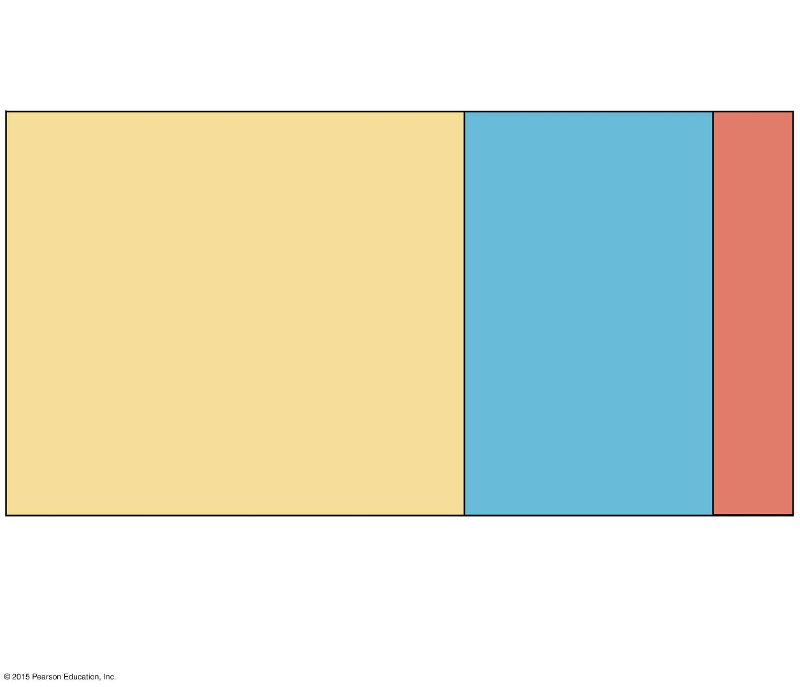
Figure 15.8 The major fluid compartments of the body.
Total body water
Volume = 40 L
60% body weight
Plasma
Interstitial fluid (IF)
Intracellular fluid (ICF)
Volume = 25 L
Volume = 3 L, 20% of ECF
Volume = 12 L
40% body weight
80% of ECF
Extracellular fluid (ECF)
Volume = 15 L
20% body weight

Slide 70
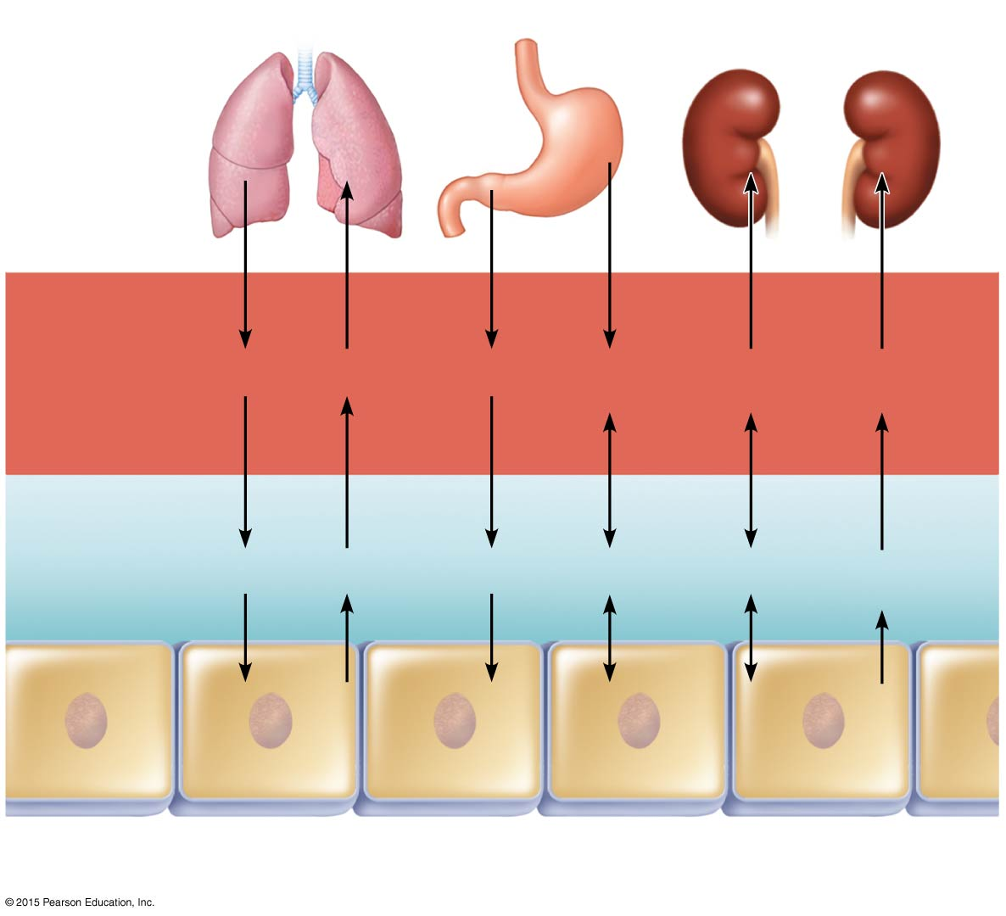
Figure 15.9 The continuous mixing of body fluids.
Lungs
Gastrointestinal tract
Kidneys
Blood plasma
O₂
CO₂
Nutrients
H₂O, Ions
H₂O, Ions
Nitrogenous wastes
Interstitial fluid
O₂
CO₂
Nutrients
H₂O
Ions
Nitrogenous wastes
Intracellular fluid in tissue cells

Slide 71
The Link Between Water and Salt
Solutes in the body include electrolytes such as sodium, potassium, and calcium ions
Changes in electrolyte balance causes water to move from one compartment to another
Alters blood volume and blood pressure
Can impair the activity of cells

Slide 72
Regulation of Water Intake and Output
Water intake must equal water output if the body is to remain properly hydrated
Sources for water intake
Ingested foods and fluids
Water produced from metabolic processes
Thirst mechanism is the driving force for water intake

Slide 73
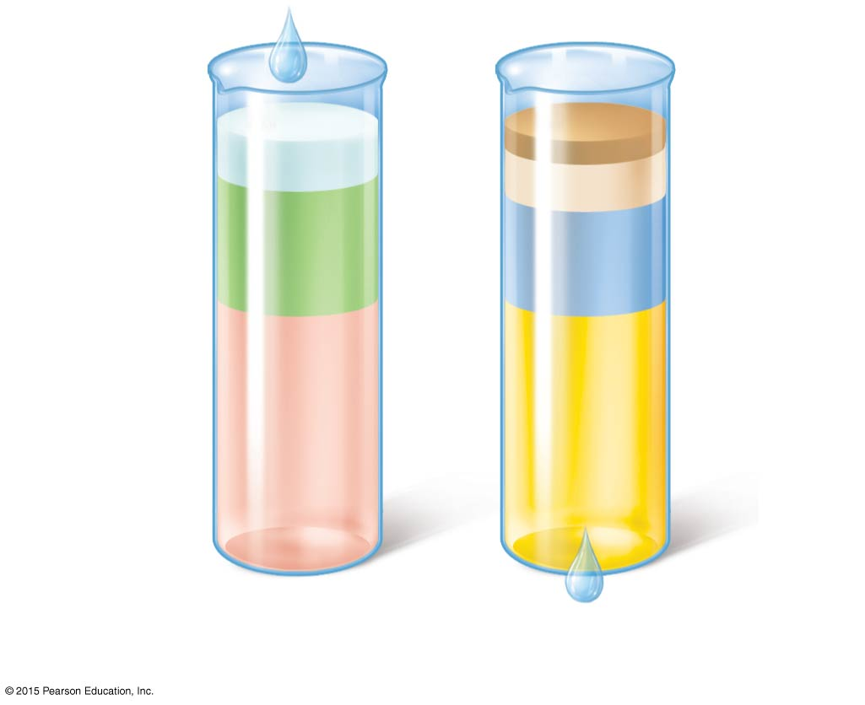
Figure 15.10 Water intake and output.
Metabolism 10%
100 ml
Feces 4%
250 ml
Sweat 8%
200 ml
Foods 30%
Insensible losses via skin and lungs 28%
750 ml
700 ml
2500 ml
Beverages 60%
1500 ml
1500 ml
Urine 60%
Average intake per day
Average output per day

Slide 74
Regulation of Water Intake and Output
Thirst mechanism
Osmoreceptors are sensitive cells in the hypothalamus that react to small changes in blood composition by becoming more active
When activated, the thirst center in the hypothalamus is notified
A dry mouth due to decreased saliva also promotes the thirst mechanism
Both reinforce the drive to drink

Slide 75
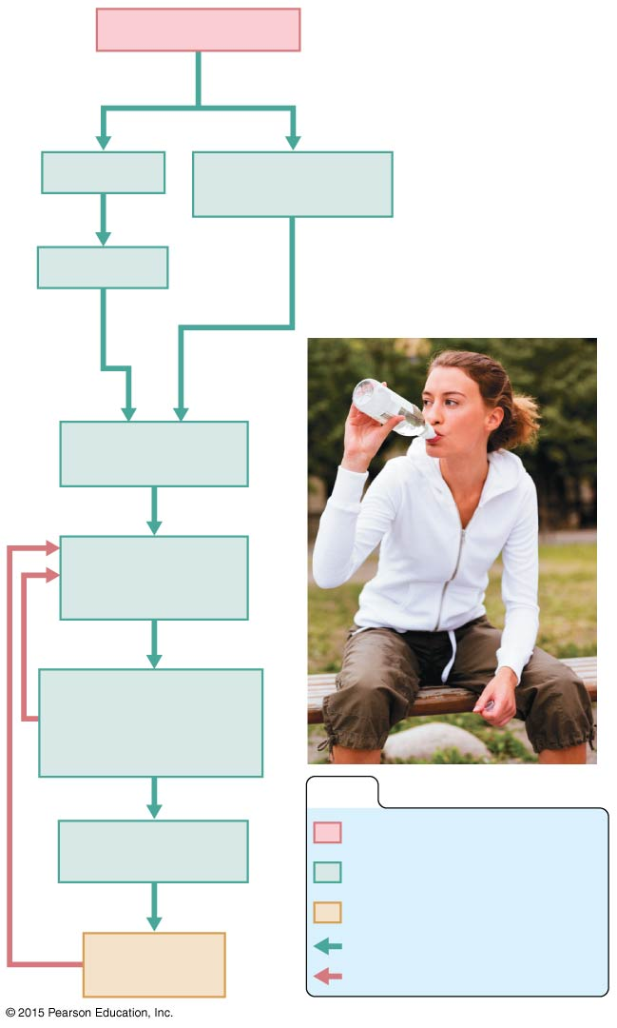
Figure 15.11 The thirst mechanism for regulating water intake.
Plasma solutes
Saliva
Osmoreceptors in hypothalamus
Dry mouth
Hypothalamic thirst center
Sensation of thirst; person takes a drink
Water moistens
mouth, throat;
stretches stomach, intestine
KEY:
Water absorbed from GI tract
Initial stimulus
Physiological response
Result
Plasma solutes
Increases, stimulates
Reduces, inhibits

Slide 76
Regulation of Water Intake and Output
Sources of water output
Lungs (insensible since we cannot sense the water leaving)
Perspiration
Feces
Urine

Slide 77
Regulation of Water Intake and Output
Hormones are primarily responsible for reabsorption of water and electrolytes by the kidneys
Antidiuretic hormone (ADH) prevents excessive water loss in the urine and increases water reabsorption
Diabetes insipidus results when ADH is not released
Leads to severe dehydration and electrolyte imbalances

Slide 78
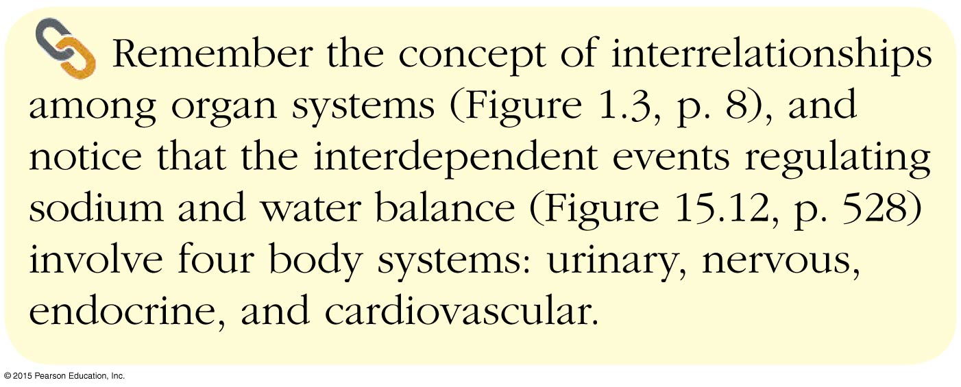
Concept Link

Slide 79
Electrolyte Balance
Hormones are primarily responsible for reabsorption of water and electrolytes by the kidneys
Aldosterone increases sodium and water reabsorption and decreases potassium reabsorption
Water follows salt: when sodium is reabsorbed, water follows it passively back into the blood

Slide 80
Electrolyte Balance
Renin-angiotensin mechanism
Important for regulating blood pressure
Mediated by the juxtaglomerular (JG) apparatus of the renal tubules
When cells of the JG apparatus are stimulated by low blood pressure, the enzyme renin is released into blood

Slide 81
Electrolyte Balance
Renin-angiotensin mechanism (continued)
Renin catalyzes reactions that produce angiotensin II
Angiotensin II causes vasoconstriction and aldosterone release
Result is increase in blood volume and blood pressure

Slide 82
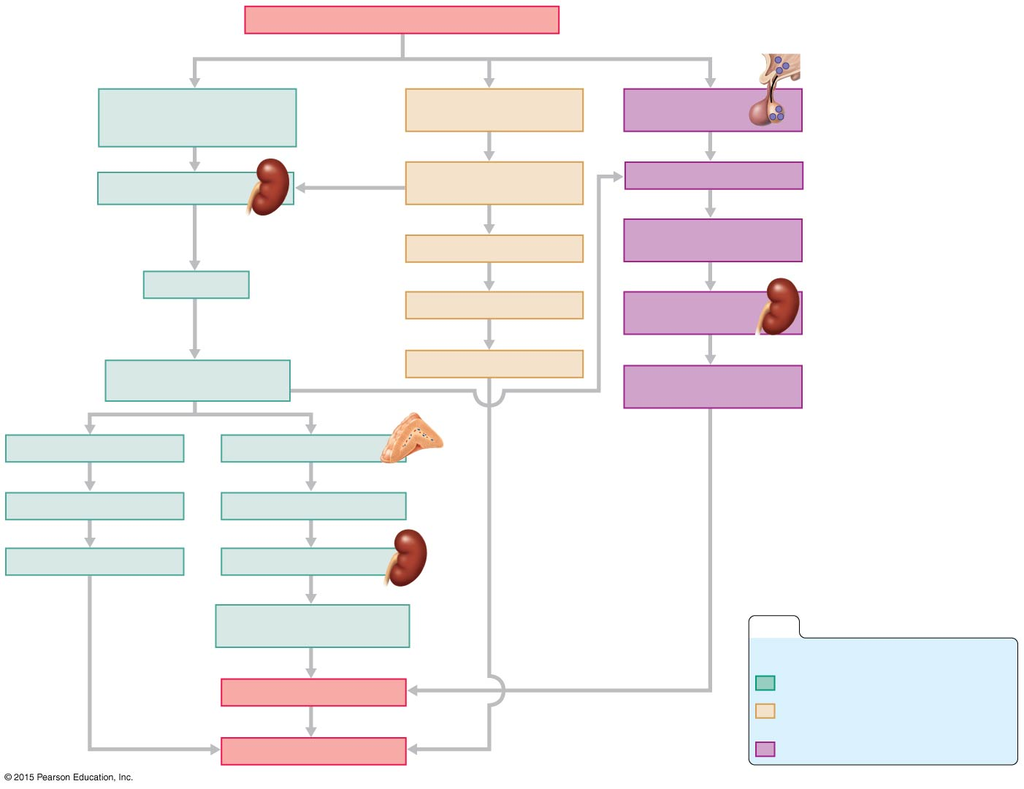
Figure 15.12 Flowchart of mechanisms regulating sodium and water balance to help maintain blood pressure homeostasis.
Falling systemic blood pressure/volume
(+)
Reduced filtrate volume or solute content in renal tubules
Inhibits baroreceptors in blood vessels
Hypothalamic osmoreceptors
(+)
(+)
(+)
JG cells of kidneys
(+)
Sympathetic nervous system
Posterior pituitary
(+)
Release
Release
Systemic arterioles
ADH (antidiuretic hormone)
Renin
Causes
(+)
Vasoconstriction
Collecting ducts of kidneys
Leads to
Results in
Causes
Angiotensin II formed in blood
Peripheral resistance
(+)
H₂O reabsorption
(+)
(+)
Systemic arterioles
Adrenal cortex
Causes
Secretes
Vasoconstriction
Aldosterone
Results in
Targets
Peripheral resistance
Kidney tubules
Causes
Na⁺ reabsorption (and H₂O absorption)
KEY:
Results in
(+)
= stimulates
Blood volume
Renin-angiotensin system
Neural regulation (sympathetic nervous system effects)
Rising blood pressure
Effects of ADH release

Slide 83
Maintaining Acid-Base Balance in Blood
Blood pH must remain between 7.35 and 7.45 to maintain homeostasis
Alkalosis—pH above 7.45
Acidosis—pH below 7.35
Physiological acidosis—pH between 7.35 and 7.0

Slide 84
Maintaining Acid-Base Balance in Blood
Kidneys play greatest role in maintaining acid-base balance
Other acid-base controlling systems
Blood buffers
Respiration

Slide 85
Blood Buffers
Acids are proton (H⁺) donors
Strong acids dissociate completely and liberate all of their H⁺ in water
Weak acids, such as carbonic acid, dissociate only partially
Bases are proton (H⁺) acceptors
Strong bases dissociate easily in water and tie up H⁺
Weak bases, such as bicarbonate ion and ammonia, are slower to accept H⁺

Slide 86
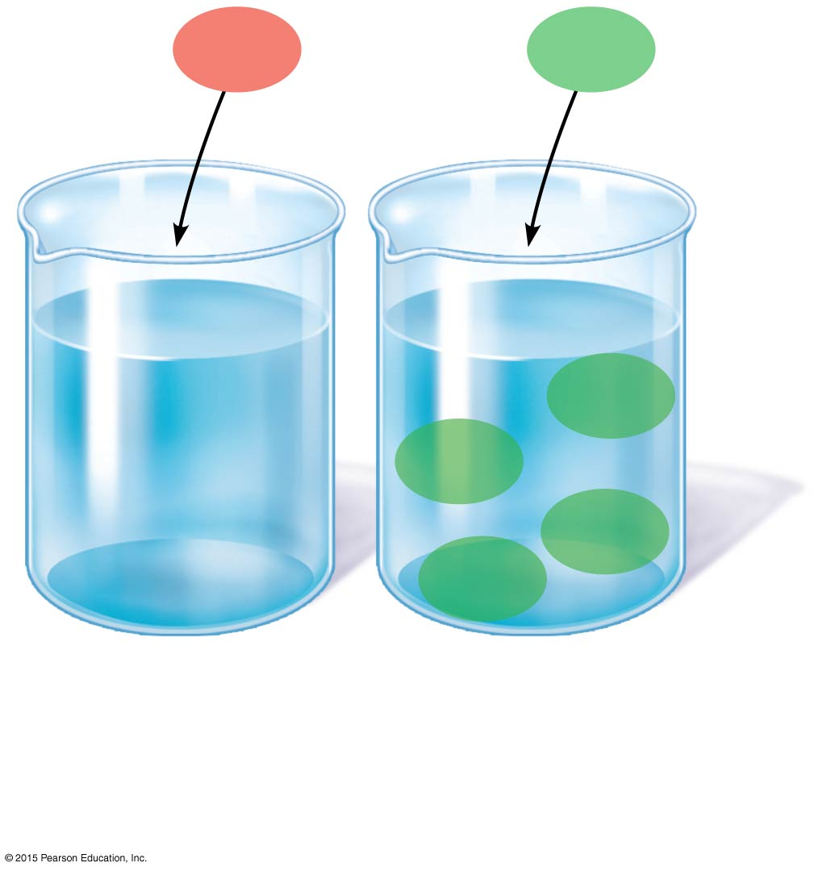
Figure 15.13 Dissociation of strong and weak acids in water.
HCl
H₂CO₃
H⁺
Cl⁻
Cl⁻
HCO₃⁻
H₂CO₃
H⁺
H⁺
Cl⁻
H⁺
H₂CO₃
HCO₃⁻
Cl⁻
Cl⁻
Cl⁻
H⁺
H⁺
H₂CO₃
H⁺
H⁺
H⁺
Cl⁻
H₂CO₃
(a) A strong acid such as HCl dissociates completely into its ions.
(b) A weak acid such as H₂CO₃ does not dissociate completely.

Slide 87
Blood Buffers
Molecules react to prevent dramatic changes in hydrogen ion (H⁺) concentrations
Bind to H⁺ when pH drops
Release H⁺ when pH rises
Three major chemical buffer systems
Bicarbonate buffer system
Phosphate buffer system
Protein buffer system

Slide 88
Blood Buffers
The bicarbonate buffer system
Mixture of carbonic acid (H₂CO₃) and sodium bicarbonate (NaHCO₃)
Carbonic acid is a weak acid that does not dissociate much in neutral or acid solutions
Bicarbonate ions (HCO₃–) react with strong acids to change them to weak acids
HCl + NaHCO₃ → H₂CO₃ + NaCl
strong acid weak base weak acid salt

Slide 89
Blood Buffers
The bicarbonate buffer system (continued)
Carbonic acid dissociates in the presence of a strong base to form a weak base and water
NaOH + H₂CO₃ → NaHCO₃ + H₂O
strong base weak acid weak base water

Slide 90
Respiratory System Controls
Respiratory rate can rise and fall depending on changing blood pH to retain CO₂ (decreasing the blood pH) or remove CO₂ (increasing the blood pH)
CO₂ + H₂O  H₂CO₃  H⁺ + HCO₃⁻

Slide 91
Renal Mechanisms
When blood pH rises:
Bicarbonate ions are excreted
Hydrogen ions are retained by kidney tubules
When blood pH falls:
Bicarbonate ions are reabsorbed
Hydrogen ions are secreted
Urine pH varies from 4.5 to 8.0

Slide 92
Developmental Aspects of the Urinary System
The kidneys begin to develop in the first few weeks of embryonic life and are excreting urine by the third month of fetal life
Common congenital abnormalities include polycystic kidney and hypospadias
Common urinary system problems in children and young to middle-aged adults include infections caused by fecal microorganisms, microorganisms causing sexually transmitted infections, and Streptococcus

Slide 93
Developmental Aspects of the Urinary System
Control of the voluntary urethral sphincter does not start until age 18 months
Complete nighttime control may not occur until the child is 4 years old
Urinary tract infections (UTIs) are the only common problems before old age
Escherichia coli (E. coli), a bacterium, accounts for 80 percent of UTIs

Slide 94
Developmental Aspects of the Urinary System
Renal failure is an uncommon but serious problem in which the kidneys are unable to concentrate urine, and dialysis must be done to maintain chemical homeostasis of blood
With age, filtration rate decreases and tubule cells become less efficient at concentrating urine, leading to urgency, frequency, and incontinence
In men, urinary retention is another common problem

Slide 95
Developmental Aspects of the Urinary System
Problems associated with aging:
Urgency—feeling that it is necessary to void
Frequency—frequent voiding of small amounts of urine
Nocturia—need to get up during the night to urinate
Incontinence—loss of control
Urinary retention—common in males, often the result of hypertrophy of the prostate gland

