Slide 2
The Reproductive System
Gonads—primary sex organs
Testes in males
Ovaries in females
Gonads produce gametes (sex cells) and secrete hormones
Sperm—male gametes
Ova (eggs)—female gametes

Slide 3
Anatomy of the Male Reproductive System
Testes
Duct system
Epididymis
Ductus (vas) deferens
Urethra

Slide 4
Anatomy of the Male Reproductive System
Accessory organs
Seminal glands (vesicles)
Prostate
Bulbo-urethral glands
External genitalia
Penis
Scrotum

Slide 5
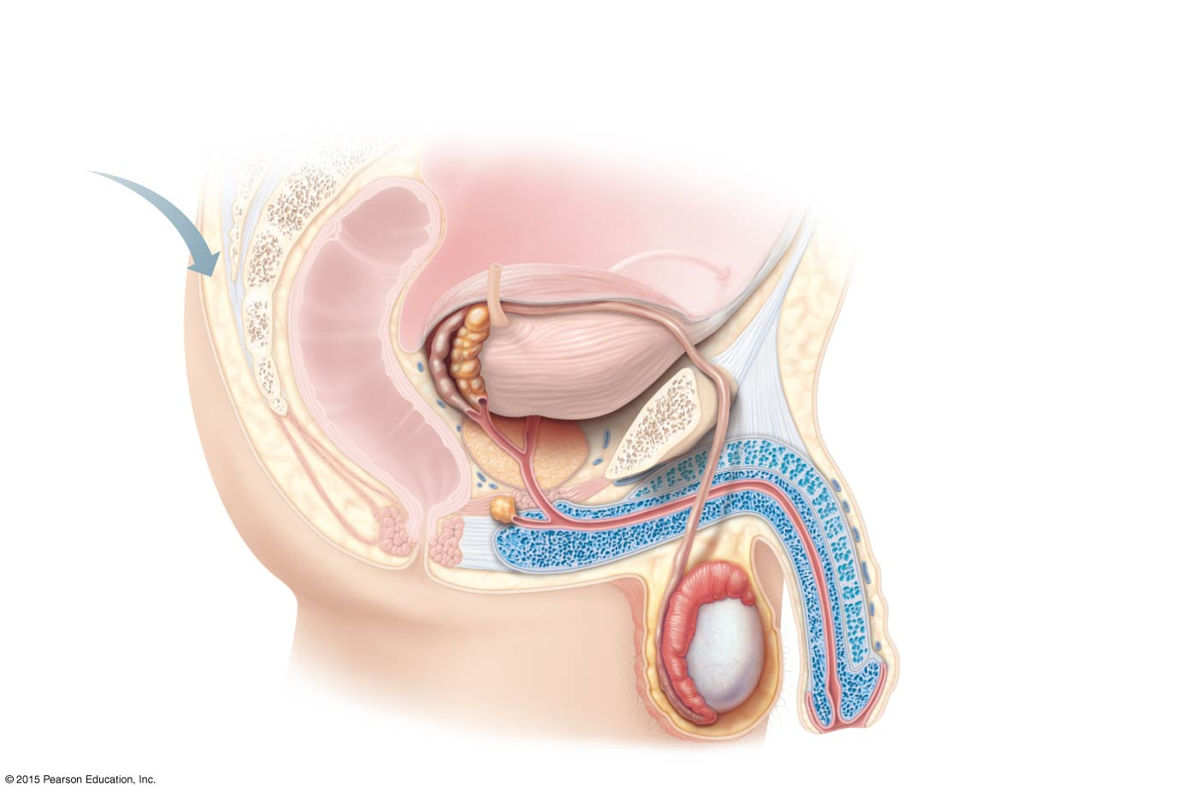
Figure 16.2a Male reproductive organs.
Ureter
Urinary bladder
Seminal vesicle
Prostatic urethra
Ampulla of ductus deferens
Pubis
Membranous urethra
Ejaculatory duct
Urogenital diaphragm
Rectum
Prostate
Erectile tissue of the penis
Bulbo-urethral gland
Spongy urethra
Ductus (vas) deferens
Shaft of the penis
Epididymis
Glans penis
Testis
Prepuce
Scrotum
External urethral orifice

Slide 6
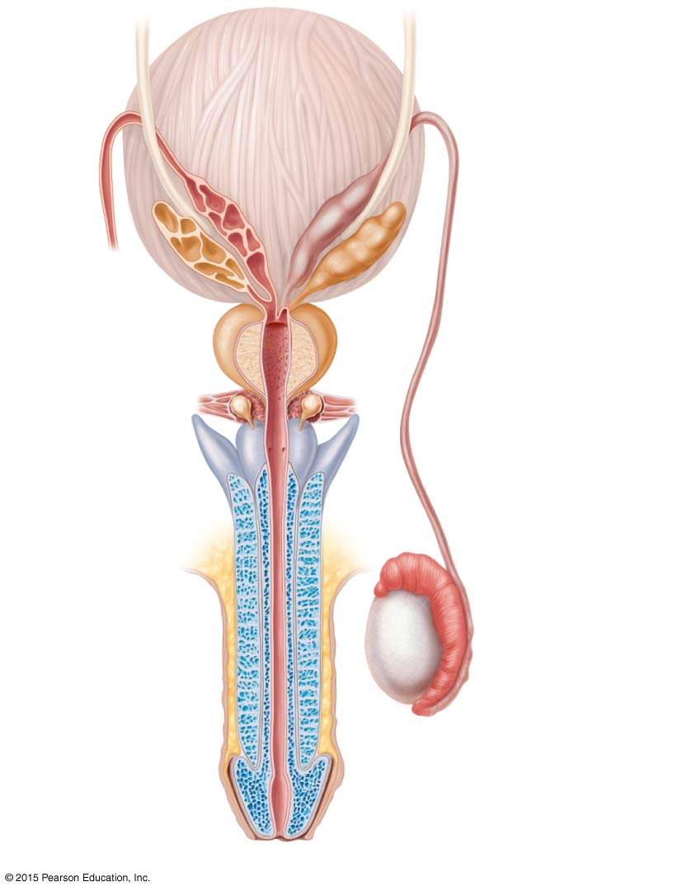
Figure 16.2b Male reproductive organs.
Urinary bladder
Ureter
Prostate
Ampulla of ductus deferens
Seminal vesicle
Prostatic urethra
Ejaculatory duct
Orifices of prostatic ducts
Bulbo-urethral gland
Membranous urethra
Ductus deferens
Root of penis
Erectile tissue of penis
Epididymis
Shaft (body) of penis
Testis
Spongy urethra
Glans penis
Prepuce
(b)
External urethral orifice

Slide 7
Testes
Coverings of the testes
Tunica albuginea—capsule that surrounds each testis
Septa—extensions of the capsule that extend into the testis and divide it into lobules

Slide 8
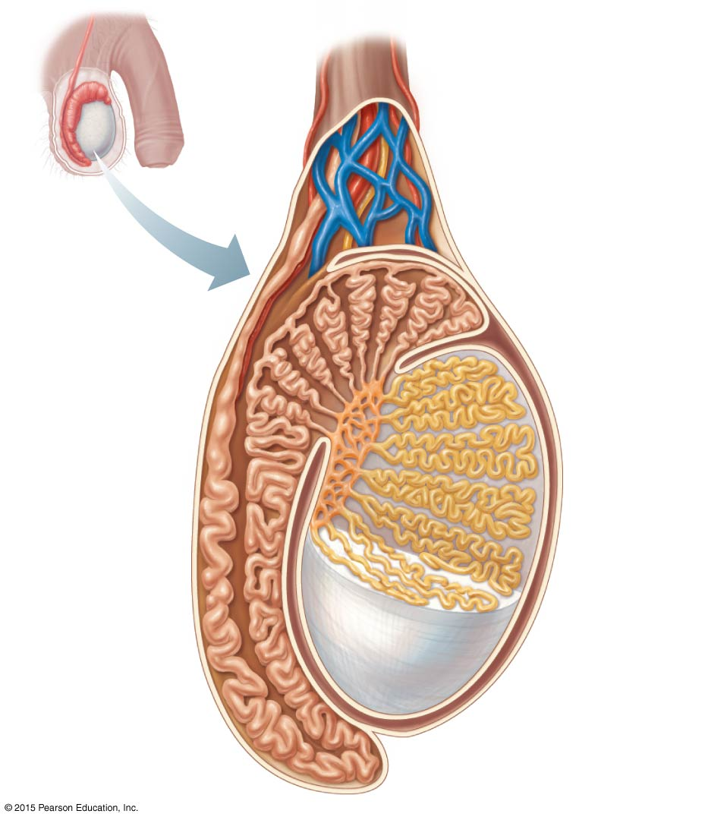
Figure 16.1 Sagittal section of the testis and associated epididymis.
Spermatic cord
Blood vessels and nerves
Seminiferous tubule
Rete testis
Ductus (vas) deferens
Lobule
Septum
Tunica albuginea
Epididymis

Slide 9
Testes
Each lobule contains one to four seminiferous tubules
Tightly coiled structures
Function as sperm-forming factories
Empty sperm into the rete testis (first part of the duct system)
Sperm travels through the rete testis to the epididymis
Interstitial cells in the seminiferous tubules produce androgens such as testosterone

Slide 10
Duct System
The duct system transports sperm from the body and includes:
Epididymis
Ductus (vas) deferens
Urethra

Slide 11
Duct System
Epididymis
Comma-shaped, tightly coiled tube
Found on the superior part of the testis and along the posterior lateral side
Sperm cells mature and gain the ability to swim over the course of 20 days in the epididymis
Sperm are expelled with the contraction of muscles in the epididymis walls to the ductus deferens

Slide 12
Figure 16.1 Sagittal section of the testis and associated epididymis.
Spermatic cord
Blood vessels and nerves
Seminiferous tubule
Rete testis
Ductus (vas) deferens
Lobule
Septum
Tunica albuginea
Epididymis

Slide 13
Duct System
Ductus (vas) deferens
Carries sperm from the epididymis to the ejaculatory duct
Passes through the inguinal canal and over the urinary bladder
Moves sperm by peristalsis
Spermatic cord—ductus deferens, blood vessels, and nerves in a connective tissue sheath

Slide 14
Duct System
Ductus (vas) deferens
Ejaculation—smooth muscle in the walls of the ductus deferens create peristaltic waves to squeeze sperm forward
Vasectomy—cutting of the ductus deferens at the level of the testes prevents transportation of sperm (form of birth control)

Slide 15
Duct System
Urethra
Extends from the base of the urinary bladder to the tip of the penis
Carries both urine and sperm
Sperm enters from the ejaculatory duct

Slide 16
Duct System
Urethra regions
Prostatic urethra—surrounded by prostate
Intermediate (membranous) urethra—travels from prostatic urethra to penis
Spongy (penile) urethra—runs the length of the penis to the external urethral orifice

Slide 17
Figure 16.2a Male reproductive organs.
Ureter
Urinary bladder
Seminal vesicle
Prostatic urethra
Ampulla of ductus deferens
Pubis
Membranous urethra
Ejaculatory duct
Urogenital diaphragm
Rectum
Prostate
Erectile tissue of the penis
Bulbo-urethral gland
Spongy urethra
Ductus (vas) deferens
Shaft of the penis
Epididymis
Glans penis
Testis
Prepuce
Scrotum
External urethral orifice

Slide 18
Figure 16.2b Male reproductive organs.
Urinary bladder
Ureter
Prostate
Ampulla of ductus deferens
Seminal vesicle
Prostatic urethra
Ejaculatory duct
Orifices of prostatic ducts
Bulbo-urethral gland
Membranous urethra
Ductus deferens
Root of penis
Erectile tissue of penis
Epididymis
Shaft (body) of penis
Testis
Spongy urethra
Glans penis
Prepuce
(b)
External urethral orifice

Slide 19
Accessory Glands and Semen
Seminal glands (vesicles)
Prostate
Bulbo-urethral glands

Slide 20
Accessory Glands and Semen
Seminal glands (vesicles)
Located at the base of the bladder
Produce a thick, yellowish secretion (60% of semen) that contains:
Fructose (sugar)
Vitamin C
Prostaglandins
Other substances that nourish and activate sperm

Slide 21
Accessory Glands and Semen
Prostate
Encircles the upper part of the urethra
Secretes a milky fluid
Helps to activate sperm
Fluid enters the urethra through several small ducts
Prostatitis–inflammation of the prostate
Prostate cancer–third most common cancer in males

Slide 22
Accessory Glands and Semen
Bulbo-urethral glands
Pea-sized glands inferior to the prostate
Produce a thick, clear mucus
Mucus cleanses the spongy (penile) urethra of acidic urine prior to ejaculation
Mucus serves as a lubricant during sexual intercourse
Mucus is released into the spongy urethra

Slide 23
Figure 16.2a Male reproductive organs.
Ureter
Urinary bladder
Seminal vesicle
Prostatic urethra
Ampulla of ductus deferens
Pubis
Membranous urethra
Ejaculatory duct
Urogenital diaphragm
Rectum
Prostate
Erectile tissue of the penis
Bulbo-urethral gland
Spongy urethra
Ductus (vas) deferens
Shaft of the penis
Epididymis
Glans penis
Testis
Prepuce
Scrotum
External urethral orifice

Slide 24
Figure 16.2b Male reproductive organs.
Urinary bladder
Ureter
Prostate
Ampulla of ductus deferens
Seminal vesicle
Prostatic urethra
Ejaculatory duct
Orifices of prostatic ducts
Bulbo-urethral gland
Membranous urethra
Ductus deferens
Root of penis
Erectile tissue of penis
Epididymis
Shaft (body) of penis
Testis
Spongy urethra
Glans penis
Prepuce
(b)
External urethral orifice

Slide 25
Accessory Glands and Semen
Semen
Milky white mixture of sperm and accessory gland secretions
Advantages of accessory gland secretions
Fructose provides energy for sperm cells
Alkalinity of semen helps neutralize the acidic environment of vagina
Semen inhibits bacterial multiplication
Elements of semen enhance sperm motility

Slide 26
External Genitalia
Scrotum
Penis

Slide 27
External Genitalia
Scrotum
Divided sac of skin outside the abdomen that houses the testes
Maintains testes at 3°C lower than normal body temperature to protect sperm viability

Slide 28
Figure 16.1 Sagittal section of the testis and associated epididymis.
Spermatic cord
Blood vessels and nerves
Seminiferous tubule
Rete testis
Ductus (vas) deferens
Lobule
Septum
Tunica albuginea
Epididymis

Slide 29
External Genitalia
Penis
Delivers sperm into the female reproductive tract
Regions of the penis
Shaft
Glans penis (enlarged tip)
Prepuce (foreskin)
Folded cuff of skin around proximal end
Often removed by circumcision

Slide 30
External Genitalia
Penis (continued)
Internally there are three areas of spongy erectile tissue around the urethra
Erections occur when this erectile tissue fills with blood during sexual excitement

Slide 31
Figure 16.2a Male reproductive organs.
Ureter
Urinary bladder
Seminal vesicle
Prostatic urethra
Ampulla of ductus deferens
Pubis
Membranous urethra
Ejaculatory duct
Urogenital diaphragm
Rectum
Prostate
Erectile tissue of the penis
Bulbo-urethral gland
Spongy urethra
Ductus (vas) deferens
Shaft of the penis
Epididymis
Glans penis
Testis
Prepuce
Scrotum
External urethral orifice

Slide 32
Figure 16.2b Male reproductive organs.
Urinary bladder
Ureter
Prostate
Ampulla of ductus deferens
Seminal vesicle
Prostatic urethra
Ejaculatory duct
Orifices of prostatic ducts
Bulbo-urethral gland
Membranous urethra
Ductus deferens
Root of penis
Erectile tissue of penis
Epididymis
Shaft (body) of penis
Testis
Spongy urethra
Glans penis
Prepuce
(b)
External urethral orifice

Slide 33
Spermatogenesis
Process of making sperm cells
Begins at puberty and continues throughout life
Sperm are formed in the seminiferous tubules

Slide 34
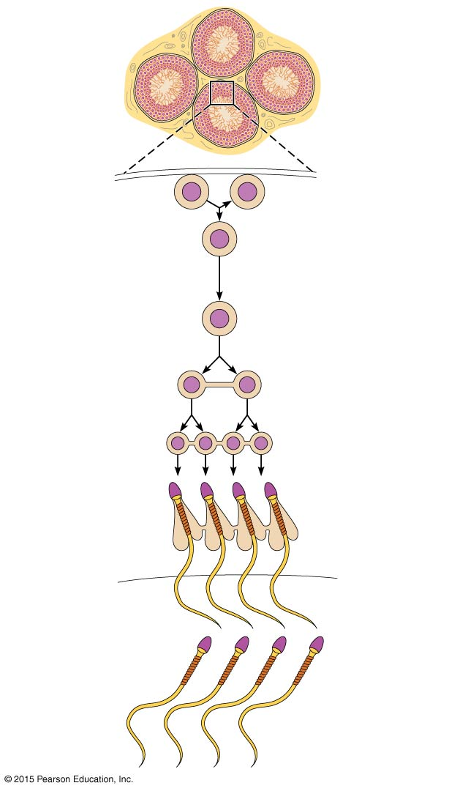
Figure 16.3 Spermatogenesis.
Seminiferous tubule
Basement membrane
Spermatogonium (stem cell)
2n
2n
Daughter cell type A (remains at basement membrane as a stem cell)
Mitosis
2n
Growth
Daughter cell type B (moves toward tubule lumen)
Enters prophase of meiosis I
2n
Primary spermatocyte
Meiosis
Meiosis I completed
n n
Secondary spermatocytes
Meiosis II
Spermatogenesis
n n n n
Early spermatids
n n n n
Late spermatids
Spermiogenesis
n n n n
Sperm
Lumen of seminiferous tubule

Slide 35
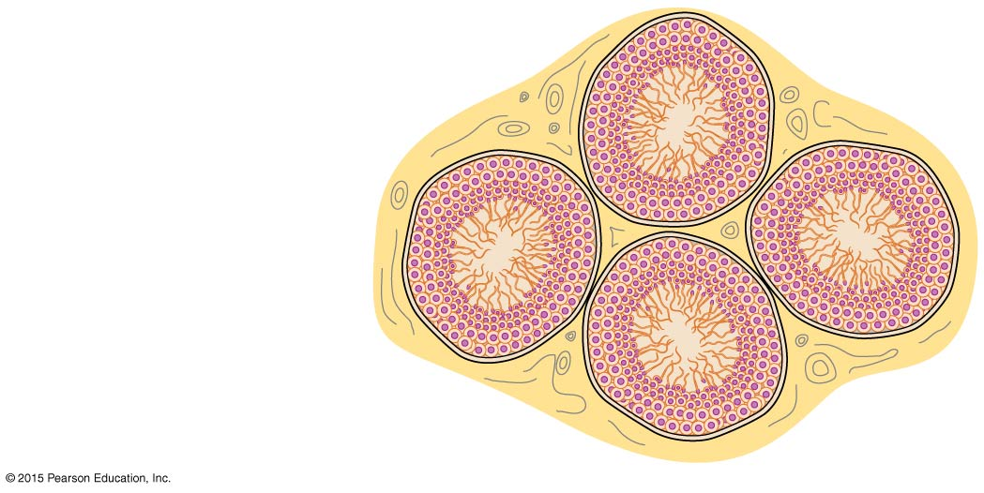
Figure 16.3 Spermatogenesis (1 of 2).
Seminiferous tubule

Slide 36
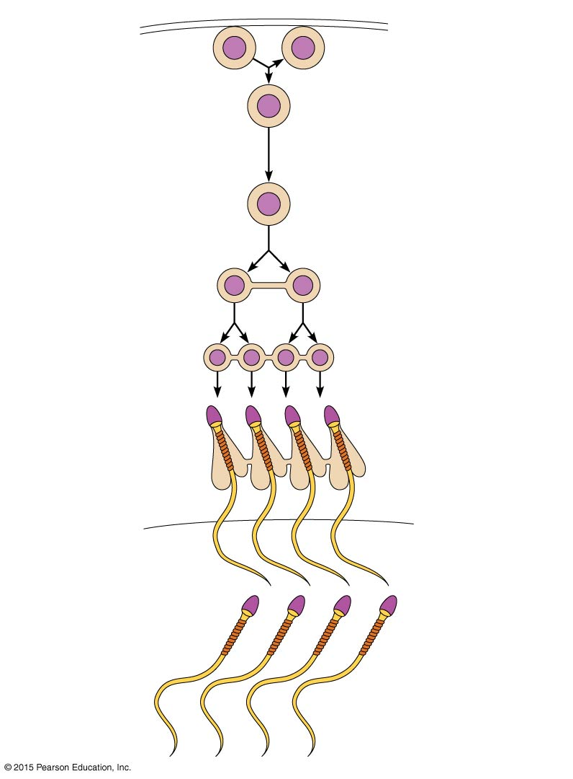
Figure 16.3 Spermatogenesis (2 of 2).
Basement membrane
2n
2n
Daughter cell type A (remains at basement membrane as a stem cell)
Spermatogonium (stem cell)
Mitosis
2n
Growth
Daughter cell type B (moves toward tubule lumen)
Enters prophase of meiosis I
2n
Primary spermatocyte
Meiosis
Meiosis I completed
n n
Secondary spermatocytes
Meiosis II
Early spermatids
n n n n
Spermatogenesis
Late spermatids
n n n n
Spermiogenesis
Sperm
n n n n
Lumen of seminiferous tubule

Slide 37
Spermatogenesis
Spermatogonia (stem cells) undergo rapid mitosis to produce more stem cells before puberty
During puberty, follicle-stimulating hormone (FSH) is secreted in increasing amounts

Slide 38
Concept Link

Slide 39
Spermatogenesis
Each division of a spermatogonium stem cell produces:
A stem cell, called a type A daughter cell, that continues the stem cell line
The other cell produced becomes a primary spermatocyte, called a type B daughter cell

Slide 40
Spermatogenesis
Primary spermatocytes undergo two successive divisions known as meiosis
One primary spermatocyte produces four haploid spermatids
Spermatids—23 chromosomes, n (half as much genetic material as other body cells)
Union of a sperm (23 chromosomes, n) with an egg (23 chromosomes, n) creates a zygote (2n, or 46 chromosomes)

Slide 41
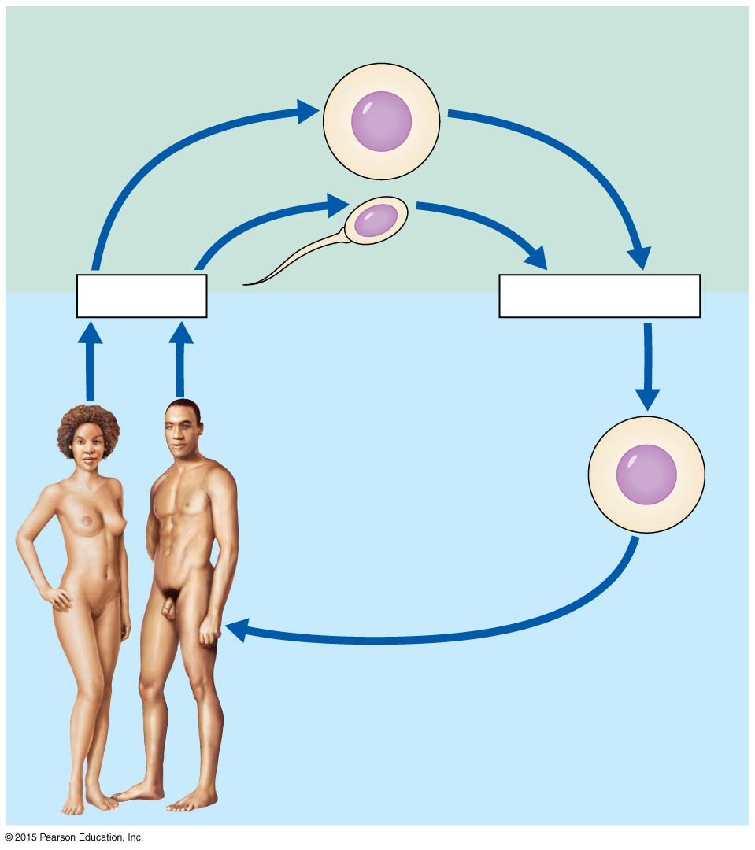
Figure 16.4 The human life cycle.
Gametes (n = 23)
n
Egg
n
Sperm
Meiosis
Fertilization
Multicellular adults (2n = 46)
Zygote (2n = 46)
2n
Mitosis and development

Slide 42
Spermatogenesis
Spermiogenesis
Streaming process that strips excess cytoplasm from a spermatid and modifies it into a sperm
Mature sperm is compacted into three regions: head, midpiece, tail
The entire process of spermatogenesis, including spermiogenesis, takes 64 to 72 days

Slide 43
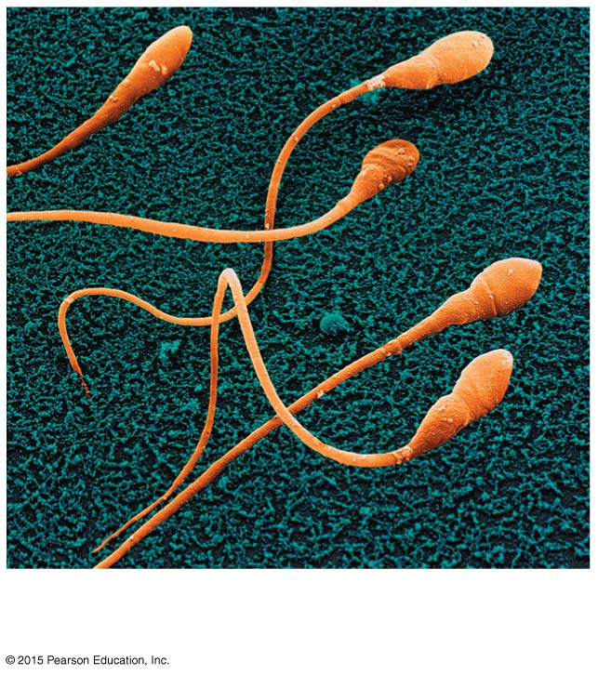
Figure 16.5a Structure of sperm.
(a)

Slide 44
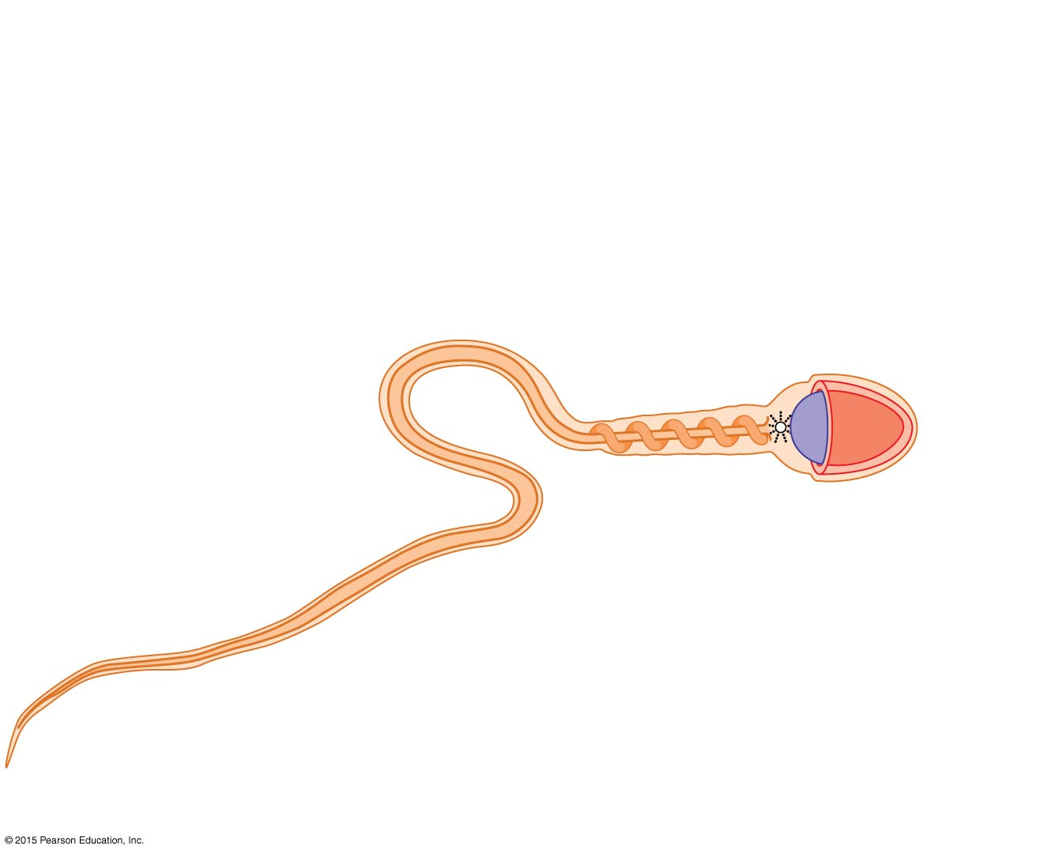
Figure 16.5b Structure of sperm.
Provides genetic instructions and a means of penetrating the follicle cell capsule and oocyte membrane
Provides energy for mobility
Plasma membrane
Neck
Provides for mobility
Tail
Head
Midpiece
Axial filament
of tail
Acrosome
Nucleus
Mitochondria
Proximal centriole

Slide 45
Testosterone Production
Testosterone is the most important hormone of the testes
Produced by interstitial cells in the testes
During puberty, luteinizing hormone (LH) from the anterior pituitary activates the interstitial cells
In turn, testosterone is produced

Slide 46
Testosterone Production
Testosterone
Stimulates reproductive organ development
Underlies sex drive
Causes secondary sex characteristics
Deepening of voice
Increased hair growth
Enlargement of skeletal muscles
Increased bone growth and density

Slide 47
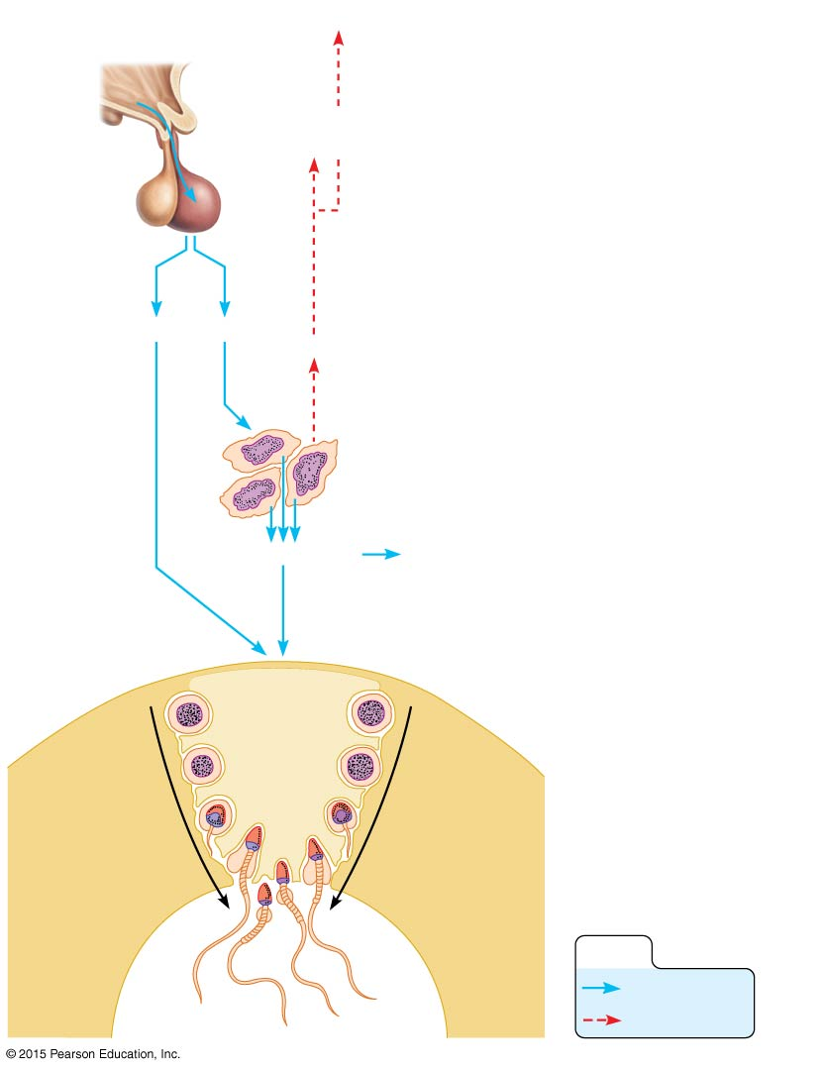
Figure 16.6 Hormonal control of the testis.
Slide 1
Hypothalamus
The hypothalamus releases gonadotropin-releasing hormone (GnRH).
1
1
GnRH
Anterior pituitary
GnRH stimulates the anterior pituitary to release gonadotropins —FSH and LH.
2
3
FSH stimulates spermatogenic cells to produce sperm.
2
5
LH stimulates the interstitial cells to release testosterone, which serves as the final trigger for spermatogenesis. Testosterone then enhances spermatogenesis.
4
FSH
LH
Testosterone
3
4
5
Rising level of testosterone exerts feedback inhibition on the hypothalamus and pituitary.
5
Testosterone
Primary and secondary sex characteristics
Supporting cell
Seminiferous tubule in testis
FSH and testosterone stimulate sperm production
Spermatogenic cells
Spermatogenesis
KEY:
Stimulates
Inhibits

Slide 48
Anatomy of the Female Reproductive System
Ovaries
Duct system
Uterine (fallopian) tubes
Uterus
Vagina
External genitalia

Slide 49
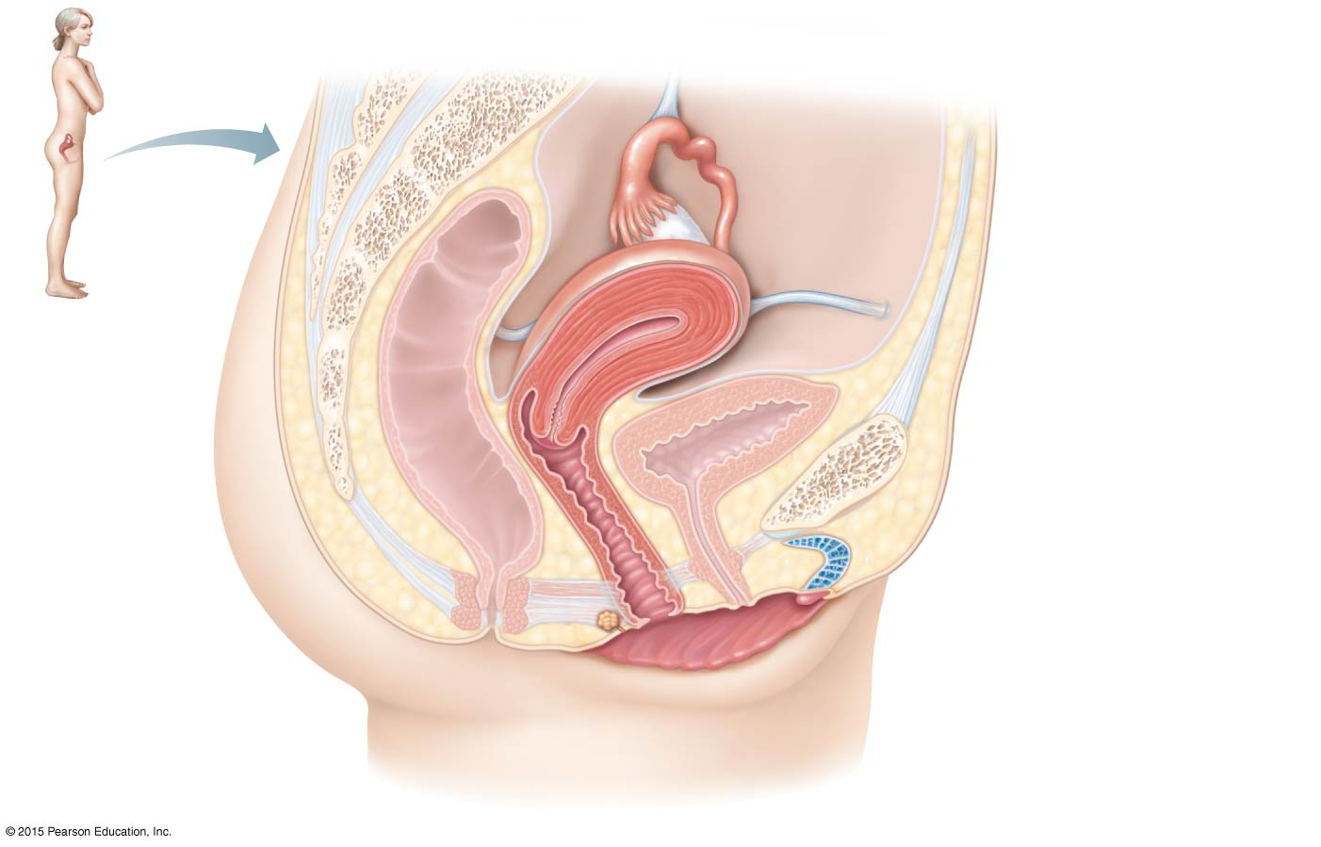
Figure 16.8a The human female reproductive organs.
Suspensory ligament of ovary (part of broad ligament)
Infundibulum
Uterine tube
Ovary
Fimbriae
Uterus (fundus)
Uterosacral ligament
Round ligament
Urinary bladder
Rectum
Pubic symphysis
Mons pubis
Cervix
Urethra
Vagina
Clitoris
Anus
Hymen
Greater vestibular gland
Labium minus
Labium majus
(a)

Slide 50
Ovaries
The ovaries house many ovarian follicles (sac-like structures)
Each follicle consists of:
Oocyte (immature egg)
Follicle cells—layers of different cells that surround the oocyte

Slide 51
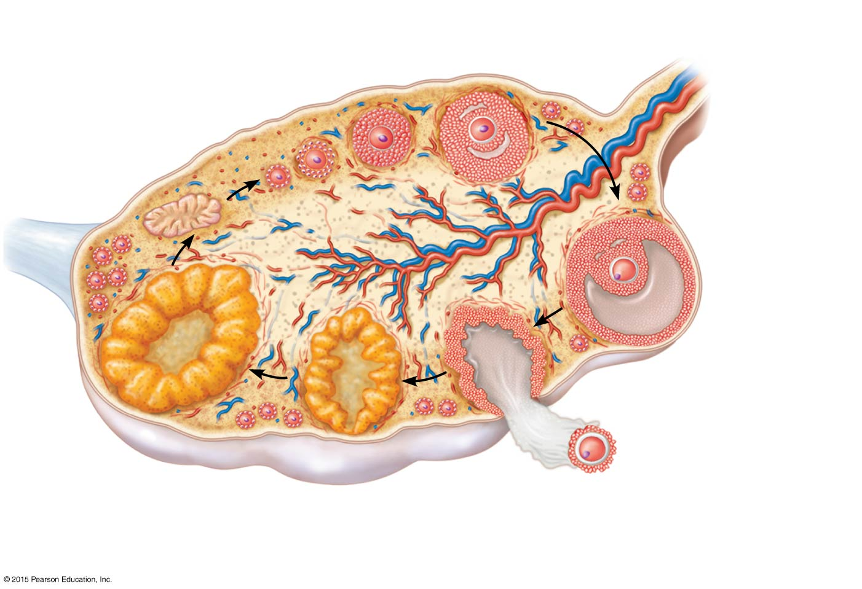
Figure 16.7 Sagittal view of a human ovary showing the developmental stages of an ovarian follicle.
Primary follicle
Growing follicles
Degenerating corpus luteum
Blood vessels
Antrum
Corona radiata
Mature vesicular (Graafian) follicle
Germinal epithelium
Corpus luteum
Developing corpus luteum
Ruptured follicle
Ovulation
Secondary oocyte

Slide 52
Ovaries
Primary follicle—contains an immature oocyte
Vesicular (Graafian) follicle—growing follicle with a maturing oocyte
Ovulation—the follicle ruptures when the egg is mature and ready to be ejected from the ovary; occurs about every 28 days
The ruptured follicle is transformed into a corpus luteum

Slide 53
Ovaries
Suspensory ligaments secure the ovaries to the lateral walls of the pelvis
Ovarian ligaments anchor the ovaries to the uterus
Broad ligaments, a fold of peritoneum, enclose and hold the ovaries in place

Slide 54
Figure 16.8a The human female reproductive organs.
Suspensory ligament of ovary (part of broad ligament)
Infundibulum
Uterine tube
Ovary
Fimbriae
Uterus (fundus)
Uterosacral ligament
Round ligament
Urinary bladder
Rectum
Pubic symphysis
Mons pubis
Cervix
Urethra
Vagina
Clitoris
Anus
Hymen
Greater vestibular gland
Labium minus
Labium majus
(a)

Slide 55
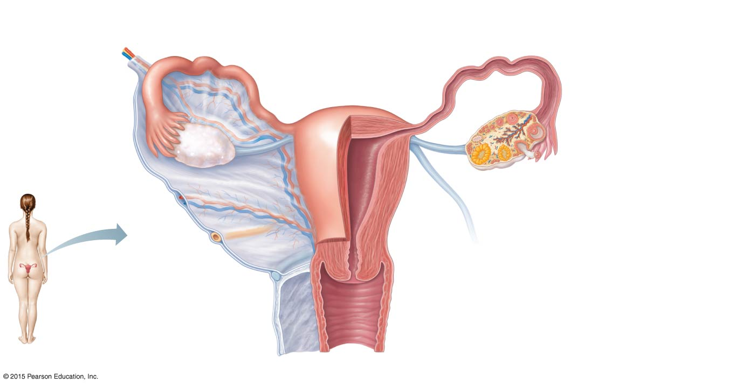
Figure 16.8b The human female reproductive organs.
Suspensory ligament of ovary
Uterine (fallopian) tube
Fundus of uterus
Lumen (cavity) of uterus
Ovarian blood vessels
Ovary
Broad ligament
Infundibulum
Uterine tube
Fimbriae
Ovarian ligament
Round ligament of uterus
Body of uterus
Endometrium
Myometrium
Wall of uterus
Ureter
Perimetrium
Uterine blood vessels
Cervical canal
Uterosacral ligament
Cervix
Vagina
(b)

Slide 56
Duct System
Uterine (fallopian) tubes
Uterus
Vagina

Slide 57
Duct System
Uterine (fallopian) tubes
Receive the ovulated oocyte from the ovaries
Provide a site for fertilization
Empty into the uterus
Little or no contact between ovaries and uterine tubes
Supported and enclosed by the broad ligament

Slide 58
Duct System
Uterine (fallopian) tube structure
Fimbriae
Fingerlike projections at the distal end of the uterine tube
Receive the oocyte from the ovary
Cilia
Located inside the uterine tube
Slowly move the oocyte towards the uterus (takes 3 to 4 days)

Slide 59
Figure 16.8b The human female reproductive organs.
Suspensory ligament of ovary
Uterine (fallopian) tube
Fundus of uterus
Lumen (cavity) of uterus
Ovarian blood vessels
Ovary
Broad ligament
Infundibulum
Uterine tube
Fimbriae
Ovarian ligament
Round ligament of uterus
Body of uterus
Endometrium
Myometrium
Wall of uterus
Ureter
Perimetrium
Uterine blood vessels
Cervical canal
Uterosacral ligament
Cervix
Vagina
(b)

Slide 60
Duct System
Uterus
Pear-shaped muscular organ situated between the urinary bladder and rectum
Receives, retains, nourishes a fertilized egg

Slide 61
Duct System
Uterus
Broad ligament suspends the uterus in the pelvis
Round ligament anchors the uterus anteriorly
Uterosacral ligament anchors the uterus posteriorly

Slide 62
Duct System
Regions of the uterus:
Body—main portion
Fundus—superior rounded region above where uterine tube enters
Cervix—narrow outlet that protrudes into the vagina

Slide 63
Duct System
Walls of the uterus
Endometrium
Inner layer
Allows for implantation of a fertilized egg
Sloughs off if no pregnancy occurs (menses)
Myometrium is the middle layer of smooth muscle that contracts during labor
Perimetrium (visceral peritoneum) is the outermost serous layer of the uterus

Slide 64
Duct System
Vagina
Passageway that extends from cervix to exterior of body and is located between urinary bladder and rectum
Serves as the canal that allows a baby or menstrual flow to leave the body
Receives the penis during sexual intercourse
Hymen—partially closes the vagina until it is ruptured

Slide 65
Figure 16.8a The human female reproductive organs.
Suspensory ligament of ovary (part of broad ligament)
Infundibulum
Uterine tube
Ovary
Fimbriae
Uterus (fundus)
Uterosacral ligament
Round ligament
Urinary bladder
Rectum
Pubic symphysis
Mons pubis
Cervix
Urethra
Vagina
Clitoris
Anus
Hymen
Greater vestibular gland
Labium minus
Labium majus
(a)

Slide 66
Figure 16.8b The human female reproductive organs.
Suspensory ligament of ovary
Uterine (fallopian) tube
Fundus of uterus
Lumen (cavity) of uterus
Ovarian blood vessels
Ovary
Broad ligament
Infundibulum
Uterine tube
Fimbriae
Ovarian ligament
Round ligament of uterus
Body of uterus
Endometrium
Myometrium
Wall of uterus
Ureter
Perimetrium
Uterine blood vessels
Cervical canal
Uterosacral ligament
Cervix
Vagina
(b)

Slide 67
External Genitalia and Female Perineum
The female external genitalia, or vulva, includes:
Mons pubis
Labia
Clitoris
Urethral orifice
Vaginal orifice
Greater vestibular glands

Slide 68
Figure 16.9 External genitalia of the human female.
Mons pubis
Labia majora
Prepuce of clitoris
Clitoris
Vestibule
Urethral orifice
Vaginal orifice
Opening of duct of greater vestibular gland
Labia minora
Perineum
Anus

Slide 69
External Genitalia and Female Perineum
Mons pubis
Fatty area overlying the pubic symphysis
Covered with pubic hair after puberty

Slide 70
External Genitalia and Female Perineum
Labia—skin folds
Labia majora
Hair-covered skin folds
Enclose the labia minora
Also encloses the vestibule
Labia minora—delicate, hair-free folds of skin

Slide 71
External Genitalia and Female Perineum
Vestibule
Enclosed by labia majora
Contains external openings of the urethra and vagina
Greater vestibular glands
One is found on each side of the vagina
Secretes lubricant during intercourse

Slide 72
External Genitalia and Female Perineum
Clitoris
Contains erectile tissue
Corresponds to the male penis
The clitoris is similar to the penis in that it is:
Hooded by a prepuce
Composed of sensitive erectile tissue
Swollen with blood during sexual excitement

Slide 73
External Genitalia and Female Perineum
Perineum
Diamond-shaped region between the anterior ends of the labial folds, anus posteriorly, and ischial tuberosities laterally

Slide 74
Figure 16.9 External genitalia of the human female.
Mons pubis
Labia majora
Prepuce of clitoris
Clitoris
Vestibule
Urethral orifice
Vaginal orifice
Opening of duct of greater vestibular gland
Labia minora
Perineum
Anus

Slide 75
Female Reproductive Functions and Cycles
The total supply of eggs is determined by the time a female is born
Ability to release eggs begins at puberty
Reproductive ability ends at menopause
Oocytes are matured in developing ovarian follicles

Slide 76
Oogenesis and the Ovarian Cycle
Oogenesis is the process of producing ova (eggs) in a female
Oogonia are female stem cells found in a developing fetus
Oogonia undergo mitosis to produce primary oocytes that are surrounded by cells that form primary follicles in the ovary

Slide 77
Oogenesis and the Ovarian Cycle
Primary oocytes are inactive until puberty
Follicle stimulating hormone (FSH) causes some primary follicles to mature each month
Cyclic monthly changes constitute the ovarian cycle

Slide 78
Oogenesis and the Ovarian Cycle
Meiosis starts inside maturing follicle
Produces a secondary oocyte and the first polar body
Follicle development to the stage of a vesicular follicle takes about 14 days
Ovulation of a secondary oocyte occurs with the release of luteinizing hormone (LH)
Secondary oocyte is released and surrounded by a corona radiata

Slide 79
Oogenesis and the Ovarian Cycle
Meiosis is completed after ovulation only if sperm penetrates the oocyte
Ovum is produced
Two additional polar bodies are produced
Once ovum is formed, the 23 chromosomes can be combined with the 23 chromosomes of the sperm to form the fertilized egg (zygote)
If the secondary oocyte is not penetrated by a sperm, it dies and does not complete meiosis to form an ovum

Slide 80
Male and Female Differences
Meiosis
Males—produces four functional sperm
Females—produces one functional ovum and three tiny polar bodies
Sex cell size and structure
Sperm are tiny, motile, and equipped with nutrients in seminal fluid
Egg is large, is nonmotile, and has nutrient reserves to nourish the embryo until implantation

Slide 81
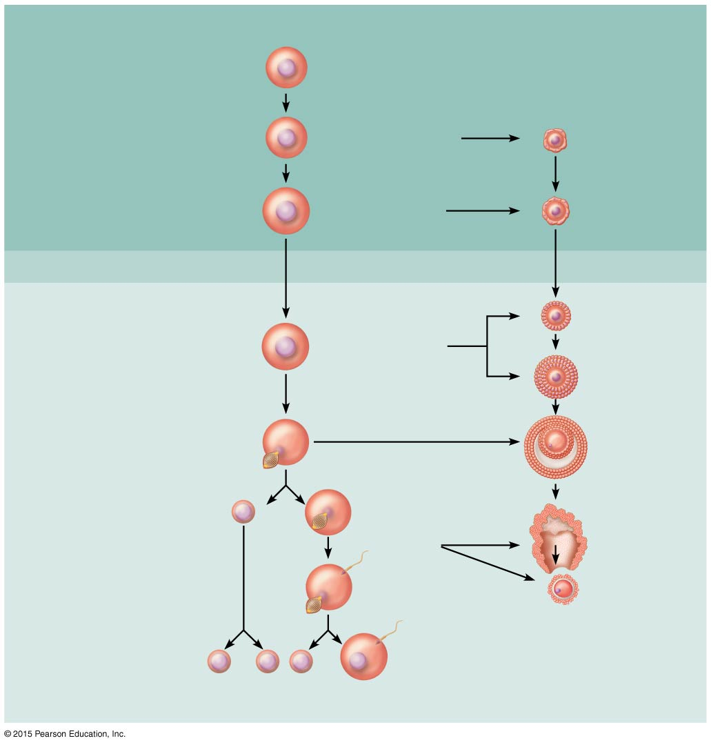
Figure 16.10 Events of oogenesis.
Meiotic Events
Follicle Development in Ovary
Before birth
2n
Oogonium (stem cell)
Mitosis
Follicle cells
Oocyte
2n
Primary oocyte
Primary follicle
Growth
2n
Primary oocyte (arrested in prophase I; present at birth)
Primary follicle
Childhood
(ovary inactive)
Monthly from puberty to menopause
Primary follicle
2n
Primary oocyte (still arrested in prophase I)
Growing follicle
Mature vesicular (Graafian) follicle
Meiosis I (completed by one primary oocyte each month)
Secondary oocyte (arrested in metaphase II)
First polar body
n
Ovulation
Sperm
Ovulated secondary oocyte
Meiosis II of polar body (may or may not occur)
Meiosis II completed (only if sperm penetration occurs)
n
n
n
n
Polar bodies (all polar bodies degenerate)
Second polar body
Ovum

Slide 82
Uterine (Menstrual) Cycle
Cyclic changes of the endometrium about 28 days in length
Regulated by cyclic production of estrogens and progesterone by the ovaries
FSH and LH, from the anterior pituitary, regulate the production of estrogens and progesterone by the ovaries
Ovulation typically occurs about midway through cycle, on day 14

Slide 83
Uterine (Menstrual) Cycle
Stages of the menstrual cycle
Menstrual phase
Proliferative stage
Secretory stage

Slide 84
Uterine (Menstrual) Cycle
Menstrual phase
Days 1 to 5
Functional layer of the endometrium is sloughed
Bleeding occurs for 3 to 5 days
Ovarian hormones are at their lowest levels
By day 5, growing ovarian follicles are producing more estrogen

Slide 85
Uterine (Menstrual) Cycle
Proliferative stage
Days 6 to 14
Regeneration of functional layer of the endometrium
Endometrium is repaired, thickens, and becomes well vascularized
Estrogen levels rise
Ovulation occurs in the ovary at the end of this stage

Slide 86
Uterine (Menstrual) Cycle
Secretory stage
Days 15 to 28
Levels of progesterone rise and increase the blood supply to the endometrium, which becomes more vascular
Progesterone is produced by the corpus luteum, which produces hormones until 10 to 14 days after ovulation
Endometrium increases in size and readies for implantation

Slide 87
Uterine (Menstrual) Cycle
Secretory stage (continued)
If fertilization does occur:
Embryo produces a hormone that causes the corpus luteum to continue producing its hormones
If fertilization does NOT occur:
Corpus luteum degenerates as LH blood levels decline
The phases are repeated about every 28 days

Slide 88
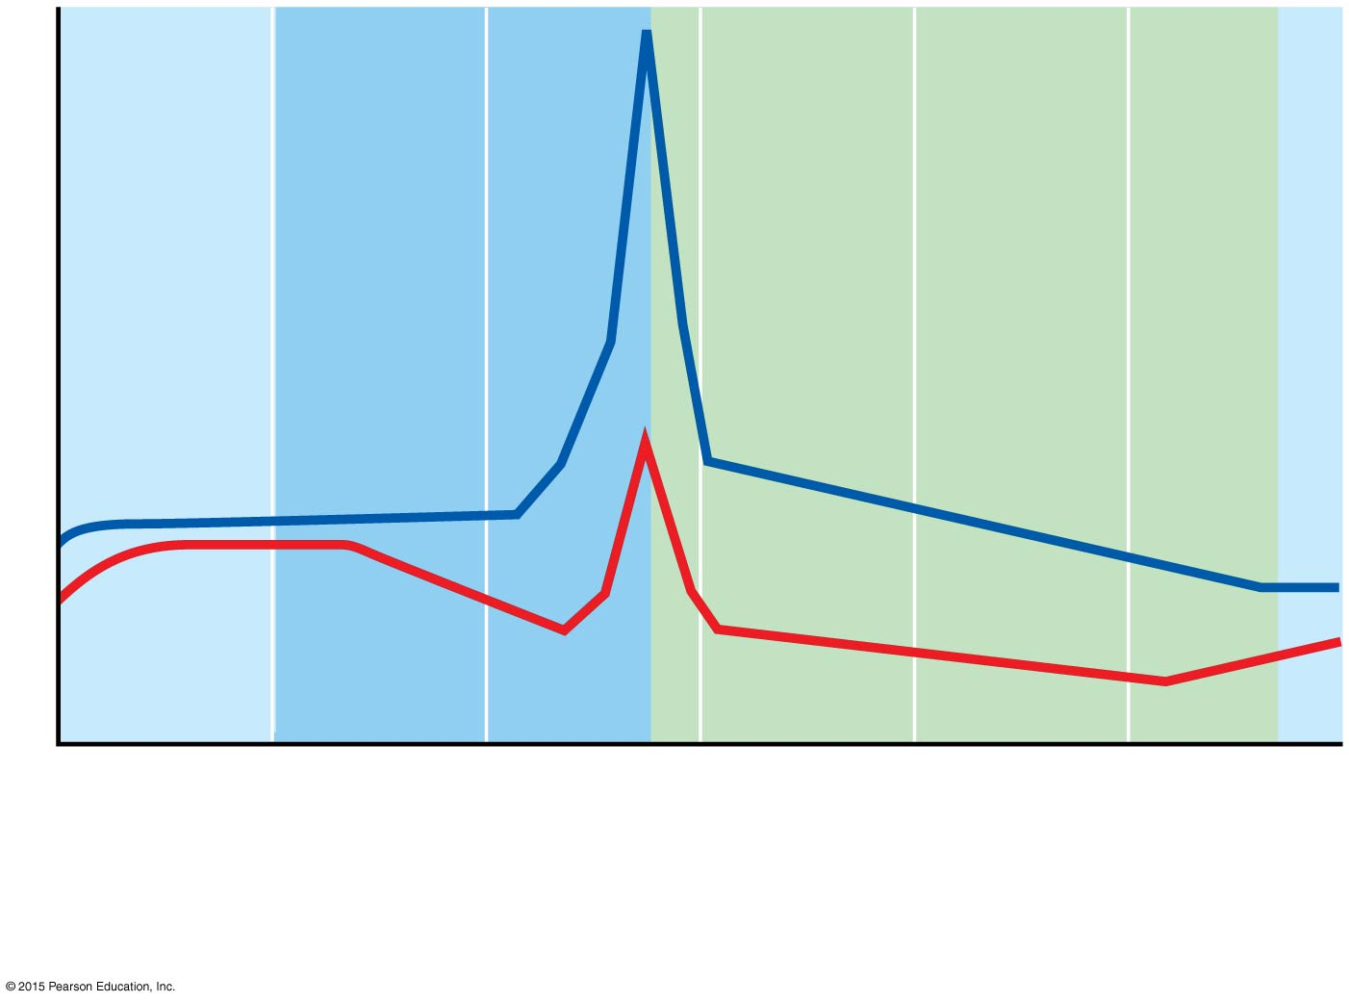
Figure 16.12a Hormonal interactions of the female cycles.
LH
Plasma hormone level
FSH
(a) Fluctuation of gonadotropin levels: Fluctuating levels of pituitary gonadotropins (FSH and LH) in the blood regulate the events of the ovarian cycle.

Slide 89
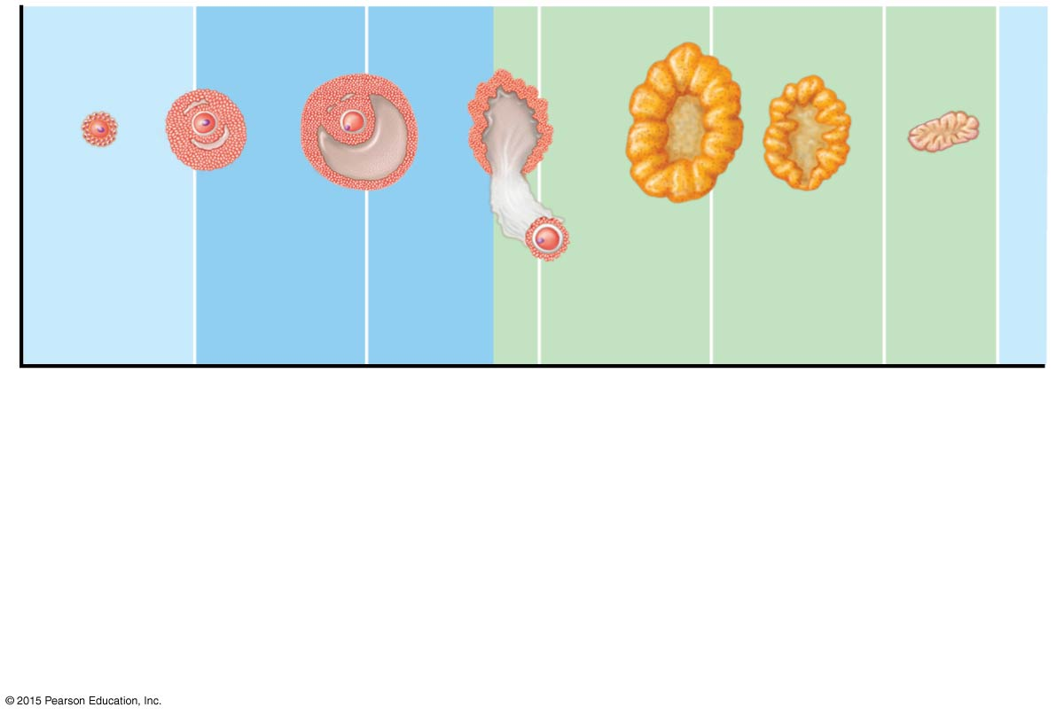
Figure 16.12b Hormonal interactions of the female cycles.
Primary follicle
Secondary follicle
Vesicular follicle
Ovulation
Corpus luteum
Degenerating corpus luteum
Follicular phase
Ovulation (Day 14)
Luteal phase
(b) Ovarian cycle: Structural changes in the ovarian follicles during the ovarian cycle are correlated with (d) changes in the endometrium of the uterus during the uterine cycle.

Slide 90
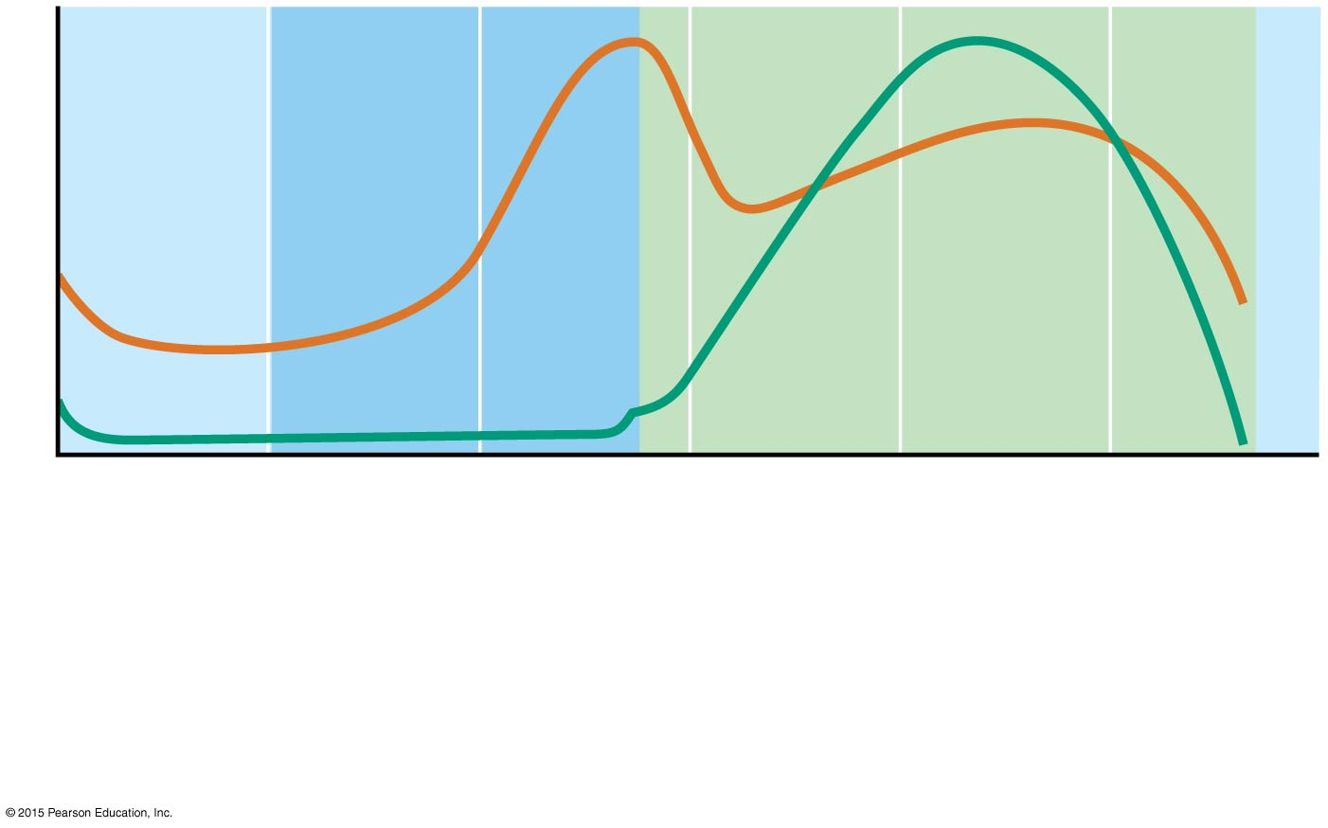
Figure 16.12c Hormonal interactions of the female cycles.
Plasma hormone level
Estrogens
Progesterone
(c) Fluctuation of ovarian hormone levels: Fluctuating levels of ovarian hormones (estrogens and progesterone) cause the endometrial changes of the uterine cycle. The high estrogen levels are also responsible for the LH/FSH surge in (a).

Slide 91
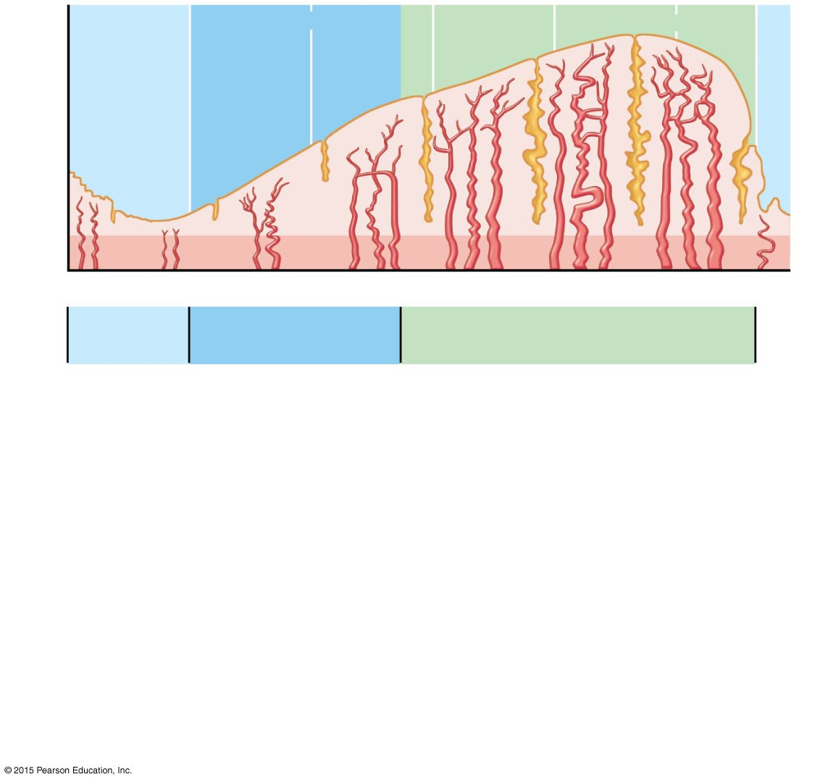
Figure 16.12d Hormonal interactions of the female cycles.
Endometrial glands
Blood vessels
Functional layer
Menstrual flow
Basal layer
1 5 10 15 20 25 28 Days
Menstrual phase
Proliferative phase
Secretory phase
The menstrual and proliferative phases occur before ovulation, and together correspond to the follicular phase of the ovarian cycle. The secretory phase corresponds in time to the luteal phase of the ovarian cycle.
(d) The three phases of the uterine cycle: • Menstrual: Shedding of the functional layer of the endometrium. • Proliferative: Rebuilding of the functional layer of the endometrium. • Secretory: Begins immediately after ovulation. Enrichment of the blood supply and glandular secretion of nutrients prepare the endometrium to receive an embryo.

Slide 92
Hormone Production by the Ovaries
Estrogens are produced by follicle cells
Cause secondary sex characteristics
Enlargement of accessory organs of the female reproductive system
Development of breasts
Appearance of axillary and pubic hair
Increase in fat beneath the skin, particularly in hips and breasts
Widening and lightening of the pelvis
Onset of menses (menstrual cycle)

Slide 93
Hormone Production by the Ovaries
Progesterone is produced by the corpus luteum
Production continues until LH diminishes in the blood
Does not contribute to the appearance of secondary sex characteristics
Other major effects
Helps maintain pregnancy
Prepares the breasts for milk production

Slide 94
Figure 16.7 Sagittal view of a human ovary showing the developmental stages of an ovarian follicle.
Primary follicle
Growing follicles
Degenerating corpus luteum
Blood vessels
Antrum
Corona radiata
Mature vesicular (Graafian) follicle
Germinal epithelium
Corpus luteum
Developing corpus luteum
Ruptured follicle
Ovulation
Secondary oocyte

Slide 95
Mammary Glands
Present in both sexes, but function only in females
Modified sweat glands
Function is to produce milk to nourish a newborn
Stimulated by sex hormones (mostly estrogens) to increase in size

Slide 96
Mammary Glands
Areola—central pigmented area
Nipple—protruding central area of areola
Lobes—internal structures that radiate around nipple
Lobules—located within each lobe and contain clusters of alveolar glands
Alveolar glands—produce milk when a woman is lactating (producing milk)
Lactiferous ducts—connect alveolar glands to nipple

Slide 97
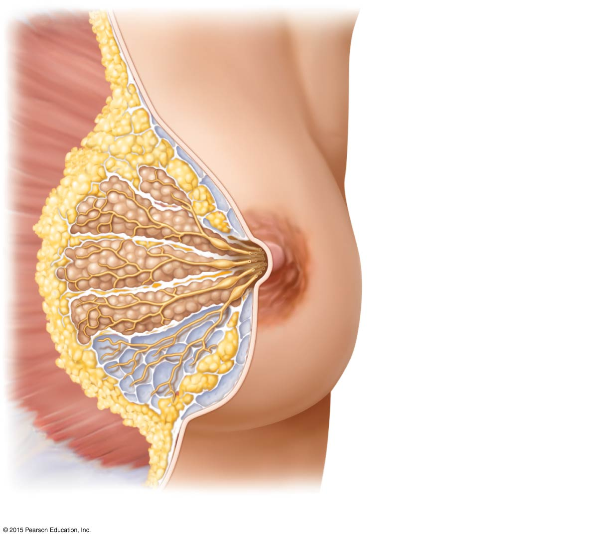
Figure 16.13a Female mammary glands.
Skin (cut)
Pectoralis major muscle
Connective tissue suspensory ligament
Adipose tissue
Lobe
Areola
Nipple
Lactiferous sinus
Lactiferous duct
Lobule containing alveoli
(a)

Slide 98
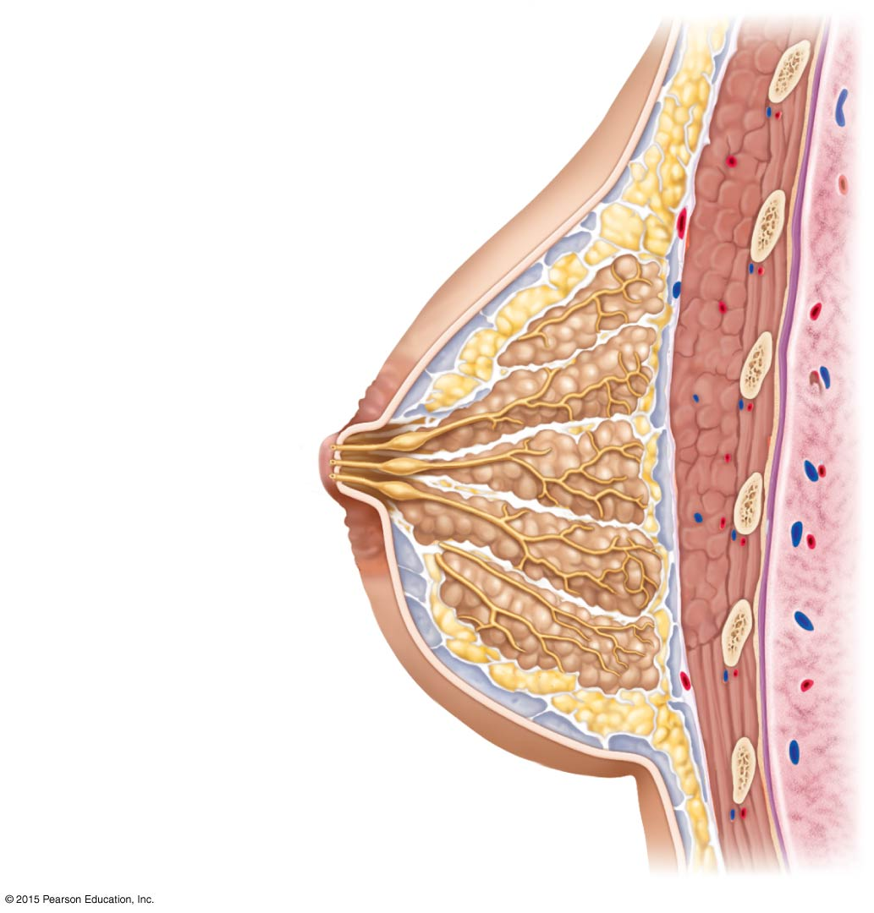
Figure 16.13b Female mammary glands.
Skin (cut)
First rib
Pectoralis major muscle
Connective tissue suspensory ligament
Adipose tissue
Lobe
Areola
Nipple
Opening of lactiferous duct
Lactiferous sinus
Lactiferous duct
Lobule containing alveoli
Hypodermis (superficial fascia)
Intercostal muscles
(b)

Slide 99
Mammography
Mammography is X-ray examination that detects breast cancers too small to feel
Recommended every 2 years for women between 40 and 49 years old and yearly thereafter
Breast cancer is often signaled by a change in skin texture, puckering, or leakage from the nipple

Slide 100
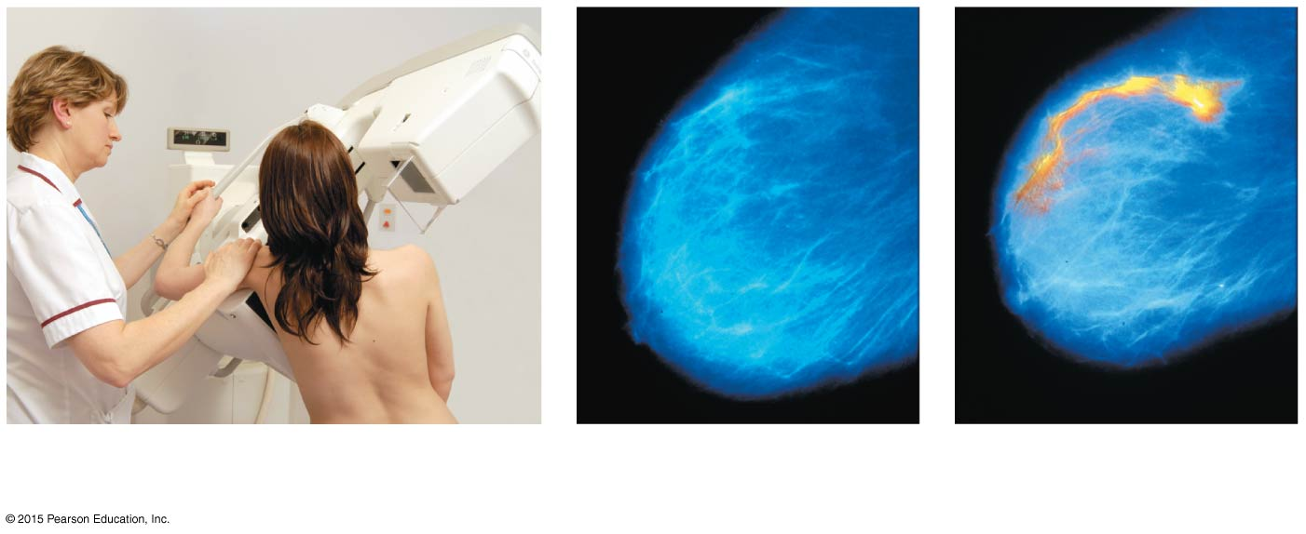
Figure 16.14 Mammograms.
Malignancy
(a) Mammogram procedure
(b) Film of normal breast
(c) Film of breast with tumor

Slide 101
Pregnancy and Embryonic Development
Pregnancy—time from fertilization until infant is born
Conceptus—developing offspring
Embryo—period of time from fertilization until week 8
Fetus—week 9 until birth
Gestation period—from date of last period until birth (approximately 280 days)

Slide 102
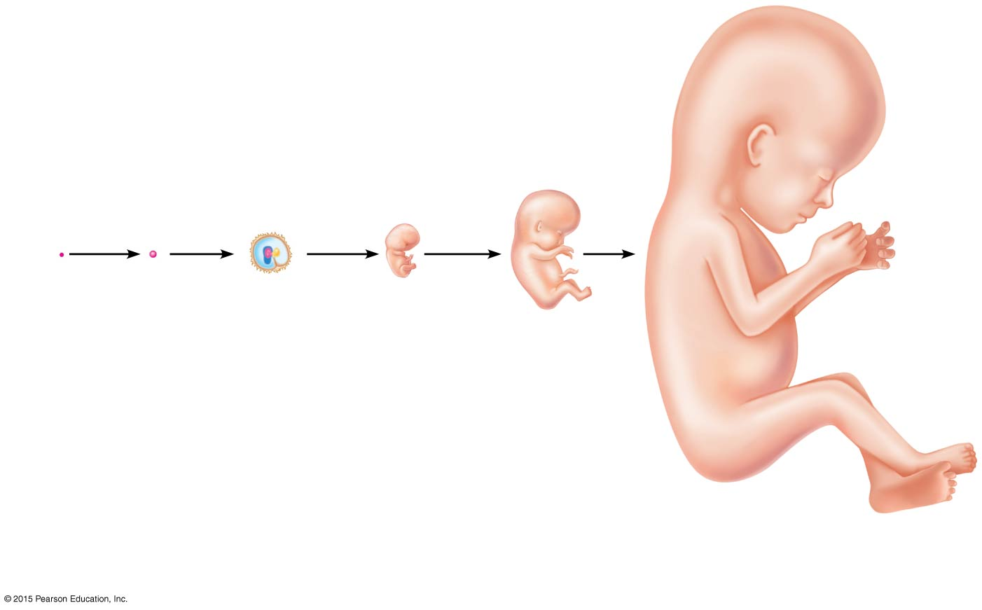
Figure 16.15 Diagrams showing the approximate size of a human conceptus from fertilization to the early fetal stage.
Embryo
Fertilization
1-week conceptus
3-week embryo (3 mm)
5-week embryo (10 mm)
8-week embryo (22 mm)
12-week fetus (90 mm)

Slide 103
Accomplishing Fertilization
An oocyte is viable up to 24 hours after ovulation
Sperm are viable up to 48 hours after ejaculation
For fertilization to occur, sexual intercourse must occur no more than 2 days before ovulation and no later than 24 hours after
Sperm cells must make their way to the uterine tube for fertilization to be possible

Slide 104
Accomplishing Fertilization
When sperm reach the oocyte, enzymes break down the follicle cells of the corona radiata around the oocyte
Once a path is cleared, sperm undergo an acrosomal reaction (acrosomal membranes break down, and enzymes digest holes in the oocyte membrane)
Membrane receptors on an oocyte pull in the head of the first sperm cell to make contact

Slide 105
Accomplishing Fertilization
The membrane of the oocyte does not permit a second sperm head to enter
The oocyte then undergoes its second meiotic division to form the ovum and a polar body
Fertilization occurs when the genetic material of a sperm combines with that of an oocyte to form a zygote

Slide 106
Events of Embryonic & Fetal Development
Zygote
First cell of a new individual
The zygote is the result of the fusion of DNA from sperm and egg
The zygote begins rapid mitotic cell divisions, known as cleavage, 24 hours after fertilization
The zygote journeys down the uterine tube, moving toward the uterus

Slide 107
Events of Embryonic & Fetal Development
Cleavage
Rapid series of mitotic divisions that begins with the zygote and ends with the blastocyst
3 to 4 days after ovulation, the preembryo reaches the uterus and floats freely for 2 to 3 days
Late blastocyst stage—embryo attaches to the endometrium (day 7 after ovulation)
By day 14 after ovulation, implantation has occurred and the placenta is forming

Slide 108
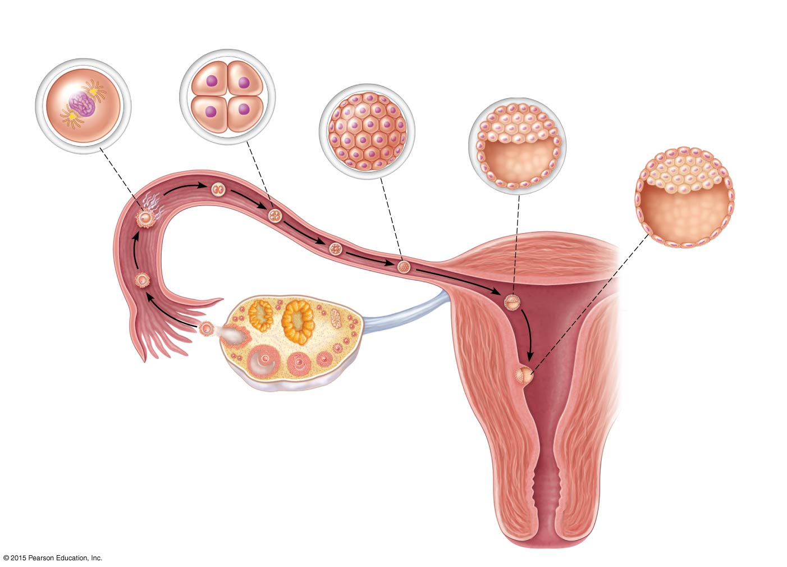
Figure 16.16 Cleavage is a rapid series of mitotic divisions that begins with the zygote and ends with the blastocyst.
Slide 1
(a) Zygote (fertilized egg)
(b) 4-cell stage 2 days
(c) Morula (a solid ball of blastomeres) 3 days
(d) Early blastocyst Morula hollows out and fills with fluid. 4 days
(e) Implanting blastocyst (Consists of a sphere of trophoblast cells and an eccentric cell cluster called the inner cell mass) 7 days
Zona pellucida
Inner cell mass
Fertilization
Blastocyst cavity
(sperm meets and enters egg)
Sperm
Uterine tube
Blastocyst cavity
Ovary
Oocyte
Trophoblast
(egg)
Ovulation
Uterus
Endometrium
Cavity of uterus

Slide 109
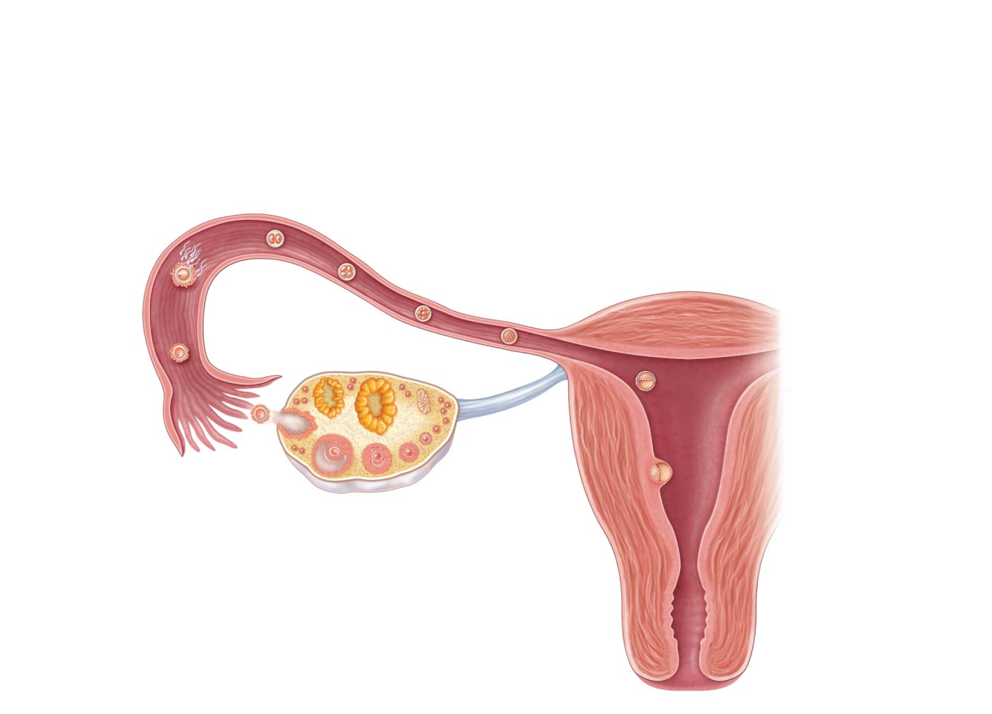
Figure 16.16 Cleavage is a rapid series of mitotic divisions that begins with the zygote and ends with the blastocyst.
Slide 2
Uterine tube
Ovary
Ovulation
Uterus
Endometrium
Cavity of uterus

Slide 110
Figure 16.16 Cleavage is a rapid series of mitotic divisions that begins with the zygote and ends with the blastocyst.
Slide 3
Uterine tube
Ovary
Oocyte
(egg)
Ovulation
Uterus
Endometrium
Cavity of uterus

Slide 111
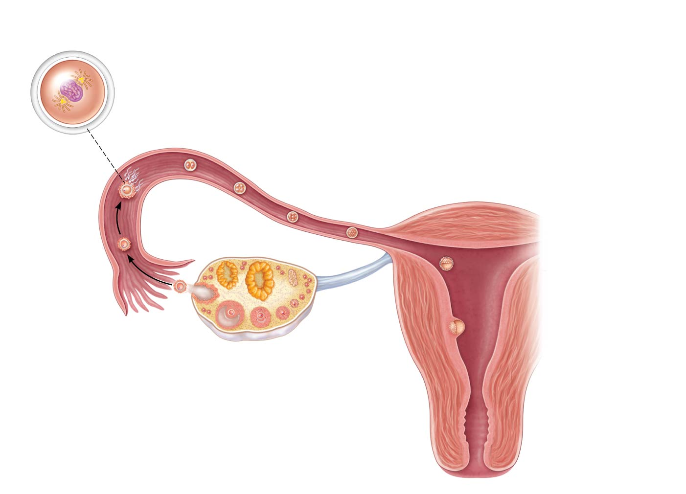
Figure 16.16 Cleavage is a rapid series of mitotic divisions that begins with the zygote and ends with the blastocyst.
Slide 4
(a) Zygote (fertilized egg)
Zona pellucida
Fertilization
(sperm meets and enters egg)
Sperm
Uterine tube
Ovary
Oocyte
(egg)
Ovulation
Uterus
Endometrium
Cavity of uterus

Slide 112
Figure 16.16 Cleavage is a rapid series of mitotic divisions that begins with the zygote and ends with the blastocyst.
Slide 5
(a) Zygote (fertilized egg)
Zona pellucida
Fertilization
(sperm meets and enters egg)
Sperm
Uterine tube
Ovary
Oocyte
(egg)
Ovulation
Uterus
Endometrium
Cavity of uterus

Slide 113
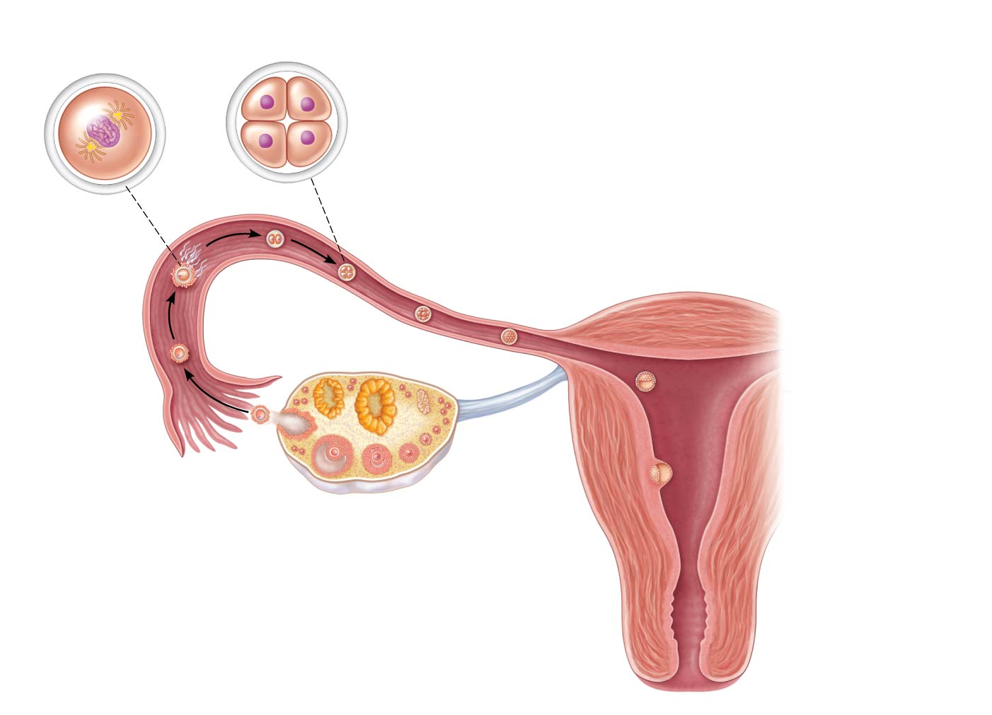
Figure 16.16 Cleavage is a rapid series of mitotic divisions that begins with the zygote and ends with the blastocyst.
Slide 6
(a) Zygote (fertilized egg)
(b) 4-cell stage 2 days
Zona pellucida
Fertilization
(sperm meets and enters egg)
Sperm
Uterine tube
Ovary
Oocyte
(egg)
Ovulation
Uterus
Endometrium
Cavity of uterus

Slide 114
Figure 16.16 Cleavage is a rapid series of mitotic divisions that begins with the zygote and ends with the blastocyst.
Slide 7
(a) Zygote (fertilized egg)
(b) 4-cell stage 2 days
Zona pellucida
Fertilization
(sperm meets and enters egg)
Sperm
Uterine tube
Ovary
Oocyte
(egg)
Ovulation
Uterus
Endometrium
Cavity of uterus

Slide 115
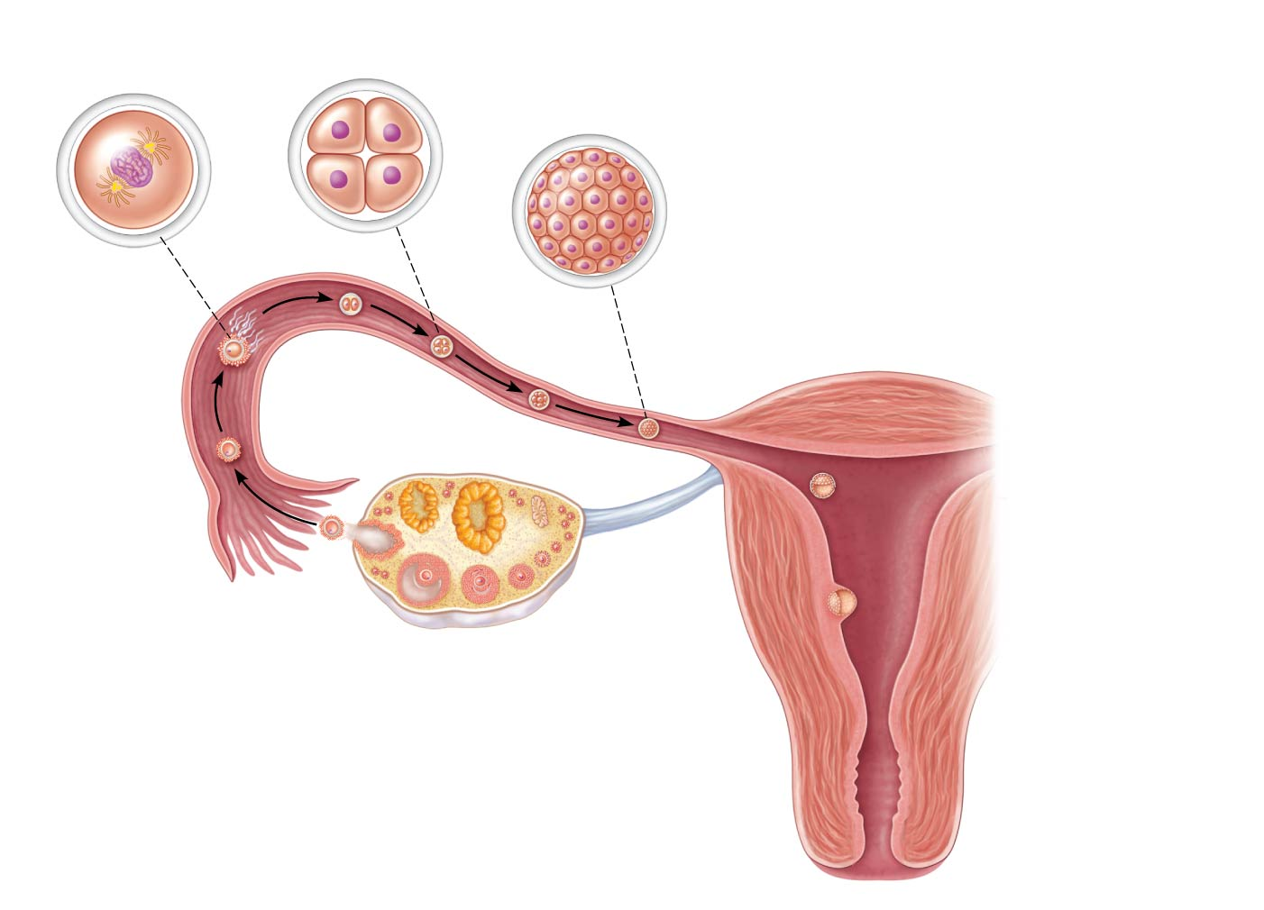
Figure 16.16 Cleavage is a rapid series of mitotic divisions that begins with the zygote and ends with the blastocyst.
Slide 8
(a) Zygote (fertilized egg)
(b) 4-cell stage 2 days
(c) Morula (a solid ball of blastomeres) 3 days
Zona pellucida
Fertilization
(sperm meets and enters egg)
Sperm
Uterine tube
Ovary
Oocyte
(egg)
Ovulation
Uterus
Endometrium
Cavity of uterus

Slide 116
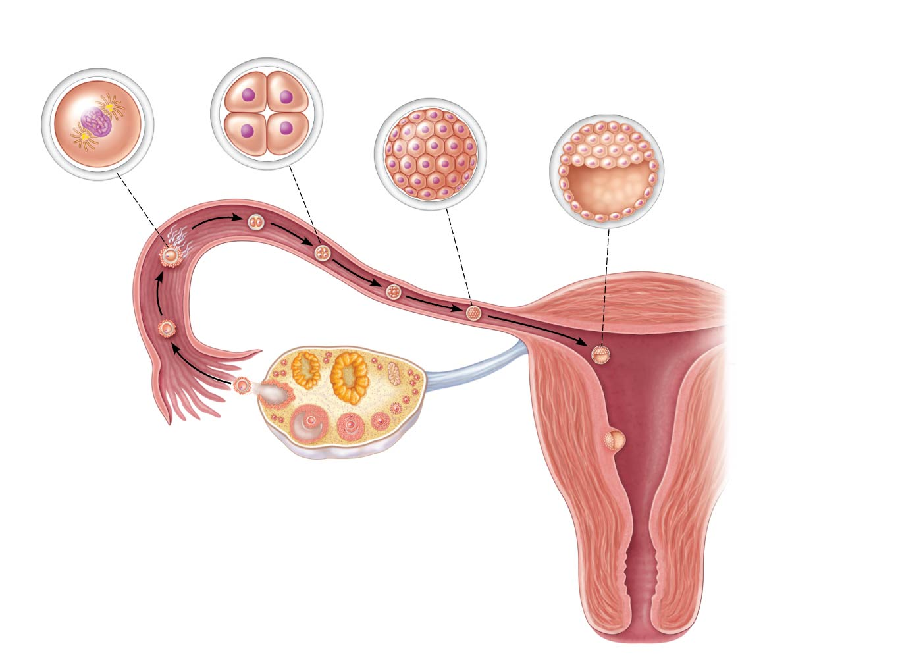
Figure 16.16 Cleavage is a rapid series of mitotic divisions that begins with the zygote and ends with the blastocyst.
Slide 9
(a) Zygote (fertilized egg)
(b) 4-cell stage 2 days
(c) Morula (a solid ball of blastomeres) 3 days
(d) Early blastocyst Morula hollows out and fills with fluid. 4 days
Zona pellucida
Fertilization
Blastocyst cavity
(sperm meets and enters egg)
Sperm
Uterine tube
Ovary
Oocyte
(egg)
Ovulation
Uterus
Endometrium
Cavity of uterus

Slide 117
Events of Embryonic & Fetal Development
Embryo—period of time from fertilization until week 8
Morula—16-cell stage
Blastocyst (chorionic vesicle)—hollow, ball-like structure containing about 100 cells
Fetus–week 9 until birth

Slide 118
Events of Embryonic & Fetal Development
Blastocyst (chorionic vesicle)
Hollow, ball-like structure of 100 cells or more
Secretes human chorionic gonadotropin (hCG) to induce the corpus luteum to continue producing hormones, preventing menses, until the placenta assumes its role

Slide 119
Events of Embryonic & Fetal Development
Functional areas of the blastocyst
Trophoblast—large fluid-filled sphere
Inner cell mass—cluster of cells to one side

Slide 120
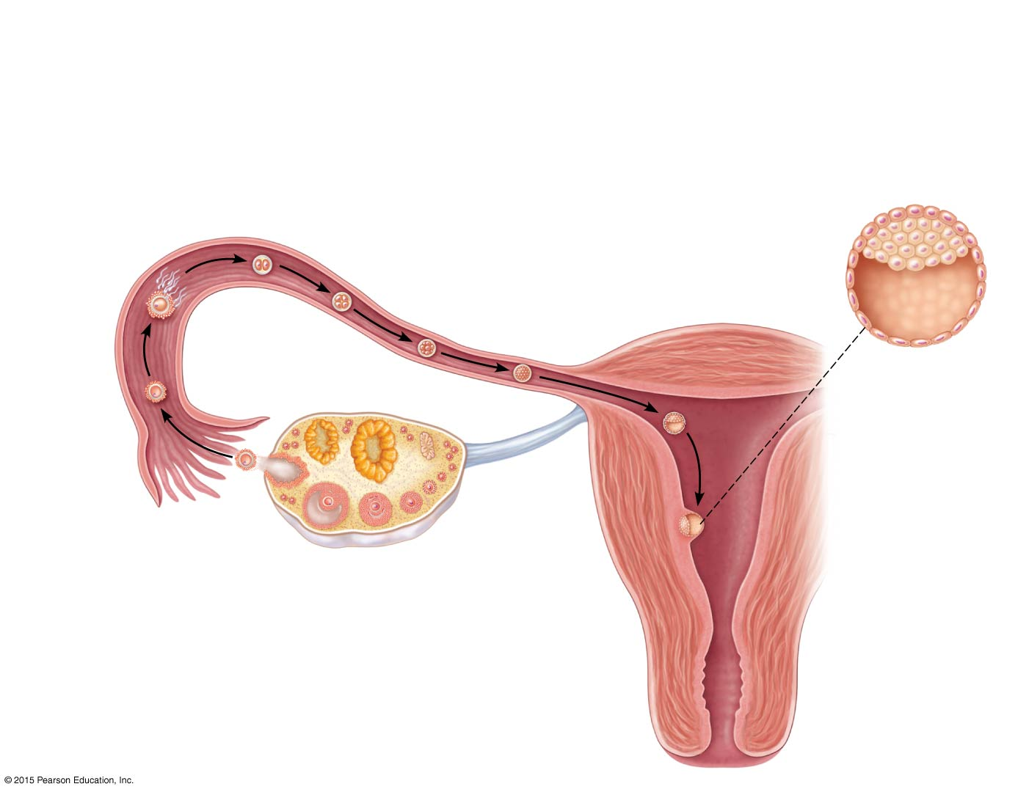
Figure 16.16e Cleavage is a rapid series of mitotic divisions that begins with the zygote and ends with the blastocyst.
(e) Implanting blastocyst (Consists of a sphere of trophoblast cells and an eccentric cell cluster called the inner cell mass) 7 days
Fertilization
(sperm meets and enters egg)
Inner cell mass
Sperm
Uterine tube
Blastocyst cavity
Ovary
Oocyte
Trophoblast
(egg)
Ovulation
Uterus
Endometrium
Cavity of uterus

Slide 121
Events of Embryonic & Fetal Development
Inner cell mass of blastocyst develops into:
Primary germ layers
Ectoderm—outside layer, which gives rise to nervous system and epidermis of skin
Endoderm—inside layer, which forms mucosae and associated glands
Mesoderm—middle layer, which gives rise to everything else

Slide 122
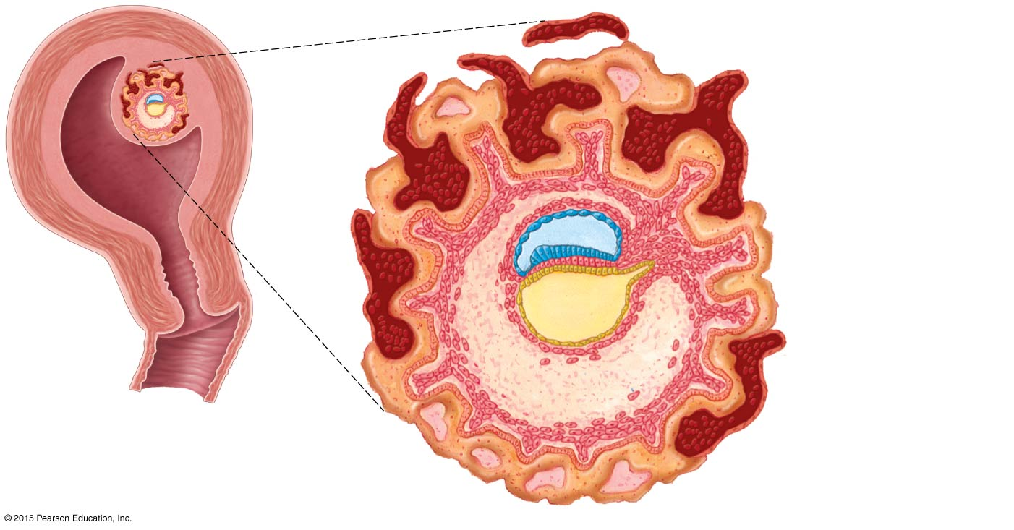
Figure 16.17 Embryo of approximately 18 days.
Umbilical cord
Amnion
Chorionic villi
Uterine cavity
Chorion
Ectoderm
Forming mesoderm
Embryo
Endoderm

Slide 123
Events of Embryonic & Fetal Development
After implantation, the trophoblast of the blastocyst develops chorionic villi (projections)
Chorionic villi combine with tissues of the uterus to form the placenta
Once the placenta has formed, the amnion is attached to the placenta by an umbilical cord
Amnion is a fluid-filled sac that surrounds the embryo
Umbilical cord is a blood vessel–containing stalk of tissue

Slide 124
Figure 16.17 Embryo of approximately 18 days.
Umbilical cord
Amnion
Chorionic villi
Uterine cavity
Chorion
Ectoderm
Forming mesoderm
Embryo
Endoderm

Slide 125
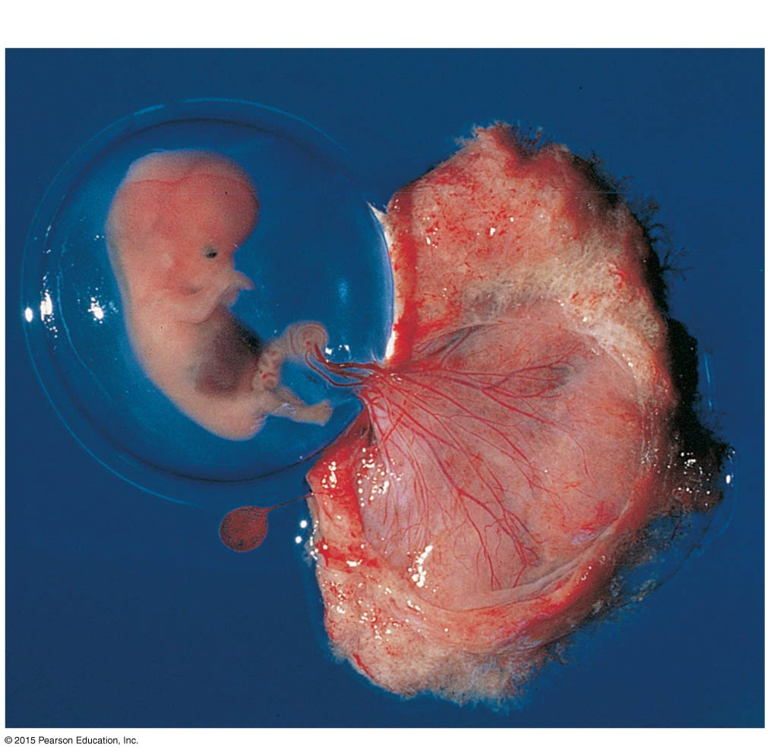
Figure 16.18 The 7-week embryo.
Amniotic sac
Umbilical cord
Umbilical vein
Chorionic villi
Yolk sac
Cut edge of chorion

Slide 126
Events of Embryonic & Fetal Development
The placenta
Forms a barrier between mother and embryo (blood is not exchanged)
Delivers nutrients and oxygen
Removes wastes from embryonic blood
Becomes an endocrine organ and takes over for the corpus luteum (by end of second month); produces estrogen, progesterone, and other hormones that maintain pregnancy

Slide 127
Events of Embryonic & Fetal Development
All organ systems are formed by the end of the eighth week
Activities of the fetus are growth and organ specialization
The fetal stage is one of tremendous growth and change in appearance
Fetal changes are summarized in Table 16.1

Slide 128
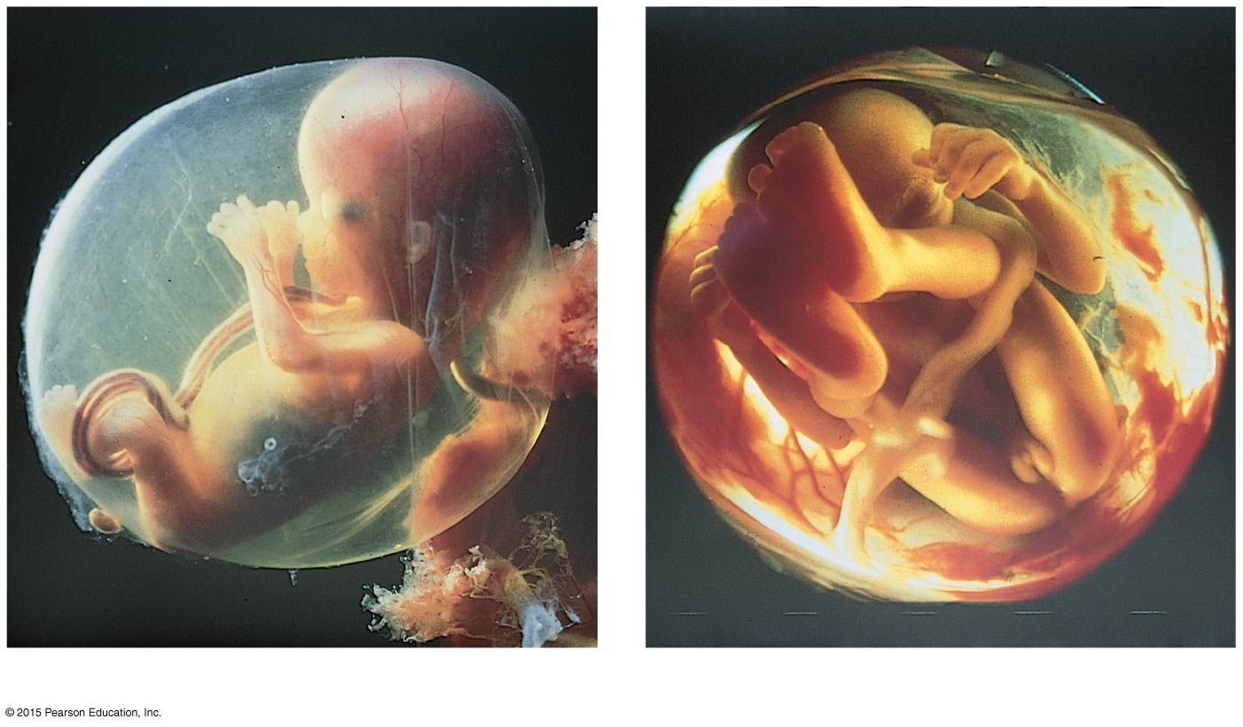
Figure 16.19 Photographs of a developing fetus.
(a)
(b)

Slide 129
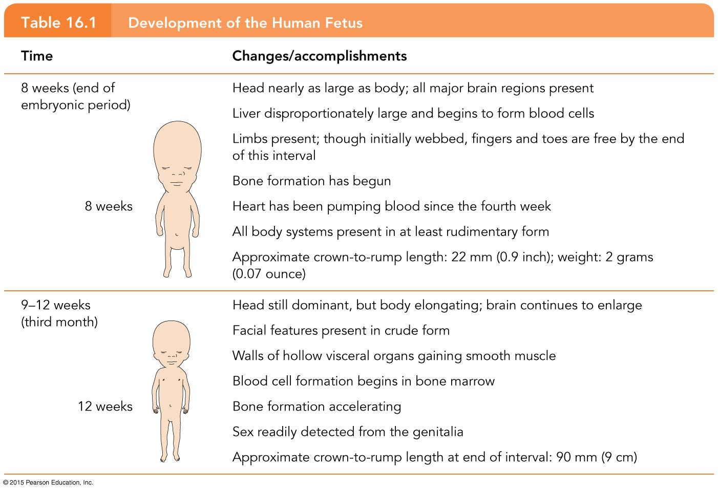
Table 16.1 Development of the Human Fetus (1 of 3).

Slide 130
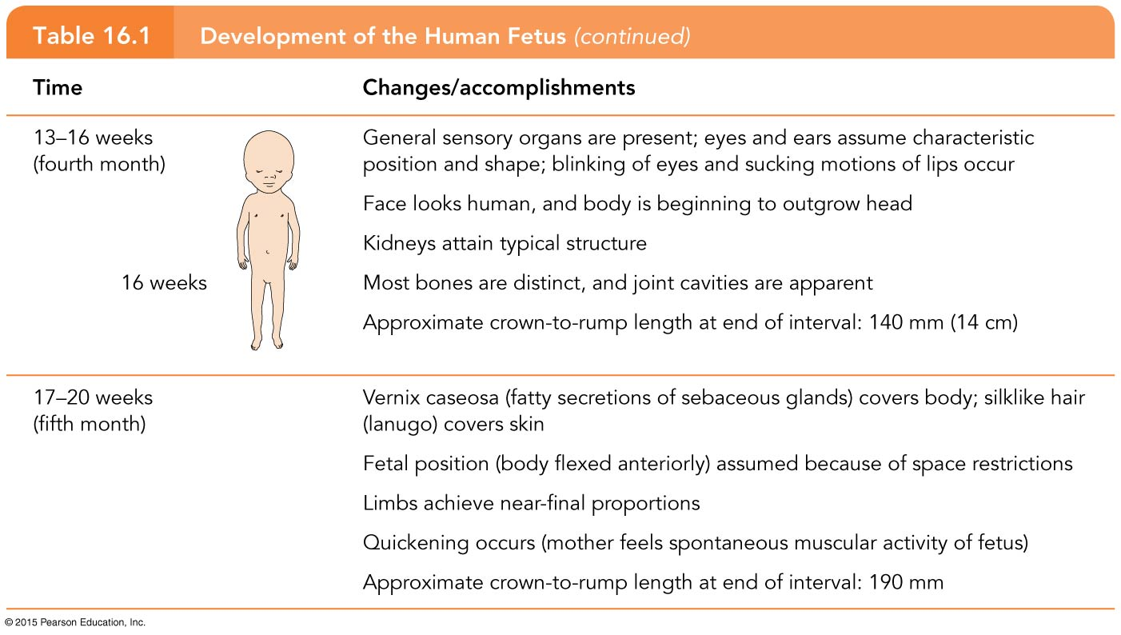
Table 16.1 Development of the Human Fetus (2 of 3).

Slide 131
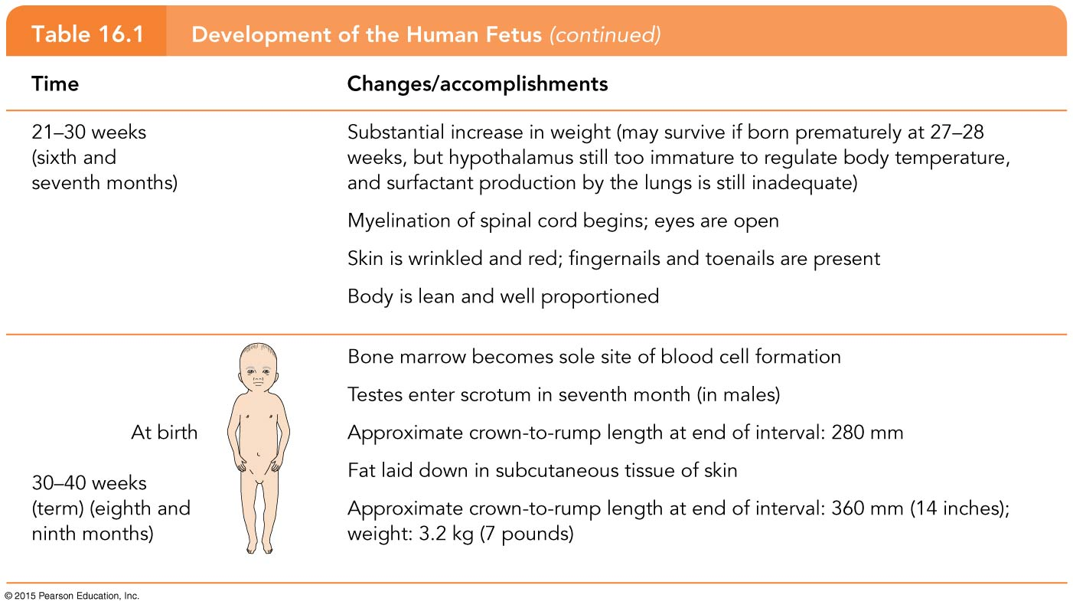
Table 16.1 Development of the Human Fetus (3 of 3).

Slide 132
Effects of Pregnancy on the Mother
Pregnancy—period from conception until birth
Anatomical changes
Enlargement of the uterus
Accentuated lumbar curvature (lordosis)
Relaxation of the pelvic ligaments and pubic symphysis due to production of relaxin

Slide 133
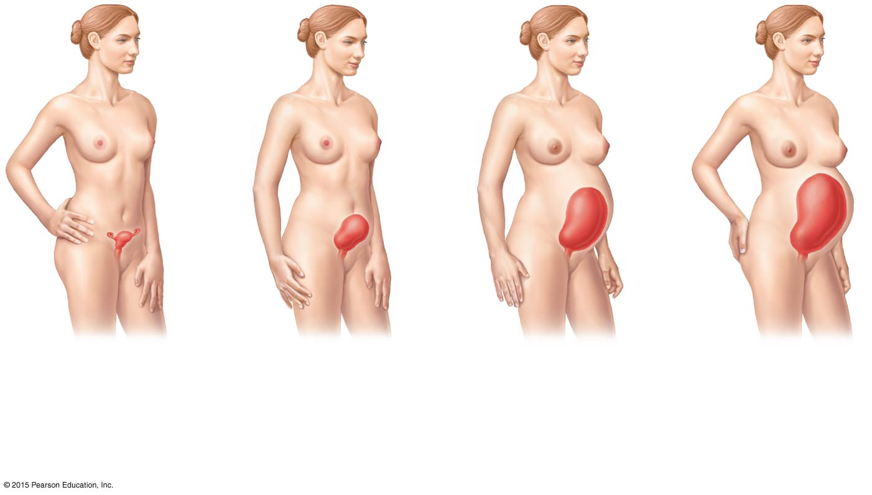
Figure 16.20 Relative size of the uterus before conception and during pregnancy.
(a) Before conception (Uterus is the size of a fist and resides in the pelvis.)
(b) 4 months (Fundus of the uterus is halfway
between the pubic symphysis and the umbilicus.)
(c) 7 months (Fundus is well above the umbilicus.)
(d) 9 months (Fundus reaches the xiphoid process.)

Slide 134
Effects of Pregnancy on the Mother
Physiological changes
Gastrointestinal system
Morning sickness is common and is due to elevated progesterone and estrogens
Heartburn is common because of organ crowding by the fetus
Constipation is caused by declining motility of the digestive tract

Slide 135
Effects of Pregnancy on the Mother
Physiological changes (continued)
Urinary system
Kidneys have additional burden and produce more urine
The uterus compresses the bladder, causing stress incontinence

Slide 136
Effects of Pregnancy on the Mother
Physiological changes (continued)
Respiratory system
Nasal mucosa becomes congested and swollen
Vital capacity and respiratory rate increase
Dyspnea (difficult breathing) occurs during later stages of pregnancy

Slide 137
Effects of Pregnancy on the Mother
Physiological changes (continued)
Cardiovascular system
Blood volume increases by 25% to 40%
Blood pressure and pulse increase
Varicose veins are common

Slide 138
Childbirth (Parturition)
Initiation of labor
Labor—the series of events that expel the infant from the uterus
Rhythmic, expulsive contractions
Operates by the positive feedback mechanism
False labor—Braxton Hicks contractions are weak, irregular uterine contractions

Slide 139
Childbirth (Parturition)
Initiation of labor
Estrogen levels rise
Uterine contractions begin
The placenta releases prostaglandins
Oxytocin is released by the pituitary
Combined effects of rising levels of hormones, oxytocin and prostaglandins, initiates contractions and forces the baby deeper into the mother’s pelvis

Slide 140
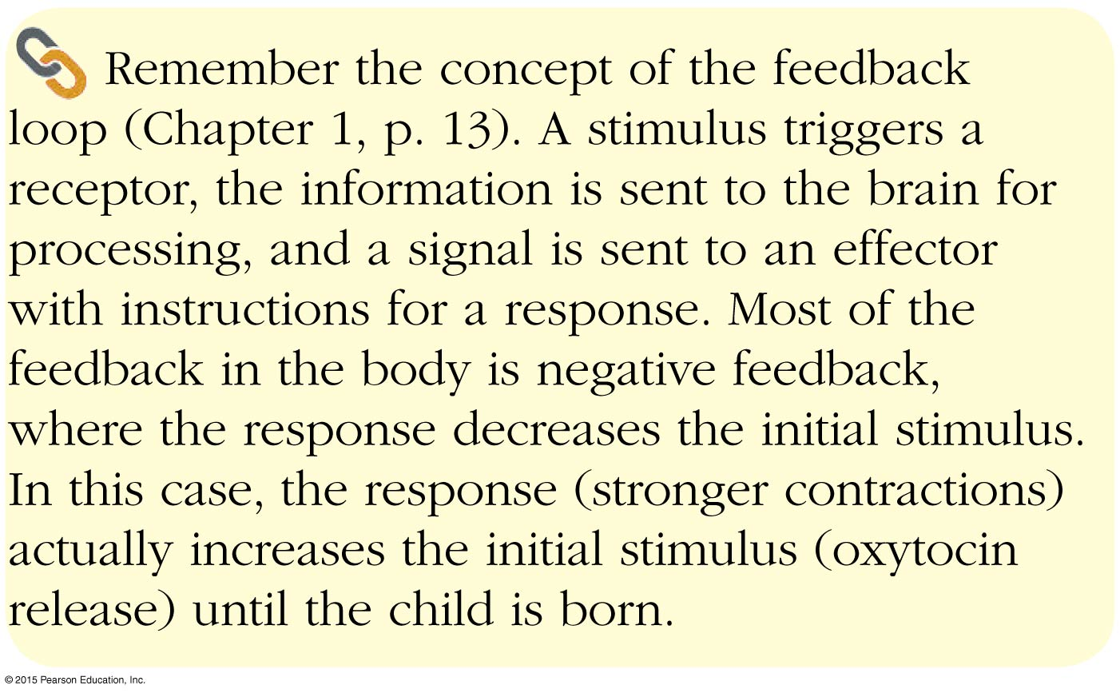
Concept Link

Slide 141
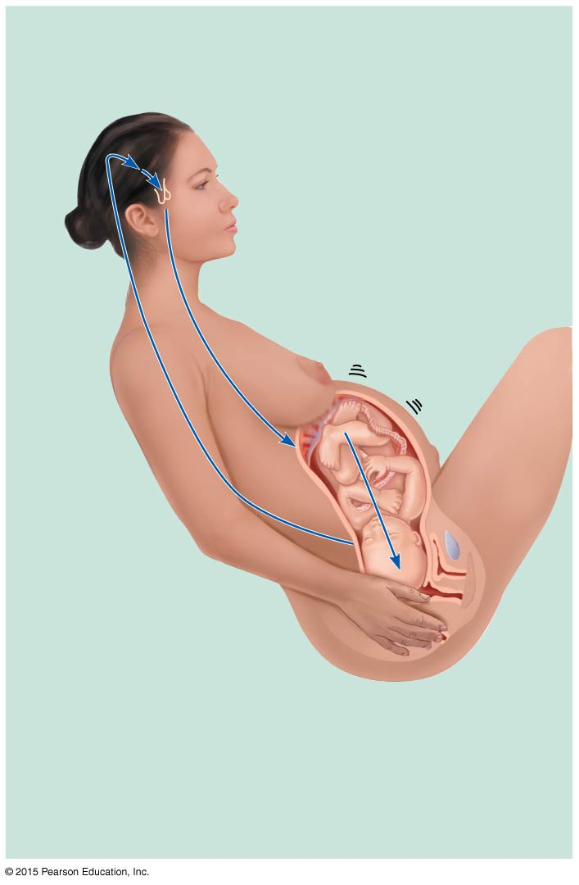
Figure 16.21 The positive feedback mechanism by which oxytocin promotes labor contractions during birth.
Slide 1
4
Hypothalamus sends efferent impulses to posterior pituitary, where oxytocin is stored
Posterior pituitary releases oxytocin to blood; oxytocin targets mother’s uterine muscle
5
Uterus responds by contracting more vigorously
6
1
Baby moves deeper into mother’s birth canal
Afferent impulses to hypothalamus
3
Pressoreceptors in cervix of uterus excited
2
Positive feedback mechanism continues to cycle until interrupted by birth of baby

Slide 142
Figure 16.21 The positive feedback mechanism by which oxytocin promotes labor contractions during birth.
Slide 2
1
Baby moves deeper into mother’s birth canal
Positive feedback mechanism continues to cycle until interrupted by birth of baby

Slide 143
Figure 16.21 The positive feedback mechanism by which oxytocin promotes labor contractions during birth.
Slide 3
1
Baby moves deeper into mother’s birth canal
Pressoreceptors in cervix of uterus excited
2
Positive feedback mechanism continues to cycle until interrupted by birth of baby

Slide 144
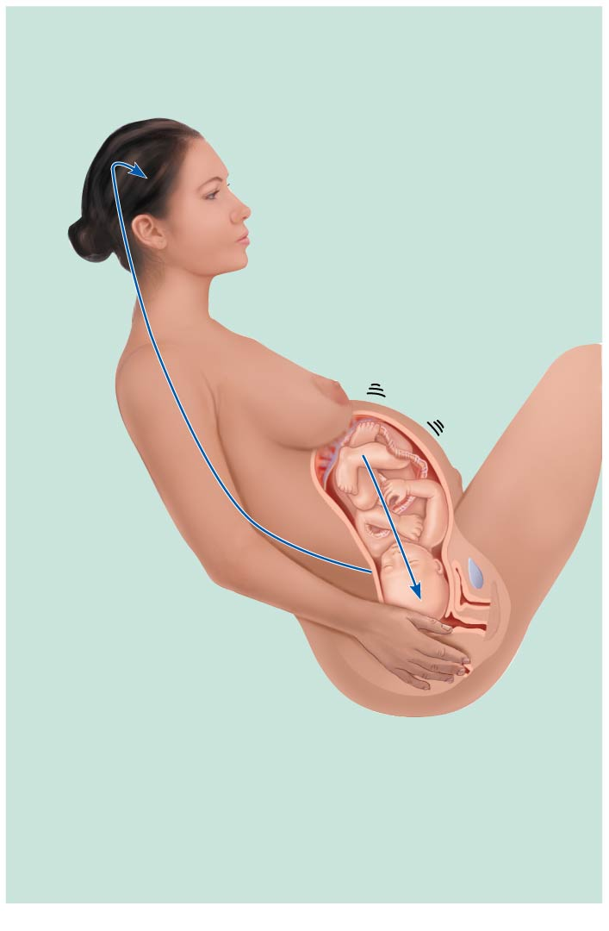
Figure 16.21 The positive feedback mechanism by which oxytocin promotes labor contractions during birth.
Slide 4
1
Baby moves deeper into mother’s birth canal
Afferent impulses to hypothalamus
3
Pressoreceptors in cervix of uterus excited
2
Positive feedback mechanism continues to cycle until interrupted by birth of baby

Slide 145
Figure 16.21 The positive feedback mechanism by which oxytocin promotes labor contractions during birth.
Slide 5
4
Hypothalamus sends efferent impulses to posterior pituitary, where oxytocin is stored
1
Baby moves deeper into mother’s birth canal
Afferent impulses to hypothalamus
3
Pressoreceptors in cervix of uterus excited
2
Positive feedback mechanism continues to cycle until interrupted by birth of baby

Slide 146
Figure 16.21 The positive feedback mechanism by which oxytocin promotes labor contractions during birth.
Slide 6
4
Hypothalamus sends efferent impulses to posterior pituitary, where oxytocin is stored
Posterior pituitary releases oxytocin to blood; oxytocin targets mother’s uterine muscle
5
1
Baby moves deeper into mother’s birth canal
Afferent impulses to hypothalamus
3
Pressoreceptors in cervix of uterus excited
2
Positive feedback mechanism continues to cycle until interrupted by birth of baby

Slide 147
Figure 16.21 The positive feedback mechanism by which oxytocin promotes labor contractions during birth.
Slide 7
4
Hypothalamus sends efferent impulses to posterior pituitary, where oxytocin is stored
Posterior pituitary releases oxytocin to blood; oxytocin targets mother’s uterine muscle
5
Uterus responds by contracting more vigorously
6
1
Baby moves deeper into mother’s birth canal
Afferent impulses to hypothalamus
3
Pressoreceptors in cervix of uterus excited
2
Positive feedback mechanism continues to cycle until interrupted by birth of baby

Slide 148
Stages of Labor
Dilation
Cervix becomes dilated
Full dilation is 10 cm
Uterine contractions begin and increase
Cervix softens and effaces (thins)
The amnion ruptures (“breaking the water”)
Longest stage at 6 to 12 hours

Slide 149
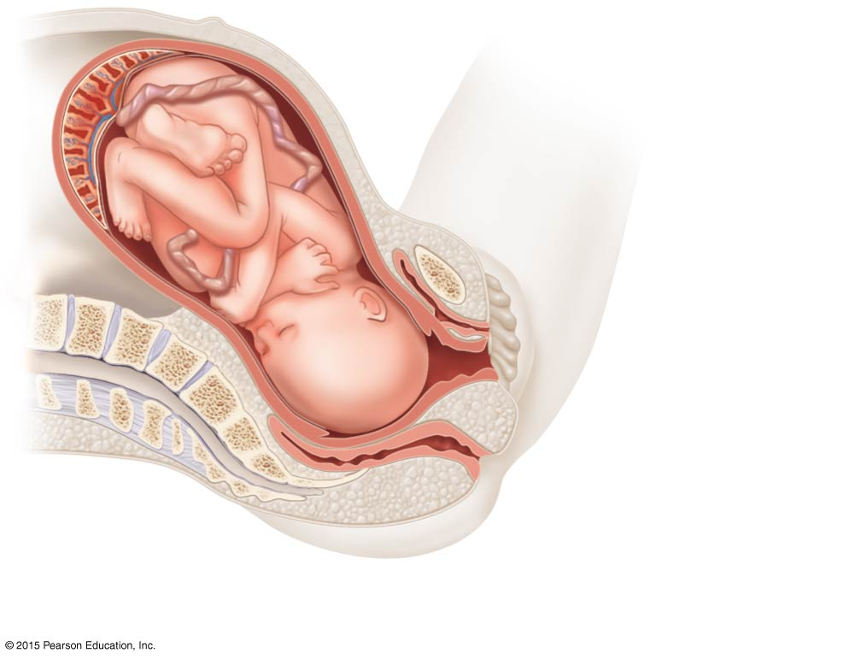
Figure 16.22a The three stages of labor.
Placenta
Umbilical cord
Uterus
Cervix
Vagina
Sacrum
(a) Dilation (of cervix)

Slide 150
Stages of Labor
Expulsion
Infant passes through the cervix and vagina
Can last as long as 2 hours, but typically is 50 minutes in the first birth and 20 minutes in subsequent births
Normal delivery is head-first (vertex position)
Breech presentation is buttocks-first

Slide 151
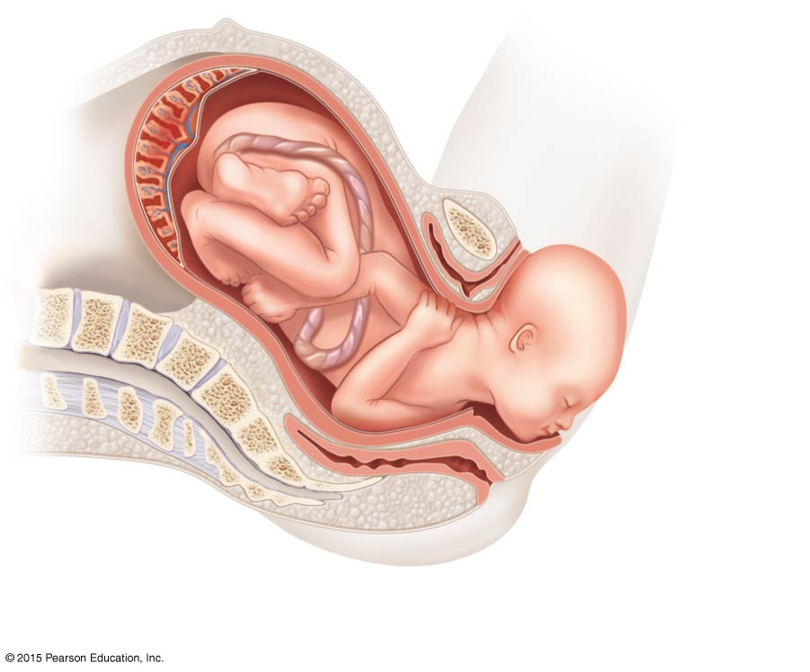
Figure 16.22b The three stages of labor.
Perineum
(b) Expulsion (delivery of infant)

Slide 152
Stages of Labor
Placental stage
Delivery of the placenta
Usually accomplished within 15 minutes after birth of infant
Afterbirth—placenta and attached fetal membranes
All placental fragments should be removed to avoid postpartum bleeding

Slide 153
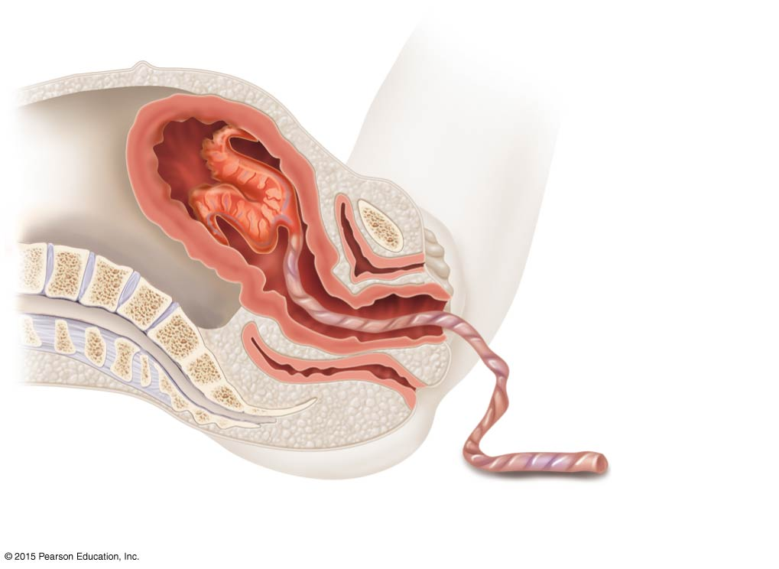
Figure 16.22c The three stages of labor.
Uterus
Placenta (detaching)
Umbilical cord
(c) Placental (delivery of the placenta)

Slide 154
Developmental Aspects of the Reproductive System
Gender is determined at fertilization
Males have XY sex chromosomes
Females have XX sex chromosomes
Reproductive system structures of males and females are identical during early development
Gonads do not begin to form until the eighth week
The presence or absence of testosterone determines whether male or female accessory reproductive organs will form

Slide 155
Developmental Aspects of the Reproductive System
Any interference with the normal pattern of sex hormone production in the embryo results in abnormalities
Pseudohermaphrodites are individuals whose external genitalia do not “match” their gonads
Hermaphrodites possess both ovarian and testicular tissues (rare)

Slide 156
Developmental Aspects of the Reproductive System
Important congenital defects result from abnormal separation of sex chromosomes during sex cell formation
Males who have an extra female sex chromosome have the normal male accessory structures, but their testes atrophy, causing them to be sterile
XO female lacks ovaries
YO males die during development

Slide 157
Developmental Aspects of the Reproductive System
The reproductive system is inactive during childhood
Reproductive system organs do not function for childbearing until puberty
Puberty usually begins between ages 10 and 15

Slide 158
Developmental Aspects of the Reproductive System
Males
Enlargement of testes and scrotum signals onset of puberty (often around age 13)
Females
Budding breasts signal puberty (often around age 11)
Menarche—first menstrual period

Slide 159
Developmental Aspects of the Reproductive System
Common reproductive problems during young adulthood are infections of the reproductive tract
Neoplasms of breast and cervix are major threats to women
Prostate cancer is the most common reproductive system cancer seen in men

Slide 160
Developmental Aspects of the Reproductive System
Menopause—a whole year has passed without menstruation
Ovaries stop functioning as endocrine organs
Childbearing ability ends
Hot flashes and mood changes may occur
There is a no equivalent of menopause in males, but there is a steady decline in testosterone

Slide 161
A Closer Look: Contraception
Contraception—birth control
Birth control pill—most-used contraceptive
Relatively constant supply of ovarian hormones from pill is similar to pregnancy
Ovarian follicles do not mature, ovulation ceases, menstrual flow is reduced

Slide 162
A Closer Look: Contraception
Morning-after pill (MAP)
Taken within 3 days of unprotected intercourse
Disrupts normal hormonal signals to the point that fertilization is prevented
Other hormonal birth control devices cause cervical mucus to thicken
Minipill (tablet)
Norplant (rods placed under the skin)

Slide 163
A Closer Look: Contraception
Intrauterine device (IUD)
Plastic or metal device inserted into uterus
Prevents implantation of fertilized egg
Sterilization
Tubal ligation (females)—cut or cauterize uterine tubes
Vasectomy (males)—cut or cauterize the ductus deferens

Slide 164
A Closer Look: Contraception
Coitus interruptus—withdrawal of penis prior to ejaculation
Rhythm (fertility awareness)—avoid intercourse during period of ovulation or fertility
Record daily basal temperature (body temperature rises after ovulation)
Record changes in pattern of cervical mucus

Slide 165
A Closer Look: Contraception
Barrier methods
Diaphragms
Cervical caps
Condoms
Spermicidal foams
Gels
Sponges

Slide 166
A Closer Look: Contraception
Abortion—termination of pregnancy
Miscarriage—spontaneous abortion is common and frequently occurs before a woman knows she is pregnant
RU486 or “abortion pill”—induces miscarriage during first 7 weeks of pregnancy

Slide 167
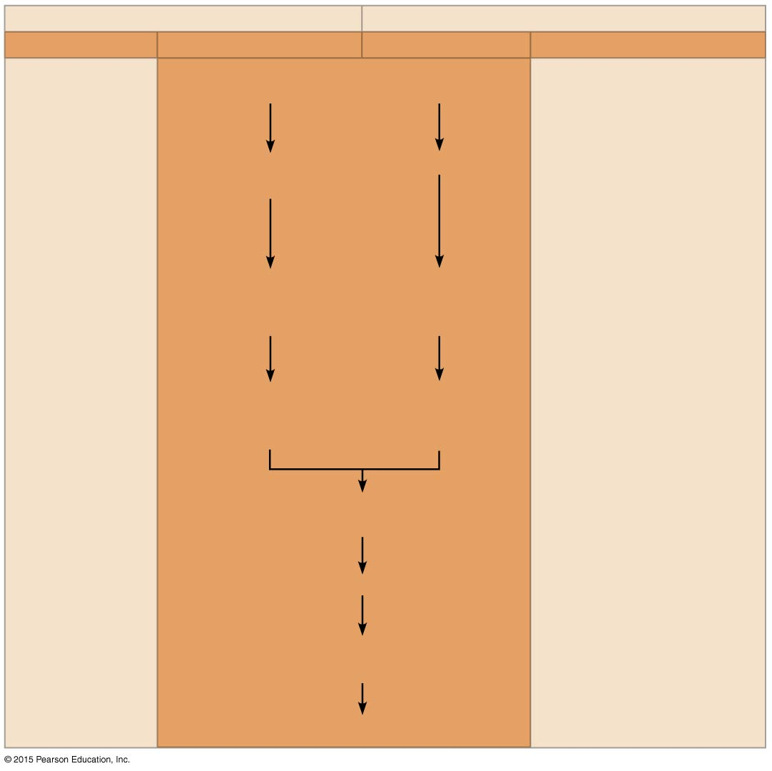
A Closer Look 16.1 Contraception: Preventing Pregnancy (1 of 2).
Male
Female
Technique Event Event Technique
Production of viable sperm
Production of viable oocytes
Vasectomy
Combination birth control “pill”, patch, monthly shot, or vaginal ring
Abstinence
Transport down the male duct system
Ovulation
Coitus interruptus
Condom
Sperm deposited in the female vagina
Capture of the oocyte by the uterine tube
Tubal ligation
Spermicides, diaphragm, cervical cap, vaginal pouch, or progestin-only minipill, implant, or injection
Sperm move through the female’s reproductive tract
Transport down the uterine tube
Meeting of sperm and oocyte in uterine tube
Morning- after pill (MAP)
Union of sperm and egg
Intrauterine device (IUD); progestin-only minipill, implant, or injection
Implantation of blastocyst in properly prepared endometrium
Birth

Slide 168
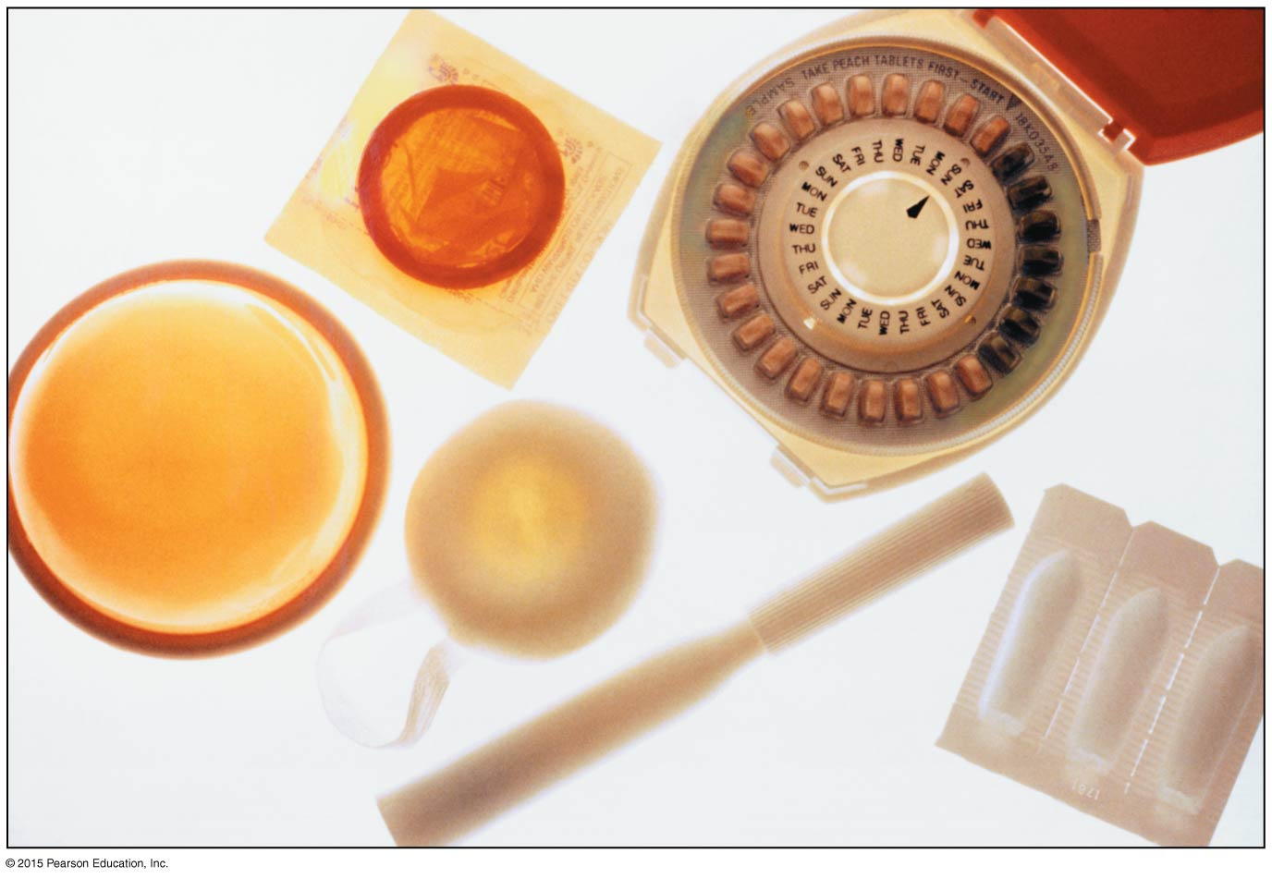
A Closer Look 16.1 Contraception: Preventing Pregnancy (2 of 2).
Condom
Birth control pills
Diaphragm
Spermicidal inserts
Contraceptive sponge
Contraceptive jelly

