Slide 1
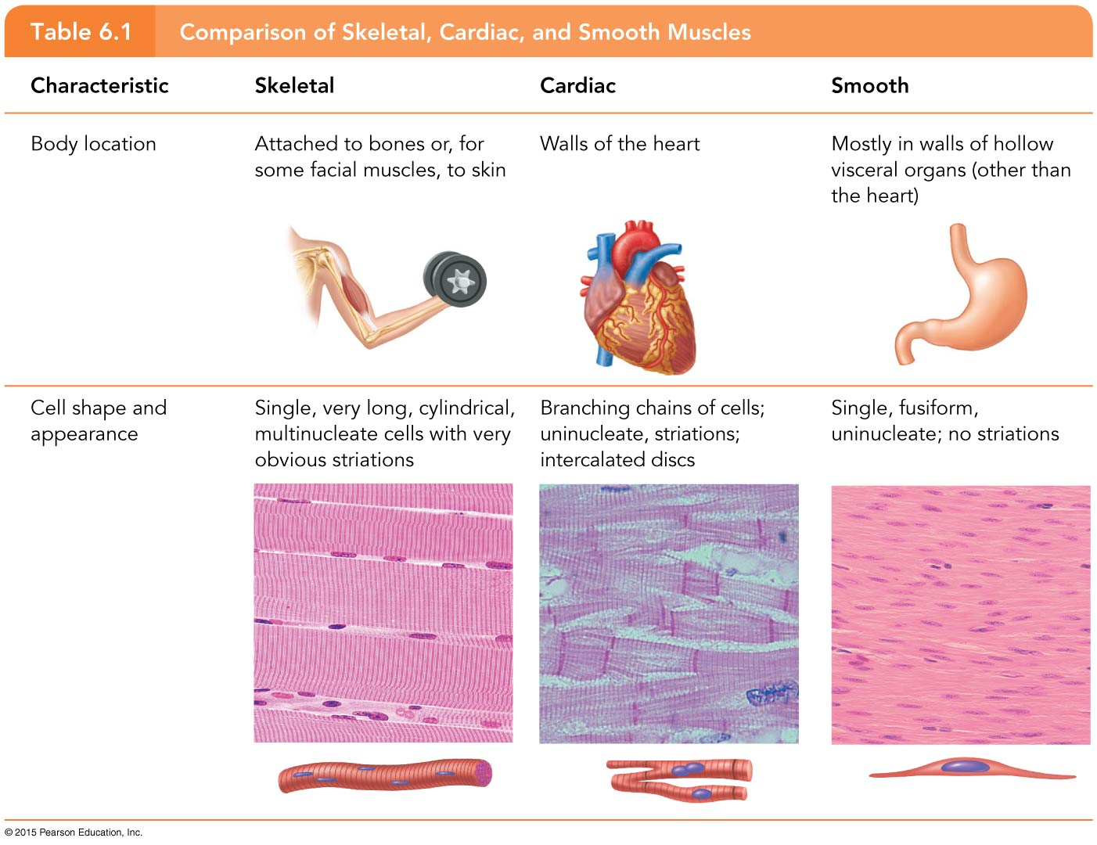
Table 6.1 Comparison of Skeletal, Cardiac, and Smooth Muscles (1 of 3)

Slide 2
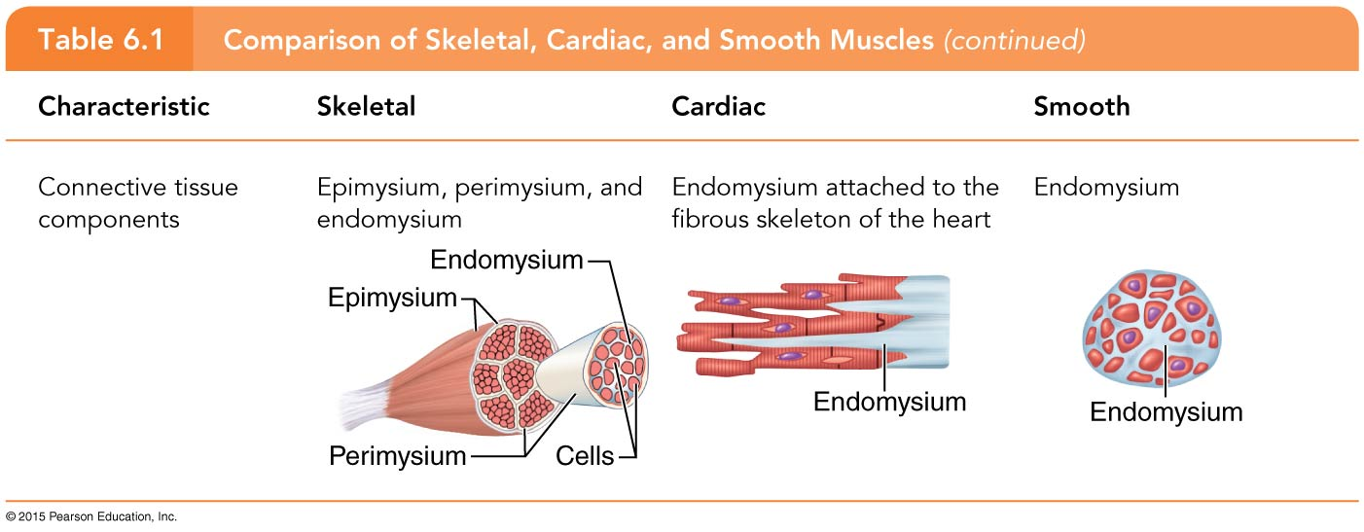
Table 6.1 Comparison of Skeletal, Cardiac, and Smooth Muscles (2 of 3)

Slide 3
Table 6.1 Comparison of Skeletal, Cardiac, and Smooth Muscles (3 of 3)

Slide 4
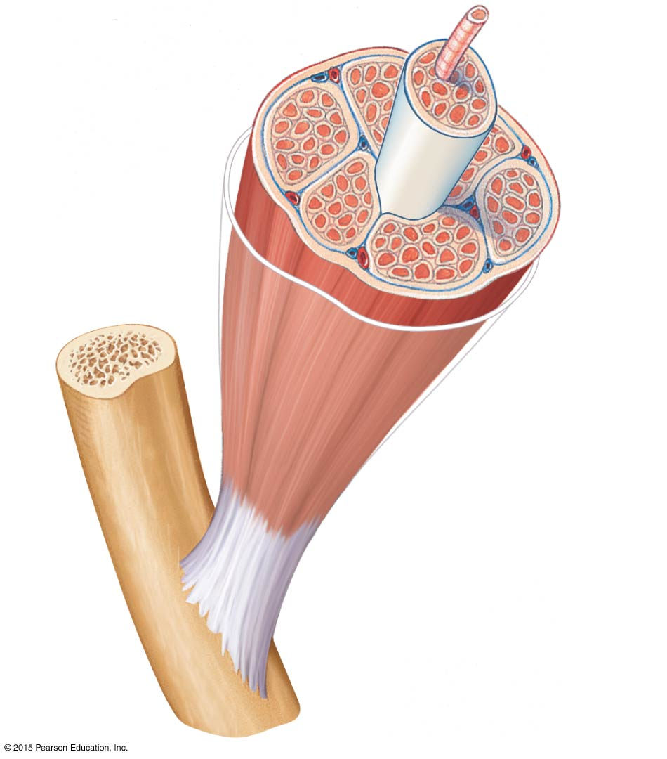
Figure 6.1 Connective tissue wrappings of skeletal muscle.
Muscle fiber (cell)
Blood vessel
Perimysium
Epimysium (wraps entire muscle)
Fascicle (wrapped by perimysium)
Endomysium (between fibers)
Tendon
Bone

Slide 5
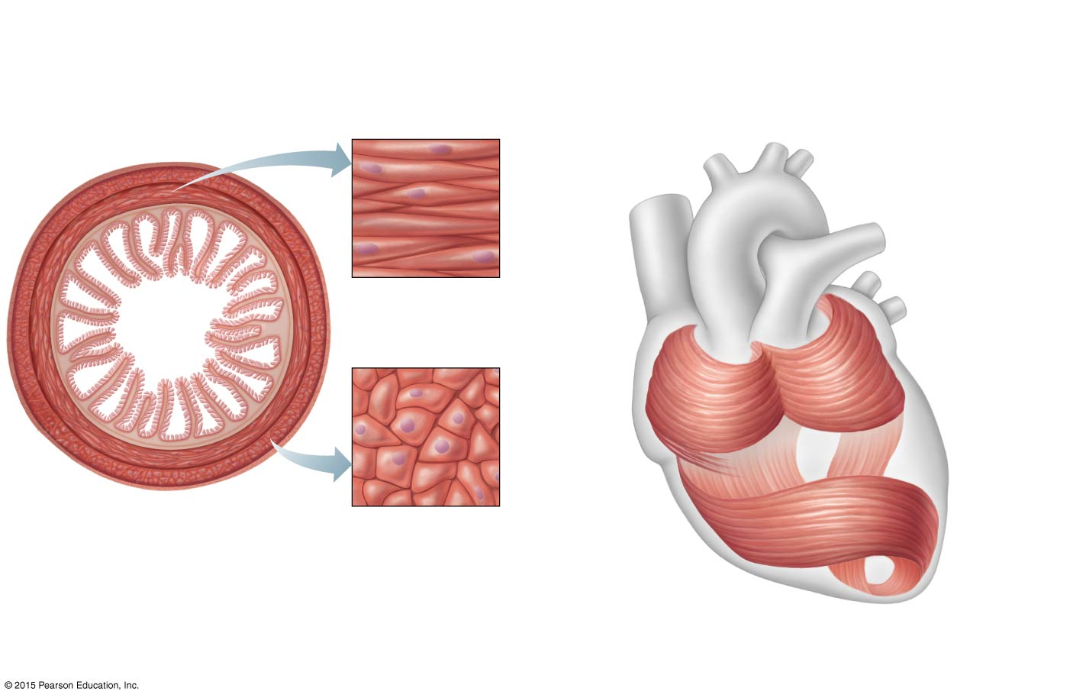
Figure 6.2 Arrangement of smooth and cardiac muscle cells.
Circular layer of smooth muscle (longitudinal view of cells)
Mucosa
Cardiac muscle bundles
Submucosa
Longitudinal layer of smooth muscle (cross-sectional view of cells)
(a)
(b)

Slide 6
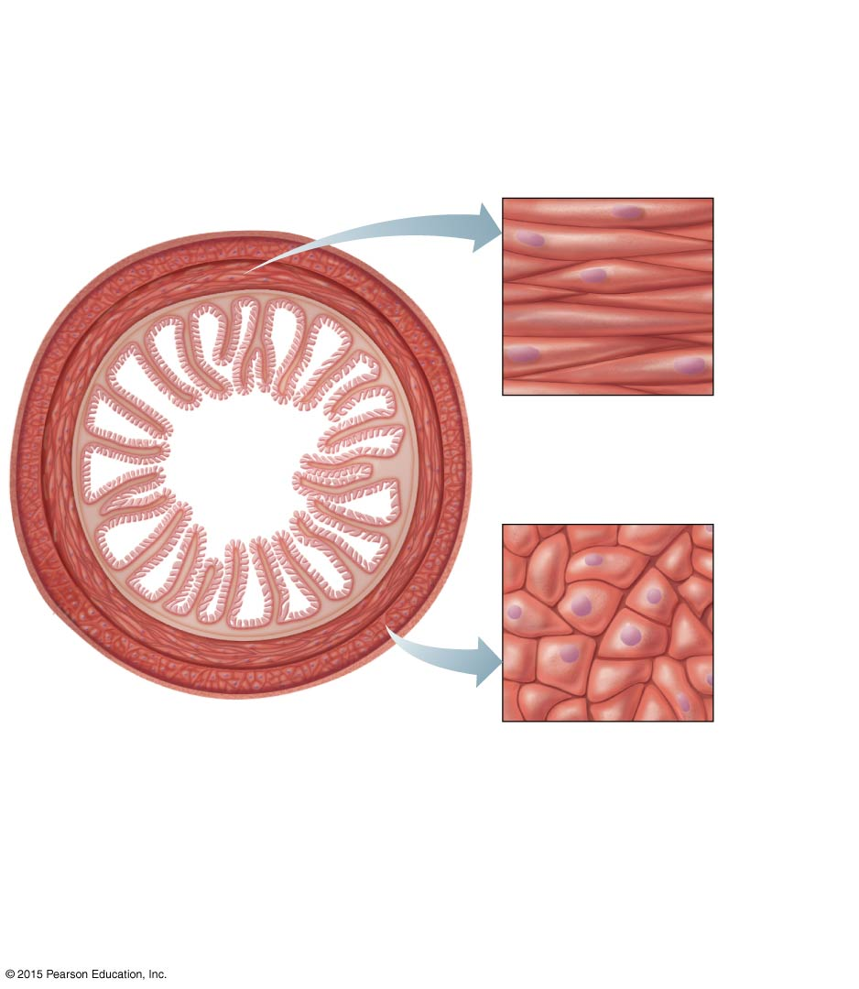
Figure 6.2a Arrangement of smooth and cardiac muscle cells.
Circular layer of smooth muscle (longitudinal view of cells)
Mucosa
Submucosa
Longitudinal layer of smooth muscle (cross-sectional view of cells)
(a)

Slide 7
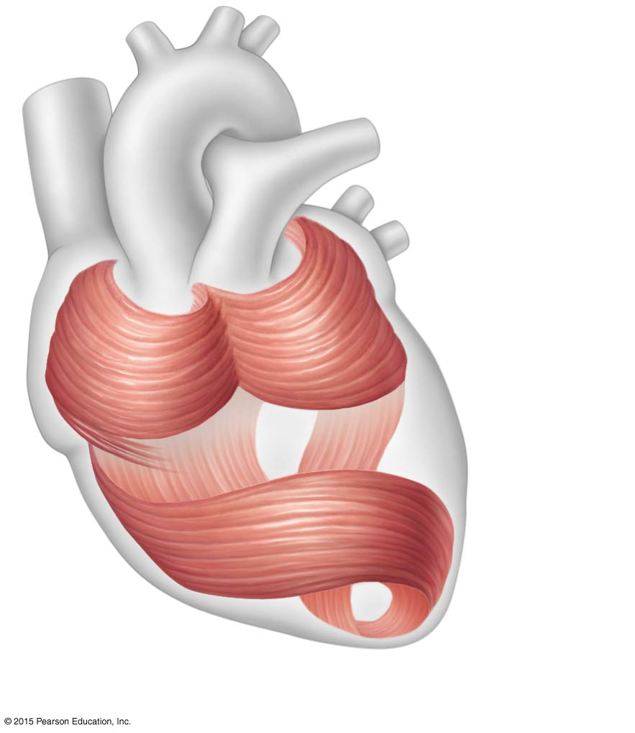
Figure 6.2b Arrangement of smooth and cardiac muscle cells.
Cardiac muscle bundles
(b)

Slide 8
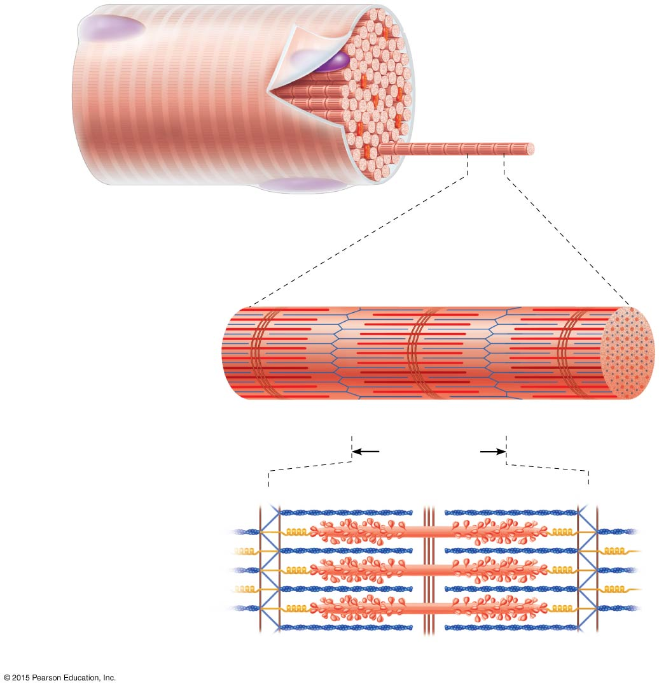
Figure 6.3 Anatomy of a skeletal muscle fiber (cell).
Sarcolemma
Myofibril
Dark (A) band
Light (I) band
Nucleus
(a) Segment of a
muscle fiber
(cell)
Z disc
H zone
Z disc
Thin (actin) myofilament
Thick (myosin) myofilament
(b)
Myofibril or fibril
I band
A band
I band
M line
(complex organelle composed of bundles of myofilaments)
Sarcomere
Z disc
M line
Z disc
Thin (actin) myofilament
Thick (myosin) myofilament
(c)
Sarcomere
(segment of a myofibril)

Slide 9
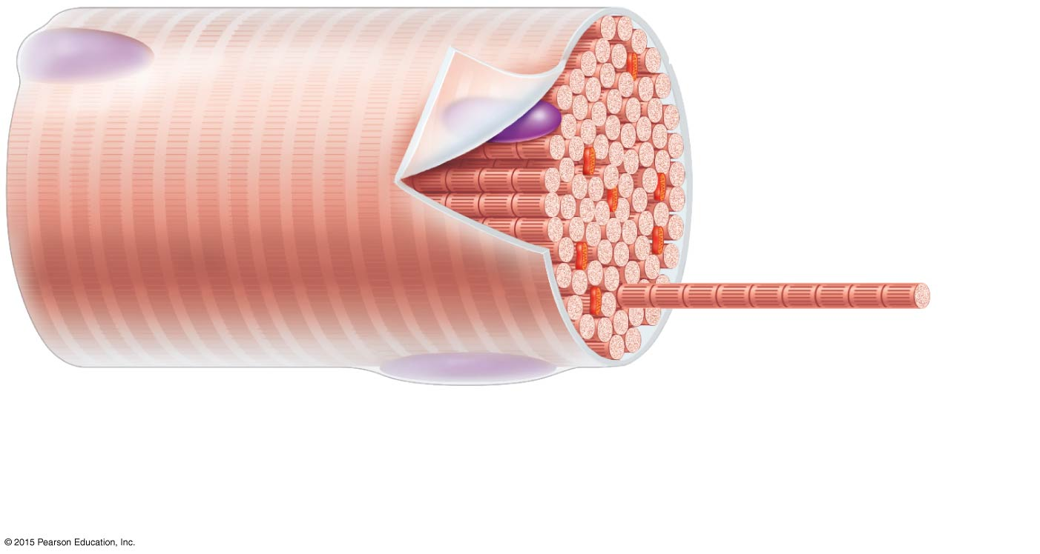
Figure 6.3a Anatomy of a skeletal muscle fiber (cell).
Sarcolemma
Myofibril
Dark (A) band
Light (I) band
Nucleus
(a) Segment of a
muscle fiber
(cell)

Slide 10
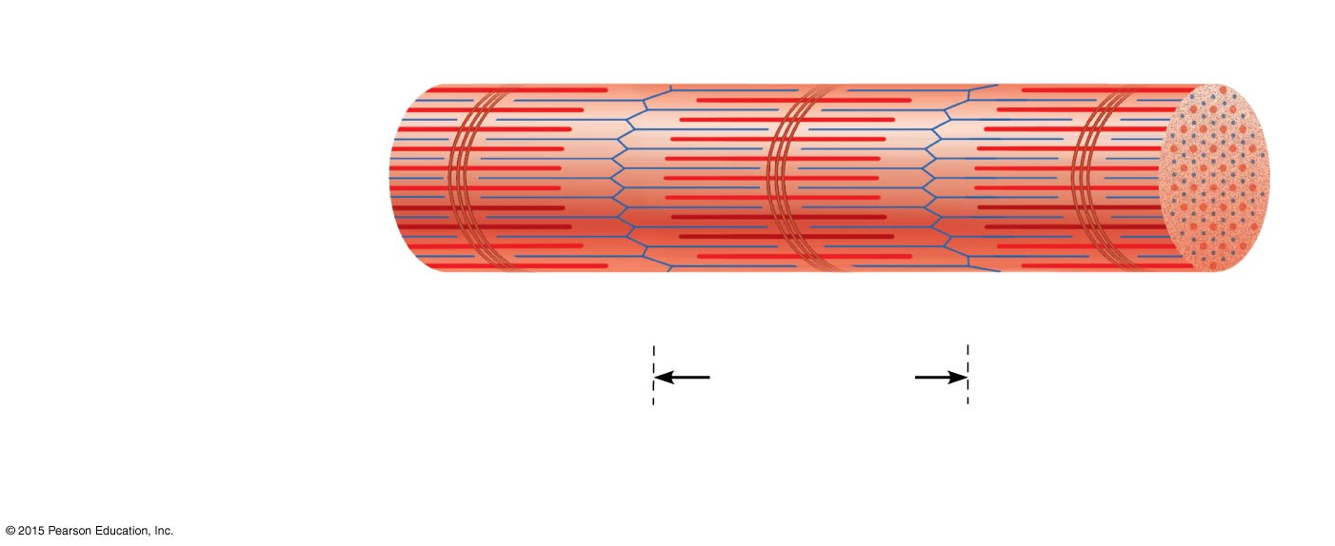
Figure 6.3b Anatomy of a skeletal muscle fiber (cell).
Z disc
H zone
Z disc
Thin (actin) myofilament
Thick (myosin) myofilament
I band
A band
I band
M line
Sarcomere
(complex organelle composed of bundles of myofilaments)
(b)
Myofibril or fibril

Slide 11
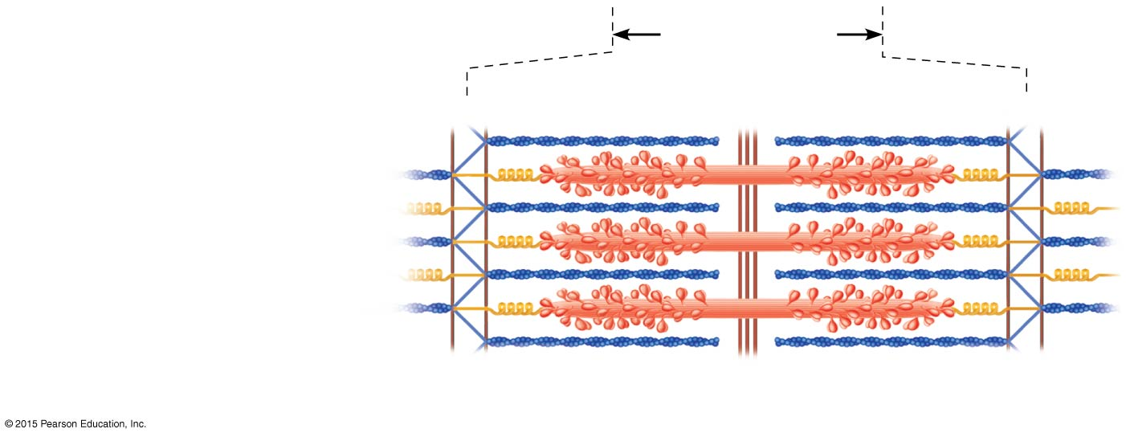
Figure 6.3c Anatomy of a skeletal muscle fiber (cell).
Sarcomere
Z disc
M line
Z disc
Thin (actin) myofilament
Thick (myosin) myofilament
(c)
Sarcomere
(segment of a myofibril)

Slide 12
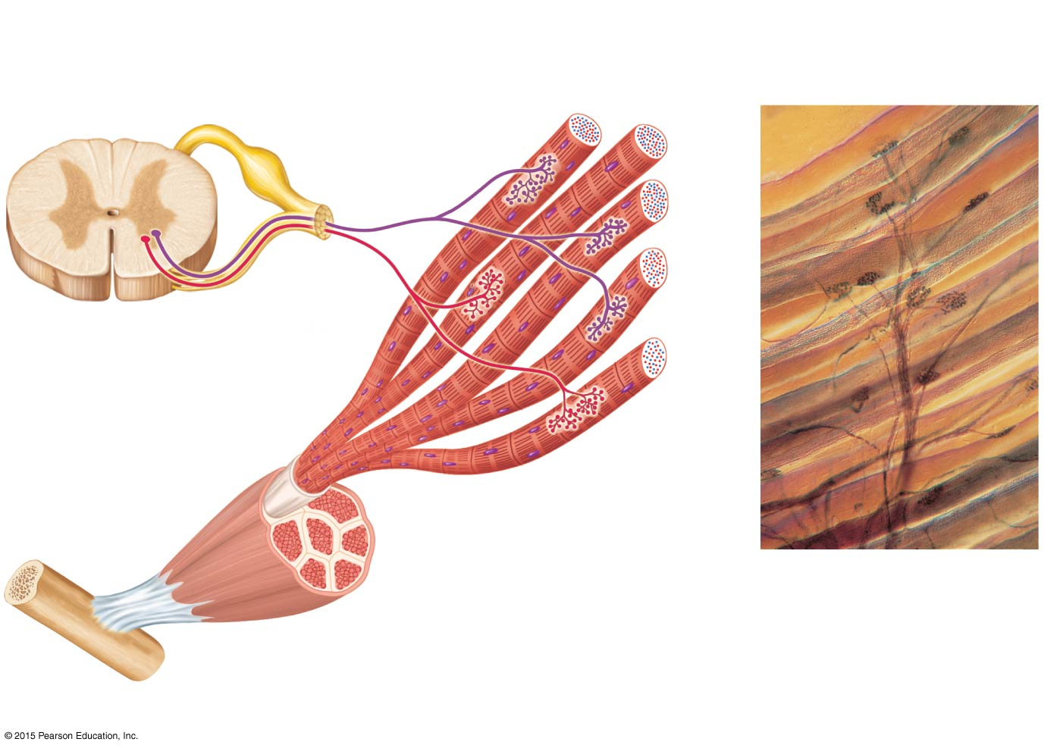
Figure 6.4 Motor units.
Axon terminals at neuromuscular junctions
Muscle fibers
Spinal cord
Motor unit 1
Motor unit 2
Nerve
Axon of motor neuron
Motor neuron cell bodies
Muscle
Muscle fibers
Branching axon to motor unit
(b)
(a)

Slide 13
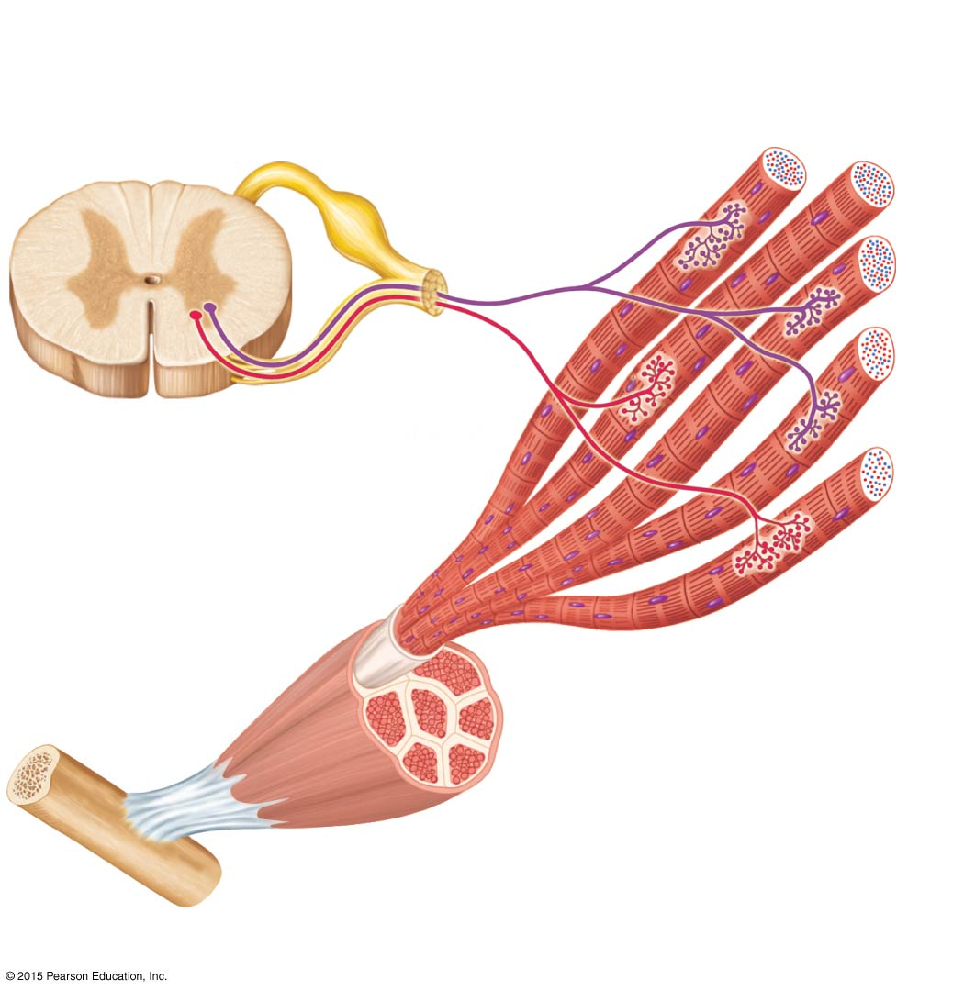
Figure 6.4a Motor units.
Axon terminals at neuromuscular junctions
Spinal cord
Motor unit 1
Motor unit 2
Nerve
Axon of motor neuron
Motor neuron cell bodies
Muscle
Muscle fibers
(a)

Slide 14
Figure 6.4b Motor units.
Axon terminals at neuromuscular junctions
Muscle fibers
Branching axon to motor unit
(b)

Slide 15
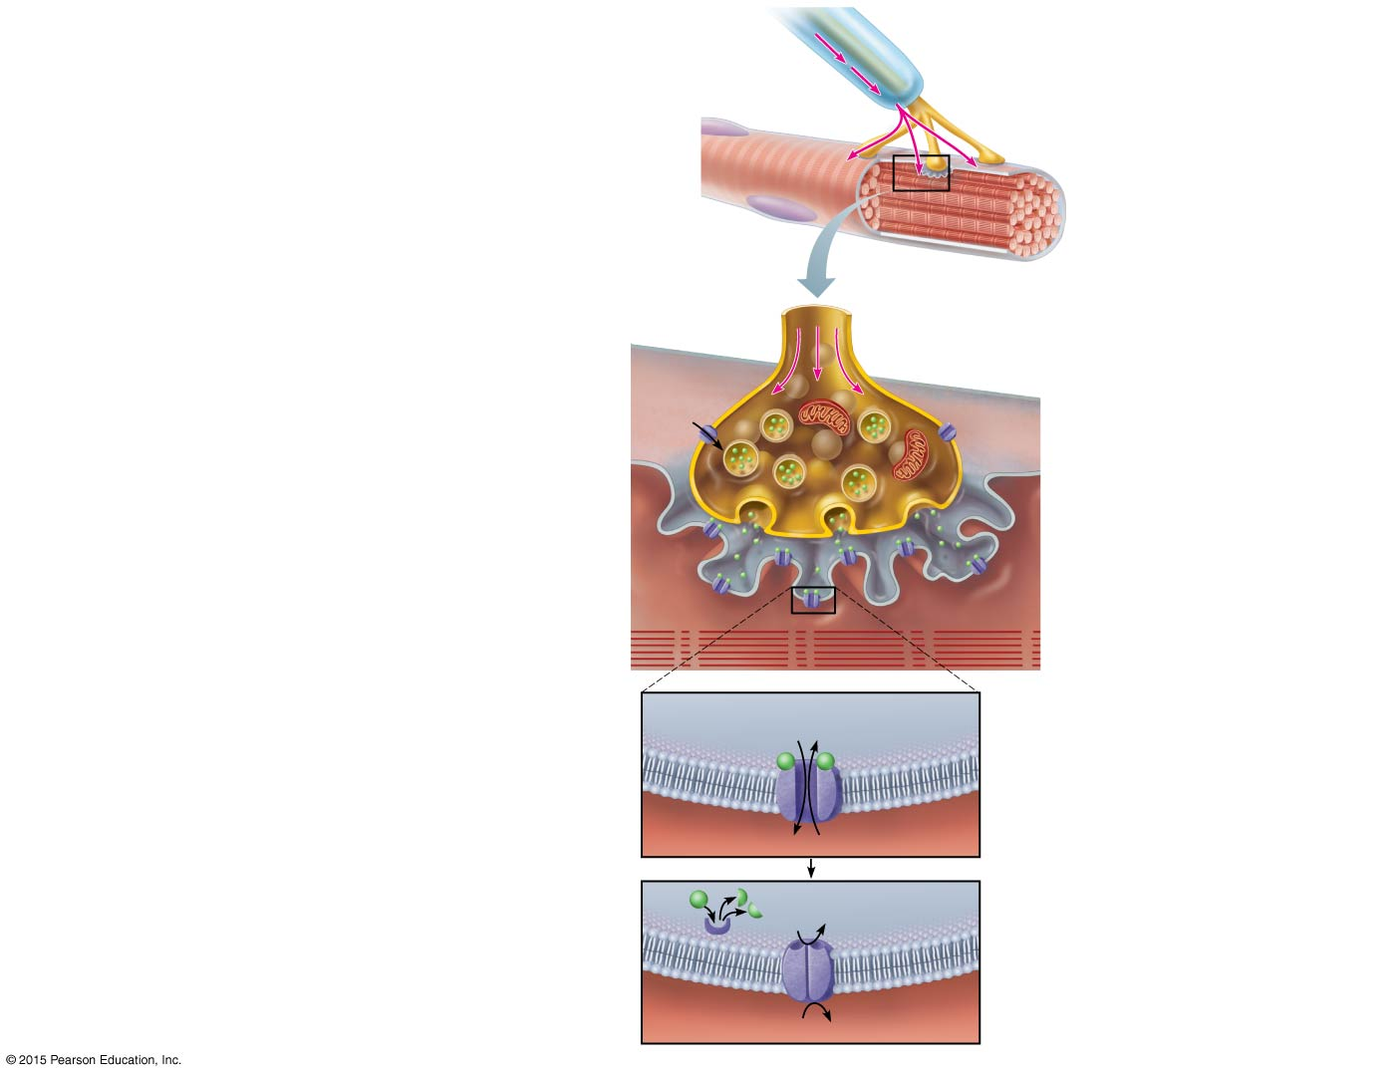
Figure 6.5 Events at the neuromuscular junction.
Myelinated axon of motor neuron
Nerve impulse
Axon terminal of neuromuscular junction
Nucleus
Sarcolemma of the muscle fiber
1
Action potential reaches axon terminal of motor neuron.
Synaptic vesicle containing ACh
2
Axon terminal of motor neuron
Calcium (Ca²⁺) channels open, and Ca²⁺ enters the axon terminal.
Mitochondrion
Ca²⁺ entry causes some synaptic vesicles to release their contents (acetylcholine, a neurotransmitter) by exocytosis.
Ca²⁺
Ca²⁺
3
Synaptic cleft
Sarcolemma
Fusing synaptic vesicle
ACh receptor
ACh
Sarcoplasm of muscle fiber
Acetylcholine diffuses across the synaptic cleft and binds to receptors in the sarcolemma.
4
Folds of sarcolemma
5
ACh binds and channels open that allow simultaneous passage of Na⁺ into the muscle fiber and K⁺ out of the muscle fiber. More Na⁺ ions enter than K⁺ ions leave, producing a local change in the electrical conditions of the membrane (depolarization). This eventually leads to an action potential.
Na⁺
K⁺
Ion channel in sarcolemma opens; ions pass.
ACh
Degraded ACh
Ion channel closed; ions cannot pass.
Na⁺
The enzyme acetylcholinesterase breaks down ACh in the synaptic cleft, ending the process.
6
Acetylcholine- sterase
K⁺

Slide 16
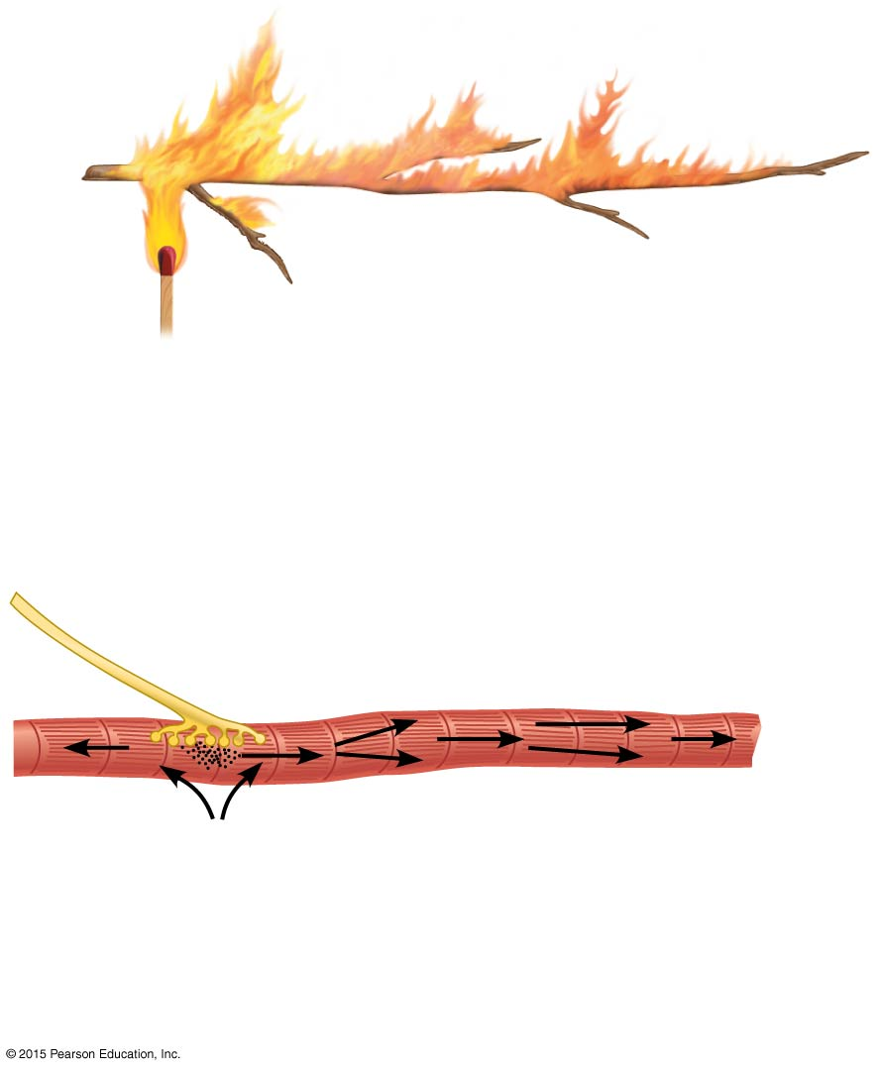
Figure 6.6 Comparing the action potential to a flame consuming a dry twig.
Small twig
Match flame
1
2
Flame ignites the twig.
Flame spreads rapidly along the twig.
(a)
Neuromuscular junction
Muscle cell or fiber
Nerve fiber
Striations
1
Na⁺ diffuses into the cell.
2
Action potential spreads rapidly along the sarcolemma.
(b)

Slide 17
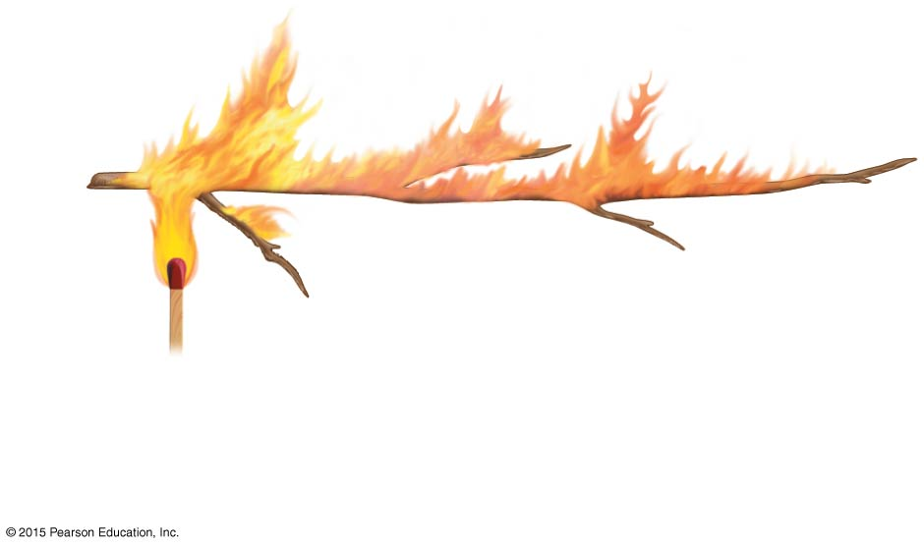
Figure 6.6a Comparing the action potential to a flame consuming a dry twig.
Small twig
Match flame
1
2
Flame ignites the twig.
Flame spreads rapidly along the twig.
(a)

Slide 18
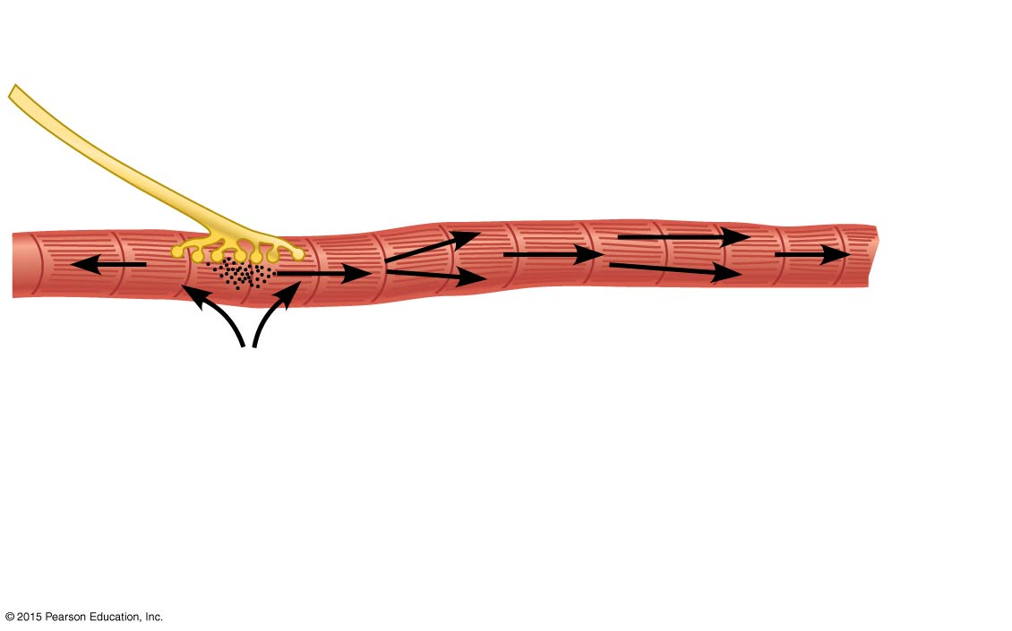
Figure 6.6b Comparing the action potential to a flame consuming a dry twig.
Neuromuscular junction
Muscle cell or fiber
Nerve fiber
Striations
1
Na⁺ diffuses into the cell.
2
Action potential spreads rapidly along the sarcolemma.
(b)

Slide 19
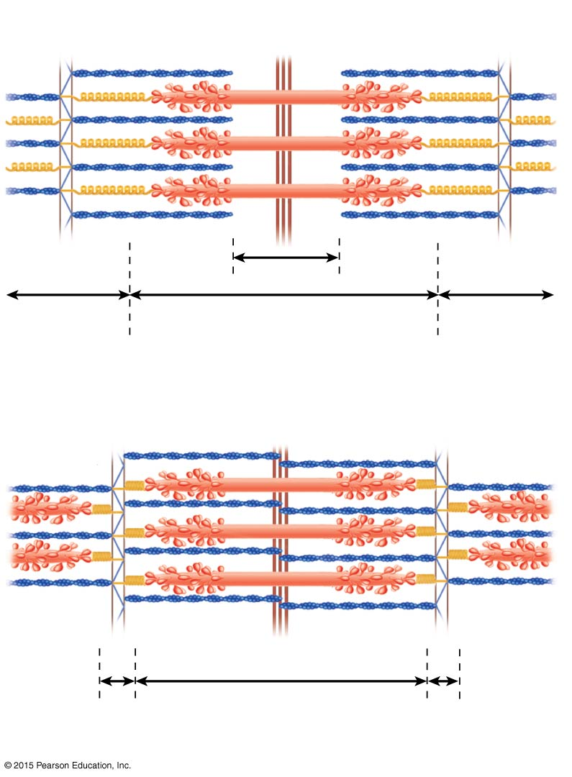
Figure 6.7 Diagrammatic views of a sarcomere.
Myosin
Actin
Z
I
H
A
Z
I
(a) Relaxed sarcomere
Z
I
Z
I
A
(b) Fully contracted sarcomere

Slide 20
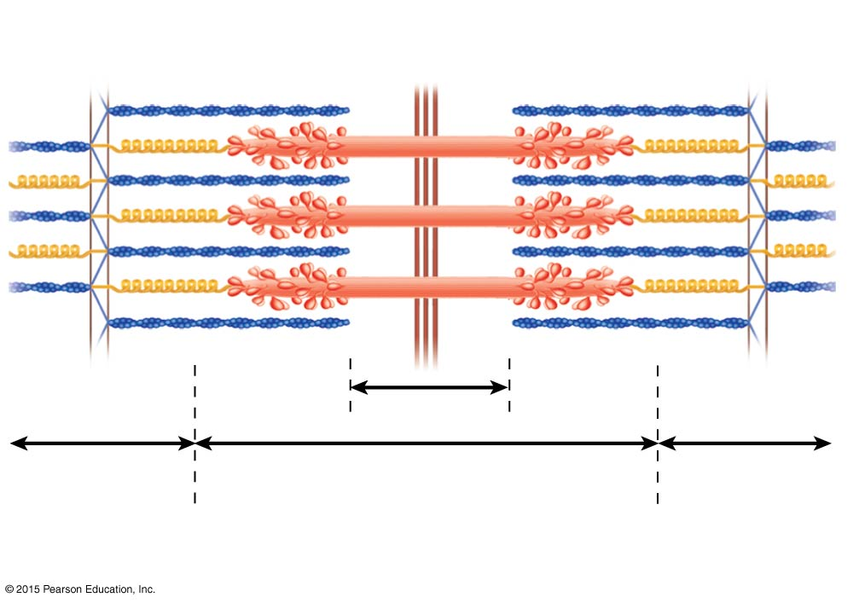
Figure 6.7a Diagrammatic views of a sarcomere.
Myosin
Actin
Z
I
H
A
Z
I
(a) Relaxed sarcomere

Slide 21
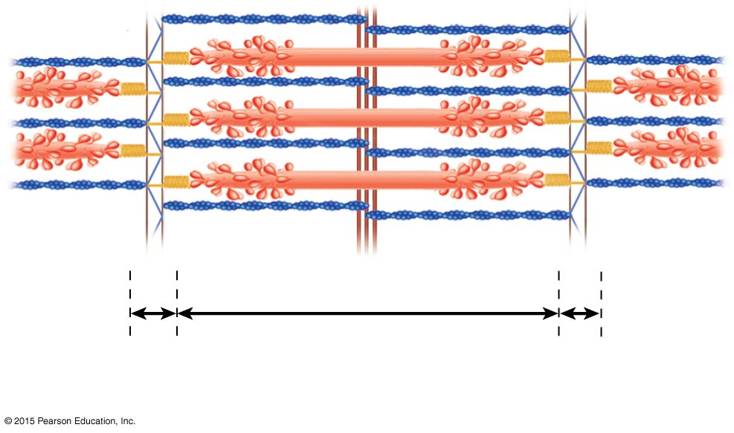
Figure 6.7b Diagrammatic views of a sarcomere.
Z
I
Z
I
A
(b) Fully contracted sarcomere

Slide 22
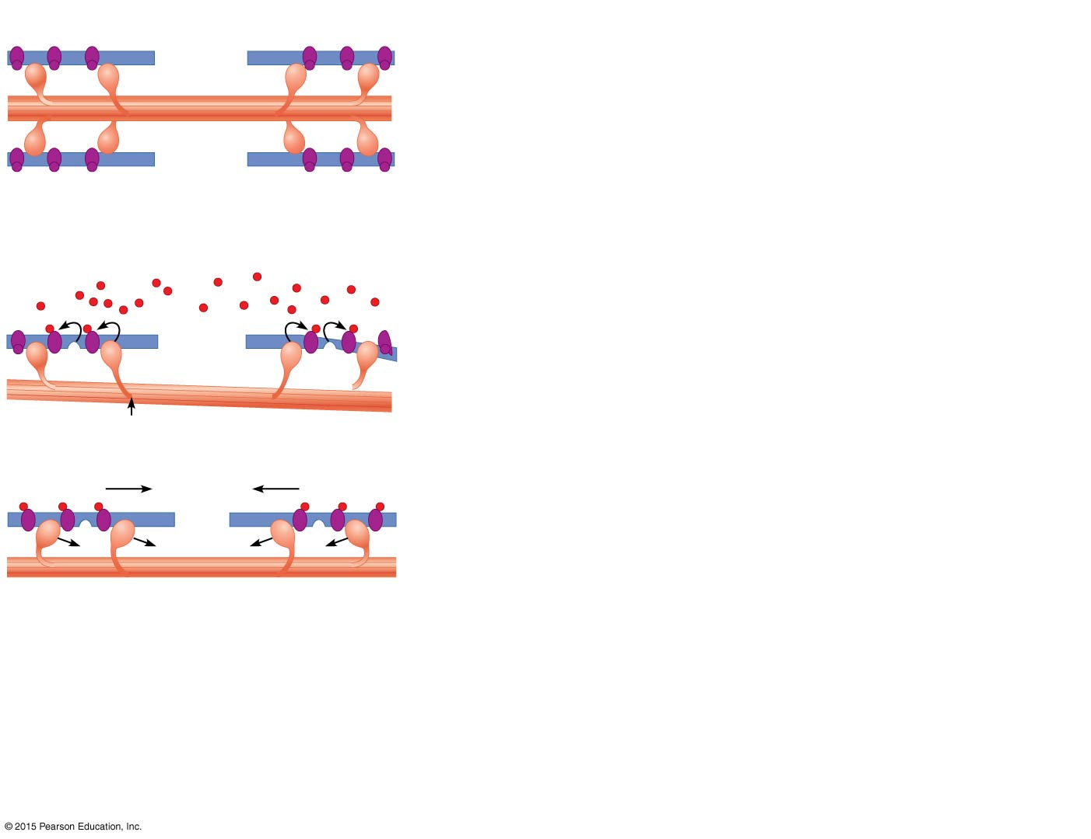
Figure 6.8 Schematic representation of contraction mechanism: The sliding filament theory.
Protein complex
In a relaxed muscle cell, the regulatory proteins forming part of the actin myofilaments prevent myosin binding (see a). When an action potential (AP) sweeps along its sarcolemma and a muscle cell is excited, calcium ions (Ca²⁺) are released from intracellular storage areas (the sacs of the sarcoplasmic reticulum).
Myosin myofilament
Actin myofilament
(a)
Myosin-binding site
Ca²⁺
The flood of calcium acts as the final trigger for contraction, because as calcium binds to the regulatory proteins on the actin filaments, the proteins undergo a change in both their shape and their position on the thin filaments. This action exposes myosin-binding sites on the actin, to which the myosin heads can attach (see b), and the myosin heads immediately begin seeking out binding sites.
Upper part of thick filament only
(b)
The free myosin heads are “cocked,” much like a set mousetrap. Myosin attachment to actin “springs the trap,” causing the myosin heads to snap (pivot) toward the center of the sarcomere. When this happens, the thin filaments are slightly pulled toward the center of the sarcomere (see c). ATP provides the energy needed to release and recock each myosin head so that it is ready to attach to a binding site farther along the thin filament. When the AP ends and calcium ions are returned to SR storage areas, the regulatory proteins resume their original shape and position, and again block myosin binding to the thin filaments. As a result, the muscle cell relaxes and settles back to its original length.
(c)

Slide 23
Figure 6.8a Schematic representation of contraction mechanism: The sliding filament theory.
Protein complex
In a relaxed muscle cell, the regulatory proteins forming part of the actin myofilaments prevent myosin binding (see a). When an action potential (AP) sweeps along its sarcolemma and a muscle cell is excited, calcium ions (Ca²⁺) are released from intracellular storage areas (the sacs of the sarcoplasmic reticulum).
Myosin myofilament
Actin myofilament
(a)

Slide 24
Figure 6.8b Schematic representation of contraction mechanism: The sliding filament theory.
Myosin-binding site
The flood of calcium acts as the final trigger for contraction, because as calcium binds to the regulatory proteins on the actin filaments, the proteins undergo a change in both their shape and their position on the thin filaments. This action exposes myosin-binding sites on the actin, to which the myosin heads can attach (see b), and the myosin heads immediately begin seeking out binding sites.
Ca²⁺
Upper part of thick filament only
(b)

Slide 25
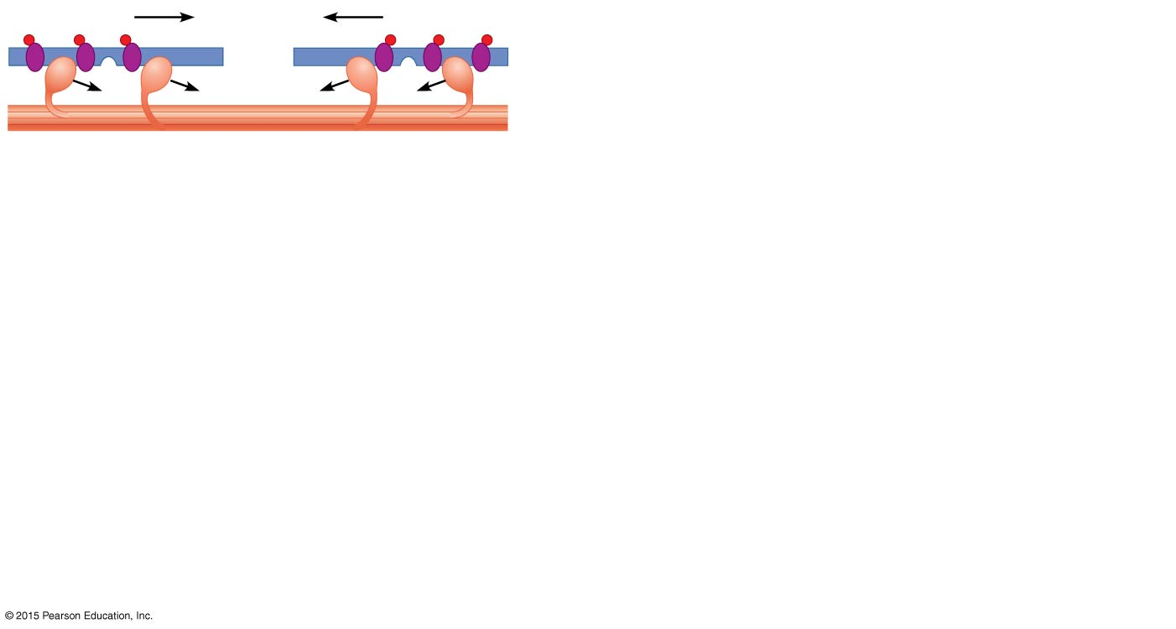
Figure 6.8c Schematic representation of contraction mechanism: The sliding filament theory.
The free myosin heads are “cocked,” much like a set mousetrap. Myosin attachment to actin “springs the trap,” causing the myosin heads to snap (pivot) toward the center of the sarcomere. When this happens, the thin filaments are slightly pulled toward the center of the sarcomere (see c). ATP provides the energy needed to release and recock each myosin head so that it is ready to attach to a binding site farther along the thin filament. When the AP ends and calcium ions are returned to SR storage areas, the regulatory proteins resume their original shape and position, and again block myosin binding to the thin filaments. As a result, the muscle cell relaxes and settles back to its original length.
(c)

Slide 26
Figure 6.9 A whole muscle’s response to different rates of stimulation.
Tension (g)
(Stimuli)
(a) Twitch
(b) Summing of contractions
(c) Unfused (incomplete) tetanus
(d) Fused (complete) tetanus

Slide 27
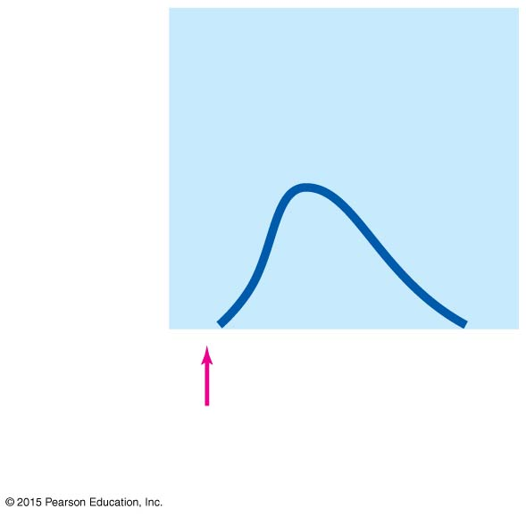
Figure 6.9a A whole muscle’s response to different rates of stimulation.
Tension (g)
(Stimuli)
(a) Twitch

Slide 28
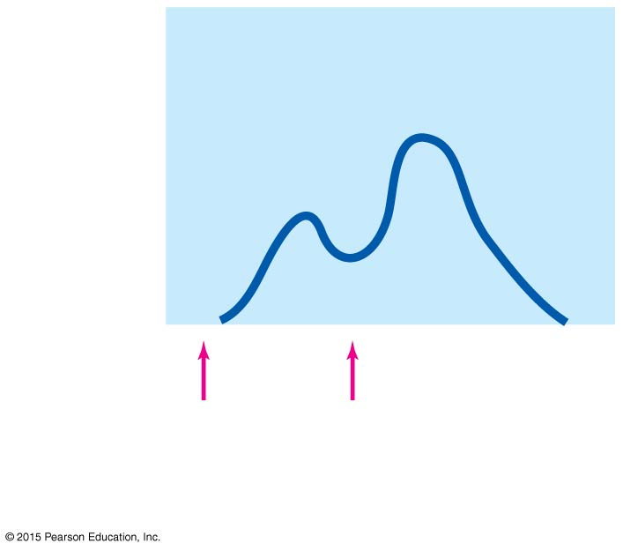
Figure 6.9b A whole muscle’s response to different rates of stimulation.
Tension (g)
(Stimuli)
(b) Summing of contractions

Slide 29
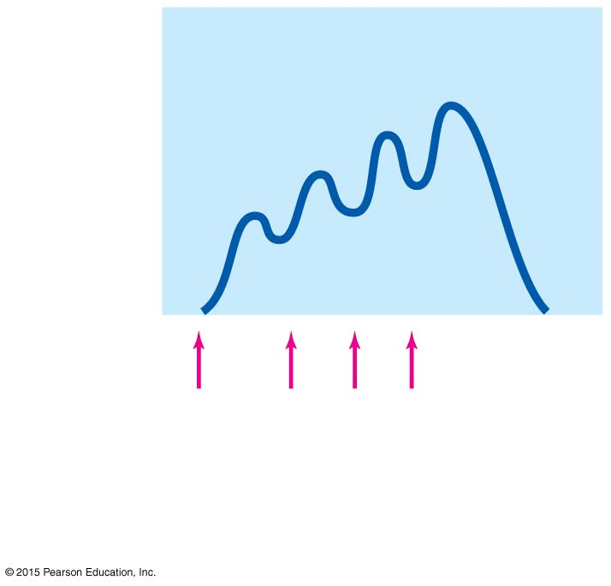
Figure 6.9c A whole muscle’s response to different rates of stimulation.
Tension (g)
(Stimuli)
(c) Unfused (incomplete) tetanus

Slide 30
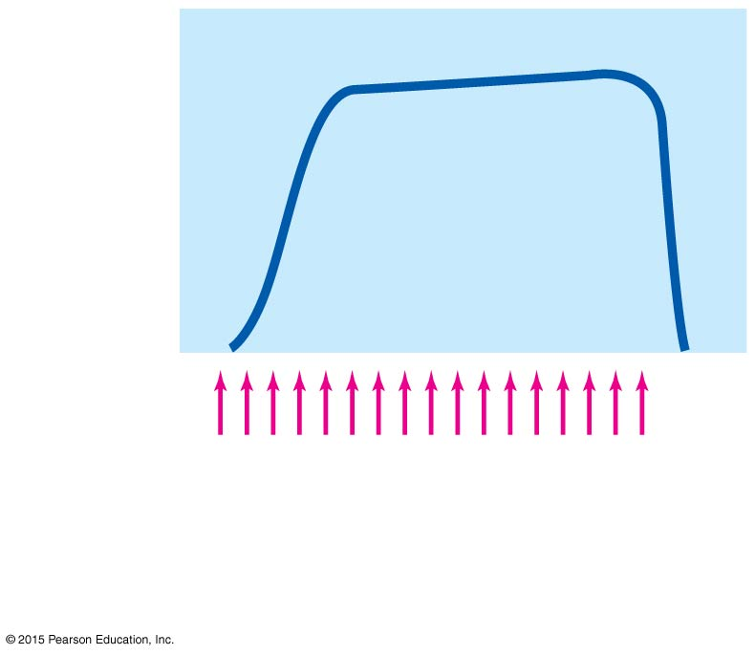
Figure 6.9d A whole muscle’s response to different rates of stimulation.
Tension (g)
(Stimuli)
(d) Fused (complete) tetanus

Slide 31
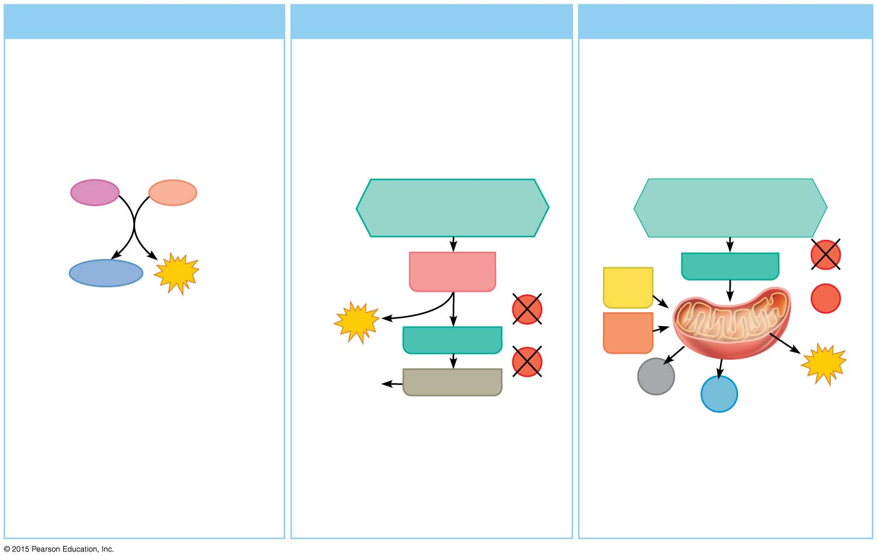
Figure 6.10 Methods of regenerating ATP during muscle activity.
(a) Direct phosphorylation
(b) Anaerobic pathway
(c) Aerobic pathway
Coupled reaction of creatine phosphate (CP) and ADP
Glycolysis and lactic acid formation
Aerobic cellular respiration
Energy source:
glucose
glucose; pyruvic acid; free fatty acids from adipose tissue; amino acids from protein catabolism
Energy source:
CP
Energy source:
CP
ADP
Glucose (from glycogen breakdown or delivered from blood)
Glucose (from glycogen breakdown or delivered from blood)
Glycolysis in cytosol
Pyruvic acid
O₂
Creatine
ATP
Fatty acids
O₂
O₂
Aerobic respiration in mitochondria
2
ATP
Amino acids
Aerobic respiration in mitochondria
net gain
Pyruvic acid
Released to blood
O₂
CO₂
32
ATP
Lactic acid
H₂O
net gain per glucose
Oxygen use:
None
Oxygen use:
None
Oxygen use:
Required
Products:
1 ATP per CP, creatine
2 ATP per glucose, lactic acid
32 ATP per glucose, CO₂, H₂O
Products:
Products:
Duration of energy provision:
Duration of energy provision:
Duration of energy provision:
15 seconds
40 seconds, or slightly more
Hours

Slide 32
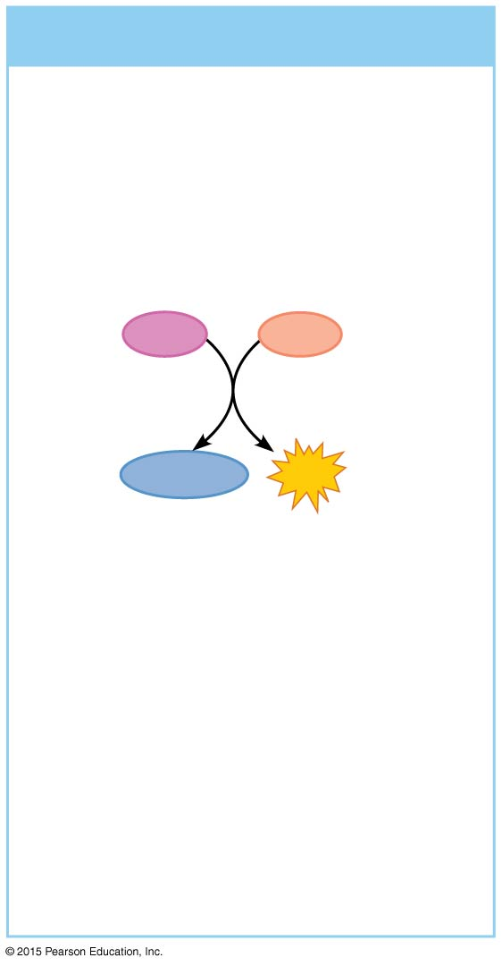
Figure 6.10a Methods of regenerating ATP during muscle activity.
(a) Direct phosphorylation
Coupled reaction of creatine phosphate (CP) and ADP
Energy source:
CP
CP
ADP
Creatine
ATP
Oxygen use:
None
Products:
1 ATP per CP, creatine
Duration of energy provision:
15 seconds

Slide 33
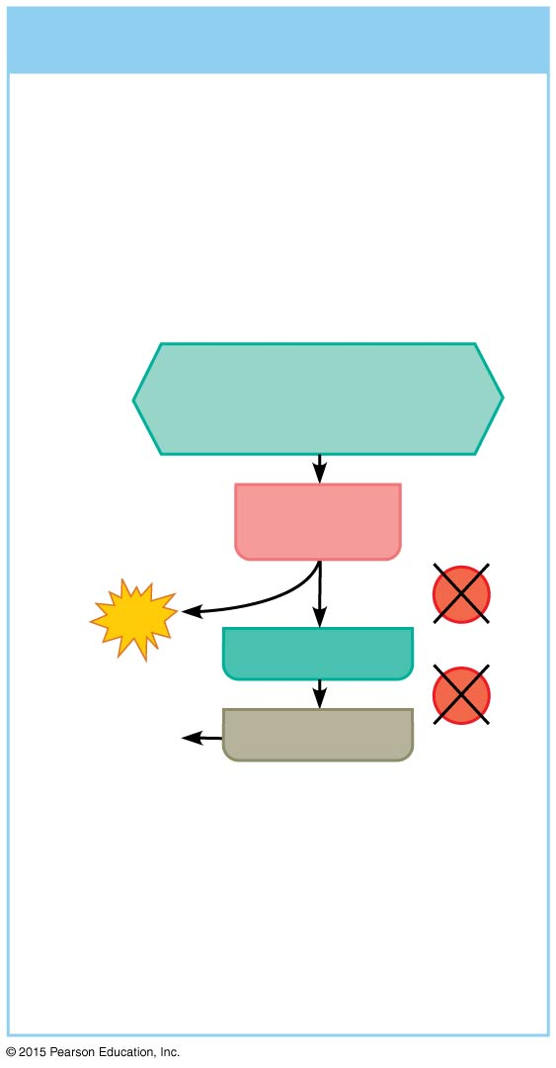
Figure 6.10b Methods of regenerating ATP during muscle activity.
(b) Anaerobic pathway
Glycolysis and lactic acid formation
Energy source:
glucose
Glucose (from glycogen breakdown or delivered from blood)
Glycolysis in cytosol
O₂
2
ATP
Pyruvic acid
net gain
O₂
Released to blood
Lactic acid
Oxygen use:
None
Products:
2 ATP per glucose, lactic acid
Duration of energy provision:
40 seconds, or slightly more

Slide 34
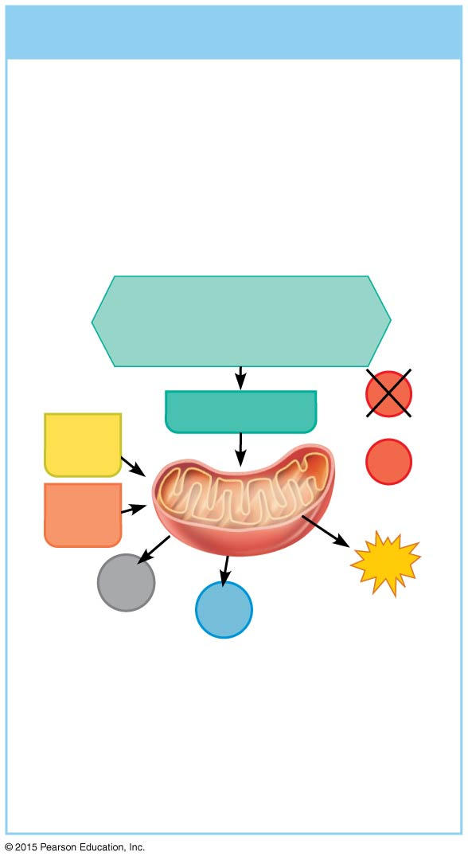
Figure 6.10c Methods of regenerating ATP during muscle activity.
(c) Aerobic pathway
Aerobic cellular respiration
glucose; pyruvic acid; free fatty acids from adipose tissue; amino acids from protein catabolism
Energy source:
Glucose (from glycogen breakdown or delivered from blood)
Pyruvic acid
O₂
Fatty acids
O₂
Aerobic respiration in mitochondria
Amino acids
Aerobic respiration in mitochondria
32
ATP
CO₂
H₂O
net gain per glucose
Oxygen use:
Required
Products:
32 ATP per glucose, CO₂, H₂O
Duration of energy provision:
Hours

Slide 35
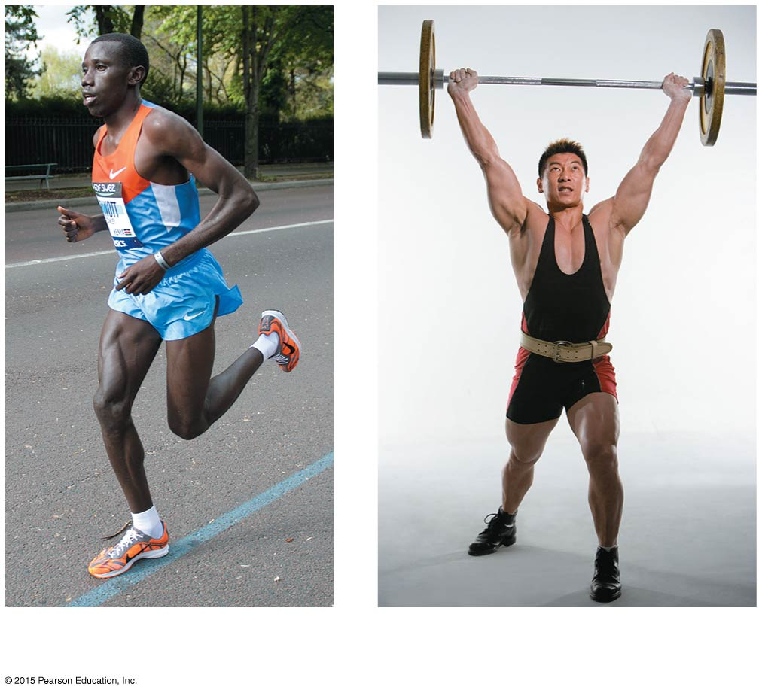
Figure 6.11 The effects of aerobic training versus strength training.
(a)
(b)

Slide 36
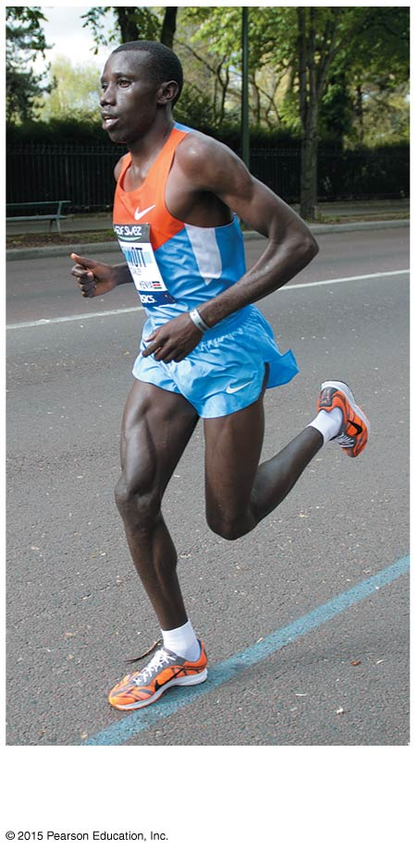
Figure 6.11a The effects of aerobic training versus strength training.
(a)

Slide 37
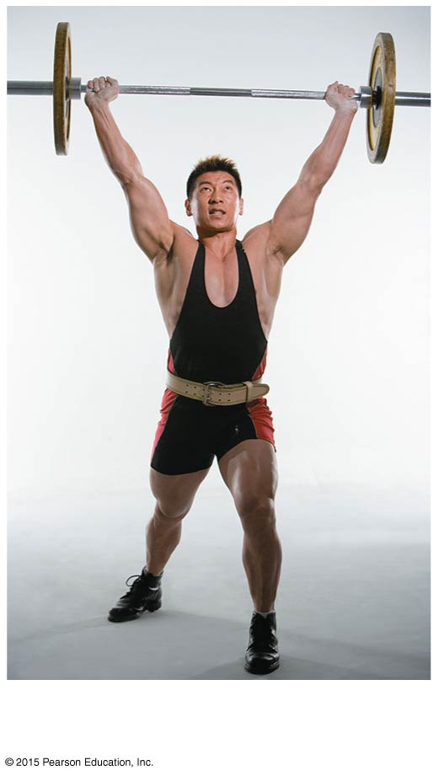
Figure 6.11b The effects of aerobic training versus strength training.
(b)

Slide 38
Table 6.2 The Five Golden Rules of Skeletal Muscle Activity.

Slide 39
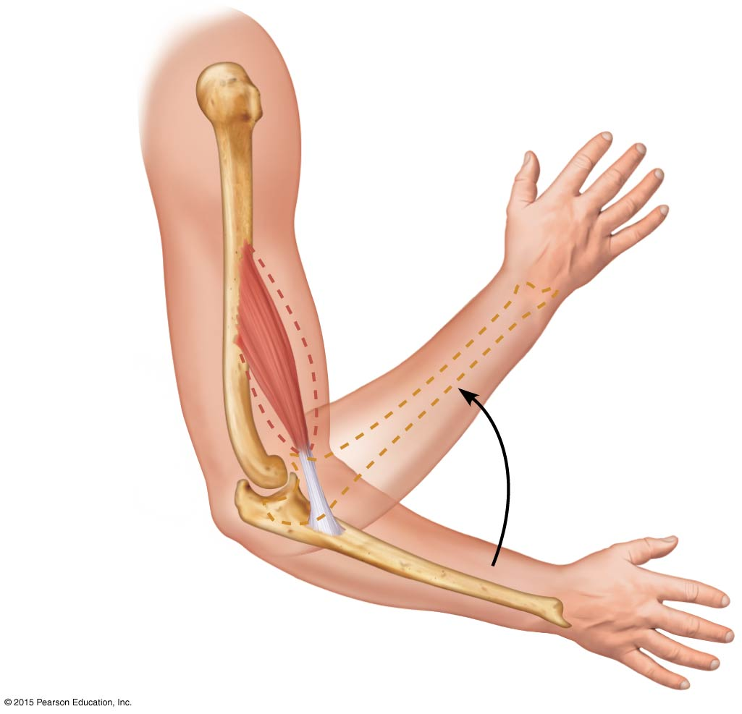
Figure 6.12 Muscle attachments (origin and insertion).
Muscle contracting
Origin
Brachialis
Tendon
Insertion

Slide 40
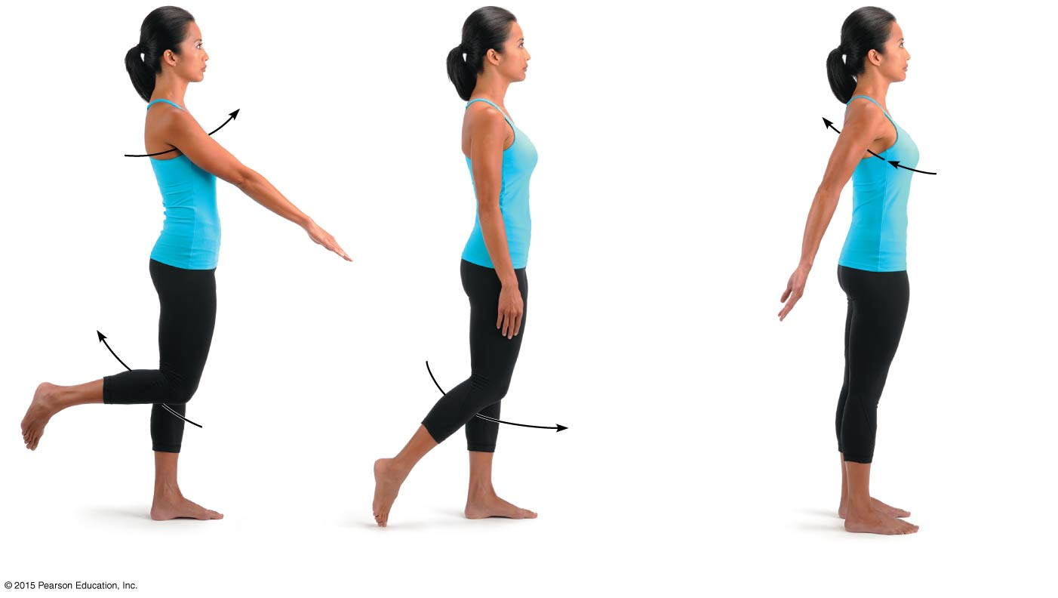
Figure 6.13a Body movements.
Flexion
Hyperextension
Extension
Flexion
Extension
(a) Flexion, extension, and hyperextension of the shoulder and knee

Slide 41
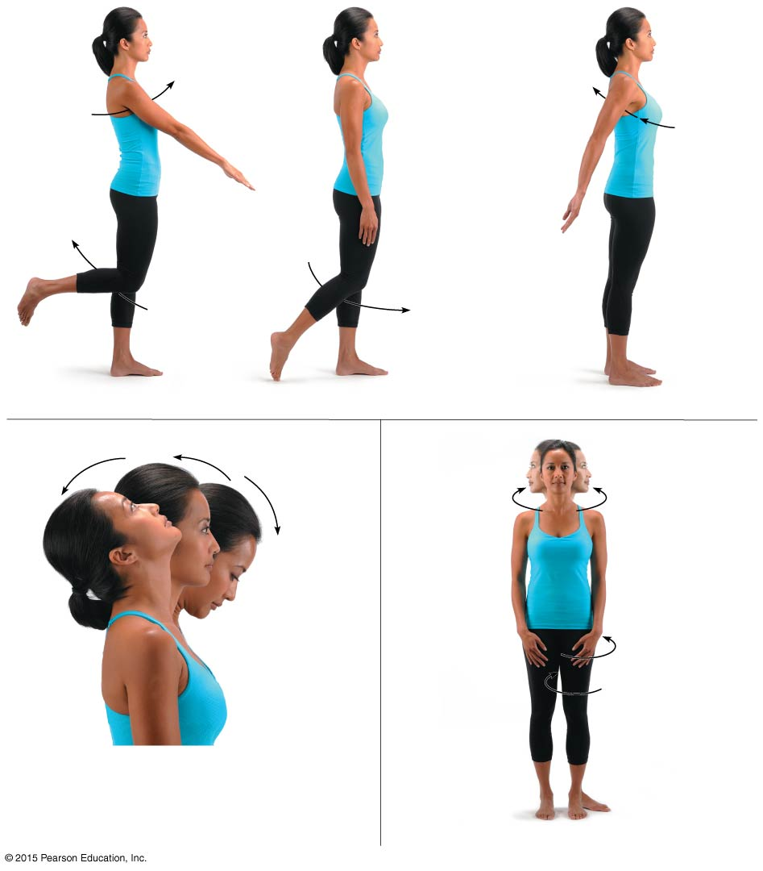
Figure 6.13a-c Body movements.
Flexion
Hyperextension
Extension
Flexion
Extension
(a) Flexion, extension, and hyperextension of the shoulder and knee
Hyperextension
Extension
Rotation
Flexion
Lateral rotation
Medial rotation
(b) Flexion, extension, and hyperextension
(c) Rotation

Slide 42
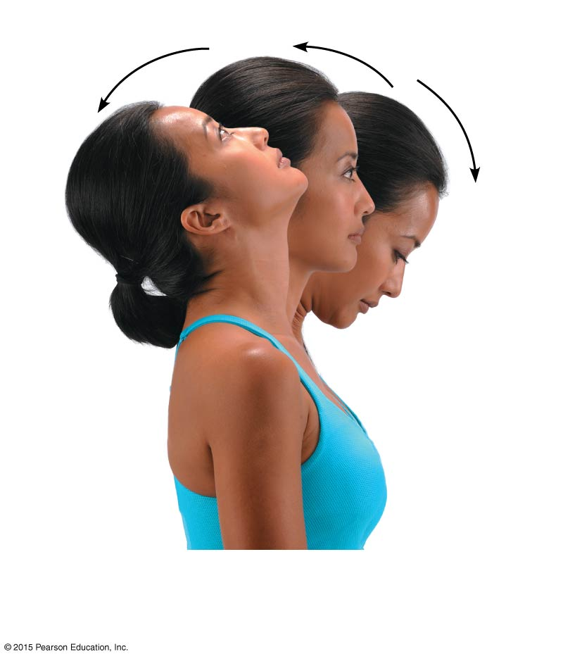
Figure 6.13b Body movements.
Hyperextension
Extension
Flexion
(b) Flexion, extension, and hyperextension

Slide 43
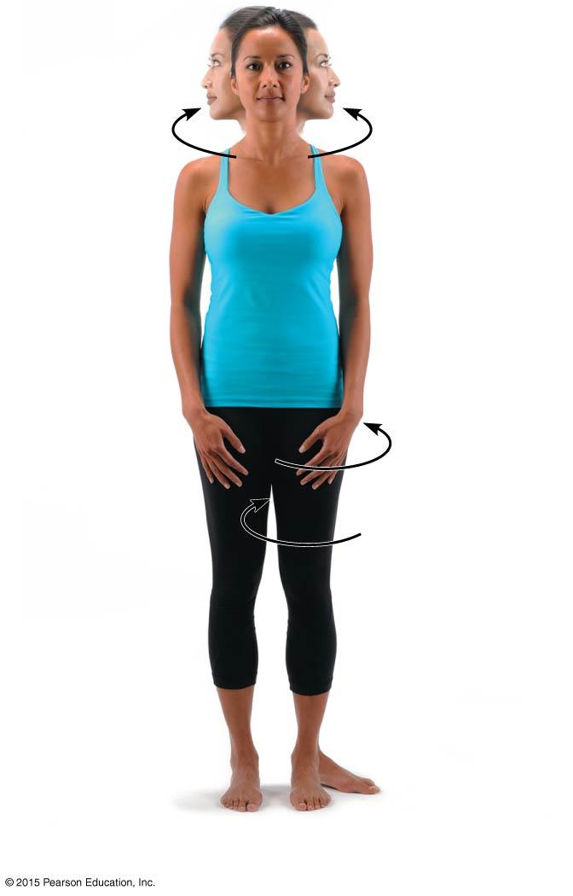
Figure 6.13c Body movements.
Rotation
Lateral rotation
Medial rotation
(c) Rotation

Slide 44
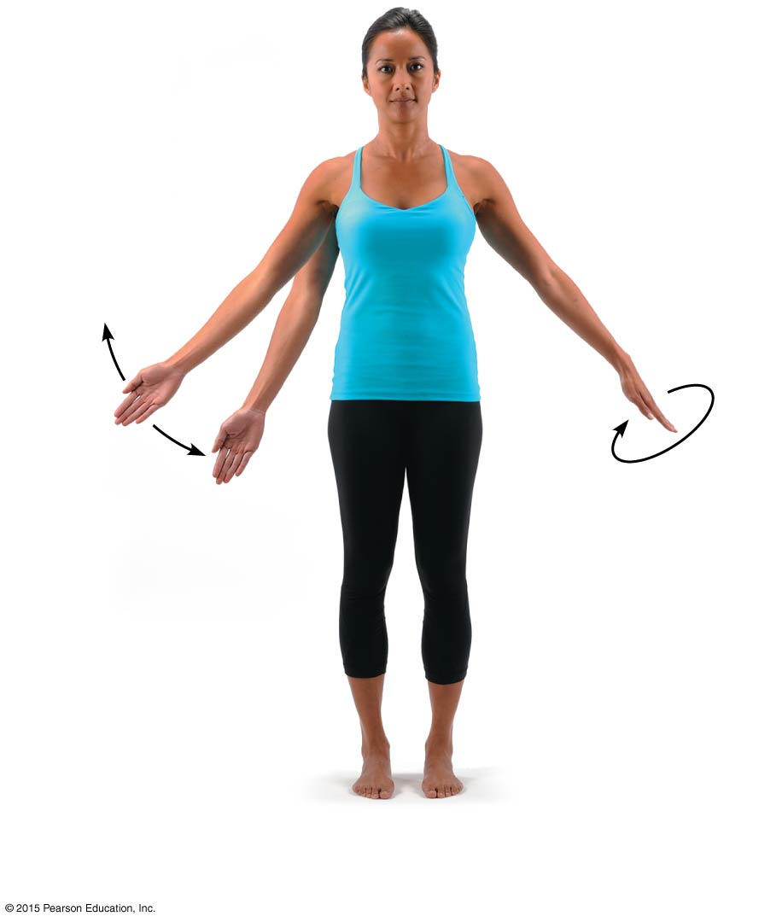
Figure 6.13d Body movements.
Abduction
Adduction
Circumduction
(d) Abduction, adduction, and circumduction

Slide 45
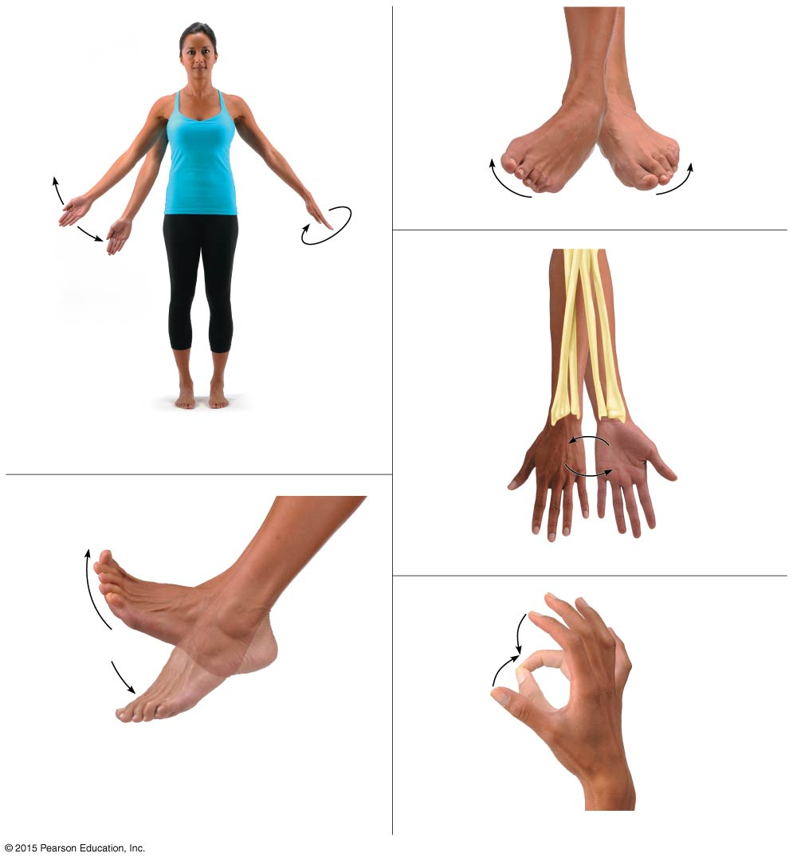
Figure 6.13d-h Body movements.
Abduction
Inversion
Eversion
(f) Inversion and eversion
Adduction
Circumduction
Pronation (radius rotates over ulna)
Supination (radius and ulna are parallel)
(d) Abduction, adduction, and circumduction
P
S
P
S
Dorsiflexion
(g) Supination (S) and pronation (P)
Plantar flexion
Opposition
(e) Dorsiflexion and plantar flexion
(h) Opposition

Slide 46
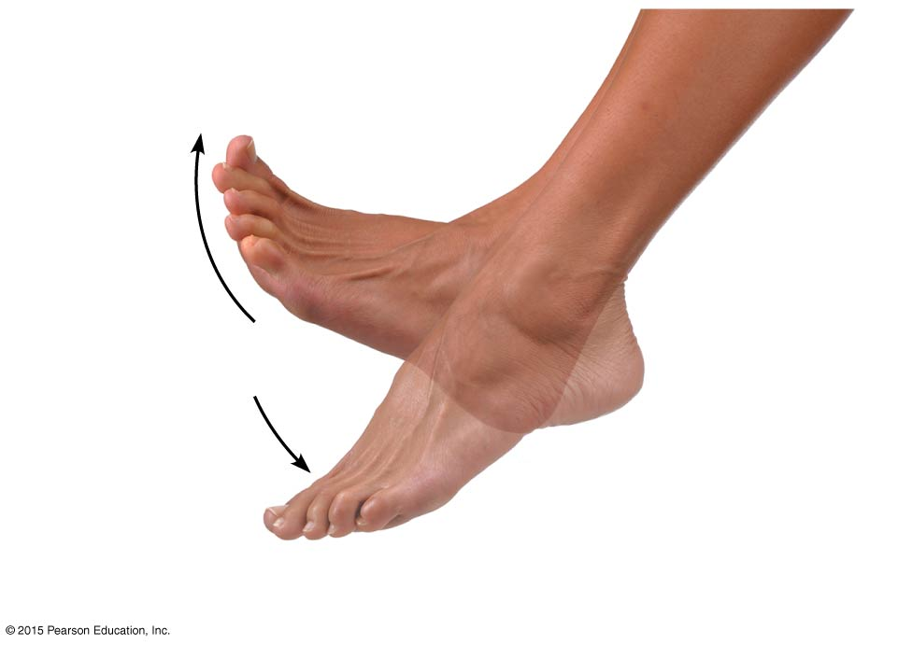
Figure 6.13e Body movements.
Dorsiflexion
Plantar flexion
(e) Dorsiflexion and plantar flexion

Slide 47
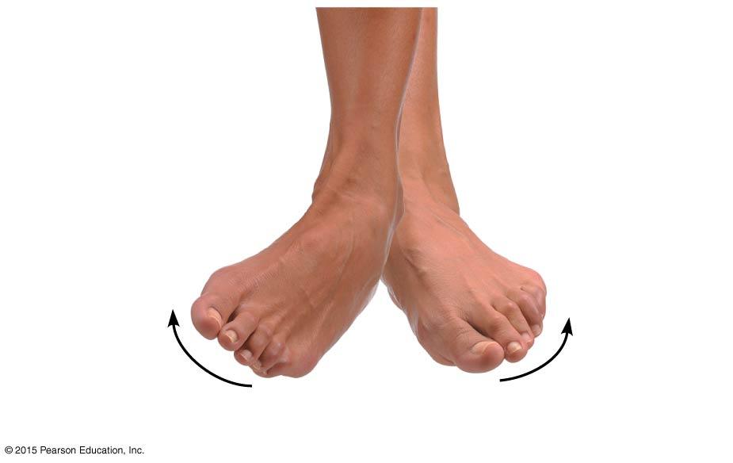
Figure 6.13f Body movements.
Inversion
Eversion
(f) Inversion and eversion

Slide 48
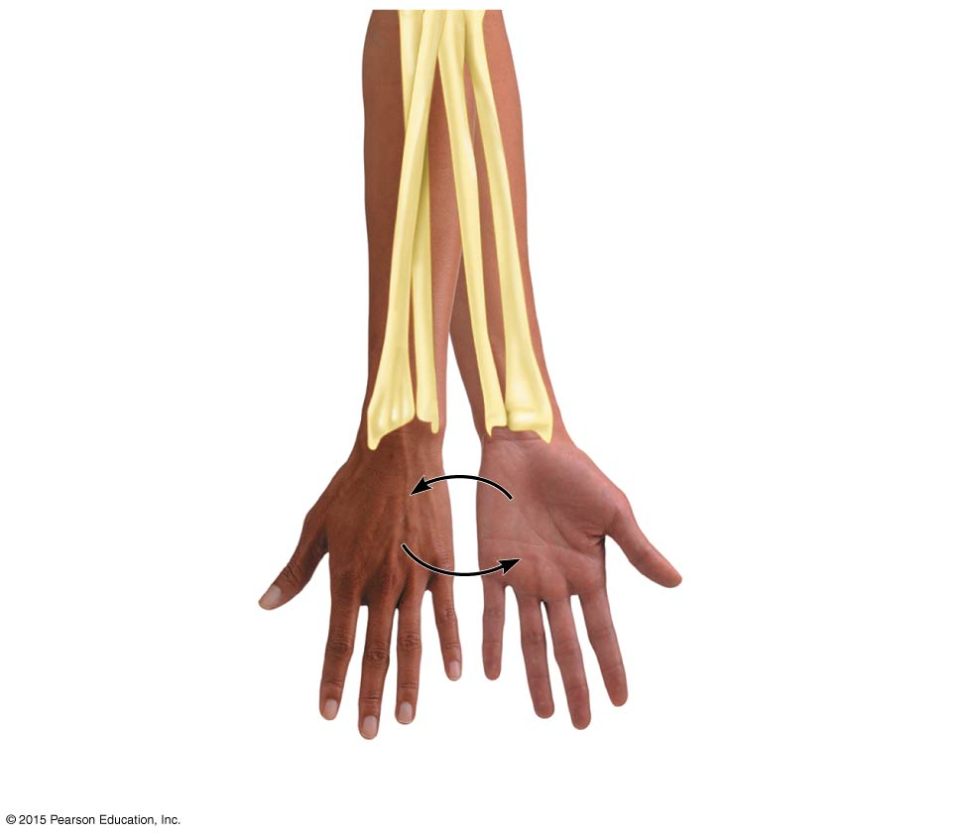
Figure 6.13g Body movements.
Pronation (radius rotates over ulna)
Supination (radius and ulna are parallel)
P
S
P
S
(g) Supination (S) and pronation (P)

Slide 49
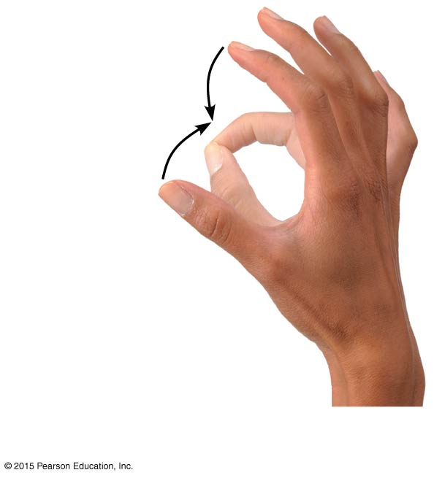
Figure 6.13h Body movements.
Opposition
(h) Opposition

Slide 50
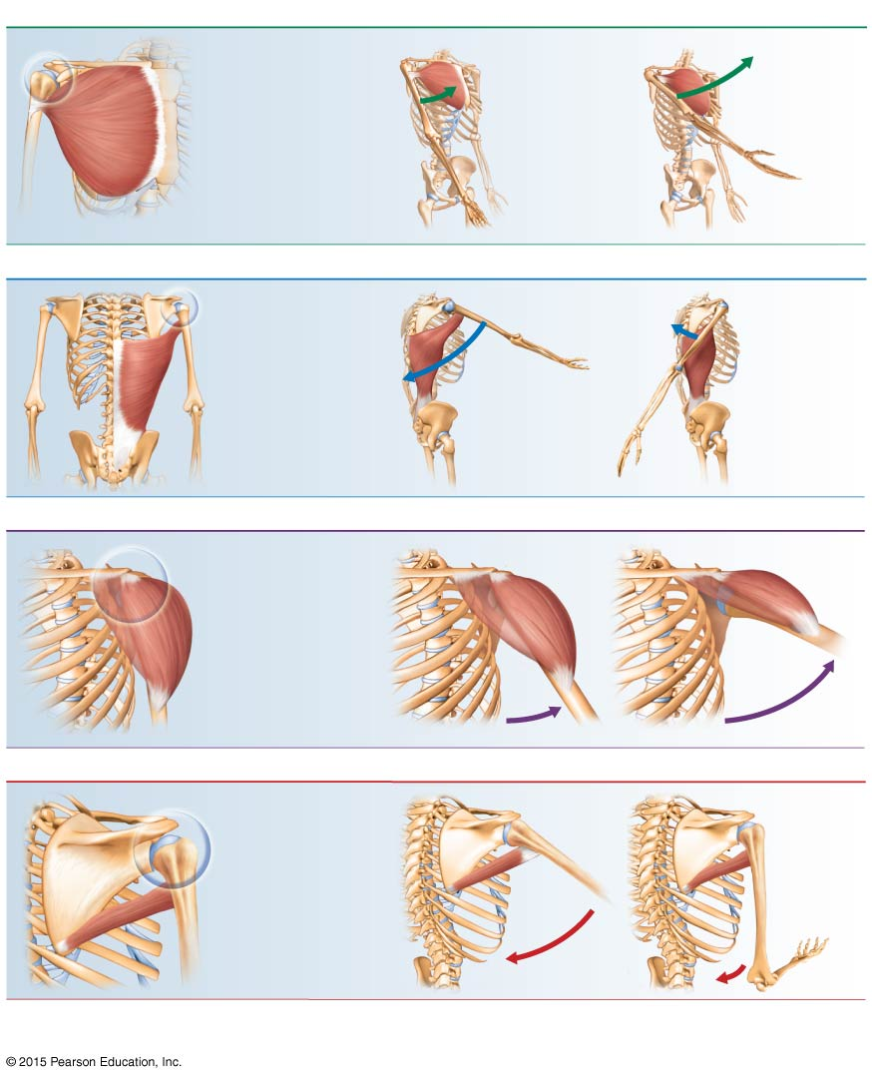
Figure 6.14 Muscle action.
(a) A muscle that crosses on the anterior side of a joint produces flexion*
Example: Pectoralis major (anterior view)
(b) A muscle that crosses on the posterior side of a joint produces extension*
Example: Latissimus dorsi (posterior view)
The latissimus dorsi is the antagonist of the pectoralis major.
(c) A muscle that crosses on the lateral side of a joint produces abduction
Example: Deltoid middle fibers (anterolateral view)
(d) A muscle that crosses on the medial side of a joint produces adduction
Example: Teres major (posterolateral view)
The teres major is the antagonist of the deltoid.
* These generalities do not apply to the knee and ankle because the lower limb is rotated during development.
The muscles that cross these joints posteriorly produce flexion, and those that cross anteriorly produce extension.

Slide 51
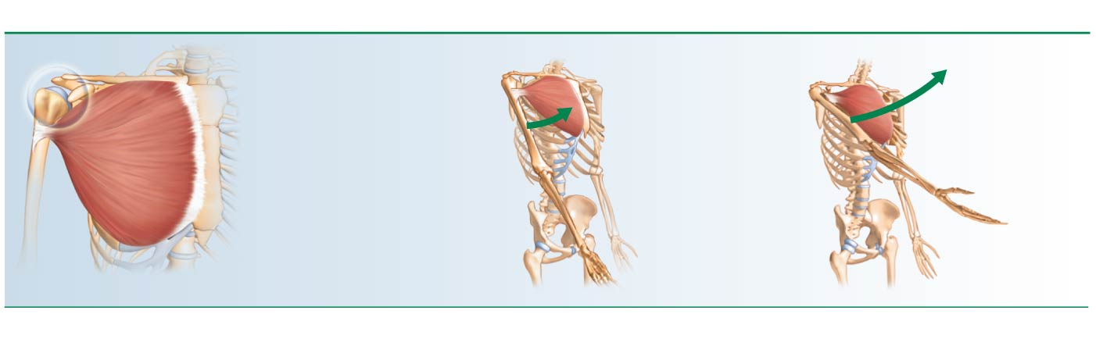
Figure 6.14a Muscle action.
(a) A muscle that crosses on the anterior side of a joint produces flexion*
Example: Pectoralis major (anterior view)
* These generalities do not apply to the knee and ankle because the lower limb is rotated during development.
The muscles that cross these joints posteriorly produce flexion, and those that cross anteriorly produce extension.

Slide 52
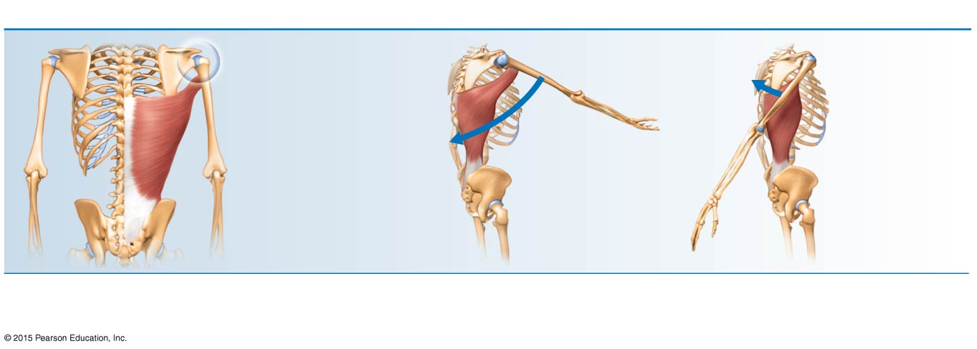
Figure 6.14b Muscle action.
(b) A muscle that crosses on the posterior side of a joint produces extension*
Example: Latissimus dorsi (posterior view)
The latissimus dorsi is the antagonist of the pectoralis major.
* These generalities do not apply to the knee and ankle because the lower limb is rotated during development.
The muscles that cross these joints posteriorly produce flexion, and those that cross anteriorly produce extension.

Slide 53
Figure 6.14c Muscle action.
(c) A muscle that crosses on the lateral side of a joint produces abduction
Example: Deltoid middle fibers (anterolateral view)

Slide 54
Figure 6.14d Muscle action.
(d) A muscle that crosses on the medial side of a joint produces adduction
Example: Teres major (posterolateral view)
The teres major is the antagonist of the deltoid.

Slide 55
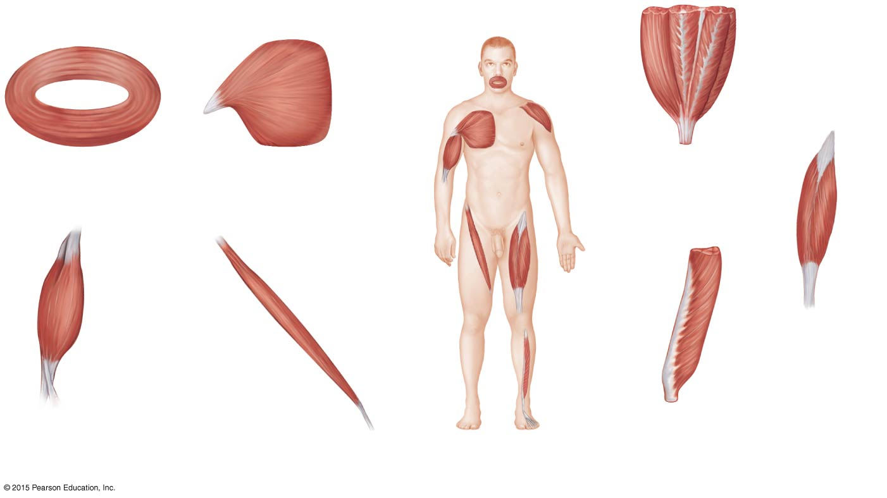
Figure 6.15 Relationship of fascicle arrangement to muscle structure.
(a)
(b)
(e)
(c)
(e) Multipennate (deltoid)
(a) Circular (orbicularis oris)
(b) Converent (pectoralis major)
(d)
(f)
(f) Bipennate (rectus femoris)
(g)
(c) Fusiform (biceps brachii)
(d) Parallel (sartorius)
(g) Unipennate (extensor digitorum longus)

Slide 56
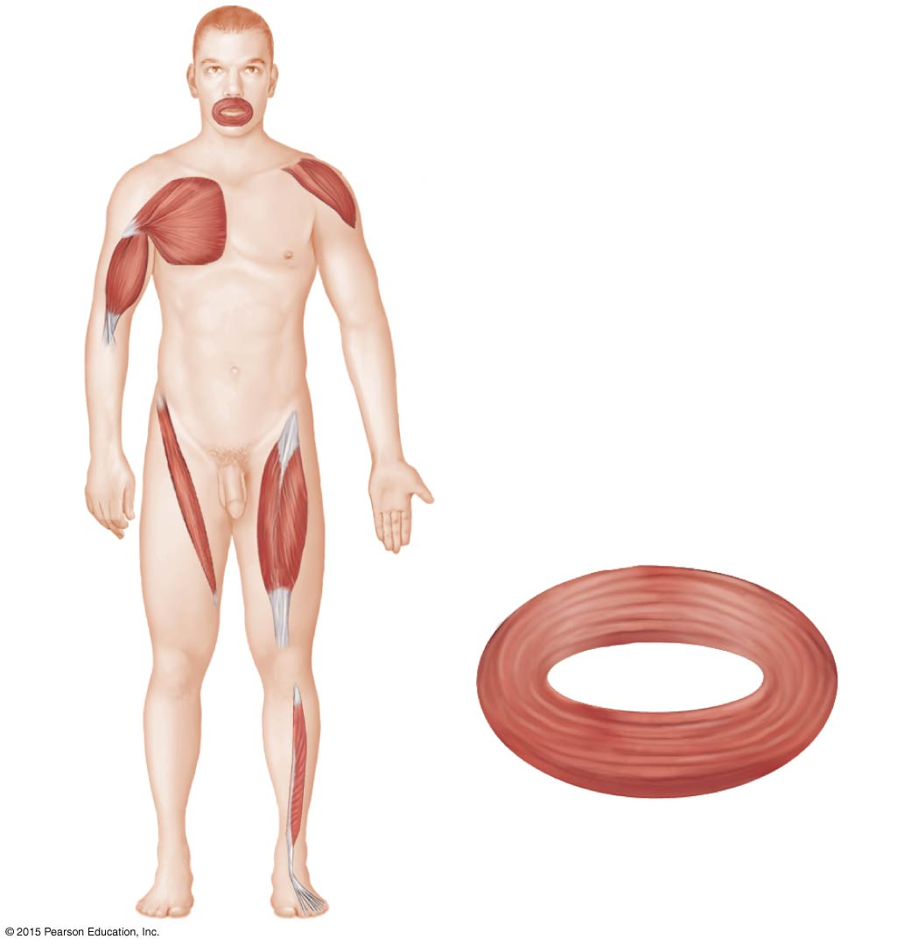
Figure 6.15a Relationship of fascicle arrangement to muscle structure.
(a)
(a) Circular (orbicularis oris)

Slide 57
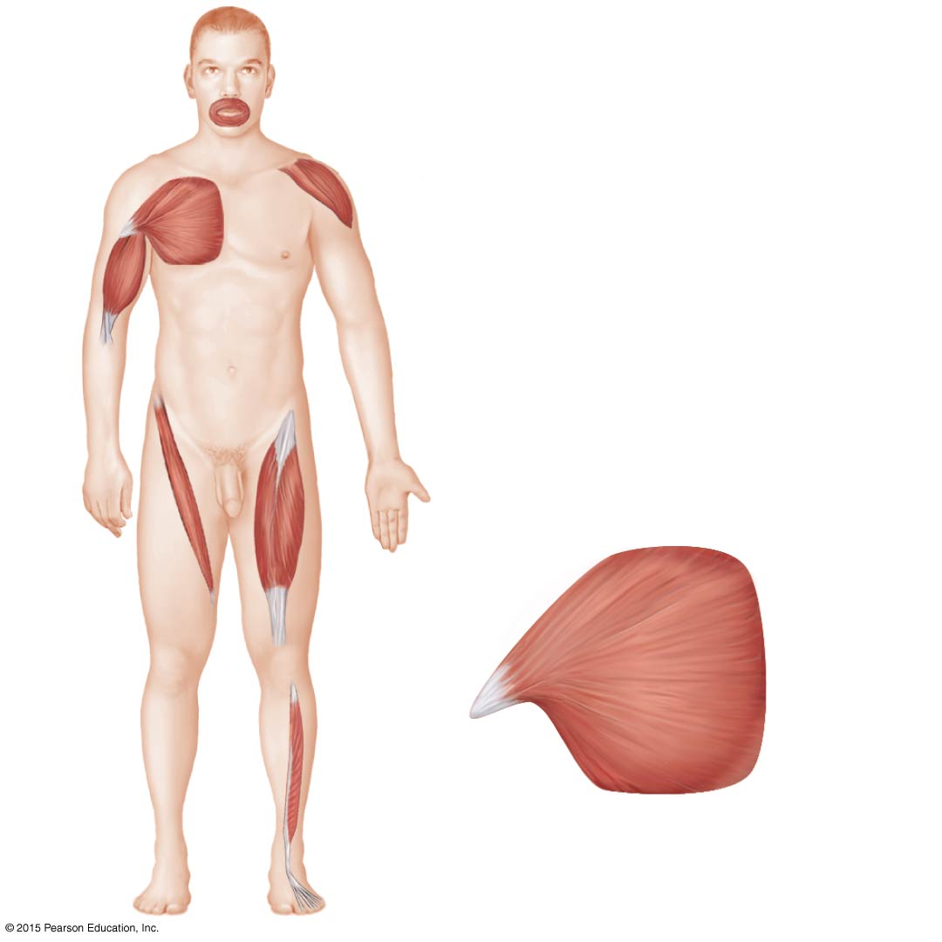
Figure 6.15b Relationship of fascicle arrangement to muscle structure.
(b)
(b) Converent (pectoralis major)

Slide 58
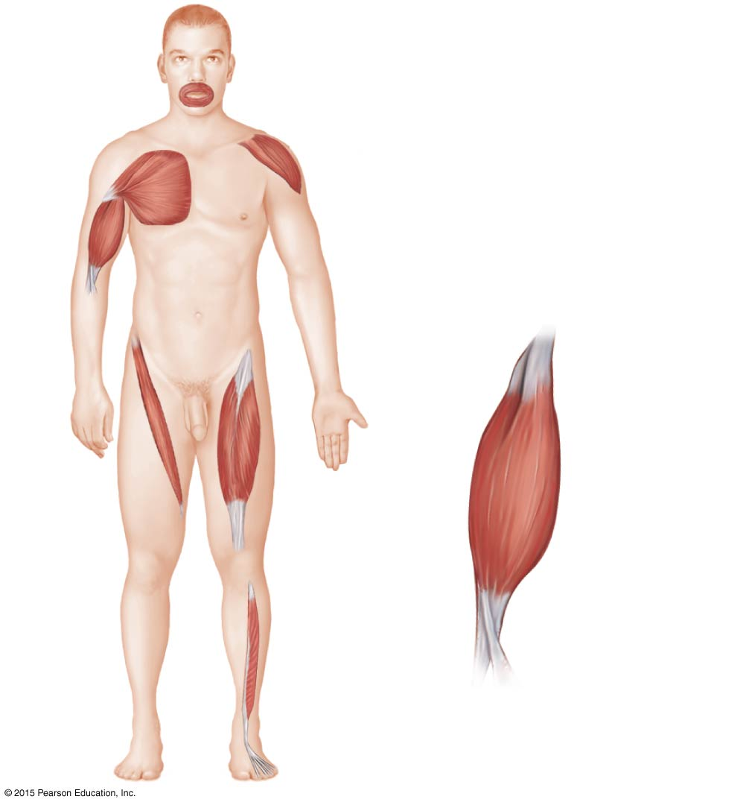
Figure 6.15c Relationship of fascicle arrangement to muscle structure.
(c)
(c) Fusiform (biceps brachii)

Slide 59
Figure 6.15d Relationship of fascicle arrangement to muscle structure.
(d)
(d) Parallel (sartorius)

Slide 60
Figure 6.15e Relationship of fascicle arrangement to muscle structure.
(e)
(e) Multipennate (deltoid)

Slide 61
Figure 6.15f Relationship of fascicle arrangement to muscle structure.
(f)
(f) Bipennate (rectus femoris)

Slide 62
Figure 6.15g Relationship of fascicle arrangement to muscle structure.
(g)
(g) Unipennate (extensor digitorum longus)

Slide 63
Figure 6.16 Superficial muscles of the face and neck.
Cranial aponeurosis
Frontalis
Temporalis
Orbicularis oculi
Occipitalis
Zygomaticus
Buccinator
Masseter
Orbicularis oris
Sternocleidomastoid
Trapezius
Platysma

Slide 64
A Closer Look 6.1 Anabolic Steroids: Dying to Win?

Slide 65
A Closer Look 6.2 Anabolic Steroids: Dying to Win?

Slide 66
Figure 6.17 Muscles of the anterior trunk, shoulder, and arm.
Clavicle
Deltoid
Pectoralis major
Sternum
Pectoralis major
Rectus abdominis
Biceps brachii
Transversus abdominis
Internal oblique
Brachialis
Brachio- radialis
External oblique
Aponeurosis
(a)
(b)

Slide 67
Figure 6.17a Muscles of the anterior trunk, shoulder, and arm.
Clavicle
Deltoid
Sternum
Pectoralis major
Biceps brachii
Brachialis
Brachio- radialis
(a)

Slide 68
Figure 6.17b Muscles of the anterior trunk, shoulder, and arm.
Pectoralis major
Rectus abdominis
Transversus abdominis
Internal oblique
External oblique
Aponeurosis
(b)

Slide 69
Figure 6.18 Muscles of the posterior neck, trunk, and arm.
Occipital bone
Sternocleidomastoid
Trapezius
Spine of scapula
C₇
Deltoid (cut)
T₁
Deltoid
Triceps brachii
Erector spinae
• Iliocostalis
Latissimus dorsi
• Longissimus
• Spinalis
Quadratus lumborum
Humerus
Olecranon process of ulna (deep to tendon)
(a)
(b)

Slide 70
Figure 6.18a Muscles of the posterior neck, trunk, and arm.
Occipital bone
Sternocleidomastoid
Spine of scapula
Trapezius
Deltoid (cut)
Deltoid
Triceps brachii
Latissimus dorsi
Humerus
Olecranon process of ulna (deep to tendon)
(a)

Slide 71
Figure 6.18b Muscles of the posterior neck, trunk, and arm.
C₇
T₁
Erector spinae
• Iliocostalis
• Longissimus
• Spinalis
Quadratus lumborum
(b)

Slide 72
Figure 6.19 The fleshy deltoid muscle is a favored site for administering intramuscular injections.
Deltoid muscle
Humerus

Slide 73
Figure 6.20a Pelvic, hip, and thigh muscles of the right side of the body.
Gluteus medius
Gluteus maximus
Adductor magnus
Iliotibial tract
Biceps femoris
Semitendinosus
Hamstring group
Semimembranosus
Gastrocnemius
(a)

Slide 74
Figure 6.20a-b Pelvic, hip, and thigh muscles of the right side of the body.
Posterior superior iliac spine
Iliac crest
Gluteus medius
Gluteus maximus
Safe area in gluteus medius
Gluteus maximus
Adductor magnus
Sciatic nerve
Iliotibial tract
Biceps femoris
(b)
Semitendinosus
Hamstring group
Semimembranosus
Gastrocnemius
(a)

Slide 75
Figure 6.20b Pelvic, hip, and thigh muscles of the right side of the body.
Posterior superior iliac spine
Iliac crest
Safe area in gluteus medius
Gluteus maximus
Sciatic nerve
(b)

Slide 76
Figure 6.20c Pelvic, hip, and thigh muscles of the right side of the body.
12th thoracic vertebra
12th rib
Iliac crest
Psoas major
Iliopsoas
Iliacus
5th lumbar vertebra
Anterior superior iliac spine
Sartorius
Adductor group
Rectus femoris
Vastus lateralis
Quadriceps
Vastus medialis
Patella
Patellar ligament
(c)

Slide 77
Figure 6.20c-d Pelvic, hip, and thigh muscles of the right side of the body.
12th thoracic vertebra
12th rib
Iliac crest
Psoas major
Iliopsoas
Iliacus
5th lumbar vertebra
Anterior superior iliac spine
Inguinal ligament
Sartorius
Adductor group
Adductor muscles
Rectus femoris
Vastus lateralis
Sartorius
Quadriceps
Vastus lateralis
Vastus medialis
Patella
(d)
Patellar ligament
(c)

Slide 78
Figure 6.20d Pelvic, hip, and thigh muscles of the right side of the body.
Inguinal ligament
Adductor muscles
Sartorius
Vastus lateralis
(d)

Slide 79
Figure 6.21 Superficial muscles of the right leg.
Fibularis longus
Gastrocnemius
Fibularis brevis
Tibia
Tibialis anterior
Soleus
Extensor digitorum longus
Fibularis tertius
Soleus
Calcaneal (Achilles) tendon
Medial malleolus
Lateral malleolus
(a)
(b)

Slide 80
Figure 6.21a Superficial muscles of the right leg.
Fibularis longus
Fibularis brevis
Tibia
Tibialis anterior
Soleus
Extensor digitorum longus
Fibularis tertius
(a)

Slide 81
Figure 6.21b Superficial muscles of the right leg.
Gastrocnemius
Soleus
Calcaneal (Achilles) tendon
Medial malleolus
Lateral malleolus
(b)

Slide 82
Figure 6.22 Major superficial muscles of the anterior surface of the body.
Facial
Facial
• Frontalis
• Temporalis
• Orbicularis oculi
• Zygomaticus
• Masseter
• Orbicularis oris
Shoulder
Neck
• Trapezius
• Platysma
• Sternocleidomastoid
• Deltoid
Thorax
Arm
• Pectoralis minor
• Triceps brachii
• Pectoralis major
• Biceps brachii
• Serratus anterior
• Brachialis
• Intercostals
Forearm
Abdomen
• Brachioradialis
• Rectus abdominis
• Flexor carpi radialis
• External oblique
Pelvis/thigh
• Internal oblique
• Iliopsoas
• Transversus abdominis
Thigh (Quadriceps)
Thigh
• Rectus femoris
• Sartorius
• Vastus lateralis
• Adductor muscle
• Vastus medialis
• Gracilis
Leg
• Fibularis longus
Leg
• Extensor digitorum longus
• Gastrocnemius
• Tibialis anterior
• Soleus

Slide 83
Table 6.3 Superficial Anterior Muscles of the Body (See Figure 6.22) (1 of 3).

Slide 84
Table 6.3 Superficial Anterior Muscles of the Body (See Figure 6.22) (2 of 3).

Slide 85
Table 6.3 Superficial Anterior Muscles of the Body (See Figure 6.22) (3 of 3).

Slide 86
Figure 6.23 Major superficial muscles of the posterior surface of the body.
Neck
• Occipitalis
• Sternocleidomastoid
• Trapezius
Arm
Shoulder/Back
• Triceps brachii
• Deltoid
• Brachialis
Forearm
• Latissimus dorsi
• Brachioradialis
• Extensor carpi radialis longus
• Flexor carpi ulnaris
• Extensor carpi ulnaris
Hip
• Extensor digitorum
• Gluteus medius
• Gluteus maximus
• Iliotibial tract
Thigh
• Adductor muscle
• Hamstrings:
Biceps femoris
Semitendinosus
Semimembranosus
Leg
• Gastrocnemius
• Soleus
• Fibularis longus
Calcaneal (Achilles) tendon

Slide 87
Table 6.4 Superior Posterior Muscles of the Body (Some Forearm Muscles Also Shown) (See Figure 6.23) (1 of 3).

Slide 88
Table 6.4 Superior Posterior Muscles of the Body (Some Forearm Muscles Also Shown) (See Figure 6.23) (2 of 3).

Slide 89
Table 6.4 Superior Posterior Muscles of the Body (Some Forearm Muscles Also Shown) (See Figure 6.23) (3 of 3).

Slide 90
Homeostatic Imbalance 6.4 A female patient with myasthenia gravis.

Slide 91
Systems in Sync 6 Homeostatic Relationships between the Muscular System and Other Body Systems.
Nervous System
Endocrine System
• Facial muscle activity allows emotions to be expressed • Nervous system stimulates and regulates muscle activity
• Growth hormone and androgens influence skeletal muscle strength and mass
Respiratory System
Lymphatic System/Immunity
• Muscular exercise increases respiratory capacity • Respiratory system provides oxygen and disposes of carbon dioxide
• Physical exercise may enhance or depress immunity depending on its intensity
• Lymphatic vessels drain leaked tissue fluids; immune system
protects muscles from disease
Cardiovascular System
• Skeletal muscle activity increases
efficiency of cardiovascular functioning;
helps prevent atherosclerosis and causes cardiac hypertrophy
• Cardiovascular system delivers oxygen and nutrients to muscles; carries away wastes
Digestive System
• Physical activity increases gastrointestinal mobility when at rest
• Digestive system provides nutrients needed for muscle health; liver metabolizes lactic acid
Reproductive System
• Skeletal muscle helps support pelvic organs (e.g., uterus in females); assists erection of penis and clitoris
• Testicular androgen promotes increased skeletal muscle size
Urinary System
• Physical activity promotes normal voiding behavior; skeletal muscle forms the voluntary sphincter of the urethra
• Urinary system disposes of nitrogen-containing wastes
Integumentary System
• Muscular exercise enhances circulation to skin and improves skin health; exercise also increases body heat, which the skin helps dissipate • Skin protects the muscles by external enclosure
Muscular System
Skeletal System
• Skeletal muscle activity maintains bone health and strength • Bones provide levers for muscle activity

