Slide 2
Blood
Blood transports everything that must be carried from one place to another, such as:
Nutrients
Wastes
Hormones
Body heat

Slide 3
Blood
The only fluid tissue in the human body
Classified as a connective tissue
Components of blood
Living cells
Formed elements
Nonliving matrix
Plasma

Slide 4
Blood
If blood is centrifuged:
Erythrocytes sink to the bottom (45 percent of blood, a percentage known as the hematocrit)
Buffy coat contains leukocytes and platelets (less than 1 percent of blood)
Buffy coat is a thin, whitish layer between the erythrocytes and plasma
Plasma rises to the top (55 percent of blood)

Slide 5
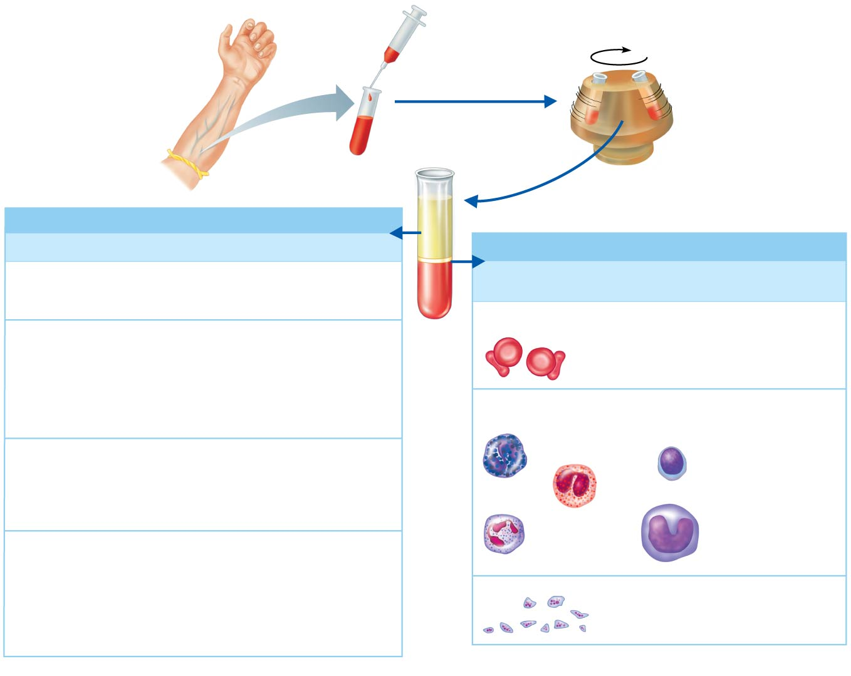
Figure 10.1 The composition of blood.
Plasma 55%
Constituent
Major Functions
Formed elements (cells) 45%
Water
90% of plasma volume; solvent
for carrying other substances;
absorbs heat
Cell Type
Number
(per mm³ of blood)
Functions
Erythrocytes
(red blood cells)
Salts (electrolytes)
4–6 million
Transport oxygen
and help transport
carbon dioxide
Sodium
Potassium
Calcium
Magnesium
Chloride
Bicarbonate
Osmotic balance, pH buffering,
regulation of membrane
permeability
Leukocytes
(white blood cells)
4,800–10,800
Defense and
immunity
Plasma proteins
Albumin
Fibrinogen
Globulins
Osmotic balance, pH buffering
Clotting of blood
Defense (antibodies)
and lipid transport
Lymphocyte
Basophil
Eosinophil
Substances transported by blood
Nutrients (glucose, fatty acids, amino acids, vitamins)
Neutrophil
Monocyte
Waste products of metabolism (urea, uric acid)
Platelets
Respiratory gases (O₂ and CO₂)
250,000–400,000
Blood clotting
Hormones (steroids and thyroid hormone
are carried by plasma proteins)

Slide 6
Physical Characteristics of Blood
Color range
Oxygen-rich blood is scarlet red
Oxygen-poor blood is dull red
pH must remain between 7.35 and 7.45
Blood temperature is slightly higher than body temperature, at 100.4°F
In a healthy man, blood volume is about 5–6 liters, or about 6 quarts
Blood makes up 8 percent of body weight

Slide 7
Blood Plasma
Composed of approximately 90 percent water
Includes many dissolved substances:
Nutrients
Salts (electrolytes)
Respiratory gases
Hormones
Plasma proteins
Waste products

Slide 8
Blood Plasma
Plasma proteins
Most abundant solutes in plasma
Most plasma proteins are made by liver
Various plasma proteins include
Albumin—regulates osmotic pressure
Clotting proteins—help to stem blood loss when a blood vessel is injured
Antibodies—help protect the body from pathogens

Slide 9
Blood Plasma
Acidosis
Blood pH becomes too acidic
Alkalosis
Blood pH becomes too basic
In each scenario, the respiratory system and kidneys help restore blood pH to normal

Slide 10
Formed Elements
Erythrocytes
Red blood cells (RBCs)
Leukocytes
White blood cells (WBCs)
Platelets
Cell fragments

Slide 11
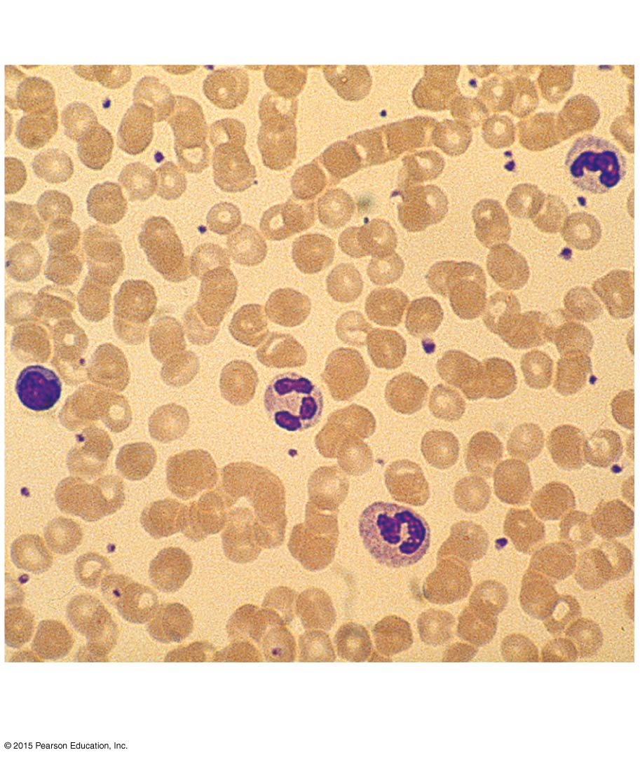
Figure 10.2 Photomicrograph of a blood smear.
Lymphocyte
Platelets
Erythrocytes
Neutrophils

Slide 12
Formed Elements
Erythrocytes (red blood cells, or RBCs)
Main function is to carry oxygen
Anatomy of circulating erythrocytes
Biconcave disks
Essentially bags of hemoglobin
Anucleate (no nucleus)
Contain very few organelles
5 million RBCs per cubic millimeter of blood is the normal count

Slide 13
Formed Elements
Hemoglobin
Iron-containing protein
Binds strongly, but reversibly, to oxygen
Each hemoglobin molecule has four oxygen binding sites
Each erythrocyte has 250 million hemoglobin molecules
Normal blood contains 12–18 g of hemoglobin per 100 mL of blood

Slide 14
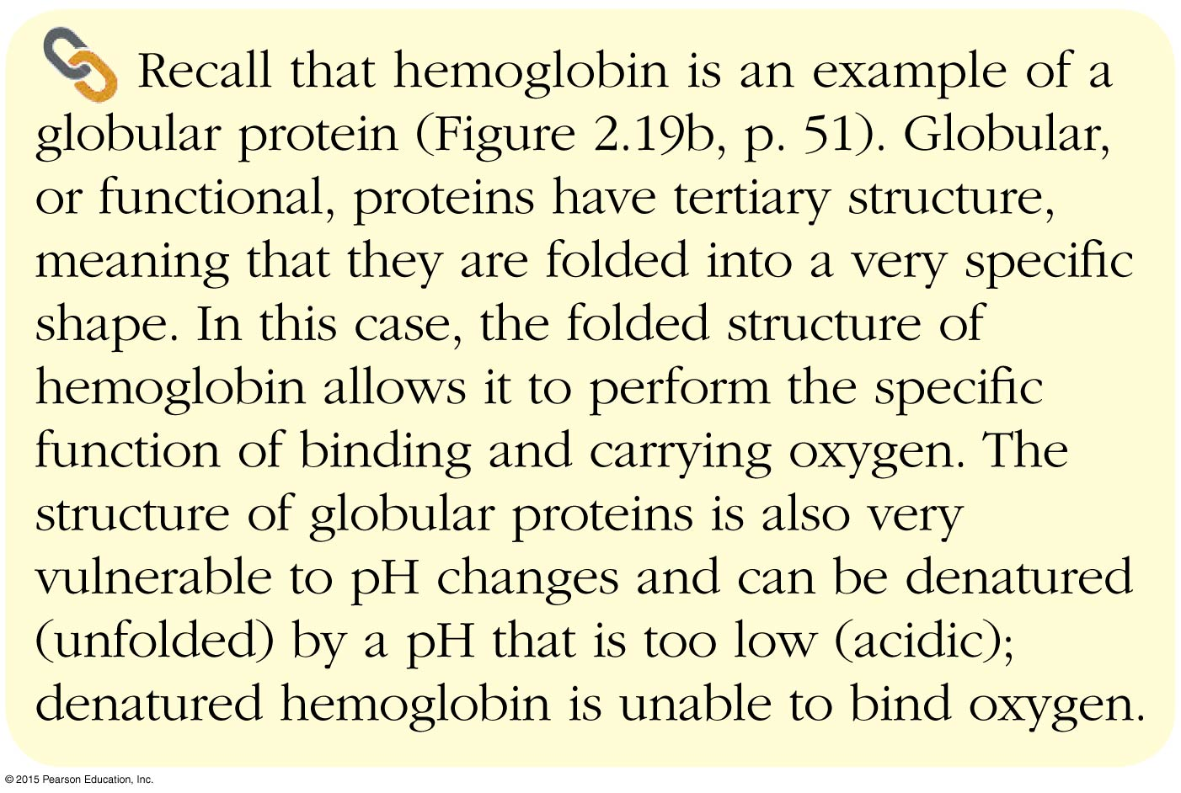
Concept Link

Slide 15
Formed Elements
Homeostatic imbalance of RBCs
Anemia is a decrease in the oxygen-carrying ability of the blood
Sickle cell anemia (SCA) results from abnormally shaped hemoglobin
Polycythemia is an excessive or abnormal increase in the number of RBCs

Slide 16
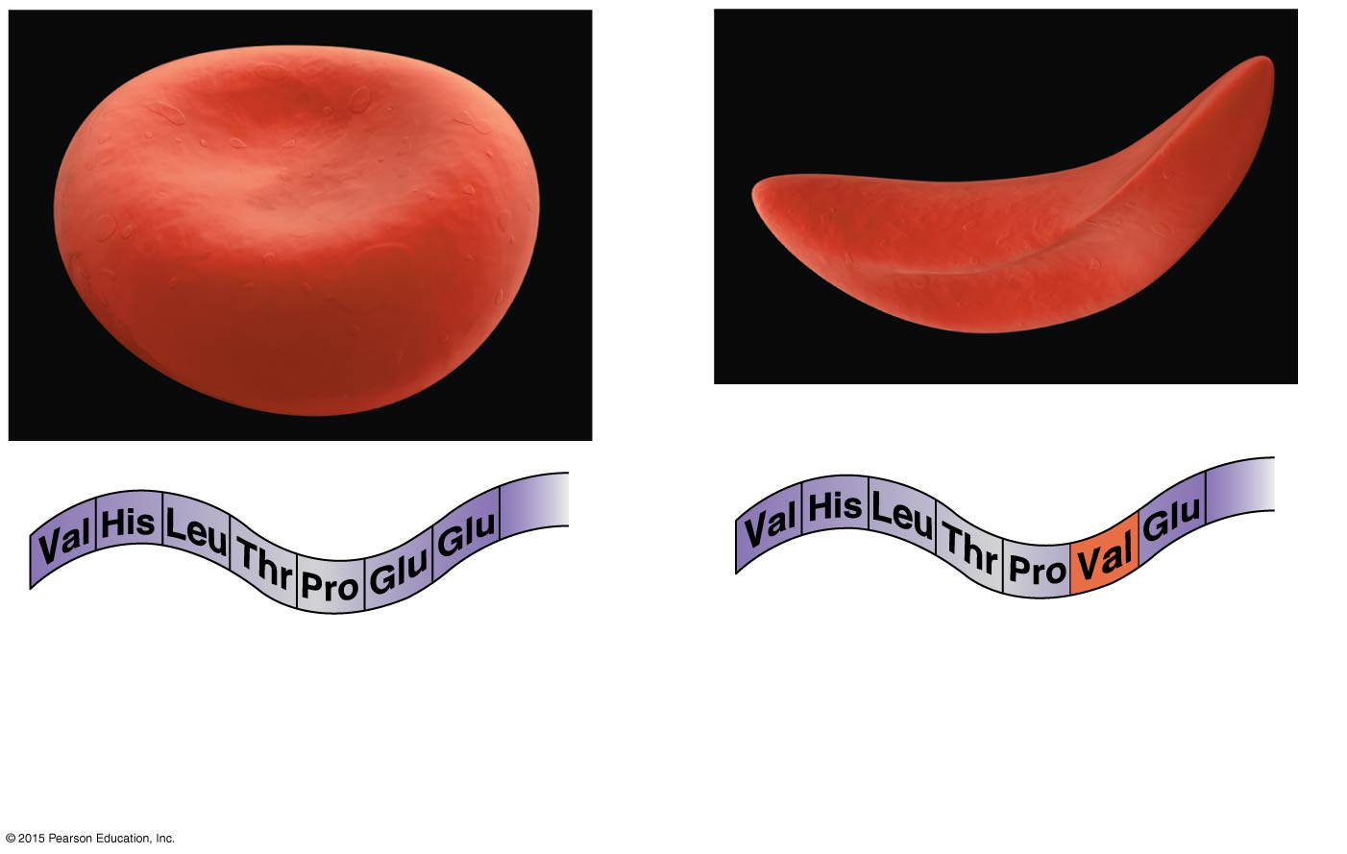
Figure 10.3 Comparison of (a) normal erythrocyte to a (b) sickled erythrocyte (6,550×).
2
1
2
3
7…146
1
3
7…146
4
6
4
6
5
5
(a)
Normal RBC and part of the
amino acid sequence of its
hemoglobin
(b)
Sickled RBC and part of its
hemoglobin sequence

Slide 17
Formed Elements
Polcythemia
Disorder resulting from excessive or abnormal increase of RBCs
May be caused by bone marrow cancer (polycythemia vera)
May be a response to life at higher altitudes (secondary polycythemia)
Increase in RBCs slows blood flow and increases blood viscosity

Slide 18
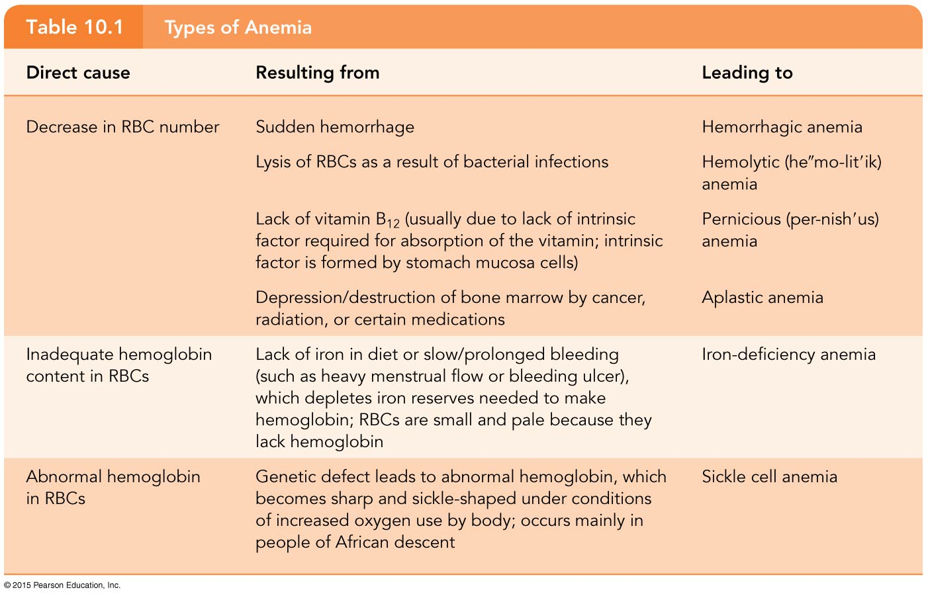
Table 10.1 Types of Anemia.

Slide 19
Formed Elements
Leukocytes (white blood cells, or WBCs)
Crucial in body’s defense against disease
Complete cells, with nucleus and organelles
Able to move into and out of blood vessels (diapedesis)
Move by amoeboid motion
Respond to chemicals released by damaged tissues (known as positive chemotaxis)
4,800 to 10,800 WBCs per cubic millimeter of blood

Slide 20
Formed Elements
Abnormal numbers of leukocytes
Leukocytosis
WBC count above 11,000 cells/mm³
Generally indicates an infection
Leukopenia
Abnormally low leukocyte level
Commonly caused by certain drugs, such as corticosteroids and anticancer agents

Slide 21
Formed Elements
Abnormal numbers of leukocytes (continued)
Leukemia
Bone marrow becomes cancerous; turns out excess WBCs

Slide 22
Formed Elements
Types of leukocytes:
Granulocytes
Granules in their cytoplasm can be stained
Possess lobed nuclei
Include neutrophils, eosinophils, and basophils
Agranulocytes
Lack visible cytoplasmic granules
Nuclei are spherical, oval, or kidney-shaped
Include lymphocytes and monocytes

Slide 23
Formed Elements
List of the WBCs, from most to least abundant
Neutrophils
Lymphocytes
Monocytes
Eosinophils
Basophils
Easy way to remember this list
Never
Let
Monkeys
Eat
Bananas

Slide 24
Formed Elements
Types of granulocytes:
Neutrophils
Cytoplasm stains pale pink and contains fine granules
Deep purple nucleus contains three to seven lobes
Function as phagocytes at active sites of infection
Numbers increase during infection
3,000–7,000 neutrophils in a cubic millimeter of blood (40–70 percent of WBCs)

Slide 25
Formed Elements
Types of granulocytes (continued):
Eosinophils
Red, coarse cytoplasmic granules
Figure-8 or bilobed nucleus stains blue-red
Function to kill parasitic worms and play a role in allergy attacks
100–400 eosinophils in a cubic millimeter of blood (1–4 percent of WBCs)

Slide 26
Formed Elements
Types of granulocytes (continued):
Basophils
Sparse but large blue-purple granules
U- or S-shaped nucleus stains dark blue
Release histamine (vasodilator) at sites of inflammation
Contain heparin (anticoagulant)
20–50 basophils in a cubic millimeter of blood (0–1 percent of WBCs)

Slide 27
Formed Elements
Types of agranulocytes:
Lymphocytes
Cytoplasm is pale blue
Dark purple-blue nucleus
Functions as part of the immune response
B lymphocytes produce antibodies
T lymphocytes are involved in graft rejection, fighting tumors and viruses
1,500–3,000 lymphocytes in a cubic millimeter of blood (20–45 percent of WBCs)

Slide 28
Formed Elements
Types of agranulocytes (continued):
Monocytes
Largest of the white blood cells
Gray-blue cytoplasm
Dark blue-purple nucleus is often kidney-shaped
Function as macrophages
Important in fighting chronic infection
100–700 monocytes per cubic millimeter of blood (4–8 percent of WBCs)

Slide 29
Formed Elements
Platelets
Derived from ruptured multinucleate cells (megakaryocytes)
Needed for the clotting process
Platelet count ranges from 150,000 to 400,000 per cubic millimeter of blood
300,000 is considered a normal number of platelets per cubic millimeter of blood

Slide 30
Table 10.2 Characteristics of Formed Elements of the Blood (1 of 3).

Slide 31
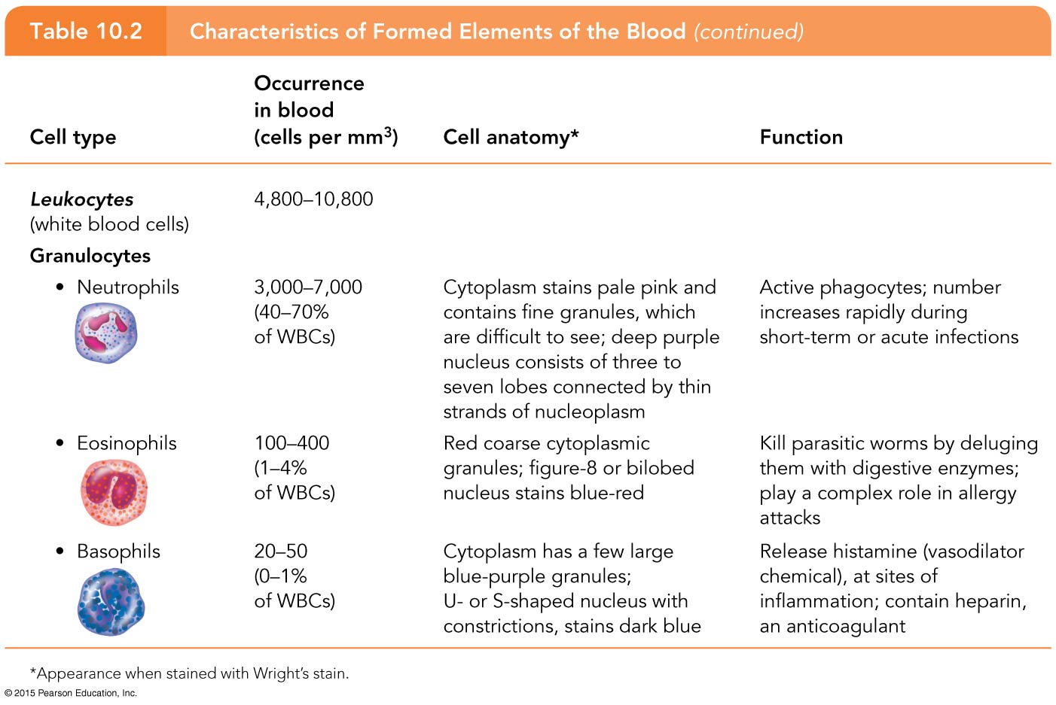
Table 10.2 Characteristics of Formed Elements of the Blood (2 of 3).

Slide 32
Table 10.2 Characteristics of Formed Elements of the Blood (3 of 3).

Slide 33
Hematopoiesis
Hematopoiesis is the process of blood cell formation
Occurs in red bone marrow
All blood cells are derived from a common stem cell (hemocytoblast)
Hemocytoblast differentiation
Lymphoid stem cell produces lymphocytes
Myeloid stem cell produces all other formed elements

Slide 34
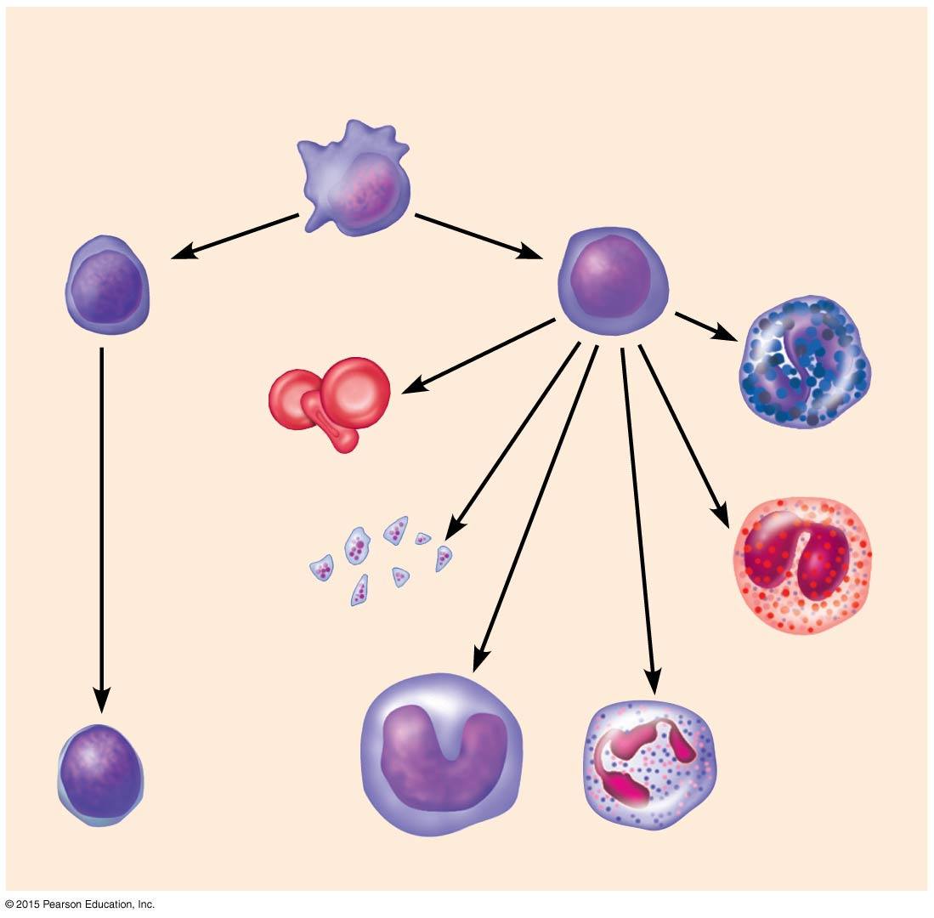
Figure 10.4 The development of blood cells.
Hemocytoblast
stem cells
Lymphoid
stem cells
Myeloid
stem cells
Secondary stem cells
Basophils
Erythrocytes
Platelets
Eosinophils
Lymphocytes
Monocytes
Neutrophils

Slide 35
Formation of Red Blood Cells
Since RBCs are anucleate, they are unable to divide, grow, or synthesize proteins
RBCs wear out in 100 to 120 days
When worn out, RBCs are eliminated by phagocytes in the spleen or liver
Lost cells are replaced by division of hemocytoblasts in the red bone marrow

Slide 36
Control of Erythrocyte Production
Rate of RBC production is controlled by a hormone called erythropoietin
Kidneys produce most erythropoietin as a response to reduced oxygen levels in the blood
Homeostasis is maintained by negative feedback from blood oxygen levels

Slide 37
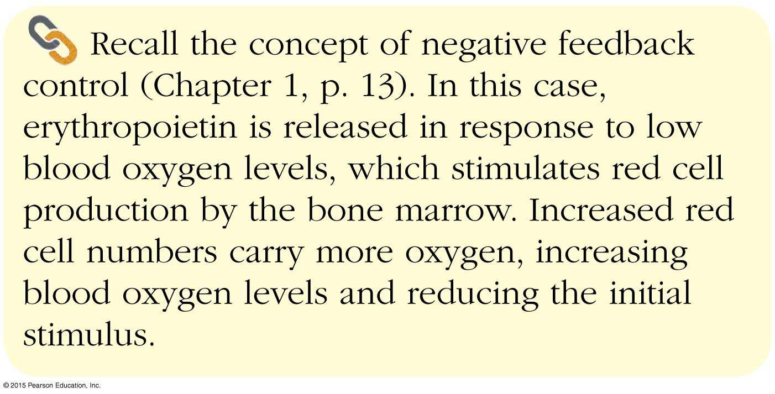
Concept Link

Slide 38
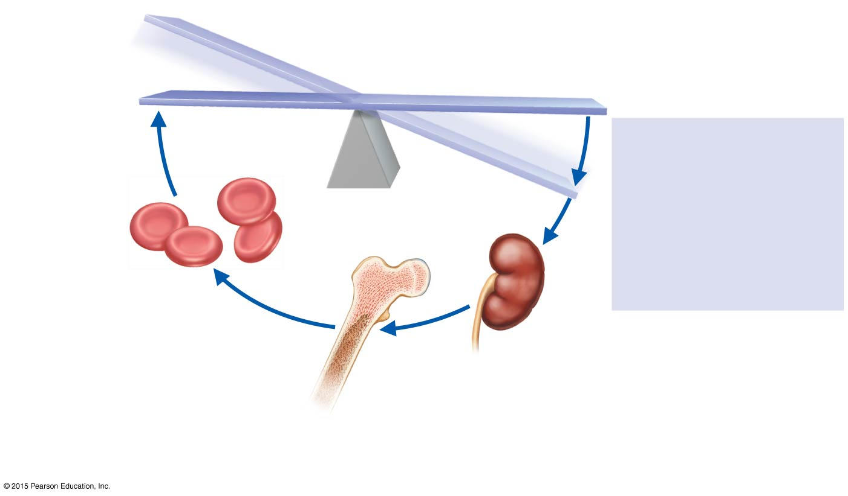
Figure 10.5 Mechanism for regulating the rate of RBC production.
Slide 1
IMBALANCE
Homeostasis: Normal blood oxygen levels
1
Stimulus
5
Low blood O₂–carrying
ability due to
• Decreased RBC count
• Decreased amount of
hemoglobin
• Decreased availability
of O₂
O₂–carrying
ability of blood
increases.
IMBALANCE
4
Enhanced
erythropoiesis
increases RBC
count.
2
Kidney (and liver,
to a smaller extent)
releases erythropoietin.
3
Erythropoietin
stimulates red bone
marrow.

Slide 39
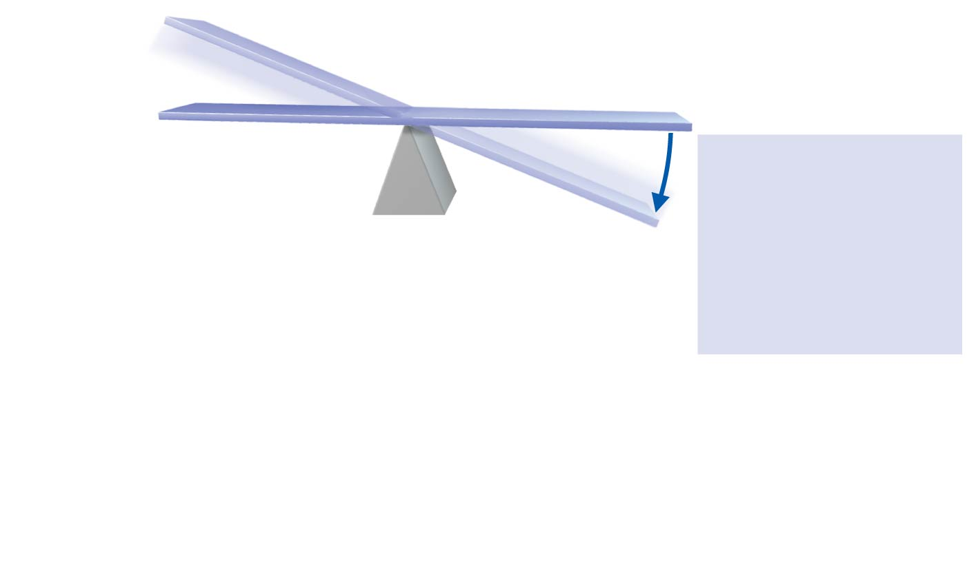
Figure 10.5 Mechanism for regulating the rate of RBC production.
Slide 2
IMBALANCE
Homeostasis: Normal blood oxygen levels
1
Stimulus
Low blood O₂–carrying
ability due to
• Decreased RBC count
• Decreased amount of
hemoglobin
• Decreased availability
of O₂
IMBALANCE

Slide 40
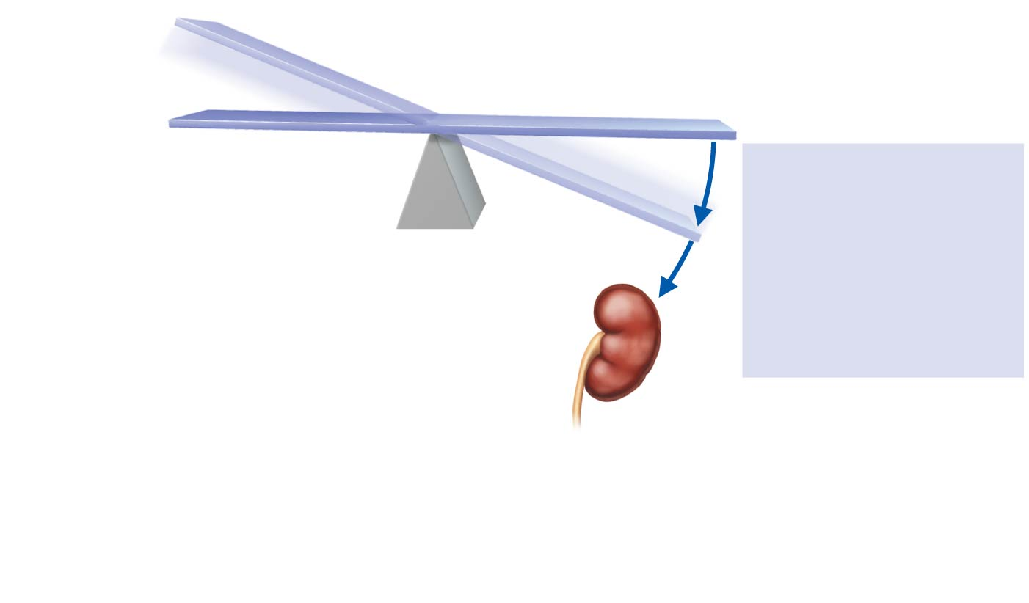
Figure 10.5 Mechanism for regulating the rate of RBC production.
Slide 3
IMBALANCE
Homeostasis: Normal blood oxygen levels
1
Stimulus
Low blood O₂–carrying
ability due to
• Decreased RBC count
• Decreased amount of
hemoglobin
• Decreased availability
of O₂
IMBALANCE
2
Kidney (and liver,
to a smaller extent)
releases erythropoietin.

Slide 41
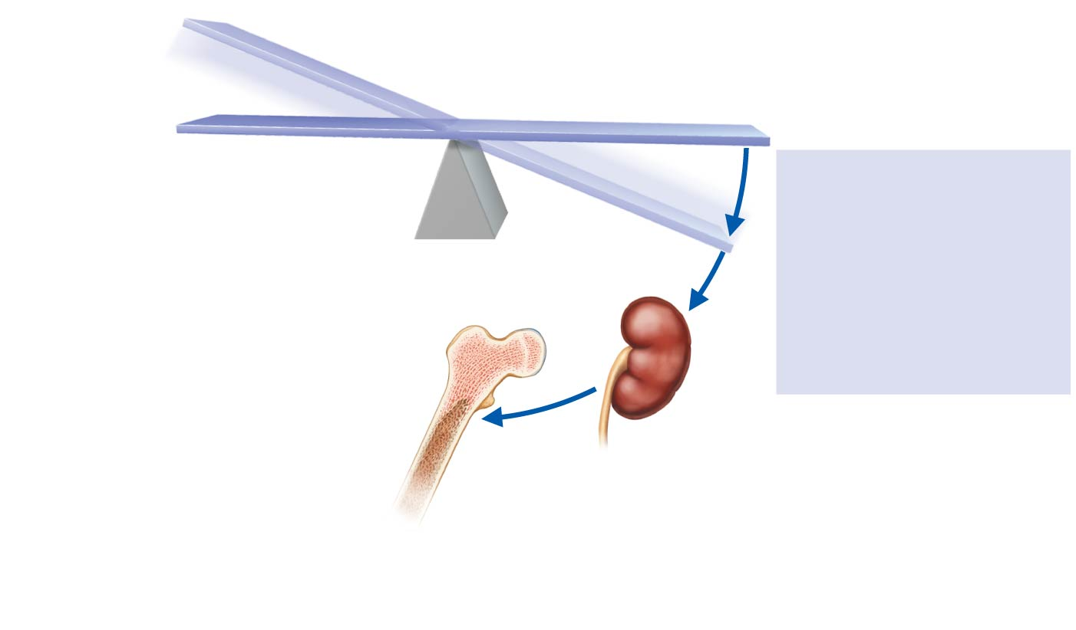
Figure 10.5 Mechanism for regulating the rate of RBC production.
Slide 4
IMBALANCE
Homeostasis: Normal blood oxygen levels
1
Stimulus
Low blood O₂–carrying
ability due to
• Decreased RBC count
• Decreased amount of
hemoglobin
• Decreased availability
of O₂
IMBALANCE
2
Kidney (and liver,
to a smaller extent)
releases erythropoietin.
3
Erythropoietin
stimulates red bone
marrow.

Slide 42
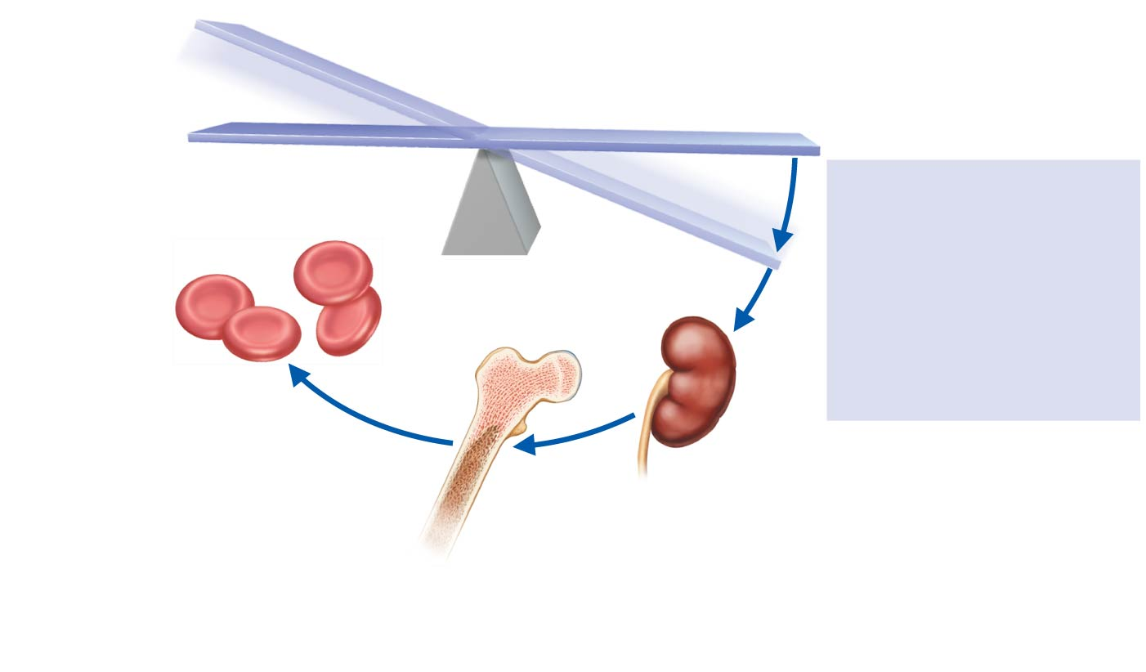
Figure 10.5 Mechanism for regulating the rate of RBC production.
Slide 5
IMBALANCE
Homeostasis: Normal blood oxygen levels
1
Stimulus
Low blood O₂–carrying
ability due to
• Decreased RBC count
• Decreased amount of
hemoglobin
• Decreased availability
of O₂
IMBALANCE
4
Enhanced
erythropoiesis
increases RBC
count.
2
Kidney (and liver,
to a smaller extent)
releases erythropoietin.
3
Erythropoietin
stimulates red bone
marrow.

Slide 43
Figure 10.5 Mechanism for regulating the rate of RBC production.
Slide 6
IMBALANCE
Homeostasis: Normal blood oxygen levels
1
Stimulus
5
Low blood O₂–carrying
ability due to
• Decreased RBC count
• Decreased amount of
hemoglobin
• Decreased availability
of O₂
O₂–carrying
ability of blood
increases.
IMBALANCE
4
Enhanced
erythropoiesis
increases RBC
count.
2
Kidney (and liver,
to a smaller extent)
releases erythropoietin.
3
Erythropoietin
stimulates red bone
marrow.

Slide 44
Formation of White Blood Cells and Platelets
Controlled by hormones
Colony stimulating factors (CSFs) and interleukins prompt bone marrow to generate leukocytes
Thrombopoietin stimulates production of platelets

Slide 45
Hemostasis
Stoppage of bleeding resulting from a break in a blood vessel
Hemostasis involves three phases:
Vascular spasms
Platelet plug formation
Coagulation (blood clotting)

Slide 46
Hemostasis
Vascular spasms
Vasoconstriction causes blood vessel to spasm
Spasms narrow the blood vessel, decreasing blood loss

Slide 47
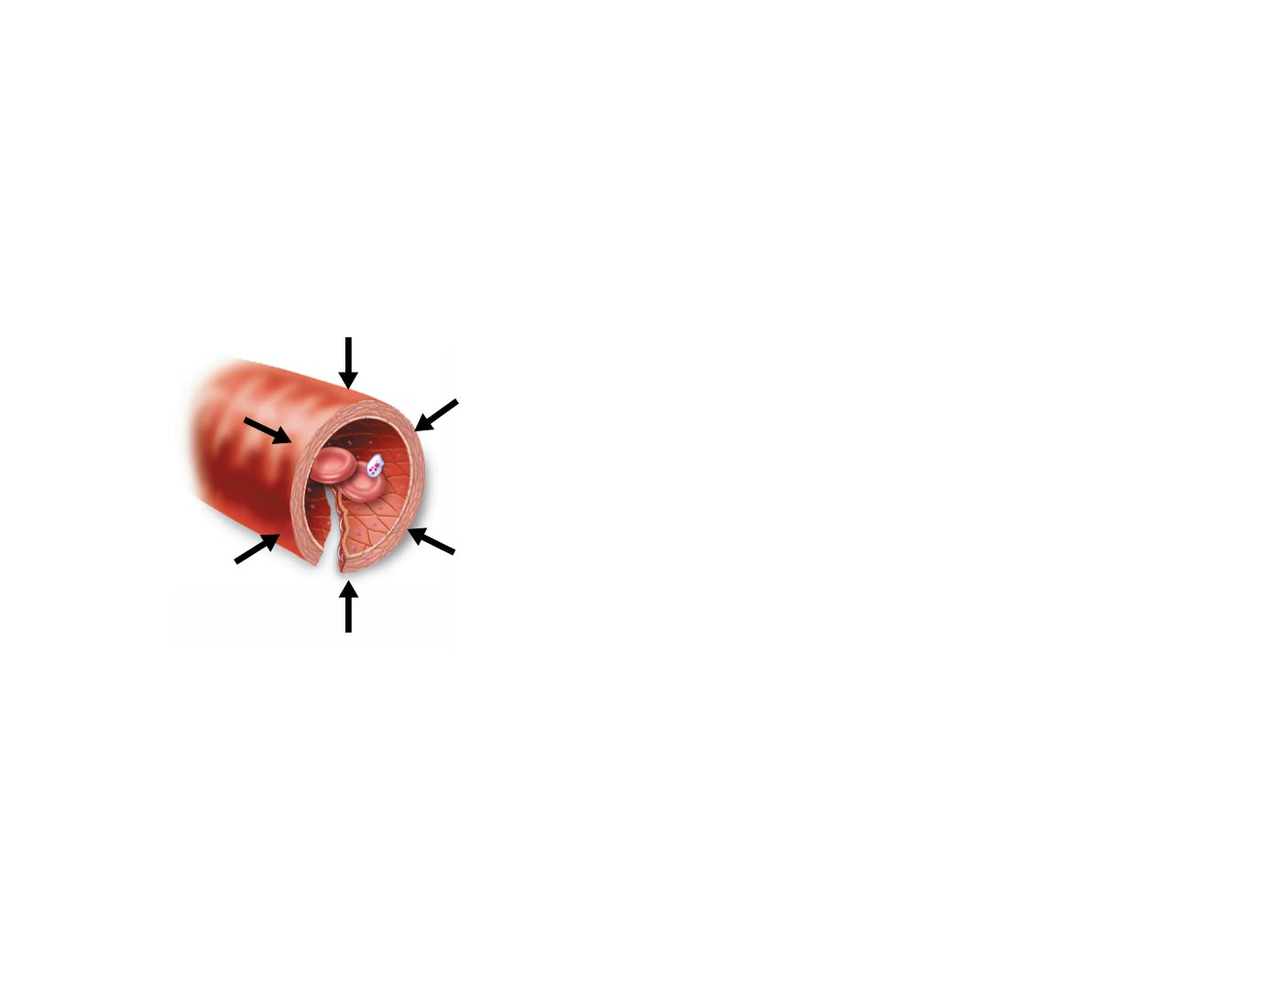
Figure 10.6 Events of hemostasis.
Slide 2
Step
1
Vascular spasms occur.
Smooth muscle contracts, causing vasoconstriction.

Slide 48
Hemostasis
Platelet plug formation
Collagen fibers are exposed by a break in a blood vessel
Platelets become “sticky” and cling to fibers
Anchored platelets release chemicals to attract more platelets
Platelets pile up to form a platelet plug (white thrombus)

Slide 49
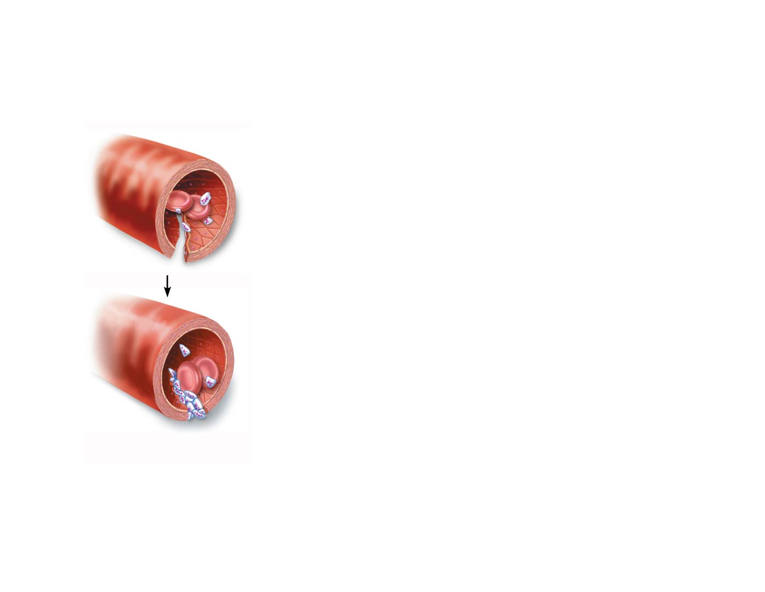
Figure 10.6 Events of hemostasis.
Slide 3
Step
2
Platelet plug forms.
Injury to lining of vessel exposes collagen fibers; platelets adhere.
Collagen
fibers
Platelets release chemicals that make nearby platelets sticky; platelet plug forms.
Platelets

Slide 50
Hemostasis
Coagulation
Injured tissues release tissue factor (TF)
PF₃ (a phospholipid) interacts with TF, blood protein clotting factors, and calcium ions to trigger a clotting cascade
Prothrombin activator converts prothrombin to thrombin (an enzyme)

Slide 51
Hemostasis
Coagulation (continued)
Thrombin joins fibrinogen proteins into hairlike molecules of insoluble fibrin
Fibrin forms a meshwork (the basis for a clot)
Within the hour, serum is squeezed from the clot as it retracts
Serum is plasma minus clotting proteins

Slide 52
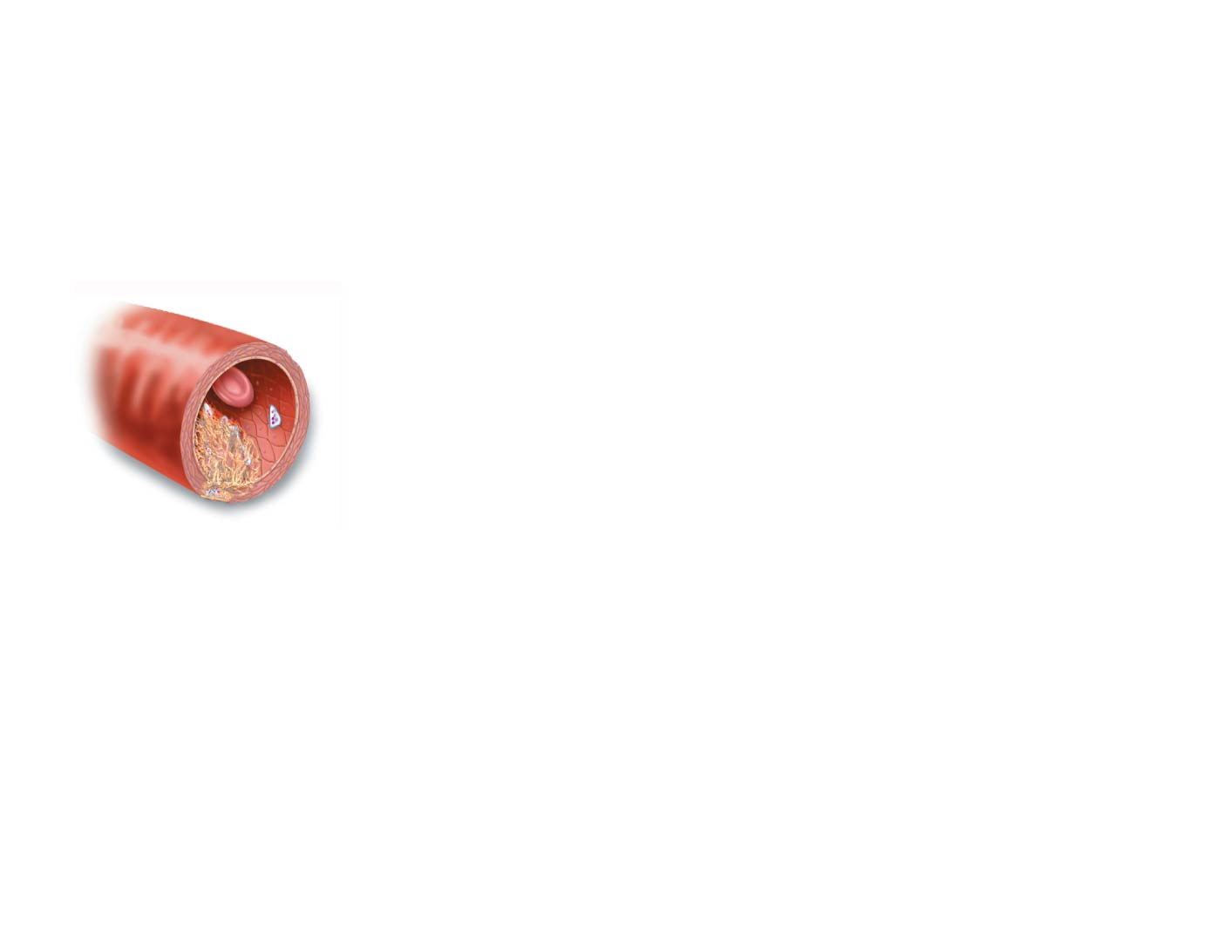
Figure 10.6 Events of hemostasis.
Slide 4
Step
3
Coagulation events occur.
Clotting factors present in plasma and released by injured tissue cells interact with Ca²⁺ to form thrombin, the enzyme that catalyzes joining of fibrinogen molecules in plasma to fibrin.
Fibrin
Fibrin forms a mesh that traps red blood cells and platelets, forming the clot.

Slide 53
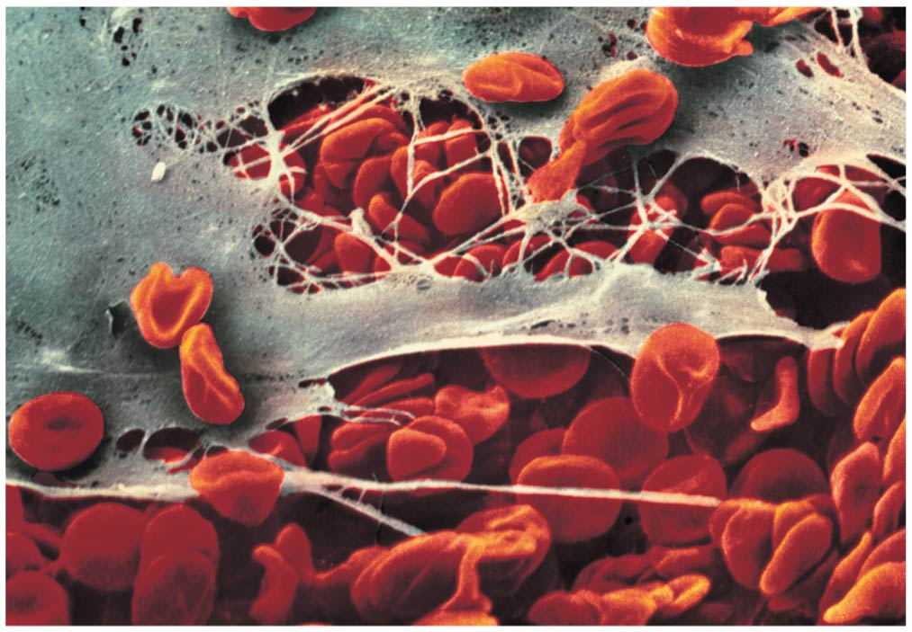
Figure 10.7 Fibrin clot.

Slide 54
Hemostasis
Blood usually clots within 3 to 6 minutes
The clot remains as endothelium regenerates
The clot is broken down after tissue repair

Slide 55
Undesirable Clotting
Thrombus
A clot in an unbroken blood vessel
Can be deadly in areas such as the heart
Embolus
A thrombus that breaks away and floats freely in the bloodstream
Can later clog vessels in critical areas such as the brain

Slide 56
Bleeding Disorders
Thrombocytopenia
Platelet deficiency
Even normal movements can cause bleeding from small blood vessels that require platelets for clotting
Evidenced by petechiae (small purplish blotches on the skin)
Hemophilia
Hereditary bleeding disorder
Normal clotting factors are missing

Slide 57
Blood Groups and Transfusions
Large losses of blood have serious consequences
Loss of 15 to 30 percent causes weakness
Loss of over 30 percent causes shock, which can be fatal
Blood transfusions are given for substantial blood loss, to treat severe anemia, or for thrombocytopenia

Slide 58
Human Blood Groups
Blood contains genetically determined proteins
Antigens are substances that the body recognizes as foreign and that the immune system may attack
Antibodies are the “recognizers”
Blood is “typed” by using antibodies that will cause blood with certain proteins to clump (agglutination) and lyse

Slide 59
Human Blood Groups
There are over 30 common red blood cell antigens
The most vigorous transfusion reactions are caused by ABO and Rh blood group antigens

Slide 60
ABO Blood Groups
Based on the presence or absence of two antigens:
Type A
Type B
The lack of these antigens is called type O

Slide 61
ABO Blood Groups
The presence of both antigens A and B is called type AB
The presence of antigen A is called type A
The presence of antigen B is called type B
The lack of both antigens A and B is called type O

Slide 62
ABO Blood Groups
Blood type AB can receive A, B, AB, and O blood
Universal recipient
Blood type B can receive B and O blood
Blood type A can receive A and O blood
Blood type O can receive O blood
Universal donor

Slide 63
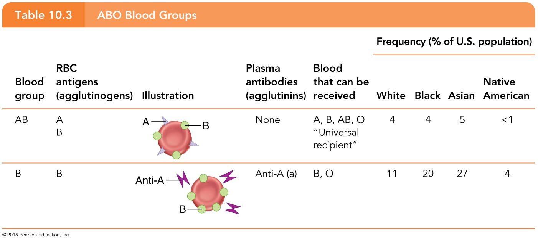
Table 10.3 ABO Blood Groups (1 of 2).

Slide 64
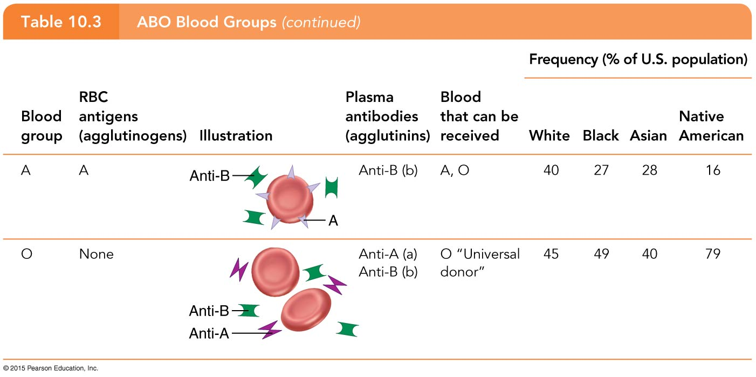
Table 10.3 ABO Blood Groups (2 of 2).

Slide 65
Rh Blood Groups
Named because of the presence or absence of one of eight Rh antigens (agglutinogen D) that was originally defined in Rhesus monkeys
Most Americans are Rh⁺ (Rh-positive)
Problems can occur in mixing Rh⁺ blood into a body with Rh– (Rh-negative) blood
Hemolysis does not occur with first transfusion, because it takes time to make antibodies
Second, and subsequent, transfusions involve antibodies attacking donor’s Rh⁺ RBCs

Slide 66
Rh Dangers During Pregnancy
Danger occurs only when the mother is Rh– and the father is Rh⁺, and the child inherits the Rh⁺ factor
RhoGAM shot can prevent buildup of anti-Rh⁺ antibodies in mother’s blood

Slide 67
Rh Dangers During Pregnancy
The mismatch of an Rh– mother carrying an Rh⁺ baby can cause problems for the unborn child
The first pregnancy usually proceeds without problems
The immune system is sensitized after the first pregnancy
In a second pregnancy, the mother’s immune system produces antibodies to attack the Rh⁺ blood (hemolytic disease of the newborn)

Slide 68
Blood Typing
Blood samples are mixed with anti-A and anti-B serum
Agglutination or the lack of agglutination leads to identification of blood type
Typing for ABO and Rh factors is done in the same manner
Cross matching—testing for agglutination of donor RBCs by the recipient’s serum, and vice versa

Slide 69
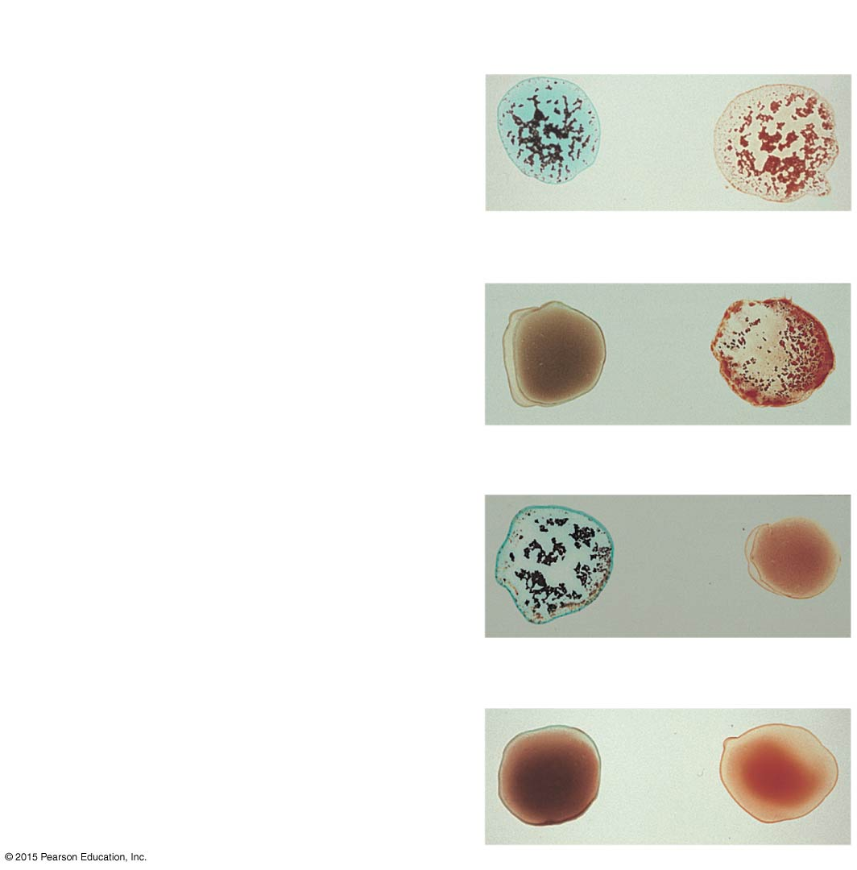
Figure 10.8 Blood typing of ABO blood groups.
Blood being tested
Serum
Anti-A
Anti-B
Type AB (contains antigens A
and B; agglutinates with both
sera)
Agglutinated
RBCs
Type B (contains antigen B;
agglutinates with anti-B serum)
Type A (contains antigen A;
agglutinates with anti-A serum)
Type O (contains no antigens;
does not agglutinate with
either serum)

Slide 70
Developmental Aspects of Blood
Sites of blood cell formation
The fetal liver and spleen are early sites of blood cell formation
Bone marrow takes over hematopoiesis by the seventh month

Slide 71
Developmental Aspects of Blood
Congenital blood defects include various types of hemolytic anemias and hemophilia
Incompatibility between maternal and fetal blood can result in fetal cyanosis, resulting from destruction of fetal blood cells
Fetal hemoglobin differs from hemoglobin produced after birth
Physiologic jaundice occurs in infants when the liver cannot rid the body of hemoglobin breakdown products fast enough

Slide 72
Developmental Aspects of Blood
Leukemias are most common in the very young and very old
Older adults are also at risk for anemia and clotting disorders

