Slide 1
Chapter 1 labeling practice

Slide 2
Levels of organization

Slide 3
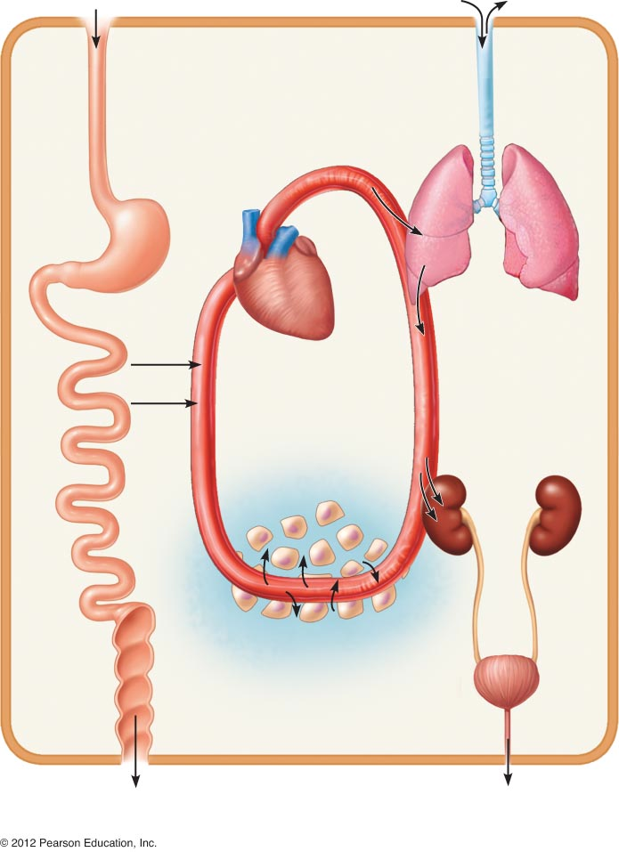
Body systems in concert

Slide 4
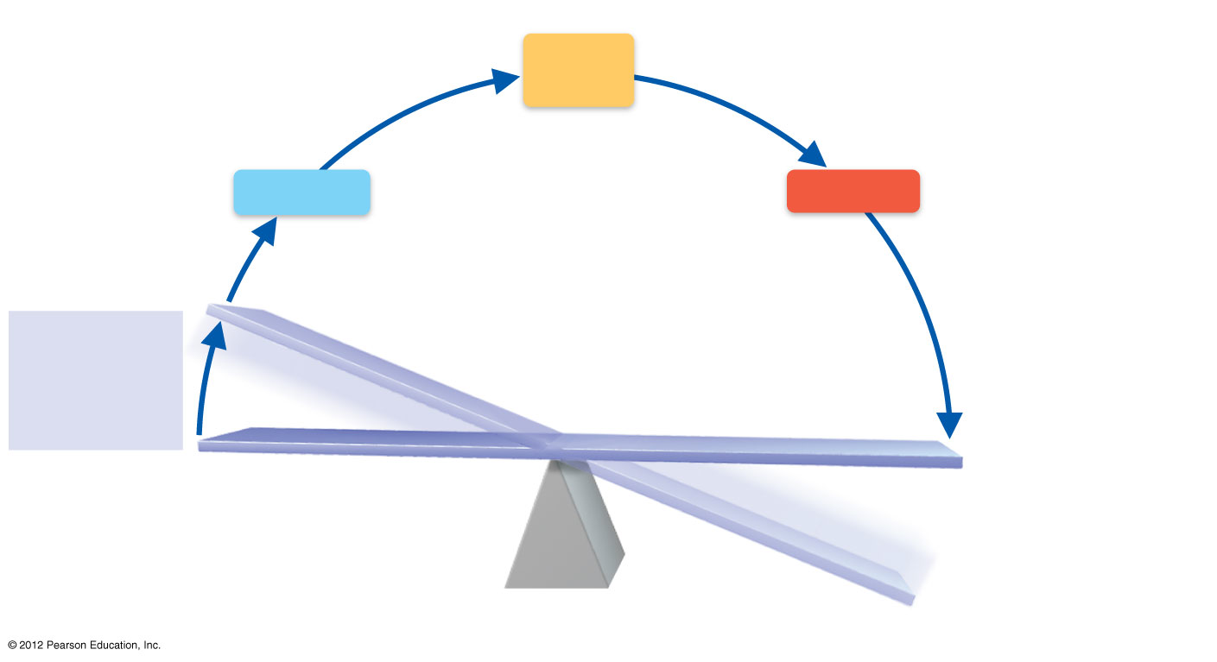
homeostasis

Slide 5
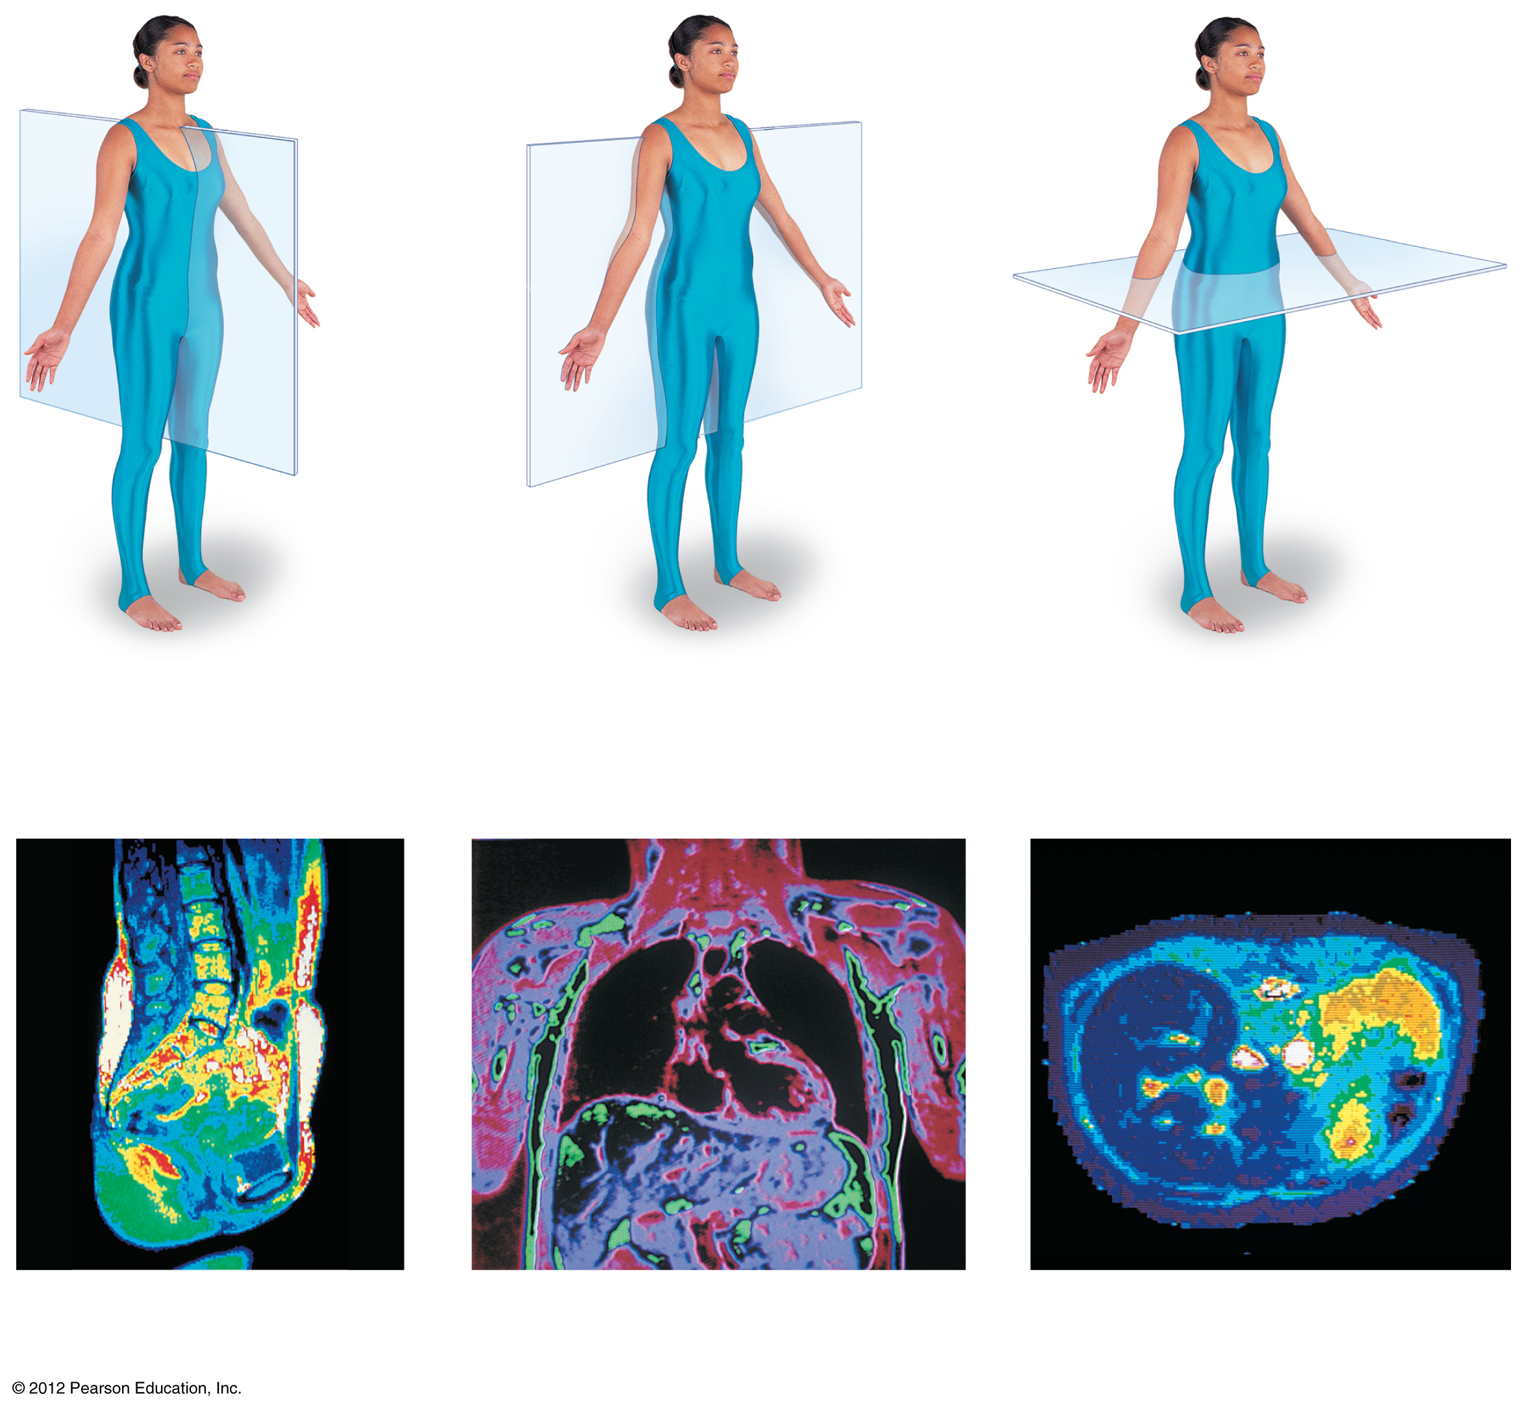
Planes of section

Slide 6
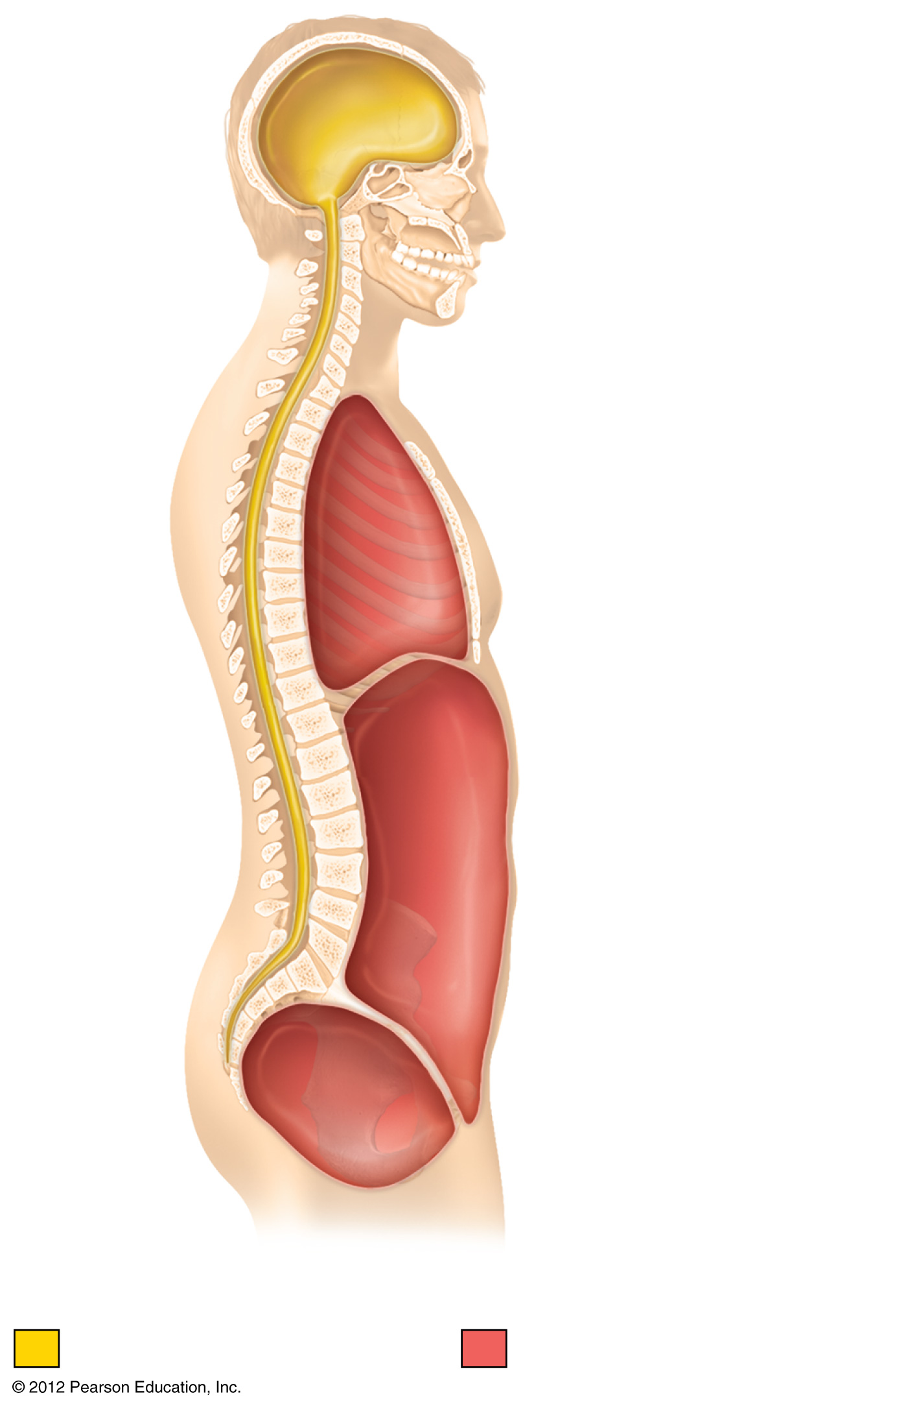
Body cavities

Slide 7
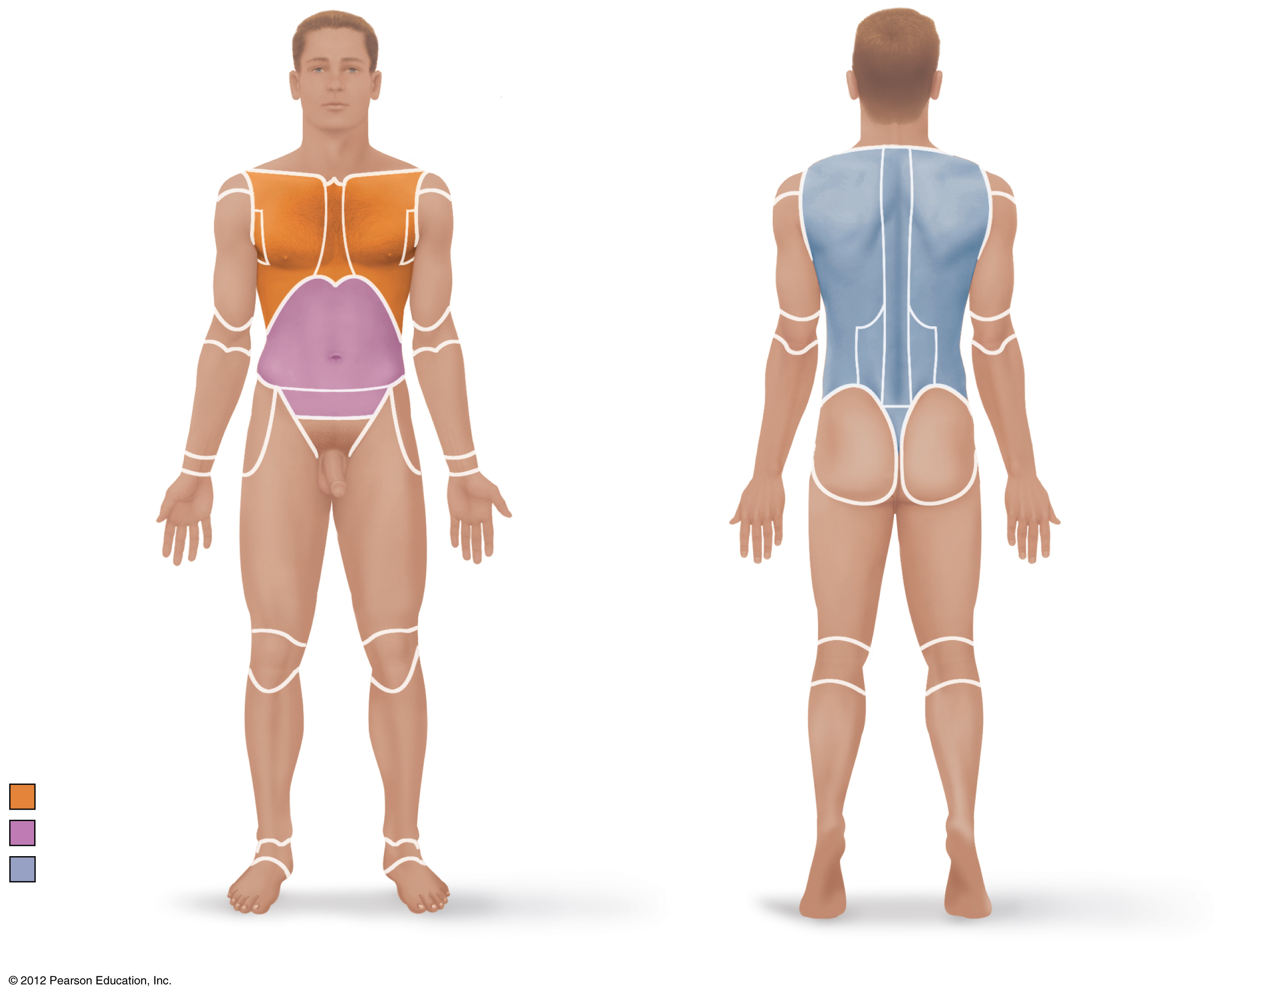
regions

Slide 8
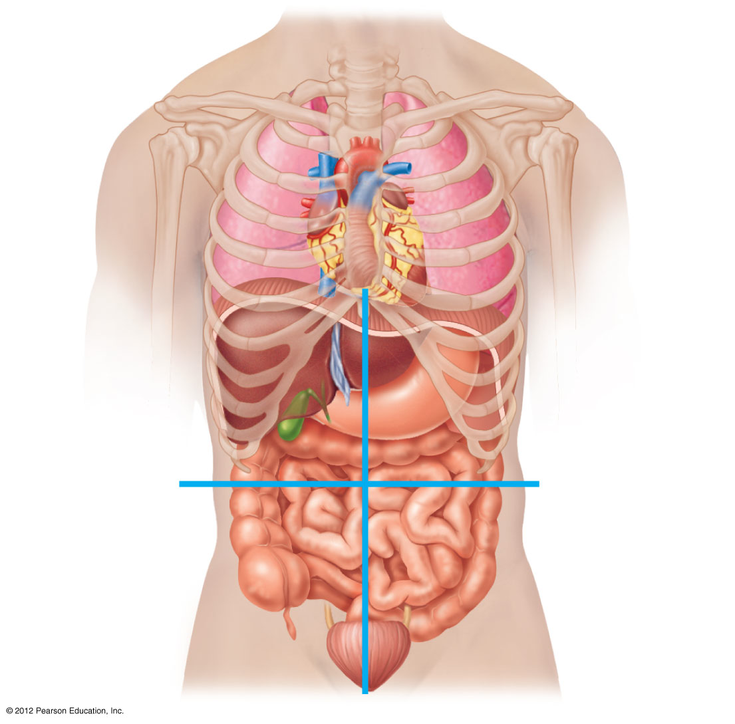
regions

Slide 9
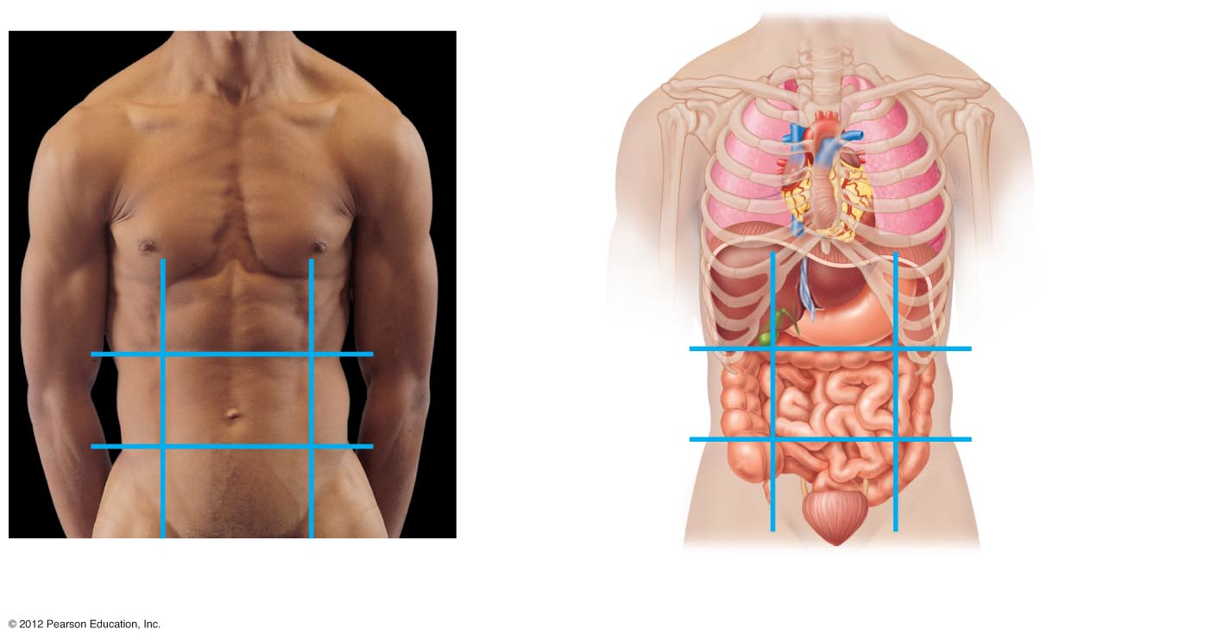
regions

