Slide 2
Body Membranes
Functions of body membranes
Cover body surfaces
Line body cavities
Form protective sheets around organs
Classified according to tissue types

Slide 3
Classification of Body Membranes
Epithelial membranes
Cutaneous membranes
Mucous membranes
Serous membranes
Connective tissue membranes
Synovial membranes

Slide 4
Cutaneous Membrane
Cutaneous membrane = skin
Dry membrane
Outermost protective boundary
Superficial epidermis is composed of keratinized stratified squamous epithelium
Underlying dermis is mostly dense (fibrous) connective tissue

Slide 5
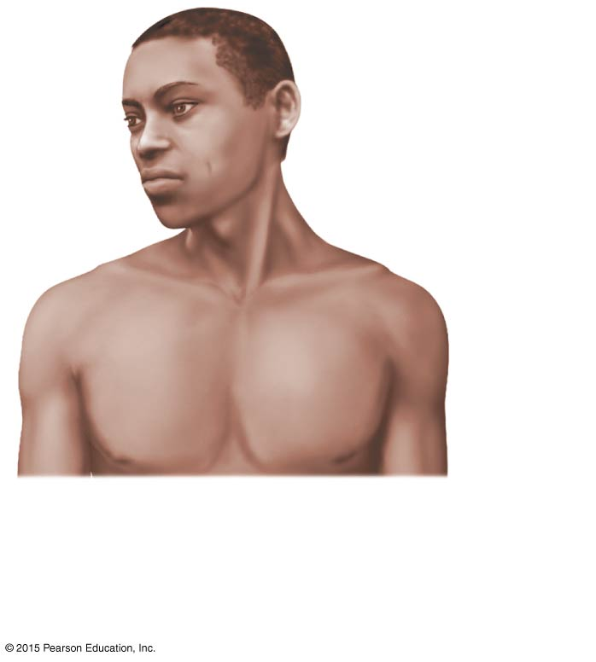
Figure 4.1a Classes of epithelial membranes.
Cutaneous
membrane
(skin)
(a) Cutaneous membrane
(the skin) covers the
body surface.

Slide 6
Mucous Membranes
Surface epithelium type depends on site
Stratified squamous epithelium (mouth, esophagus)
Simple columnar epithelium (rest of digestive tract)
Underlying loose connective tissue (lamina propria)
Lines all body cavities that open to the exterior body surface
Moist membranes adapted for absorption or secretion

Slide 7
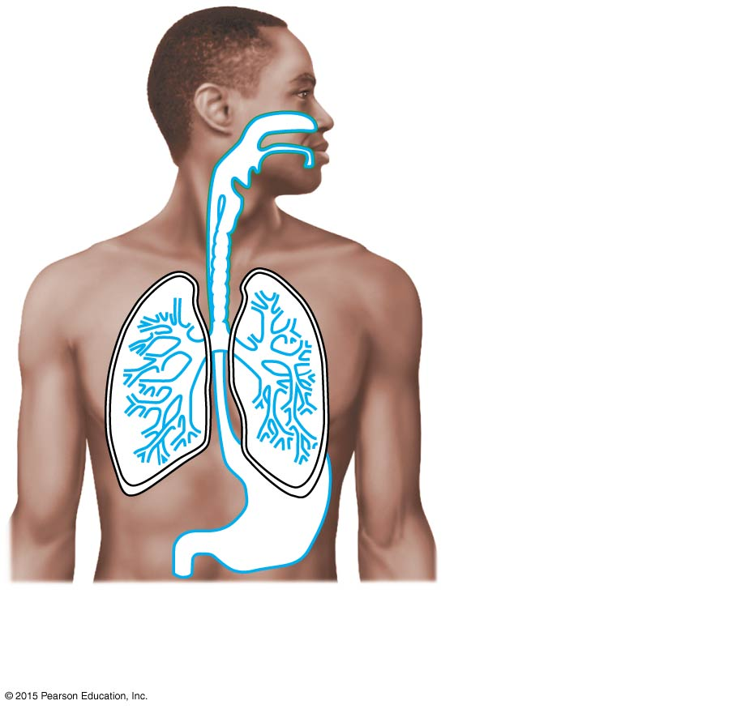
Figure 4.1b Classes of epithelial membranes.
Mucosa of
nasal cavity
Mucosa of
mouth
Esophagus
lining
Mucosa of
lung bronchi
(b) Mucous membranes line body
cavities open to the exterior.

Slide 8
Serous Membranes (Serosa)
Surface is a layer of simple squamous epithelium
Underlying layer is a thin layer of areolar connective tissue
Lines open body cavities that are closed to the exterior of the body
Serous membranes occur in pairs separated by serous fluid
Visceral layer covers the outside of the organ
Parietal layer lines a portion of the wall of ventral body cavity

Slide 9
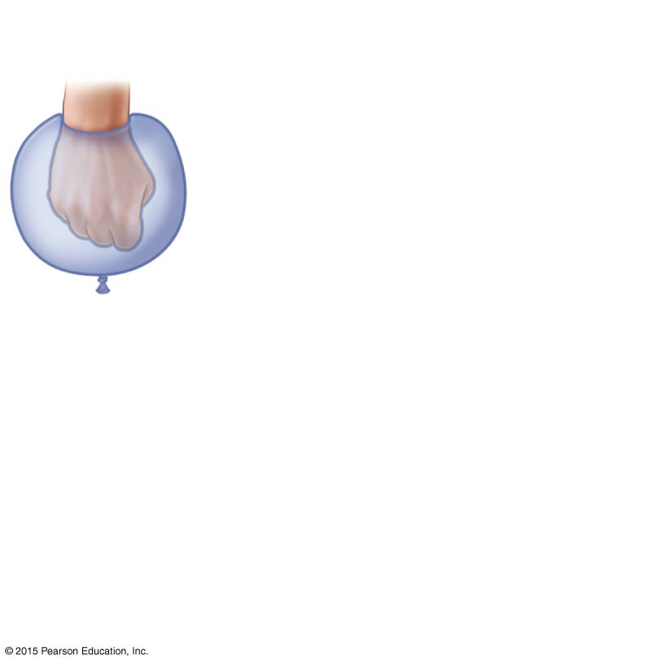
Figure 4.1d Classes of epithelial membranes.
Outer balloon wall
(comparable to
parietal serosa)
Air (comparable to
serous cavity)
Inner balloon wall
(comparable to
visceral serosa)
(d) A fist thrust into a flaccid
balloon demonstrates the
relationship between the
parietal and visceral
serous membrane layers.

Slide 10
Serous Membranes
Specific serous membranes
Peritoneum
Abdominal cavity
Pleura
Around the lungs
Pericardium
Around the heart

Slide 11
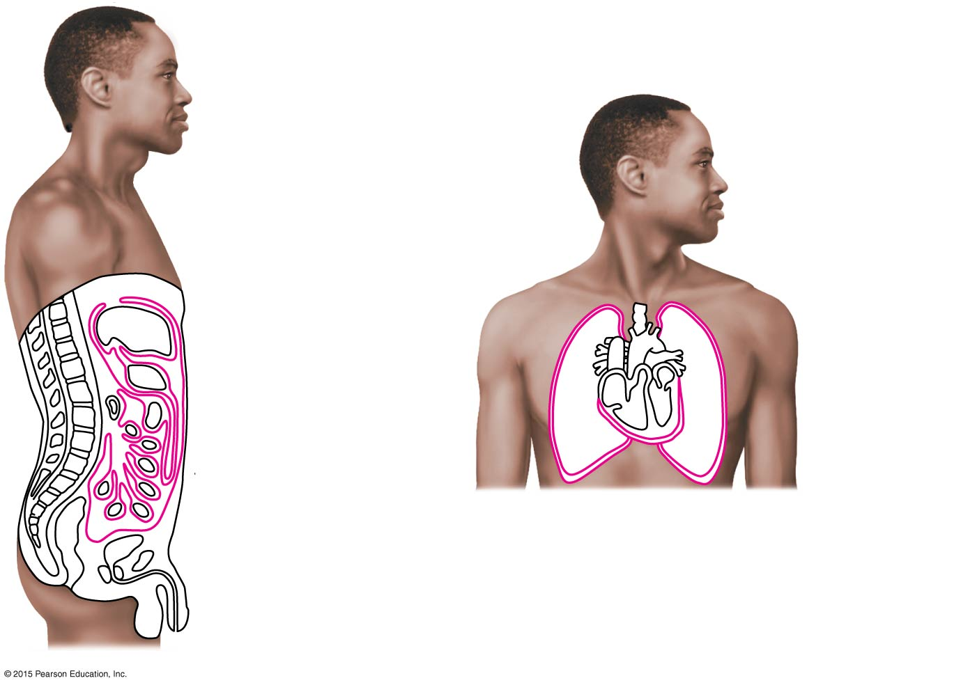
Figure 4.1c Classes of epithelial membranes.
Parietal
pleura
Parietal
peritoneum
Visceral
pleura
Visceral
peritoneum
Parietal
pericardium
Visceral
pericardium
(c) Serous membranes line body
cavities closed to the exterior.

Slide 12
Connective Tissue Membrane
Synovial membrane
Connective tissue only
Lines fibrous capsules surrounding joints
Lines bursae
Lines tendon sheaths
Secretes a lubricating fluid

Slide 13
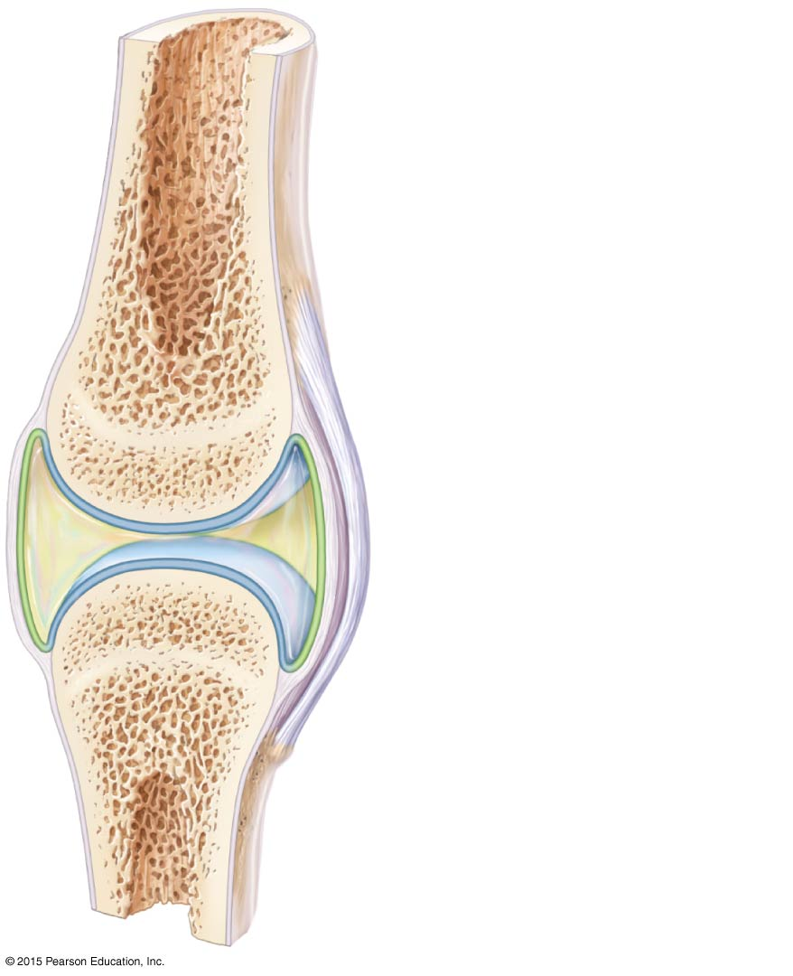
Figure 4.2 A typical synovial joint.
Ligament
Joint cavity
(contains
synovial fluid)
Articular (hyaline)
cartilage
Fibrous
layer
Synovial
membrane
Articular
capsule

Slide 14
Integumentary System
Integumentary system includes:
Skin (cutaneous membrane)
Skin derivatives
Sweat glands
Oil glands
Hair
Nails

Slide 15
Skin (Integument) Functions
Protects deeper tissues from:
Mechanical damage (bumps)
Chemical damage (acids and bases)
Bacterial damage
Ultraviolet radiation (sunlight)
Thermal damage (heat or cold)
Desiccation (drying out)
Keratin protects the skin from water loss

Slide 16
Skin Functions
Aids in loss or retention of body heat as controlled by the nervous system
Aids in excretion of urea and uric acid
Synthesizes vitamin D
Cutaneous sensory receptors detect touch, temperature, pressure, and pain

Slide 17
Table 4.1 Functions of the Integumentary System (1 of 2).

Slide 18
Table 4.1 Functions of the Integumentary System (2 of 2).

Slide 19
Skin Structure
Epidermis—outer layer
Stratified squamous epithelium
Cornified or keratinized (hardened by keratin) to prevent water loss
Avascular
Most cells are keratinocytes
Dermis
Dense connective tissue

Slide 20
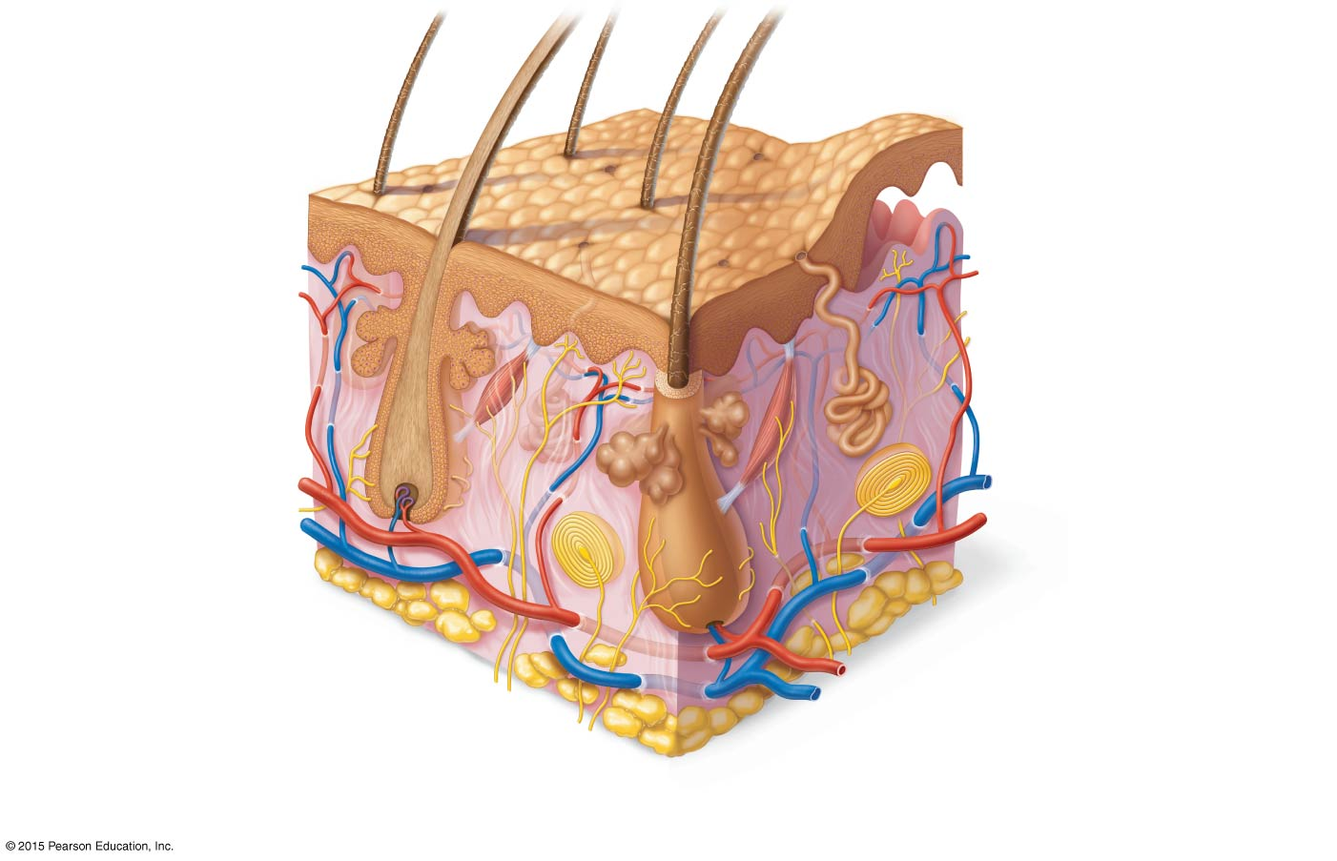
Figure 4.3 Skin structure.
Hair shaft
Dermal papillae
Epidermis
Papillary
layer
Pore
Appendages of skin
• Eccrine sweat gland
Dermis
• Arrector pili muscle
Reticular
layer
• Sebaceous (oil) gland
• Hair follicle
• Hair root
Hypodermis
(subcutaneous
tissue)
Cutaneous vascular plexus
Nervous structures
• Sensory nerve fiber
Adipose tissue
• Lamellar corpuscle
• Hair follicle receptor
(root hair plexus)

Slide 21
Skin Structure
Subcutaneous tissue (hypodermis) is deep to dermis
Not technically part of the skin
Anchors skin to underlying organs
Composed mostly of adipose tissue
Serves as a shock absorber and insulates deeper tissues

Slide 22
Layers of the Epidermis
The epidermis is composed of up to five layers
The epidermis is avascular
Most of the cells in the epidermis are keratinocytes
Keratin, a fibrous protein, makes the epidermis tough
The layers are covered, next, from deepest to most superficial

Slide 23
Layers of the Epidermis
Stratum basale (stratum germinativum)
Deepest layer of epidermis
Lies next to dermis
Wavy borderline with the dermis anchors the two together
Cells undergoing mitosis
Daughter cells are pushed upward to become the more superficial layers
Stratum spinosum

Slide 24
Layers of the Epidermis
Stratum granulosum
Stratum lucidum
Formed from dead cells of the deeper strata
Occurs only in thick, hairless skin of the palms of hands and soles of feet
Stratum corneum
Outermost layer of epidermis
Shingle-like dead cells are filled with keratin (protective protein prevents water loss from skin)

Slide 25
Layers of the Epidermis
Summary of layers from deepest to most superficial
Stratum basale
Stratum spinosum
Stratum granulosum
Stratum lucidum (thick, hairless skin only)
Stratum corneum

Slide 26
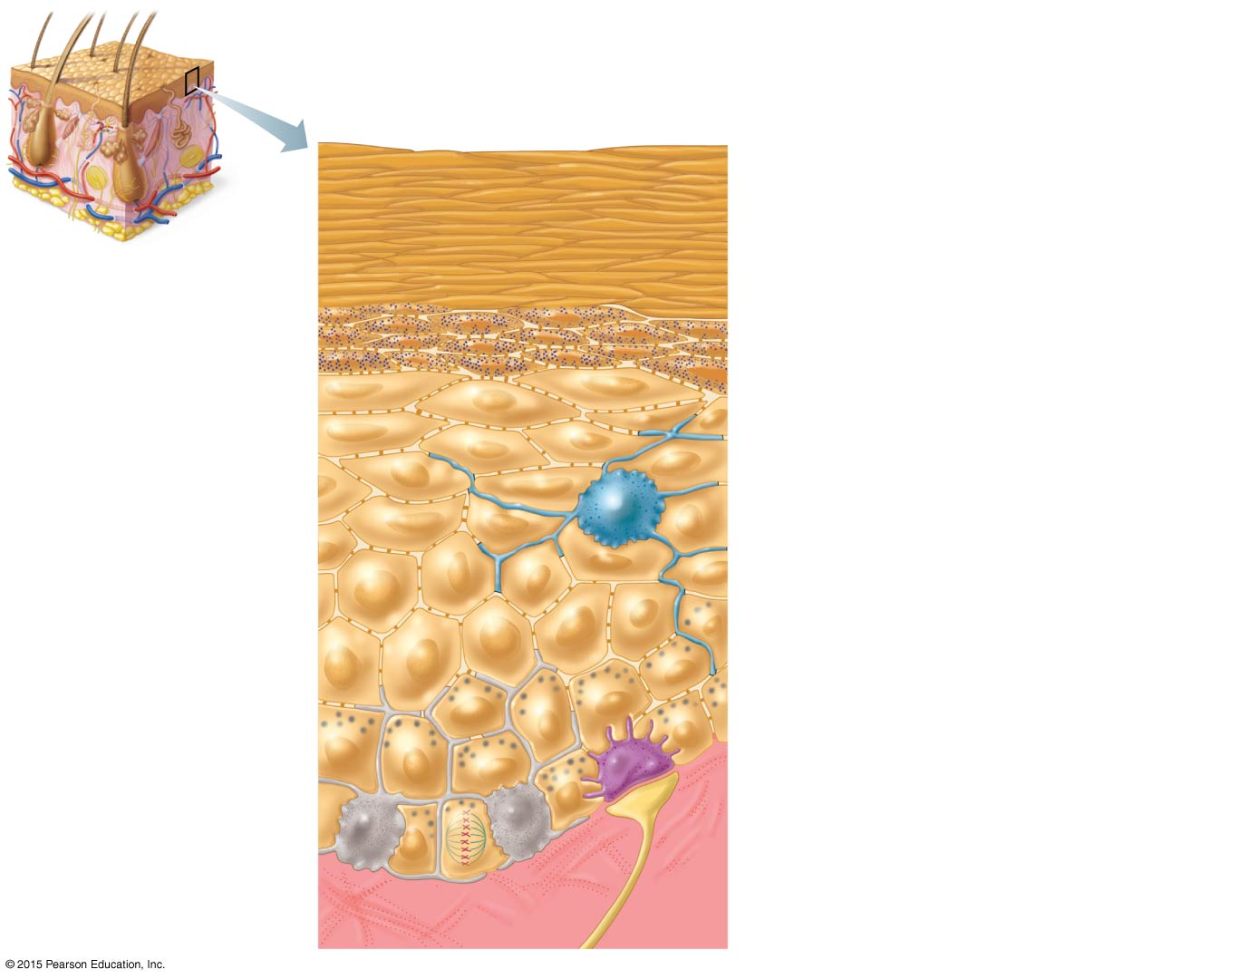
Figure 4.4 The main structural features of the epidermis.
Keratinocytes
Epidermal
dendritic cell
Desmosomes
Stratum corneum. Cells are dead;
represented only by flat
membranous sacs filled with
keratin. Glycolipids in extracellular
space.
Stratum granulosum. Cells are
flattened, organelles are deteriorating;
cytoplasm full of granules.
Stratum spinosum. Cells contain
thick bundles of intermediate
filaments made of pre-keratin.
Stratum basale. Cells are actively
dividing stem cells; some newly
formed cells become part of the more
superficial layers.
Merkel
cell
Sensory
nerve
ending
Dermis
Melanocytes
Melanin
granules

Slide 27
Melanin
Pigment (melanin) produced by melanocytes
Color is yellow to brown to black
Melanocytes are mostly in the stratum basale
Melanin accumulates in membrane-bound granules called melanosomes
Amount of melanin produced depends upon genetics and exposure to sunlight

Slide 28
Epidermal Dendritic Cells & Merkel Cells
Epidermal dendritic cells
Alert and activate immune cells to a threat (bacterial or viral invasion)
Merkel cells
Associated with sensory nerve endings
Serve as touch receptors called Merkel discs

Slide 29
Dermis
Two layers
Papillary layer (upper dermal region)
Projections called dermal papillae
Some contain capillary loops
Others house pain receptors (free nerve endings) and touch receptors
Fingerprints are identifying films of sweat

Slide 30
Dermis
Two layers
Reticular layer (deepest skin layer)
Blood vessels
Sweat and oil glands
Deep pressure receptors (lamellar corpuscles)

Slide 31
Dermis
Overall dermis structure
Collagen and elastic fibers located throughout the dermis
Collagen fibers give skin its toughness
Elastic fibers give skin elasticity
Blood vessels play a role in body temperature regulation
Nerve supply sends messages to the central nervous system

Slide 32
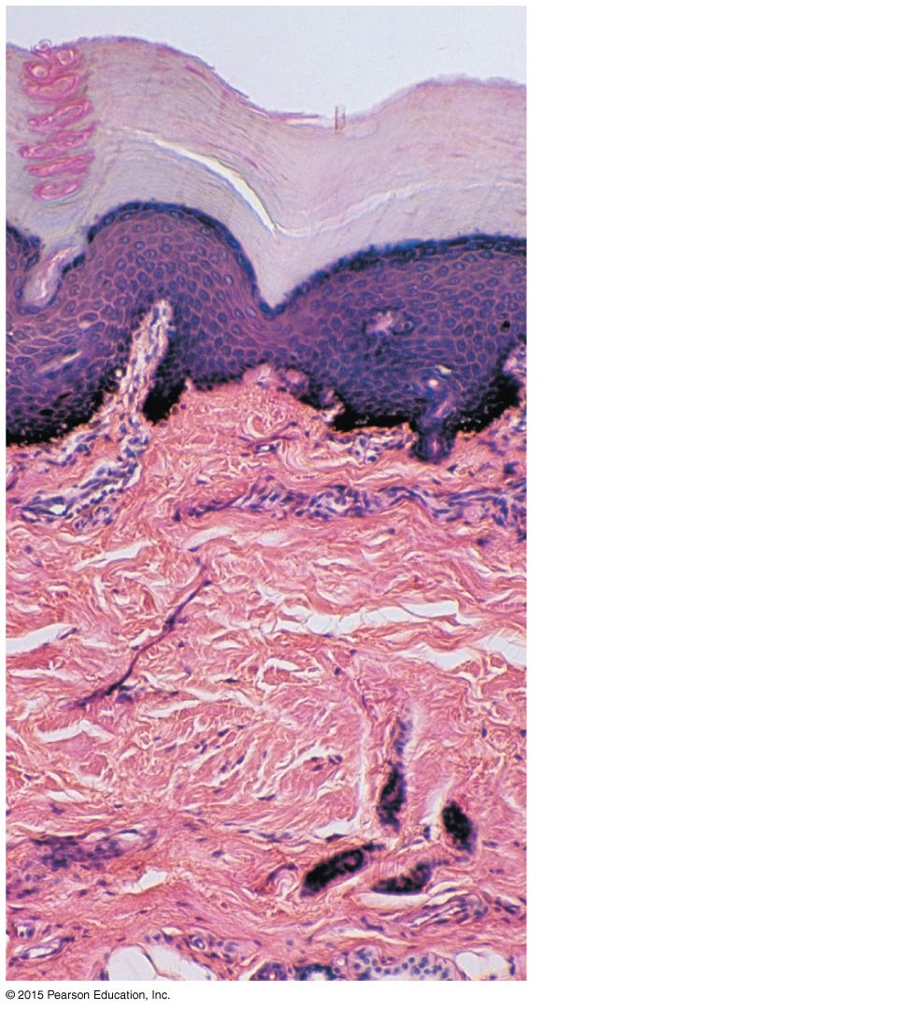
Figure 4.5 Light micrograph of the two regions of the dermis (100×).
Epidermis
Papillary
layer
Dermis
Reticular
layer

Slide 33
Skin Color
Three pigments contribute to skin color:
Melanin
Yellow, reddish brown, or black pigments
Carotene
Orange-yellow pigment from some vegetables
Hemoglobin
Red coloring from blood cells in dermal capillaries
Oxygen content determines the extent of red coloring

Slide 34
Alterations in Skin Color
Redness (erythema)—due to embarrassment, inflammation, hypertension, fever, or allergy
Pallor (blanching)—due to emotional stress (such as fear), anemia, low blood pressure, impaired blood flow to an area
Jaundice (yellowing)—liver disorder
Bruises (black and blue marks)—hematomas

Slide 35
Appendages of the Skin
Cutaneous glands are all exocrine glands
Sebaceous glands
Sweat glands
Hair
Hair follicles
Nails

Slide 36
Figure 4.3 Skin structure.
Hair shaft
Dermal papillae
Epidermis
Papillary
layer
Pore
Appendages of skin
• Eccrine sweat gland
Dermis
• Arrector pili muscle
Reticular
layer
• Sebaceous (oil) gland
• Hair follicle
• Hair root
Hypodermis
(subcutaneous
tissue)
Cutaneous vascular plexus
Nervous structures
• Sensory nerve fiber
Adipose tissue
• Lamellar corpuscle
• Hair follicle receptor
(root hair plexus)

Slide 37
Appendages of the Skin
Sebaceous (oil) glands
Produce sebum (oil)
Lubricant for skin
Prevents brittle hair
Kills bacteria
Most have ducts that empty into hair follicles; others open directly onto skin surface
Glands are activated at puberty

Slide 38
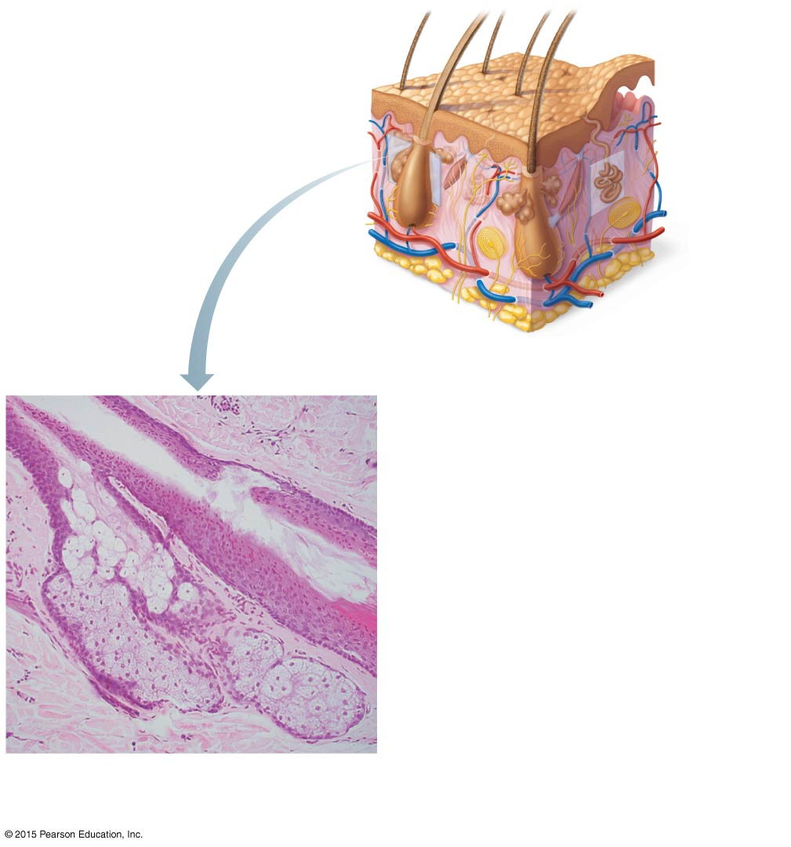
Figure 4.7a Cutaneous glands.
Sweat
pore
Sebaceous
gland
Eccrine
gland
Sebaceous
gland duct
Dermal connective
tissue
Hair in
hair follicle
Secretory cells
(a) Photomicrograph of a sectioned
sebaceous gland (100×)

Slide 39
Appendages of the Skin
Sweat (sudoriferous) glands
Produce sweat
Widely distributed in skin

Slide 40
Appendages of the Skin
Two types of sudoriferous glands
Eccrine glands
Open via duct to pore on skin surface
Produce sweat

Slide 41
Appendages of the Skin
Sweat:
Composition
Mostly water
Salts and vitamin C
Some metabolic waste
Fatty acids and proteins (apocrine only)
Function
Helps dissipate excess heat
Excretes waste products
Acidic nature inhibits bacteria growth
Odor is from associated bacteria

Slide 42
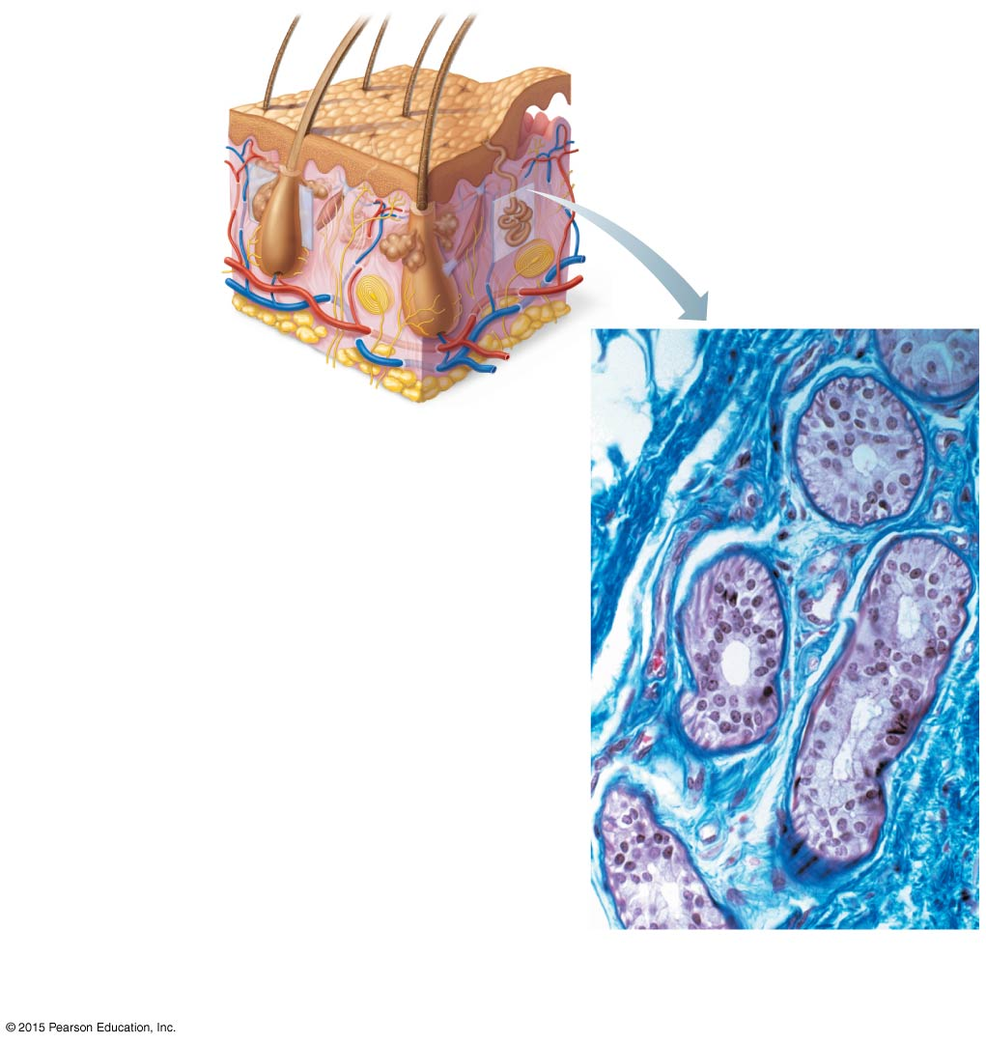
Figure 4.7b Cutaneous glands.
Sweat
pore
Sebaceous
gland
Eccrine
gland
Dermal connective
tissue
Eccrine
gland duct
Secretory cells
(b) Photomicrograph of a sectioned
eccrine gland (205×)

Slide 43
Appendages of the Skin
Two types of sudoriferous glands
Apocrine glands
Ducts empty into hair follicles
Begin to function at puberty
Release sweat that also contains fatty acids and proteins (milky or yellowish color)

Slide 44
Appendages of the Skin
Hair
Produced by hair follicle
Root is enclosed in the follicle
Shaft projects from the surface of the scalp or skin
Consists of hard keratinized epithelial cells
Melanocytes provide pigment for hair color
Hair grows in the matrix of the hair bulb in stratum basale

Slide 45
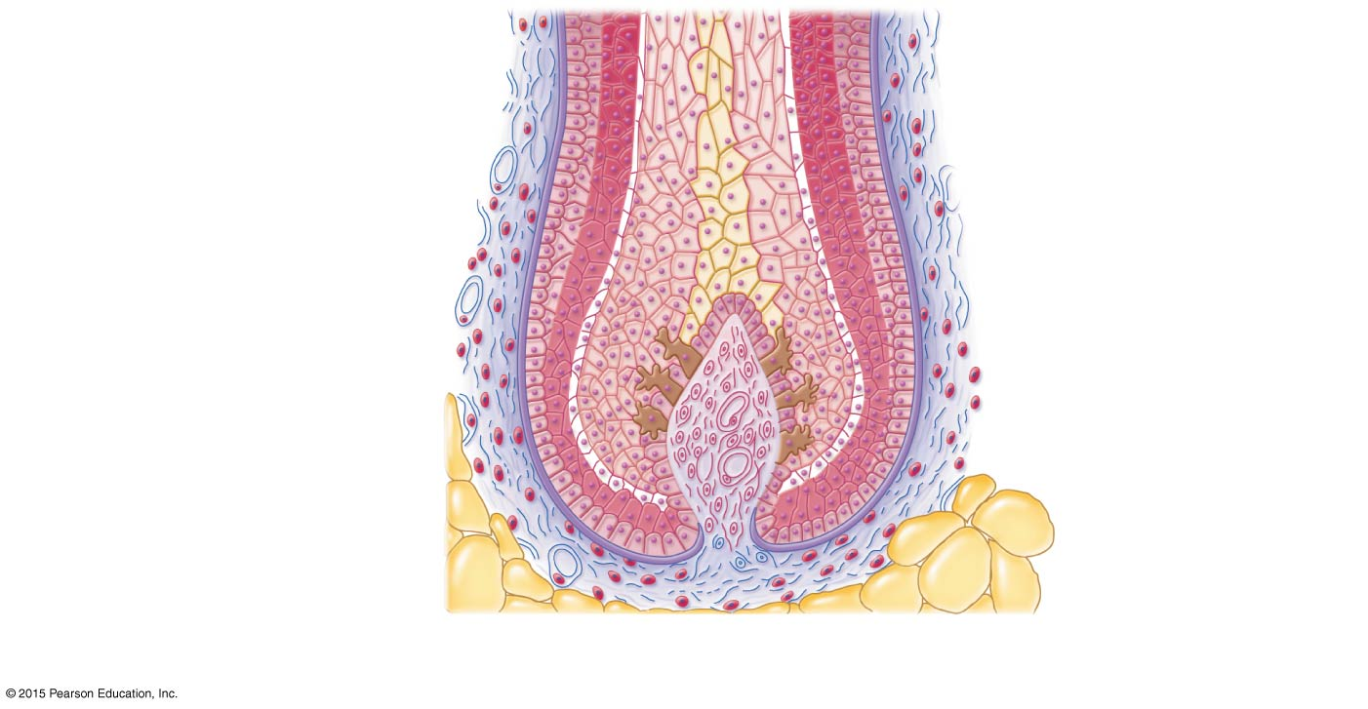
Figure 4.8c Structure of a hair and hair follicle.
Fibrous
sheath
Hair
follicle
Epithelial
sheath
Hair matrix (growth
zone) in hair bulb
Melanocyte
Hair papilla
containing
blood vessels
Subcutaneous
adipose tissue
(c)

Slide 46
Appendages of the Skin
Hair anatomy
Central medulla
Cortex surrounds medulla
Cuticle on outside of cortex
Most heavily keratinized region of the hair

Slide 47
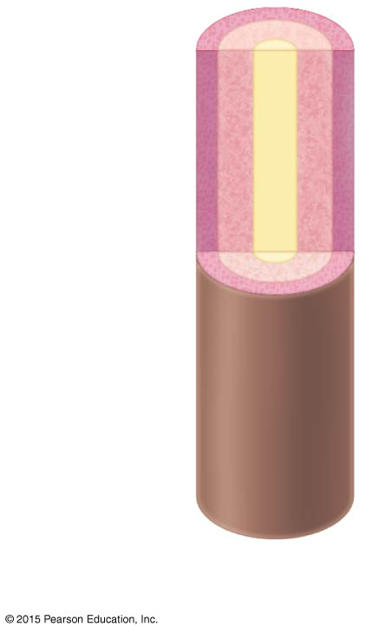
Figure 4.8b Structure of a hair and hair follicle.
Cuticle
Cortex
Medulla
(b) Hair

Slide 48
Appendages of the Skin
Associated hair structures
Hair follicle
Dermal and epidermal sheath surround hair root
Arrector pili muscle
Smooth muscle
Pulls hairs upright when person is cold or frightened
Sebaceous gland
Sudoriferous gland

Slide 49
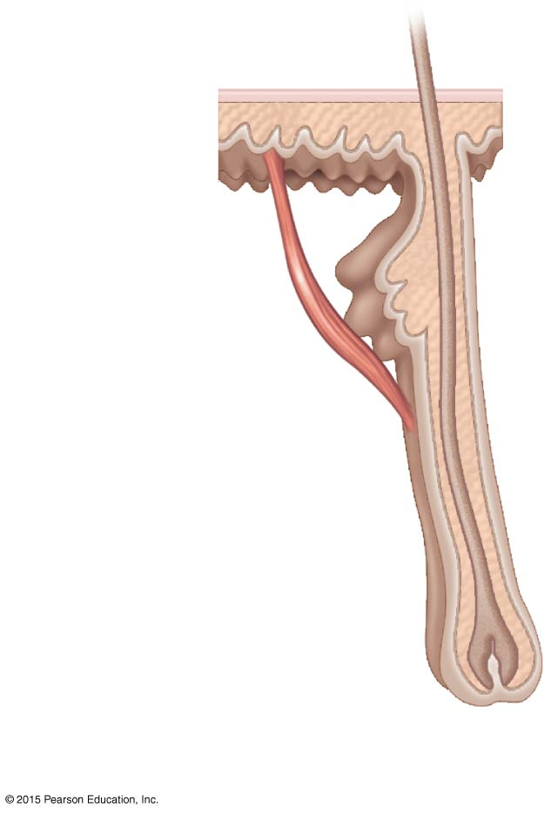
Figure 4.8a Structure of a hair and hair follicle.
Hair
shaft
Arrector
pili
Sebaceous
gland
Hair root
Hair bulb
in follicle
(a)

Slide 50
Appendages of the Skin
Notice how the scale-like cells of the cuticle overlap one another in this hair shaft image (660×)

Slide 51
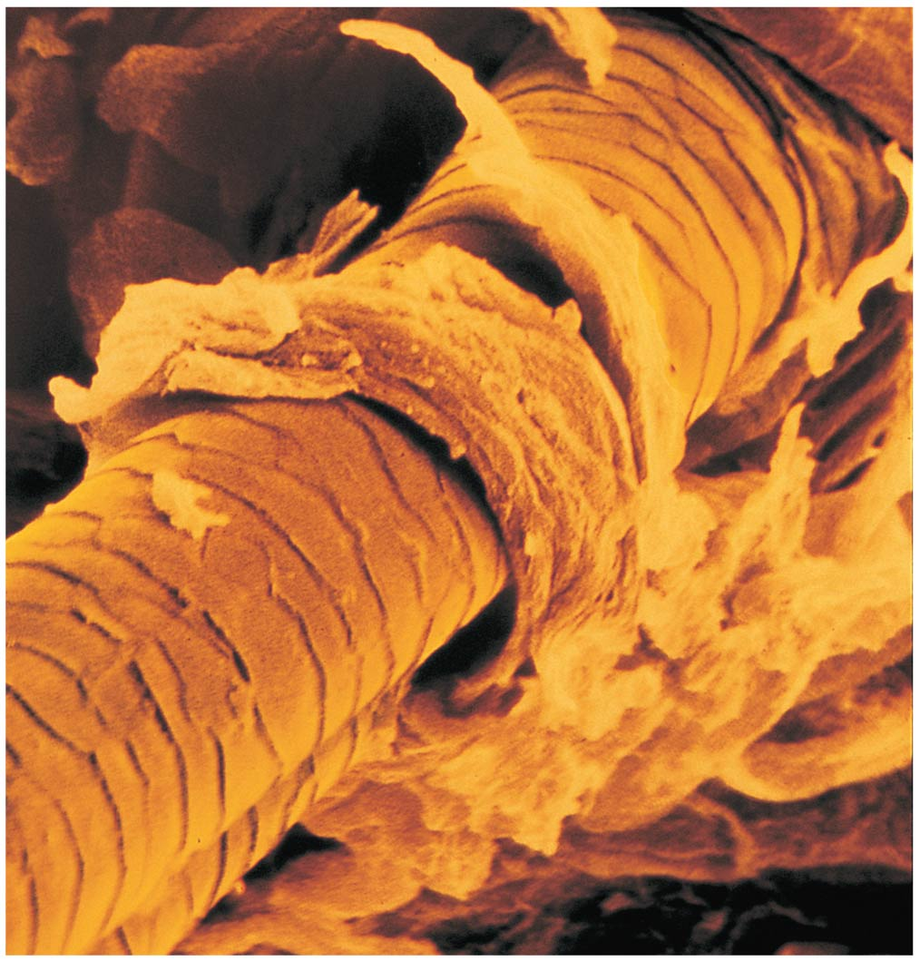
Figure 4.9 Scanning electron micrograph showing a hair shaft emerging from a follicle at the skin surface.

Slide 52
Appendages of the Skin
Nails
Scale-like modifications of the epidermis
Heavily keratinized
Stratum basale extends beneath the nail bed
Responsible for growth
Lack of pigment makes them colorless

Slide 53
Appendages of the Skin
Nail structures
Free edge
Body is the visible attached portion
Nail folds are skin folds that overlap the edges of the nail
Growth occurs from nail matrix
Root of nail is embedded in skin
Cuticle is the proximal nail fold that projects onto the nail body

Slide 54
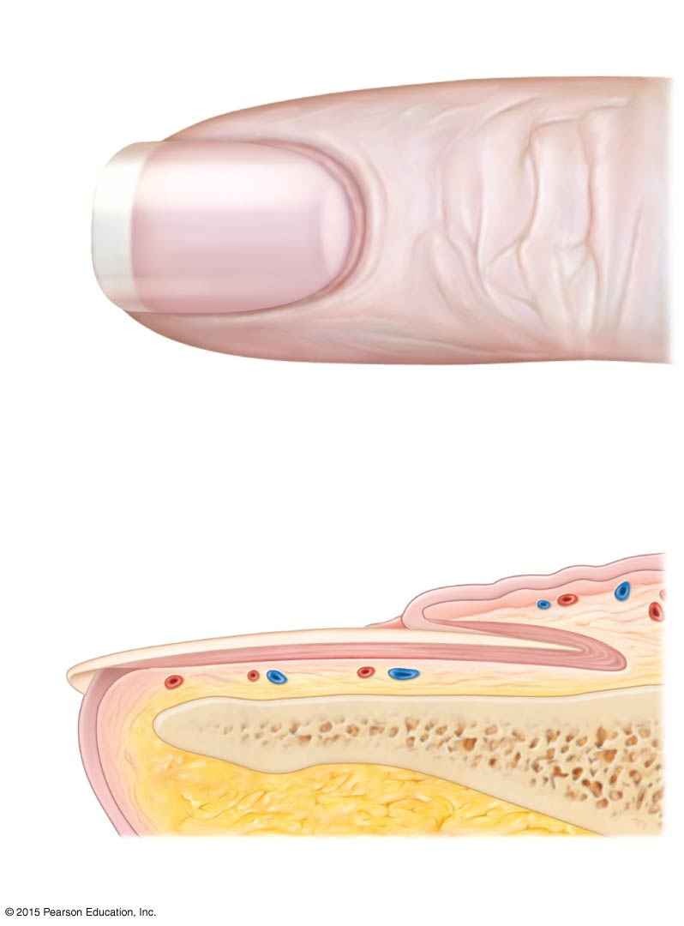
Figure 4.10 Structure of a nail.
Lunule
Lateral
nail fold
(a)
Free
edge
of
nail
Body
of
nail
Cuticle
Root of nail
Proximal
nail fold
Nail
matrix
(b)
Nail bed
Bone of fingertip

Slide 55
Skin Homeostatic Imbalances
Burns
Tissue damage and cell death caused by heat, electricity, UV radiation, or chemicals
Associated dangers
Dehydration
Electrolyte imbalance
Circulatory shock
Result in loss of body fluids and invasion of bacteria

Slide 56
Rule of Nines
Way to determine the extent of burns
Body is divided into 11 areas for quick estimation
Each area represents about 9 percent of total body surface area
The area surrounding the genitals (the perineum) represents 1 percent of body surface area

Slide 57
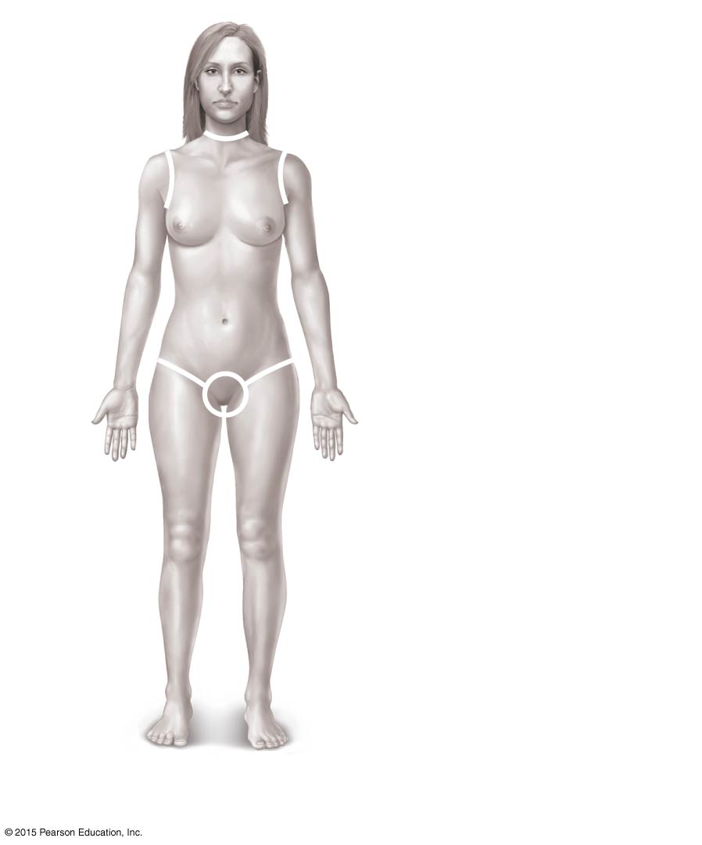
Figure 4.11a Burns.
Totals
4¹/₂%
Anterior and posterior
head and neck, 9%
Anterior and posterior
upper limbs, 18%
Anterior and posterior
trunk, 36%
4¹/₂%
4¹/₂%
Anterior
trunk, 18%
Perineum, 1%
9%
9%
Anterior and posterior
lower limbs, 36%
100%
(a)

Slide 58
Severity of Burns
First-degree burns (partial-thickness burn)
Only epidermis is damaged
Skin is red and swollen
Second-degree burns (partial-thickness burn)
Epidermis and upper dermis are damaged
Skin is red with blisters
Third-degree burns (full-thickness burn)
Destroys entire skin layer; burned area is painless
Requires skin grafts
Burn is gray-white or black

Slide 59
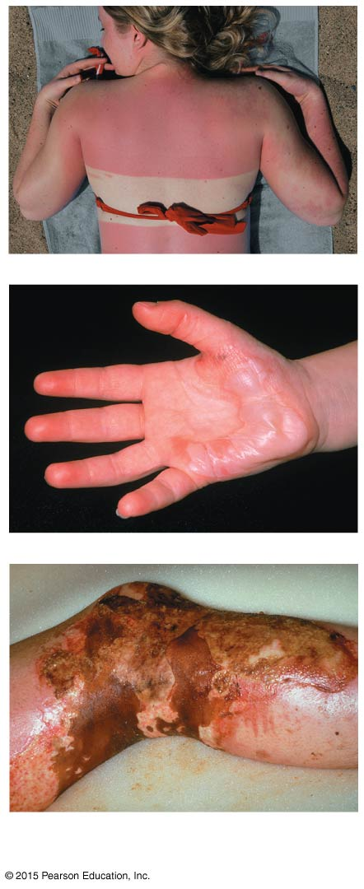
Figure 4.11b Burns.
Burns of increasing
severity, from top to bottom: first-degree, second-degree,
third-degree.
(b)

Slide 60
Critical Burns
Burns are considered critical if
Over 25 percent of body has second-degree burns
Over 10 percent of the body has third-degree burns
There are third-degree burns of the face, hands, or feet

Slide 61
Skin Homeostatic Imbalances
Infections
Athlete’s foot (tinea pedis)
Caused by fungal infection
Boils and carbuncles
Caused by bacterial infection
Cold sores
Caused by virus

Slide 62
Skin Homeostatic Imbalances
Infections and allergies
Contact dermatitis
Exposures cause allergic reaction
Impetigo
Caused by bacterial infection
Psoriasis
Cause is unknown
Triggered by trauma, infection, stress

Slide 63
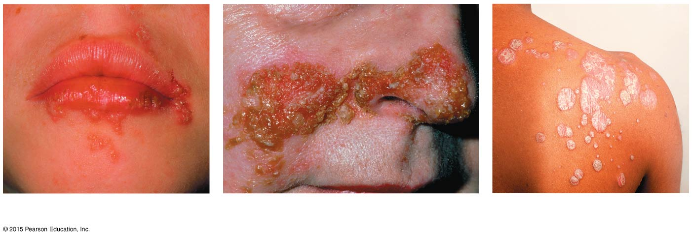
Figure 4.12 Cutaneous lesions.
(a) Cold sores
(b) Impetigo
(c) Psoriasis

Slide 64
Skin Cancer
Cancer—abnormal cell mass
Classified two ways
Benign
Does not spread (encapsulated)
Malignant
Metastasizes (moves) to other parts of the body
Skin cancer is the most common type of cancer

Slide 65
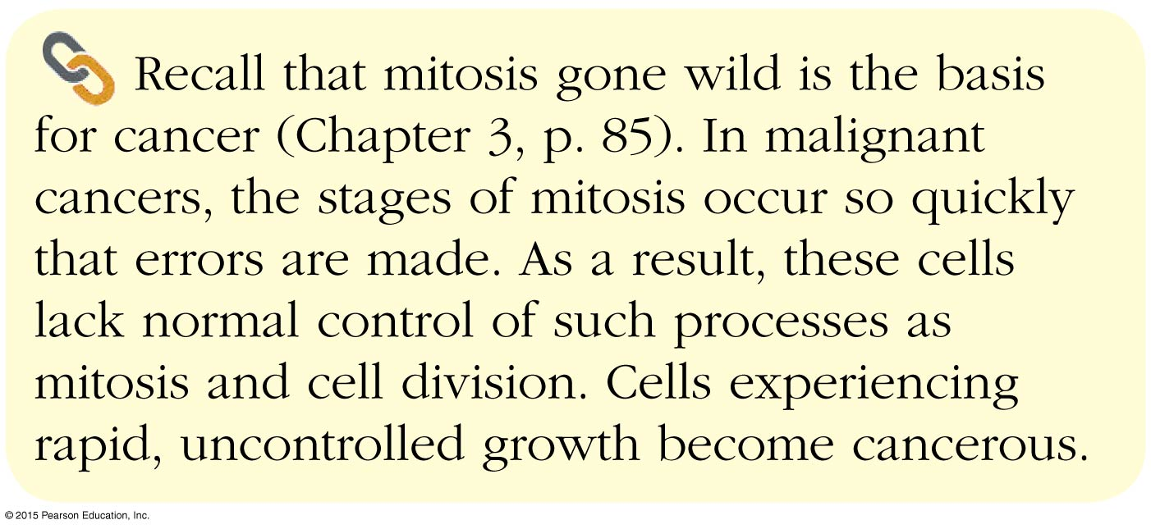

Slide 66
Skin Cancer Types
Basal cell carcinoma
Least malignant
Most common type
Arises from stratum basale

Slide 67
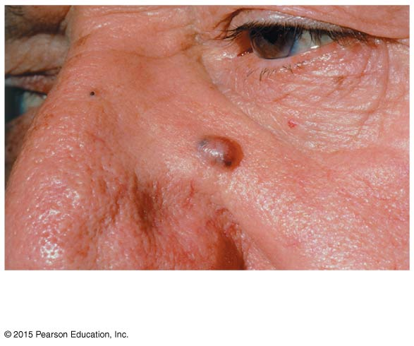
Figure 4.13a Photographs of skin cancers.
(a) Basal cell carcinoma

Slide 68
Skin Cancer Types
Squamous cell carcinoma
Metastasizes to lymph nodes if not removed
Early removal allows a good chance of cure
Believed to be sun-induced
Arises from stratum spinosum

Slide 69
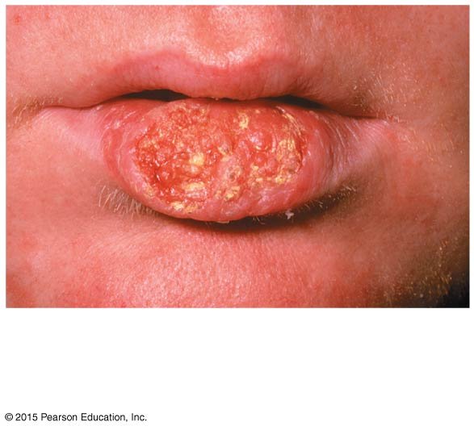
Figure 4.13b Photographs of skin cancers.
(b) Squamous cell
carcinoma

Slide 70
Skin Cancer Types
Malignant melanoma
Most deadly of skin cancers
Cancer of melanocytes
Metastasizes rapidly to lymph and blood vessels
Detection uses ABCD rule

Slide 71
ABCD Rule
A = Asymmetry
Two sides of pigmented mole do not match
B = Border irregularity
Borders of mole are not smooth
C = Color
Different colors in pigmented area
D = Diameter
Spot is larger than 6 mm in diameter

Slide 72
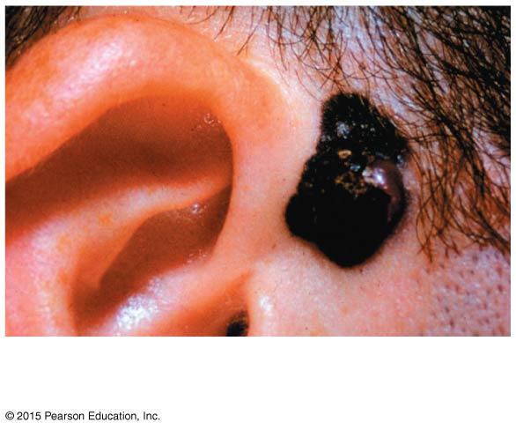
Figure 4.13c Photographs of skin cancers.
(c) Melanoma

Slide 73
Developmental Aspects of Skin
In youth, skin is thick, resilient, and well hydrated
With aging, skin loses elasticity and thins
Skin cancer is a major threat to skin exposed to excessive sunlight
Balding and/or graying occurs with aging; both are genetically determined; other factors that may contribute include drugs and emotional stress

