Slide 1
3
Cells and Tissues

Slide 2
Concepts of the Cell Theory
A cell is the basic structural and functional unit of living organisms.
The activity of an organism depends on the collective activities of its cells.
According to the principle of complementarity, the biochemical activities of cells are dictated by the relative number of their specific subcellular structures.
Continuity of life has a cellular basis.

Slide 3
Chemical Components of Cells
Most cells are composed of the following four elements
Carbon
Hydrogen
Oxygen
Nitrogen

Slide 4
Cells and Tissues
Carry out all chemical activities needed to sustain life
Cells are the building blocks of all living things.
Tissues are groups of cells that are similar in structure and function.

Slide 5
Anatomy of the Cell
Cells are not all the same.
All cells share general structures.
All cells have three main regions
Nucleus
Cytoplasm
Plasma membrane

Slide 6
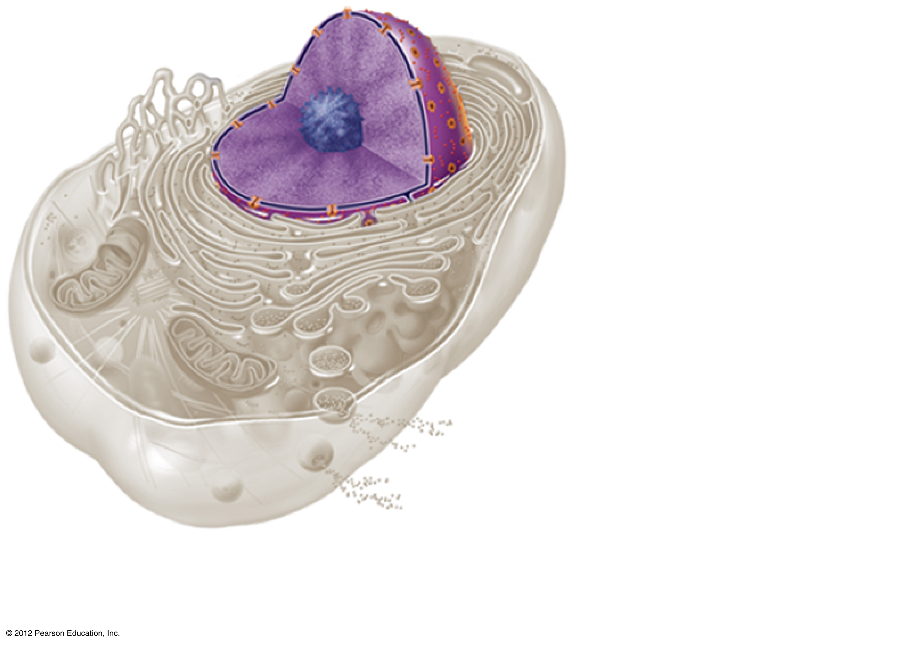
Nucleus
Cytoplasm
Plasma
membrane
(a)
Figure 3.1a

Slide 7
The Nucleus
Control center of the cell
Contains genetic material (DNA)
Three regions
Nuclear envelope (membrane)
Nucleolus
Chromatin

Slide 8
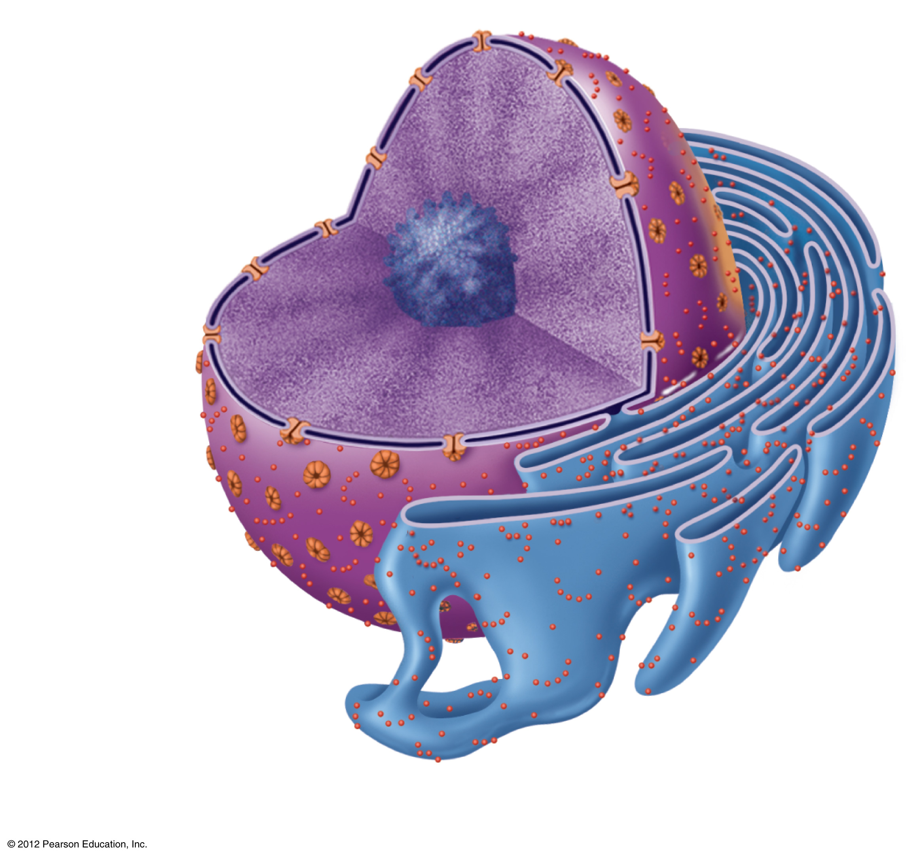
Nuclear envelope
Chromatin
Nucleus
Nucleolus
Nuclear
pores
Rough ER
(b)
Figure 3.1b

Slide 9
The Nucleus
Nuclear envelope (membrane)
Barrier of the nucleus
Consists of a double membrane
Contains nuclear pores that allow for exchange of material with the rest of the cell

Slide 10
The Nucleus
Nucleoli
Nucleus contains one or more nucleoli
Sites of ribosome assembly
Ribosomes migrate into the cytoplasm through nuclear pores

Slide 11
The Nucleus
Chromatin
Composed of DNA and protein
Present when the cell is not dividing
Scattered throughout the nucleus
Condenses to form chromosomes when the cell divides

Slide 12
Plasma Membrane
Barrier for cell contents
Double phospholipid layer
Hydrophilic heads
Hydrophobic tails
Also contains proteins, cholesterol, and glycoproteins

Slide 13
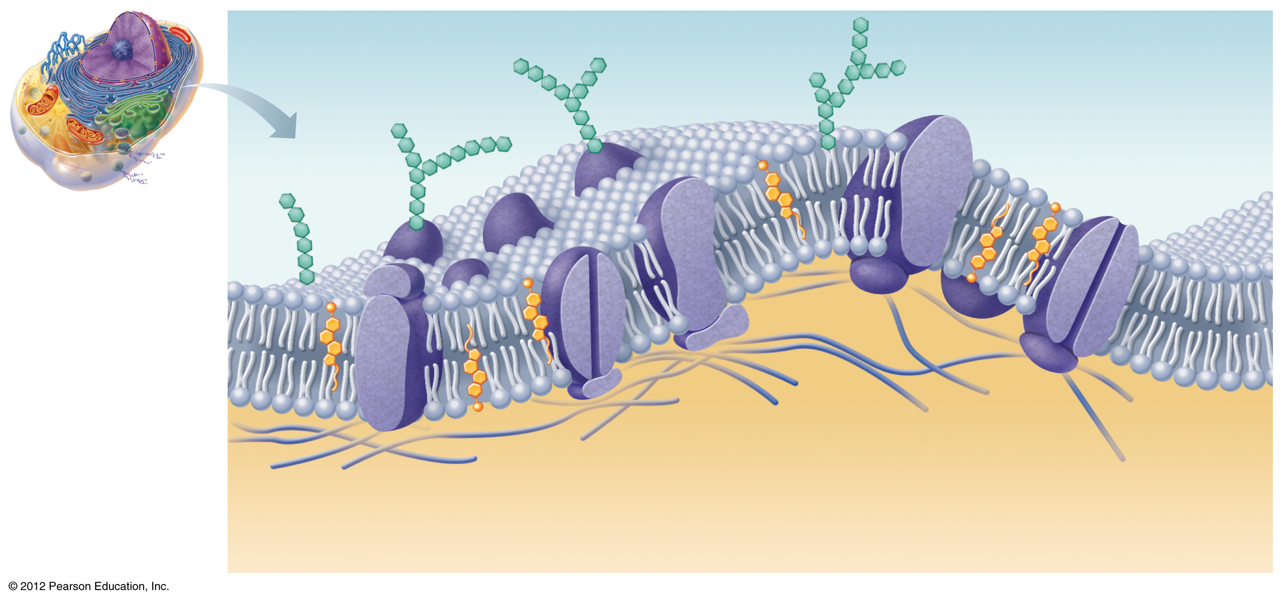
Extracellular fluid
(watery environment)
Glycoprotein
Glycolipid
Cholesterol
Sugar
group
Polar heads of
phospholipid
molecules
Bimolecular
lipid layer containing proteins
Channel
Nonpolar tails of phospholipid
molecules
Proteins
Filaments of
cytoskeleton
Cytoplasm
(watery environment)
Figure 3.2

Slide 14
Plasma Membrane Junctions
Membrane junctions
Tight junctions
Impermeable junctions
Bind cells together into leakproof sheets
Desmosomes
Anchoring junctions that prevent cells from being pulled apart
Gap junctions
Allow communication between cells

Slide 15
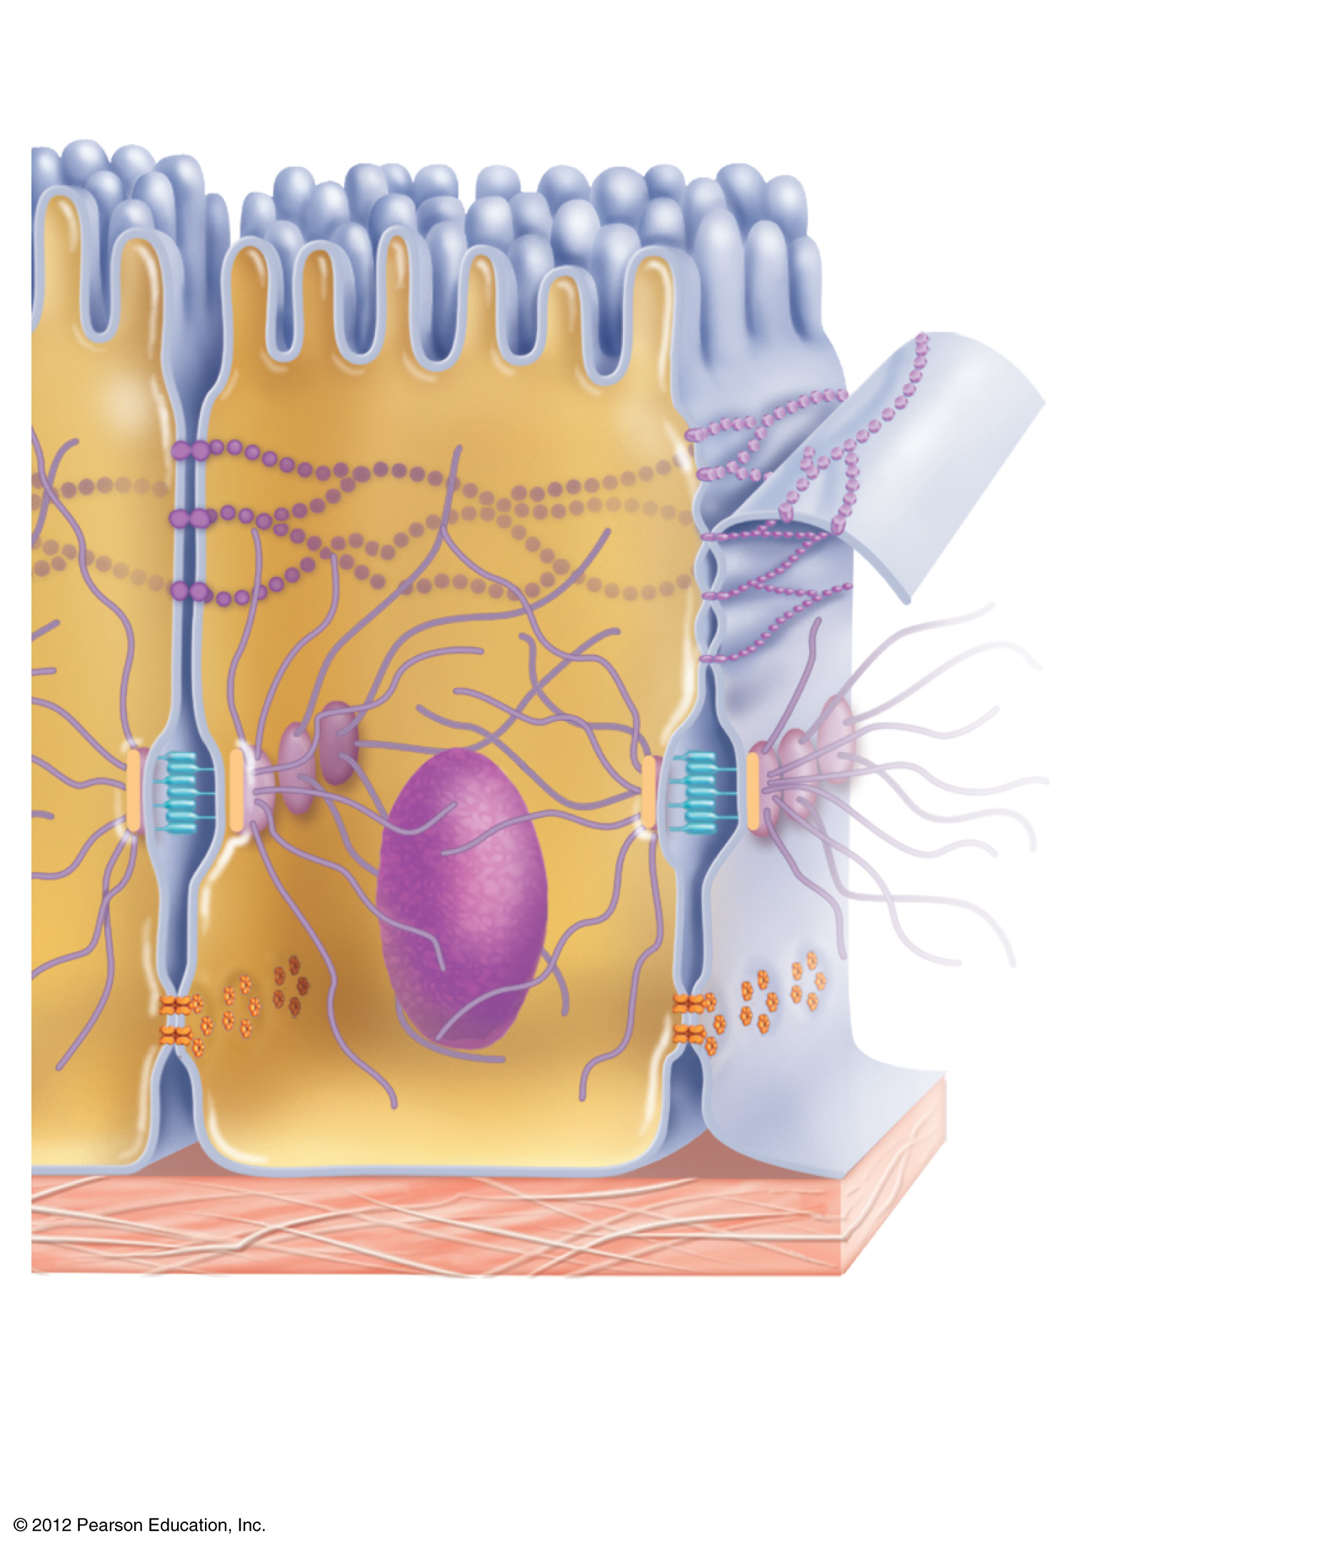
Microvilli
Tight
(impermeable)
junction
Desmosome
(anchoring
junction)
Plasma
membranes of
adjacent cells
Connexon
Underlying
basement
membrane
Extracellular
space between
cells
Gap
(communicating)
junction
Figure 3.3

Slide 16
Cytoplasm
The material outside the nucleus and inside the plasma membrane
Site of most cellular activities

Slide 17
Cytoplasm
Contains three major elements
Cytosol
Fluid that suspends other elements
Organelles
Metabolic machinery of the cell
“Little organs” that perform functions for the cell
Inclusions
Chemical substances such as stored nutrients or cell products

Slide 18
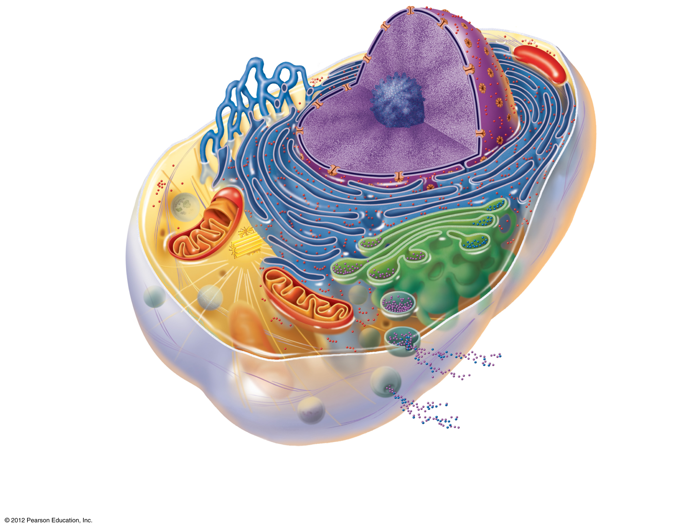
Chromatin
Nuclear envelope
Nucleolus
Nucleus
Smooth endoplasmic
reticulum
Plasma
membrane
Cytosol
Lysosome
Mitochondrion
Rough
endoplasmic
reticulum
Centrioles
Ribosomes
Golgi apparatus
Secretion being released
from cell by exocytosis
Microtubule
Peroxisome
Intermediate
filaments
Figure 3.4

Slide 19
Cytoplasmic Organelles
Mitochondria
“Powerhouses” of the cell
Change shape continuously
Carry out reactions where oxygen is used to break down food
Provides ATP for cellular energy

Slide 20
Cytoplasmic Organelles
Ribosomes
Made of protein and RNA
Sites of protein synthesis
Found at two locations
Free in the cytoplasm
As part of the rough endoplasmic reticulum

Slide 21
Cytoplasmic Organelles
Endoplasmic reticulum (ER)
Fluid-filled tubules for carrying substances
Two types of ER
Rough endoplasmic reticulum
Studded with ribosomes
Synthesizes proteins
Smooth endoplasmic reticulum
Functions in lipid metabolism and detoxification of drugs and pesticides

Slide 22
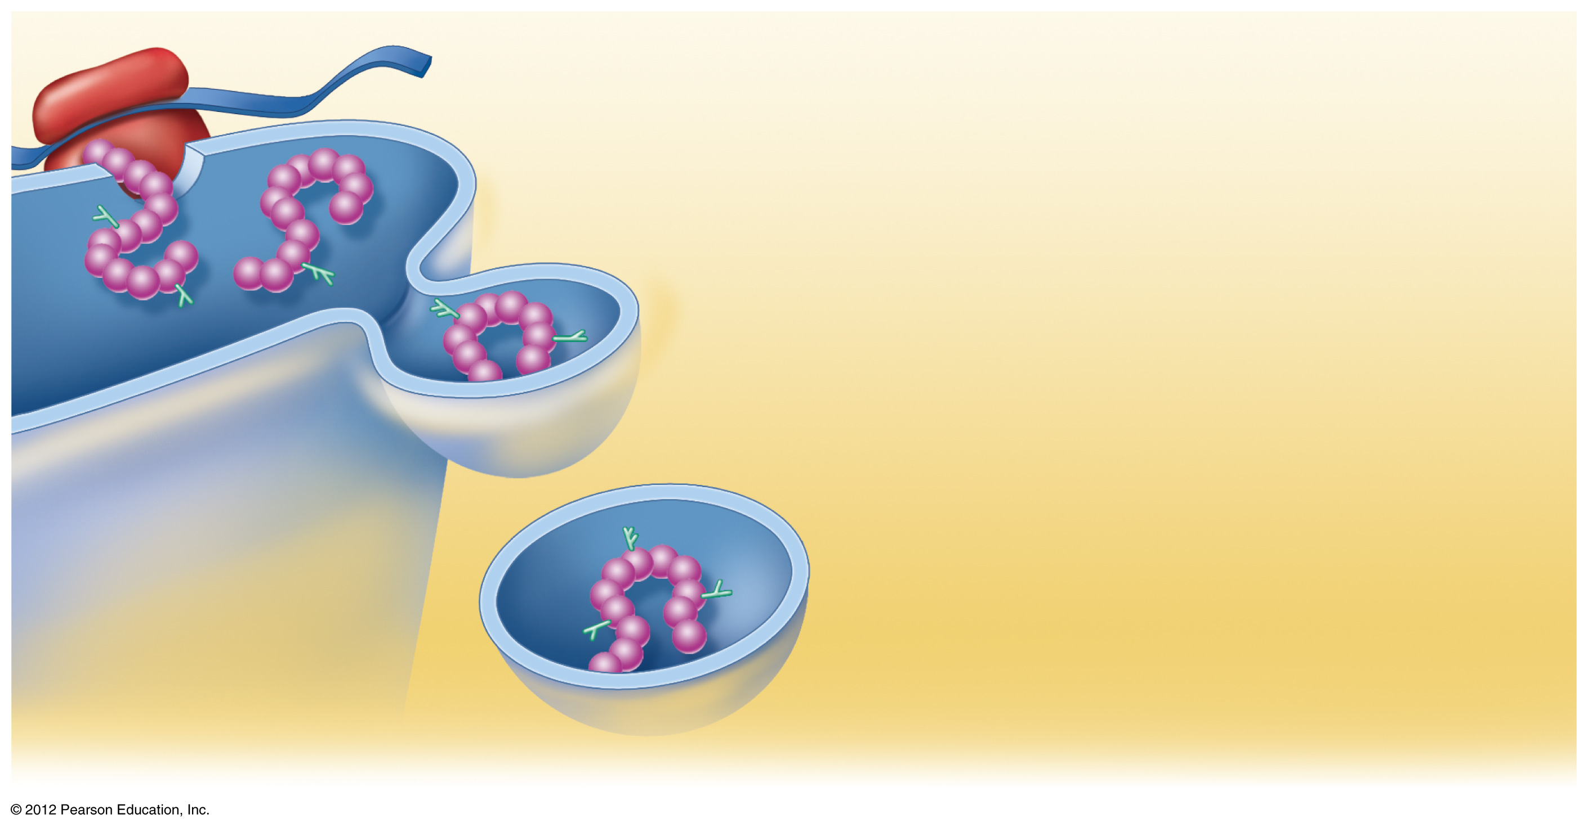
Ribosome
mRNA
1
Rough ER
As the protein is synthesized on the
ribosome, it migrates into the rough ER
cistern.
2
In the cistern, the protein folds into its
functional shape. Short sugar chains
may be attached to the protein (forming
a glycoprotein).
1
3
2
Protein
The protein is packaged in a tiny
membranous sac called a transport
vesicle.
3
Transport
vesicle buds off
4
The transport vesicle buds from the
rough ER and travels to the Golgi
apparatus for further processing.
4
Protein inside
transport vesicle
Figure 3.5

Slide 23
Ribosome
mRNA
1
Rough ER
As the protein is synthesized on the
ribosome, it migrates into the rough ER
cistern.
1
Protein
Figure 3.5, step 1

Slide 24
Ribosome
mRNA
1
Rough ER
As the protein is synthesized on the
ribosome, it migrates into the rough ER
cistern.
2
In the cistern, the protein folds into its
functional shape. Short sugar chains
may be attached to the protein (forming
a glycoprotein).
1
2
Protein
Figure 3.5, step 2

Slide 25
Ribosome
mRNA
1
Rough ER
As the protein is synthesized on the
ribosome, it migrates into the rough ER
cistern.
2
In the cistern, the protein folds into its
functional shape. Short sugar chains
may be attached to the protein (forming
a glycoprotein).
1
3
2
Protein
The protein is packaged in a tiny
membranous sac called a transport
vesicle.
3
Transport
vesicle buds off
Figure 3.5, step 3

Slide 26
Ribosome
mRNA
1
Rough ER
As the protein is synthesized on the
ribosome, it migrates into the rough ER
cistern.
2
In the cistern, the protein folds into its
functional shape. Short sugar chains
may be attached to the protein (forming
a glycoprotein).
1
3
2
Protein
The protein is packaged in a tiny
membranous sac called a transport
vesicle.
3
Transport
vesicle buds off
4
The transport vesicle buds from the
rough ER and travels to the Golgi
apparatus for further processing.
4
Protein inside
transport vesicle
Figure 3.5, step 4

Slide 27
Cytoplasmic Organelles
Golgi apparatus
Modifies and packages proteins
Produces different types of packages
Secretory vesicles
Cell membrane components
Lysosomes

Slide 28
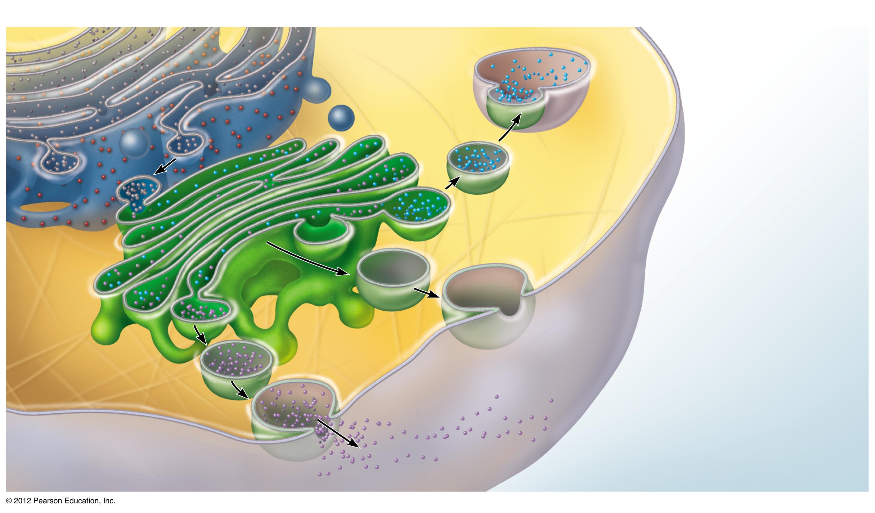
Rough ER
Cisterna
Proteins in cisterna
Membrane
Lysosome fuses with
ingested substances
Transport
vesicle
Golgi vesicle containing
digestive enzymes
becomes a lysosome
Pathway 3
Golgi
apparatus
Pathway 2
Golgi vesicle containing
membrane components
fuses with the plasma
membrane
Pathway 1
Secretory vesicles
Golgi vesicle containing
proteins to be secreted
becomes a secretory
vesicle
Proteins
Secretion by
exocytosis
Plasma membrane
Extracellular fluid
Figure 3.6

Slide 29
Cytoplasmic Organelles
Lysosomes
Contain enzymes produced by ribosomes
Packaged by the Golgi apparatus
Digest worn-out or nonusable materials within the cell

Slide 30
Cytoplasmic Organelles
Peroxisomes
Membranous sacs of oxidase enzymes
Detoxify harmful substances such as alcohol and formaldehyde
Break down free radicals (highly reactive chemicals)
Replicate by pinching in half

Slide 31
Cytoplasmic Organelles
Cytoskeleton
Network of protein structures that extend throughout the cytoplasm
Provides the cell with an internal framework
Three different types of elements
Microfilaments (largest)
Intermediate filaments
Microtubules (smallest)

Slide 32
(a) Microfilaments
(b) Intermediate filaments
(c) Microtubules
Tubulin subunits
Actin subunit
Fibrous subunits
7 nm
10 nm
25 nm
Microfilaments form the blue
network surrounding the pink
nucleus.
Intermediate filaments form
the purple batlike network.
Microtubules appear as gold
networks surrounding the
cells’ pink nuclei.
Figure 3.7a-c

Slide 33
Cytoplasmic Organelles
Centrioles
Rod-shaped bodies made of microtubules
Direct the formation of mitotic spindle during cell division

Slide 34
Cellular Projections
Not found in all cells
Cilia move materials across the cell surface
Located in the respiratory system to move mucus
Flagella propel the cell
The only flagellated cell in the human body is sperm
Microvilli are tiny, fingerlike extensions of the plasma membrane
Increase surface area for absorption

Slide 35
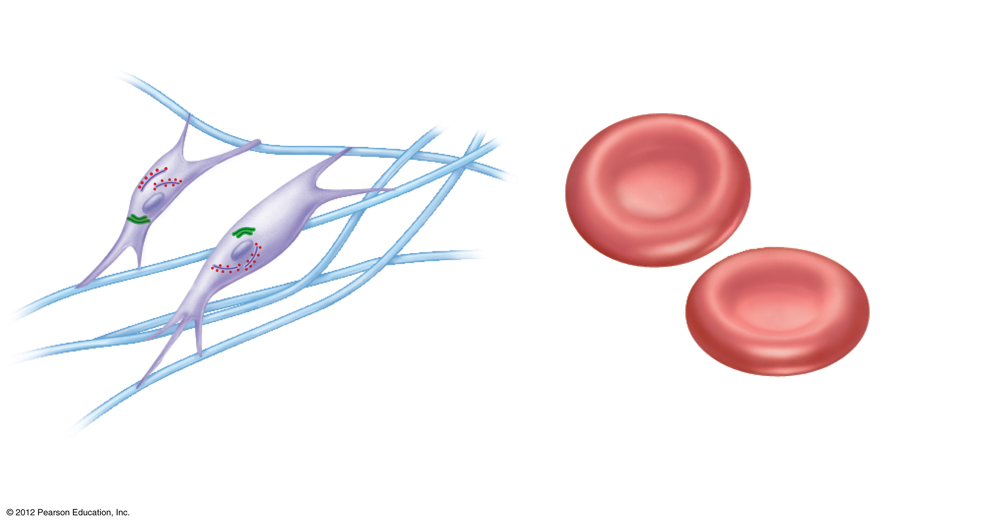
Fibroblasts
Rough ER and Golgi
apparatus
No organelles
Nucleus
Erythrocytes
(a) Cells that connect body parts
Figure 3.8a

Slide 36
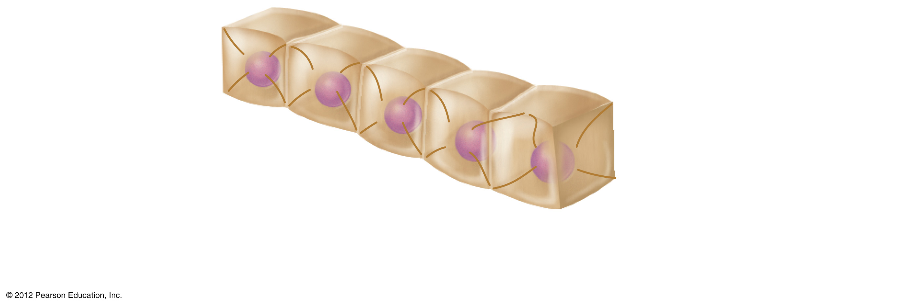
Nucleus
Epithelial
cells
Intermediate
filaments
(b) Cells that cover and line body organs
Figure 3.8b

Slide 37
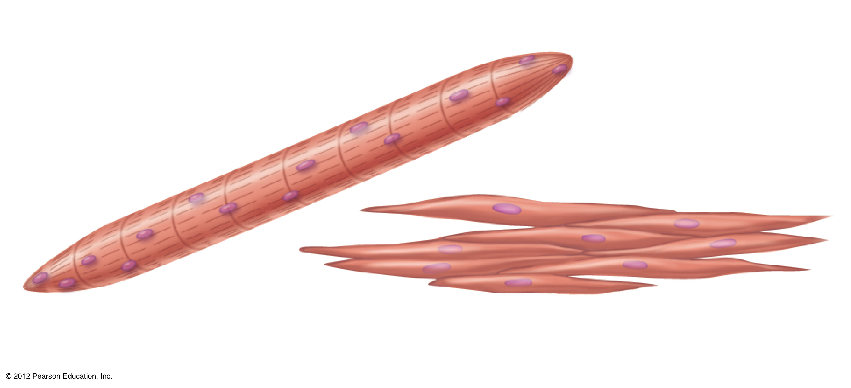
Skeletal
muscle cell
Nuclei
Contractile
filaments
Smooth
muscle cells
(c) Cells that move organs and body parts
Figure 3.8c

Slide 38
Fat cell
Lipid droplet
Nucleus
(d) Cell that stores
nutrients
Figure 3.8d

Slide 39
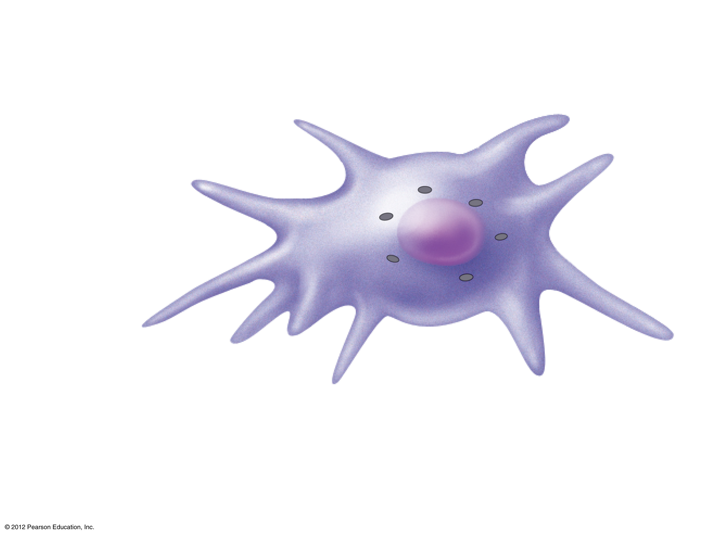
Lysosomes
Macrophage
Pseudo-
pods
(e) Cell that fights
disease
Figure 3.8e

Slide 40
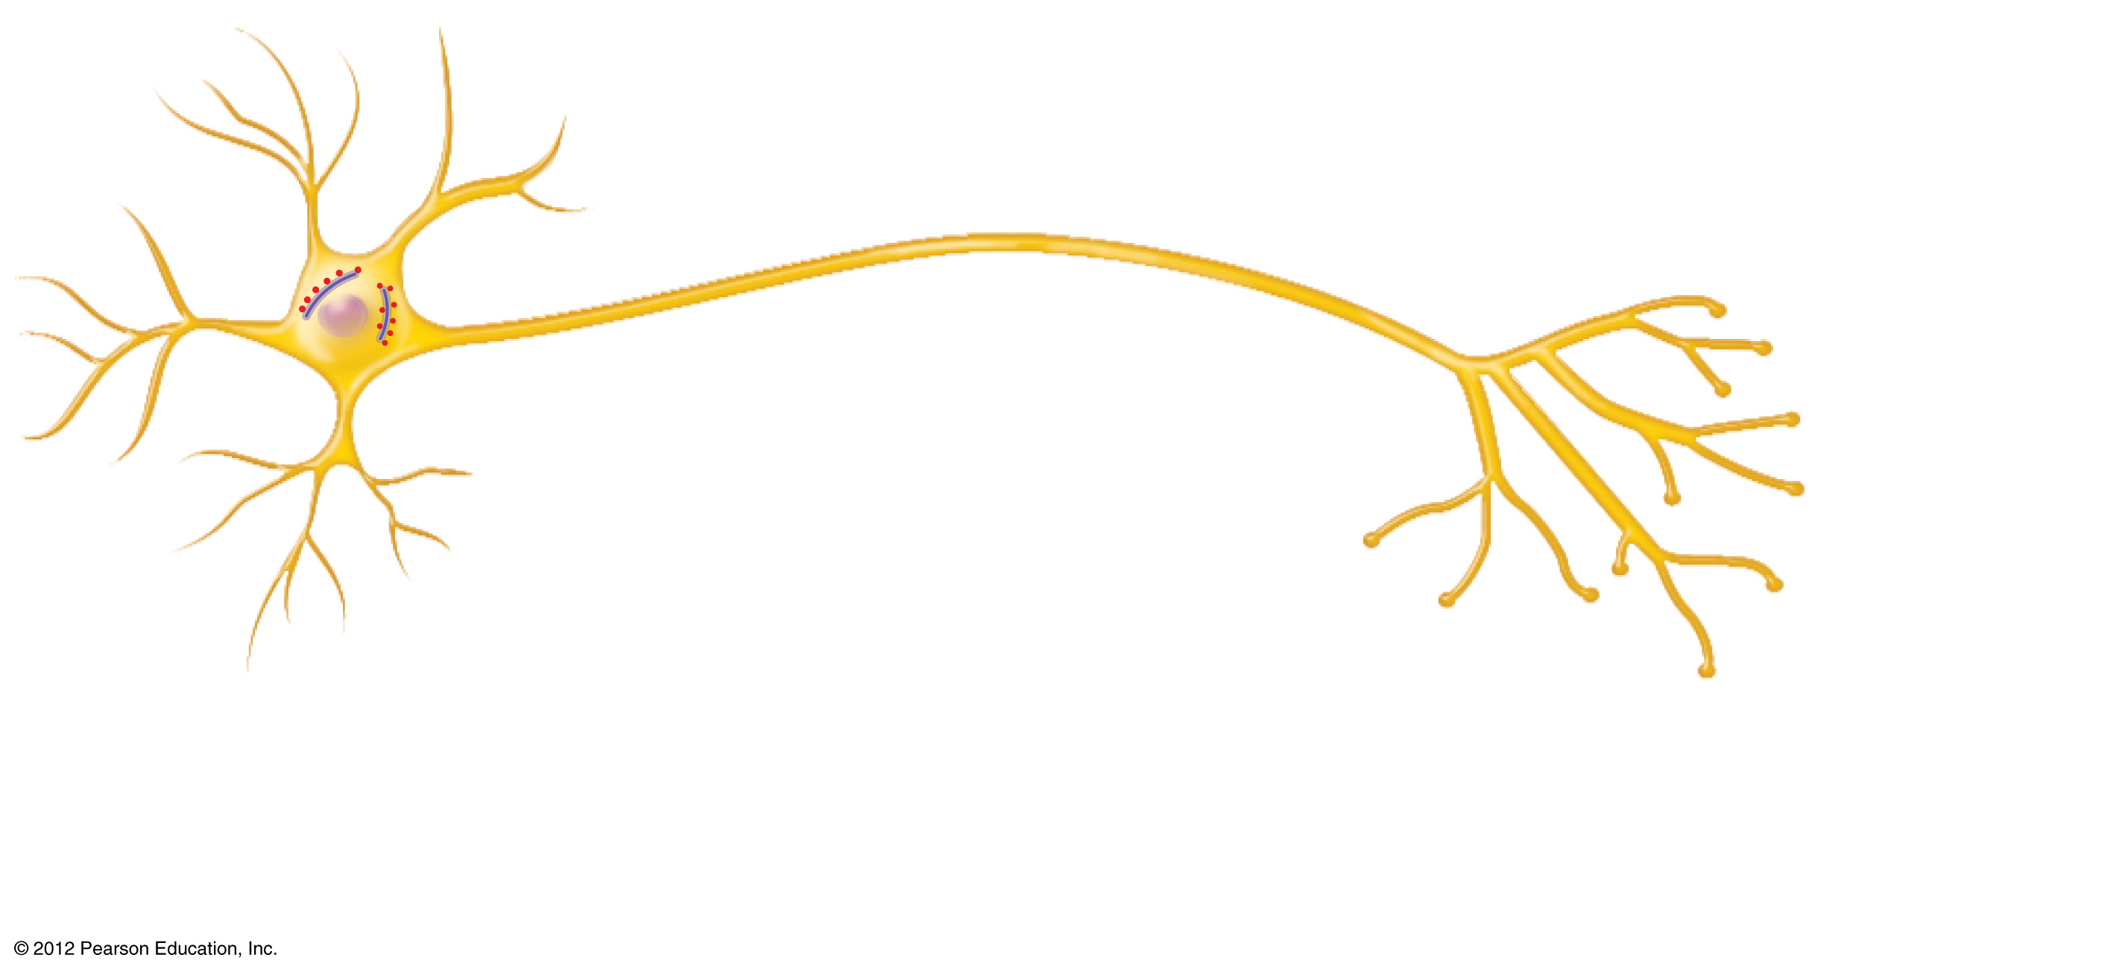
Processes
Rough ER
Nerve cell
Nucleus
(f) Cell that gathers information and controls body
functions
Figure 3.8f

Slide 41
Nucleus
Flagellum
Sperm
(g) Cell of reproduction
Figure 3.8g

