Slide 1
Body Tissues
Tissues
  Groups of cells with similar structure and function
  Four primary types
    Epithelial tissue (epithelium)
    Connective tissue
    Muscle tissue
    Nervous tissue

Slide 2
Epithelial Tissues
Locations
  Body coverings
  Body linings
  Glandular tissue
Functions
  Protection
  Absorption
  Filtration
  Secretion

Slide 3
Epithelium Characteristics
Cells fit closely together and often form sheets
The apical surface is the free surface of the tissue
The lower surface of the epithelium rests on a basement membrane
Avascular (no blood supply)
Regenerate easily if well nourished

Slide 4
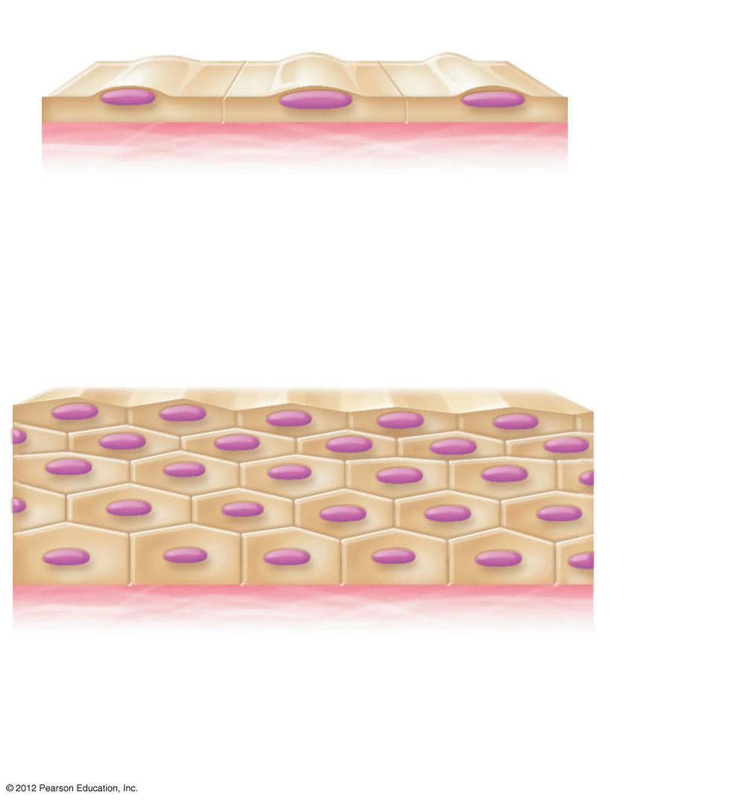
Apical surface
Basal
surface
Simple
Apical surface
Basal
surface
Stratified
(a) Classification based on number of cell layers
Figure 3.17a

Slide 5
Classification of Epithelia
Number of cell layers
  Simple—one layer
  Stratified—more than one layer

Slide 6
Apical surface
Basal
surface
Simple
Apical surface
Basal
surface
Stratified
(a) Classification based on number of cell layers
Figure 3.17a

Slide 7
Classification of Epithelia
Shape of cells
  Squamous
    flattened
  Cuboidal
    cube-shaped
  Columnar
    column-like

Slide 8
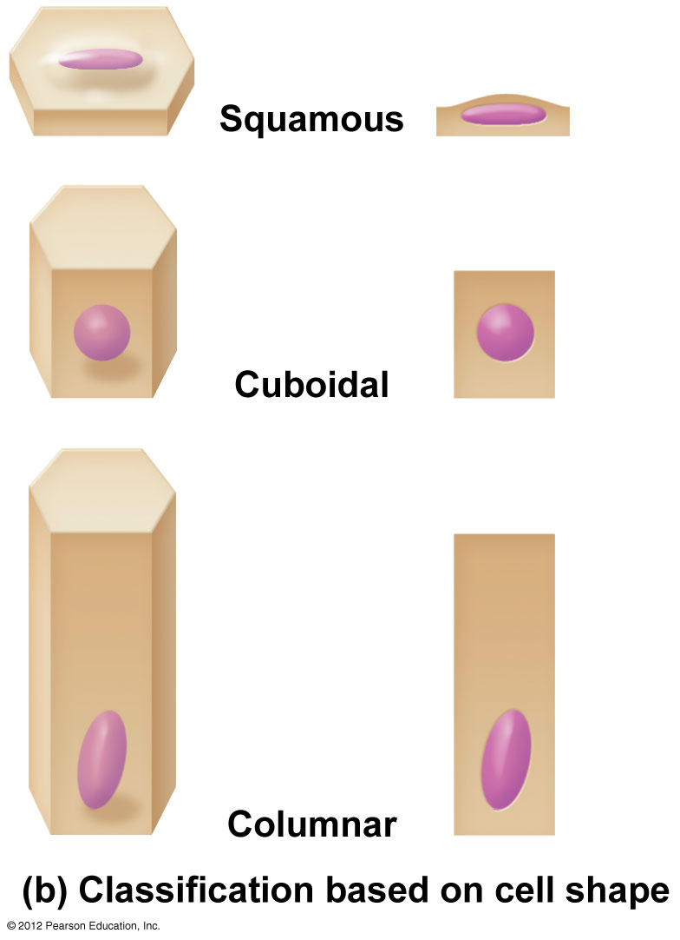
Figure 3.17b

Slide 9
Simple Epithelia
Simple squamous
  Single layer of flat cells
  Location - usually forms membranes
    Lines body cavities
    Lines lungs and capillaries
  Functions in diffusion, filtration, or secretion in membranes

Slide 10
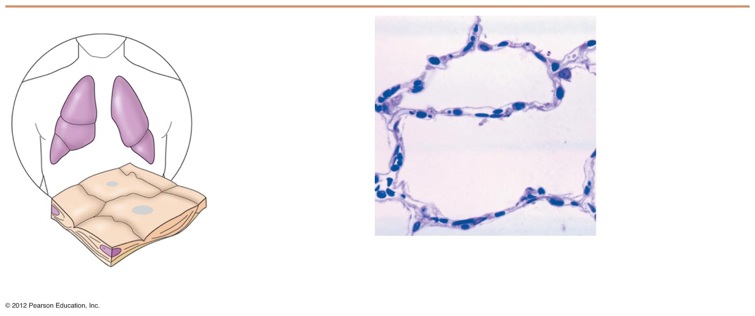
Air sacs of
lungs
Nucleus of
squamous
epithelial cell
Nuclei of
squamous
epithelial
cells
Basement
membrane
Photomicrograph: Simple
squamous epithelium forming part
of the alveolar (air sac) walls (185×).
(a) Diagram: Simple squamous
Figure 3.18a

Slide 11
Simple Epithelia
Simple cuboidal
  Single layer of cube-like cells
  Locations
    Common in glands and their ducts
    Forms walls of kidney tubules
    Covers the ovaries
  Functions in secretion and absorption; ciliated types propel mucus or reproductive cells

Slide 12
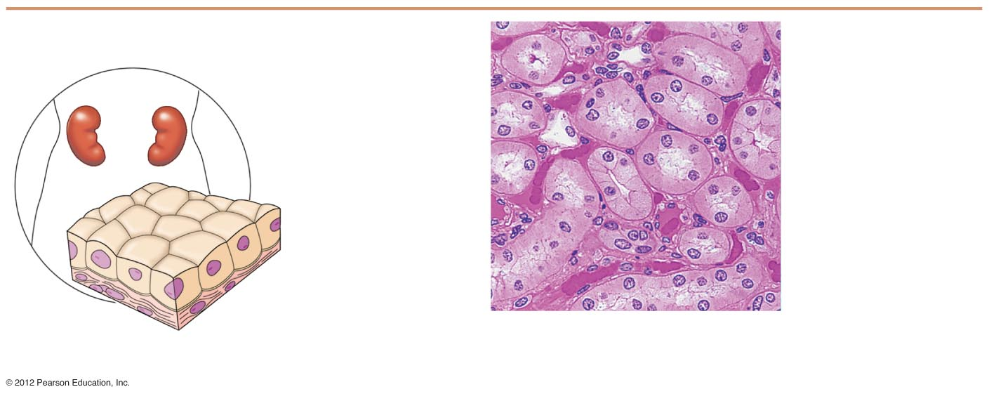
Nucleus of
simple
cuboidal
epithelial
cell
Simple
cuboidal
epithelial
cells
Basement
membrane
Basement
membrane
Connective
tissue
Photomicrograph: Simple cuboidal
epithelium in kidney tubules (250×).
(b) Diagram: Simple cuboidal
Figure 3.18b

Slide 13
Simple Epithelia
Simple columnar
  Single layer of tall cells
  Often includes mucus-producing goblet cells
  Location - lines digestive tract
  Functions in secretion and absorption; ciliated types propel mucus or reproductive cells

Slide 14
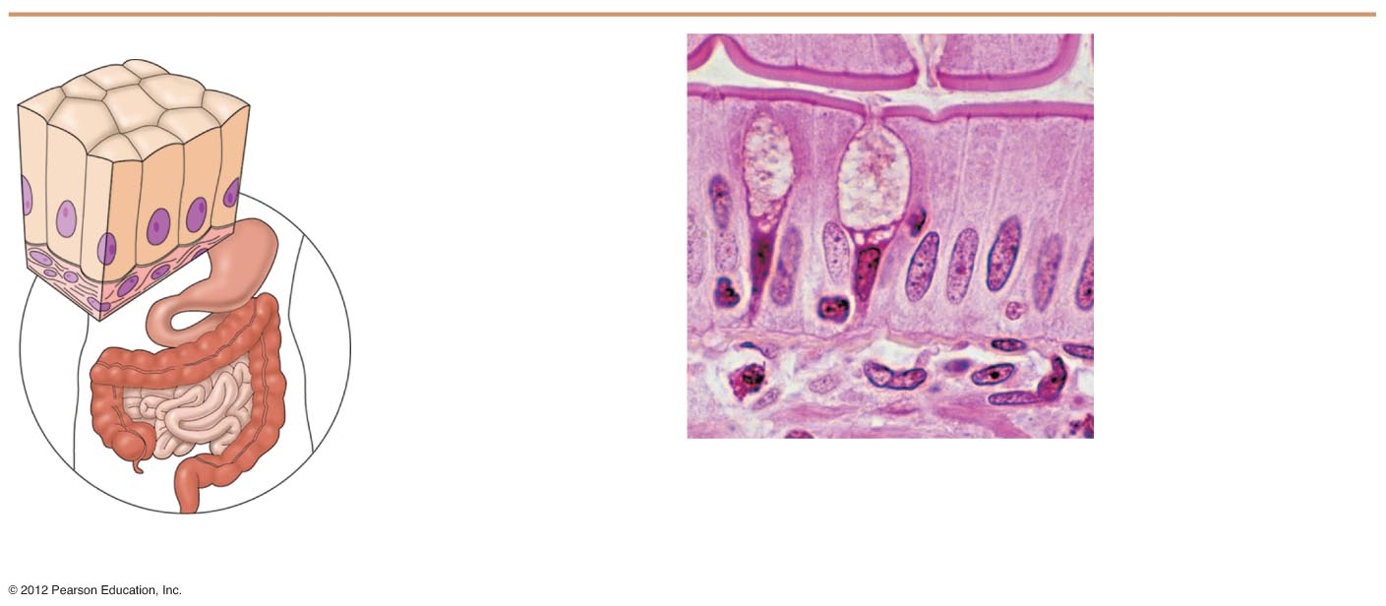
Simple
columnar
epithelial
cell
Nucleus of simple
columnar epithelial cell
Goblet cell
Basement
membrane
Connective
tissue
Basement
membrane
Photomicrograph: Simple columnar
epithelium of the small intestine
(430×).
(c) Diagram: Simple columnar
Figure 3.18c

Slide 15
Simple Epithelia
Pseudostratified columnar
  Single layer, but some cells are shorter than others
  Often looks like a double layer of cells but all cells rest on the basement membrane
  Location - respiratory tract, where it is ciliated
  Functions in absorption or secretion

Slide 16
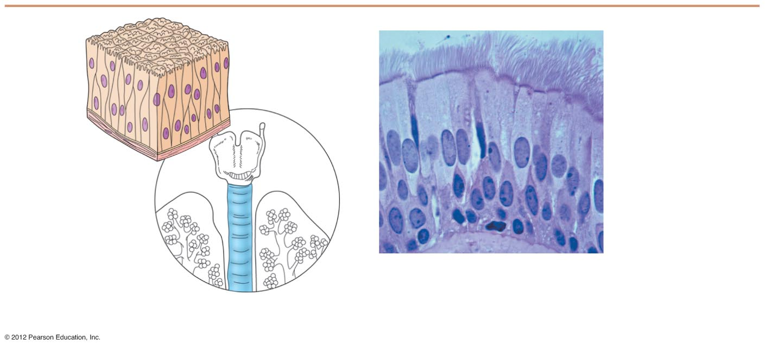
Cilia
Pseudo-
stratified
epithelial
layer
Pseudo-
stratified
epithelial
layer
Basement
membrane
Basement
membrane
Connective
tissue
Photomicrograph: Pseudostratified
ciliated columnar epithelium lining
the human trachea (430×).
(d) Diagram: Pseudostratified (ciliated)
columnar
Figure 3.18d

Slide 17
Stratified Epithelia
Stratified squamous
  Cells at the apical surface are flattened
  Functions as a protective covering where friction is common
  Locations - lining of the:
    Skin
    Mouth
    Esophagus

Slide 18
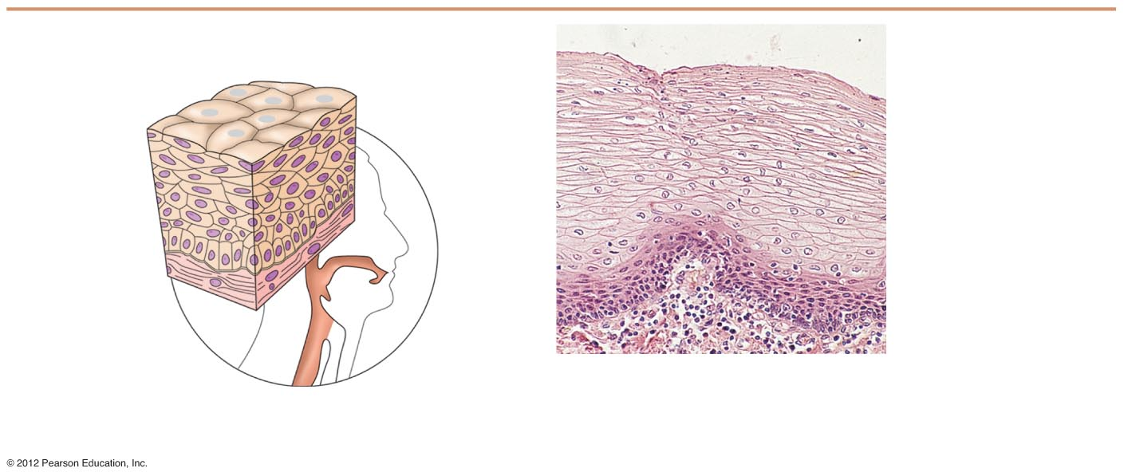
Nuclei
Stratified
squamous
epithelium
Stratified
squamous
epithelium
Basement
membrane
Basement
membrane
Photomicrograph: Stratified
squamous epithelium lining of
the esophagus (140×).
Connective
tissue
(e) Diagram: Stratified squamous
Figure 3.18e

Slide 19
Stratified Epithelia
Stratified cuboidal—two layers of cuboidal cells; functions in protection
Stratified columnar—surface cells are columnar, cells underneath vary in size and shape; functions in protection
Stratified cuboidal and columnar
  Rare in human body
  Found mainly in ducts of large glands

Slide 20
Stratified Epithelia
Transitional epithelium
  Composed of modified stratified squamous epithelium
  Shape of cells depends upon the amount of stretching
  Functions in stretching and the ability to return to normal shape
  Location - lines organs of the urinary system

Slide 21
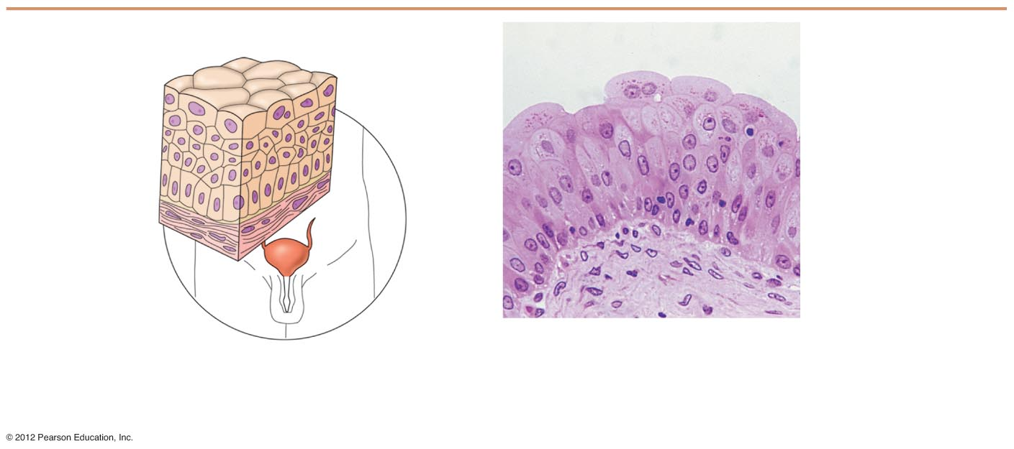
Basement
membrane
Transi-
tional
epithelium
Transitional
epithelium
Basement
membrane
Connective
tissue
Photomicrograph: Transitional epithelium lining of
the bladder, relaxed state (215×); surface rounded
cells flatten and elongate when the bladder fills
with urine.
(f) Diagram: Transitional
Figure 3.18f

Slide 22
Glandular Epithelium
Gland
  One or more cells responsible for secreting a particular product
  Secretions contain protein molecules in an aqueous (water-based) fluid

Slide 23
Glandular Epithelium
Two major gland types
  Endocrine gland
    Ductless since secretions diffuse into blood vessels
    All secretions are hormones
  Exocrine gland
    Secretions empty through ducts to the epithelial surface
    Include sweat and oil glands

Slide 24
Connective Tissue
Found everywhere in the body
Includes the most abundant and widely distributed tissues
Functions
  Binds body tissues together
  Supports the body
  Provides protection

Slide 25
Connective Tissue Characteristics
Variations in blood supply
  Some tissue types are well vascularized
  Some have a poor blood supply or are avascular
Extracellular matrix
  Non-living material that surrounds living cells

Slide 26
Extracellular Matrix
Two main elements
Ground substance—mostly water along with adhesion proteins and polysaccharide molecules
  Fibers
    Produced by the cells
    Three types
      Collagen (white) fibers
      Elastic (yellow) fibers
      Reticular fibers

Slide 27
Connective Tissue Types
Bone (osseous tissue)
  Composed of
    Bone cells in lacunae (cavities)
    Hard matrix of calcium salts
    Large numbers of collagen fibers
  Functions to protect and support the body

Slide 28
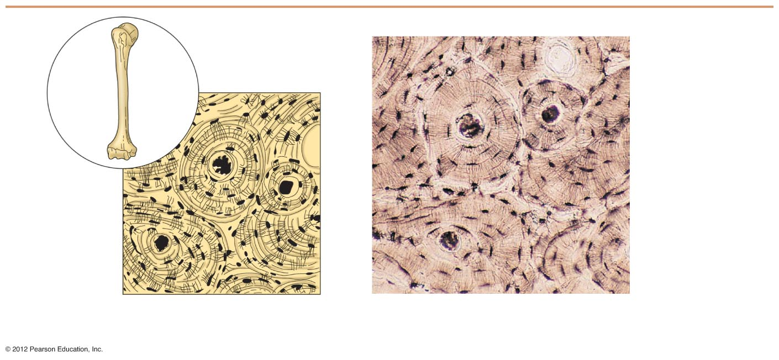
Bone cells in
lacunae
Central canal
Lacunae
Lamella
(a) Diagram: Bone
Photomicrograph: Cross-sectional view
of ground bone (300×).
Figure 3.19a

Slide 29
Connective Tissue Types
Hyaline cartilage
  Most common type of cartilage
  Composed of
    Abundant collagen fibers
    Rubbery matrix
  Locations
    Larynx
    Entire fetal skeleton prior to birth
  Functions as a more flexible skeletal element than bone

Slide 30
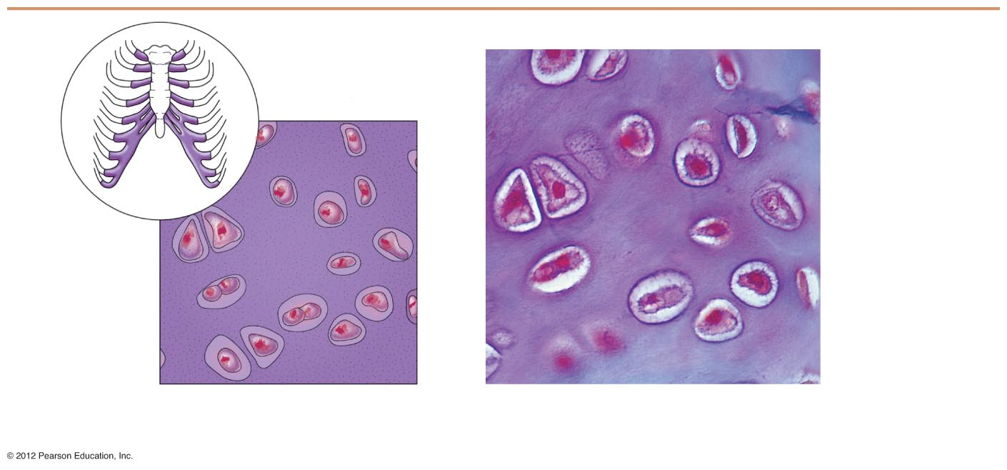
Chondrocyte
(Cartilage cell)
Chondrocyte
in lacuna
Lacunae
Matrix
(b) Diagram: Hyaline cartilage
Photomicrograph: Hyaline cartilage
from the trachea (500×).
Figure 3.19b

Slide 31
Connective Tissue Types
Elastic cartilage
  Provides elasticity
  Location
    Supports the external ear
Fibrocartilage
  Highly compressible
  Location
    Forms cushion-like discs between vertebrae

Slide 32
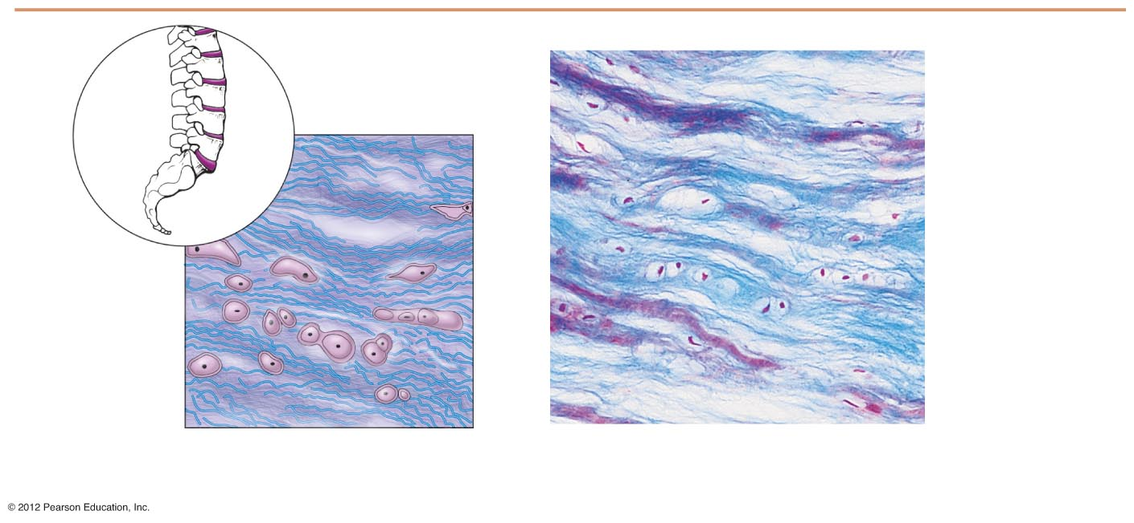
Chondrocytes
in lacunae
Chondro-
cites in
lacunae
Collagen fiber
Collagen
fibers
(c) Diagram: Fibrocartilage
Photomicrograph: Fibrocartilage of an
intervertebral disc (110×).
Figure 3.19c

Slide 33
Connective Tissue Types
Dense connective tissue (dense fibrous tissue)
  Main matrix element is collagen fiber
  Fibroblasts are cells that make fibers
  Locations
    Tendons—attach skeletal muscle to bone
    Ligaments—attach bone to bone at joints
    Dermis—lower layers of the skin

Slide 34
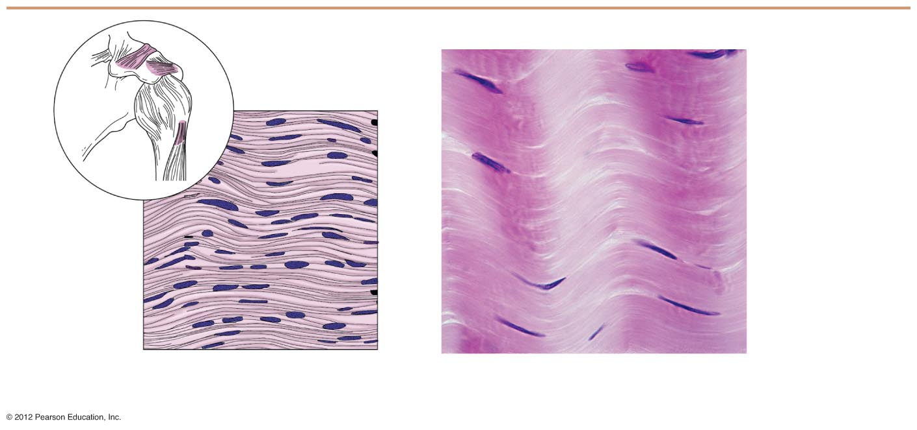
Ligament
Tendon
Collagen
fibers
Collagen
fibers
Nuclei of
fibroblasts
Nuclei of
fibroblasts
(d) Diagram: Dense fibrous
Photomicrograph: Dense fibrous connective tissue
from a tendon (500×).
Figure 3.19d

Slide 35
Connective Tissue Types
Loose connective tissue types
  Areolar tissue
    Most widely distributed connective tissue
    Soft, pliable tissue like “cobwebs”
    Functions as a packing tissue
    Contains all fiber types
    Can soak up excess fluid (causes edema)

Slide 36
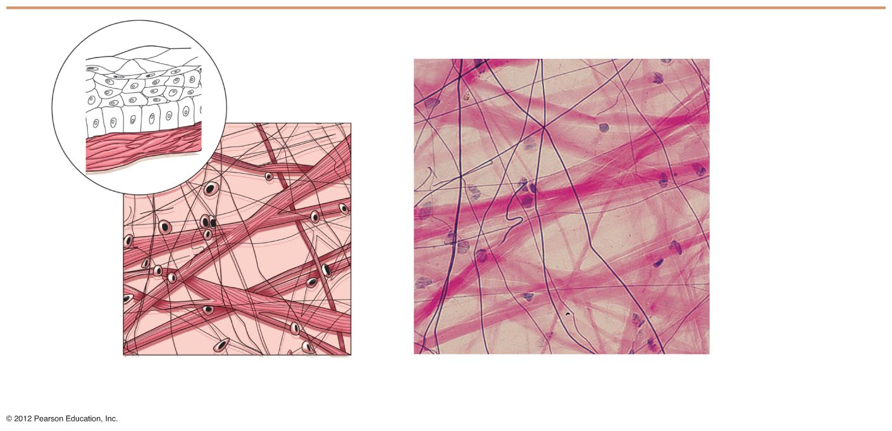
Mucosa
epithelium
Lamina
propria
Elastic
fibers
Collagen
fibers
Fibers of
matrix
Fibroblast
nuclei
Nuclei of
fibroblasts
(e) Diagram: Areolar
Photomicrograph: Areolar connective tissue, a
soft packaging tissue of the body (300×).
Figure 3.19e

Slide 37
Connective Tissue Types
Loose connective tissue types
  Adipose tissue
    Matrix is an areolar tissue in which fat globules predominate
    Many cells contain large lipid deposits
    Functions
      Insulates the body
      Protects some organs
      Serves as a site of fuel storage

Slide 38
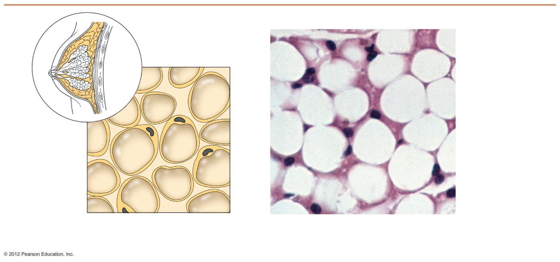
Nuclei of
fat cells
Vacuole
containing
fat droplet
Nuclei of
fat cells
Vacuole
containing
fat droplet
(f) Diagram: Adipose
Photomicrograph: Adipose tissue from the
subcutaneous layer beneath the skin (430×).
Figure 3.19f

Slide 39
Connective Tissue Types
Loose connective tissue types
  Reticular connective tissue
    Delicate network of interwoven fibers
    Locations
      Forms stroma (internal supporting network) of lymphoid organs
        Lymph nodes
        Spleen
        Bone marrow

Slide 40
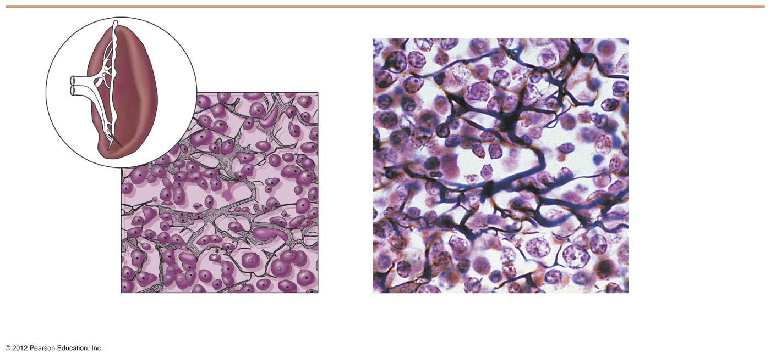
Spleen
White blood cell
(lymphocyte)
Reticular
cell
Reticular fibers
Blood
cell
Reticular
fibers
(g) Diagram: Reticular
Photomicrograph: Dark-staining network
of reticular connective tissue (430×).
Figure 3.19g

Slide 41
Connective Tissue Types
Blood (vascular tissue)
  Blood cells surrounded by fluid matrix called blood plasma
  Fibers are visible during clotting
  Functions as the transport vehicle for materials

Slide 42
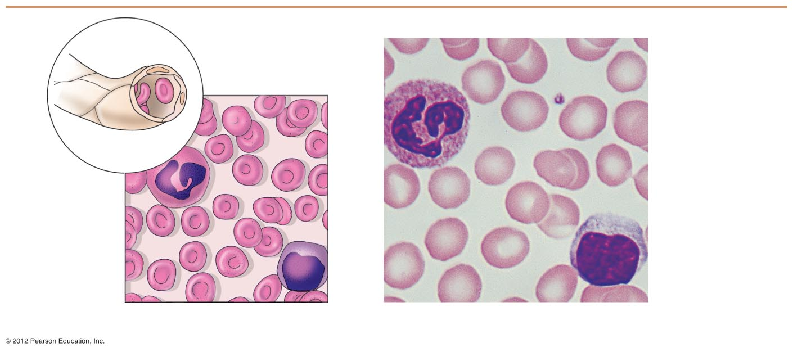
Blood cells
in capillary
Neutrophil
(white blood
cell)
White
blood cell
Red blood
cells
Monocyte
(white blood
cell)
Red
blood cells
(h) Diagram: Blood
Photomicrograph: Smear of human blood (1300×)
Figure 3.19h

Slide 43
Muscle Tissue
Function is to produce movement
Three types
  Skeletal muscle
  Cardiac muscle
  Smooth muscle

Slide 44
Muscle Tissue Types
Skeletal muscle
  Under voluntary control
  Contracts to pull on bones or skin
  Produces gross body movements or facial expressions
  Characteristics of skeletal muscle cells
    Striated
    Multinucleate (more than one nucleus)
    Long, cylindrical cells

Slide 45
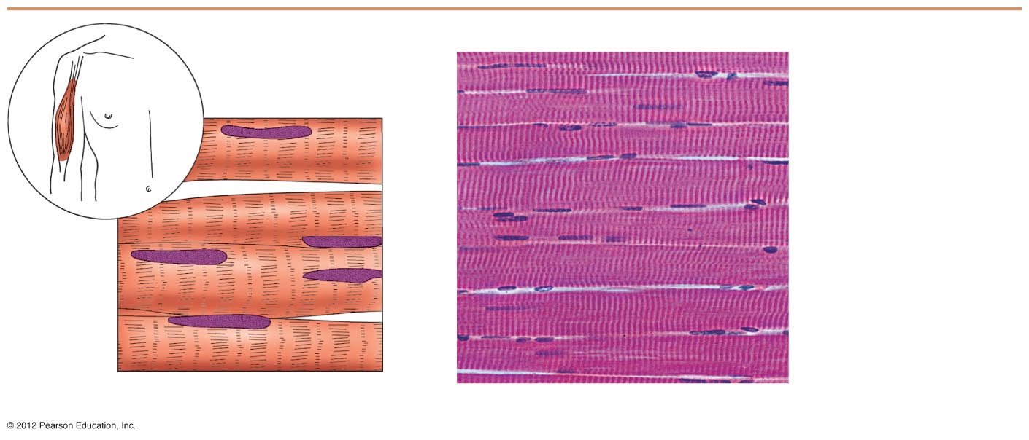
Nuclei
Part of muscle
fiber
(a) Diagram: Skeletal muscle
Photomicrograph: Skeletal muscle (approx. 300×).
Figure 3.20a

Slide 46
Muscle Tissue Types
Cardiac muscle
  Under involuntary control
  Found only in the heart
  Function is to pump blood
  Characteristics of cardiac muscle cells
    Striated
    One nucleus per cell
    Cells are attached to other cardiac muscle cells at intercalated disks

Slide 47
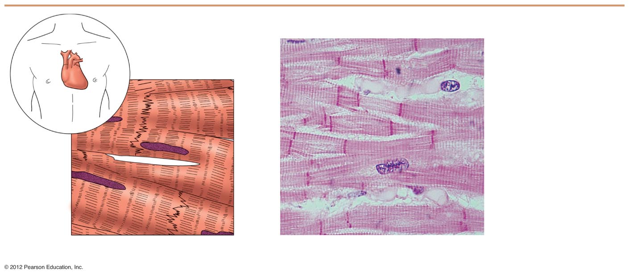
Intercalated
discs
Nucleus
(b) Diagram: Cardiac muscle
Photomicrograph: Cardiac muscle (430×).
Figure 3.20b

Slide 48
Muscle Tissue Types
Smooth muscle
  Under involuntary muscle
  Found in walls of hollow organs such as stomach, uterus, and blood vessels
  Characteristics of smooth muscle cells
    No visible striations
    One nucleus per cell
    Spindle-shaped cells

Slide 49
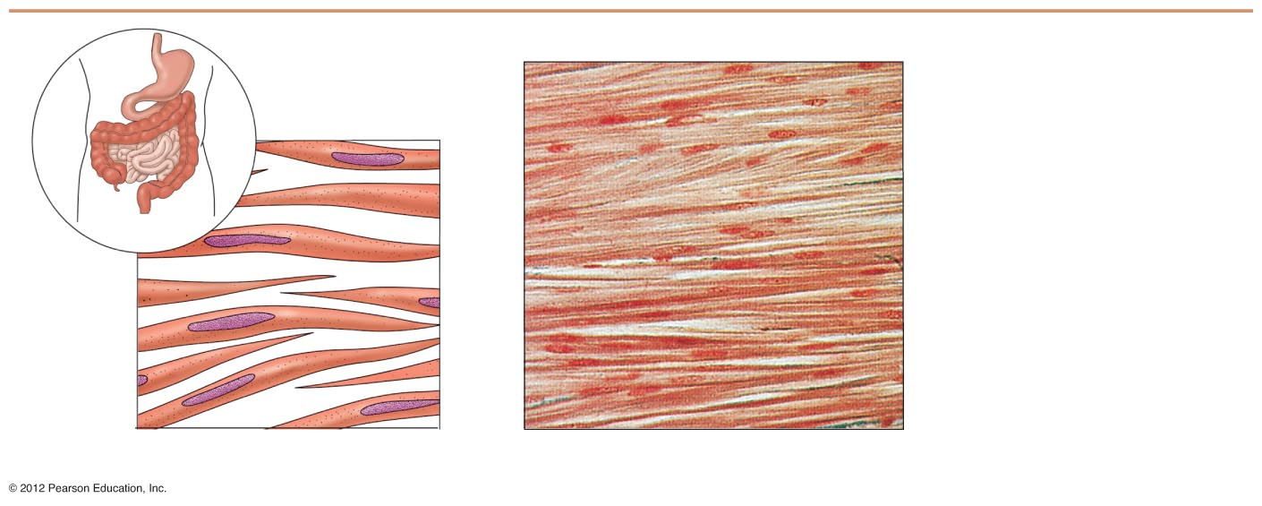
Smooth
muscle cell
Nuclei
(c) Diagram: Smooth muscle
Photomicrograph: Sheet of smooth muscle (approx. 300×).
Figure 3.20c

Slide 50
Nervous Tissue
Composed of neurons and nerve support cells
Function is to send impulses to other areas of the body
  Irritability
  Conductivity
Support cells called neuroglia insulate, protect, and support neurons

Slide 51
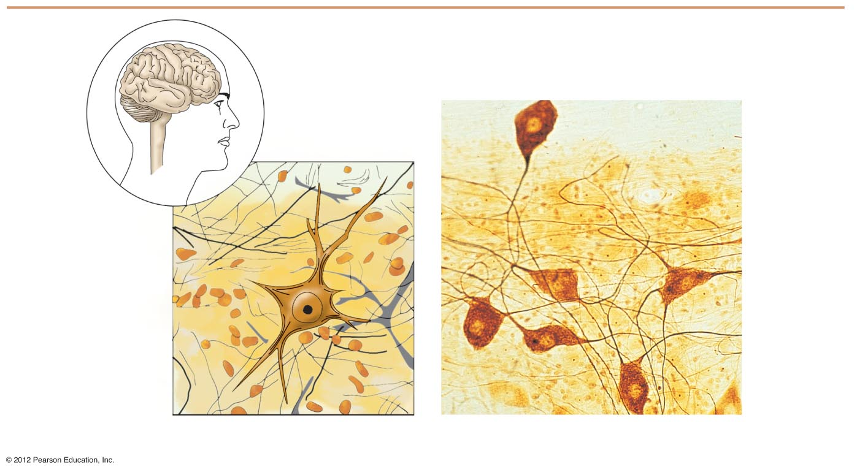
Brain
Nuclei of
supporting
cells
Spinal
cord
Cell body
of neuron
Nuclei of
supporting
cells
Cell body
of neuron
Neuron
processes
Neuron
processes
Diagram: Nervous tissue
Photomicrograph: Neurons (150×)
Figure 3.21

Slide 52
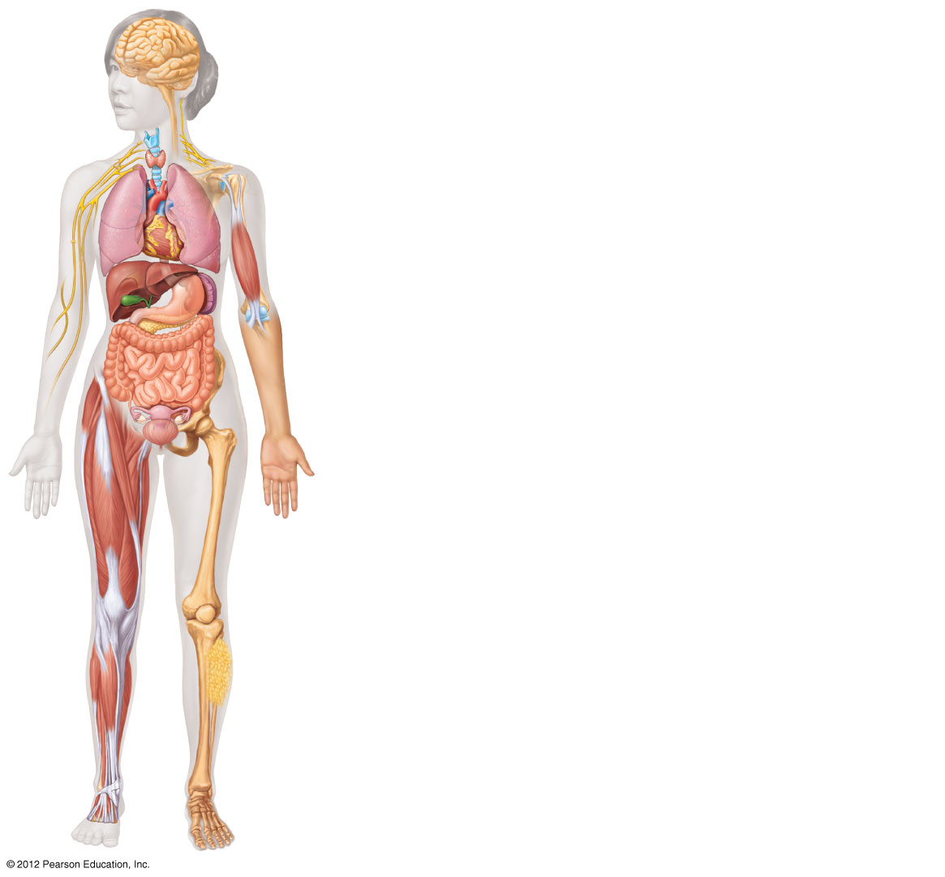
Nervous tissue: Internal communication
• Brain, spinal cord, and nerves
Muscle tissue: Contracts to cause movement
• Muscles attached to bones (skeletal)
• Muscles of heart (cardiac)
• Muscles of walls of hollow organs (smooth)
Epithelial tissue: Forms boundaries between different
environments, protects, secretes, absorbs, filters
• Lining of GI tract organs and other hollow organs
• Skin surface (epidermis)
Connective tissue: Supports, protects, binds
other tissues together
• Bones
• Tendons
• Fat and other soft padding tissue
Figure 3.22

Slide 53
Tissue Repair (Wound Healing)
Regeneration
  Replacement of destroyed tissue by the same kind of cells
Fibrosis
  Repair by dense (fibrous) connective tissue (scar tissue)
Whether regeneration or fibrosis occurs depends on:
  Type of tissue damaged
  Severity of the injury

Slide 54
Events in Tissue Repair
Inflammation
  Capillaries become very permeable
  Clotting proteins migrate into the area from the blood stream
  A clot walls off the injured area
Granulation tissue forms
  Growth of new capillaries
  Rebuild collagen fibers
Regeneration of surface epithelium
  Scab detaches

Slide 55
Regeneration of Tissues
Tissues that regenerate easily
  Epithelial tissue (skin and mucous membranes)
  Fibrous connective tissues and bone
Tissues that regenerate poorly
  Skeletal muscle
Tissues that are replaced largely with scar tissue
  Cardiac muscle
  Nervous tissue within the brain and spinal cord

Slide 56
Developmental Aspects of Tissue
Epithelial tissue arises from all three primary germ layers
Muscle and connective tissue arise from the mesoderm
Nervous tissue arises from the ectoderm
With old age, there is a decrease in mass and viability in most tissues

