Slide 1
Solutions and Transport
Solution—homogeneous mixture of two or more components
  Solvent—dissolving medium; typically water in the body
  Solutes—components in smaller quantities within a solution
Intracellular fluid—nucleoplasm and cytosol
Interstitial fluid—fluid on the exterior of the cell

Slide 2
Selective Permeability
The plasma membrane allows some materials to pass while excluding others.
This permeability influences movement both into and out of the cell.

Slide 3
Cell Physiology: Membrane Transport
Membrane transport—movement of substances into and out of the cell
Cell membranes are selectively permeable (some substances can pass through but others cannot)
Two basic methods of transport
  Passive processes
    No energy is required
  Active processes
    Cell must provide metabolic energy (ATP)

Slide 4
Passive Processes
Diffusion
  Particles tend to distribute themselves evenly within a solution
  Movement is from high concentration to low concentration, or down a concentration gradient

Slide 5
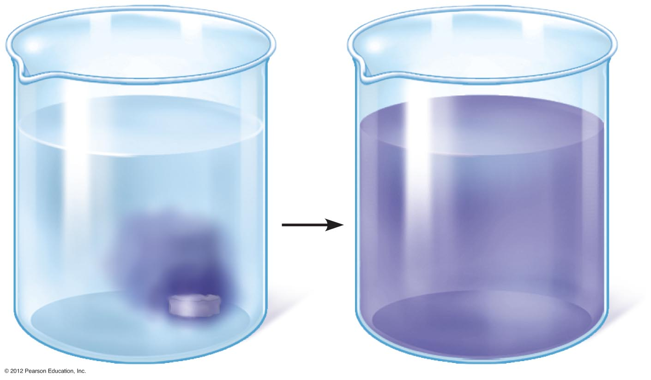
Figure 3.9

Slide 6
Passive Processes
Types of diffusion
  Simple diffusion
    An unassisted process
    Solutes are lipid-soluble materials or small enough to pass through membrane pores

Slide 7
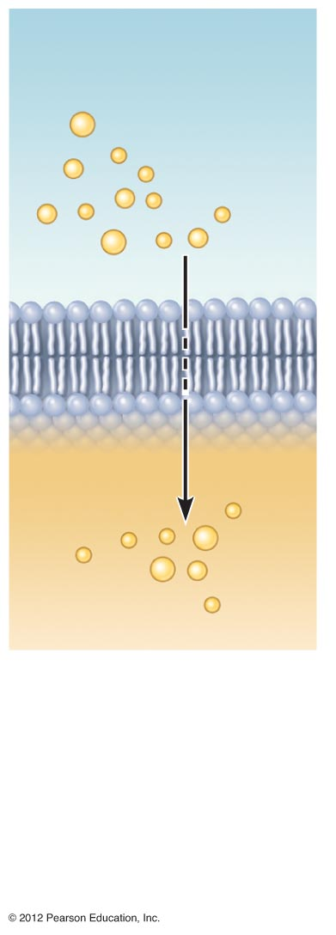
Extracellular fluid
Lipid-
soluble
solutes
Cytoplasm
(a) Simple diffusion
of fat-soluble
molecules
directly through
the phospholipid
bilayer
Figure 3.10a

Slide 8
Passive Processes
Types of diffusion (continued)
  Osmosis—simple diffusion of water
    Highly polar water molecules easily cross the plasma membrane through aquaporins

Slide 9
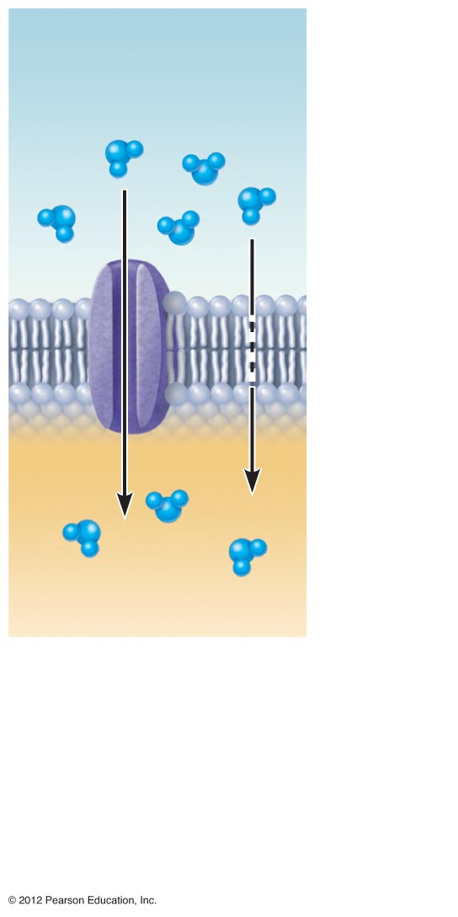
Water
molecules
Lipid
bilayer
(d) Osmosis, diffusion
of water through a
specific channel
protein (aquaporin)
or through the lipid
bilayer
Figure 3.10d

Slide 10
Passive Processes
Facilitated diffusion
    Substances require a protein carrier for passive transport
    Transports lipid-insoluble and large substances

Slide 11
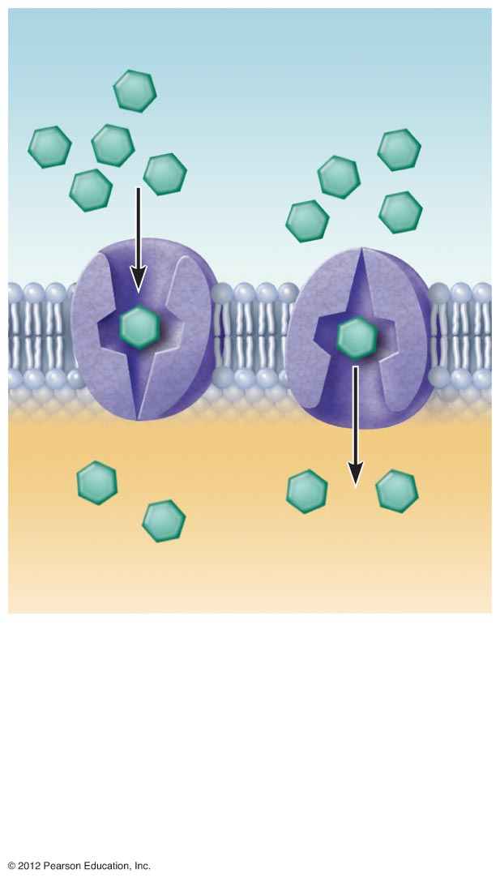
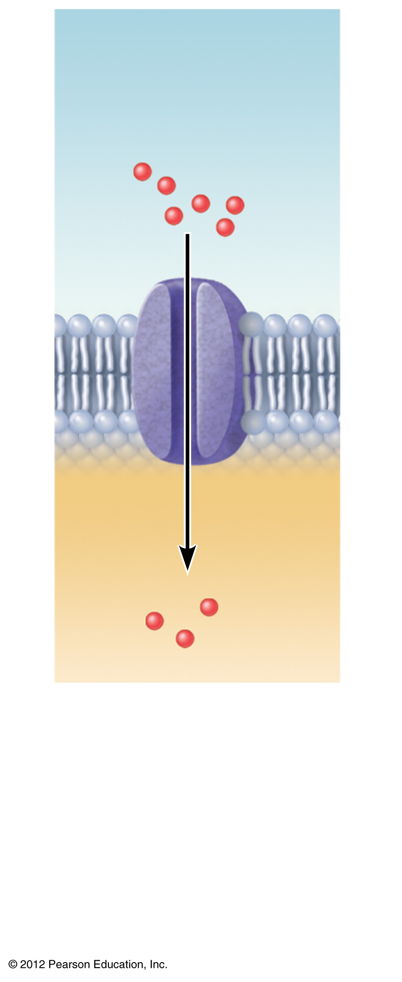
Lipid-
insoluble
solutes
Small lipid-
insoluble
solutes
(b) Carrier-mediated facilitated
diffusion via protein carrier
specific for one chemical;
binding of substrate causes
shape change in transport
protein
(c) Channel-mediated
facilitated diffusion
through a channel
protein; mostly ions
selected on basis
of size and charge
Figure 3.10b–c

Slide 12
Passive Processes
Filtration
  Water and solutes are forced through a membrane by fluid, or hydrostatic pressure
  A pressure gradient must exist
    Solute-containing fluid is pushed from a high-pressure area to a lower pressure area

Slide 13
Active Processes
Substances are transported that are unable to pass by diffusion
  Substances may be too large
  Substances may not be able to dissolve in the fat core of the membrane
  Substances may have to move against a concentration gradient
ATP is used for transport

Slide 14
Active Processes
Two common forms of active transport
  Active transport (solute pumping)
  Vesicular transport
    Exocytosis
    Endocytosis
      Phagocytosis
      Pinocytosis

Slide 15
Active Processes
Active transport (solute pumping)
  Amino acids, some sugars, and ions are transported by protein carriers called solute pumps
  ATP energizes protein carriers
  In most cases, substances are moved against concentration gradients

Slide 16
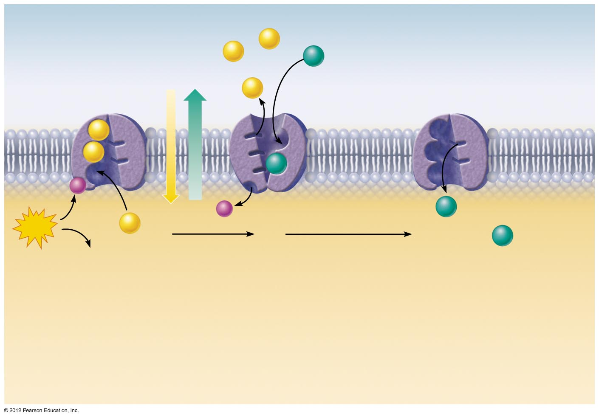
Extracellular fluid
Na⁺
Na⁺
K⁺
Na⁺
Na⁺
Na⁺
K⁺
P
P
K⁺
ATP
Na⁺
1
2
3
K⁺
ADP
2
3
Binding of cytoplasmic
Na⁺ to the pump protein
stimulates phosphorylation
by ATP, which causes the
pump protein to change its
shape.
The shape change expels
Na⁺ to the outside.
Extracellular K⁺ binds,
causing release of the
phosphate group.
Loss of phosphate
restores the original
conformation of the pump
protein. K⁺ is released to the
cytoplasm and Na⁺ sites are
ready to bind Na⁺ again; the
cycle repeats.
1
Cytoplasm
Figure 3.11

Slide 17
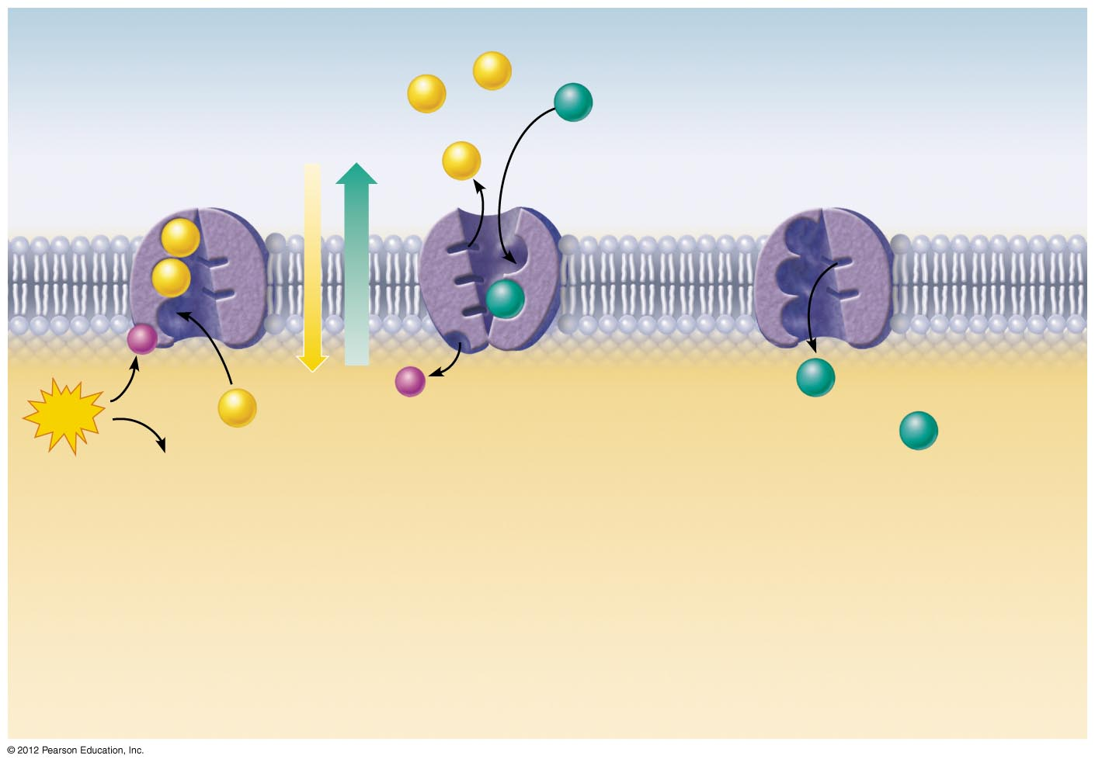
Extracellular fluid
Na⁺
Na⁺
P
ATP
Na⁺
1
ADP
Binding of cytoplasmic
Na⁺ to the pump protein
stimulates phosphorylation
by ATP, which causes the
pump protein to change its
shape.
1
Cytoplasm
Figure 3.11, step 1

Slide 18
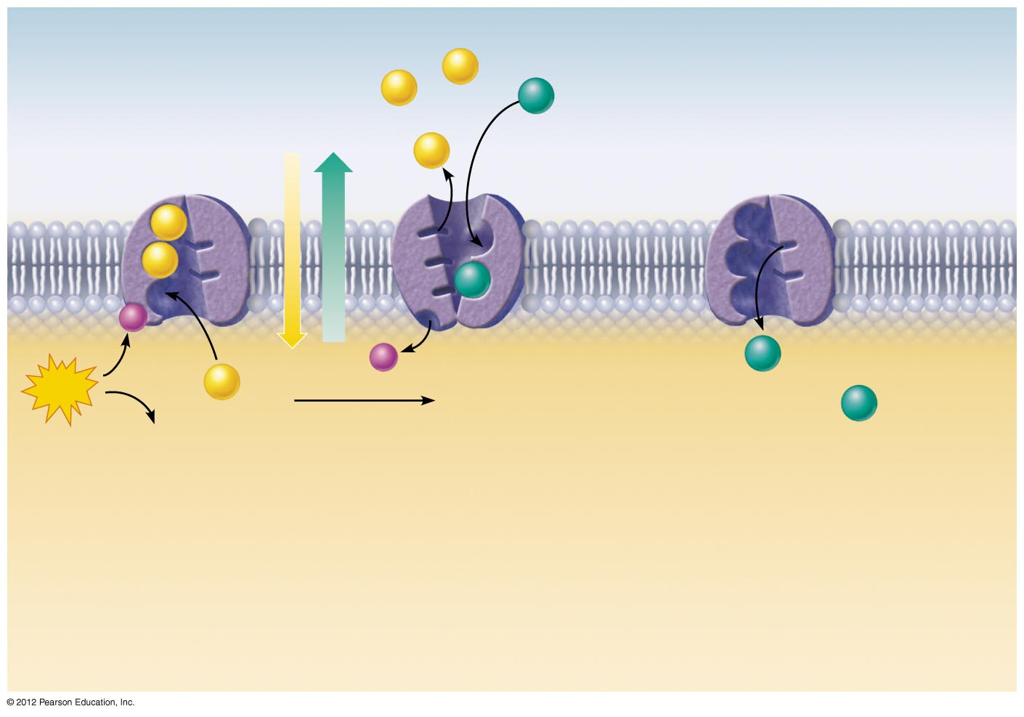
Extracellular fluid
Na⁺
Na⁺
K⁺
Na⁺
Na⁺
Na⁺
K⁺
P
P
ATP
Na⁺
1
2
ADP
2
Binding of cytoplasmic
Na⁺ to the pump protein
stimulates phosphorylation
by ATP, which causes the
pump protein to change its
shape.
The shape change expels
Na⁺ to the outside.
Extracellular K⁺ binds,
causing release of the
phosphate group.
1
Cytoplasm
Figure 3.11, step 2

Slide 19
Extracellular fluid
Na⁺
Na⁺
K⁺
Na⁺
Na⁺
Na⁺
K⁺
P
P
K⁺
ATP
Na⁺
1
2
3
K⁺
ADP
2
3
Binding of cytoplasmic
Na⁺ to the pump protein
stimulates phosphorylation
by ATP, which causes the
pump protein to change its
shape.
The shape change expels
Na⁺ to the outside.
Extracellular K⁺ binds,
causing release of the
phosphate group.
Loss of phosphate
restores the original
conformation of the pump
protein. K⁺ is released to the
cytoplasm and Na⁺ sites are
ready to bind Na⁺ again; the
cycle repeats.
1
Cytoplasm
Figure 3.11, step 3

Slide 20
Active Processes
Vesicular transport
  Exocytosis
    Moves materials out of the cell
    Material is carried in a membranous vesicle
    Vesicle migrates to plasma membrane
    Vesicle combines with plasma membrane
    Material is emptied to the outside

Slide 21
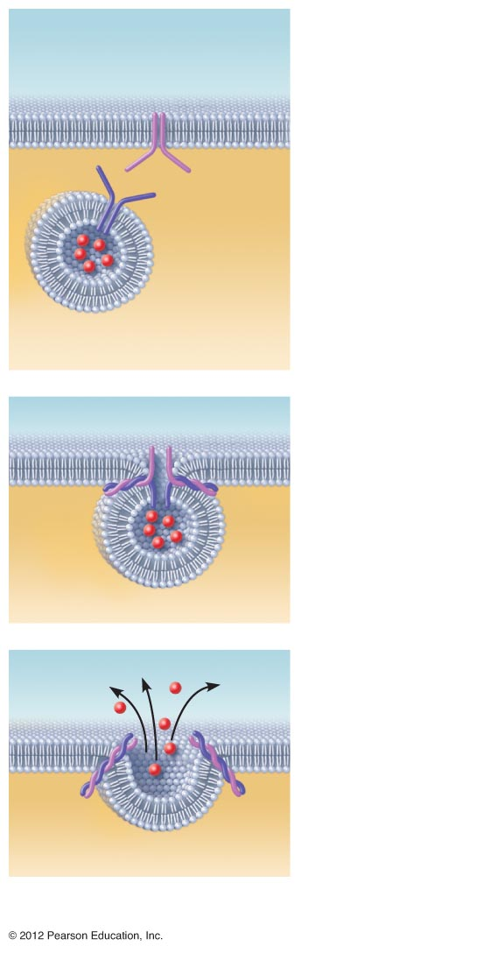
Extracellular
fluid
Plasma
membrane
SNARE
(t-SNARE)
1
The membrane-
bound vesicle
migrates to the
plasma membrane.
Vesicle
SNARE
(v-SNARE)
Molecule
to be
secreted
Secretory
vesicle
Cytoplasm
Fusion pore formed
2
There,
v-SNAREs bind
with t-SNAREs, the
vesicle and plasma
membrane fuse,
and a pore opens
up.
Fused
SNAREs
3
Vesicle
contents are
released to the
cell exterior.
(a) The process of exocytosis
Figure 3.12a

Slide 22
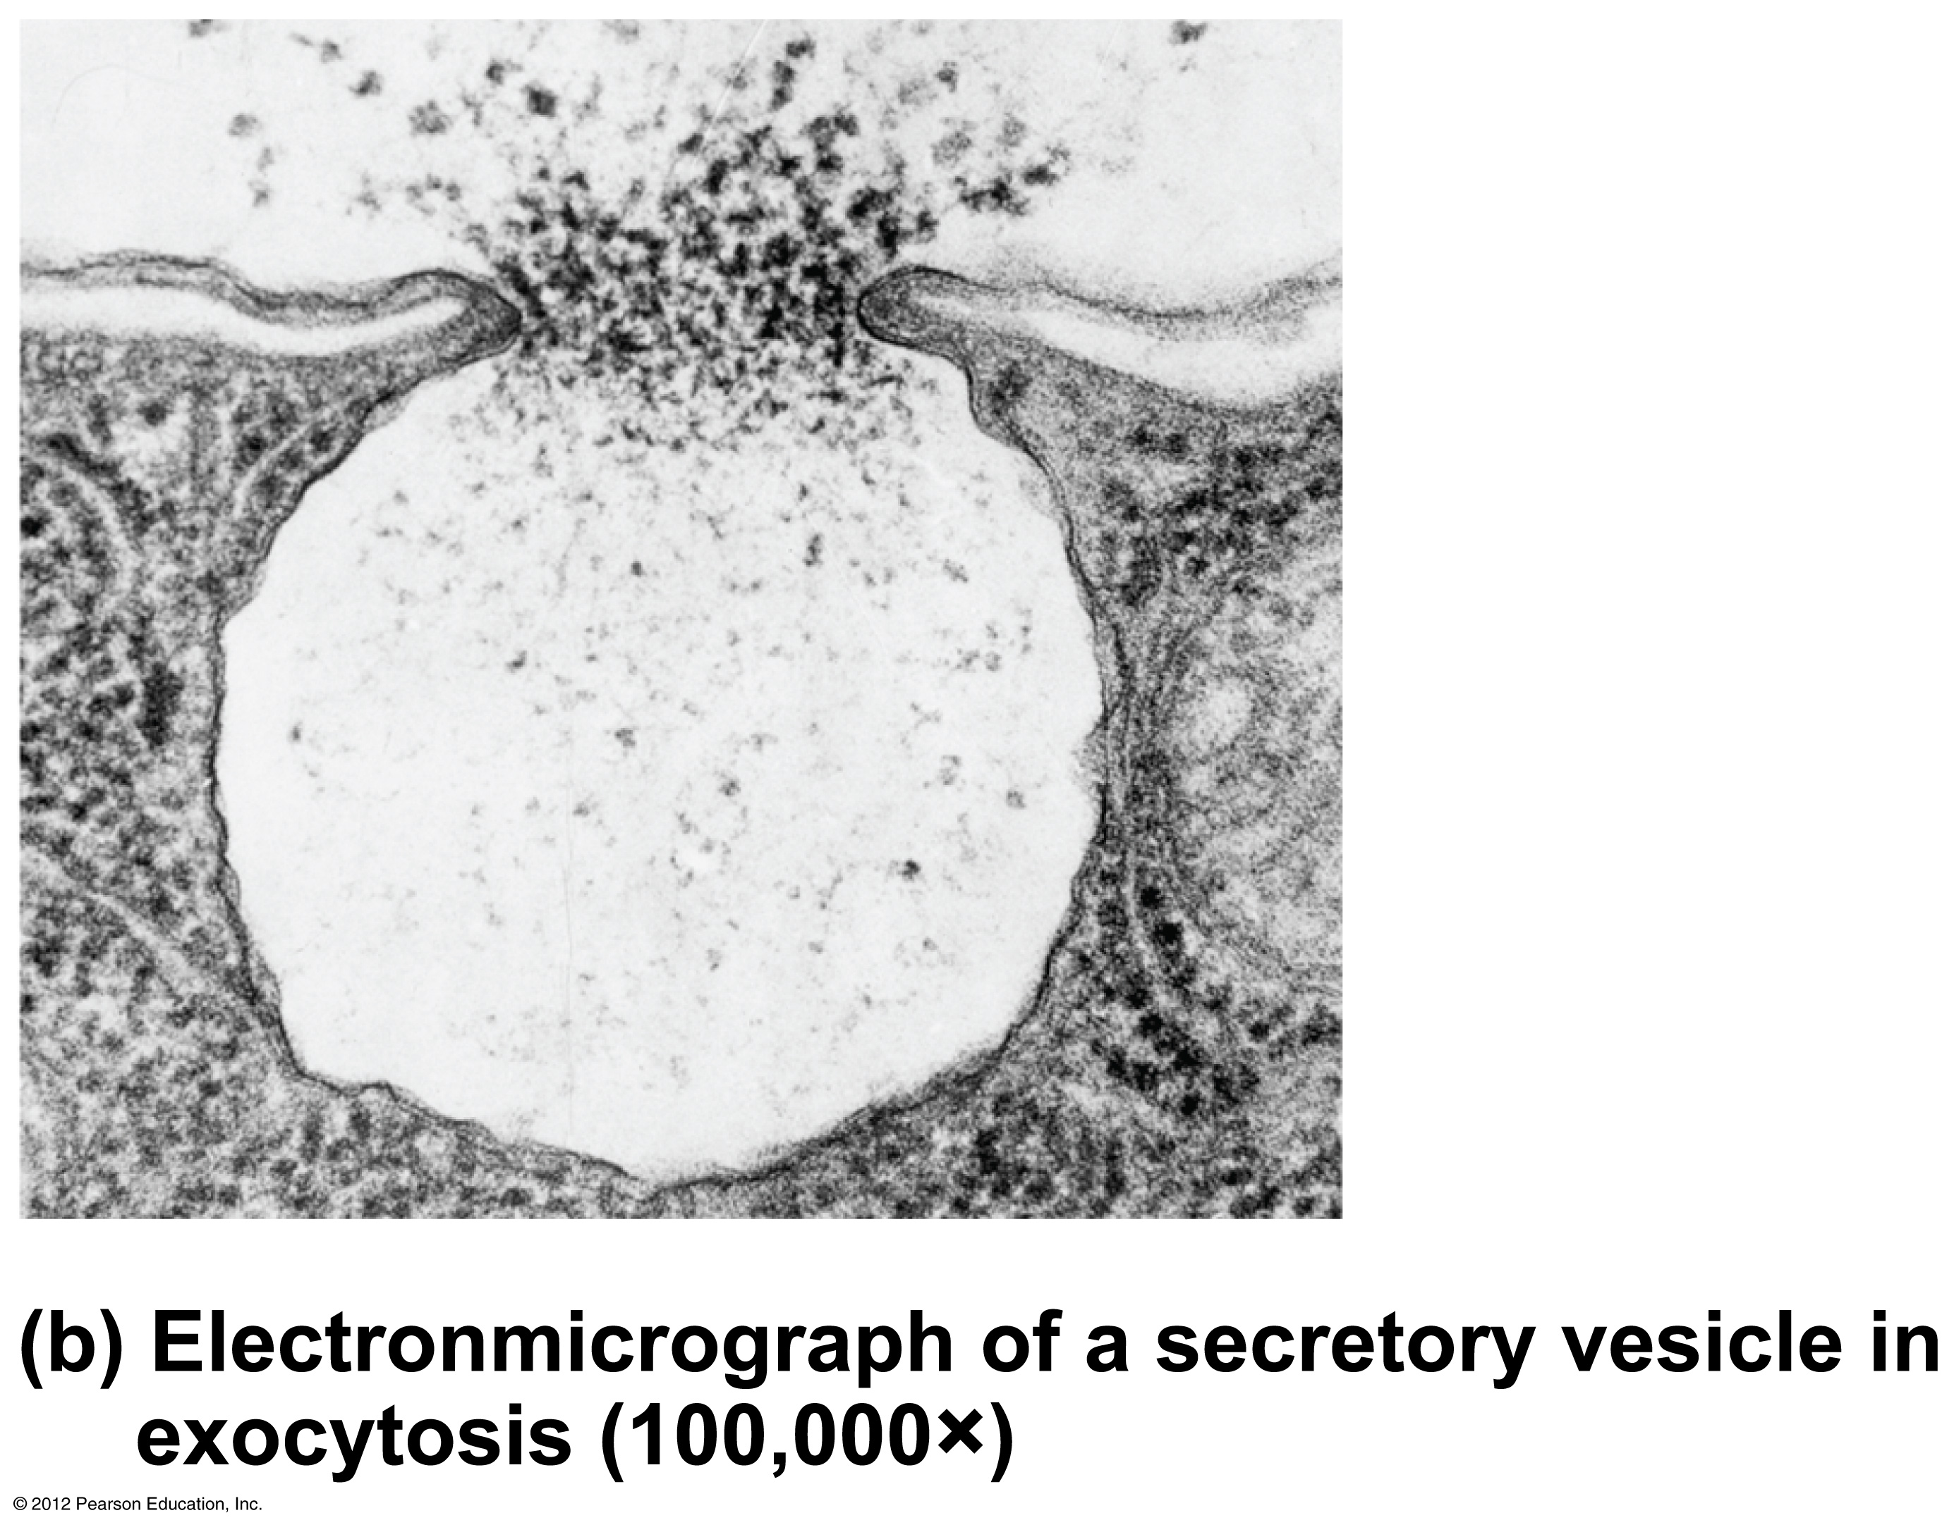
Figure 3.12b

Slide 23
Active Processes
Vesicular transport (continued)
  Endocytosis
    Extracellular substances are engulfed by being enclosed in a membranous vescicle
  Types of endocytosis
    Phagocytosis—“cell eating”
    Pinocytosis—“cell drinking”

Slide 24
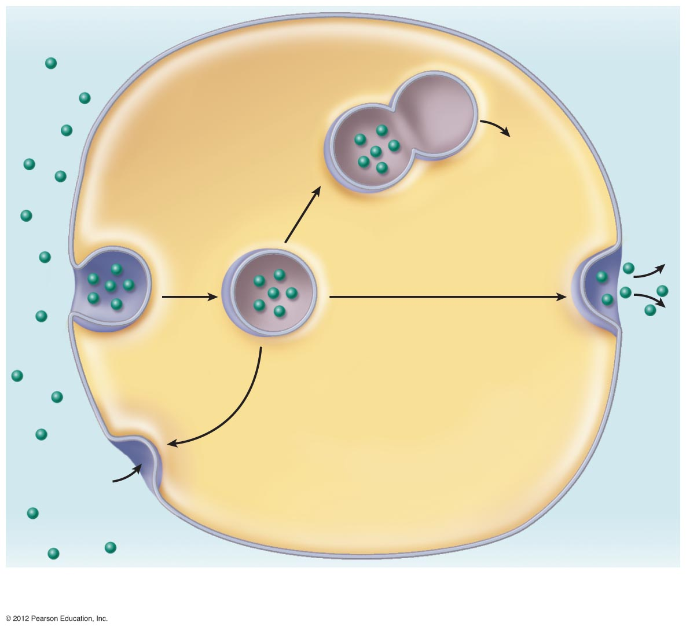
Extracellular
fluid
Cytosol
Plasma
membrane
Vesicle
Lysosome
1
Vesicle
fusing with
lysosome
for digestion
Release of
contents to
cytosol
Ingested
substance
2
Transport to plasma
membrane and exocytosis
of vesicle contents
Detached vesicle
containing ingested
material
3
Membranes and
receptors (if present)
recycled to plasma
membrane
Pit
Figure 3.13a

Slide 25
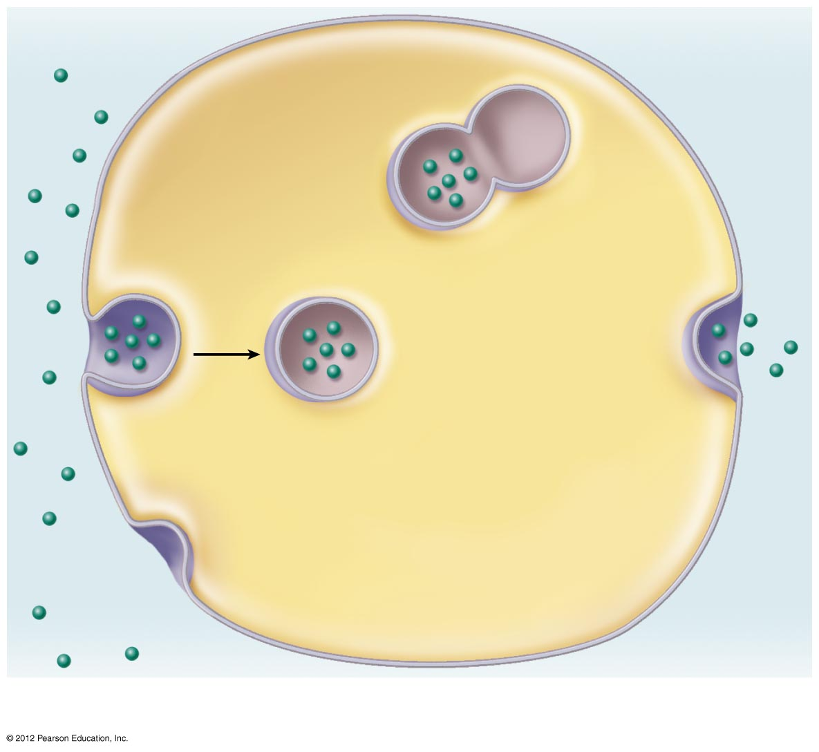
Extracellular
fluid
Plasma
membrane
1
Vesicle
fusing with
lysosome
for digestion
Ingested
substance
Figure 3.13a, step 1

Slide 26
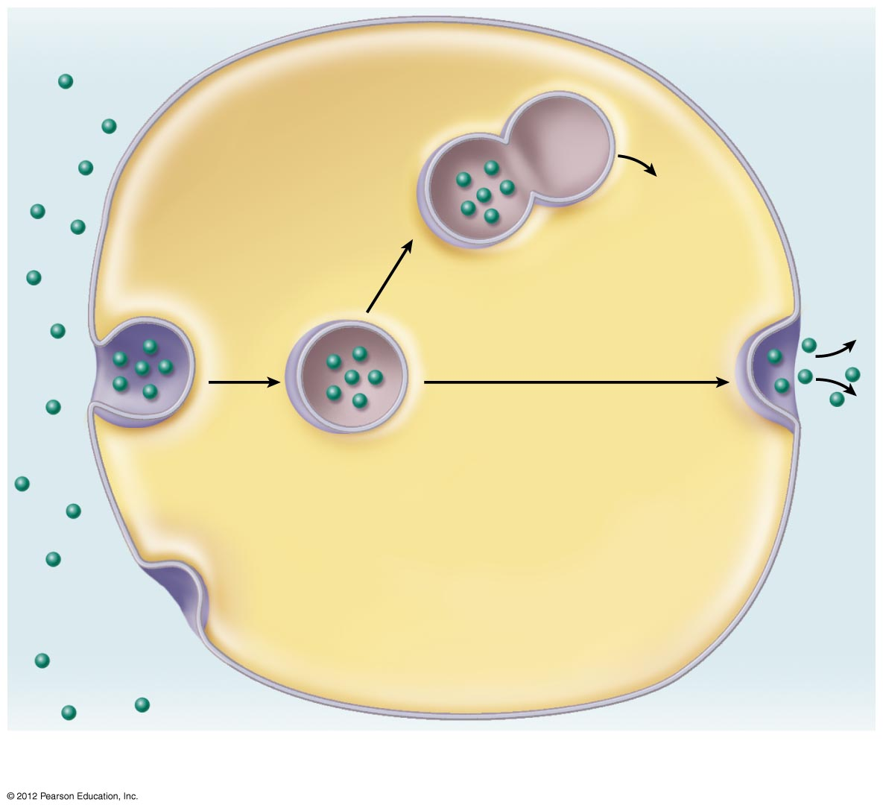
Extracellular
fluid
Cytosol
Plasma
membrane
Vesicle
Lysosome
1
Vesicle
fusing with
lysosome
for digestion
Release of
contents to
cytosol
Ingested
substance
2
Transport to plasma
membrane and exocytosis
of vesicle contents
Detached vesicle
containing ingested
material
Figure 3.13a, step 2

Slide 27
Extracellular
fluid
Cytosol
Plasma
membrane
Vesicle
Lysosome
1
Vesicle
fusing with
lysosome
for digestion
Release of
contents to
cytosol
Ingested
substance
2
Transport to plasma
membrane and exocytosis
of vesicle contents
Detached vesicle
containing ingested
material
3
Membranes and
receptors (if present)
recycled to plasma
membrane
Pit
Figure 3.13a, step 3

Slide 28
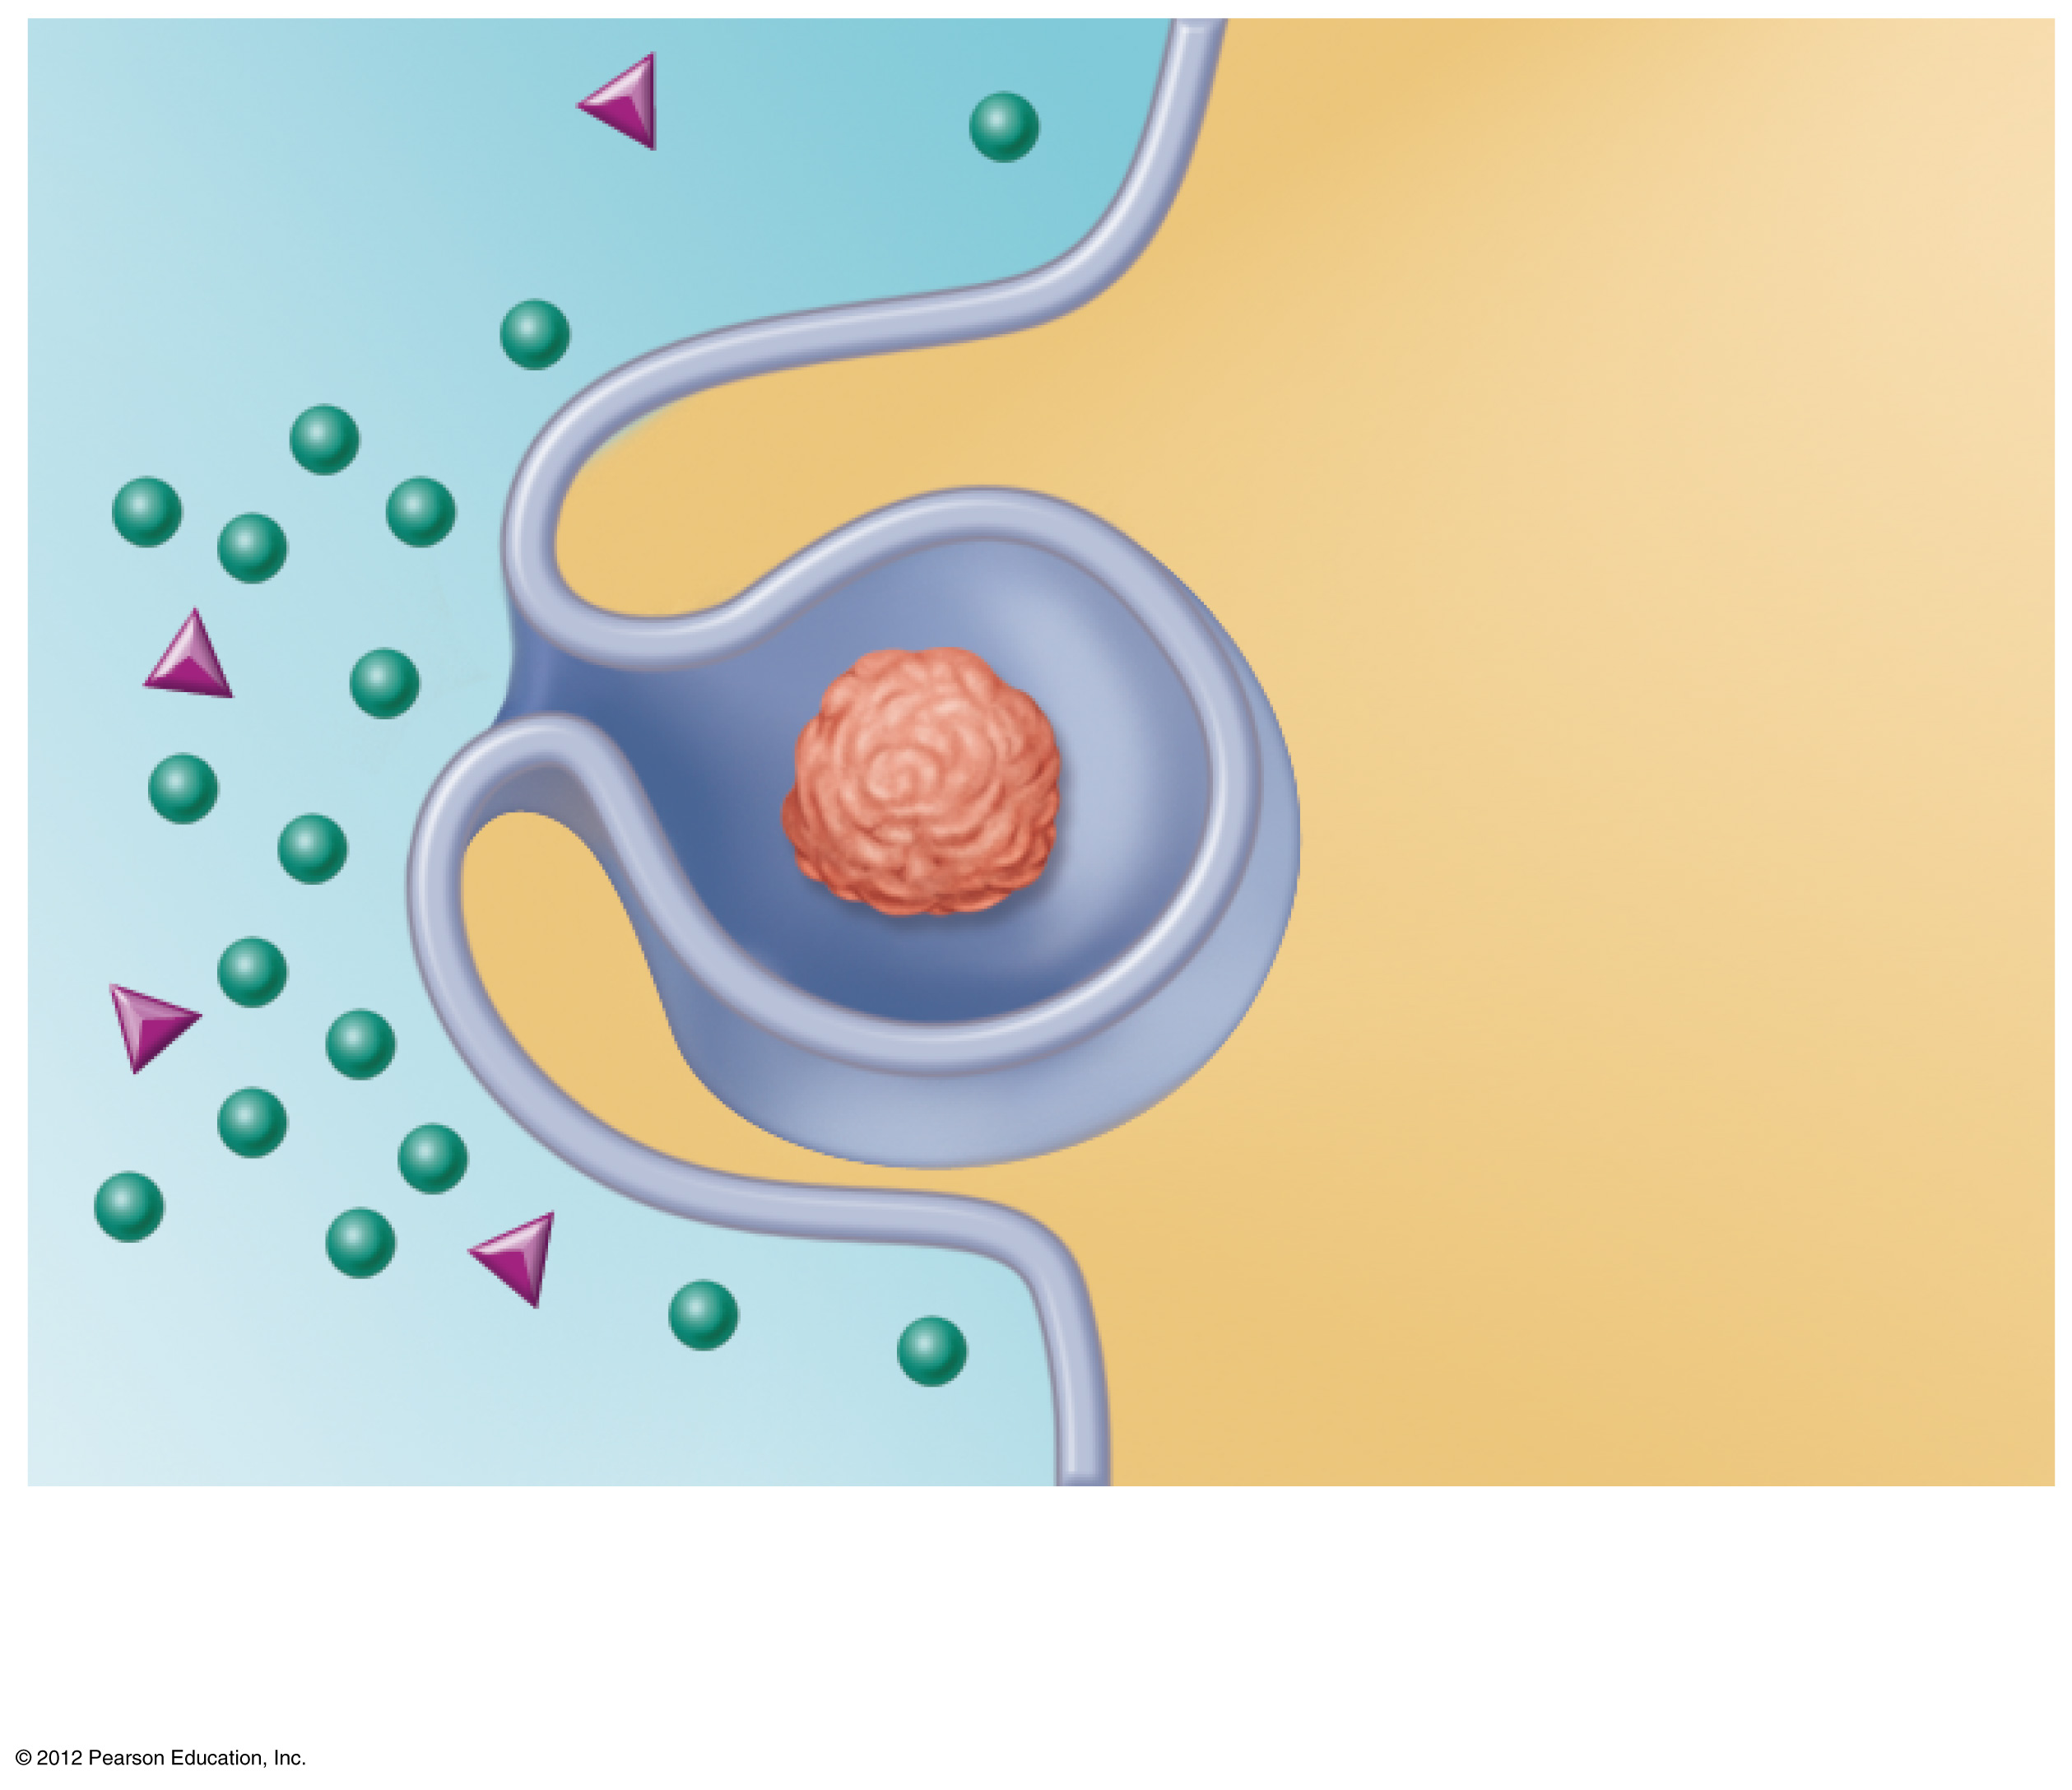
Cytoplasm
Extracellular
fluid
Bacterium
or other
particle
Pseudopod
(b)
Figure 3.13b

Slide 29
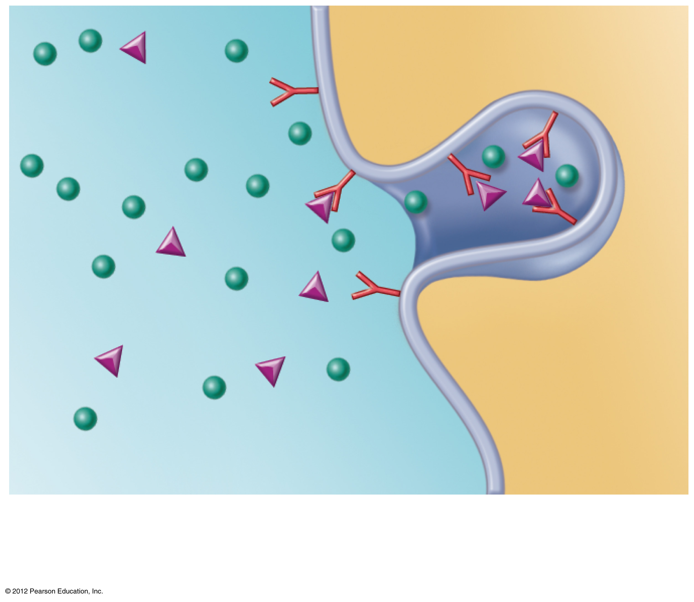
Membrane
receptor
(c)
Figure 3.13c

Slide 30
Cell Life Cycle
Cells have two major periods
  Interphase
    Cell grows
    Cell carries on metabolic processes
  Cell division
    Cell replicates itself
    Function is to produce more cells for growth and repair processes

Slide 31
DNA Replication
Genetic material is duplicated and readies a cell for division into two cells
Occurs toward the end of interphase
DNA uncoils and each side serves as a template

Slide 32
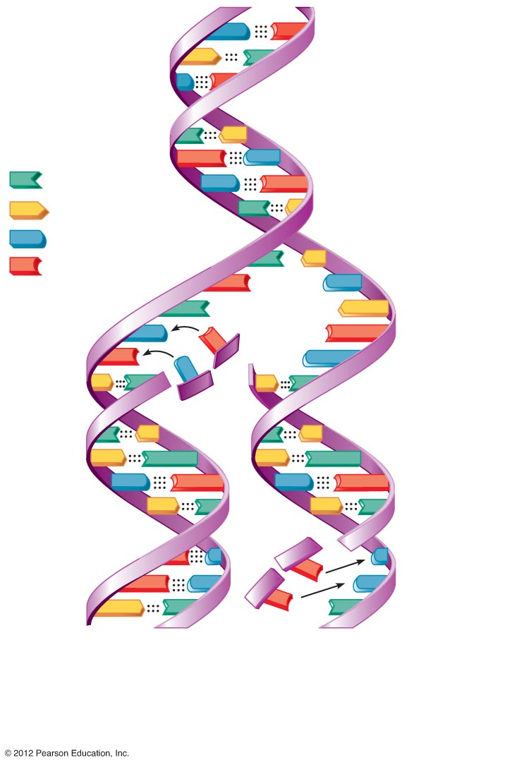
C
G
T
A
C
G
Key:
A
T
G
C
= Adenine
C
G
= Thymine
A
T
= Cytosine
= Guanine
A
T
G
C
A
T
C
G
G
G
C
C
T
A
T
A
A
T
A
T
T
A
T
A
C
G
C
G
T
A
T
A
G
C
G
C
G
C
G
C
T
A
A
Old
(template)
strand
Newly
synthesized
strand
New
strand
forming
Old (template)
strand
DNA of one chromatid
Figure 3.14

Slide 33
Events of Cell Division
Mitosis—division of the nucleus
  Results in the formation of two daughter nuclei
Cytokinesis—division of the cytoplasm
  Begins when mitosis is near completion
  Results in the formation of two daughter cells
PLAY
A&P Flix™: Mitosis

Slide 34
Stages of Mitosis
Prophase
  First part of cell division
  Centrioles migrate to the poles to direct assembly of mitotic spindle fibers
  DNA appears as double-stranded chromosomes
  Nuclear envelope breaks down and disappears

Slide 35
Stages of Mitosis
Metaphase
  Chromosomes are aligned in the center of the cell on the metaphase plate

Slide 36
Stages of Mitosis
Anaphase
  Chromosomes are pulled apart and toward the opposite ends of the cell
  Cell begins to elongate

Slide 37
Stages of Mitosis
Telophase
  Chromosomes uncoil to become chromatin
  Nuclear envelope reforms around chromatin
  Spindles break down and disappear

Slide 38
Stages of Mitosis
Cytokinesis
  Begins during late anaphase and completes during telophase
  A cleavage furrow forms to pinch the cells into two parts

Slide 39
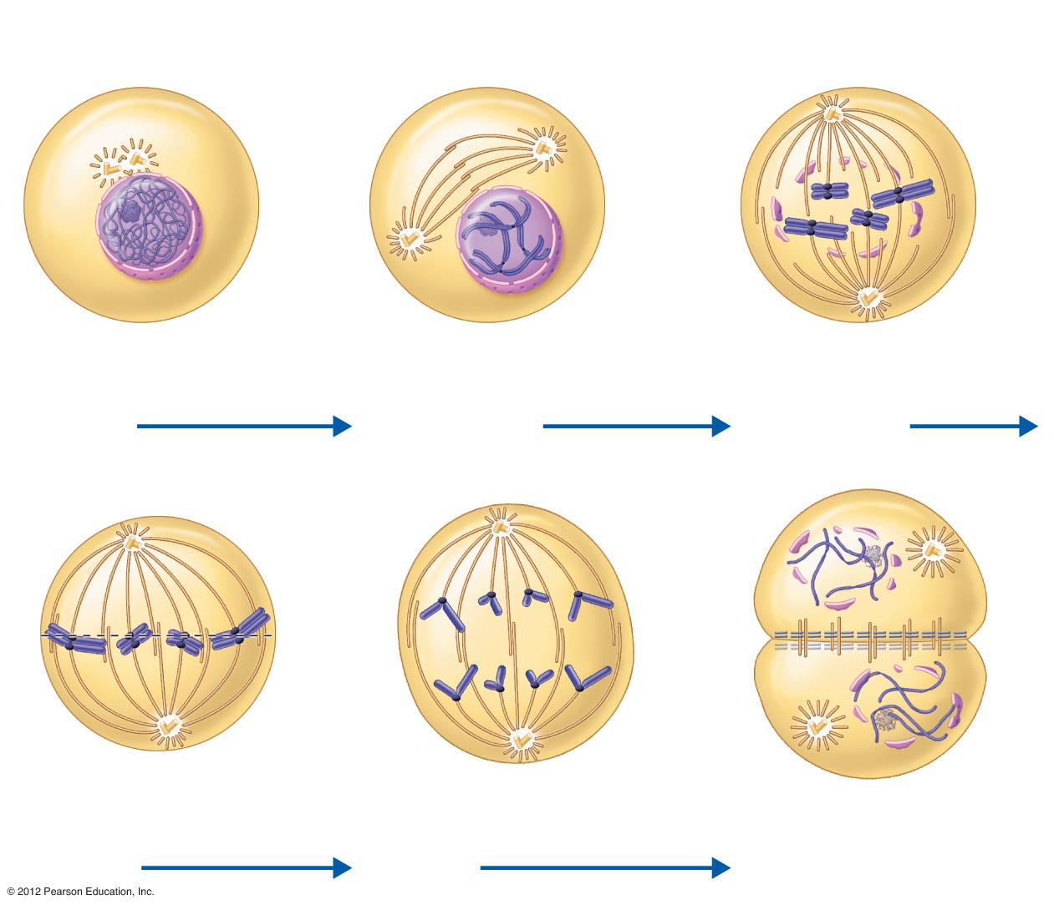
Centrioles
Chromatin
Centrioles
Spindle
microtubules
Centromere
Forming
mitotic
spindle
Centromere
Plasma
membrane
Nuclear
envelope
Chromosome,
consisting of two
sister chromatids
Fragments of
nuclear envelope
Spindle
pole
Nucleolus
Interphase
Early prophase
Late prophase
Metaphase
plate
Nucleolus
forming
Cleavage
furrow
Nuclear
envelope
forming
Spindle
Sister
chromatids
Daughter
chromosomes
Metaphase
Anaphase
Telophase and cytokinesis
Figure 3.15

Slide 40
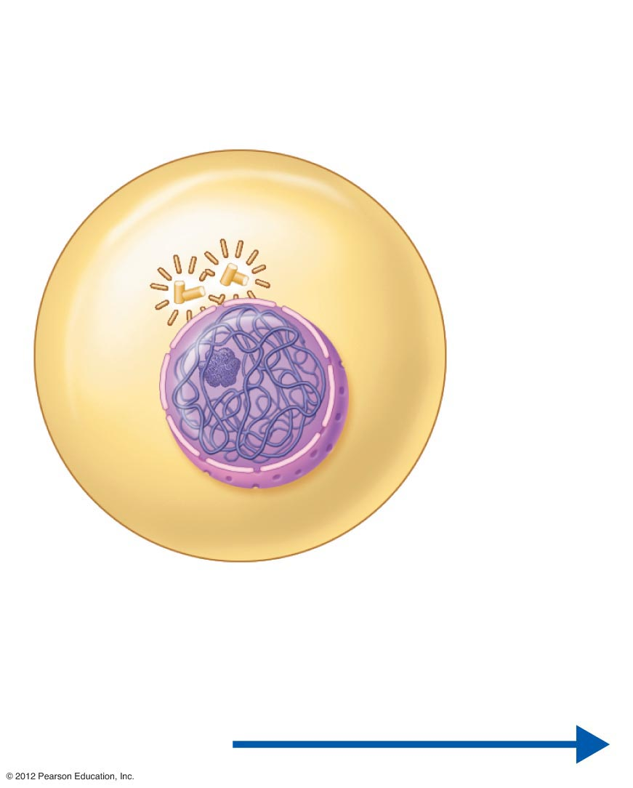
Centrioles
Chromatin
Plasma
membrane
Nuclear
envelope
Nucleolus
Interphase
Figure 3.15, step 1

Slide 41
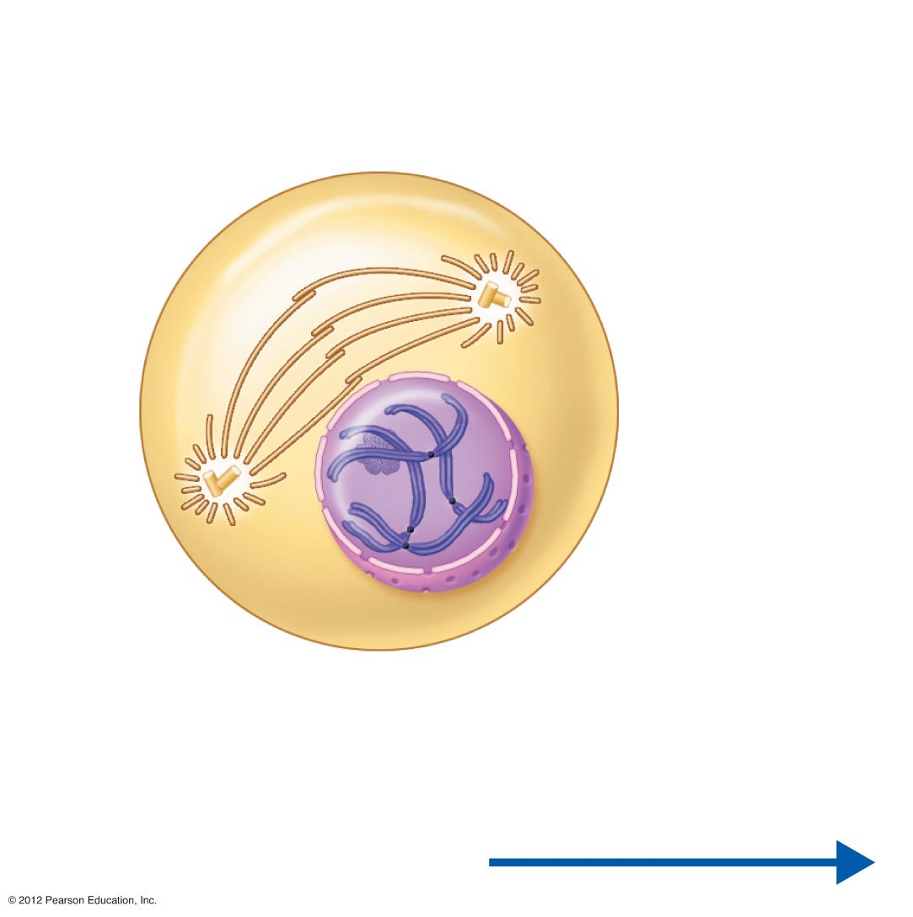
Centrioles
Forming
mitotic
spindle
Centromere
Chromosome,
consisting of two
sister chromatids
Early prophase
Figure 3.15, step 2

Slide 42
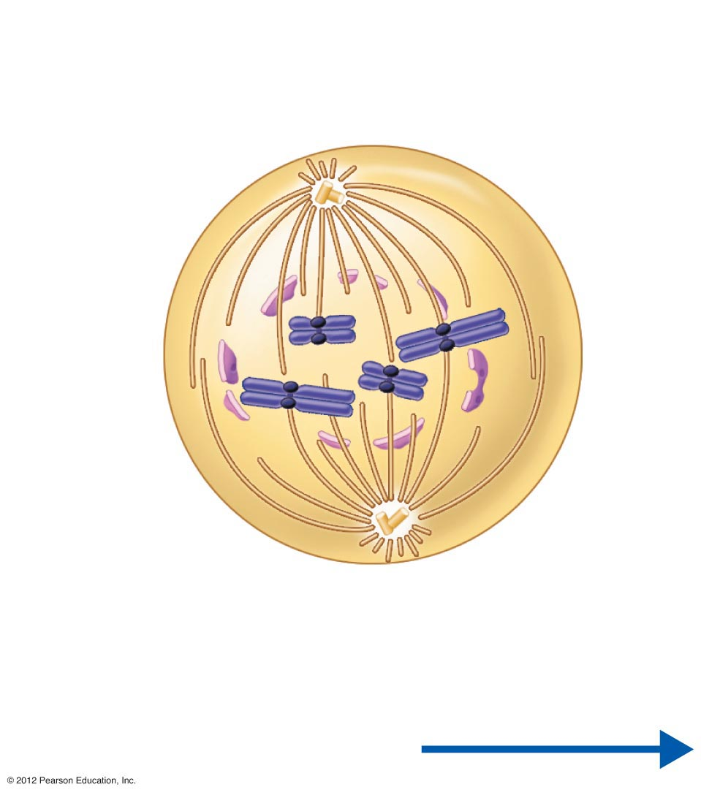
Spindle
microtubules
Centromere
Fragments of
nuclear envelope
Spindle
pole
Late prophase
Figure 3.15, step 3

Slide 43
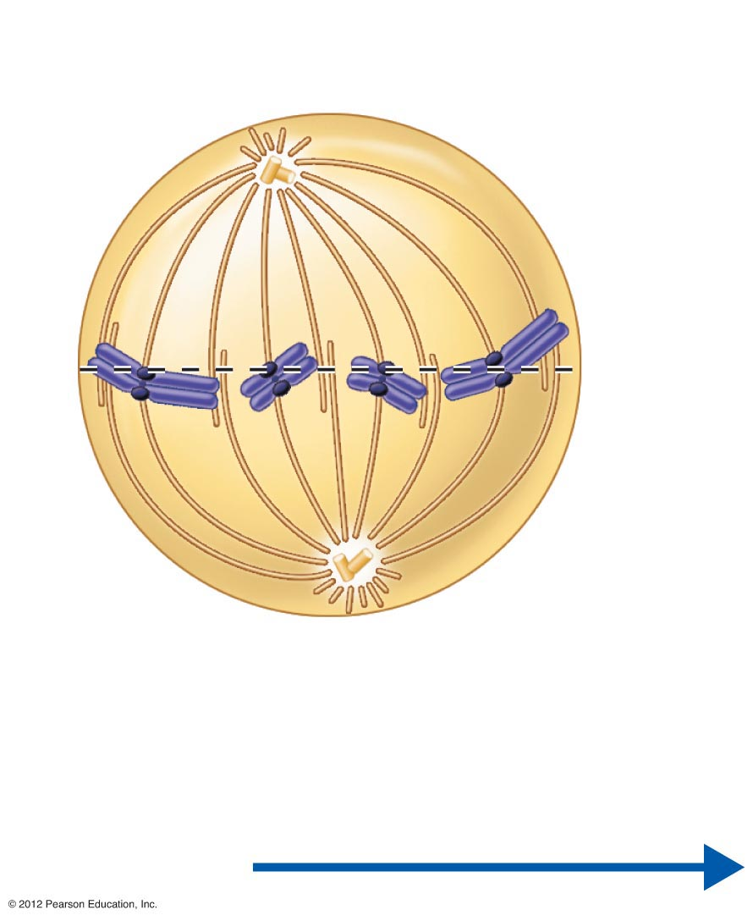
Metaphase
plate
Spindle
Sister
chromatids
Metaphase
Figure 3.15, step 4

Slide 44
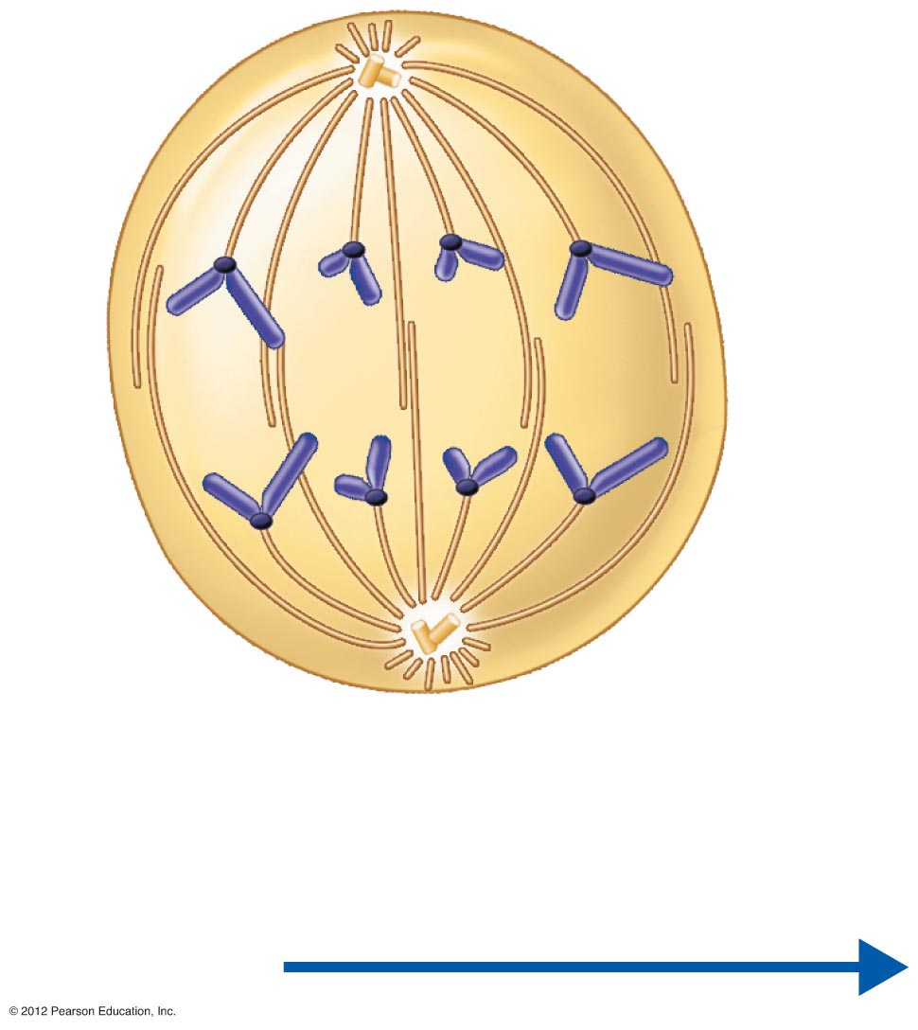
Daughter
chromosomes
Anaphase
Figure 3.15, step 5

Slide 45
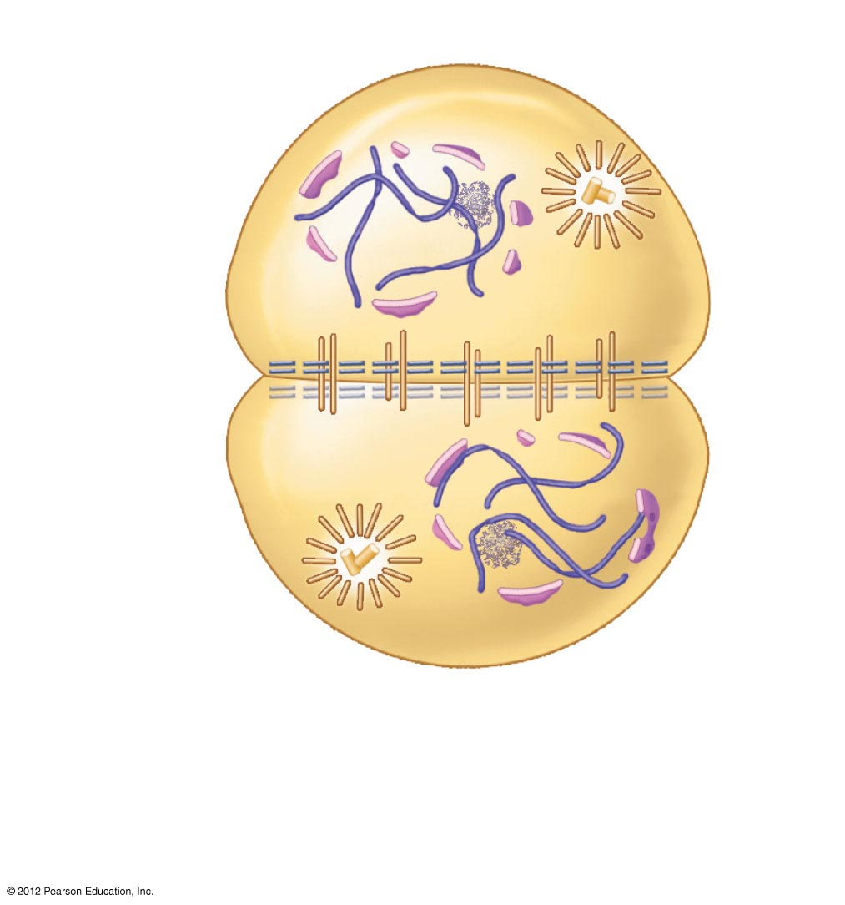
Nucleolus
forming
Cleavage
furrow
Nuclear
envelope
forming
Telophase and cytokinesis
Figure 3.15, step 6

Slide 46
Protein Synthesis
Gene—DNA segment that carries a blueprint for building one protein
Proteins have many functions
  Building materials for cells
  Act as enzymes (biological catalysts)
RNA is essential for protein synthesis

Slide 47
Role of RNA
Transfer RNA (tRNA)
  Transfers appropriate amino acids to the ribosome for building the protein
Ribosomal RNA (rRNA)
  Helps form the ribosomes where proteins are built
Messenger RNA (mRNA)
  Carries the instructions for building a protein from the nucleus to the ribosome

Slide 48
Transcription and Translation
Transcription
  Transfer of information from DNA’s base sequence to the complimentary base sequence of mRNA
  Three-base sequences on mRNA are called codons

Slide 49
Transcription and Translation
Translation
  Base sequence of nucleic acid is translated to an amino acid sequence
  Amino acids are the building blocks of proteins

Slide 50
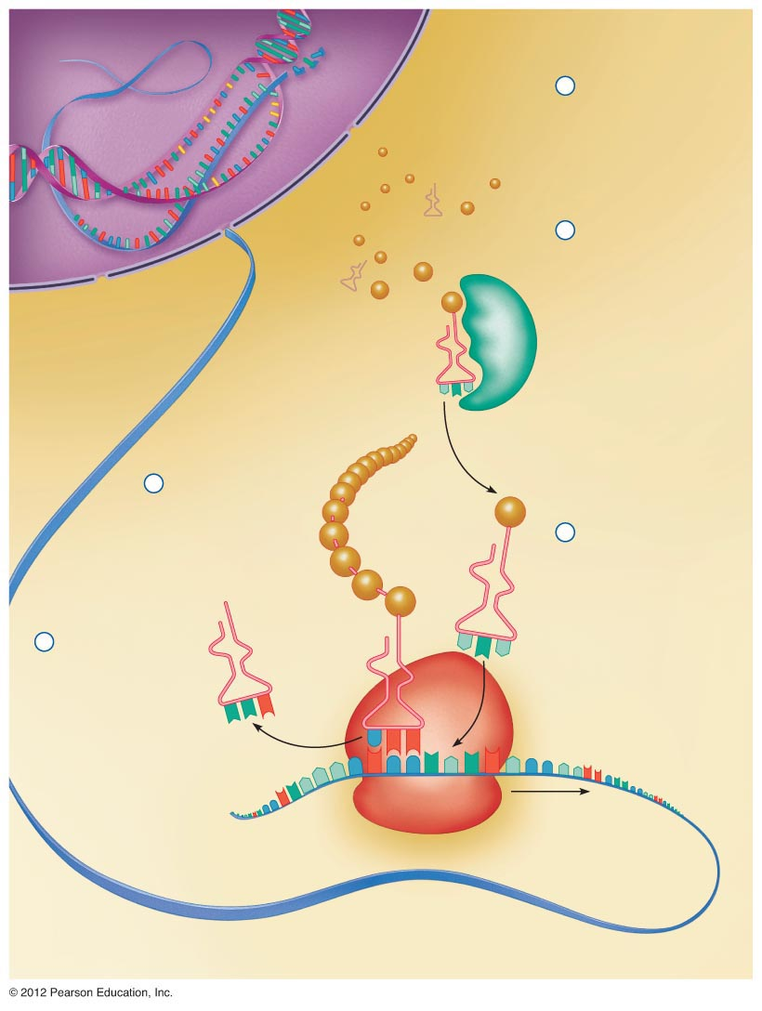
Nucleus
(site of transcription)
DNA
Cytoplasm
(site of translation)
A
A
T
C
G
T
T
C
G
C
T
A
U
U
A
G
C
A
A
G
C
G
A
U
1
T
mRNA specifying
one polypeptide is
made on DNA template.
T
A
G
C
A
A
G
C
G
A
T
2
Amino
acids
mRNA leaves
nucleus and attaches to
ribosome, and
translation begins.
mRNA
Nuclear pore
Nuclear membrane
Correct amino
acid attached
to each species
of tRNA by an
enzyme
Synthetase
enzyme
As the ribosome
moves along the
mRNA, a new amino
acid is added to the
growing protein chain.
4
Growing
polypeptide
chain
Met
lle
Gly
3
Incoming tRNA
recognizes a
complementary mRNA
codon calling for its amino
acid by binding via its
anticodon to the codon.
Ser
Phe
Ala
5
Peptide bond
U
tRNA “head”
bearing anticodon
Released tRNA
reenters the cytoplasmic
pool, ready to be
recharged with a new
amino acid.
A
U
G
A
A
C
Large ribosomal subunit
G
G
G
C
C
C
C
A
U
A
G
U
C
U
U
U
A
Codon
Direction of ribosome
advance; ribosome
moves the mRNA strand
along sequentially
as each codon is read.
Portion of
mRNA already
translated
Small ribosomal subunit
Figure 3.16

Slide 51

Nucleus
(site of transcription)
DNA
Cytoplasm
(site of translation)
A
A
T
C
G
T
T
C
G
C
T
A
U
U
A
G
C
A
A
G
C
G
A
U
1
T
mRNA specifying
one polypeptide is
made on DNA template.
T
A
G
C
A
A
G
C
G
A
T
mRNA
Amino
acids
Nuclear pore
Nuclear membrane
Correct amino
acid attached
to each species
of tRNA by an
enzyme
Synthetase
enzyme
Growing
polypeptide
chain
Met
lle
Gly
Ser
Phe
Ala
Peptide bond
U
tRNA “head”
bearing anticodon
A
U
G
A
A
C
Large ribosomal subunit
G
G
G
C
C
C
C
A
U
A
G
U
C
U
U
U
A
Codon
Direction of ribosome
advance; ribosome
moves the mRNA strand
along sequentially
as each codon is read.
Portion of
mRNA already
translated
Small ribosomal subunit
Figure 3.16, step 1

Slide 52

Nucleus
(site of transcription)
DNA
Cytoplasm
(site of translation)
A
A
T
C
G
T
T
C
G
C
T
A
U
U
A
G
C
A
A
G
C
G
A
U
1
T
mRNA specifying
one polypeptide is
made on DNA template.
T
A
G
C
A
A
G
C
G
A
T
2
Amino
acids
mRNA leaves
nucleus and attaches to
ribosome, and
translation begins.
mRNA
Nuclear pore
Nuclear membrane
Correct amino
acid attached
to each species
of tRNA by an
enzyme
Synthetase
enzyme
Growing
polypeptide
chain
Met
lle
Gly
Ser
Phe
Ala
Peptide bond
U
tRNA “head”
bearing anticodon
A
U
G
A
A
C
Large ribosomal subunit
G
G
G
C
C
C
C
A
U
A
G
U
C
U
U
U
A
Codon
Direction of ribosome
advance; ribosome
moves the mRNA strand
along sequentially
as each codon is read.
Portion of
mRNA already
translated
Small ribosomal subunit
Figure 3.16, step 2

Slide 53

Nucleus
(site of transcription)
DNA
Cytoplasm
(site of translation)
A
A
T
C
G
T
T
C
G
C
T
A
U
U
A
G
C
A
A
G
C
G
A
U
1
T
mRNA specifying
one polypeptide is
made on DNA template.
T
A
G
C
A
A
G
C
G
A
T
2
Amino
acids
mRNA leaves
nucleus and attaches to
ribosome, and
translation begins.
mRNA
Nuclear pore
Nuclear membrane
Correct amino
acid attached
to each species
of tRNA by an
enzyme
Synthetase
enzyme
Growing
polypeptide
chain
Met
lle
Gly
3
Incoming tRNA
recognizes a
complementary mRNA
codon calling for its amino
acid by binding via its
anticodon to the codon.
Ser
Phe
Ala
Peptide bond
U
tRNA “head”
bearing anticodon
A
U
G
A
A
C
Large ribosomal subunit
G
G
G
C
C
C
C
A
U
A
G
U
C
U
U
U
A
Codon
Direction of ribosome
advance; ribosome
moves the mRNA strand
along sequentially
as each codon is read.
Portion of
mRNA already
translated
Small ribosomal subunit
Figure 3.16, step 3

Slide 54

Nucleus
(site of transcription)
DNA
Cytoplasm
(site of translation)
A
A
T
C
G
T
T
C
G
C
T
A
U
U
A
G
C
A
A
G
C
G
A
U
1
T
mRNA specifying
one polypeptide is
made on DNA template.
T
A
G
C
A
A
G
C
G
A
T
2
Amino
acids
mRNA leaves
nucleus and attaches to
ribosome, and
translation begins.
mRNA
Nuclear pore
Nuclear membrane
Correct amino
acid attached
to each species
of tRNA by an
enzyme
Synthetase
enzyme
As the ribosome
moves along the
mRNA, a new amino
acid is added to the
growing protein chain.
4
Growing
polypeptide
chain
Met
lle
Gly
3
Incoming tRNA
recognizes a
complementary mRNA
codon calling for its amino
acid by binding via its
anticodon to the codon.
Ser
Phe
Ala
Peptide bond
U
tRNA “head”
bearing anticodon
A
U
G
A
A
C
Large ribosomal subunit
G
G
G
C
C
C
C
A
U
A
G
U
C
U
U
U
A
Codon
Direction of ribosome
advance; ribosome
moves the mRNA strand
along sequentially
as each codon is read.
Portion of
mRNA already
translated
Small ribosomal subunit
Figure 3.16, step 4

Slide 55
Nucleus
(site of transcription)
Nucleus
(site of transcription)
DNA
Cytoplasm
(site of translation)
DNA
A
A
T
C
G
T
T
C
G
C
T
A
U
U
A
G
C
A
A
G
C
G
A
U
1
T
mRNA specifying
one polypeptide is
made on DNA template.
T
A
G
C
A
A
G
C
G
A
T
2
Amino
acids
mRNA leaves
nucleus and attaches to
ribosome, and
translation begins.
mRNA
Nuclear pore
Nuclear membrane
Correct amino
acid attached
to each species
of tRNA by an
enzyme
Synthetase
enzyme
As the ribosome
moves along the
mRNA, a new amino
acid is added to the
growing protein chain.
4
Growing
polypeptide
chain
Met
lle
Gly
3
Incoming tRNA
recognizes a
complementary mRNA
codon calling for its amino
acid by binding via its
anticodon to the codon.
Ser
Phe
Ala
5
Peptide bond
U
tRNA “head”
bearing anticodon
Released tRNA
reenters the cytoplasmic
pool, ready to be
recharged with a new
amino acid.
A
U
G
A
A
C
Large ribosomal subunit
G
G
G
C
C
C
C
A
U
A
G
U
C
U
U
U
A
Codon
Direction of ribosome
advance; ribosome
moves the mRNA strand
along sequentially
as each codon is read.
Portion of
mRNA already
translated
Small ribosomal subunit
Figure 3.16, step 5

