Slide 1
14
The Digestive System and Body Metabolism

Slide 2
The Digestive System Functions
Ingestion—taking in food
Digestion—breaking food down both physically and chemically
Absorption—movement of nutrients into the bloodstream
Defecation—rids the body of indigestible waste

Slide 3
Functions of the Digestive System
Food breakdown as mechanical digestion
Examples:
Mixing food in the mouth by the tongue
Churning food in the stomach
Segmentation in the small intestine
Mechanical digestion prepares food for further degradation by enzymes

Slide 4
Functions of the Digestive System
Absorption
End products of digestion are absorbed in the blood or lymph
Food must enter mucosal cells and then into blood or lymph capillaries
Defecation
Elimination of indigestible substances from the GI tract in the form of feces

Slide 5
Functions of the Digestive System
Food breakdown as chemical digestion
Enzymes break down food molecules into their building blocks
Each major food group uses different enzymes
Carbohydrates are broken to simple sugars
Proteins are broken to amino acids
Fats are broken to fatty acids and alcohols

Slide 6
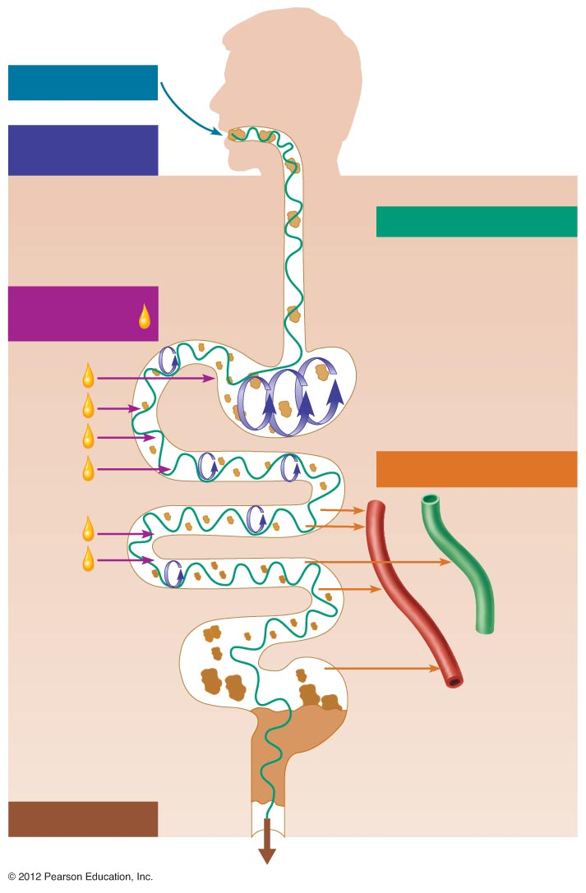
Ingestion
Food
Mechanical
digestion
Pharynx
Chewing (mouth)
Esophagus
Churning (stomach)
Propulsion
Segmentation
(small intestine)
Swallowing
(oropharynx)
Chemical
digestion
Peristalsis
(esophagus,
stomach,
small intestine,
large intestine)
Stomach
Absorption
Lymph
vessel
Small
intestine
Large
intestine
Blood
vessel
Mainly H₂O
Feces
Defecation
Anus
Figure 14.11

Slide 7
Organs of the Digestive System
Two main groups of organs
Alimentary canal (gastrointestinal or GI tract)—continuous coiled hollow tube
These organs ingest, digest, absorb, defecate
Accessory digestive organs
Includes teeth, tongue, and other large digestive organs

Slide 8
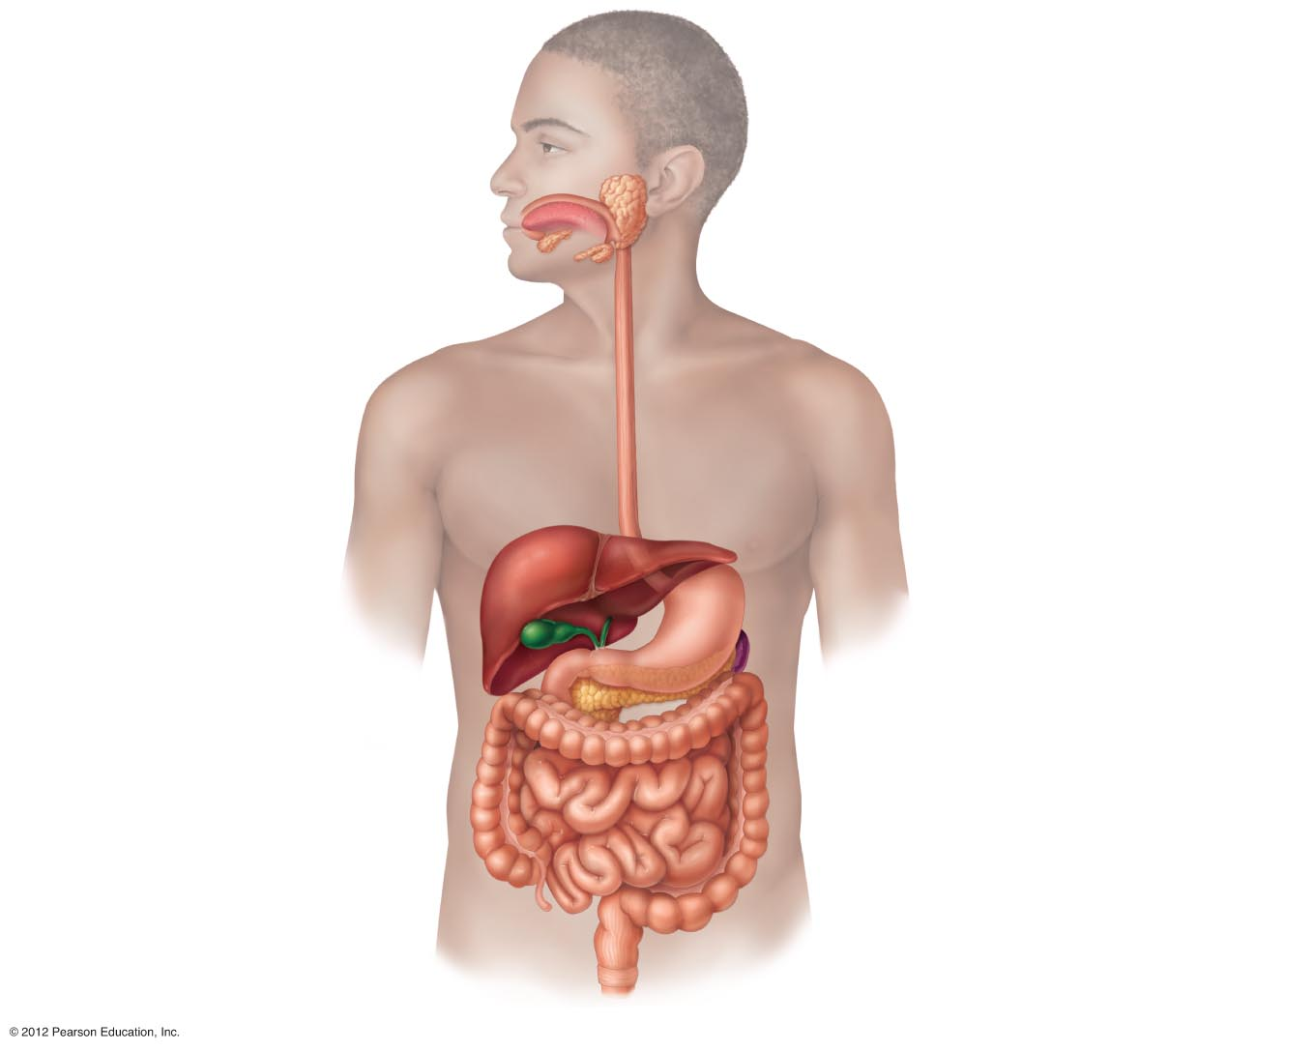
Mouth (oral cavity)
Parotid gland
Tongue
Sublingual gland
Salivary glands
Submandibular
gland
Esophagus
Pharynx
Stomach
Pancreas
Liver
(Spleen)
Gallbladder
Transverse
colon
Duodenum
Descending
colon
Small intestine
Jejunum
lleum
Ascending
colon
Cecum
Large intestine
Sigmoid colon
Rectum
Anus
Appendix
Anal canal
Figure 14.1

Slide 9
Organs of the Alimentary Canal
Mouth
Pharynx
Esophagus
Stomach
Small intestine
Large intestine
Anus

Slide 10
Mouth (Oral Cavity) Anatomy
Lips (labia)—protect the anterior opening
Cheeks—form the lateral walls
Hard palate—forms the anterior roof
Soft palate—forms the posterior roof
Uvula—fleshy projection of the soft palate

Slide 11
Mouth (Oral Cavity) Anatomy
Vestibule—space between lips externally and teeth and gums internally
Oral cavity proper—area contained by the teeth
Tongue—attached at hyoid bone and styloid processes of the skull, and by the lingual frenulum to the floor of the mouth
Tonsils
Palatine—located at posterior end of oral cavity
Lingual—located at the base of the tongue

Slide 12
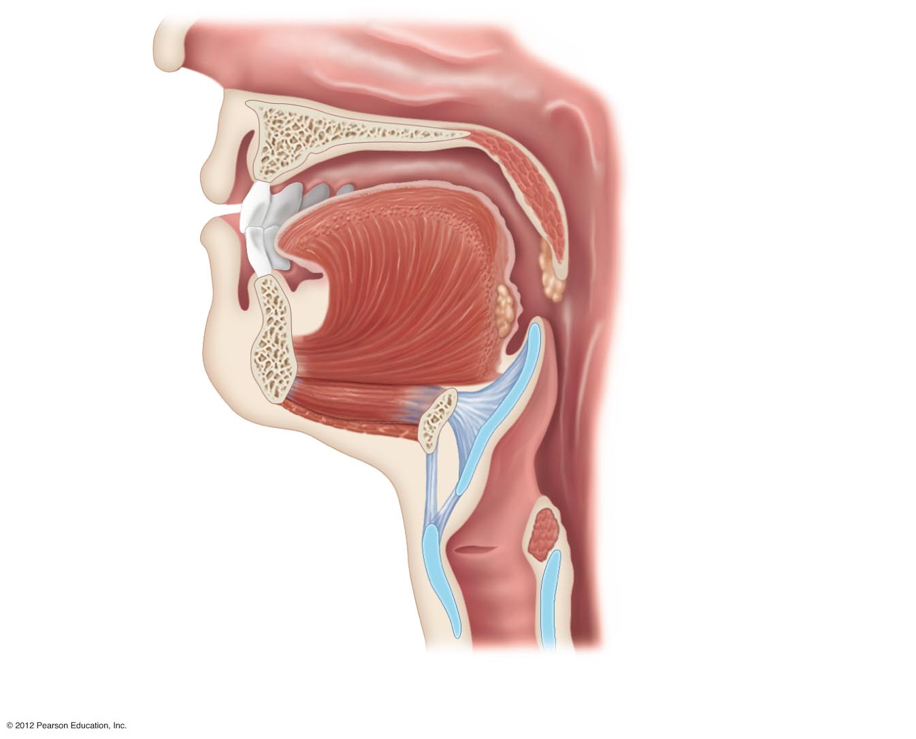
Nasopharynx
Hard
palate
Soft palate
Oral
cavity
Uvula
Lips (labia)
Palatine tonsil
Vestibule
Lingual tonsil
Oropharynx
Lingual
frenulum
Epiglottis
Tongue
Laryngopharynx
Hyoid bone
Esophagus
Trachea
(a)
Figure 14.2a

Slide 13
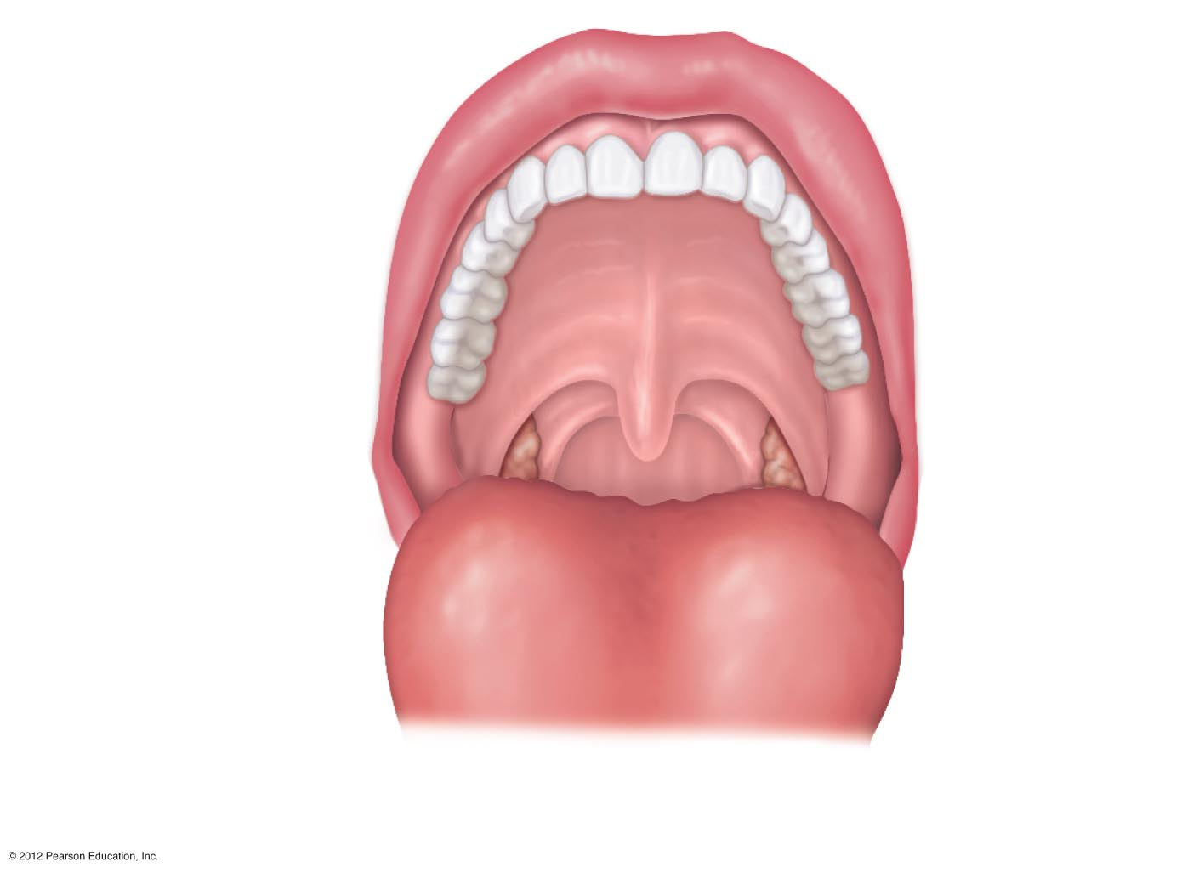
Upper lip
Gingivae
(gums)
Hard palate
Soft palate
Uvula
Palatine tonsil
Oropharynx
Tongue
(b)
Figure 14.2b

Slide 14
Mouth Physiology
Mastication (chewing) of food
Mixing masticated food with saliva
Initiation of swallowing by the tongue
Allows for the sense of taste

Slide 15
Pharynx Anatomy
Nasopharynx—not part of the digestive system
Oropharynx—posterior to oral cavity
Laryngopharynx—below the oropharynx and connected to the esophagus

Slide 16
Nasopharynx
Hard
palate
Soft palate
Oral
cavity
Uvula
Lips (labia)
Palatine tonsil
Vestibule
Lingual tonsil
Oropharynx
Lingual
frenulum
Epiglottis
Tongue
Laryngopharynx
Hyoid bone
Esophagus
Trachea
(a)
Figure 14.2a

Slide 17
Pharynx Physiology
Serves as a passageway for air and food
Food is propelled to the esophagus by two muscle layers
Longitudinal inner layer
Circular outer layer
Food movement is by alternating contractions of the muscle layers (peristalsis)

Slide 18
Esophagus Anatomy and Physiology
Anatomy
About 10 inches long
Runs from pharynx to stomach through the diaphragm
Physiology
Conducts food by peristalsis (slow rhythmic squeezing)
Passageway for food only (respiratory system branches off after the pharynx)

Slide 19
Layers of Tissue in the Alimentary Canal Organs
Four layers from deep to superficial:
Mucosa
Submucosa
Muscularis externa
Serosa

Slide 20
Layers of Tissue in the Alimentary Canal Organs
Mucosa
Innermost, moist membrane consisting of
Surface epithelium
Small amount of connective tissue (lamina propria)
Small smooth muscle layer
Lines the cavity (known as the lumen)

Slide 21
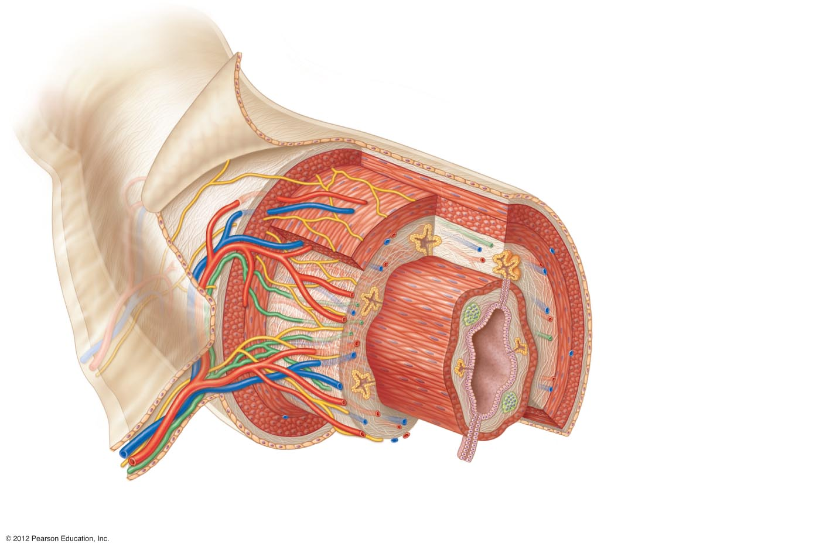
Visceral peritoneum
Intrinsic nerve plexuses
• Myenteric nerve plexus
• Submucosal nerve plexus
Submucosal glands
Mucosa
• Surface epithelium
• Lamina propria
• Muscle layer
Submucosa
Muscularis externa
• Longitudinal muscle layer
• Circular muscle layer
Serosa
(visceral peritoneum)
Nerve
Gland in
mucosa
Lumen
Artery
Mesenter y
Vein
Duct of gland
outside alimentary
canal
Lymphoid tissue
Figure 14.3

Slide 22
Layers of Tissue in the Alimentary Canal Organs
Submucosa
Just beneath the mucosa
Soft connective tissue with blood vessels, nerve endings, mucosa-associated lymphoid tissue, and lymphatics

Slide 23
Visceral peritoneum
Intrinsic nerve plexuses
• Myenteric nerve plexus
• Submucosal nerve plexus
Submucosal glands
Mucosa
• Surface epithelium
• Lamina propria
• Muscle layer
Submucosa
Muscularis externa
• Longitudinal muscle layer
• Circular muscle layer
Serosa
(visceral peritoneum)
Nerve
Gland in
mucosa
Lumen
Artery
Mesenter y
Vein
Duct of gland
outside alimentary
canal
Lymphoid tissue
Figure 14.3

Slide 24
Layers of Tissue in the Alimentary Canal Organs
Muscularis externa—smooth muscle
Inner circular layer
Outer longitudinal layer
Serosa—outermost layer of the wall contains fluid-producing cells
Visceral peritoneum—outermost layer that is continuous with the innermost layer
Parietal peritoneum—innermost layer that lines the abdominopelvic cavity

Slide 25
Visceral peritoneum
Intrinsic nerve plexuses
• Myenteric nerve plexus
• Submucosal nerve plexus
Submucosal glands
Mucosa
• Surface epithelium
• Lamina propria
• Muscle layer
Submucosa
Muscularis externa
• Longitudinal muscle layer
• Circular muscle layer
Serosa
(visceral peritoneum)
Nerve
Gland in
mucosa
Lumen
Artery
Mesenter y
Vein
Duct of gland
outside alimentary
canal
Lymphoid tissue
Figure 14.3

Slide 26
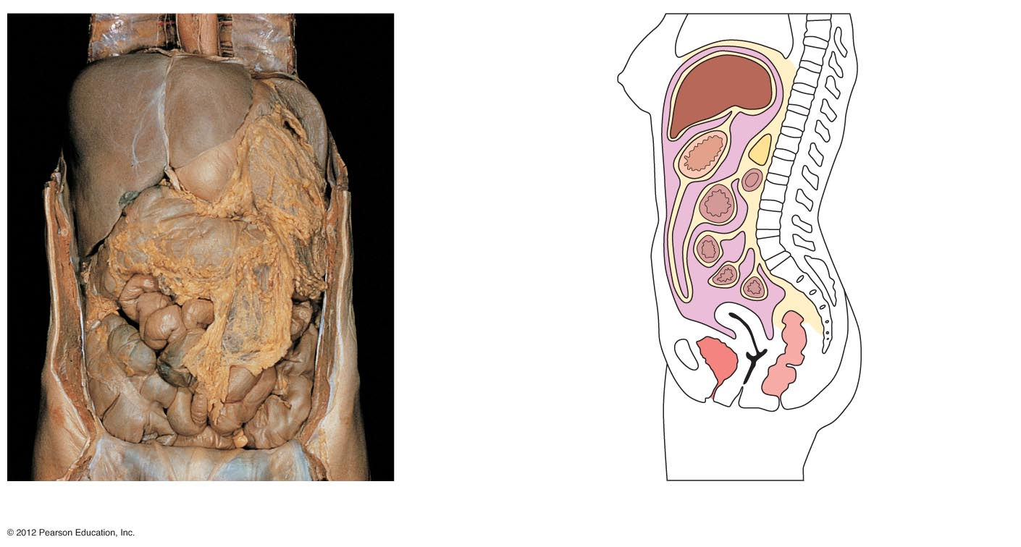
Diaphragm
Falciform ligament
Liver
Lesser
omentum
Spleen
Pancreas
Gallbladder
Stomach
Duodenum
Visceral peritoneum
Transverse
colon
Greater omentum
Mesenteries
Parietal peritoneum
Small intestine
Peritoneal
cavity
Uterus
Large intestine
Cecum
Rectum
Urinary bladder
Anus
(a)
(b)
Figure 14.5

Slide 27
Alimentary Canal Nerve Plexuses
Two important nerve plexuses serve the alimentary canal
Both are part of the autonomic nervous system
Submucosal nerve plexus
Myenteric nerve plexus
Function is to regulate mobility and secretory activity of the GI tract organs

Slide 28
Stomach Anatomy
Located on the left side of the abdominal cavity
Food enters at the cardioesophageal sphincter
Food empties into the small intestine at the pyloric sphincter (valve)

Slide 29
Stomach Anatomy
Regions of the stomach
Cardiac region—near the heart
Fundus—expanded portion lateral to the cardiac region
Body—midportion
Pylorus—funnel-shaped terminal end

Slide 30
Stomach Anatomy
Rugae—internal folds of the mucosa
Stomach can stretch and hold 4 L (1 gallon) of food when full
External regions
Lesser curvature—concave medial surface
Greater curvature—convex lateral surface

Slide 31
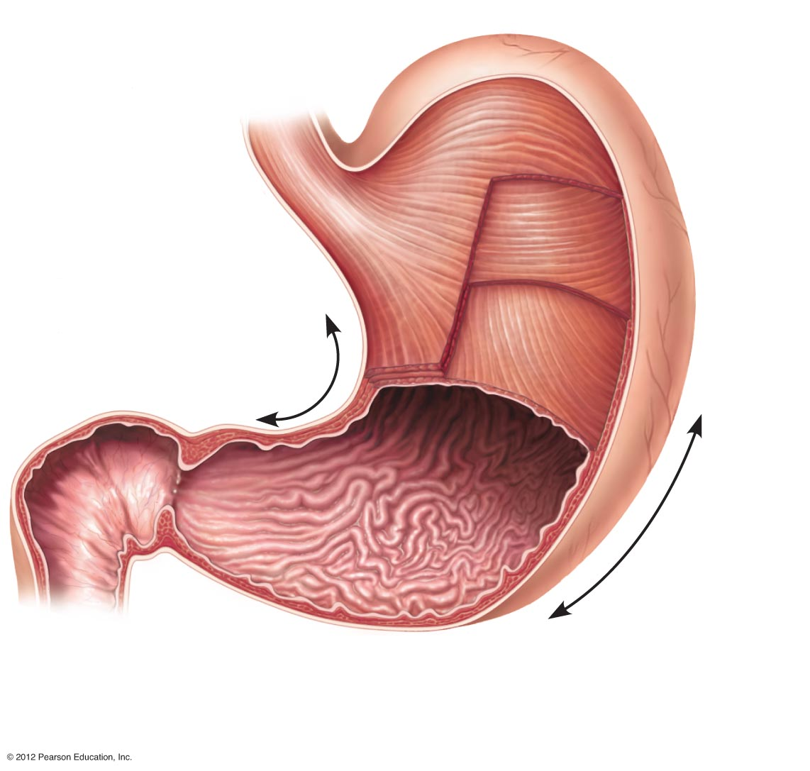
Cardioesophageal
sphincter
Fundus
Esophagus
Muscularis
externa
Serosa
• Longitudinal layer
• Circular layer
Body
• Oblique layer
Lesser
curvature
Rugae
of
mucosa
Pylorus
Greater
curvature
Duodenum
Pyloric
Sphincter
(valve)
Pyloric
antrum
(a)
Figure 14.4a

Slide 32
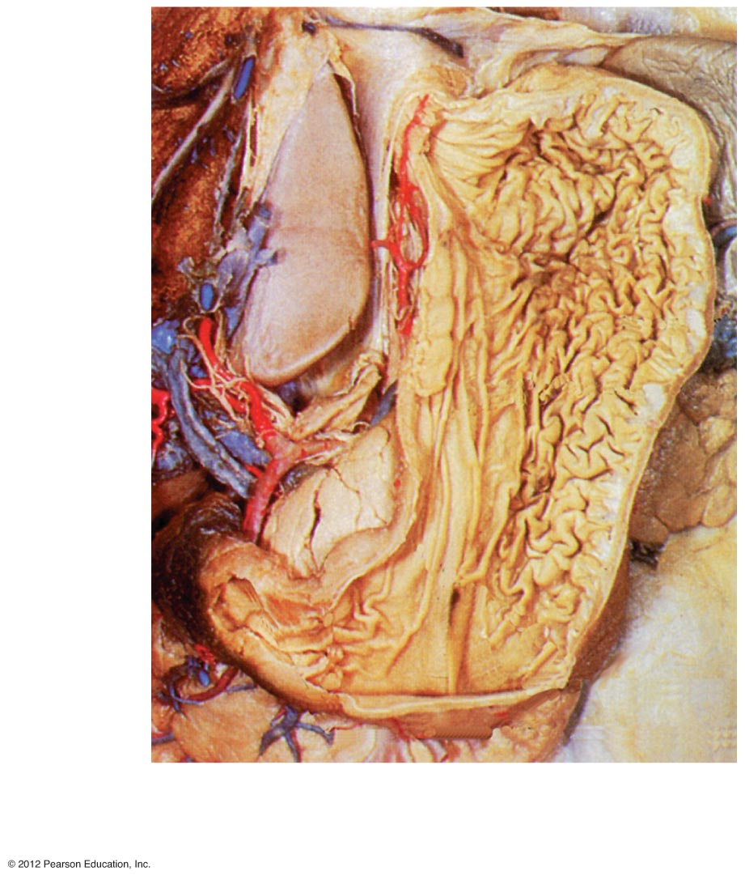
Fundus
Body
Rugae
of
mucosa
(b)
Pyloric
sphincter
Pyloric
antrum
Figure 14.4b

Slide 33
Stomach Anatomy
Layers of peritoneum attached to the stomach
Lesser omentum—attaches the liver to the lesser curvature
Greater omentum—attaches the greater curvature to the posterior body wall
Embedded fat insulates, cushions, and protects abdominal organs
Lymph follicles contain macrophages
Muscularis externa has a third layer
Oblique layer helps to churn, mix, and pummel the food

Slide 34
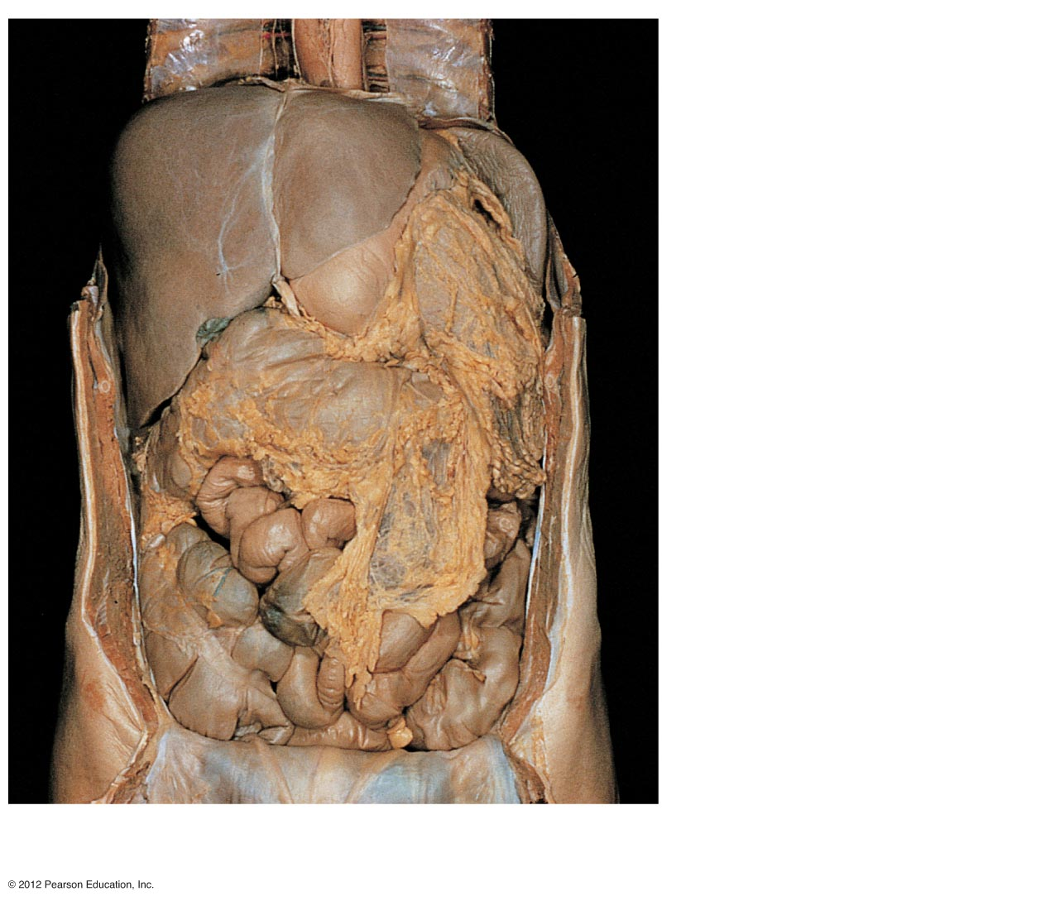
Diaphragm
Falciform ligament
Liver
Spleen
Gallbladder
Stomach
Greater omentum
Small intestine
Large intestine
Cecum
(a)
Figure 14.5a

Slide 35
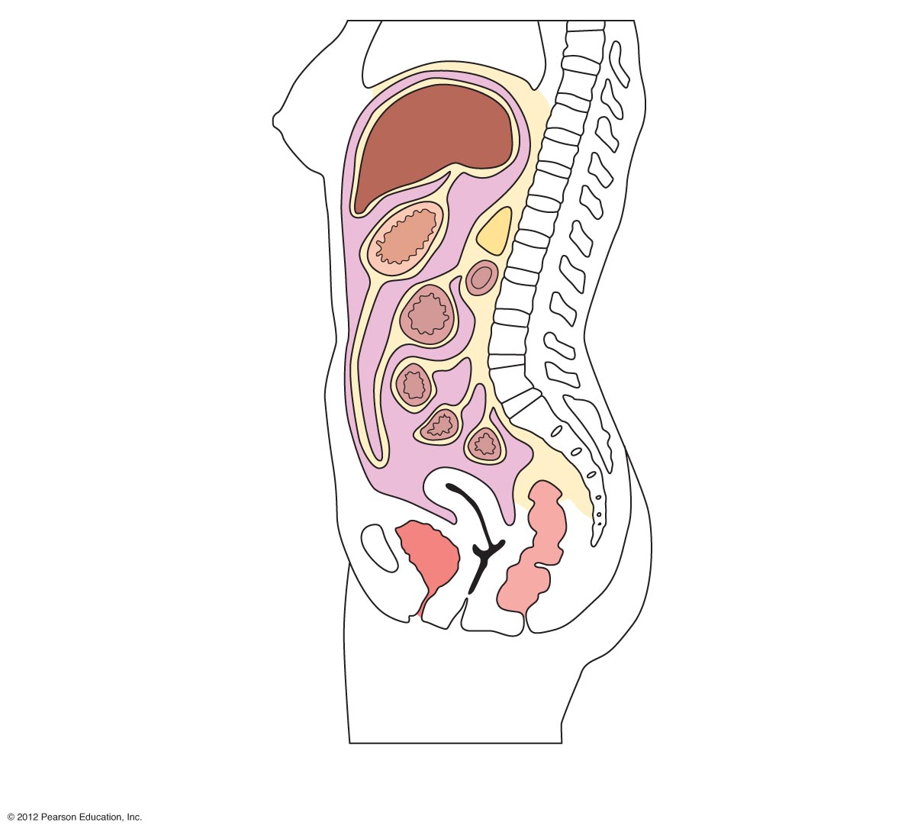
Diaphragm
Liver
Lesser
omentum
Pancreas
Stomach
Duodenum
Visceral peritoneum
Transverse
colon
Greater omentum
Mesenteries
Parietal peritoneum
Small intestine
Peritoneal
cavity
Uterus
Rectum
Urinary bladder
Anus
(b)
Figure 14.5b

Slide 36
Stomach Physiology
Temporary storage tank for food
Site of food breakdown
Chemical breakdown of protein begins
Delivers chyme (processed food) to the small intestine

Slide 37
Structure of the Stomach Mucosa
Mucosa is simple columnar epithelium
Mucous neck cells—produce a sticky alkaline mucus
Gastric glands—situated in gastric pits and secrete gastric juice
Chief cells—produce protein-digesting enzymes (pepsinogens)
Parietal cells—produce hydrochloric acid
Enteroendocrine cells—produce gastrin

Slide 38
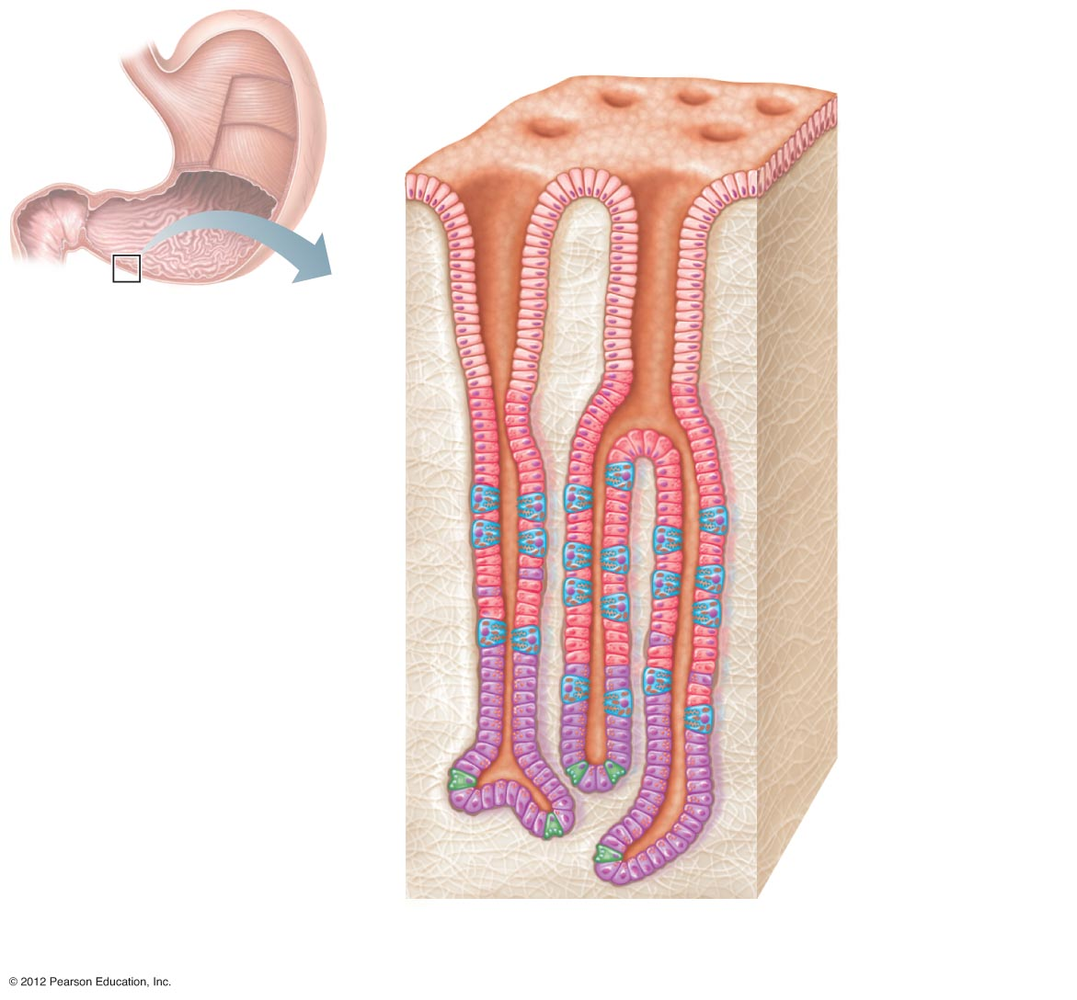
Gastric pits
Surface
epithelium
Gastric pit
Pyloric
sphincter
Mucous
neck cells
Parietal cells
Gastric gland
Gastric
glands
Chief cells
(c)
Figure 14.4c

Slide 39
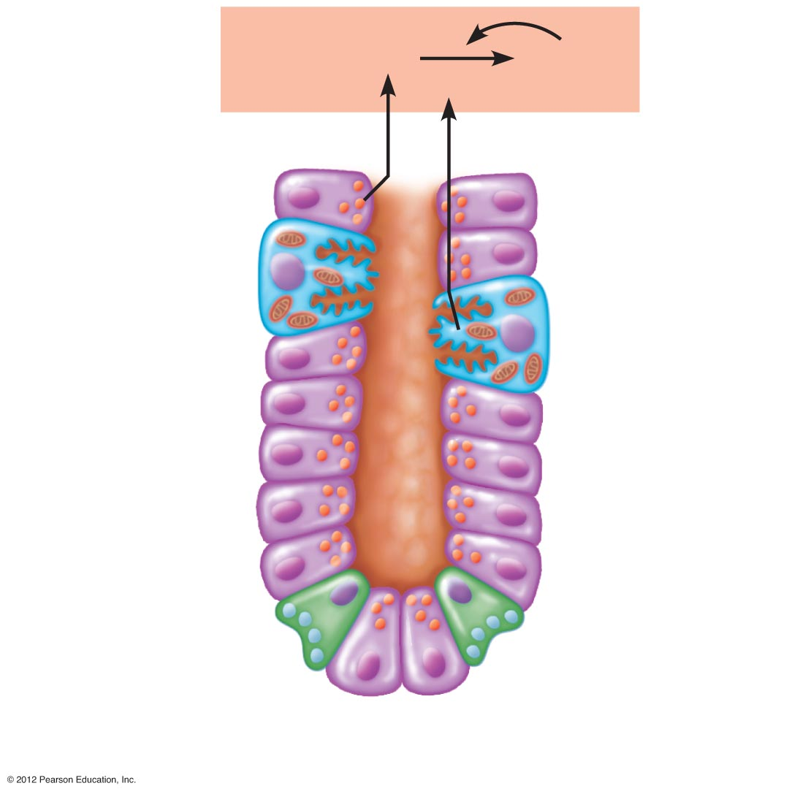
Pepsinogen
Pepsin
HCl
Parietal cells
Chief cells
Enteroendocrine
cell
(d)
Figure 14.4d

Slide 40
Small Intestine
The body’s major digestive organ
Site of nutrient absorption into the blood
Muscular tube extending from the pyloric sphincter to the ileocecal valve
Suspended from the posterior abdominal wall by the mesentery

Slide 41
Subdivisions of the Small Intestine
Duodenum
Attached to the stomach
Curves around the head of the pancreas
Jejunum
Attaches anteriorly to the duodenum
Ileum
Extends from jejunum to large intestine

Slide 42
Chemical Digestion in the Small Intestine
Chemical digestion begins in the small intestine
Enzymes are produced by
Intestinal cells
Pancreas
Pancreatic ducts carry enzymes to the small intestine
Bile, formed by the liver, enters via the bile duct

Slide 43
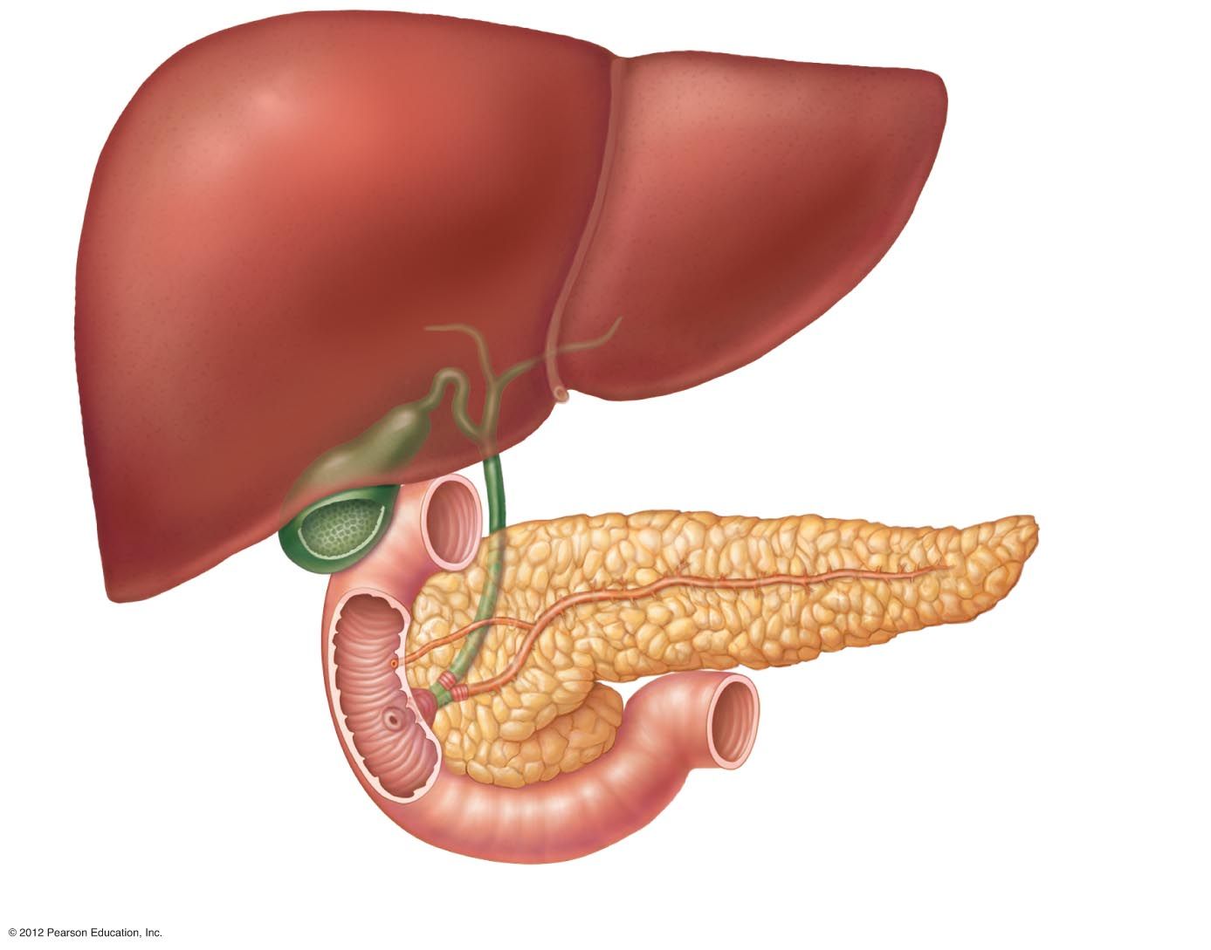
Right and left
hepatic ducts
from liver
Cystic duct
Common hepatic duct
Bile duct and sphincter
Accessory pancreatic duct
Pancreas
Gallbladder
Jejunum
Duodenal
papilla
Hepatopancreatic
ampulla and sphincter
Main pancreatic duct and sphincter
Duodenum
Figure 14.6

Slide 44
Small Intestine Anatomy
Three structural modifications that increase surface area
Microvilli—tiny projections of the plasma membrane (create a brush border appearance)
Villi—fingerlike structures formed by the mucosa
Circular folds (plicae circulares)—deep folds of mucosa and submucosa

Slide 45
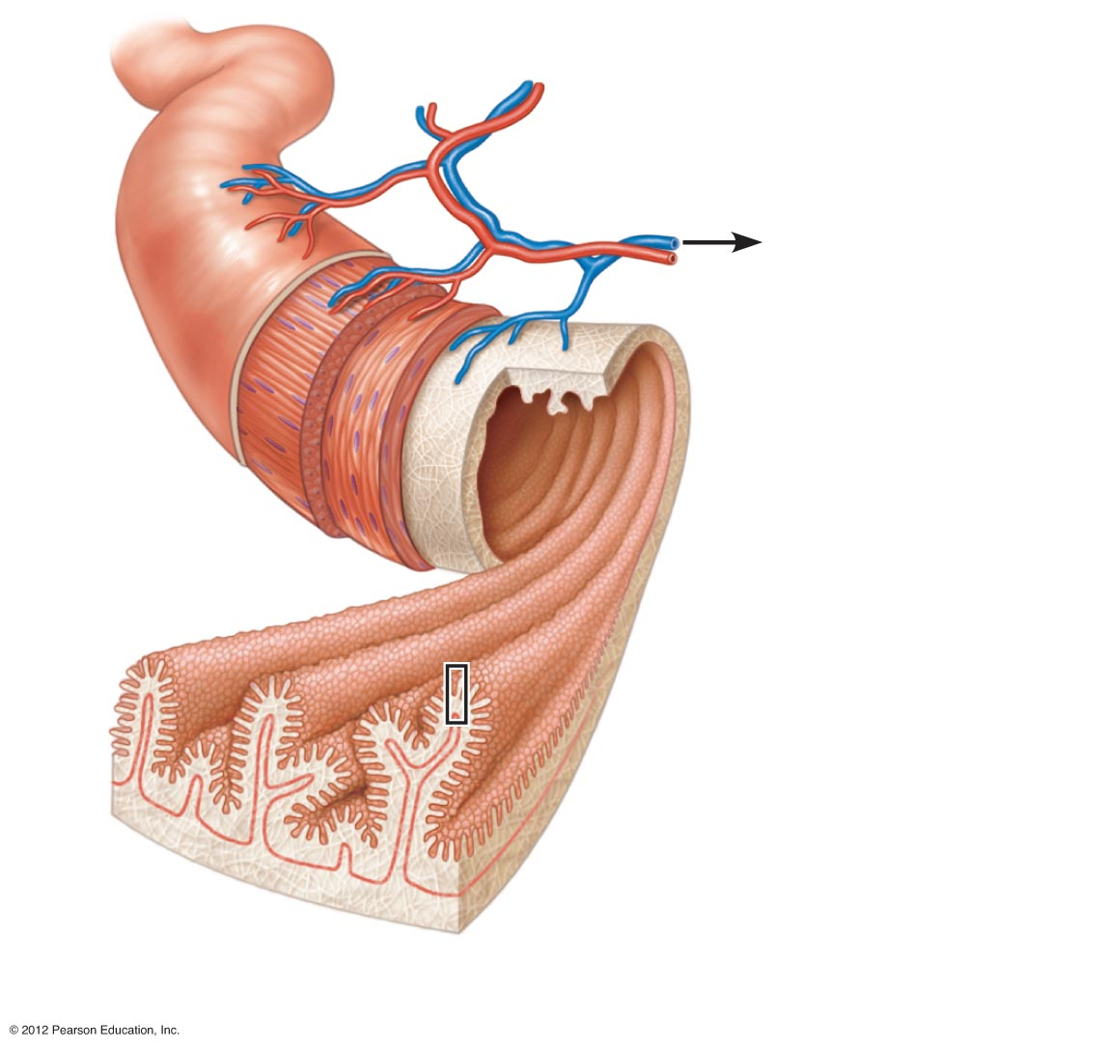
Blood vessels
serving the small
intestine
Lumen
Muscle
layers
Circular folds
(plicae circulares)
Villi
(a) Small intestine
Figure 14.7a

Slide 46
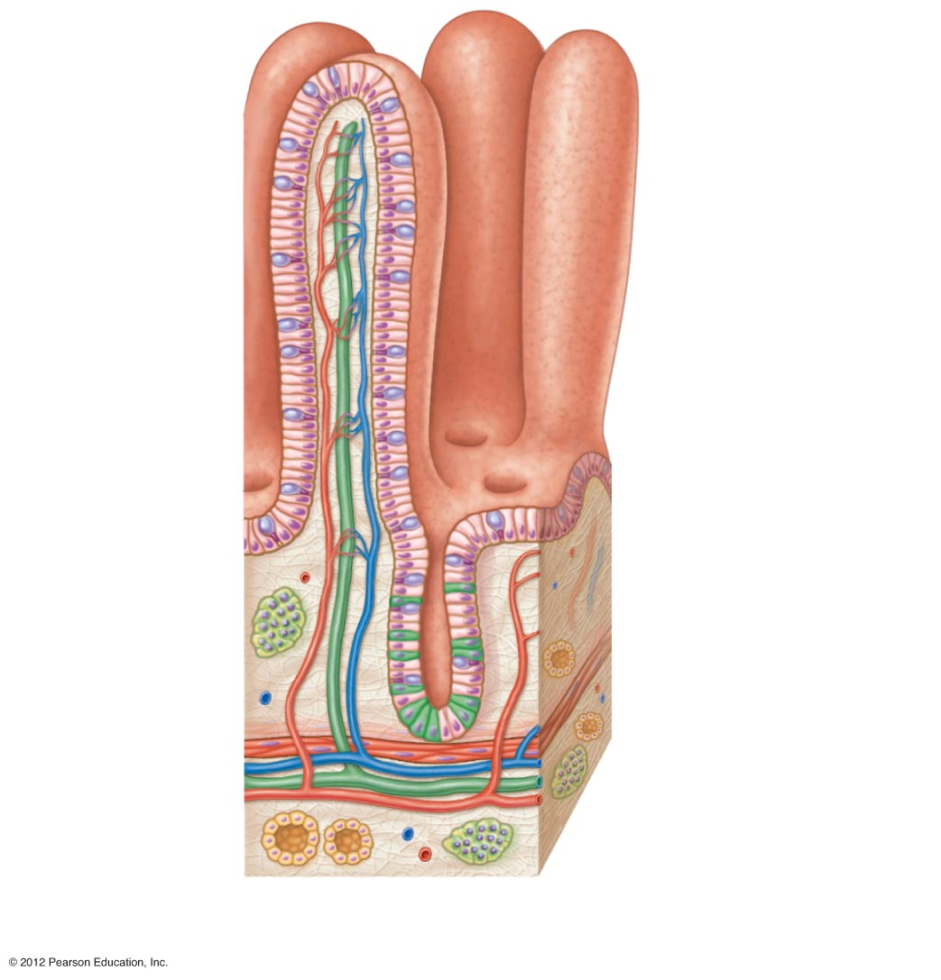
Absorptive
cells
Lacteal
Villus
Blood
capillaries
Lymphoid
tissue
Intestinal
crypt
Muscularis
mucosae
Venule
Lymphatic vessel
Submucosa
(b) Villi
Figure 14.7b

Slide 47
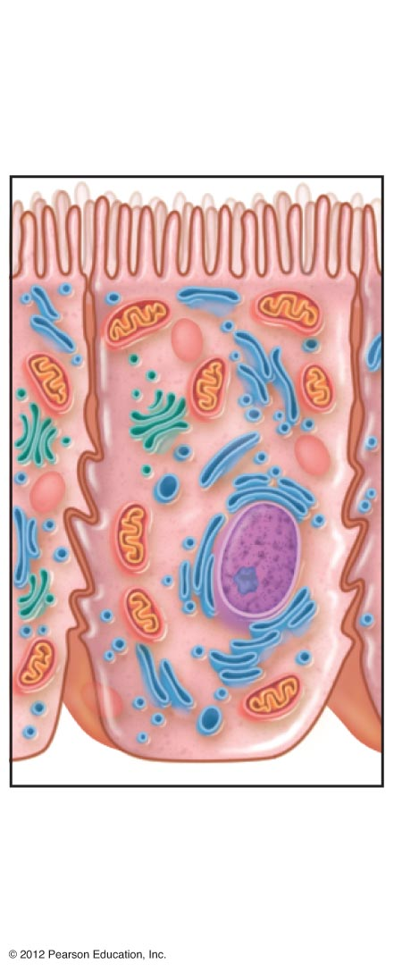
Microvilli
(brush border)
(c) Absorptive
cells
Figure 14.7c

Slide 48
Large Intestine
Larger in diameter, but shorter in length, than the small intestine
Extends from the ileocecal valve to the anus
Subdivisions:
Cecum
Appendix
Colon
Rectum
Anal canal

Slide 49
Large Intestine Anatomy
Cecum—saclike first part of the large intestine
Appendix
Accumulation of lymphatic tissue that sometimes becomes inflamed (appendicitis)
Hangs from the cecum

Slide 50
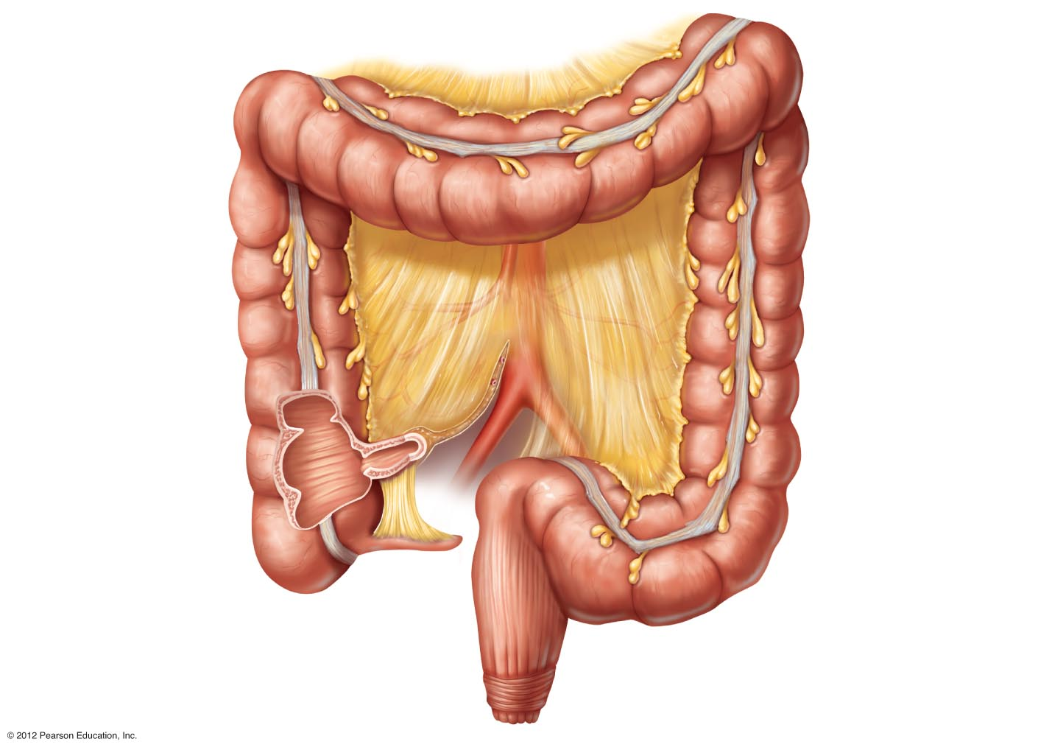
Left colic
(splenic) flexure
Transverse
mesocolon
Right colic
(hepatic) flexure
Transverse colon
Haustrum
Descending colon
Ascending colon
IIeum (cut)
Cut edge of
mesentery
IIeocecal valve
Teniae coli
Cecum
Sigmoid colon
Appendix
Rectum
Alan canal
External anal sphincter
Figure 14.8

Slide 51
Large Intestine Anatomy
Colon
Ascending—travels up right side of abdomen
Transverse—travels across the abdominal cavity
Descending—travels down the left side
Sigmoid—S-shaped region; enters the pelvis
Rectum and anus also are located in the pelvis

Slide 52
Left colic
(splenic) flexure
Transverse
mesocolon
Right colic
(hepatic) flexure
Transverse colon
Haustrum
Descending colon
Ascending colon
IIeum (cut)
Cut edge of
mesentery
IIeocecal valve
Teniae coli
Cecum
Sigmoid colon
Appendix
Rectum
Alan canal
External anal sphincter
Figure 14.8

Slide 53
Large Intestine Anatomy
Anus—opening of the large intestine
External anal sphincter—formed by skeletal muscle and under voluntary control
Internal involuntary sphincter—formed by smooth muscle
These sphincters are normally closed except during defecation

Slide 54
Left colic
(splenic) flexure
Transverse
mesocolon
Right colic
(hepatic) flexure
Transverse colon
Haustrum
Descending colon
Ascending colon
IIeum (cut)
Cut edge of
mesentery
IIeocecal valve
Teniae coli
Cecum
Sigmoid colon
Appendix
Rectum
Alan canal
External anal sphincter
Figure 14.8

Slide 55
Large Intestine Anatomy
No villi present
Goblet cells produce alkaline mucus which lubricates the passage of feces
Muscularis externa layer is reduced to three bands of muscle called teniae coli
These bands cause the wall to pucker into haustra (pocketlike sacs)

Slide 56
Accessory Digestive Organs
Teeth
Salivary glands
Pancreas
Liver
Gallbladder

Slide 57
Teeth
Function is to masticate (chew) food
Humans have two sets of teeth
Deciduous (baby or “milk”) teeth
A baby has 20 teeth by age two
First teeth to appear are the lower central incisors

Slide 58
Teeth
Permanent teeth
Replace deciduous teeth between the ages of 6 and 12
A full set is 32 teeth, but some people do not have wisdom teeth (third molars)
If they do emerge, the wisdom teeth appear between ages of 17 and 25

Slide 59
Classification of Teeth
Incisors—cutting
Canines (eyeteeth)—tearing or piercing
Premolars (bicuspids)—grinding
Molars—grinding

Slide 60
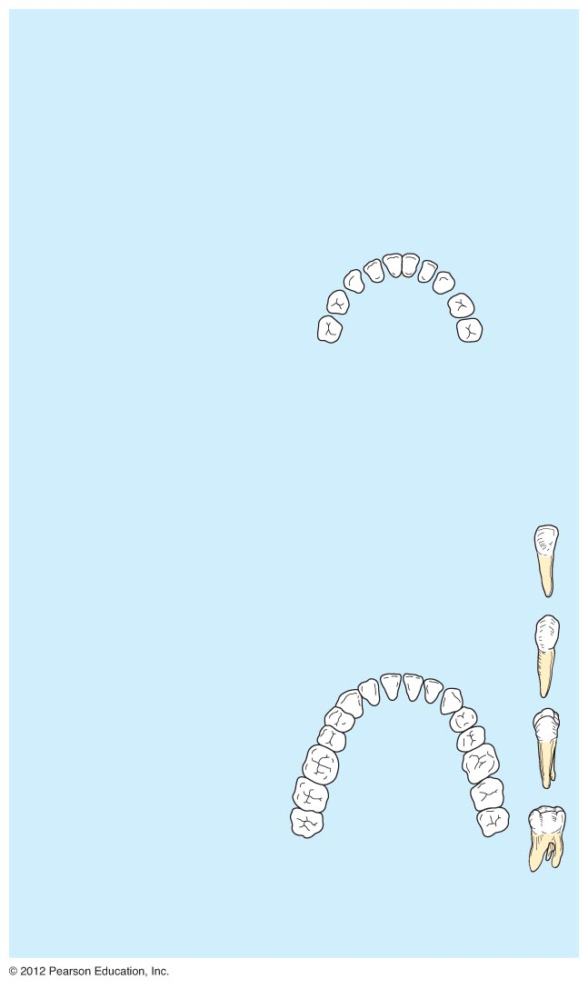
Incisors
Central
(6–8 mo)
Lateral
(8–10 mo)
Canine (eyetooth)
(16–20 mo)
Molars
First molar
(10–15 mo)
Second molar
(about 2 yr)
Deciduous
(milk) teeth
Incisors
Central (7 yr)
Lateral (8 yr)
Canine (eyetooth)
(11 yr)
Premolars
(bicuspids)
First premolar
(11 yr)
Second premolar
(12–13 yr)
Molars
First molar
(6–7 yr)
Second molar
(12–13 yr)
Permanent
teeth
Third molar
(wisdom tooth)
(17–25 yr)
Figure 14.9

Slide 61
Regions of a Tooth
Crown—exposed part
Enamel—hardest substance in the body
Dentin—found deep to the enamel and forms the bulk of the tooth
Pulp cavity—contains connective tissue, blood vessels, and nerve fibers
Root canal—where the pulp cavity extends into the root

Slide 62
Regions of a Tooth
Neck
Region in contact with the gum
Connects crown to root
Root
Cementum—covers outer surface and attaches the tooth to the periodontal membrane

Slide 63
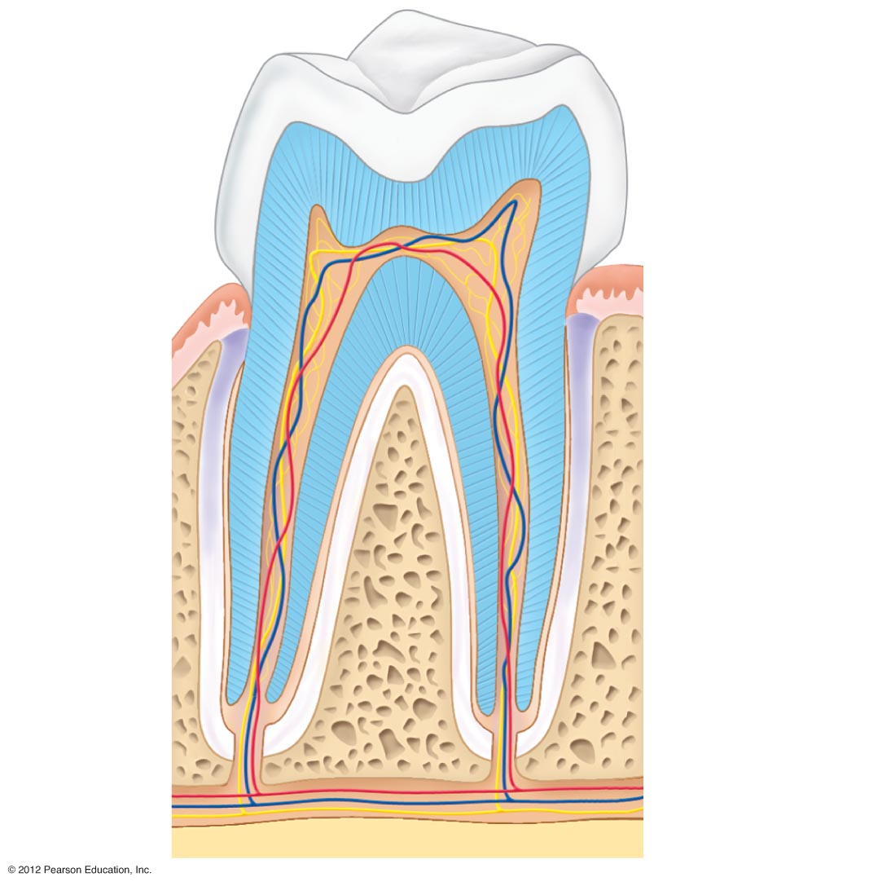
Enamel
Crown
Dentin
Pulp cavity
Gum
(gingiva)
Neck
Periodontal
membrane
Bone
Root
Cement
Root canal
Blood
vessels and
nerves in
pulp
Figure 14.10

Slide 64
Salivary Glands
Three pairs of salivary glands empty secretions into the mouth
Parotid glands
Found anterior to the ears
Submandibular glands
Sublingual glands
Both submandibular and sublingual glands empty saliva into the floor of the mouth through small ducts

Slide 65
Mouth (oral cavity)
Parotid gland
Tongue
Sublingual gland
Salivary glands
Submandibular
gland
Esophagus
Pharynx
Stomach
Pancreas
Liver
(Spleen)
Gallbladder
Transverse
colon
Duodenum
Descending
colon
Small intestine
Jejunum
lleum
Ascending
colon
Cecum
Large intestine
Sigmoid colon
Rectum
Anus
Appendix
Anal canal
Figure 14.1

Slide 66
Saliva
Mixture of mucus and serous fluids
Helps to form a food bolus
Contains salivary amylase to begin starch digestion
Dissolves chemicals so they can be tasted

Slide 67
Pancreas
Found posterior to the parietal peritoneum
Its location is retroperitoneal
Extends across the abdomen from spleen to duodenum

Slide 68
Pancreas
Produces a wide spectrum of digestive enzymes that break down all categories of food
Enzymes are secreted into the duodenum
Alkaline fluid introduced with enzymes neutralizes acidic chyme coming from stomach
Hormones produced by the pancreas
Insulin
Glucagon

Slide 69
Mouth (oral cavity)
Parotid gland
Tongue
Sublingual gland
Salivary glands
Submandibular
gland
Esophagus
Pharynx
Stomach
Pancreas
Liver
(Spleen)
Gallbladder
Transverse
colon
Duodenum
Descending
colon
Small intestine
Jejunum
lleum
Ascending
colon
Cecum
Large intestine
Sigmoid colon
Rectum
Anus
Appendix
Anal canal
Figure 14.1

Slide 70
Right and left
hepatic ducts
from liver
Cystic duct
Common hepatic duct
Bile duct and sphincter
Accessory pancreatic duct
Pancreas
Gallbladder
Jejunum
Duodenal
papilla
Hepatopancreatic
ampulla and sphincter
Main pancreatic duct and sphincter
Duodenum
Figure 14.6

Slide 71
Liver
Largest gland in the body
Located on the right side of the body under the diaphragm
Consists of four lobes suspended from the diaphragm and abdominal wall by the falciform ligament
Connected to the gallbladder via the common hepatic duct

Slide 72
Mouth (oral cavity)
Parotid gland
Tongue
Sublingual gland
Salivary glands
Submandibular
gland
Esophagus
Pharynx
Stomach
Pancreas
Liver
(Spleen)
Gallbladder
Transverse
colon
Duodenum
Descending
colon
Small intestine
Jejunum
lleum
Ascending
colon
Cecum
Large intestine
Sigmoid colon
Rectum
Anus
Appendix
Anal canal
Figure 14.1

Slide 73
Diaphragm
Falciform ligament
Liver
Lesser
omentum
Spleen
Pancreas
Gallbladder
Stomach
Duodenum
Visceral peritoneum
Transverse
colon
Greater omentum
Mesenteries
Parietal peritoneum
Small intestine
Peritoneal
cavity
Uterus
Large intestine
Cecum
Rectum
Urinary bladder
Anus
(a)
(b)
Figure 14.5a-b

Slide 74
Bile
Produced by cells in the liver
Bile leaves the liver through the common hepatic duct
Composition is
Bile salts
Bile pigments (mostly bilirubin from the breakdown of hemoglobin)
Cholesterol
Phospholipids
Electrolytes

Slide 75
Bile
Function—emulsify fats by physically breaking large fat globules into smaller ones

Slide 76
Gallbladder
Sac found in hollow fossa of liver
When no digestion is occurring, bile backs up the cystic duct for storage in the gallbladder
When digestion of fatty food is occurring, bile is introduced into the duodenum from the gallbladder
Gallstones are crystallized cholesterol which can cause blockages

Slide 77
Mouth (oral cavity)
Parotid gland
Tongue
Sublingual gland
Salivary glands
Submandibular
gland
Esophagus
Pharynx
Stomach
Pancreas
Liver
(Spleen)
Gallbladder
Transverse
colon
Duodenum
Descending
colon
Small intestine
Jejunum
lleum
Ascending
colon
Cecum
Large intestine
Sigmoid colon
Rectum
Anus
Appendix
Anal canal
Figure 14.1

Slide 78
Right and left
hepatic ducts
from liver
Cystic duct
Common hepatic duct
Bile duct and sphincter
Accessory pancreatic duct
Pancreas
Gallbladder
Jejunum
Duodenal
papilla
Hepatopancreatic
ampulla and sphincter
Main pancreatic duct and sphincter
Duodenum
Figure 14.6

Slide 79
Functions of the Digestive System
Ingestion—placing food into the mouth
Propulsion—moving foods from one region of the digestive system to another
Peristalsis—alternating waves of contraction and relaxation that squeezes food along the GI tract
Segmentation—moving materials back and forth to aid with mixing in the small intestine

Slide 80
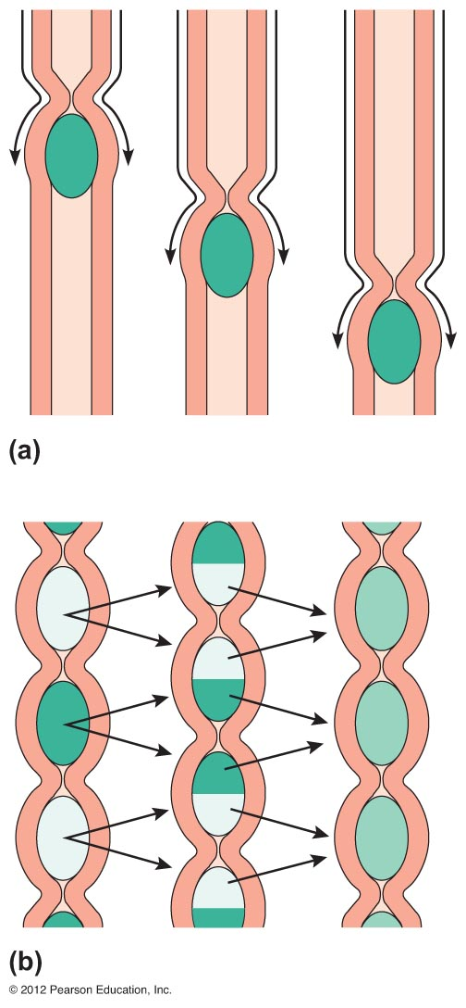
Figure 14.12a-b

Slide 81
Ingestion
Food
Mechanical
digestion
Pharynx
Chewing (mouth)
Esophagus
Churning (stomach)
Propulsion
Segmentation
(small intestine)
Swallowing
(oropharynx)
Chemical
digestion
Peristalsis
(esophagus,
stomach,
small intestine,
large intestine)
Stomach
Absorption
Lymph
vessel
Small
intestine
Large
intestine
Blood
vessel
Mainly H₂O
Feces
Defecation
Anus
Figure 14.11

Slide 82
Functions of the Digestive System
Food breakdown as chemical digestion
Enzymes break down food molecules into their building blocks
Each major food group uses different enzymes
Carbohydrates are broken to simple sugars
Proteins are broken to amino acids
Fats are broken to fatty acids and alcohols

Slide 83
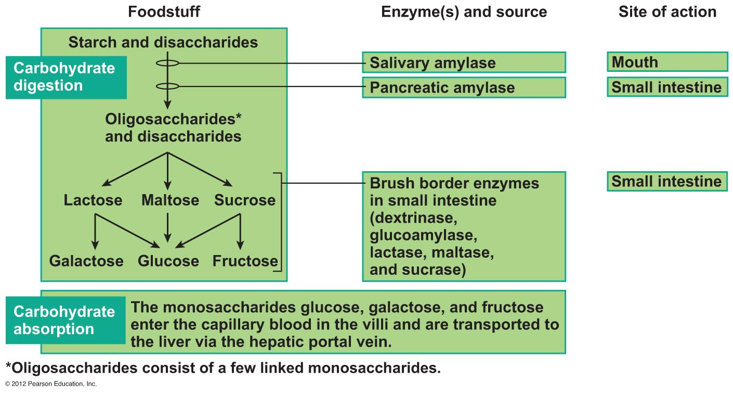
Figure 14.13 (1 of 3)

Slide 84
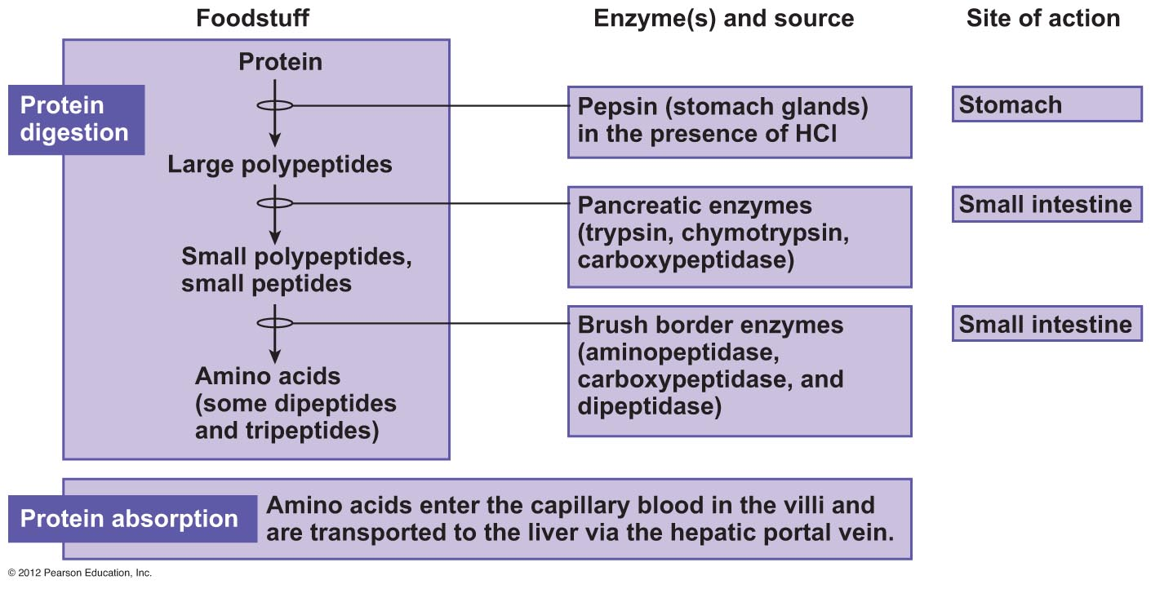
Figure 14.13 (2 of 3)

Slide 85
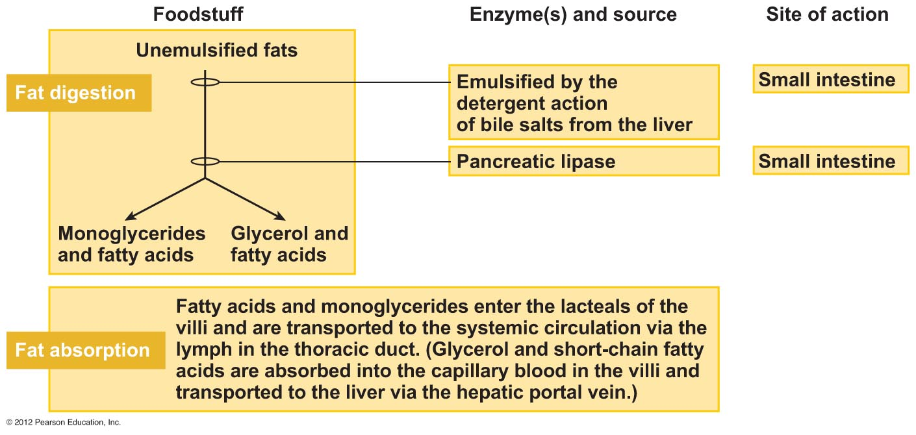
Figure 14.13 (3 of 3)

Slide 86
Ingestion
Food
Mechanical
digestion
Pharynx
Chewing (mouth)
Esophagus
Churning (stomach)
Propulsion
Segmentation
(small intestine)
Swallowing
(oropharynx)
Chemical
digestion
Peristalsis
(esophagus,
stomach,
small intestine,
large intestine)
Stomach
Absorption
Lymph
vessel
Small
intestine
Large
intestine
Blood
vessel
Mainly H₂O
Feces
Defecation
Anus
Figure 14.11

Slide 87
Control of Digestive Activity
Mostly controlled by reflexes via the parasympathetic division
Chemical and mechanical receptors are located in organ walls that trigger reflexes

Slide 88
Control of Digestive Activity
Stimuli include
Stretch of the organ
pH of the contents
Presence of breakdown products
Reflexes include
Activation or inhibition of glandular secretions
Smooth muscle activity

Slide 89
Digestive Activities of the Mouth
Mechanical breakdown
Food is physically broken down by chewing
Chemical digestion
Food is mixed with saliva
Starch is broken down into maltose by salivary amylase

Slide 90
Activities of the Pharynx and Esophagus
These organs have no digestive function
Serve as passageways to the stomach

Slide 91
Deglutition (Swallowing)
Buccal phase
Voluntary
Occurs in the mouth
Food is formed into a bolus
The bolus is forced into the pharynx by the tongue

Slide 92
Deglutition (Swallowing)
Pharyngeal-esophageal phase
Involuntary transport of the bolus
All passageways except to the stomach are blocked
Tongue blocks off the mouth
Soft palate (uvula) blocks the nasopharynx
Epiglottis blocks the larynx

Slide 93
Deglutition (Swallowing)
Pharyngeal-esophogeal phase (continued)
Peristalsis moves the bolus toward the stomach
The cardioesophageal sphincter is opened when food presses against it

Slide 94
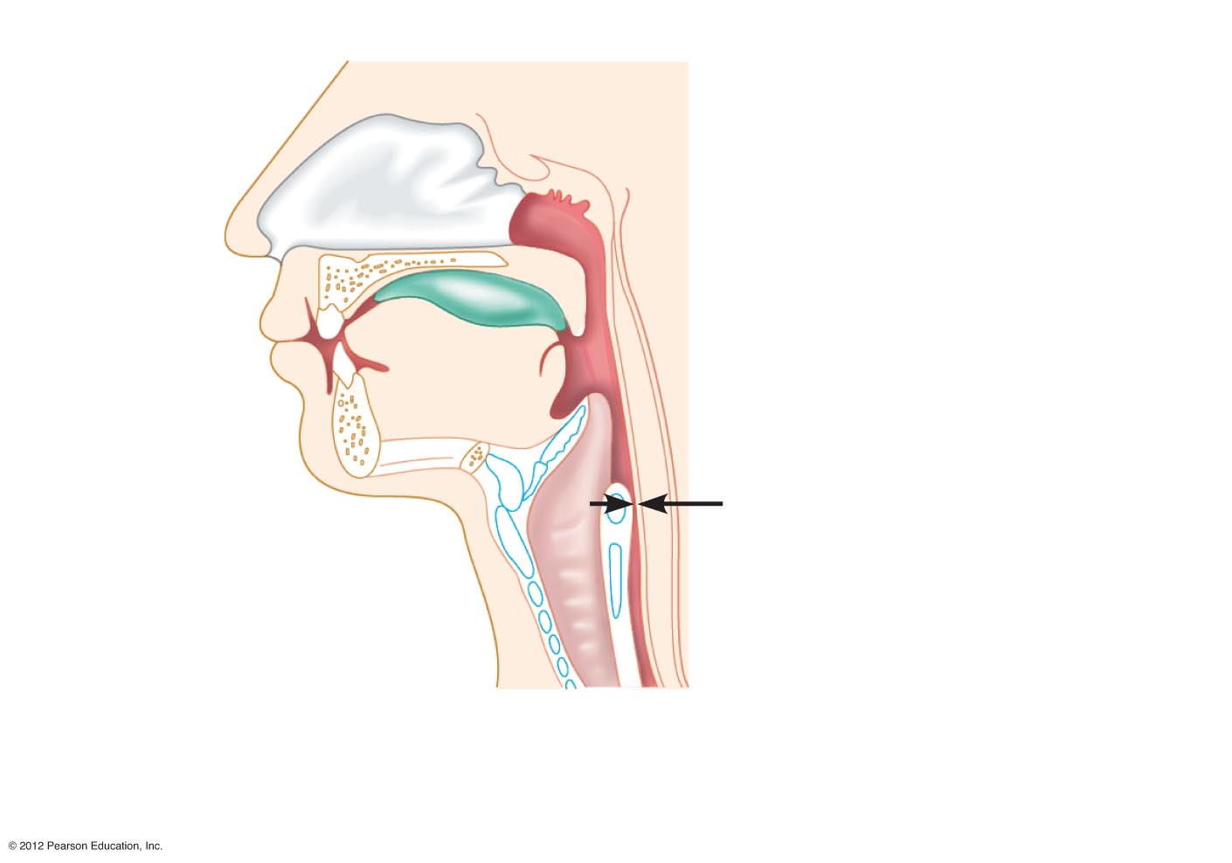
Bolus of food
Tongue
Pharynx
Epiglottis
up
Upper
esophageal
sphincter
Glottis (lumen)
of larynx
Trachea
Esophagus
(a) Upper esophageal
sphincter contracted
Figure 14.14a

Slide 95
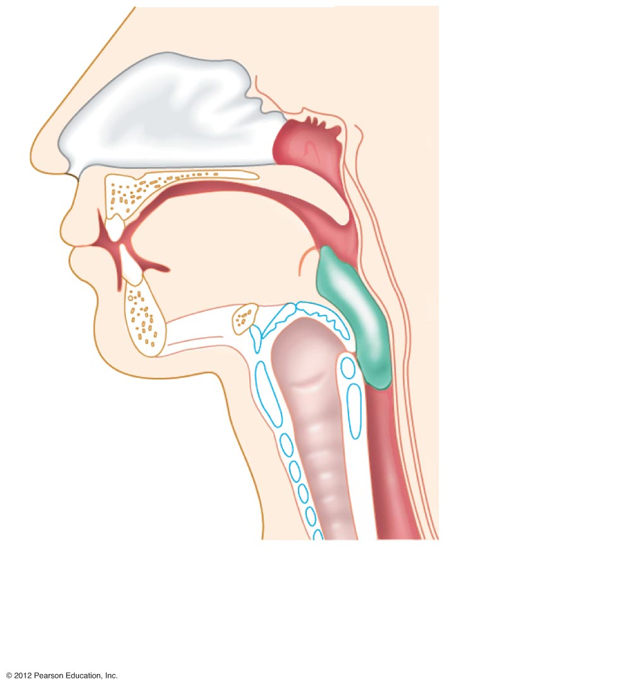
Uvula
Bolus
Epiglottis
down
Larynx up
Esophagus
(b) Upper esophageal
sphincter relaxed
Figure 14.14b

Slide 96
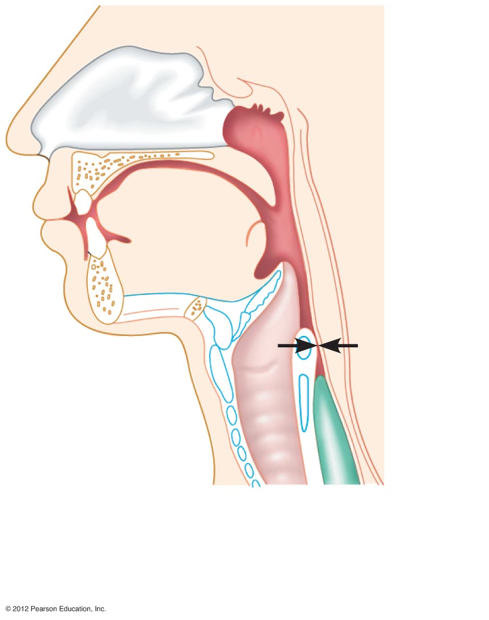
Bolus
(c) Upper esophageal
sphincter contracted
Figure 14.14c

Slide 97
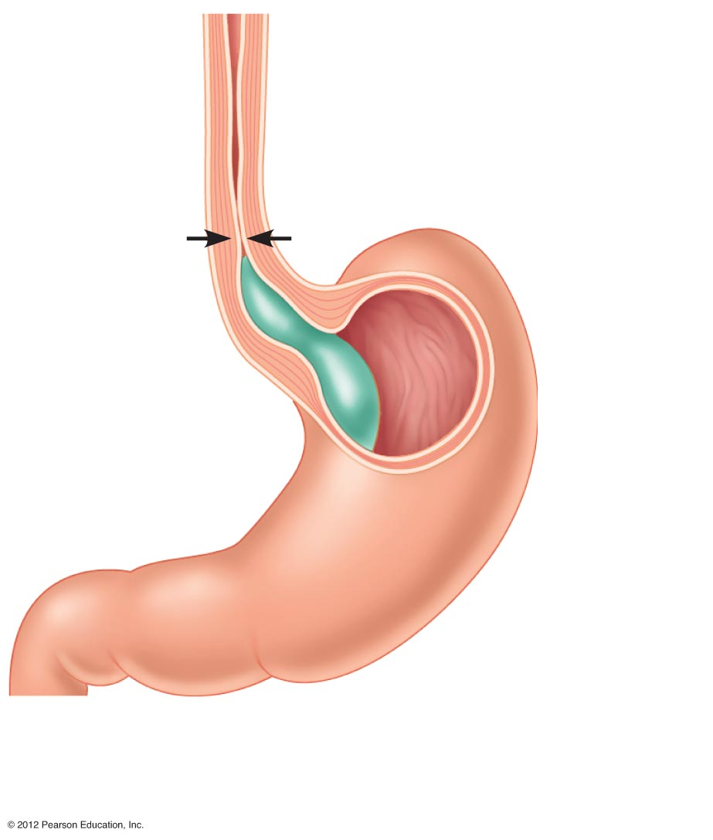
Relaxed
muscles
Cardioesophageal
sphincter open
(d) Cardioesophageal
sphincter relaxed
Figure 14.14d

Slide 98
Food Breakdown in the Stomach
Gastric juice is regulated by neural and hormonal factors
Presence of food or rising pH causes the release of the hormone gastrin
Gastrin causes stomach glands to produce
Protein-digesting enzymes
Mucus
Hydrochloric acid

Slide 99
Food Breakdown in the Stomach
Hydrochloric acid makes the stomach contents very acidic
Acidic pH
Activates pepsinogen to pepsin for protein digestion
Provides a hostile environment for microorganisms

Slide 100
Digestion and Absorption in the Stomach
Protein digestion enzymes
Pepsin—an active protein-digesting enzyme
Rennin—works on digesting milk protein in infants, not adults
Alcohol and aspirin are the only items absorbed in the stomach

Slide 101
Propulsion in the Stomach
Food must first be well mixed
Rippling peristalsis occurs in the lower stomach
Propulsion
Grinding
Retropulsion
The pylorus meters out chyme into the small intestine (3 mL at a time)
The stomach empties in 4–6 hours

Slide 102
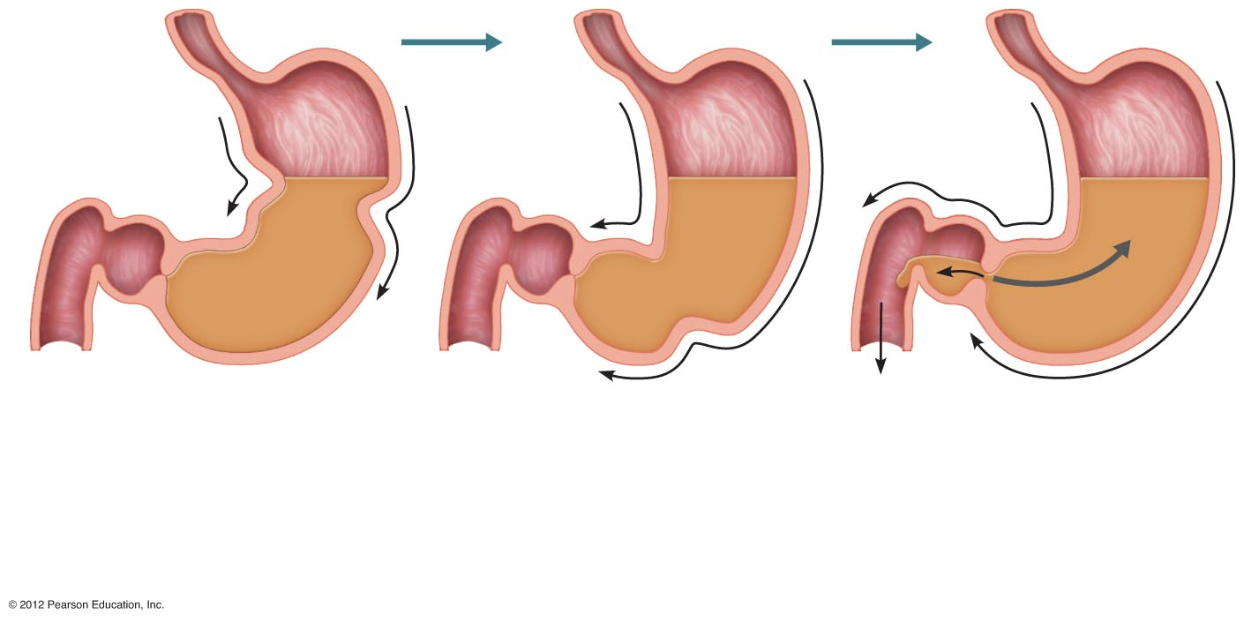
Pyloric
sphincter
slightly
open
Pyloric
sphincter
closed
Pyloric
sphincter
closed
Propulsion: Peristaltic
waves move from the
fundus to the pylorus.
Grinding: The most
vigorous peristalsis and
mixing action occur close
to the pylorus.
Retropulsion: The pyloric
end of the stomach pumps
small amounts of chyme
into the duodenum, while
simultaneously forcing most
of its contents backward
into the stomach.
1
2
3
Figure 14.15

Slide 103
Digestion in the Small Intestine
Enzymes from the brush border function to
Break double sugars into simple sugars
Complete some protein digestion

Slide 104
Digestion in the Small Intestine
Pancreatic enzymes play the major digestive function
Help complete digestion of starch (pancreatic amylase)
Carry out about half of all protein digestion
Digest fats using lipases from the pancreas
Digest nucleic acids using nucleases
Alkaline content neutralizes acidic chyme

Slide 105
Regulation of Pancreatic Juice Secretion
Release of pancreatic juice into the duodenum is stimulated by
Vagus nerve
Local hormones
Secretin
Cholecystokinin (CCK)
Hormones travel the blood to stimulate the pancreas to release enzyme- and bicarbonate-rich product

Slide 106
Regulation of Pancreatic Juice Secretion
Secretin causes the liver to increase bile output
CCK causes the gallbladder to release stored bile
Bile is necessary for fat absorption and absorption of fat-soluble vitamins (K, D, A)

Slide 107
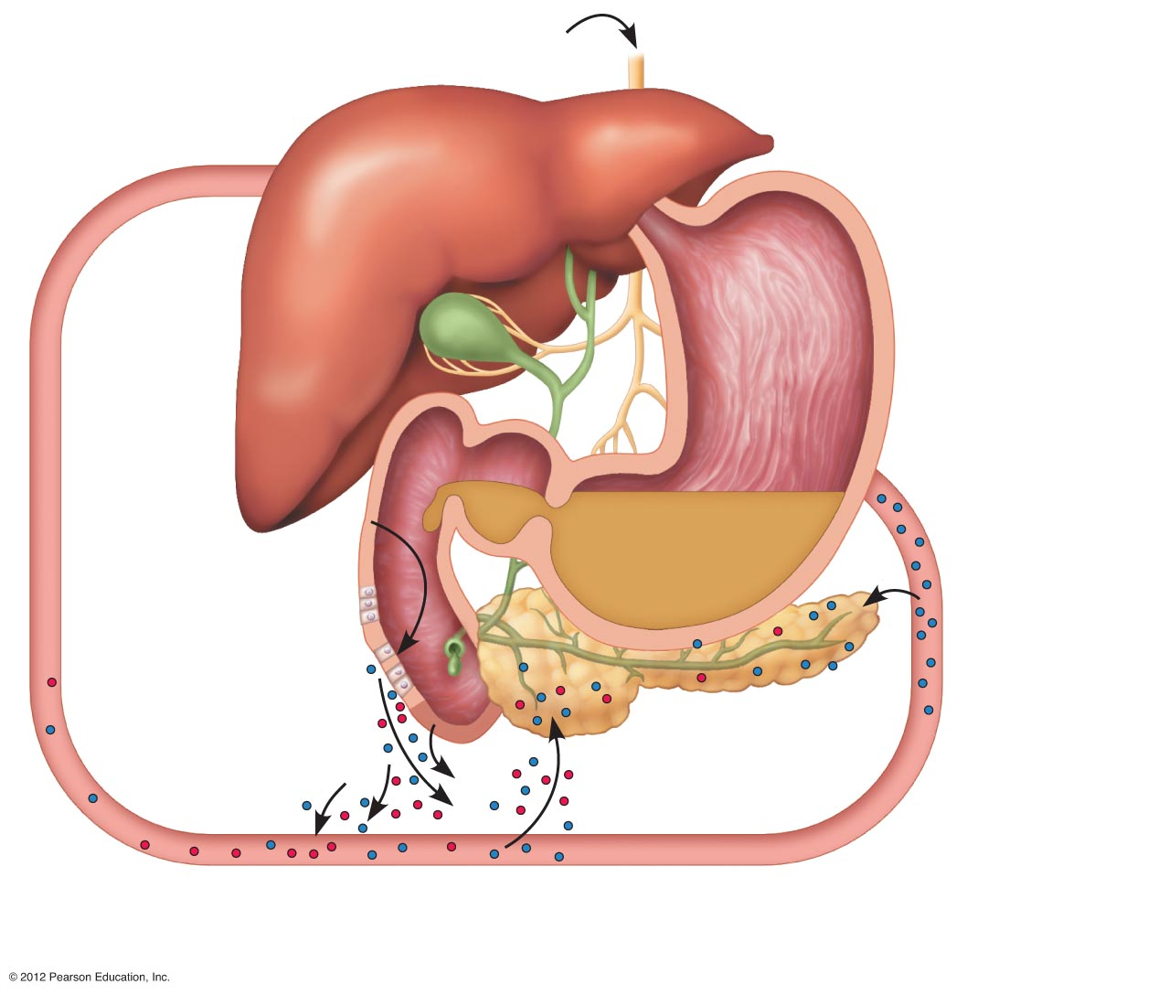
Stimulation by vagal nerve
fibers causes release of
pancreatic juice and weak
contractions of the gallbladder.
Secretin causes the liver to
secrete more bile; CCK stimulates
the gallbladder to release stored
bile and the hepatopancreatic
sphincter to relax (allows bile to
enter the duodenum).
5
4
Chyme entering
duodenum causes the
enteroendocrine cells
of the duodenum to
release secretin and
cholecystokinin (CCK).
1
CCK (red dots)
and secretin (blue
dots) enter
bloodstream.
2
Upon reaching the
pancreas, CCK
induces secretion of
enzyme-rich pancreatic
juice; secretin causes
secretion of bicarbonate-
rich pancreatic juice.
3
Figure 14.16

Slide 108
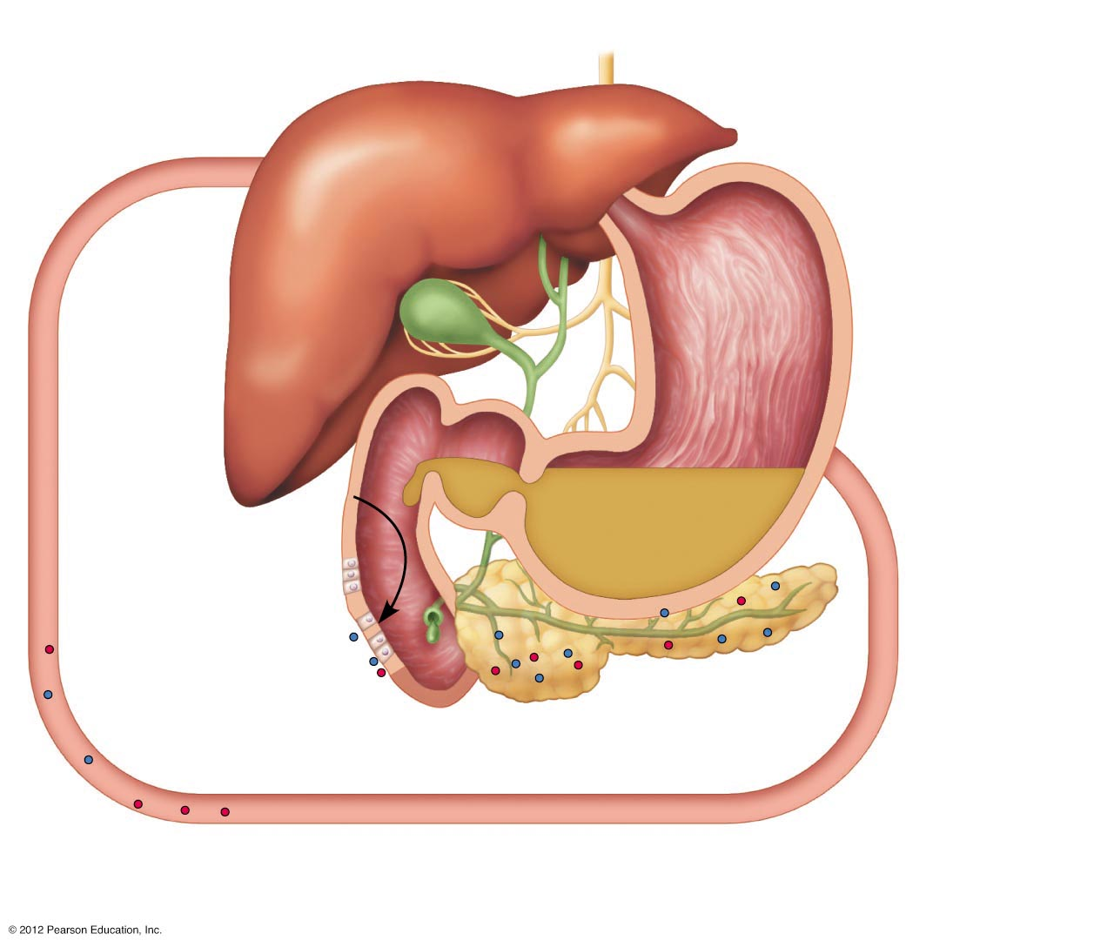
Chyme entering
duodenum causes the
enteroendocrine cells
of the duodenum to
release secretin and
cholecystokinin (CCK).
1
Figure 14.16, step 1

Slide 109
Chyme entering
duodenum causes the
enteroendocrine cells
of the duodenum to
release secretin and
cholecystokinin (CCK).
1
CCK (red dots)
and secretin (blue
dots) enter
bloodstream.
2
Figure 14.16, step 2

Slide 110
Chyme entering
duodenum causes the
enteroendocrine cells
of the duodenum to
release secretin and
cholecystokinin (CCK).
1
CCK (red dots)
and secretin (blue
dots) enter
bloodstream.
2
Upon reaching the
pancreas, CCK
induces secretion of
enzyme-rich pancreatic
juice; secretin causes
secretion of bicarbonate-
rich pancreatic juice.
3
Figure 14.16, step 3

Slide 111
Secretin causes the liver to
secrete more bile; CCK stimulates
the gallbladder to release stored
bile and the hepatopancreatic
sphincter to relax (allows bile to
enter the duodenum).
4
Chyme entering
duodenum causes the
enteroendocrine cells
of the duodenum to
release secretin and
cholecystokinin (CCK).
1
CCK (red dots)
and secretin (blue
dots) enter
bloodstream.
2
Upon reaching the
pancreas, CCK
induces secretion of
enzyme-rich pancreatic
juice; secretin causes
secretion of bicarbonate-
rich pancreatic juice.
3
Figure 14.16, step 4

Slide 112
Stimulation by vagal nerve
fibers causes release of
pancreatic juice and weak
contractions of the gallbladder.
Secretin causes the liver to
secrete more bile; CCK stimulates
the gallbladder to release stored
bile and the hepatopancreatic
sphincter to relax (allows bile to
enter the duodenum).
5
4
Chyme entering
duodenum causes the
enteroendocrine cells
of the duodenum to
release secretin and
cholecystokinin (CCK).
1
CCK (red dots)
and secretin (blue
dots) enter
bloodstream.
2
Upon reaching the
pancreas, CCK
induces secretion of
enzyme-rich pancreatic
juice; secretin causes
secretion of bicarbonate-
rich pancreatic juice.
3
Figure 14.16, step 5

Slide 113
Absorption in the Small Intestine
Water is absorbed along the length of the small intestine
End products of digestion
Most substances are absorbed by active transport through cell membranes
Lipids are absorbed by diffusion
Substances are transported to the liver by the hepatic portal vein or lymph

Slide 114
Propulsion in the Small Intestine
Peristalsis is the major means of moving food
Segmental movements
Mix chyme with digestive juices
Aid in propelling food

Slide 115
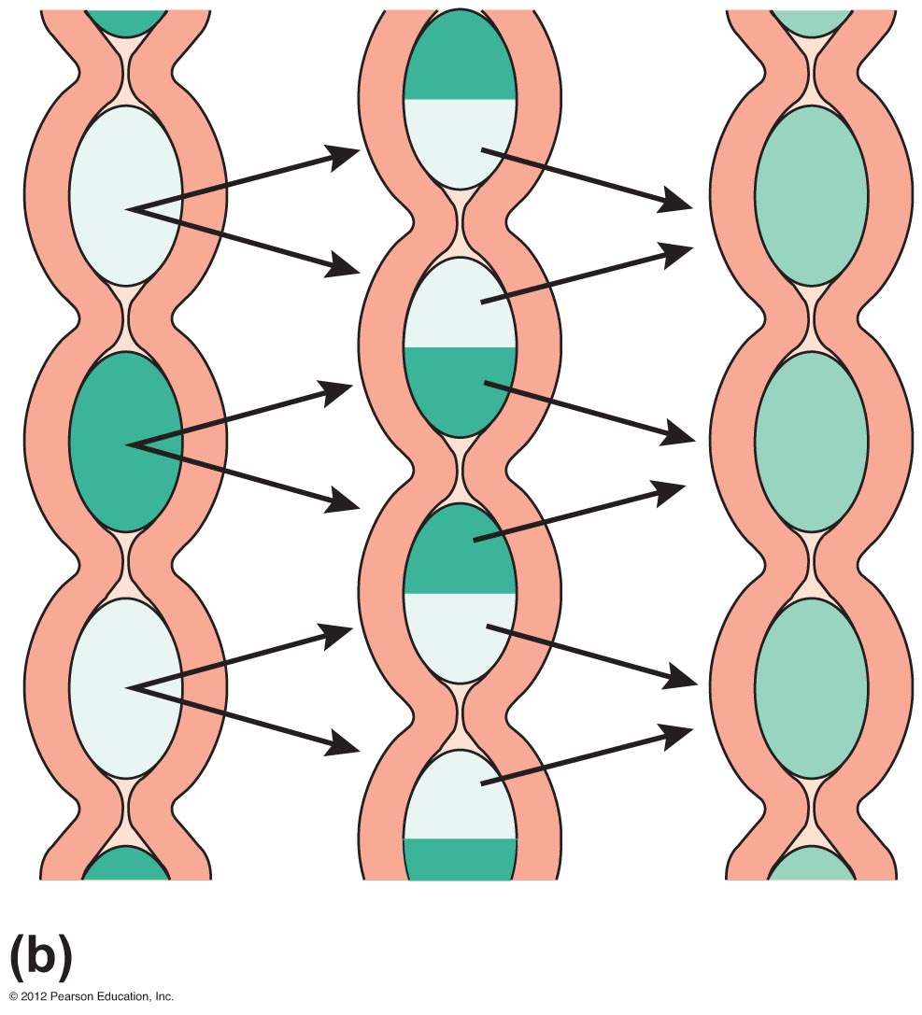
Figure 14.12b

Slide 116
Food Breakdown and Absorption in the Large Intestine
No digestive enzymes are produced
Resident bacteria digest remaining nutrients
Produce some vitamin K and B
Release gases
Water and vitamins K and B are absorbed
Remaining materials are eliminated via feces

Slide 117
Food Breakdown and Absorption in the Large Intestine
Feces contains
Undigested food residues
Mucus
Bacteria
Water

Slide 118
Propulsion in the Large Intestine
Sluggish peristalsis
Mass movements
Slow, powerful movements
Occur three to four times per day
Presence of feces in the rectum causes a defecation reflex
Internal anal sphincter is relaxed
Defecation occurs with relaxation of the voluntary (external) anal sphincter

Slide 119
Nutrition
Nutrient—substance used by the body for growth, maintenance, and repair
Major nutrients
Carbohydrates
Lipids
Proteins
Water
Minor nutrients
Vitamins
Minerals

Slide 120
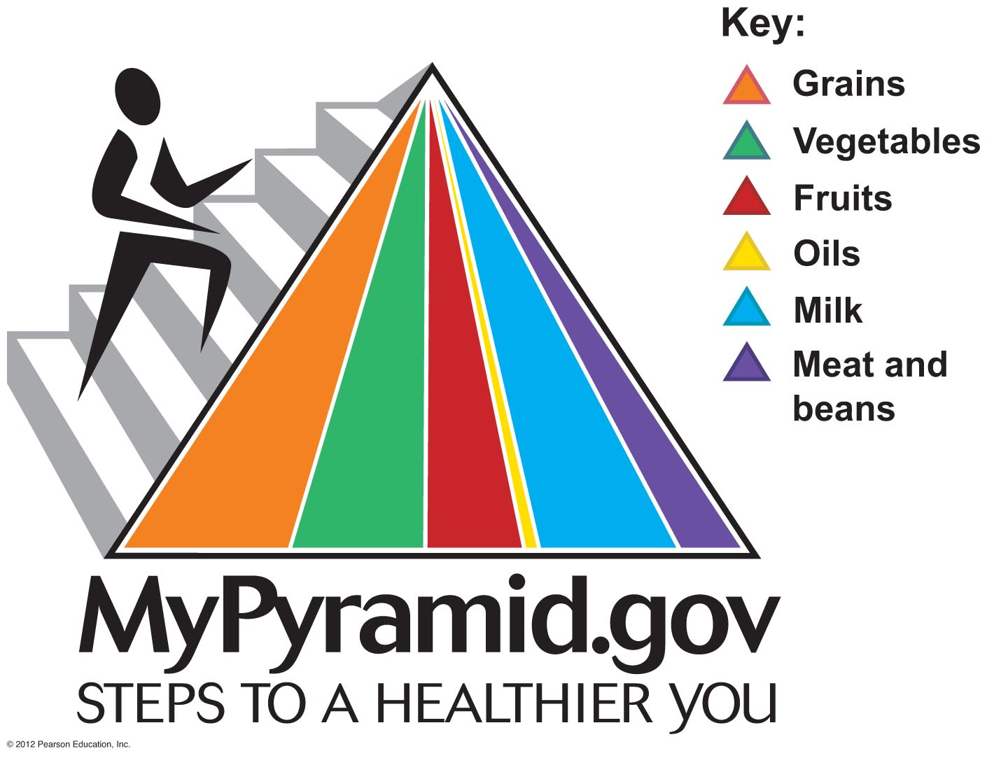
Figure 14.17

Slide 121
Dietary Sources of Major Nutrients
Carbohydrates
Most are derived from plants
Exceptions: lactose from milk and small amounts of glycogens from meats
Lipids
Saturated fats from animal products
Unsaturated fats from nuts, seeds, and vegetable oils
Cholesterol from egg yolk, meats, and milk products

Slide 122
Dietary Sources of Major Nutrients
Proteins
Complete proteins—contain all essential amino acids
Most are from animal products
Essential amino acids are ones that our bodies cannot make
We must obtain essential amino acids through our diet
Legumes and beans also have proteins, but are incomplete

Slide 123
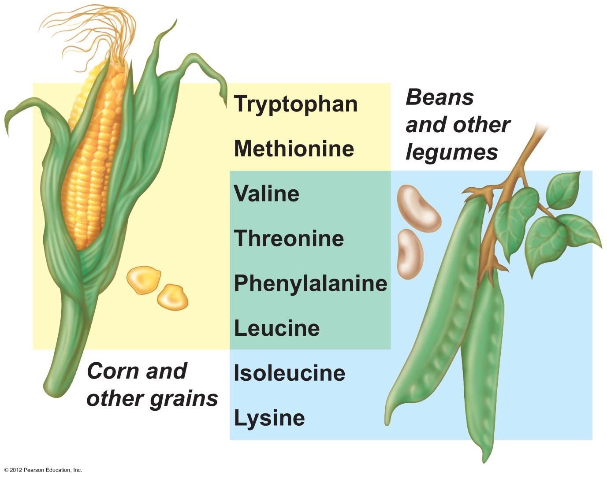
Figure 14.18

Slide 124
Dietary Sources of Major Nutrients
Vitamins
Most vitamins are used as coenzymes
Found in all major food groups

Slide 125
Dietary Sources of Major Nutrients
Minerals
Play many roles in the body
Most mineral-rich foods are vegetables, legumes, milk, and some meats

Slide 126
Metabolism
Chemical reactions necessary to maintain life
Catabolism—substances are broken down to simpler substances; energy is released
Anabolism—larger molecules are built from smaller ones

Slide 127
Carbohydrate Metabolism
Carbohydrates are the body’s preferred source to produce cellular energy (ATP)
Glucose (blood sugar)
Major breakdown product of carbohydrate digestion
Fuel used to make ATP

Slide 128
Cellular Respiration
Oxygen-using events take place within the cell to create ATP from ADP
Carbon leaves cells as carbon dioxide (CO₂)
Hydrogen atoms are combined with oxygen to form water
Energy produced by these reactions adds a phosphorus to ADP to produce ATP
ATP can be broken down to release energy for cellular use

Slide 129
Figure 14.19

Slide 130
Metabolic Pathways Involved in Cellular Respiration
Glycolysis—energizes a glucose molecule so it can be split into two pyruvic acid molecules and yield ATP

Slide 131
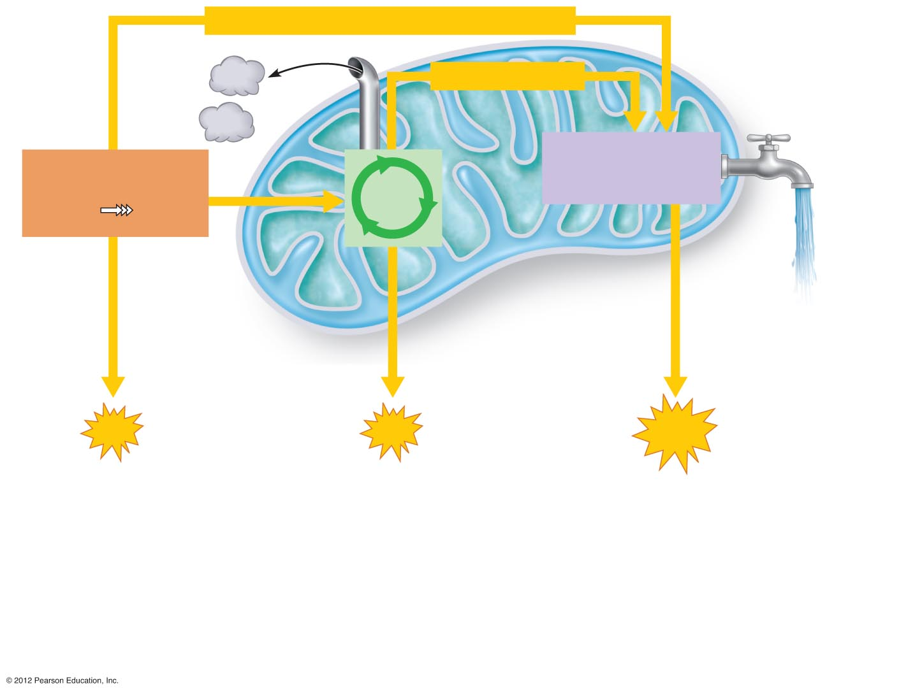
Chemical energy (high-energy electrons)
CO₂
Chemical energy
CO₂
Electron transport
chain and oxidative
phosphorylation
Glycolysis
Pyruvic
acid
Krebs
cycle
Glucose
H₂O
Cytosol
of cell
Mitochondrion
Mitochondrial
cristae
Via oxidative
phosphorylation
Via substrate-level
phosphorylation
2
ATP
2
ATP
28
ATP
During glycolysis, each
glucose molecule is
broken down into two
molecules of pyruvic acid
as hydrogen atoms
containing high-energy
electrons are removed.
The pyruvic acid enters
the mitochondrion where
Krebs cycle enzymes
remove more hydrogen
atoms and decompose it to
CO₂. During glycolysis and
the Krebs cycle, small
amounts of ATP are formed.
Energy-rich electrons picked up by
coenzymes are transferred to the electron
transport chain, built into the cristae
membrane. The electron transport chain
carries out oxidative phosphorylation,
which accounts for most of the ATP
generated by cellular respiration, and
finally unites the removed hydrogen with
oxygen to form water.
1
2
3
Figure 14.20

Slide 132
Metabolism of Carbohydrates
Hyperglycemia—excessively high levels of glucose in the blood
Excess glucose is stored in body cells as glycogen
If blood glucose levels are still too high, excesses are converted to fat

Slide 133
(a) Carbohydrates: polysaccharides, disaccharides;
composed of simple sugars (monosaccharides)
ATP
Polysaccharides
Glycogen and fat
broken down for
ATP formation
Cellular uses
GI digestion to
simple sugars
To
capillary
Excess stored as
glycogen or fat
Broken down to glucose
and released to blood
Monosaccharides
Figure 14.22a

Slide 134
Metabolism of Carbohydrates
Hypoglycemia—low levels of glucose in the blood
Liver breaks down stored glycogen and releases glucose into the blood

Slide 135
Fat Metabolism
Handled mostly by the liver
Uses some fats to make ATP
Synthesizes lipoproteins, thromboplastin, and cholesterol
Releases breakdown products to the blood
Body cells remove fat and cholesterol to build membranes and steroid hormones

Slide 136
Protein Metabolism
Proteins are conserved by body cells because they are used for most cellular structures
Ingested proteins are broken down to amino acids

Slide 137
Protein Metabolism
Cells remove amino acids to build proteins
Synthesized proteins are actively transported across cell membranes
Amino acids are used to make ATP only when proteins are overabundant or there is a shortage of other sources

Slide 138
Role of the Liver in Metabolism
Several roles in digestion
Manufactures bile
Detoxifies drugs and alcohol
Degrades hormones
Produces cholesterol, blood proteins (albumin and clotting proteins)
Plays a central role in metabolism
Can regenerate if part of it is damaged or removed

Slide 139
Metabolic Functions of the Liver
Glycogenesis—“glycogen formation”
Glucose molecules are converted to glycogen
Glycogen molecules are stored in the liver
Glycogenolysis—“glucose splitting”
Glucose is released from the liver after conversion from glycogen
Gluconeogenesis—“formation of new sugar”
Glucose is produced from fats and proteins

Slide 140
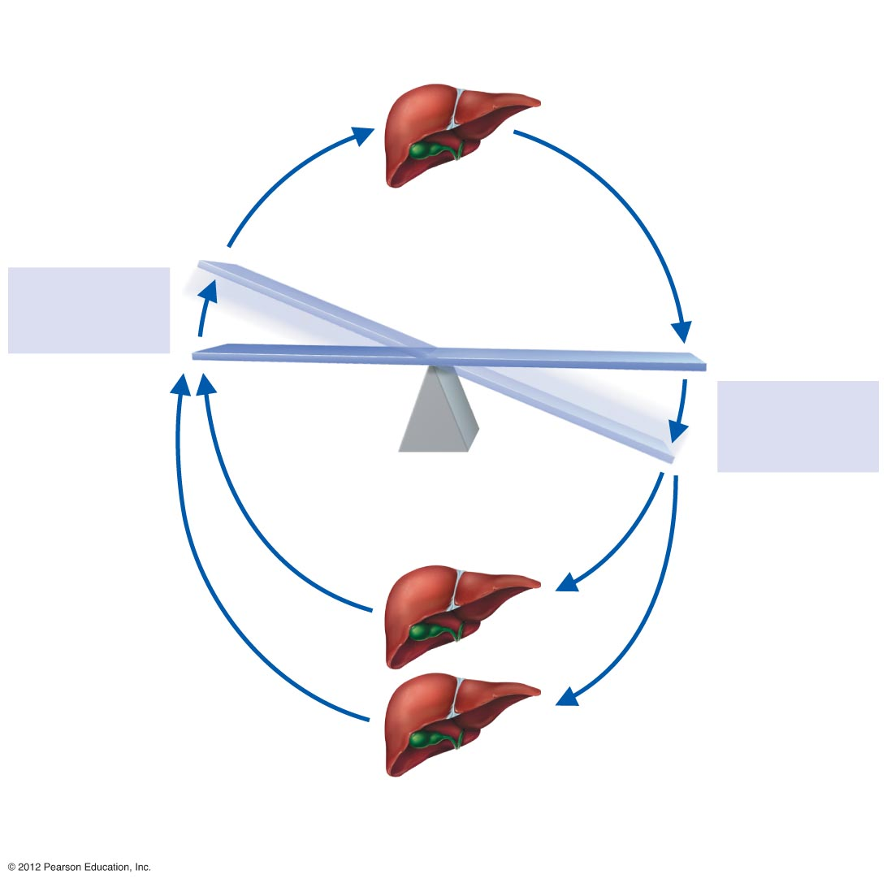
Glycogenesis:
Glucose converted to
glycogen and stored
Stimulus:
Rising blood
glucose level
IMBALANCE
HOMEOSTATIC BLOOD SUGAR
Stimulus:
Falling blood
glucose level
IMBALANCE
Glycogenolysis:
Stored glycogen
converted to glucose
Gluconeogenesis:
Amino acids and fats
converted to glucose
Figure 14.23

Slide 141
Cholesterol Metabolism
Cholesterol is not used to make ATP
Functions of cholesterol
Serves as a structural basis of steroid hormones and vitamin D
Is a major building block of plasma membranes
Most cholesterol is produced in the liver (85 percent) and is not from diet (15 percent)

Slide 142
Cholesterol Transport
Cholesterol and fatty acids cannot freely circulate in the bloodstream
They are transported by lipoproteins (lipid-protein complexes)
Low-density lipoproteins (LDLs) transport to body cells
Rated “bad lipoproteins” since they can lead to artherosclerosis
High-density lipoproteins (HDLs) transport from body cells to the liver

Slide 143
Body Energy Balance
Energy intake = total energy output
(heat + work + energy storage)
Energy intake is the energy liberated during food oxidation
Energy produced during glycolysis, Krebs cycle and the electron transport chain
Energy output
Energy we lose as heat (60 percent)
Energy stored as fat or glycogen

Slide 144
Regulation of Food Intake
Body weight is usually relatively stable
Energy intake and output remain about equal
Mechanisms that may regulate food intake
Levels of nutrients in the blood
Hormones
Body temperature
Psychological factors

Slide 145
Metabolic Rate and Body Heat Production
Basic metabolic rate (BMR)—amount of heat produced by the body per unit of time at rest
Average BMR is about 60 to 72 kcal/hour
Kilocalorie (kcal) is the unit of measure for the energy value of foods and the amount of energy used by the body

Slide 146
Metabolic Rate and Body Heat Production
Factors that influence BMR
Surface area—a small body usually has a higher BMR
Gender—males tend to have higher BMRs
Age—children and adolescents have higher BMRs
The amount of thyroxine produced is the most important control factor
More thyroxine means a higher metabolic rate

Slide 147
Total Metabolic Rate (TMR)
TMR = Total amount of kilocalories the body must consume to fuel ongoing activities
TMR increases with an increase in body activity
TMR must equal calories consumed to maintain homeostasis and maintain a constant weight

Slide 148
Body Temperature Regulation
Most energy is released as foods are oxidized
Most energy escapes as heat

Slide 149
Body Temperature Regulation
The body has a narrow range of homeostatic temperature
Must remain between 35.6°C to 37.8°C (96°F to 100°F)
The body’s thermostat is in the hypothalamus
Initiates heat-loss or heat-promoting mechanisms

Slide 150
Body Temperature Regulation
Heat-promoting mechanisms
Vasoconstriction of blood vessels
Blood is rerouted to deeper, more vital body organs
Shivering—contraction of muscles produces heat

Slide 151
Body Temperature Regulation
Heat-loss mechanisms
Heat loss from the skin via radiation and evaporation
Skin blood vessels and capillaries are flushed with warm blood
Evaporation of perspiration cools the skin

Slide 152
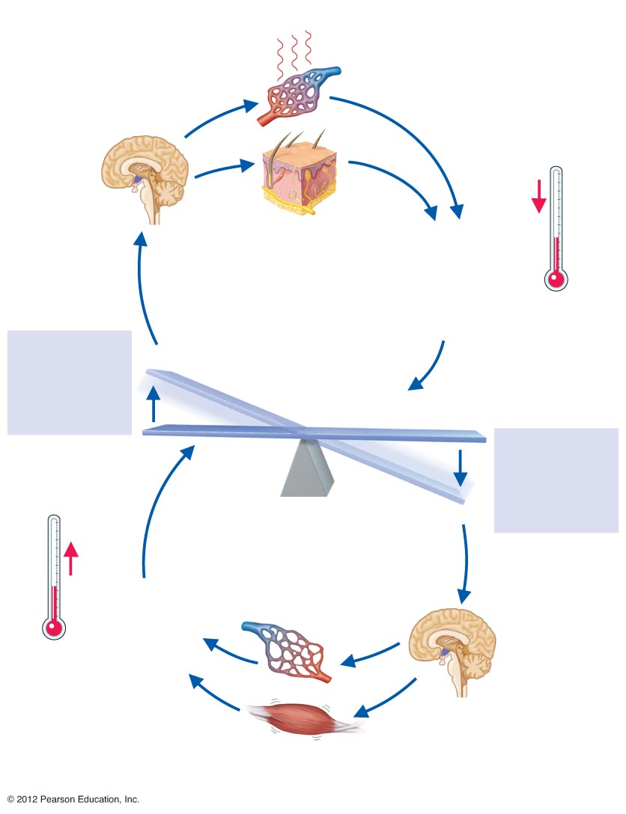
Skin blood vessels dilate:
Capillaries become flushed
with warm blood; heat
radiates from skin surface
Activates
heat-loss center
in hypothalamus
Sweat glands activated:
Secrete perspiration, which
is vaporized by body heat,
helping to cool the body
Body temperature
decreases: Blood
temperature
declines and
hypothalamus
heat-loss center
“shuts off”
Blood warmer
than hypothalamic
set point
Stimulus:
Increased body
temperature
(e.g., when
exercising or the
climate is hot)
IMBALANCE
HOMEOSTASIS = normal body temperature
(35.6°C–37.8°C)
Stimulus:
Decreased body
temperature
(e.g., due to cold
environmental
temperatures)
IMBALANCE
Skin blood vessels constrict:
Blood is diverted from skin
capillaries and withdrawn to
deeper tissues; minimizes
overall heat loss from
skin surface
Blood cooler than
hypothalamic set
point
Body temperature
increases: Blood
temperature rises
and hypothalamus
heat-promoting
center “shuts off”
Activates heat-
promoting center
in hypothalamus
Skeletal muscles
activated when more
heat must be generated;
shivering begins
Figure 14.24

Slide 153
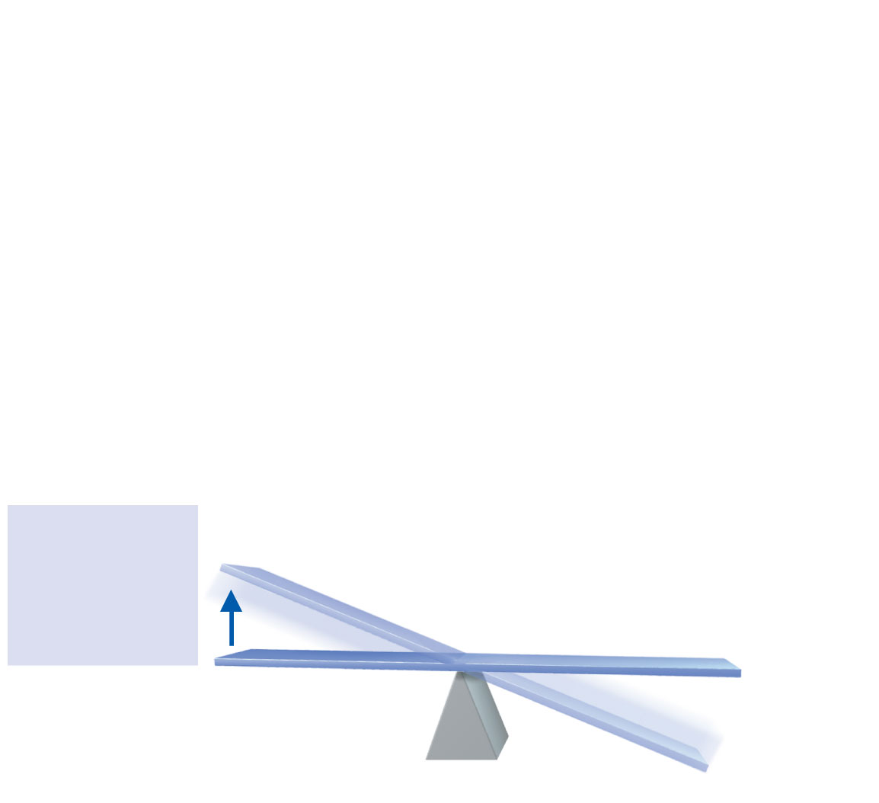
Stimulus:
Increased body
temperature
(e.g., when
exercising or the
climate is hot)
IMBALANCE
HOMEOSTASIS = normal body temperature
(35.6°C–37.8°C)
IMBALANCE
Figure 14.24, step 1

Slide 154
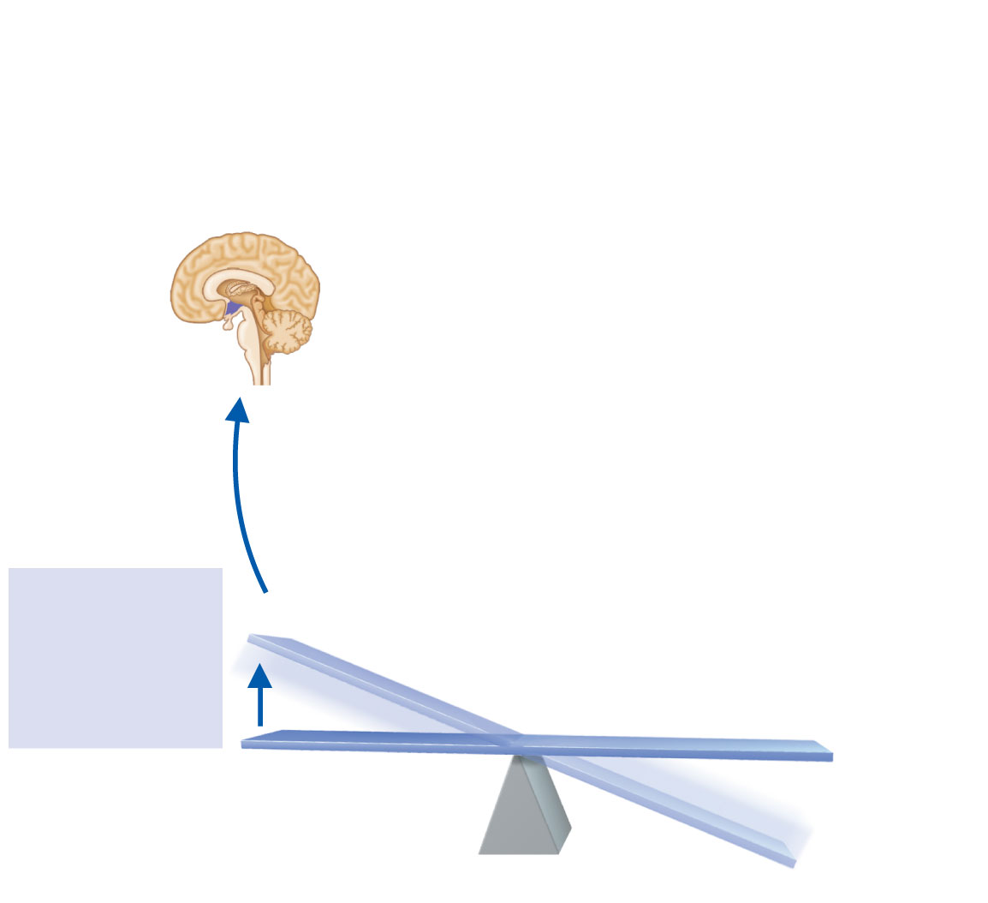
Activates
heat-loss center
in hypothalamus
Blood warmer
than hypothalamic
set point
Stimulus:
Increased body
temperature
(e.g., when
exercising or the
climate is hot)
IMBALANCE
HOMEOSTASIS = normal body temperature
(35.6°C–37.8°C)
IMBALANCE
Figure 14.24, step 2

Slide 155
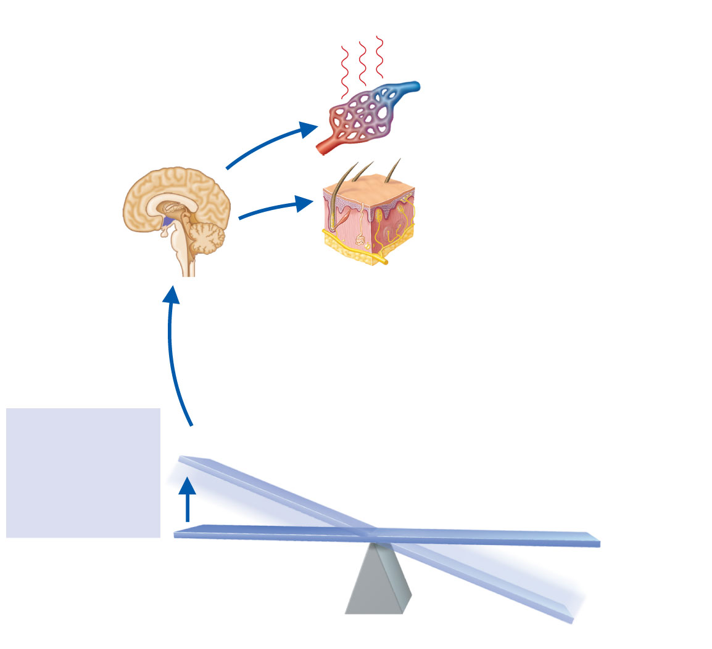
Skin blood vessels dilate:
Capillaries become flushed
with warm blood; heat
radiates from skin surface
Activates
heat-loss center
in hypothalamus
Sweat glands activated:
Secrete perspiration, which
is vaporized by body heat,
helping to cool the body
Blood warmer
than hypothalamic
set point
Stimulus:
Increased body
temperature
(e.g., when
exercising or the
climate is hot)
IMBALANCE
HOMEOSTASIS = normal body temperature
(35.6°C–37.8°C)
IMBALANCE
Figure 14.24, step 3

Slide 156
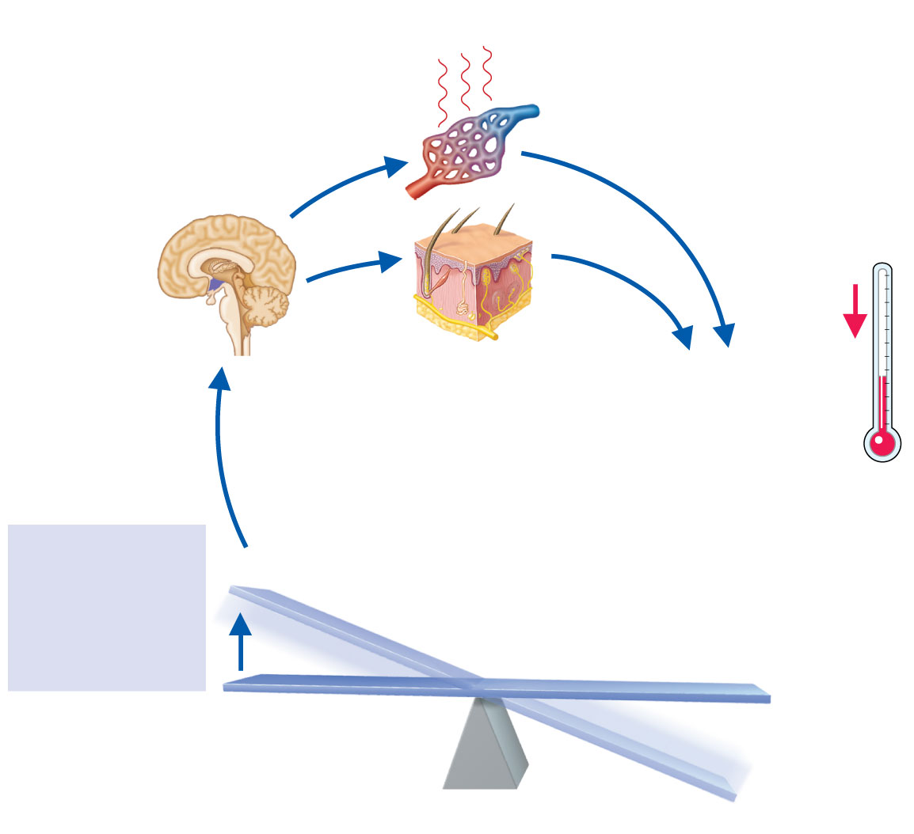
Skin blood vessels dilate:
Capillaries become flushed
with warm blood; heat
radiates from skin surface
Activates
heat-loss center
in hypothalamus
Sweat glands activated:
Secrete perspiration, which
is vaporized by body heat,
helping to cool the body
Body temperature
decreases: Blood
temperature
declines and
hypothalamus
heat-loss center
“shuts off”
Blood warmer
than hypothalamic
set point
Stimulus:
Increased body
temperature
(e.g., when
exercising or the
climate is hot)
IMBALANCE
HOMEOSTASIS = normal body temperature
(35.6°C–37.8°C)
IMBALANCE
Figure 14.24, step 4

Slide 157
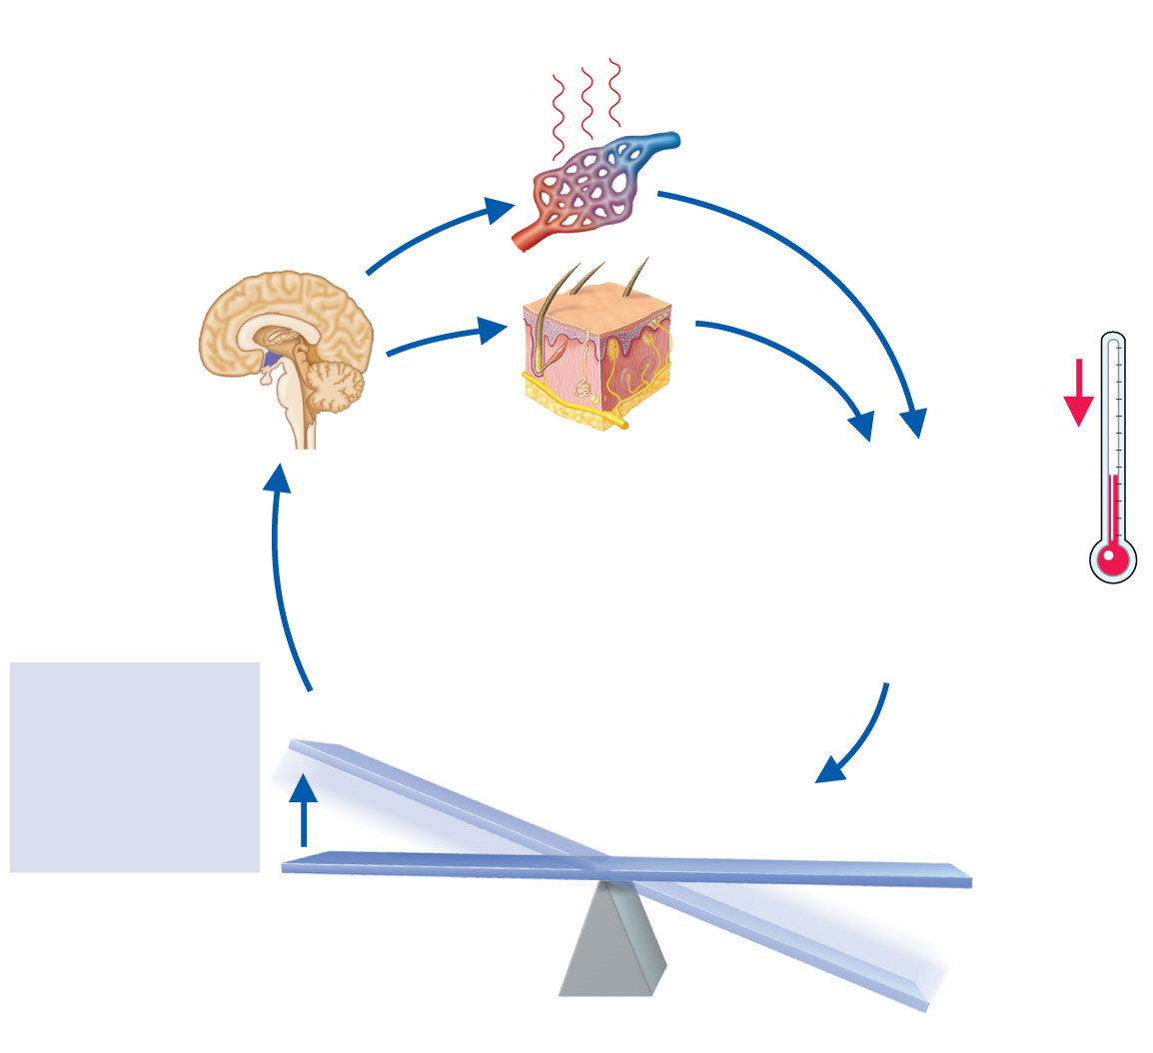
Skin blood vessels dilate:
Capillaries become flushed
with warm blood; heat
radiates from skin surface
Activates
heat-loss center
in hypothalamus
Sweat glands activated:
Secrete perspiration, which
is vaporized by body heat,
helping to cool the body
Body temperature
decreases: Blood
temperature
declines and
hypothalamus
heat-loss center
“shuts off”
Blood warmer
than hypothalamic
set point
Stimulus:
Increased body
temperature
(e.g., when
exercising or the
climate is hot)
IMBALANCE
HOMEOSTASIS = normal body temperature
(35.6°C–37.8°C)
IMBALANCE
Figure 14.24, step 5

Slide 158
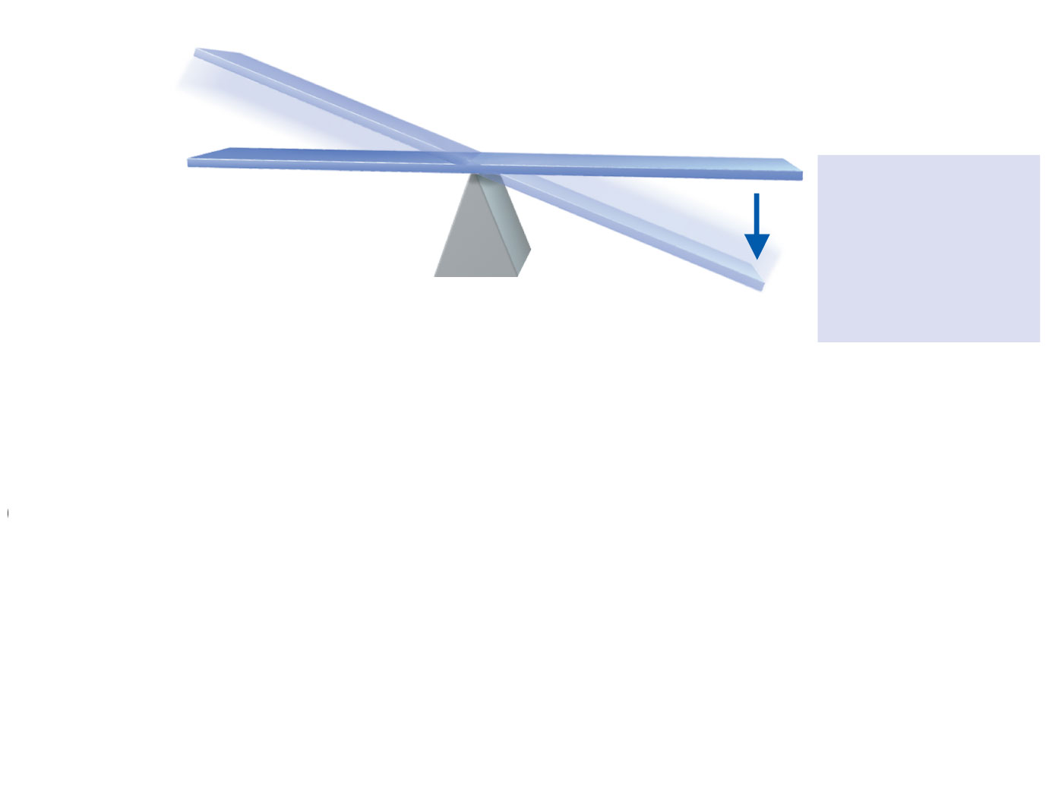
IMBALANCE
HOMEOSTASIS = normal body temperature
(35.6°C–37.8°C)
Stimulus:
Decreased body
temperature
(e.g., due to cold
environmental
temperatures)
IMBALANCE
Figure 14.24, step 6

Slide 159
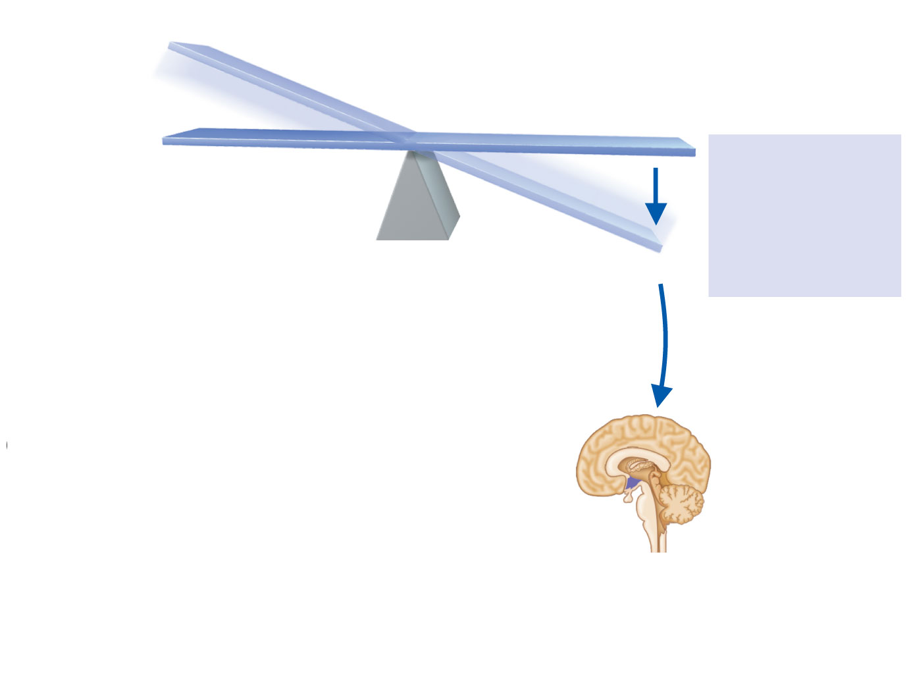
IMBALANCE
HOMEOSTASIS = normal body temperature
(35.6°C–37.8°C)
Stimulus:
Decreased body
temperature
(e.g., due to cold
environmental
temperatures)
IMBALANCE
Blood cooler than
hypothalamic set
point
Activates heat-
promoting center
in hypothalamus
Figure 14.24, step 7

Slide 160
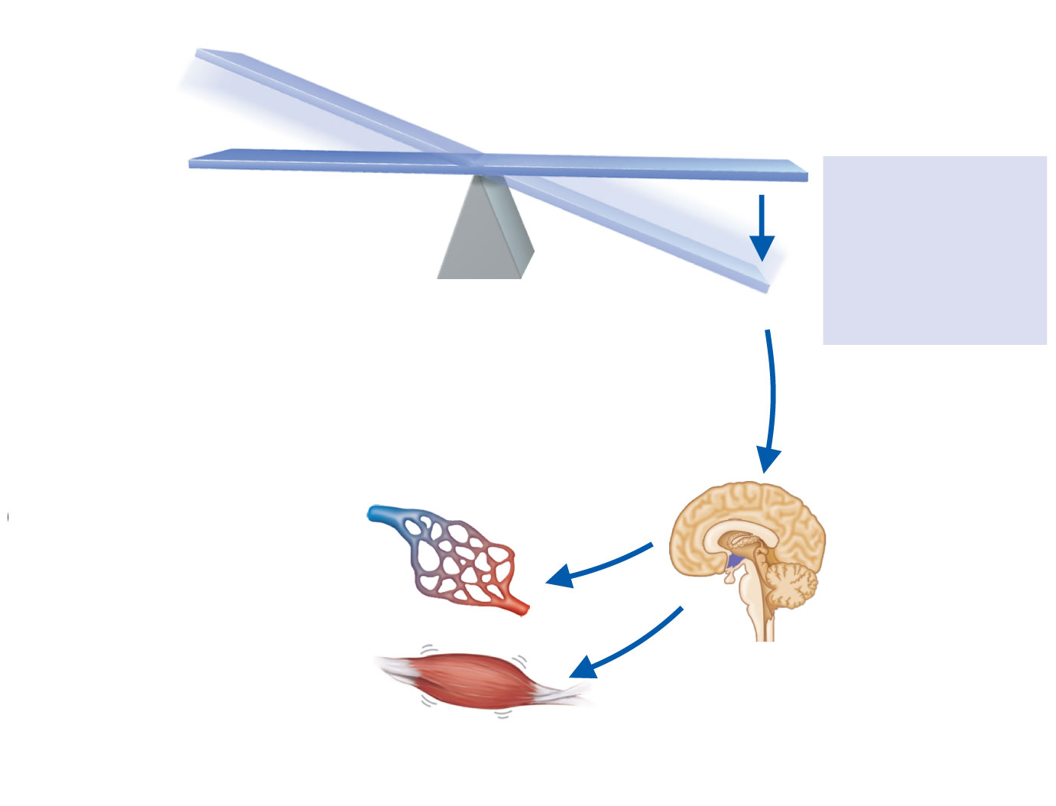
IMBALANCE
HOMEOSTASIS = normal body temperature
(35.6°C–37.8°C)
Stimulus:
Decreased body
temperature
(e.g., due to cold
environmental
temperatures)
IMBALANCE
Skin blood vessels constrict:
Blood is diverted from skin
capillaries and withdrawn to
deeper tissues; minimizes
overall heat loss from
skin surface
Blood cooler than
hypothalamic set
point
Activates heat-
promoting center
in hypothalamus
Skeletal muscles
activated when more
heat must be generated;
shivering begins
Figure 14.24, step 8

Slide 161
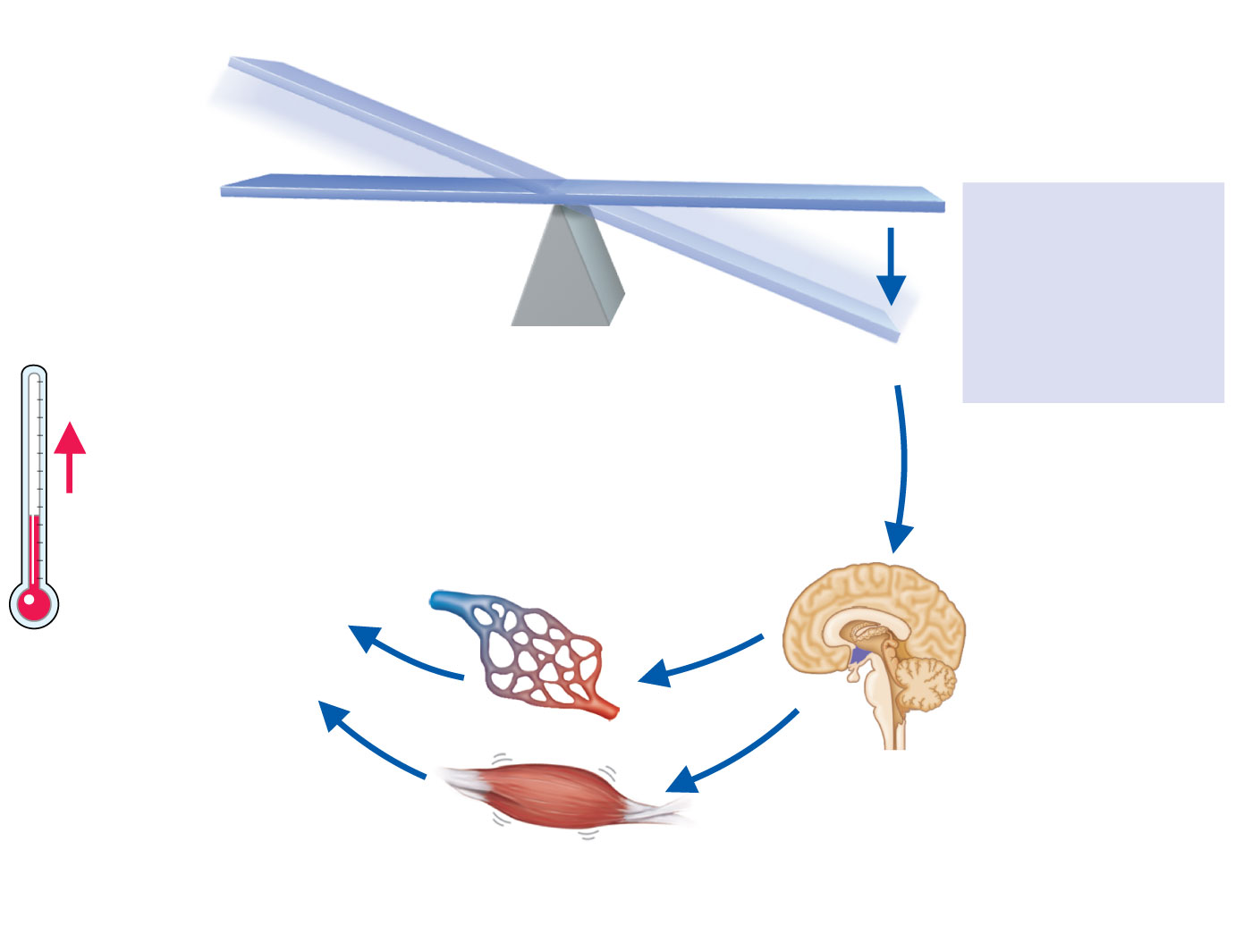
IMBALANCE
HOMEOSTASIS = normal body temperature
(35.6°C–37.8°C)
Stimulus:
Decreased body
temperature
(e.g., due to cold
environmental
temperatures)
IMBALANCE
Skin blood vessels constrict:
Blood is diverted from skin
capillaries and withdrawn to
deeper tissues; minimizes
overall heat loss from
skin surface
Blood cooler than
hypothalamic set
point
Body temperature
increases: Blood
temperature rises
and hypothalamus
heat-promoting
center “shuts off”
Activates heat-
promoting center
in hypothalamus
Skeletal muscles
activated when more
heat must be generated;
shivering begins
Figure 14.24, step 9

Slide 162
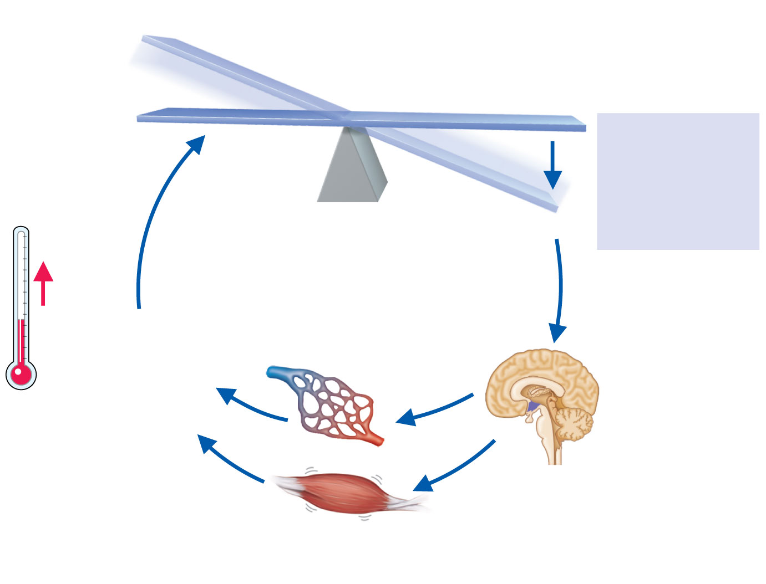
IMBALANCE
HOMEOSTASIS = normal body temperature
(35.6°C–37.8°C)
Stimulus:
Decreased body
temperature
(e.g., due to cold
environmental
temperatures)
IMBALANCE
Skin blood vessels constrict:
Blood is diverted from skin
capillaries and withdrawn to
deeper tissues; minimizes
overall heat loss from
skin surface
Blood cooler than
hypothalamic set
point
Body temperature
increases: Blood
temperature rises
and hypothalamus
heat-promoting
center “shuts off”
Activates heat-
promoting center
in hypothalamus
Skeletal muscles
activated when more
heat must be generated;
shivering begins
Figure 14.24, step 10

Slide 163
Body Temperature Regulation
Fever—controlled hyperthermia
Results from infection, cancer, allergic reactions, CNS injuries
If the body thermostat is set too high, body proteins may be denatured and permanent brain damage may occur

Slide 164
Developmental Aspects of the Digestive System
The alimentary canal is a continuous tube by the fifth week of development
Digestive glands bud from the mucosa of the alimentary tube
The developing fetus receives all nutrients through the placenta
In newborns, feeding must be frequent, peristalsis is inefficient, and vomiting is common

Slide 165
Developmental Aspects of the Digestive System
Newborn reflexes
Rooting reflex helps the infant find the nipple
Sucking reflex helps the infant hold on to the nipple and swallow
Teething begins around age six months

Slide 166
Developmental Aspects of the Digestive System
Problems of the digestive system
Gastroenteritis—inflammation of the gastrointestinal tract
Appendicitis—inflammation of the appendix
Metabolism decreases with old age
Middle-age digestive problems
Ulcers
Gallbladder problems

Slide 167
Developmental Aspects of the Digestive System
Activity of the digestive tract in old age
Fewer digestive juices
Peristalsis slows
Diverticulosis and cancer are more common

